Slide 1
Muscle Hub: A/B Testing: What are the effects of a fitness test on our business?
Capstone Project andreas.bleiker@gmail.com
username: bleikera

Slide 2
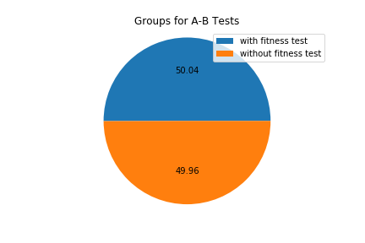
About the study
Research questions:
Is there a significant difference between people who took a test and people who did not take a test with regard to:
in the number of applications filled in
in actual purchases
Data
collected during July and August 2017 from 5000 people who visited Musclehub studios
Methodology: A/B Test.

Slide 3
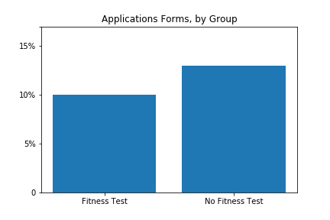
After a fitness test, one is less likely to apply for a membership
The difference is statistically significant. (p-value: 0.001)

Slide 4
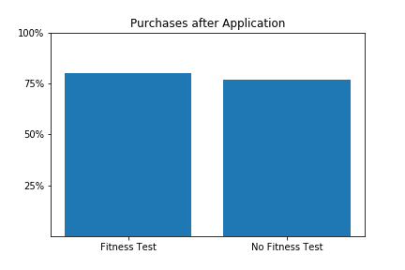
Once someone filled in an application, a fitness test does not have a significant impact on purchasing a membership
The difference is statistically not significant.
(p-value: 0.433)

Slide 5
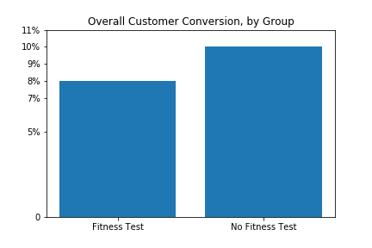
Fitness-tests are hurting our business: After a fitness test, significantly fewer people turn into paying members
The difference is statistically significant. (p-value: 0.015)

Slide 6
Summary of Qualitative Interviews
A couple of interviews with customers show a mixed perspective.
While some folks stress the value of the fitness test, others are deterred by it.
I took the MuscleHub fitness test because my coworker Laura recommended it. Regretted it.
- Sonny "Dad Bod", 26, Brooklyn
… the whole sign-up process took a matter of minutes. I tried to sign up for LiftCity last year, but the fitness test was way too intense. …
- Shirley, 22, Williamsburg

Slide 7
Recommendations
As the quantitative data suggests, fitness tests are not helping to push sales of memberships.
The qualitative data however suggests that people with a predisposition for serious training might like the test, while people who are not so sure about the benefits of a membership are rather deterred by a test, as it might make the threshold of signing up even harder.
As a possible strategy:
Don’t make the test mandatory. But offer it voluntarily as an option.
We do currently not have enough data that this revised strategy might work, but its effects could be tested again after a short collection period of data

