Slide 1


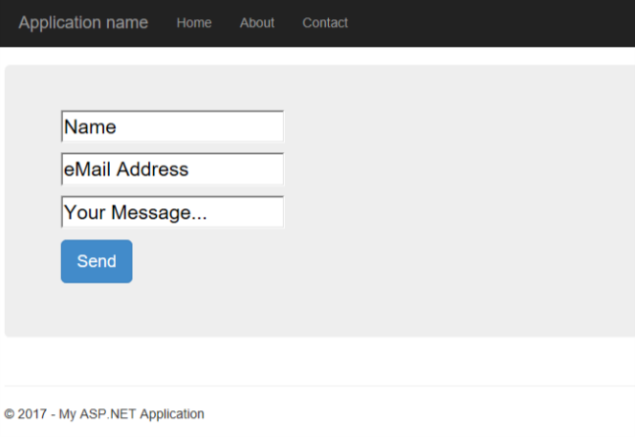
Azure WebApp
Azure Storage Queue
Azure Function
SMTP
server
User orders
a new vm using the
web form
WebApp enqueues
New job in storage
queue
Azure function processes
Job and clones new vm,
Then sends out email to user

