Slide 1


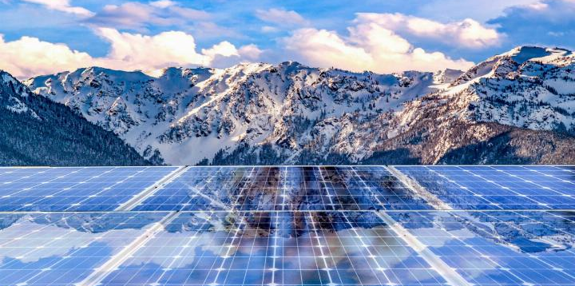
Assessing uncertainties in ecosystem services impacts of solar energy systems in Switzerland
Franziska Walther, Benjamin Black, Jonas Schwaab, Adrienne Grêt-Regamey
16. September 2025
International Mountain Conference Energy transitions and their impacts in mountain areas (FS 3.222)
Notes:
Good afternoon. I am Franziska Walther, PhD student ETH, Zurich. Today I would like to present to you my study approach and preliminary results, still ongoing,
-> TITLE

Slide 2

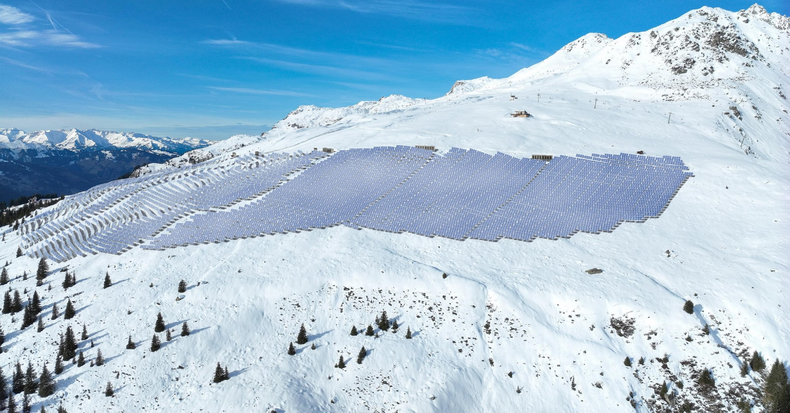

ENERGY TRANSITION
Mountain areas in Switzerland are increasingly being targeted for the installation of solar energy systems, i.e. ground-mounted photovoltaic (PV) systems
Swiss policy context
Paris Agreement
climate neutrality by 2050
Solarexpress (Art. 71a EnG)
financial incentive for large-scale solar
systems in high alpine areas in Switzerland
Projected visualization: Madrisa Solar, Grisons, Switzerland
(currently under construction)
Notes:
Global efforts to mitigate climate change rely on a transition towards renewable energy systems. Mountain regions, with their high potential for solar energy production especially in winter, are increasingly being targeted for the installation of solar energy systems, such as ground-mounted photovoltaics.
In case of Switzerland …

Slide 3
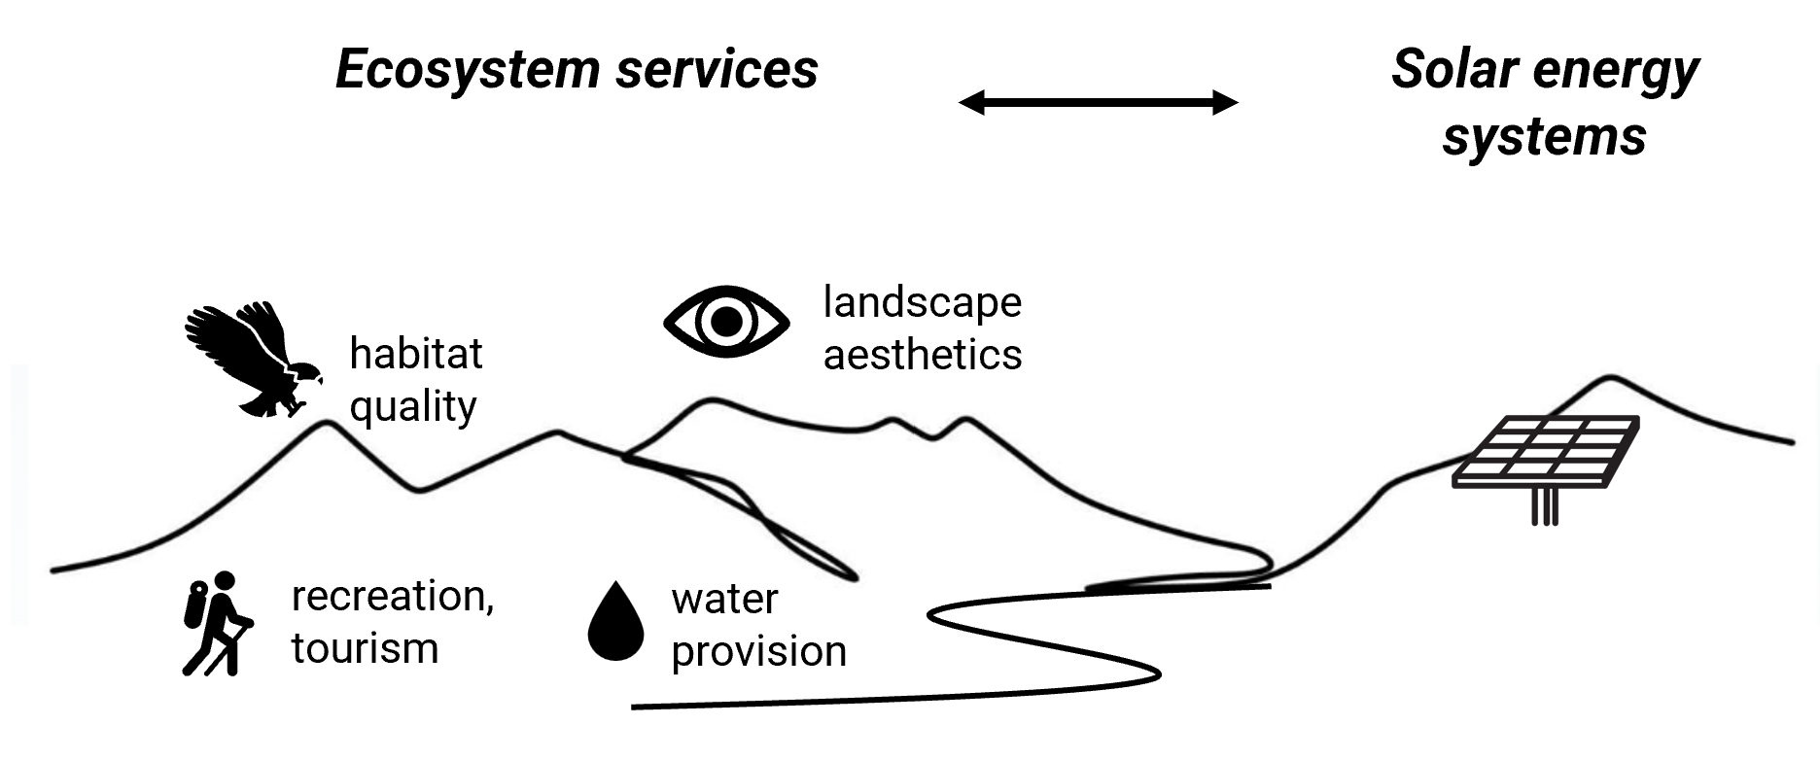

ENERGY TRANSITION & ECOSYSTEM SERVICES
Mountain areas provide a multitude of ecosystem services that may be affected by the installation of solar energy systems
→ Assessing ecosystem services and PV impacts is essential for identifying suitable solar energy system sites
Notes:
The installation of ground-mounted PV systems demands space. At the same time the mountain areas provide a multitude of ecosystem services
To make sure that climate change mitigation goes hand in hand with the sustainable management and conservation of ecosystems and their services … we need to assess the PV impact on ecosystem services.
However, there are many unknowns. For example, as the implementation of this technology in high alpine areas is very new we lack studies on how PV imapcts ES.
Further, especially mountain areas are highly vulnerable to global changes, resulting in land use land cover changes. Consequently, the supply of ES that are courrently there are changing over time and space.

Slide 4
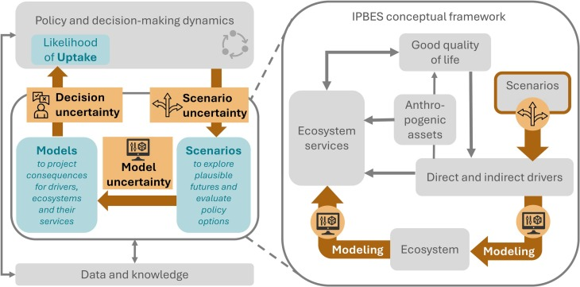

UNCERTAINTIES IN ECOSYSTEM SERVICES ASSESSMENTS
Uncertainties are inherent in scenario development (scenario uncertainty), modeling (model uncertainty) and the translation of results to decision-makers (decision uncertainty)
Literature review (n= 904 articles) has shown that: Including the assessment of uncertainties can improve the potential for uptake*.
*Uptake = the potential use of ES assessment results by decision-makers.
Walther et al. (2025)
→ Assessing uncertainties makes ES assessment more useful for decision-making
Notes:
The conceptual figure (left) shows the concept of how Ecosystem Services are assessed, and how there are different sources of uncertainty inherent.
We recently reviewed 900 ES studies, and found out that including the explicit assessment of uncertainties can actually improve the uptake, i.e. the potential use of research findings in practice.
🡪 Highlights the need to assess uncertainties also in our case of PV systems.

Slide 5




Research question: How does the integration of uncertainties in ecosystem services (ES) assessments influence
siting of ground-mounted solar PV systems?
Methodology: Spatially explicit, expert-based Bayesian network
Netica
LULC
nodes
edges
Conditional probability
table (CPT)
PV impact on ES_{x}
ES value_{x}
Change in ES_{x}
PV Suitability*
*Suitability = minimal decrease in ES, or potential increase, due to PV.
Notes:
Therefore, I have chosen a Bayesian network that allows for the integration of uncertainties. Its a probabilistic graphical model (simplified version - left)
A BN consists of nodes and edges; each node has a CPT defining its probabilities given its parents.
The Bayesian network is created to identify how suitable a location is for PV under consideration of the changes in ES.
Suitability here means …

Slide 6



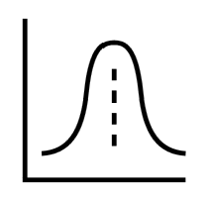
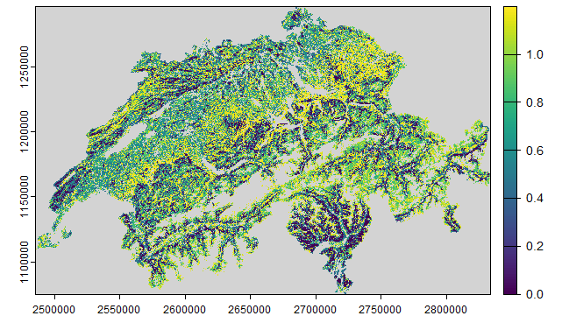
Research question: How does the integration of uncertainties in ecosystem services (ES) assessments influence
siting of ground-mounted solar PV systems?
Methodology: Spatially explicit, expert-based Bayesian network
Netica
LULC
LULC Map
nodes
edges
Conditional probability
table (CPT)
PV impact on ES_{x}
ES value_{x}
ES Map
Evidence
Expert
Survey
Spatial
Data
Change in ES_{x}
Expert
Survey
PV Suitability*
*Suitability = minimal decrease in ES, or potential increase, due to PV.
Notes:
Spatially explicit Bayesian network (using gBay) 🡪 Here I am inserting information on LULC and ES value from Maps.
Then the idea is to get a spatial output, here the suitability, which is for each pixel a probability.
The changes in ES are related to the general PV impact on ES, being shifted by the ES value (low – high). Thereby I distinguish between different LULC classes.

Slide 7


PRELIMINARY RESULTS
Methodology: Spatially explicit, expert-based Bayesian network
Expert Survey for CPT Elicitation of PV Impact
How do ground-mounted photovoltaics affect ES in Switzerland?
LULC
PV impact on ES_{x}
ES value_{x}
Expert
Survey
Change in ES_{x}
-3 -2 -1 0 1 2 3
-3 -2 -1 0 1 2 3
PV Suitability
PV Impact
Average weighted response per Likert scale category (from strong decrease to strong increase in ES), differentiated by LULC class (amount of respondents in blue).
Notes:
As the PV impact on ES is so uncertain and data is scarce. I integrate expert knowledge from a survey 🡪 where experts can answer how PV impaxct ES – conditioned on LULC.
Example of preliminary results:

Slide 8
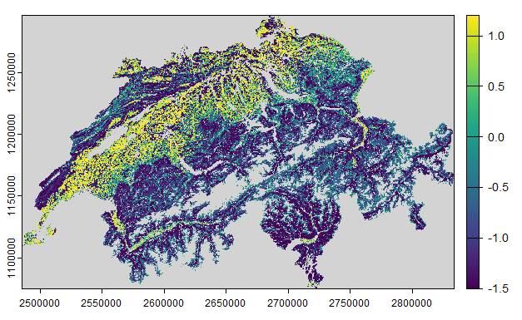
Mean for suitability value
PRELIMINARY RESULTS
Potential areas of synergies between PV and ES
LULC
Potential areas of trade-offs between PV and ES
PV impact on ES_{x}
ES value_{x}
Standard deviation for suitability value
Change in ES_{x}
High uncertainty (less robust)
PV Suitability
Ecosystem services included:
Recreation potential
Habitat quality
Carbon storage
Low uncertainty (more robust)

Slide 9
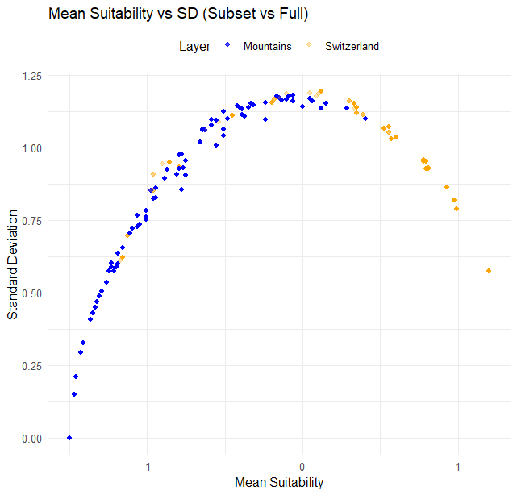
PRELIMINARY RESULTS
LULC
PV impact on ES_{x}
ES value_{x}
Change in ES_{x}
PV Suitability
In mountain areas, trade-offs between PV and ES prevail, while synergies are at lower altitudes.

Slide 10

OUTLOOK Future changes
Would you like to participate in the SURVEY?
Enter your contact details to receive an email invitation:
LULC
∆LULC
PV impact on ES_{x}
ES value_{x}
∆ES
Change in ES_{x}
PV Suitability
Survey link: https://pv-eco-survey.ethz.ch

Slide 11
THANK YOU FOR YOUR ATTENTION!
Would you like to participate in the SURVEY?
Enter your contact details to receive an email invitation:
Franziska Walther
Contact: fwalther@ethz.ch
Survey link: https://pv-eco-survey.ethz.ch

Slide 12
Bibliography
Anderegg, D., Strebel, S., & Rohrer, J. (2023). Alpine Photovoltaik Versuchsanlage Davos Totalp: Erkenntnisse aus 5 Jahren Betrieb. ZHAW Zürcher Hochschule für Angewandte Wissenschaften, IUNR Institut für Umwelt und Natürliche Ressourcen
Black, B., Adde, A., Farinotti, D., Guisan, A., Külling, N., Kurmann, M., Martin, C., Mayer, P., Rabe, S.-E., Streit, J., Zekollari, H., Grêt-Regamey, A., 2024. Broadening the horizon in land use change modelling: Normative scenarios for nature positive futures in Switzerland. In press, Regional Environmental Change.
Mayer P, Rabe SE, Grêt-Regamey A (2023) Operationalizing the nature futures framework for ecological infrastructure. Sustain Sci. https://doi.org/10.1007/s11625-023-01380-7
Rounsevell, M.D.A., Arneth, A., Brown, C., Cheung, W.W.L., Gimenez, O., Holman, I., Leadley, P., Luj´ an, C., Mahevas, S., Mar´echaux, I., P´elissier, R., Verburg, P.H., Vieilledent, G., Wintle, B.A., Shin, Y.-J., 2021. Identifying uncertainties in scenarios and models of socio-ecological systems in support of decision-making. One Earth 4 (7), 967–985. https://doi.org/10.1016/j.oneear.2021.06.003.
F. Walther, D. N. Barton, J. Schwaab, J. Kato-Huerta, B. Immerzeel, M. Adamescu, E. Andersen, M. V. Arámbula Coyote, I. Arany, M. Balzan, A. Bruggeman, C. Carvalho-Santos, C. Cazacu, D. Geneletti, R. Giuca, M. Inácio, E. Lagabrielle, S. Lange, S. Le Clec’h, Z. Y. V. Lim, U. Mörtberg, S. Nedkov, A. P. Portela, A. Porucznik, T. Racoviceanu, P. Rendón, D. Ribeiro, J. Seguin, M. Šmid Hribar, V. Stoycheva, H. Vejre, C. Zoumides and A. Grêt-Regamey, 2025. Uncertainties in ecosystem services assessments and their implications for decision support – A semi-systematic literature review. Ecosystem Services. 73. https://doi.org/10.1016/j.ecoser.2025.101714.

Slide 13
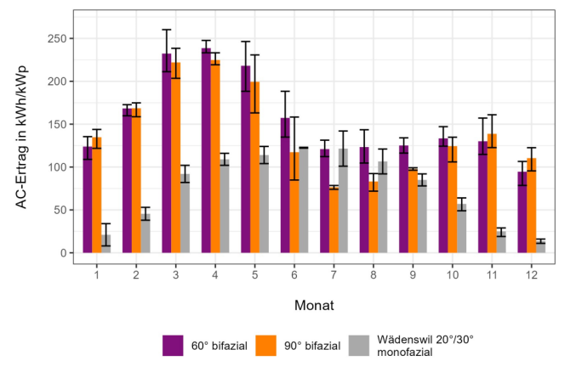
ENERGY TRANSITION
Mountain areas in Switzerland are increasingly being targeted for the installation of solar energy systems, i.e. ground-mounted photovoltaic (PV) systems
AC yield in kWh/kWp
Average AC monthly yields as bars with respective maximum and minimum values shown as double-T. Test facility Davos Totalp compared with a facility in Wädenswil ZH. Observation period: October 1, 2020 to August 31, 2023.
Anderegg et al. (2023)
month
60° bifacial
90° bifacial
Wädenswil 20°/30°
monofacial
Notes:
Global efforts to mitigate climate change rely on a transition towards renewable energy systems. Mountain regions, with their high potential for solar energy production, are increasingly being targeted for the installation of solar energy systems, such as ground-mounted photovoltaics.

Slide 14



Model uncertainty
The representation of processes in models and how this is done.
Sources of
Uncertainty
(Rounsevell et al. 2021)
Scenario uncertainty
Decision uncertainty
The qualitative description of alternative worldviews and their development into the future and the quantification of model input parameters that are conditional on these descriptions.
Communicating and translating the results of scenario and modeling studies into decision-making.
Notes:
I would like to introduce this concept of uncertainty, which categorizes uncertainty into three main sources: scenario, model and decision uncertainty.
Scenario uncertainty is involved in the qualitative and quantitative description of global change through (future) alternatives, such as representative concentration pathways (RCPs) and shared socioeconomic pathways (SSPs).
Further, model uncertainty exists due to the incomplete and inaccurate data and models to describe a real world phenomenon.
Decision uncertainty is intricately linked to the interpretation and application of research findings by policymakers, as well as the alignment of scientific spatiotemporal scales with those relevant to societal issues.

Slide 15
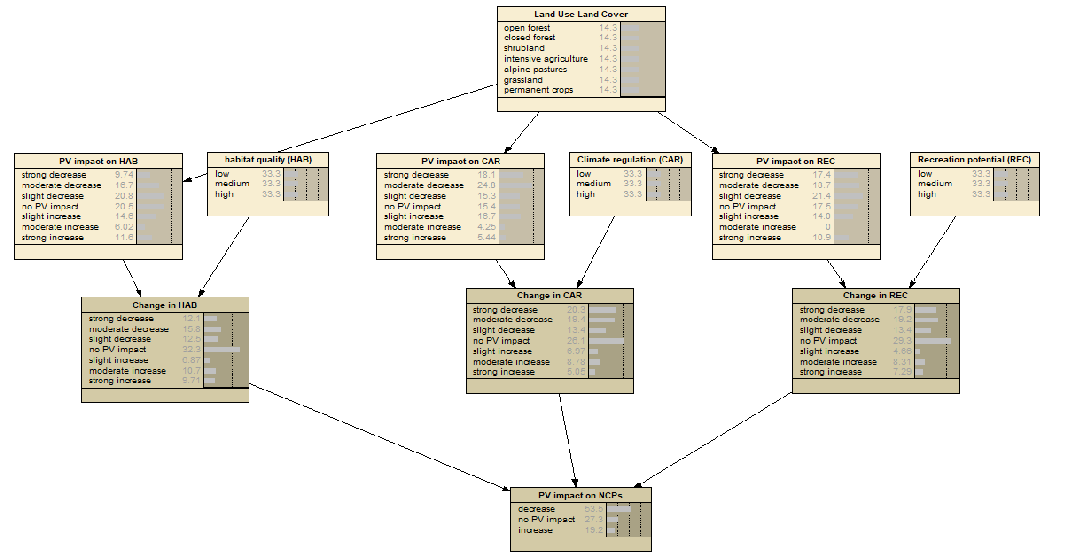
Bayesian network (for 3 ES)

Slide 16

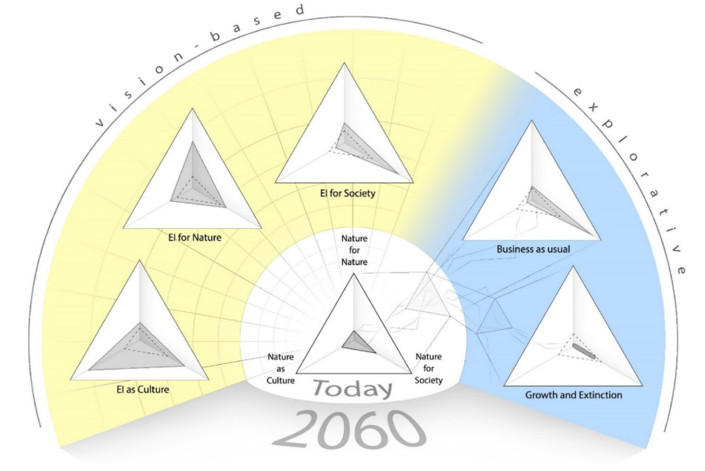
Outlook
Addressing uncertainties in ecosystem services impacts of solar energy systems under future changes
Meyer et al., 2023
Black et al., 2024

Slide 17
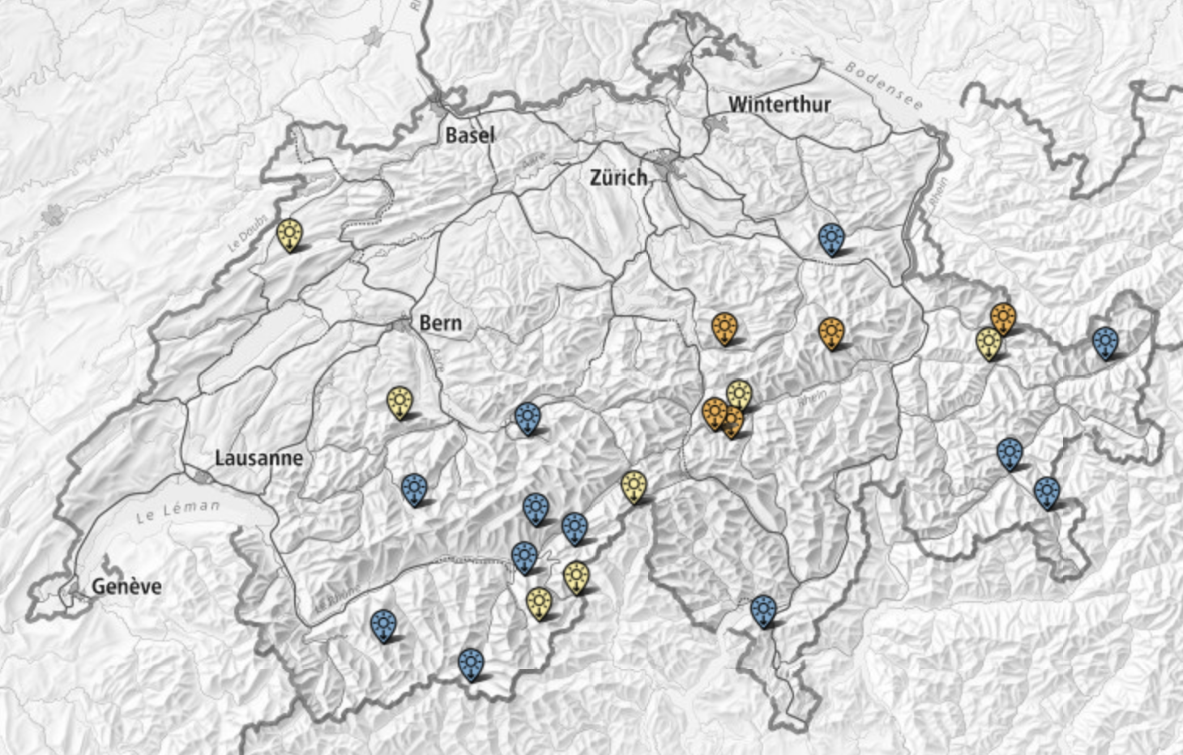
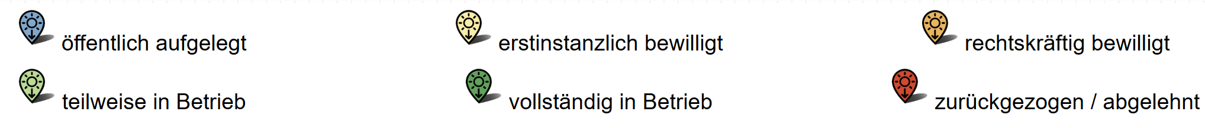
Ground-mounted solar PV systems in high-alpine areas, Switzerland (https://www.uvek-gis.admin.ch/BFE/storymaps/EE_AlpineSolaranlagen/)
Notes:
https://www.uvek-gis.admin.ch/BFE/storymaps/EE_AlpineSolaranlagen/

Slide 18

ES data
ES | Model | Description of input parameters (see sources in D.2: Tabel D.1 from Black et al., 2025)
HAB | InVEST | LULC inputs assigned parameter values (look-up tables): Land use Sensitivity table: habitat-specific sensitivity values indicating relative vulnerability of each land use type to different threats Threats table: impact, maximum distance of influence, decay type of each identified threat affecting habitat quality Half saturation constant: parameter representing the threshold at which habitat quality decreases by half
POL | InVEST | Land use Guild table: pollinator guilds, specifying nesting habitats, foraging habitats, flight ranges, and pollination activity patterns Biophysical table: crop-specific data on pollination services and yield increases
CAR | InVEST | LULC inputs assigned parameter values (look-up tables): Land use Biophysical tables: carbon storage values by land use category, region and elevation
SDR | InVEST | LULC inputs assigned parameter values (look-up tables): Land use DEM USLE relevant parameters: Erosivity: rainfall erosivitiy data) Soil erodibility: soil susceptibility to erosion Biophysical table: land-use specfic erosion parameters Watersheds Threshold flow accumulation Borselli K parameter: parameter for sediment transport efficiency Maximum SDR value: upper boundary for sediment export Borselli IC0 parameter: Controls sediment connectivity Maximum L value: Max slope-length factor
NDR | InVEST | LULC inputs assigned parameter values (look-up tables): Land use DEM Nutrient runoff proxy (precipitation-based) Watersheds Biophysical table: nutrient load and retention parameters Threshold flow accumulation: minimum number of upslope cells to generate a stream Borselli K parameter: calibration parameter for nutrient transport

Slide 19
ES data
ES | Model | Description of input parameters (see sources in D.2: Tabel D.1 from Black et al., 2025)
PC | nSDM-based | Habitat suitability of 50 predator species of common agricultural pests
FF | FAO’s Ecocrop model | Land use Monthly precipitation Monthly average temperature Soil pH
WY | InVEST | LULC inputs assigned parameter values (llok-up tables) Precipiation (annual) evapotranspiration (annual) root restricting layer depth: soil depth limits soil water available to plants biophysical table: water balance parameters Z parameter (for empirical calibration) watersheds (hydrological bonudaries)
REC | ESTIMAP recreation model | Land use Naturalness score Protected areas Distance to lakes
ID | nSDM-based | Habitat suitability of 15 emblematic species (Schirpke et al., 2018)

