Slide 1

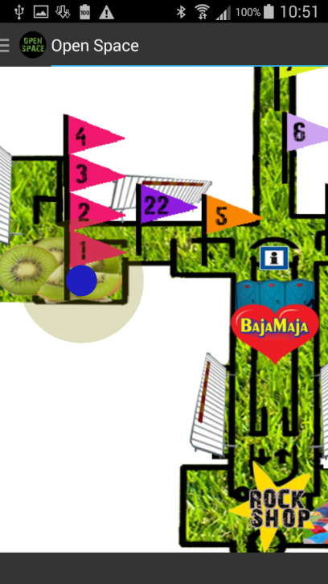

Download the official Open Space app from Google Play, search for “Ericsson Open Space”) for Open Space positioning, proximity information and the Open Space quiz questions.
For iOS users, see information at the event.

