Slide 1
FULL DISCLOSURE:
ADVICE FOR COMPOSING JAVASCRIPT
Benjamin Lerner
Affiliates Day 2009

Slide 2
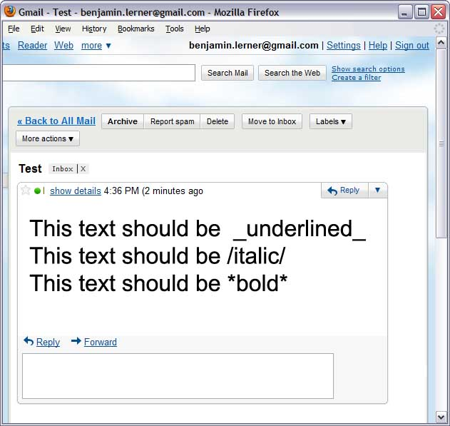

Extension example: text formatting
Most email clients turn this:
into this:
Gmail doesn’t – how can we add this feature?

Slide 3
Motivation: Extending the Web
Extending Web Applications
  “User scripts”
  Bookmarklets
Extending the Browser
  Firefox extensions
  Chrome extensions, Opera widgets…
Very popular
Unknown numbers of problems…
40,000 scripts
“When Gmail loads, run this script to preprocess and reformat the messages”
6,000 extensions
“When I open a new tab,
show me thumbnails of my ten
most recently visited websites”

Slide 4
Userscript: Formatting Gmail messages
Most email clients turn this:
This text should be _underlined_
into this:
This text should be underlined
2. Replace the function with a new one…
1. Save the original function
var oldP = unsafeWindow.P;
unsafeWindow.P = function(iframe, data) {
if (data[0] == "mb")
data[1] = format(data[1]);
return oldP.apply(iframe, arguments);
}
3. … that transforms punctuation to HTML
4. … and then calls the original function

Slide 5
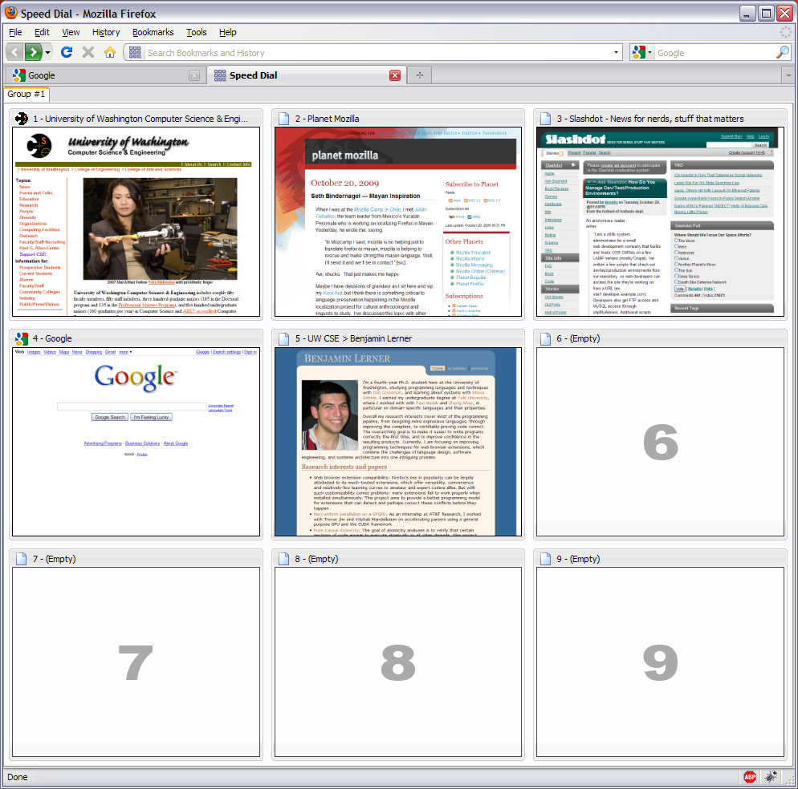
Extension: “SpeedDial” Firefox tabs

Slide 6
Extension: “SpeedDial” Firefox tabs
SpeedDial.init = function () {
...
eval("getBrowser().removeTab = "+
getBrowser().removeTab
.toString()
.replace(
'this.addTab("about:blank");',
'if (SpeedDial.loadInLastTab) {'
+'this.addTab("chrome://speeddial'
+'/content/speeddial.xul"'
+')} else {$!}'
));
...
}
4. And replace the function with the modified version
1. Find the function
2. Retrieve its source code…
3. …edit that string to include changes…

Slide 7
How are extensions written?
Mostly in JavaScript, HTML, and CSS
No overarching software engineering guidelines
“Just get it to work”
  HTML & CSS: Overlays
  JS: Wrapping
  JS: Monkey-patching

Slide 8
Drawbacks of these approaches
Wrapping is inflexible
  can’t be “inside” the function
Monkey patching is brittle
  Patch may silently fail, may introduce syntax errors
Both are incorrect for closures
  They are new closures that have the wrong environment
Both are incorrect for aliases
  All other aliases are unmodified
What to do?

Slide 9
Aspects
An aspect defines what new code to run, and when to run it
Advice defines what new code to run
Pointcuts define when to trigger it
at pointcut(callee(Math.sin)) before(x) {
print(“x is ”, x);
}
Pointcut
Type of advice
Arguments to function
Advice

Slide 10
Advising names versus closures
Suppose preprocess == window.P
Global object
Closure for P
preprocess
Window object
Advice for P
window
P
Userscript does not correctly advise preprocess!
Advice is visible to
all aliases to window.P
Userscript-defined
closure for P

Slide 11
Aspects for functions
Support before, after, and around advice
at pointcut(callee(launchMissiles)) around(x)
{
if (!authorized(x))
print(“WARNING!!!”);
else if (proceed() == false) {
print(“Launch failed”);
}
return retval;
}

Slide 12
Revisiting the Gmail userscript
Use before callee advice:
var oldP = unsafeWindow.P;
unsafeWindow.P = function(iframe, data) {
if (data[0] == "mb")
data[1] = format(data[1]);
return oldP.apply(iframe, arguments);
}
at pointcut(callee(unsafeWindow.P)) before(iframe, data) {
if (data[0] == "mb")
data[1] = format(data[1]);
}

Slide 13
Revisiting the SpeedDial extension
Use before statementContaining advice:
eval("getBrowser().removeTab = "+
getBrowser().removeTab
.toString().replace(
'this.addTab("about:blank");',
'if (SpeedDial.loadInLastTab)' +
'this.addTab("chrome://speeddial/content/speeddial.xul"); else $!'
));
at pointcut(statementContaining(this.addTab("about:blank")) &&
within(getBrowser().removeTab) )
before {
if (SpeedDial.loadInLastTab)
this.addTab("chrome://speeddial/content/speeddial.xul")
else
this.addTab("about:blank")
}

Slide 14
“Full Disclosure”: Aspects with a twist
We want to support an aspect language for JS that:
  Has standard before/after/around function advice
  Can access local variables within functions
  Can syntactically revise existing functions
  Is as easy as monkey-patching
…and:
  Introduces minimal runtime overhead
  Permits static analysis of aspects
Technique: open up closures and modify them

Slide 15
Implementing Aspects for JS
Targeting MSR JScript Compiler
High-level relevant features:
  Entirely managed code
    Runtime environment, generated code are standard .NET
  JIT compilation
    Can implement weaving as we JIT the code
    Makes dynamic weaving “almost free”

Slide 16
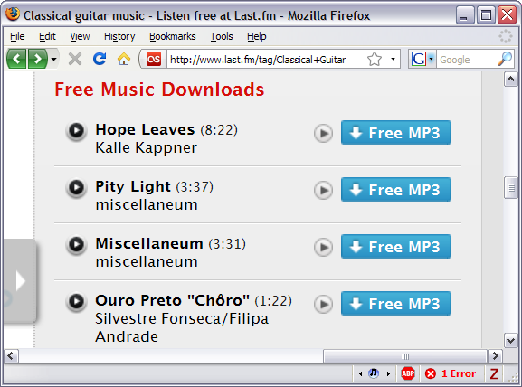
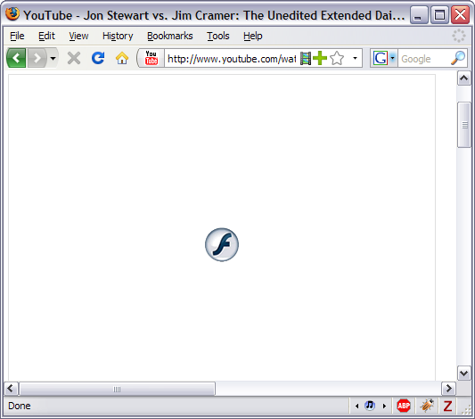
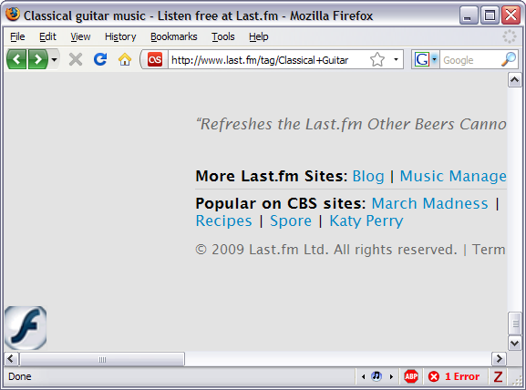
Future work

Slide 17
Future work
Given aspects that can replace most monkey-patches, efficiently and more correctly…
Re-implement this scheme for other JS engines
Manually translate more extensions to use aspects, and see how often they’re useful
Develop static analyses to detect conflicts among extensions before runtime.

Slide 18
Backup

Slide 19
Wrapping
“This function doesn’t quite do what I want; let me replace it”
How?
function square(x) {
return x*x;
}
function square(x) {
print(“x is ”, x);
return x*x;
}
Pros:
simple
Cons:
clutters the namespace
can only change behavior
before or after function
only fixes one alias to function
(function() {
var oldSquare = square;
square = function(x) {
print(“x is ”, x);
return oldSquare(x);
};
})();

Slide 20
Monkey patching
“This function doesn’t quite do what I want; let me tweak it”
How?
function square(x) {
return x*x;
}
function square(x) {
print(“x is ”, x);
return x*x;
}
eval(“square = ” +
square.toString()
.replace(“return”,
“print(\"s is \", x);\n return”));

Slide 21
Monkey patching: “idioms”
eval('window.aioTabFocus = '+window.aioTabFocus.toSource()
.replace(
/\{/,
'{'+
'if (e.originalTarget.ownerDocument != document) return;'+
'var b = e.originalTarget;'+
'while (b.localName != "tabbrowser")'+
'b = b.parentNode;'
).replace(
/aioTabsNb/g,
'b.aioTabsNb'
).replace(
/aioContent/g,
'b'
).replace(
/aioRendering/g,
'(b.mPanelContainer || b)'
)
);
From SplitBrowser 0.5.2008101801

Slide 22
Monkey patching: making a mess
onPopupShowing: function BM_onPopupShowing(event) {
...
if (!(hasMultipleURIs || siteURIString)) {
...
return;
}
else if ((hasMultipleURIs || siteURIString)) {
for (var i = target.childNodes.length - 1; i > -1; i--){
if (target.childNodes[i].getAttribute("builder") == "end"){
target._endMarker = i;
break;
}
}
}
if (!target._endOptSeparator) {
...
}
...
}
From MultiRow Bookmarks Toolbar 2.9

Slide 23
Easy case: Syntactic advice
We have the AST of the code to be JITted
For statementContaining and field advice:
  Search for the expression/statement of interest,
  And insert the advice as appropriate,
  And then JIT the revised AST
Meets our goals:
  Has access to local variables, can revise function
  Is no more expensive than JITting the function and advice…which we’d have to do anyway

Slide 24
Medium case: Advising script functions (1/2)
Again want to inline the advice
Again, rewrite code at JIT time
  Still meets our goals
Challenge: proper control flow
Naïve inlining
function square(x) {
return x*x;
}
at pointcut(call(square)) after(x) {
print(“x = ”, x, “ x*x = ”, retval);
}
function square(x) {
return x*x;
print(“x = ”, x, “ x*x = ”, retval);
}
Dead code!

Slide 25
Medium case: Advising script functions (2/2)
Solution: play games with either JS or with the codegen, to change the target of that return
Note: Do not try this at home!
function square(x) {
while (true) {
return x*x;
}
print(“x = ”, x, “ x*x = ”, retval);
}
retval = x*x;
break;

Slide 26
Hard case: Predefined functions (1/2)
print(“Three and five makes ”, 3+5)
ReferenceToProperty
PredefinedFunction
Delegate
print
Type[] expectedTypes
Delegate doPrint
Delegate GetDelegate(
params Type[] offeredTypes
)
new Delegate((s, d) => {
String d’ = d.ToString();
return doPrint(s, d’)
}
Resolve reference
Call GetDelegate(String, Double) on the PredefinedFunction
  Offered types (String, Double) don’t match expected types (String, String)
  Create a thunk that converts argument types and calls doPrint
Call the delegate

Slide 27
Hard case: Predefined functions (2/2)
print(“Three and five makes ”, 3+5)
at pointcut(call(print)) ...
ReferenceToProperty
PredefinedFunction
ScriptFunction
print
Type[] expectedTypes
List<Advice> advice
Delegate doPrint
Delegate GetDelegate(
params Type[] offeredTypes
)
Type[] expectedTypes
List<Advice> advice
function (args) {
doPrint(args)
}
List<Advice> advice
List<Advice> advice
Resolve reference
Call GetDelegate(String, Double) on the PredefinedFunction
  There’s advice, so construct a ScriptFunction that calls the original doPrint delegate
  Install the advice on the ScriptFunction
  Call GetDelegate(String, Double) on the ScriptFunction
    Construct a thunk, as before, and return it
Call the delegate

Slide 28
Outline
Motivation: Browser extensions
Aspects for JavaScript
Implementation challenges
Future work

