Slide 1
Language Support for Extensible Web Browsers
Benjamin Lerner and Dan Grossman

Slide 2
Position
Browser extensions are a good thing
  What are extensions?
  Why use them?
Current approaches have important flaws
  False design tradeoffs
  Languages used are poor
PL techniques can help
  UI: declarative compositional overlays
  Behavior: aspects

Slide 3
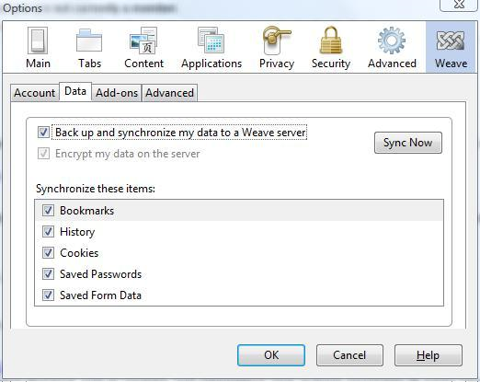
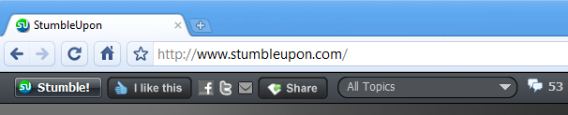
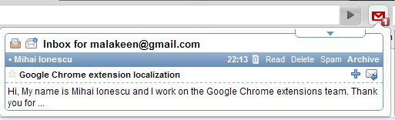
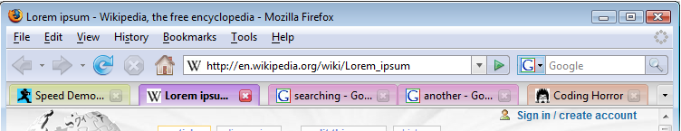
What are web-browser extensions?
Downloadable code to customize the browser
Different from plugins

Slide 4
Why extensions?
Extensions avoid bloat
  Pick and choose the features you want
Extensions can experiment
  Provide new features after products ship
Wildly popular:
  6,000+ extensions
  1.5 Billion downloads

Slide 5
What’s wrong with extensions today?
Two browser designs: Firefox and Chrome
The designs force a trade-off:
  Huge flexibility, or
  Robustness
For both, the programming model is very poor
Why can’t we do better?

Slide 6
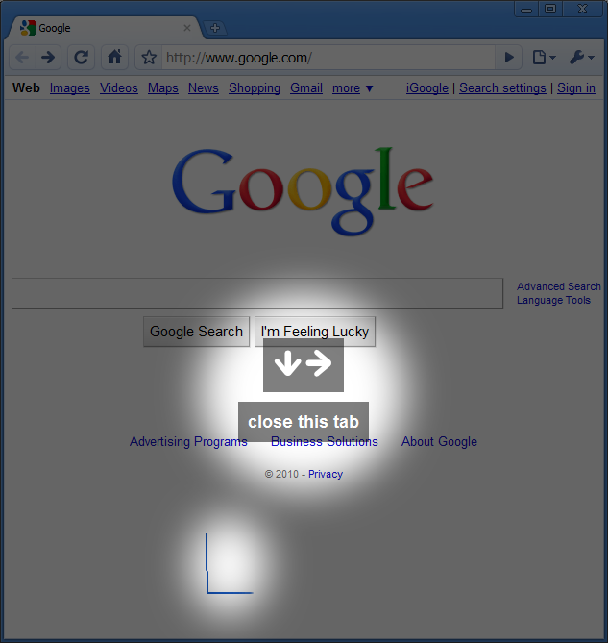
Programming example: Mouse Gestures
“Right-click-and-drag” gestures
Shape of gesture ➔ browser command
Work-alike versions for Chrome and Firefox

Slide 7
Firefox: flexible but brittle
Firebug + YSlow, Firefinder, FireCookie…
  Deliberately extend another extension
    http://sixrevisions.com/web-development/10-useful-firefox-extensions-to-supercharge-firebug/
AdBlock Plus + NoScript
  Deliberately break another extension
    http://hackademix.net/2009/05/04/dear-adblock-plus-and-noscript-users-dear-mozilla-community/
Currently no way to distinguish these cases

Slide 8
Firefox: free-form code injection
aioContent = document.getElementById("content");
aioContent.aioNativeRemoveTab = aioContent.removeTab;
eval("aioContent.aioNativeRemoveTab = " + aioContent.aioNativeRemoveTab.toString().replace(
'this.selectedTab',
'…various replacement code…'));
aioContent.removeTab = function(aTab) {
…various preprocessing…
aioContent.aioNativeRemoveTab(aTab);
}
Get a reference to the main window
Alias the removeTab function
Modify the function at that alias
Replace the original with a call to the modified version

Slide 9
Chrome: robust but limited
StumbleUpon
  Provides a “toolbar” in the page,
  …but it’s not a true chrome toolbar
    http://www.stumbleupon.com/sublog/su_chrome_extension/
Currently no fix without new APIs

Slide 10
Chrome: tightly-constrained
In the background page:
close_tab:function(tab){
chrome.tabs.remove(tab.id);
},
Injected into the main page:
var ACTION = {
…
"close this tab" : function(){
connection.postMessage('close_tab');
},
…
}
Predefined object to manipulate tabs
Page communicates to background via postMessage API

Slide 11
Towards a middle ground
Goal: flexibility and robustness
  Free-form UI extension
  Benign extensions can extend each other
  Malicious extensions can’t hurt each other
Separate techniques for UI and code:
  UI: Declarative, compositional overlays
  Code: aspects

Slide 12
Overlays
Intuition: “Tree-structured patch”
When are overlays successfully applied?
When are overlays in conflict?
When should overlays be prohibited?
<overlay>
<div id=“greeting”>
<p><b>World</b></p>
</div>
</overlay>
<div id=“greeting”>
<p>Hello</p>
</div>
<div id=“greeting”>
<p>Hello</p>
<p><b>World</b></p>
</div>

Slide 13
Compositional overlays
The tree-patching part is fine, but need to:
Declare expectations of the base document
Declare invariants asserted by the overlay
Can now detect conflicting assertions
Require “greeting”
Last “greeting”
(“greeting”,
<p><b>World</b></p>)
Last “greeting”
Require “greeting”
Last “greeting”
(“greeting”,
<p><b>Toronto</b></p>)
Last “greeting”

Slide 14
Programming redux: using aspects
aioContent = document.getElementById("content");
aioContent.aioNativeRemoveTab = aioContent.removeTab;
eval("aioContent.aioNativeRemoveTab = " + aioContent.aioNativeRemoveTab.toString().replace(
'this.selectedTab',
'…various replacement code…'));
aioContent.removeTab = function(aTab) {
…various preprocessing…
aioContent.aioNativeRemoveTab(aTab);
}
aioContent = document.getElementById("content");
aioContent.aioNativeRemoveTab = aioContent.removeTab;
at pointcut(field(this.selectedTab) && within(aioContent.removeTab)) around { get { …various replacement code… }
};
at pointcut(callee(aioContent.removeTab))
before (aTab) {
…various preprocessing…
}
Get a reference to the main window
When are aspects successfully woven?
When should aspects be prohibited?
Alias the removeTab function
Advise field accesses explicitly
Add before advice to the function
Come to OOPSLA for more details

Slide 15
Conclusion
Browser extensions are here to stay
Programming them needs our help
Two potential techniques:
  UI: compositional overlays
  Code: aspects

