Slide 1
Detecting Conflicts Among Declarative UI Extensions
Benjamin Lerner
Brown University
Dan Grossman
UW Computer Science & Engineering

Slide 2
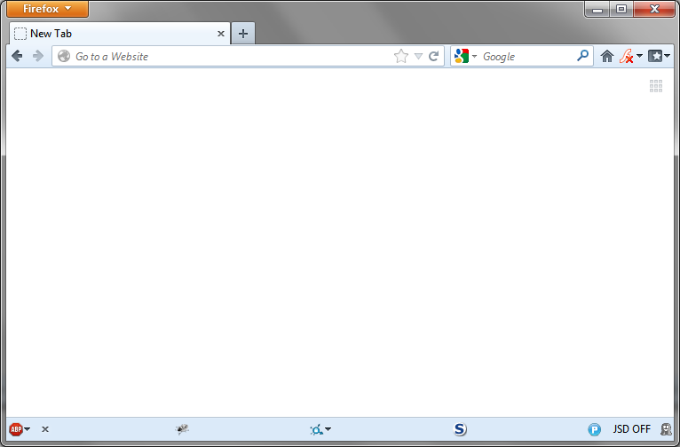
How many browsers do you see?
Each one defined by an extension

Slide 3
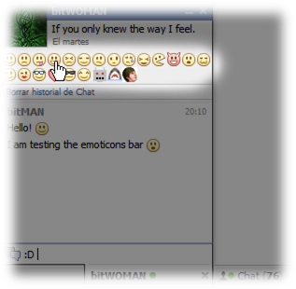
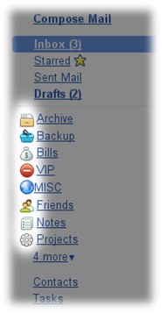
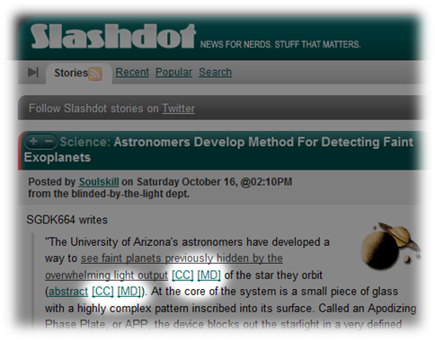
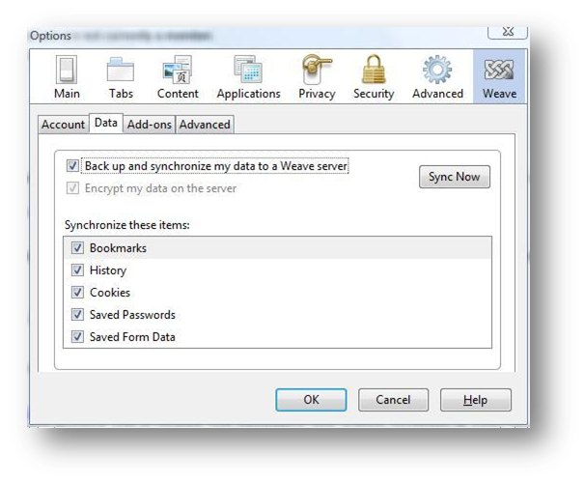
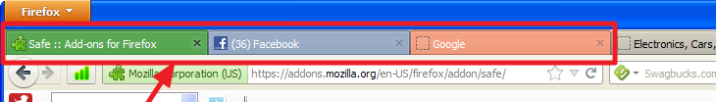
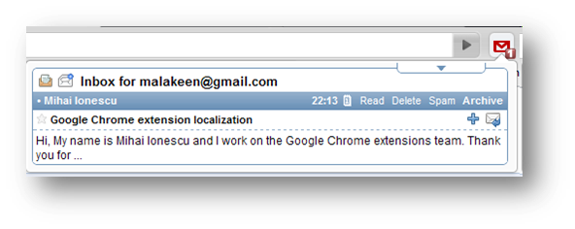
What are extensions?

Slide 4
Why extensions?
Experiment with new features
Even after the application ships
User-specific customization
Without bloating it for everyone

Slide 5
Scope of the challenge
Popular!
3+ billion downloads
Diverse
6000+ Firefox extensions
Written by 3rd party developers, worldwide
Combinatorial blowup
What could possibly go wrong?

Slide 6
Designing Extension Systems

Slide 7
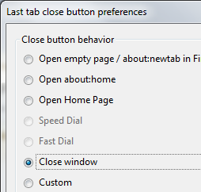
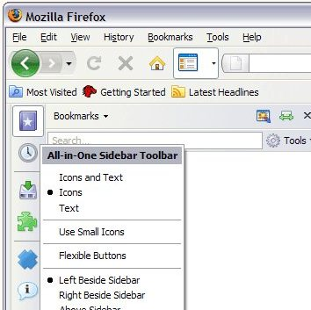
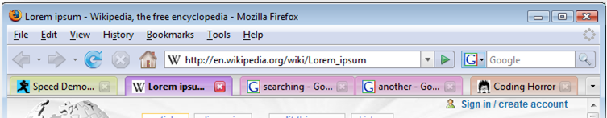
What can extensions do?
Modify or add behavior
Modify or add UI

Slide 8
How to build a UI? extension system
Hard-code the UI
Tedious to implement
Inflexible to change
Use a UI description language
General-purpose, works for many UIs
Easy to modify as needed
Pick your language: HTML, XUL, XAML, …

Slide 9
How to build a UI extension system?
Hard-code the UI extension points
Tedious to implement
Inflexible to change
Use a UI description language
General-purpose, works for many UIs
Easy to modify as needed

Slide 10
Overlays
General-purpose UI extension mechanism
Intuition: “tree-structured patch”
Base document
Overlay
<window xmlns="...">
<vbox id="msg">
<description>
Hello, World
</description>
</vbox>
</window>
<vbox id="msg">
<button>Overlay!</button>
</vbox>
<overlay xmlns="...">
<vbox id="msg">
<button>Overlay!</button>
</vbox>
</overlay>
+
<button>Overlay!</button>

Slide 11
Overlays
“Tree-structured patch”
Find positions in the document tree
Insert new content or modify existing nodes
Base document
Overlay
Composite
<window xmlns="...">
<vbox id="msg">
<description>
Hello, World
</description>
</vbox>
</window>
<overlay xmlns="...">
<vbox id="msg">
<button>Overlay!</button>
</vbox>
</overlay>
<overlay xmlns="...">
<vbox id="msg">
<description>
Hello, World
</description>
<button>Overlay!</button>
</vbox>
</overlay>
+
=

Slide 12
What can go wrong?*
Given a base document
And overlay
What should happen when Ctrl+L is pressed?
<InputBindings id="Hotkeys">
<KeyBinding Modifiers="Ctrl" Key="L" Command="Close" />
</InputBindings>
<modify element="InputBindings" id="Hotkeys">
<KeyBinding Modifiers="Ctrl" Key="L"
Command="GoToLocation" />
</modify>
(*adapted from real-world example)

Slide 13
What can go wrong?*
Given a base document
And overlay
Where should this modification go?
<PopupSet id="MainPopupSet">
<Popup>...</Popup>
</PopupSet>
<modify element="PopupSet" id="AllPopups">
<Popup>...New content...</Popup>
</modify>
(*adapted from real-world example)

Slide 14
Recap: overlays problem space
Design choices:
How expressive is the selector language?
What actions can extensions take?
Erroneous behaviors:
Structural errors, semantic errors, others?
How to detect all errors, for various designs?
…Idea: use declarative structure for analysis
Notes:
MENTION anti-patterns here: jetpacks, android xml, chrome extensions, all use markup but do so stupidly.

Slide 15
Detecting Extension Conflicts

Slide 16
Abstracting away overlay details
Overlay
Means…
Can we simplify some of these details?
<modify selector="InputBindings" where="after">
<KeyBinding Modifiers="Ctrl" Key="L"
Command="GoToLocation" />
</modify>
(Append <KeyBinding ... /> to <InputBindings>,
assuming
{Require existence of InputBindings,
No one else uses Key "Ctrl+L"})

Slide 17
A core language of overlays
Insert new content X into Y,
Append new content X after Y
(Append <KeyBinding ... /> to <InputBindings>,
assuming
{Require existence of InputBindings,
No one else uses Key "Ctrl+L" } )
(Take some action,
Guarded
Guarded
Resource1
Resource2
Assert something be Defined,
Assert something be Undefined,
Assert something be Clean,
Assert something be Frozen
Elements by Name and ID,
Key bindings,
Form elements, …

Slide 18
When do extensions conflict?
Extension 1:
(Insert Resource #2 in Resource #1, assuming
{No one else uses Resource #1} )
Ext1 can’t follow Ext2:
It defines Resource2 that Ext2 uses
Ext1 can’t follow Ext3:
Ext3 prevents Ext1
from using Resource1
Extension 2:
(Do something to Resource #2, assuming
{No one else uses Resource #2} )
CONFLICT
Ext3 can’t follow Ext1, either
Extension 3:
(Do something to Resource #1, assuming
{No one else uses Resource #1} )

Slide 19
Creating the dependency graph
Summarize the state S of the document by 4 sets:
Summarize each extension as a state transformer: document in state S_{in} ➔ document in state S_{out}
Create a “cannot-follow” dependency graph with:
One node per extension
An edge from N¹ → N² if S²_{out} contradicts S¹_{in}
{Defined : resources that must exist,
Undefined : resources that must not yet exist,
Clean : resources that have not been extended,
Frozen : resources that must never be extended}

Slide 20
Supporting the base document
Treat the base document as an extension too:
Action: defines each element in the document
Guards: reject prior definitions of those elements
Result: base document must precede all extensions
Main document:
(Insert Every element into the empty document, assuming
{No one has defined Every Element} )

Slide 21
Hotkeys example: Different keys, No conflict
Base document:
➔
#1
{Undefined : {InputBindings}}
{Defined : {InputBindings}}
Document needs
InputBindings to be
Undefined, but overlay
asserts it’s Defined
Document needs
InputBindings to be
Undefined, but overlay
asserts it’s Defined
Overlay #1:
➔
#2
Overlay #2:
➔
{Defined : {InputBindings},
Undefined : {Key(Ctrl+L)}}
{Defined : {InputBindings},
Undefined : {Key(Alt+M)}}
{Defined : {InputBindings,
Key(Ctrl+L)},
Frozen : {Key(Ctrl+L)}}
{Defined : {InputBindings,
Key(Alt+M)},
Frozen : {Key(Alt+M)}}
#3

Slide 22
Hotkeys example: Same keys, Conflict
Base document:
➔
{Undefined : {InputBindings}}
{Defined : {InputBindings}}
Document needs
InputBindings to be
Undefined, but overlay
asserts it’s Defined
Document needs
InputBindings to be
Undefined, but overlay
asserts it’s Defined
Overlay #1:
➔
Overlay #2:
➔
Overlay #2:
➔
{Defined : {InputBindings},
Undefined : {Key(Ctrl+L)}}
CONFLICT
{Defined : {InputBindings},
Undefined : {Key(Ctrl+L)}}
{Defined : {InputBindings},
Undefined : {Key(Alt+M)}}
Defines Ctrl+L,
which other overlay
says is Frozen
{Defined : {InputBindings,
Key(Ctrl+L)},
Frozen : {Key(Ctrl+L)}}
{Defined : {InputBindings,
Key(Ctrl+L)},
Frozen : {Key(Ctrl+L)}}
{Defined : {InputBindings,
Key(Alt+M)},
Frozen : {Key(Alt+M)}}

Slide 23
Experimental results
Examined snapshot of top 350 Firefox extensions
261 define overlays for main browser UI:
1120 individual actions
~15,000 “semantic requirements”
This is too big for manual checking
Conflicts found:
6 inter-extension conflicts
50 imprecise overlays
20 incorrectly declared overlays
150 missing dependencies
All these errors are silently ignored by Firefox

Slide 24
Useful feedback
Feedback to developers:
“Your extension conflicts with extension X, because of Y.”
Feedback to end-users:
“Extensions A, B and C conflict; you cannot install them all at once.”
Actionable

Slide 25
Expressiveness and Analysis Precision

Slide 26
Design choice: Increasing selector expressiveness
Flexible matching of multiple items
“all tweets in the page…”
“all-but-the-first list item…”
“3rd element after 2nd heading…”
These all might describe same thing!
Essentially, “may alias” analysis:
When might two selectors pick the same nodes?
Precision of analysis depends on flexibility of selectors

Slide 27
Takeaway Lessons
Overlays are powerful, flexible way to structure extensible UI
Rich design space of expressiveness
(see paper for details)
Declarative language ➔ clear notion of conflicts
Simple overlays ➔ efficient conflict detection
Complex overlays ➔ more power, more problems

