Slide 1

The TeJaS Family of Type-systems for JavaScript
Benjamin Lerner
Joe Politz
Arjun Guha
Shriram Krishnamurthi

Slide 2

Engineering JavaScript Semantics
λ_{JS}
Desugar
SpiderMonkey, V8,
Rhino, …
Small (100LOC)
interpreter
diff
“Their answer”
“Our answer”

Slide 3

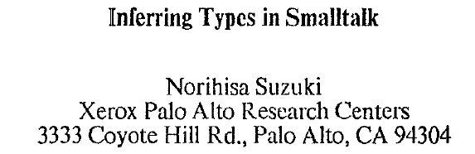
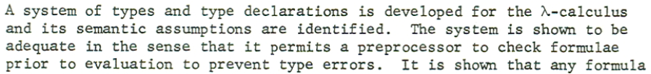
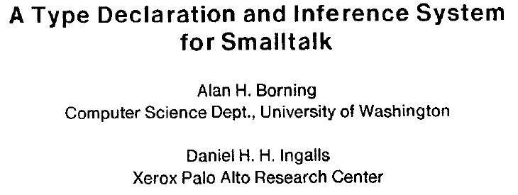
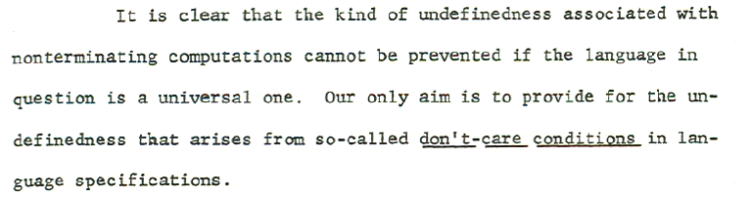
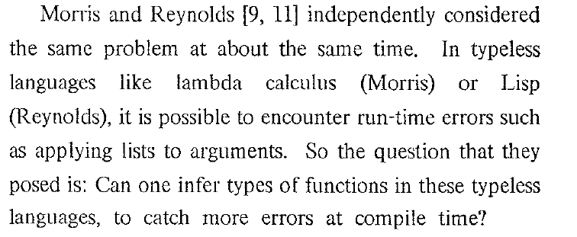
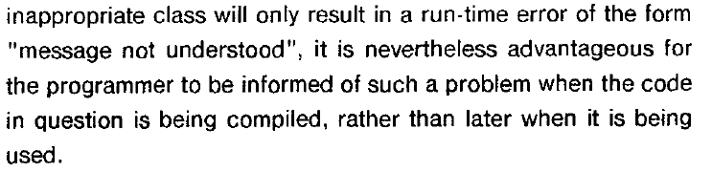
PhD 1968
POPL 1981
POPL 1982

Slide 4
Retrofitted Type System Design Principle
Statically prevent (most)
existing run-time errors

Slide 5
“a string” – “another string”
→ NaN
Arithmetic doesn’t signal errors
No arity mismatch errors
Reading non-existent field → undefined
Writing non-existent field → creates field
Unbound identifiers → same story
Breaching array bounds → undefined
Some object weirdness, too

Slide 6
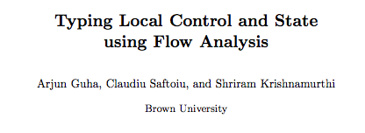
stop: Num ∪ Undef
var slice = function (arr, start, stop) {
if (typeof stop === "undefined") {
stop = arr.length – 1;
}
var result = [];
for (var i = 0; i <= stop - start; i++) {
result[i] = arr[start + i];
}
return result;
}
slice([5, 7, 11, 13], 0, 2)
→ [5, 7, 11]
slice([5, 7, 11, 13], 2)
→ [11, 13]
stop: Undef
stop: Num
stop: Num

Slide 7
A Completely Different Application

Slide 8
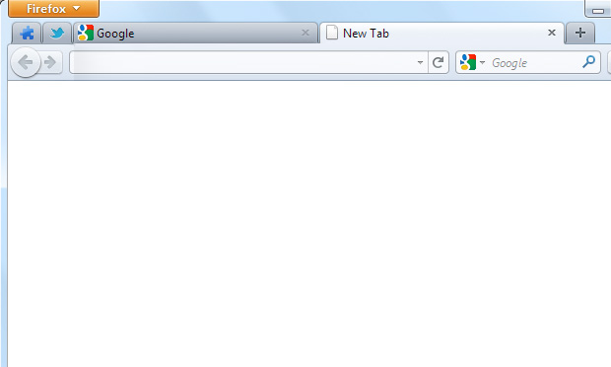
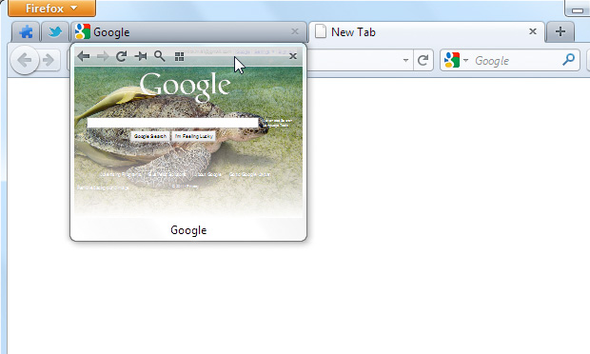
Notes:
“What might browser extensions do? Well, here’s one example, where an extension adds a thumbnail preview of background tabs to your browser. It even adds a mini-navigation bar, too. In general, extensions can do just about anything your browser can already do (talk to the network, download/upload files, cookies, etc), and for the most part, extensions are benign and helpful.”

Slide 9
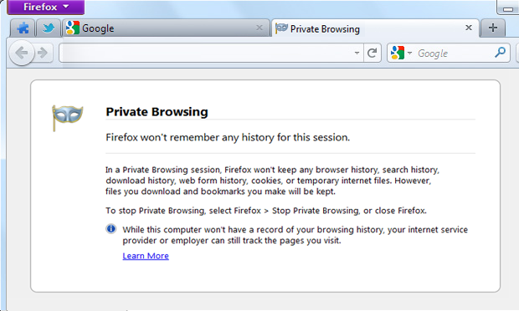
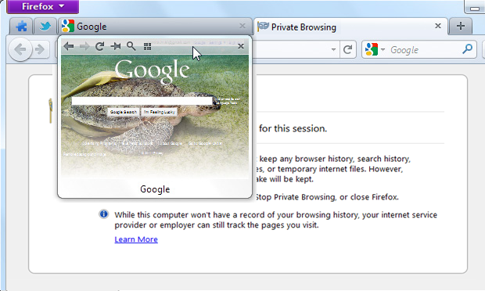
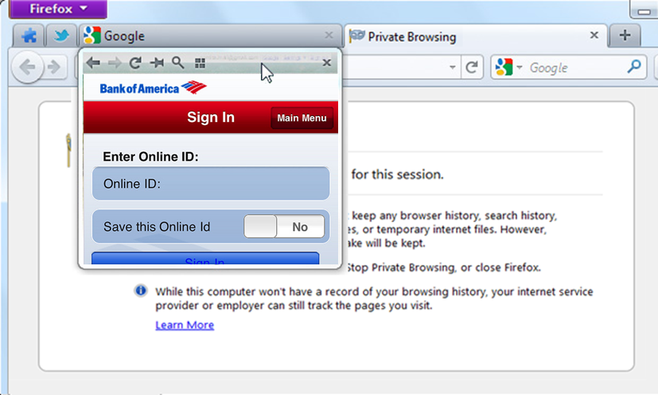
Notes:
“But browsers have other features besides extensibility, that may not obviously work right when extensions are present. For instance, browsers also implement a so-called ‘private browsing mode’, or ‘incognito mode’. Browsers inform you that PBM will leave behind no history, cookies, or temp files. And browser vendors have spent huge development effort engineering PBM to be correct and robust. And *you* installed an extension! That same thumbnail extension that seemed so benign before is now taking screenshots of your private session, and possibly of private details, too. It isn’t *malicious*, it just wasn’t written with PBM in mind.”

Slide 10
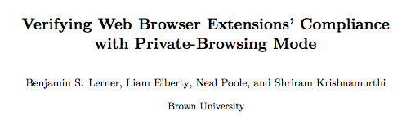
Always true in PBM
Has type File = {
read : Num → Str,
write : Unsafe,
}
function autoSaveSettings() {
var aFile = getSettingsFile();
if (!inPrivateBrowsingMode) {
aFile.write(currentSettings);
}
}
getSettingsFile()
inPrivateBrowsingMode
aFile.write(currentSettings)
ERROR: Cannot call
Unsafe function!
This code is dead in private mode…so no violation!
Notes:
“If that were all we did, then extensions could never use Unsafe APIs, even in non-PBM. But let’s look at the following simplistic example. Suppose an extension had a ‘save settings’ function that ran every so often. It does two things: open the settings file, and write to it. This isn’t safe in PBM, because it’s persisting (possibly-sensitive) data to disk. But if we add a check for private browsing mode, then the write becomes dead code, so we shouldn’t flag it as an error.”

Slide 11
And another…

Slide 12
What does this jQuery code do?
$(“.tweet span”).next().html()
Depends on the shape of the page!

Slide 13
What’s going on here?
Query: Selects some nodes in the page
Manipulate: Retrieve or modify data from node(s)
$(“.tweet span”).next().html()
$(“.tweet span”)
.next()
.html()
Navigate: Move to new nodes, relative to existing ones

Slide 14

How to catch these errors?
Working backwards:
x.html() is ok if x has exactly 1 node
x.next() is ok if x has at least 1 node
The $() function returns some number of nodes, based on its argument…
Need more than just simple types:
Need to track sizes

Slide 15
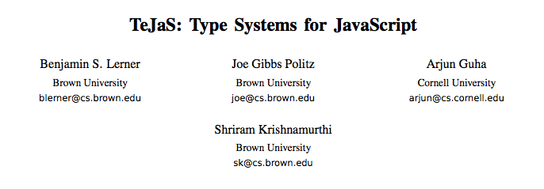

Slide 16
Base type system:
Numbers, strings, functions, objects, union, intersection, references, polymorphism, …
Extensions:
Private Browsing: Base + “Unsafe” + “Ext” types
JQuery: Base + multiplicities
ADsafety: Base + “Widget type” + flow typing
…
Key Point: One system isn’t enough

Slide 17
Type systems build on the base system…
So should their implementations!

Slide 18
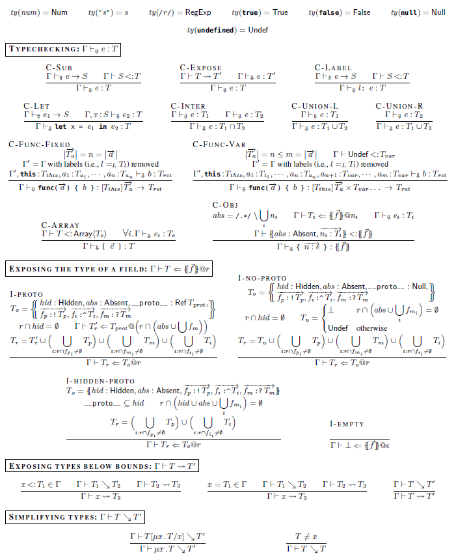
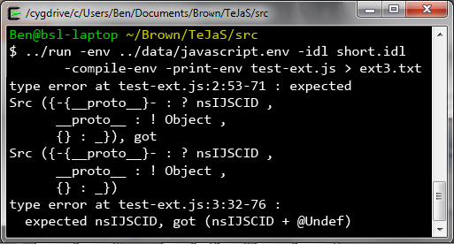
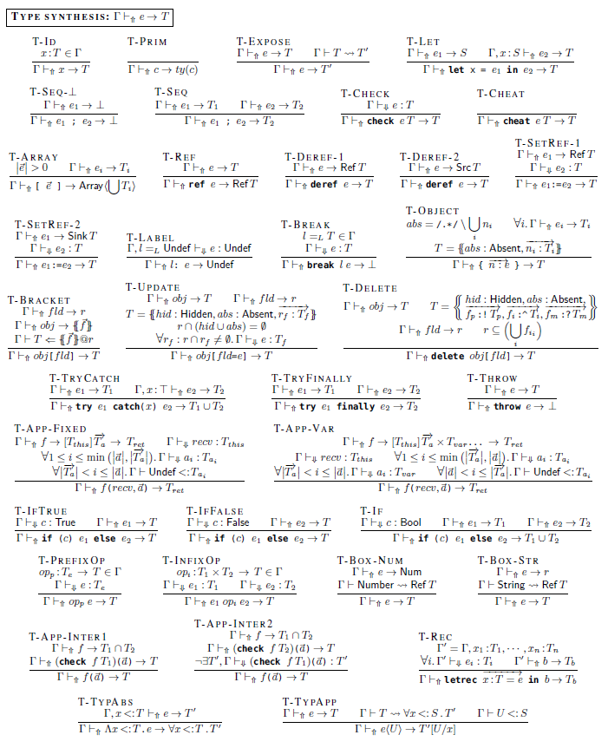
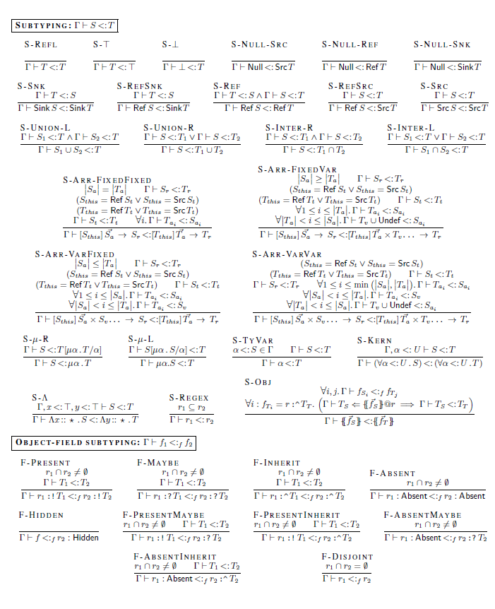
What TeJaS provides
module Base_TypeSystem = struct
end
module PPrinter = struct
end
Hooks for easily building variations on the base type system

Slide 19
Implementation: ML functors
module BASE = functor ... -> struct
type kind =
(* base kinds *)
| KEmbed of EXT.kind
type typ =
(* base types *)
| TEmbed of EXT.typ
...
end
module BASE = struct
type kind =
(* base kinds *)
| KEmbed of EXT.kind
type typ =
(* base types *)
| TEmbed of EXT.typ
...
end
module EXT = functor ... -> struct
type kind =
(* and anything new... *)
| KBase of BASE.kind
type typ =
(* and anything new... *)
| TBase of BASE.typ
...
end
Mutual recursion allows Ext to extend Base,
and also embed Ext within Base

Slide 20
Points of Variation
Concrete syntax/Syntactic sugar for types
Type environments
➔ ADsafety, Private Browsing systems
New type/kind constructors
➔ JQuery system
New/different (sub-)typing rules
➔ TypeScript example system

Slide 21
Object extension:
A FooBar object is just a Foo object with an extra field named ‘bar’
➔
type Foo = { ... }
type FooBar = { Foo with bar : Num }

Slide 22
Object construction trios:
3 mutually recursive types for constructor functions, prototype objects, and instances
➔
type constructor FooConstr = [Foo] … -> Foo
and prototype FooProto = { …shared functions… }
and instance Foo = { … instance fields … }

Slide 23
module TypeScript = functor ... -> struct
type typ =
| TBase of BASE.typ
| TArrow of typ list * typ
...
end
New Type
Definitions:
module TypeScript_Subtyping = functor ... -> struct
...
let rec subtype (env : env) s t : bool =
match unwrap_t s, unwrap_t t with
| TBase t1, TBase t2 -> BaseSub.subtype env t1 t2
| TArrow (args1, ret1), TArrow (args2, ret2) ->
(List.for_all2 (fun t1 t2 ->
(subtype env t1 t2) || (subtype env t2 t1))
args1 args2) &&
subtype env ret1 ret2
| _ -> false
end
New
Subtyping:

Slide 24

TeJaS
Customizable, extensible type systems for JS
https://github.com/brownplt/TeJaS
http://www.jswebtools.org/

Slide 25
$(“.tweet span”).next().html()
<Body>
<Div class=“header-bar”>
<Div class=“main-content”>
<Div class=“sidebar”>
<Div class=“stream”>
<Div class=“tweet”>
<Span class=“Author”> Ben
<Span class=“Time”> Now
<Span class=“Content”> Hi
<Div class=“tweet”>
…

Slide 26
$(“.tweet span”).next().html()
<Body>
<Div class=“header-bar”>
<Div class=“main-content”>
<Div class=“sidebar”>
<Div class=“stream”>
<Div class=“tweet”>
<Span class=“Author”> Ben
<Span class=“Time”> Now
<Span class=“Content”> Hi
<Div class=“tweet”>
…

Slide 27
$(“.tweet span”).next().html()
<Body>
<Div class=“header-bar”>
<Div class=“main-content”>
<Div class=“sidebar”>
<Div class=“stream”>
<Div class=“tweet”>
<Span class=“Author”> Ben
<Span class=“Time”> Now
<Span class=“Content”> Hi
<Div class=“tweet”>
…

Slide 28
$(“.tweet span”).next().html()
<Body>
<Div class=“header-bar”>
<Div class=“main-content”>
<Div class=“sidebar”>
<Div class=“stream”>
<Div class=“tweet”>
<Span class=“Author”> Ben
<Span class=“Time”> Now
<Span class=“Content”> Hi
<Div class=“tweet”>
…

Slide 29
$(“.tweet span”).next().html()
<Body>
<Div class=“header-bar”>
<Div class=“main-content”>
<Div class=“sidebar”>
<Div class=“stream”>
<Div class=“tweet”>
“<Span class=“Time”> Now”
<Span class=“Author”> Ben
<Span class=“Time”> Now
<Span class=“Content”> Hi
<Div class=“tweet”>
…

Slide 30
$(“.tweet span”).next().text()
<Body>
<Div class=“header-bar”>
<Div class=“main-content”>
<Div class=“sidebar”>
<Div class=“stream”>
<Div class=“tweet”>
“ Now Hi”
<Span class=“Author”> Ben
<Span class=“Time”> Now
<Span class=“Content”> Hi
<Div class=“tweet”>
…

