Slide 1

Verifying Web Browser Extensions’ Compliance with Private-Browsing Mode
Benjamin Lerner, Neal Poole,
Liam Elberty, Shriram Krishnamurthi
Brown University
ESORICS 2013

Slide 2
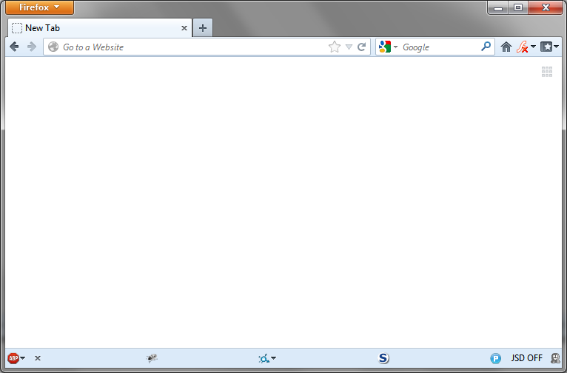
How many browsers do you see?
Each one defined by an extension

Slide 3

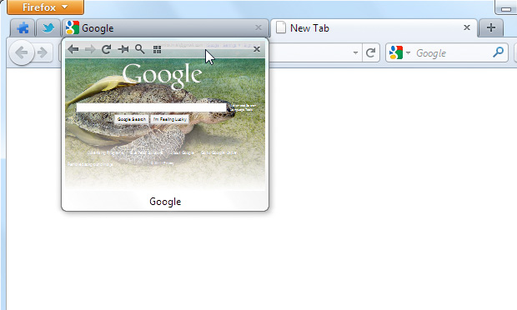
Notes:
“What might browser extensions do? Well, here’s one example, where an extension adds a thumbnail preview of background tabs to your browser. It even adds a mini-navigation bar, too. In general, extensions can do just about anything your browser can already do (talk to the network, download/upload files, cookies, etc), and for the most part, extensions are benign and helpful.”

Slide 4
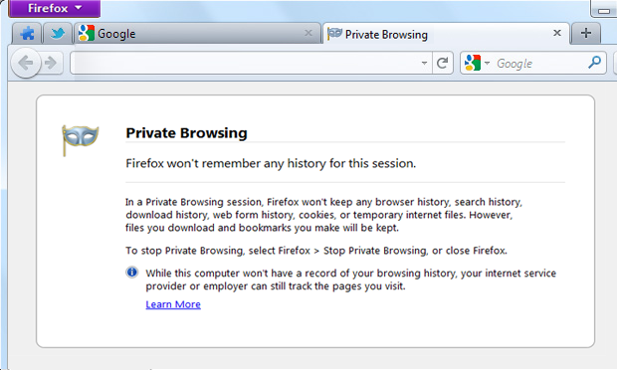
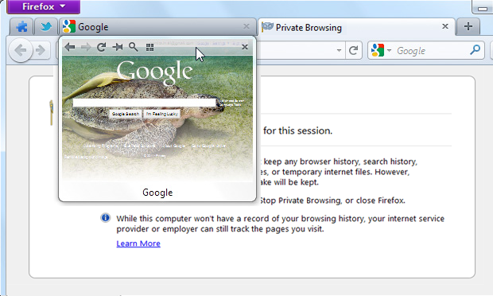
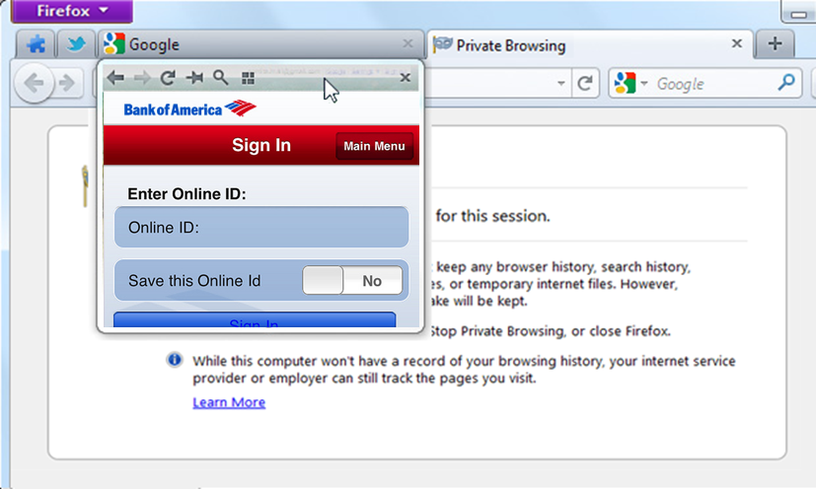
Notes:
“But browsers have other features besides extensibility, that may not obviously work right when extensions are present. For instance, browsers also implement a so-called ‘private browsing mode’, or ‘incognito mode’. Browsers inform you that PBM will leave behind no history, cookies, or temp files. And browser vendors have spent huge development effort engineering PBM to be correct and robust. And *you* installed an extension! That same thumbnail extension that seemed so benign before is now taking screenshots of your private session, and possibly of private details, too. It isn’t *malicious*, it just wasn’t written with PBM in mind.”

Slide 5
Solutions
“Extensions are too powerful. Don’t support them.”
3+ billion downloads for Firefox extensions alone
Top extensions have millions of users (9.5M for Chrome; 14M for Firefox)
Over 300 million Firefox users have extensions installed
“Extensions shouldn’t do that. Turn off bad APIs!”
Downloading and saving the latest malware blacklist: good
Saving a cached copy of a web form: bad
…but if the user deliberately tries to save a copy of a form: good!

Slide 6


Approaches
Off by default in Incognito mode
You can turn them on… but caveat emptor
On by default in Private Browsing mode
Every extension is audited by Mozilla…

Slide 7
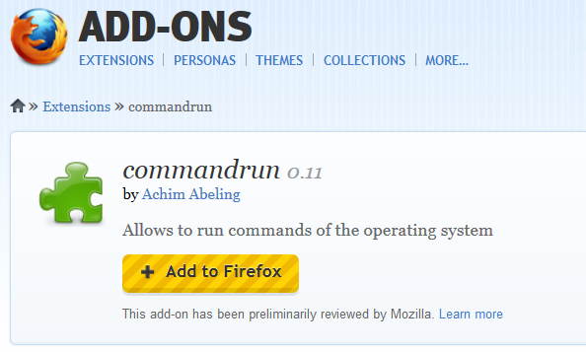
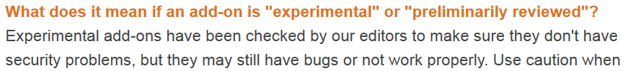
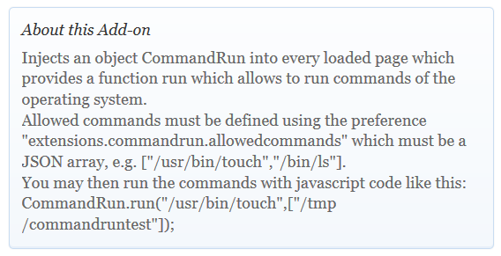
Notes:
“The commandrun extension is a small (~100LOC) developers’ tool, that lets you spawn processes from within your browser. Powerful, right? Not only that, but it exposes this functionality to arbitrary web content! This seems like a dangerous-enough extension even in normal mode, but surely it’s too powerful for PBM? Yet it has been preliminarily reviewed by Mozilla, meaning the reviewers think there are no security problems here! We’ll come back to the many issues of this extension later, but the point remains: manual review of extensions is hard and error-prone.”

Slide 8
Problem Scope
1400+ classes, ~14K properties/methods
4 APIs to detect private-browsing status
~50-100 privacy-sensitive APIs
Browser itself relies on all these APIs
Chrome: 26 classes, ~200 + properties/methods; 1 API to detect incognito status… We don’t yet know the semantics for sure

Slide 9
Typing Extensions
Also, define type Unsafe
If code typechecks as Ext, it cannot call Unsafe code
Ext = Number + String + Bool + Undef + Null +
__proto__: Object,
prototype :? Ext,
code : Undef +
([Ext] Ext ... => Ext),
defaultView : Absent,
« : Ext,
Objects
Primitive types
Custom prototypes
Safe functions
Missing fields
Everything else
Notes:
“So what do we do? We automate a large portion of the problem, by transforming it into a typechecking problem. And we know how to typecheck. Here’s the two key types in our system, Ext…and Unsafe. Unsafe means it *might* be used to break the PBM guarantee; remember, all these APIs are dual-purpose and could be used to write innocuous data too”

Slide 10
Our approach, in one slide
Always true in PBM
Has type File = {
read : Num → Str,
write : Unsafe,
}
function autoSaveSettings() {
var aFile = getSettingsFile();
if (!inPrivateBrowsingMode) {
aFile.write(currentSettings);
}
}
ERROR: Cannot call
Unsafe function!
This code is dead in private mode…so no violation!
Notes:
“If that were all we did, then extensions could never use Unsafe APIs, even in non-PBM. But let’s look at the following simplistic example. Suppose an extension had a ‘save settings’ function that ran every so often. It does two things: open the settings file, and write to it. This isn’t safe in PBM, because it’s persisting (possibly-sensitive) data to disk. But if we add a check for private browsing mode, then the write becomes dead code, so we shouldn’t flag it as an error.”

Slide 11
Staying Safe
In PBM, must not use Unsafe functions
inPrivateBrowsingMode is guaranteed to be True
Must check to make sure such functions aren’t called
In normal mode, can use any functions at all
inPrivateBrowsingMode is guaranteed to be False
Nothing in particular to typecheck
Might as well not bother!
Notes:
“So how do we distinguish safe calls to unsafe functions from unsafe calls to unsafe functions? Well, only in PBM do we need to avoid Unsafe calls. And fortunately we have a flag telling us whether we’re in PBM or not. In PBM that flag is always true, and outside PBM, we don’t even need to check.”

Slide 12



Idea
Represent True and False as primitive types
Define Bool = True + False
Give inPrivateBrowsingMode the type True
Use these types to check only the relevant branches
➔ dead-code-for-private-browsing-mode elimination
Notes:
“Now we start getting technical. We choose a type system that is more refined that you might expect. In particular, True and False are primitives, and Bool is a compound type. And we can use those True and False types in our typing rules, to ignore dead code. (If we don’t know for sure, then the normal if-rule ensures we check both branches.”

Slide 13
Checking for PBM
The singleton Private-browsing service
/*: ??? */
textareaCache.inPrivateBrowsing = function () {
return this._PBS.privateBrowsingEnabled;
};
/*: () -> Bool */
True
We give this type True
textareaCache.beforeWrite = function(node) {
if (this.inPrivateBrowsing()) return;
...
this.writeToPref(node);
};
Unreachable code
Notes:
“Let’s look at one real example, where the developer was keenly aware of PBM, and tried to make his code more robust. He refactored the check for PBM into a helper function, and made sure to call that helper everywhere necessary. Let’s see how our typing rules handle it. This code is intended to work in old versions of Firefox, that predate PBM, so the private browsing service may not yet exist. If it doesn’t, the helper returns false (there’s no PBM to be in), otherwise it returns whether private browsing is enabled. So this helper function has type () -> Bool. But then our typing rules say that the call to writeToPref is reachable…and that’s bad. If the developer had changed the default to *true*, then the helper would have type () -> True, and our type system would see that the return statement is always taken, and the writeToPref call is dead code.”

Slide 14
Two Practical Issues
“cheat”s
With 14K APIs, must automate the environment creation
All APIs obtained through a single factory method
➔ need to have a very precise type for that method!

Slide 15
Modeling Mozilla APIs
Components.classes[“@mozilla.org/file/local;1”]
.createInstance(Components.interfaces.nsIFile)
A function mapping nsIFooIID to Foo, and nsIBarIID to Bar, and …
A dictionary of all nsIJSIIDs
Components.classes[cID].createInstance(Components.interfaces.foo)
createInstance :
(nsIFile_IID → nsIFile) &
(nsIProcess_IID → nsIProcess) &
(nsIPrefBranch_IID → nsIPrefBranch) &
... &
(nsIJSIID → nsISupports)
Notes:
“This is the typical factory method invocation. There’s an array of factory objects that can call createInstance to construct the corresponding object for some interface (named foo, here). Let’s walk through the steps here…”

Slide 16
When Unsafe Functions Escape!
CommandRunHandler = function() {
this.isCommandAllowed =
/*: Str*... -> Bool */ function(command, args){ ... };
this.run =
/*:cheat @Unsafe*/
function(command, args){
...if isCommandAllowed(command) then run command...
};
};
function (x,y) { return true; }
CommandRun = {
onPageLoad: function(event) {
var win = event.originalTarget.defaultView.wrappedJSObject ;
win.CommandRun = new CommandRunHandler();
}
};
Risky!
VERY Risky!
Injects object into arbitrary web code
Notes:
“There’s one more challenge we have to address. Sometimes, the Unsafe functions aren’t called directly, but they escape to an uncontrolled context. Let’s look again at the commandrun extension. Here, there’s a handler object that has two methods: a predicate checking if a given command is allowed, and a run command method. Oddly, these methods are never called from within the extension. Instead, this handler object is injected into web content! WE have three opportunities to catch this escape. First, we note that the defaultView field leads to potentially unsafe values, so that in itself is risky. Second, the “wrappedJSObject” field is the escape hatch from Firefox’s built-in protections, giving the extension unmediated access to the actual web content object. Very risky! And finally, the assignment on the last line fails too, because the CommandRunHandler object is not a safe Ext-typed thing, because it has an Unsafe run() method. In order for any of this code to typecheck, we’d require several cheat statements…functions can’t escape without notice ☺”

Slide 17
Type Annotations
Type system based on System F<: and so type inference is generally impossible
Choose reasonable default annotation: Ext
Still have to annotate:
Functions that return specific Mozilla objects
Objects with (transitively) Unsafe fields

Slide 18
Evaluation
Retrofitted annotations onto 12 extensions (total 6.8KLOC)
Two ground rules: no* refactoring and type everything
Refactoring would have improved types and reduced annotation
Seven extensions found to be safe
One extension uses Unsafe code and shouldn’t
It initializes a settings file with default values
All file output is Unsafe, but these values are constant…
Four extensions have security vulnerabilities
Two confirmed by authors so far; two have not yet responded
Notes:
THIS IS NOT A SLIDE – it’s just stats you can pull apart into slides as you see fit. For the cheats to Bool or Str, it was a pain to change the default in our typechecker (you can’t change the rule that says true has type True, or else if-splitting won’t work; similarly for strings). A production system could easily be engineered to fix this.

Slide 19
Evaluation: low-level details
818 Annotations
33 type definitions
413 checked upcasts
372 “cheats”

Slide 20
Evaluation: low-level details
GREAT! These are the missing, implicit specs of the code!
818 Annotations
Specifications
21 coerce to Num, Bool, or Str
33 type definitions
(Mostly) Safe checks
It’s always fine to mark a function as Unsafe
413 checked upcasts
(e.g., /*: Bool*/true, or /*:Str*/“”)
34 cheat for mutability
36 cheat to user-defined types
119 downcast to Mozilla APIs
19 cheat imports
Deleting fields,
using Arrays, using Unsafe functions as callbacks (cast to Ext -> Ext), …
66 mark entire functions as Unsafe
77 have Unsafe annotations, many of which could be problematic

Slide 21
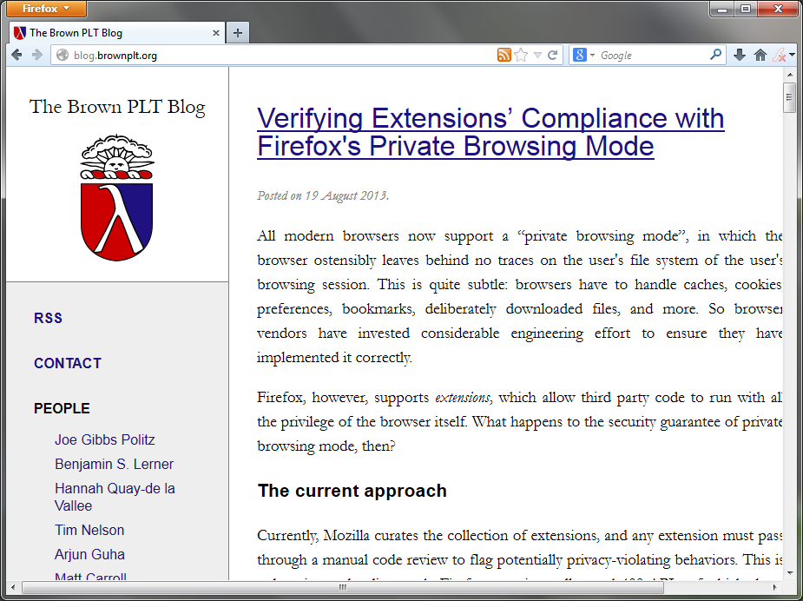
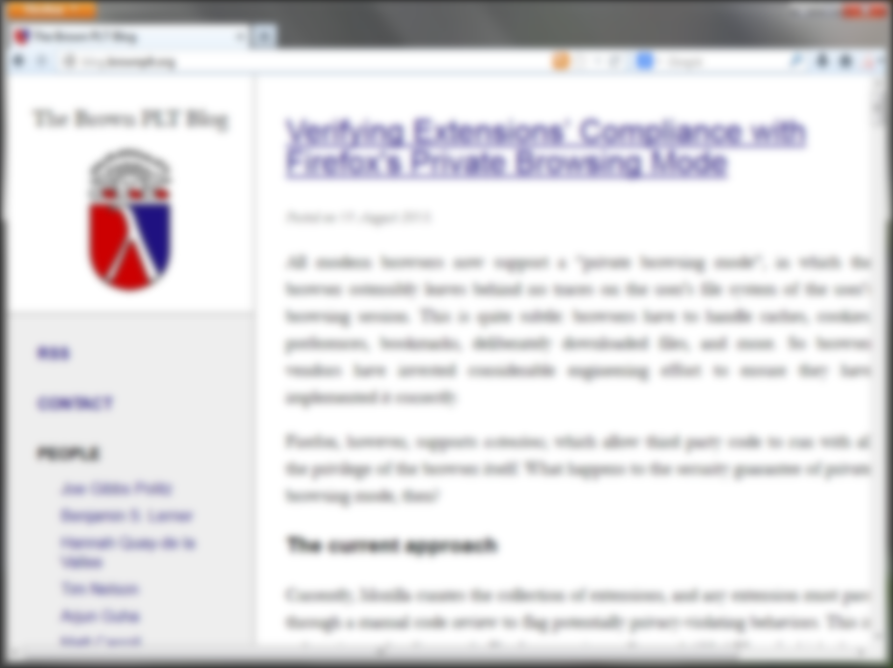
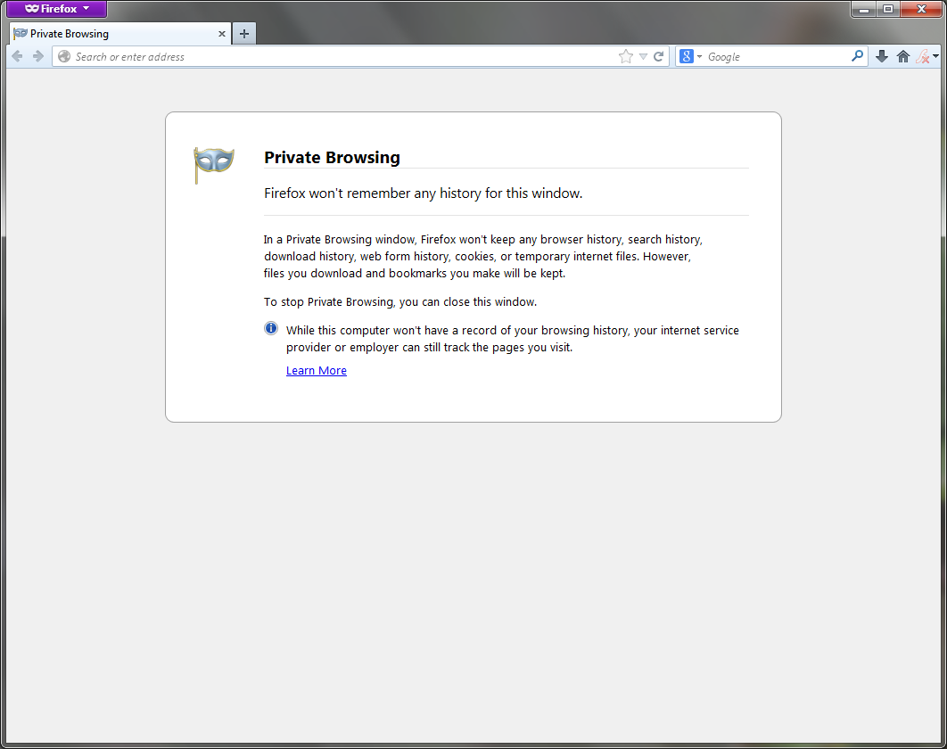

When policies change
Public and private “modes” can now mix!
Just update the type environment to make more APIs Unsafe
And rerun the typechecker

Slide 22
Summary
Extensions + private-browsing is subtle
Analyze interactions with type systems
Sufficiently precise to model relevant behavior
Sufficiently lightweight for real use
Sufficiently flexible when policies change

Slide 23


Want more?
Code: https://github.com/brownplt/TeJaS/
Blog: https://brownplt.github.org/
Tools: http://www.jswebtools.org/

