Slide 1
Supporting Dynamic, Third-Party Code Customizations in JavaScript Using Aspects
Benjamin Lerner, Herman Venter, and Dan Grossman
University of Washington, Microsoft Research

Slide 2
How do web pages run?
Web pages =
HTML (structure)
CSS (style)
JS (behavior)
Extensions =
New JS inserted into the page
<html>
...
<body>
<script>
function msg() {
return "Salutations";
}
body.onclick = "alert(msg());";
</script>
...
<script>
function msg() { return "hi"; }
</script>
</body>
</html>
Notes:
This is a talk about enabling third-party extensions to web pages and web browsers

Slide 3
Outline
Motivation
Userscripts
Browser extensions
Techniques and semantic flaws
Wrapping
Monkey-patching
Language approach: weaving mechanism
Functions
Filters
Evaluation
Expressiveness
Performance

Slide 4
Outline
Motivation
Userscripts
Browser extensions
Techniques and semantic flaws
Wrapping
Monkey-patching
Language approach: weaving mechanism
Functions
Filters
Evaluation
Expressiveness
Performance

Slide 5
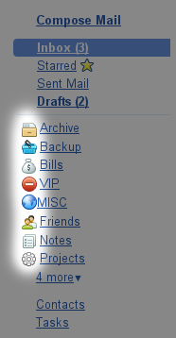

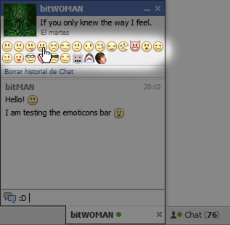
Motivation: Userscripts
Lightweight extensions to individual web pages
Add or change features of the site in ways the site designer never anticipated

Slide 6
Key features of Userscripts
Execution
Userscripts are appended to the page
Once added, they behave identically to page scripts
Popularity
60K scripts
10M+ users

Slide 7
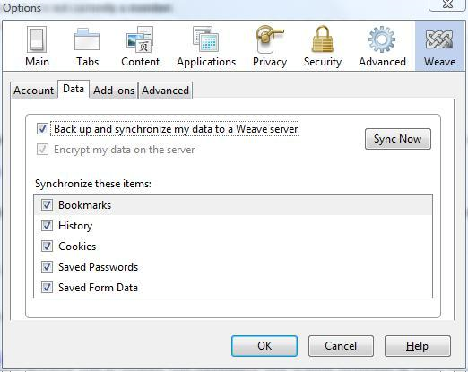
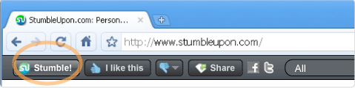
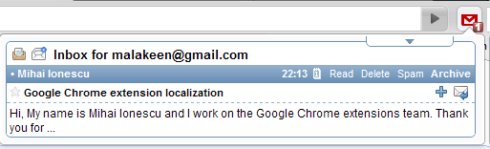
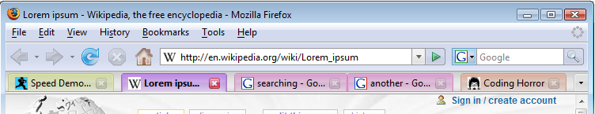
Motivation: Web-browser Extensions
Downloadable code that customizes a browser
Notes:
Web developers really like the separation of content, style, and execution, and users really like the extensibility it provides. This model is so popular that browsers, in particular Firefox but to varying degrees other browsers too, have defined their own UIs in terms of HTML-like content and JS execution, and that in turn brings extensibility to the browser UI.

Slide 8
How do these extensions work?
Can’t only append new code to the page
It won’t get called
Need to replace existing code too
Only two techniques available within JS:
Wrapping
Monkey patching

Slide 9
Wrapping
“This function doesn’t quite do what I want; let me replace it”
How?
function P(iframe, data) {
...
}
function P(iframe, data) {
if (data[0] == "mb")
data[1] = format(data[1]);
...
}
var oldP = window.P;
window.P = function(iframe, data) {
if (data[0] == "mb")
data[1] = format(data[1]);
return oldP.apply(iframe, arguments);
}

Slide 10
Monkey patching
“This function doesn’t quite do what I want; let me tweak it”
Create a new closure and bind to existing name
A closure’s toString() returns its source code
eval("foo = " +
foo.toString()
.replace("some code",
"modified code"));
A closure
String-level search & replace

Slide 11
Monkey patching “idioms”
function XULBrowserWindow.setOverLink(link) {
...
}
eval("XULBrowserWindow.setOverLink = " +
XULBrowserWindow.setOverLink.toString().replace(/{/,
"$& link = Fission.setOverLink(link);"));
Idiom: $& inserts whatever was matched
Idiom: the first { is always the start of the function
When does this code run?
What is link?
function XULBrowserWindow.setOverLink(link) {
link = Fission.setOverLink(link);
...
}
Notes:
Well, this ‘works’, but let’s remind ourselves, as PL researchers, why this should feel grossly wrong…

Slide 12
Drawbacks of these approaches
Incorrect for aliases
All other aliases are unmodified
function foo(x) { return x*x; }
var bar = foo;
eval("foo = " + foo.toString().replace("x*x", "42"));
> foo(5) == bar(5);
> false

Slide 13
So, don’t alias functions…?
Function aliases are everywhere in web JS code
Installing event handlers creates aliases
Needs a solution that works with existing web code
function onLoad(evt) { window.alert("hello"); }
window.addEventListener("load", onLoad, ...);
eval("onLoad = " + onLoad.toString.replace('hello', 'hi there'));
> ...loading the page...
> Alert: “hello”

Slide 14
Drawbacks of these approaches
Incorrect for closures
They are new closures that have the wrong environment
function makeAdder(x) { return function(y){ return x+y; }; }
var addFive = makeAdder(5);
eval("addFive = " + addFive.toString.replace('y', 'z'));
> addFive(3)
> error: ‘x’ is undefined

Slide 15
Recap
Extensions are very popular…
…but have a very strange programming model
Can’t simply outlaw them.
PL opportunity! ☺
Rest of talk:
Language design, implementation
Evaluation of performance, expressiveness

Slide 16
Outline
Motivation
Userscripts
Browser extensions
Techniques and semantic flaws
Wrapping
Monkey-patching
Language approach: weaving mechanism
Functions
Filters
Evaluation
Expressiveness
Performance

Slide 17
Goal: combine extensions & mainline
Extensions need to:
Define what new code to run
When it needs to run
How it interacts with existing code
Sounds a lot like dynamic aspect weaving!
…Unless you’d rather we not call it “aspects”
These aren’t traditional “cross-cutting concerns”
We use the same mechanism, not the same motivation
Notes:
We are going to define new JS language primitives aimed squarely at the needs of extension authors. That may not seem much like AspectJ, and that’s fine.

Slide 18
Aspects
Aspects = Advice + Pointcuts
Advice defines what new code to run
Pointcuts define when to trigger it
Pointcut
Type of advice
at pointcut(callee(square)) before (x) {
print("x is ", x);
}
callee(square)
before
(x)
print("x is ", x);
Arguments to function
Advice

Slide 19
Key features of our aspects
at pointcut(callee(square)) before (x) {
print("x is ", x);
}
callee(square)
print("x is ", x);
square
env
code _
+ advice
aliasToSquare
This cannot be done in JS

Slide 20
Kinds of aspects
Function advice:
Before, around, after calls to functions
Before, around, after bodies of functions
Field advice:
Around getting, setting fields
Statement advice:
Before, after, around statements within functions
…others?

Slide 21
Aspects for functions
At runtime, evaluate this to a closure and modify it
callee(launchMissiles)
at pointcut(callee(launchMissiles)) around(x)
{
if (!authorized(x))
print("WARNING!!!");
else if (proceed() == false) {
print("Launch failed");
}
return retval ;
}
Call next advice, or mainline function
proceed()
retval
(Mutable) binding of return value from proceed()

Slide 22
Filtering pointcuts
All calls to a function may be too frequent
May want to apply only in some cases
Stack filters: predicates on the shape of the stack
Full technical details in the paper
stack(a, !b)
at pointcut(callee(f) && stack(a, !b)) ...
Pointcut will trigger when f is called…
…but only when the stack contains a, and does not contain b after a

Slide 23
Implementation: function advice
Targeting a JIT compiler
Key idea: weaving = inlining advice + invalidating JITed closure
Inlining advice:
Avoids function-call overhead
Ensures advice has access to local variables
Invalidating JITed closure:
Ensures next calls to function get the advice
Amortizes weaving cost across all calls to function

Slide 24
Implementation: filters
Idea:
Treat filter as a state machine
Store the state in the (representation of the) closure
For each function in the filter, weave advice to update the state
Time- and space-efficient
Much more efficient than mimicking it in JS directly

Slide 25
Outline
Motivation
Userscripts
Browser extensions
Techniques and semantic flaws
Wrapping
Monkey-patching
Language approach: weaving mechanism
Functions
Filters
Evaluation
Expressiveness
Performance

Slide 26
Expressiveness
350 top Firefox extensions: 35 use monkey patching
Examined 20 of these 35 extensions
Total size: 0.3—14KLOC, total 99KLOC
Monkey patch size: 11—900LOC, total 2.7KLOC
636 observed monkey patches
We can express 621/636 patches easily.

Slide 27
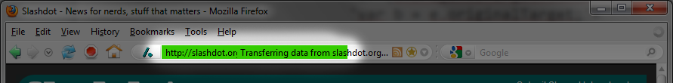
Expressiveness: aspects aid clarity
eval("XULBrowserWindow.setOverLink = " +
XULBrowserWindow.setOverLink.toString().replace(/{/,
"$& link = Fission.setOverLink(link);"));
at pointcut(callee(XULBrowserWindow.setOverLink)) before(link) {
link = Fission.setOverLink(link);
}
Notes:
Note: not any shorter, but a lot clearer!

Slide 28
Performance
Advise a simple function
Weave advice once, call function N times
Wrapping: extra function calls hurt
Monkey-patching: regexps, eval hurt
Manual code
Advice: identical to manual code

Slide 29
Performance
Advise a simple function with a stack filter
Weave advice once, call function N times
Wrapping: extra function calls still hurt
Monkey-patching:
amortizes to manual version
Manual code
Advice: better than manual code

Slide 30
Conclusions
Extensions have strange behavior
Existing techniques within JS are inadequate
But we can’t simply outlaw all extensions
Introduced dynamic aspect weaving as new JS language feature
Provides cleaner semantics
Provides better performance
Provides sufficient expressive power for real extensions
Win-win!

Slide 31
Monkey patching: making a mess
onPopupShowing: function BM_onPopupShowing(event) {
...
if (!(hasMultipleURIs || siteURIString)) {
...
return;
}
else if ((hasMultipleURIs || siteURIString)) {
for (var i = target.childNodes.length - 1; i > -1; i--){
if (target.childNodes[i].getAttribute("builder") == "end"){
target._endMarker = i;
break;
}
}
}
if (!target._endOptSeparator) {
...
}
...
}
From MultiRow Bookmarks Toolbar 2.9

