Slide 1
SEMINAL: Searching for ML Type-Error Messages
Benjamin Lerner, Dan Grossman, Craig Chambers
University of Washington

Slide 2
Example: Curried functions
# let map2 f aList bList =
List.map
(fun (a, b) -> f a b)
(List.combine aList bList);;
val map2 : ('a -> 'b -> 'c) ->
'a list ->
'b list ->
'c list = <fun>
# map2 (fun (x, y) -> x + y)
[1;2;3] [4;5;6];;
This expression has type int but is here used with type 'a -> 'b
Try replacing
fun (x, y) -> x + y
with
fun x y -> x + y

Slide 3
Example: Nested matches
# type a = A1 | A2 | A3;;
# type b = B1 | B2;;
# let x : a = ...;;
# let y : b = ...;;
# match x with
A1 -> 1
| A2 -> match y with
B1 -> 11
| B2 -> 21
| A3 -> 5;;
This pattern matches values
of type a but is here used
to match values of type b
Try replacing
match x with
A1 -> 1
| A2 -> match y with
B1 -> 11
| B2 -> 21
| A3 -> 5;;
with
match x with
A1 -> 1
| A2 -> (match y with
B1 -> 11
| B2 -> 21)
| A3 -> 5;;

Slide 4
What went wrong?
Sometimes, existing type-error messages…
…are not local
  Symptoms <> Problems
…are not intuitive
  Very lengthy types are hard to read
…are not descriptive
  Location + types <> Solution
…have a steep learning curve

Slide 5
Related work
Instrument the type-checker
  Change the order of unification
  Explanation systems
  Program slicing
  Interactive systems
  Reparation systems
But that leads to…
See paper for citations

Slide 6
Tight coupling with type-checker
Implementing a Hindley-Milner TC is easy
Implementing a production TC is hard
  Adding good error messages makes it even harder
  Interferes with easy revision or extension of TC
Error messages in TC adds to compiler’s trusted computing base

Slide 7
Our Approach, in one slide
Treats type checker as oracle
  Makes no assumptions about the type system
  Note: no dependence on unification
Tries many variations on program, see which ones work
  Must do this carefully – there are too many!
  Note: “Variant works” <> “Variant is right”
Ranks successful suggestions, presents results to programmer

Slide 8
Outline
Examples of confusing messages
Related work
Our approach
Running example
Architecture overview
Preliminary results
Ongoing work
Conclusions

Slide 9
Example: Curried functions
# let map2 f xs ys =
List.map
(fun (x, y) -> f x y)
(List.combine xs ys);;
val map2 : ('a -> 'b -> 'c) ->
'a list ->
'b list ->
'c list = <fun>
# map2 (fun (x, y) -> x + y)
[1;2;3] [4;5;6];;
This expression has type int
but is here used with type
'a -> 'b
Suggestions:
Try replacing
fun (x, y) -> x + y
with
fun x y -> x + y
of type
int -> int -> int
within context
(map2 (fun x y -> x + y)
[1; 2; 3] [4; 5; 6])

Slide 10
Finding the changes, part 0
Change
let map2 f aList bList = … ;;
map2 (fun (x, y) -> x+y) [1;2;3] [4;5;6]
Into…

map2 (fun(x,y)->x+y) [1;2;3] [4;5;6]
let map2 f aList bList = … ;;


Slide 11
What’s that ?
Seminal examines the given AST
“Replace with ” = “Replace in AST”
Any particular  means
  Expressions: raise Foo
  ...

Slide 12
Finding the changes, part 1
Change
map2 (fun (x, y) -> x+y) [1;2;3] [4;5;6]
Into…
map2 ((fun(x,y)->x+y), [1;2;3], [4;5;6])
map2 ((fun(x,y)->x+y) [1;2;3] [4;5;6])
…
 (fun (x,y)->x+y) [1;2;3] [4;5;6]
map2  [1;2;3] [4;5;6]
map2 (fun (x,y)->x+y)  [4;5;6]
map2 (fun (x,y)->x+y) [1;2;3] 

Slide 13
Finding the changes, part 2
Change
(fun (x, y) -> x + y)
Into…
fun (x, y)  -> x + y
fun  (x, y) -> x + y
fun (y, x) -> x + y
…
fun x y -> x + y

Slide 14
Ranking the suggestions
Replace
map2 (fun (x,y)->x+y)
[1;2;3] [4;5;6]
with 
Replace map2
with 
Replace (fun (x,y)->x+y) with 
Replace (fun (x,y)->x+y) with (fun x y -> x+y)
Prefer smaller changes over larger ones
Prefer non-deleting changes over others

Slide 15
Tidying up
Find type of replacement
  Get this for free from TC
Maintain surrounding context
  Help user locate the replacement
Suggestions:
Try replacing
fun (x, y) -> x + y
with
fun x y -> x + y
of type
int -> int -> int
within context
(map2 (fun x y -> x + y)
[1; 2; 3] [4; 5; 6])

Slide 16
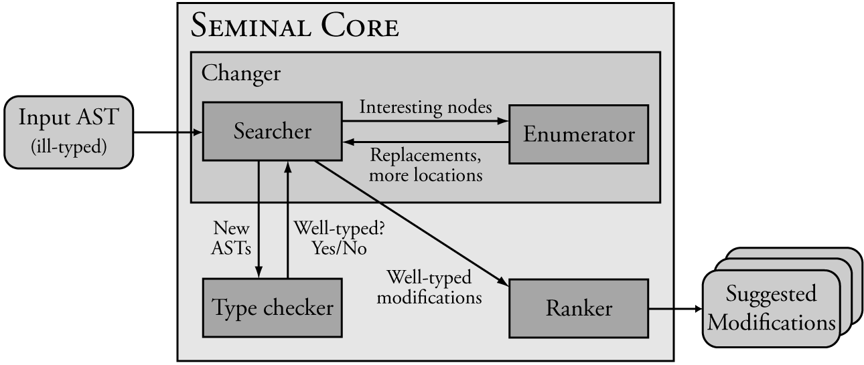
Behind the scenes

Slide 17
Searcher
Defines the strategy for looking for fixes:
Look for single AST subtree to remove that will make problem “go away”
  Replace subtree with “wildcards” 
Interesting subtrees guide the search
  If removing a subtree worked, try its children …
  Often improves on existing messages’ locations
Rely on Enumerator’s suggestions for more detail

Slide 18
Enumerator
Defines the fixes to be tried:
Try custom attempts for each type of AST node
  E.g. Function applications break differently than if-then expressions
Enumeration is term-directed
  A function of AST nodes only
  More enumerated attempts ➔ better messages
Called by Searcher when needed

Slide 19
Ranker
Defines the relative merit of successful fixes:
Search can produce too many results
Not all results are helpful to user
  E.g. “Replace whole program with ”!
Use heuristics to filter and sort messages
  “Smallest fixes are best”
  “Currying a function is better than deleting it”
Simple heuristics seem sufficient

Slide 20
Preliminary results
Prototype built on ocaml-3.08.4
Reasonable performance
  Can fully examine most files in under ~2sec
  Compare with human speed…
Bottleneck is time spent in TC
  Many calls + repetitive data > 90% of time
  TC can be improved independently from SEMINAL ☺

Slide 21
Current analysis
Ongoing analysis of ~2K files collected from students
Methods:
  Group messages as “good”, “misleading”, “bad”
  Check if message precisely locates problem
  Check if message approximates student’s actual fix
Results:
  Very good precision on small test cases
  Good precision on real, large problems
  Most poor results stem from common cause

Slide 22
Ongoing work
Dealing with multiple errors:
Errors may be widely separated
Least common parent is too big
Idea: ignore most code, focus on one error
Triage:
Trade “complete”
for “small”
Not in workshop paper!

Slide 23
Example: Multiple errors
Try replacing
match (x, y) with
0, [] -> []
| _, [] -> x
| _, 5 -> 5 + "hi"
with

Not an effective suggestion!
# val x : int;;
# val y : 'a list;;
# match (x, y) with
0, [] -> []
| _, [] -> x
| _, 5 -> 5 + "hi"
This pattern matches values of type int * int but is here used to match values of type int * 'a list
Problems:
The last two patterns don’t match
the same types
The first two cases don’t match
The last case doesn’t type-check
1) Try replacing
_, 5
with
_, 
2) Try replacing
x
with

3) Try replacing
5 + "hi"
with
5 + 

Slide 24
Example: Multiple errors
# val x : int;;
# val y : 'a list;;
# match (x, y) with
0, [] -> []
| _, [] -> x
| _, 5 -> 5 + "hi"
First try just the scrutinee
match (x, y) with
 -> 
Then try the patterns
match (x, y) with
0, [] -> 
| _, [] -> 
| _, 5 -> 
Finally try the whole expression
match (x, y) with
0, [] -> []
| _, [] -> x
| _, 5 -> 5 + "hi"

Slide 25
Conclusions
Searching for repairs yields intuitively helpful messages
SEMINAL decouples type-checker from error-message generator
  Simpler TC architecture
  Smaller trusted computing base
It’s a win-win scenario!
Version available soon – happy hacking!

