Slide 1
Searching for
Type-Error Messages
Benjamin Lerner, Matthew Flower,
Dan Grossman, Craig Chambers
University of Washington
Notes:
This is a talk about getting better type error messages, particularly for langs with t.i.

Slide 2
Example: Curried functions
# let map2 f aList bList =
List.map
(fun (a, b) -> f a b)
(List.combine aList bList);;
val map2 : ('a -> 'b -> 'c) ->
'a list ->
'b list ->
'c list = <fun>
# map2 (fun (x, y) -> x + y)
[1;2;3] [4;5;6];;
This expression has type int but is here used with type 'a -> 'b
Notes:
Here’s an example of programming in a language with t.i., here ML. Map2 is a function applying a function to a list of pairs…

Slide 3
So what to do?
Could stop using type inference
  But it’s key to ML’s & Haskell’s convenience
  … and Java generics
  … and C# LINQ
  … and C++ templates
  …
Makes error messages more important

Slide 4
So what to do?
# let map2 f aList bList =
List.map
(fun (a, b) -> f a b)
(List.combine aList bList);;
val map2 : ('a -> 'b -> 'c) ->
'a list ->
'b list ->
'c list = <fun>
# map2 (fun (x, y) -> x + y)
[1;2;3] [4;5;6];;
This expression has type int but is here used with type 'a -> 'b
Try replacing
fun (x, y) -> x + y
with
fun x y -> x + y
Notes:
Here’s an example of programming in a language with t.i., here ML. Map2 is a function applying a function to a list of pairs…

Slide 5
Outline
Error-message architecture
Example of searching
Types of search suggestions
Multiple errors
Comparative results
Conclusions

Slide 6
How are messages generated?
Existing compilers:
Must be correct
Lexing,
Parsing
Compiler
Back-end
Type Checker and
Error Message Generation
AST
Error
messages
Notes:
Trusted^H^H^H “if we overengineer the typechecker, then we potentially increase the risk of adding bugs into the compiler”

Slide 7
How are messages generated?
“Minimal” compilers:
Must be correct
Lexing,
Parsing
Compiler
Back-end
Type
Checker
AST
“NO”
Notes:
Trusted^H^H^H “if we overengineer the typechecker, then we potentially increase the risk of adding bugs into the compiler”

Slide 8
How are messages generated?
Our approach:
Must be correct
Lexing,
Parsing
Compiler
Back-end
Error
Message
Generation
Type
Checker
AST
Error
messages

Slide 9
Our approach, in one slide
Treats type checker as oracle
  Makes no assumptions about type system
Tries many variations on program, see which ones type-check
  “Variant type-checks” ≠ “Variant is right”
Ranks successful suggestions, presents results to programmer
  Programmer knows which are right
Notes:
“we speak loosely of a fix, but our suggestions may not always be a ‘fix’ per se, but just indicative of what should be done”

Slide 10
Example: Curried functions
# let map2 f aList bList =
List.map
(fun (a, b) -> f a b)
(List.combine aList bList);;
val map2 : ('a -> 'b -> 'c) ->
'a list ->
'b list ->
'c list = <fun>
# map2 (fun (x, y) -> x + y)
[1;2;3] [4;5;6];;
This expression has type int but is here used with type 'a -> 'b
Suggestions:
Try replacing
fun (x, y) -> x + y
with
fun x y -> x + y

Slide 11
Finding the changes
Change
let map2 f aList bList = … ;;
map2 (fun (x, y) -> x+y) [1;2;3] [4;5;6]
Into…
 ;;
map2 (fun(x,y)->x+y) [1;2;3] [4;5;6]
let map2 f aList bList = … ;;

Note:  is a placeholder that always type-checks

Slide 12
Finding the changes
Change
map2 (fun (x, y) -> x+y) [1;2;3] [4;5;6]
Into…
map2 ((fun(x,y)->x+y), [1;2;3], [4;5;6])
map2 ((fun(x,y)->x+y) [1;2;3] [4;5;6])
…
 (fun (x,y)->x+y) [1;2;3] [4;5;6]
map2  [1;2;3] [4;5;6]
map2 (fun (x,y)->x+y)  [4;5;6]
map2 (fun (x,y)->x+y) [1;2;3] 

Slide 13
Finding the changes
Change
(fun (x, y) -> x + y)
Into…
fun (x, y)  -> x + y
fun  (x, y) -> x + y
fun (y, x) -> x + y
…
fun x y -> x + y

Slide 14
Ranking the suggestions
Try replacing
map2 (fun (x,y)->x+y)
[1;2;3] [4;5;6]
with 
Try replacing map2
with 
Try replacing (fun (x,y)->x+y) with 
Try replacing (fun (x,y)->x+y) with (fun x y -> x+y)
Prefer smaller changes over larger ones
Prefer non-deleting changes over others

Slide 15
Kinds of Changes
Recursive descent
  Finds small expression to change
  May not be where type-checker thinks error is
Language-neutral suggestions
  Reassociate parentheses
  Insert function arguments
  …
Language-specific suggestions
  Replace r.fld := e with r.fld <- e
  Add missing keywords
  …
Notes:
Should simplify

Slide 16
Handling n errors
Try replacing
match (x, y) with
0, [] -> []
| _, [] -> x
| _, 5 -> 5 + "hi"
with

Not an effective suggestion!
# val x : int;;
# val y : 'a list;;
# match (x, y) with
0, [] -> []
| _, [] -> x
| _, 5 -> 5 + "hi"
This pattern matches values of type int * int but is here used to match values of type int * 'a list
Note: Other errors may still exist.
Try one of the following:
1) Try replacing
_, 5
with
_, 
2) Try replacing
x
with

3) Try replacing
5 + "hi"
with
5 + 

Slide 17
Outline
Error-message architecture
Example of searching
Types of search suggestions
Multiple errors
Comparative results
Conclusions

Slide 18
How well does it work?
Examined 1086 student homework files
  After removing consecutive files with same error
Comparisons:
  How big is reported error?
  Does message precisely locate problem?
  Does message approximate student’s actual fix?
  Which algorithm is better?
Compare existing approach to 1-error alg., then to n-error alg.

Slide 19
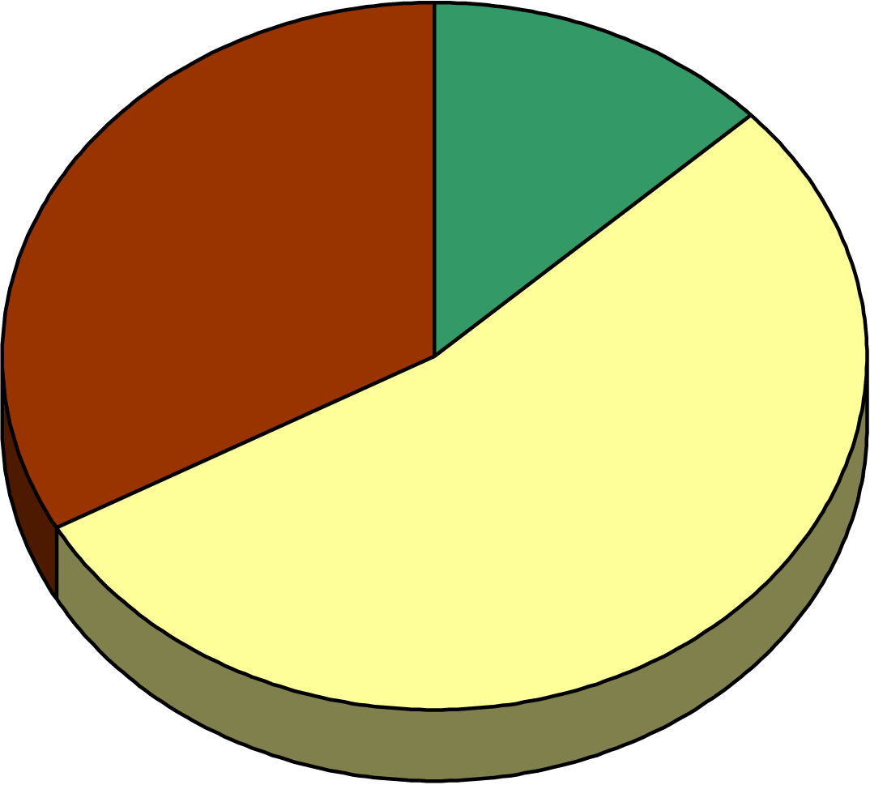
Comparative results: 1-error alg.
Existing approach clearly best
1-error algorithm clearly best
13%
33%
54%
All messages comparable

Slide 20
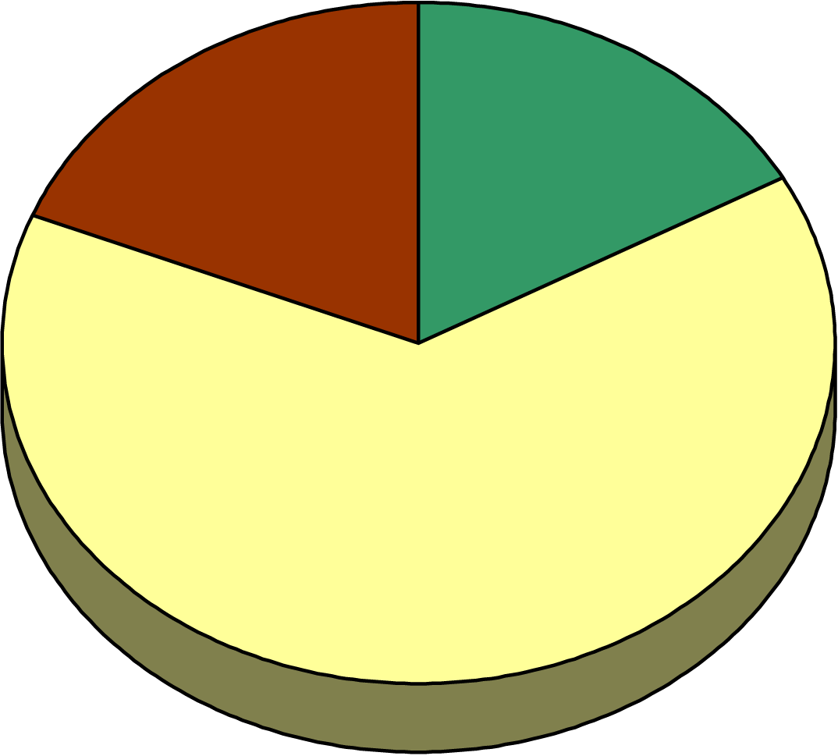
Comparative results: n-error alg.
Existing approach clearly best
n-error algorithm clearly best
17%
19%
64%
All messages comparable

Slide 21
Student Example
(* List.mem : ’a -> ’a list -> bool *)
let add str lst =
if List.mem str lst
then lst
else str::lst
(* ... in a function later in the file ... *)
add vList1 s
Type-checker:
The expression s has type string but is here used with type string list list
Our approach:
Try replacing
add vList1 s
with
add s vList1
...
Notes:
Having spent far too much time looking through these files, here’s an example where the student tries adding a string to a set, but called the arguments in the wrong order. You have to understand the ocaml type system to realize why the ocaml message suggests what it does. Instead…

Slide 22
Conclusions
Searching for error messages works!
  Yields useful messages as often as current compiler
  Can be improved easily
  Robust implementation for OCaml
  Prototype implementation for C++ template errors
Good for programmers, good for compiler writers
Handling multiple errors gracefully is crucial

