Slide 1


ENHANCING DIGITAL INFRASTRUCTURE AT ADELEKE UNIVERSITY
THE ESTABLISHMENT OF AN OFFICIAL NACOS ADELEKE UNIVERSITY WEBSITE AIMS TO IMPROVE COMMUNICATION AND OFFER VALUABLE RESOURCES TAILORED FOR COMPUTING STUDENTS. THIS INITIATIVE WILL PROVIDE A CENTRALIZED PLATFORM FOR INFORMATION SHARING, ACADEMIC MATERIALS, AND COMMUNITY ENGAGEMENT, THEREBY FOSTERING A MORE CONNECTED AND INFORMED STUDENT BODY.

Slide 2



PROJECT OVERVIEW ?

Slide 3
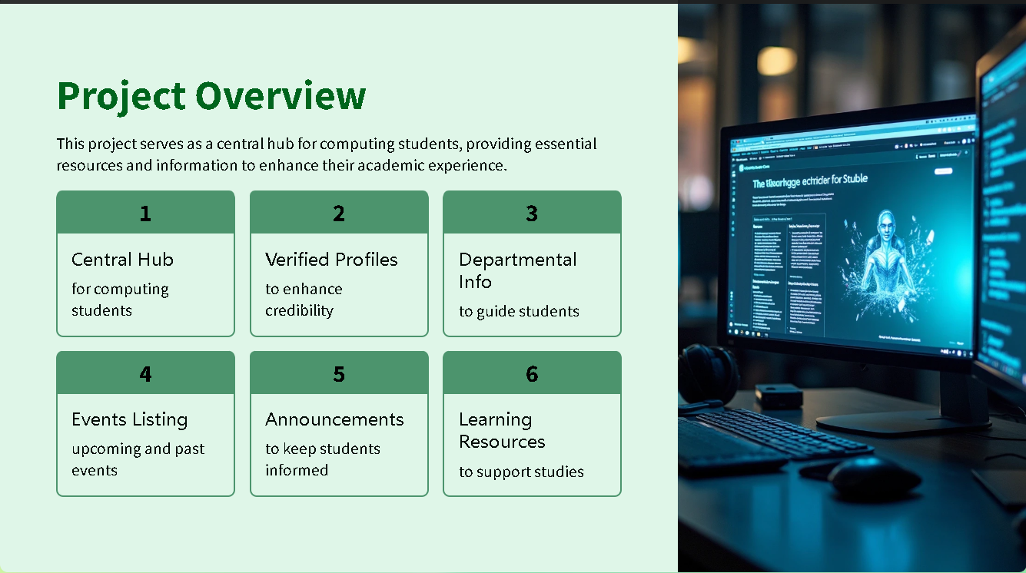

Slide 4
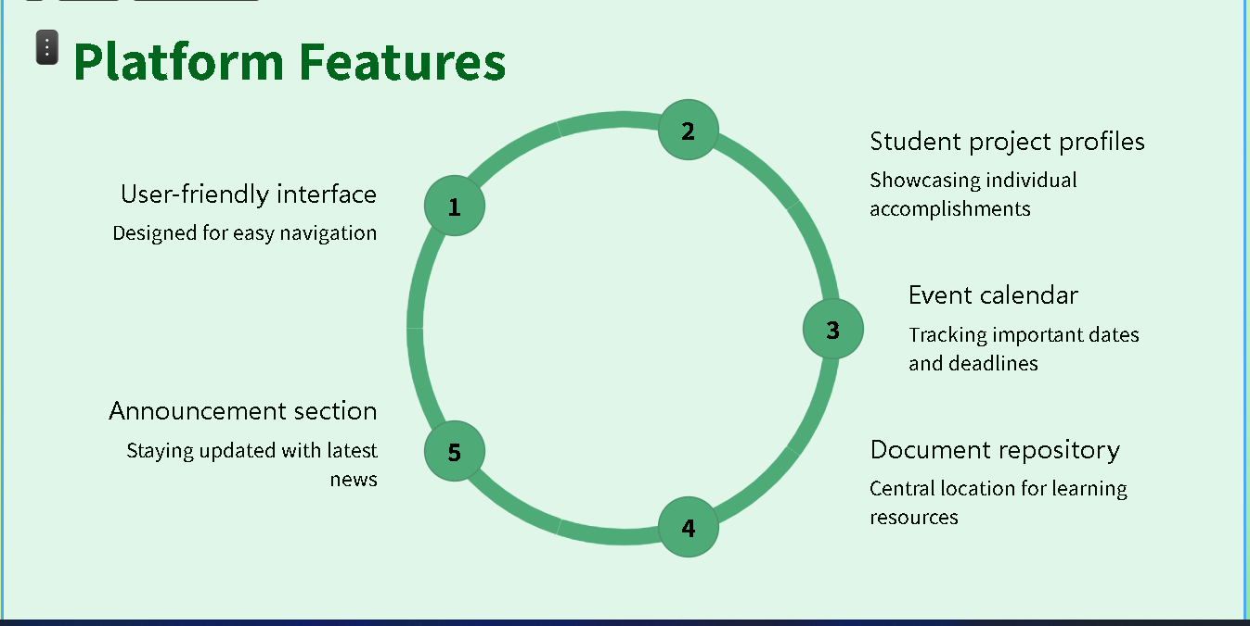

Slide 5
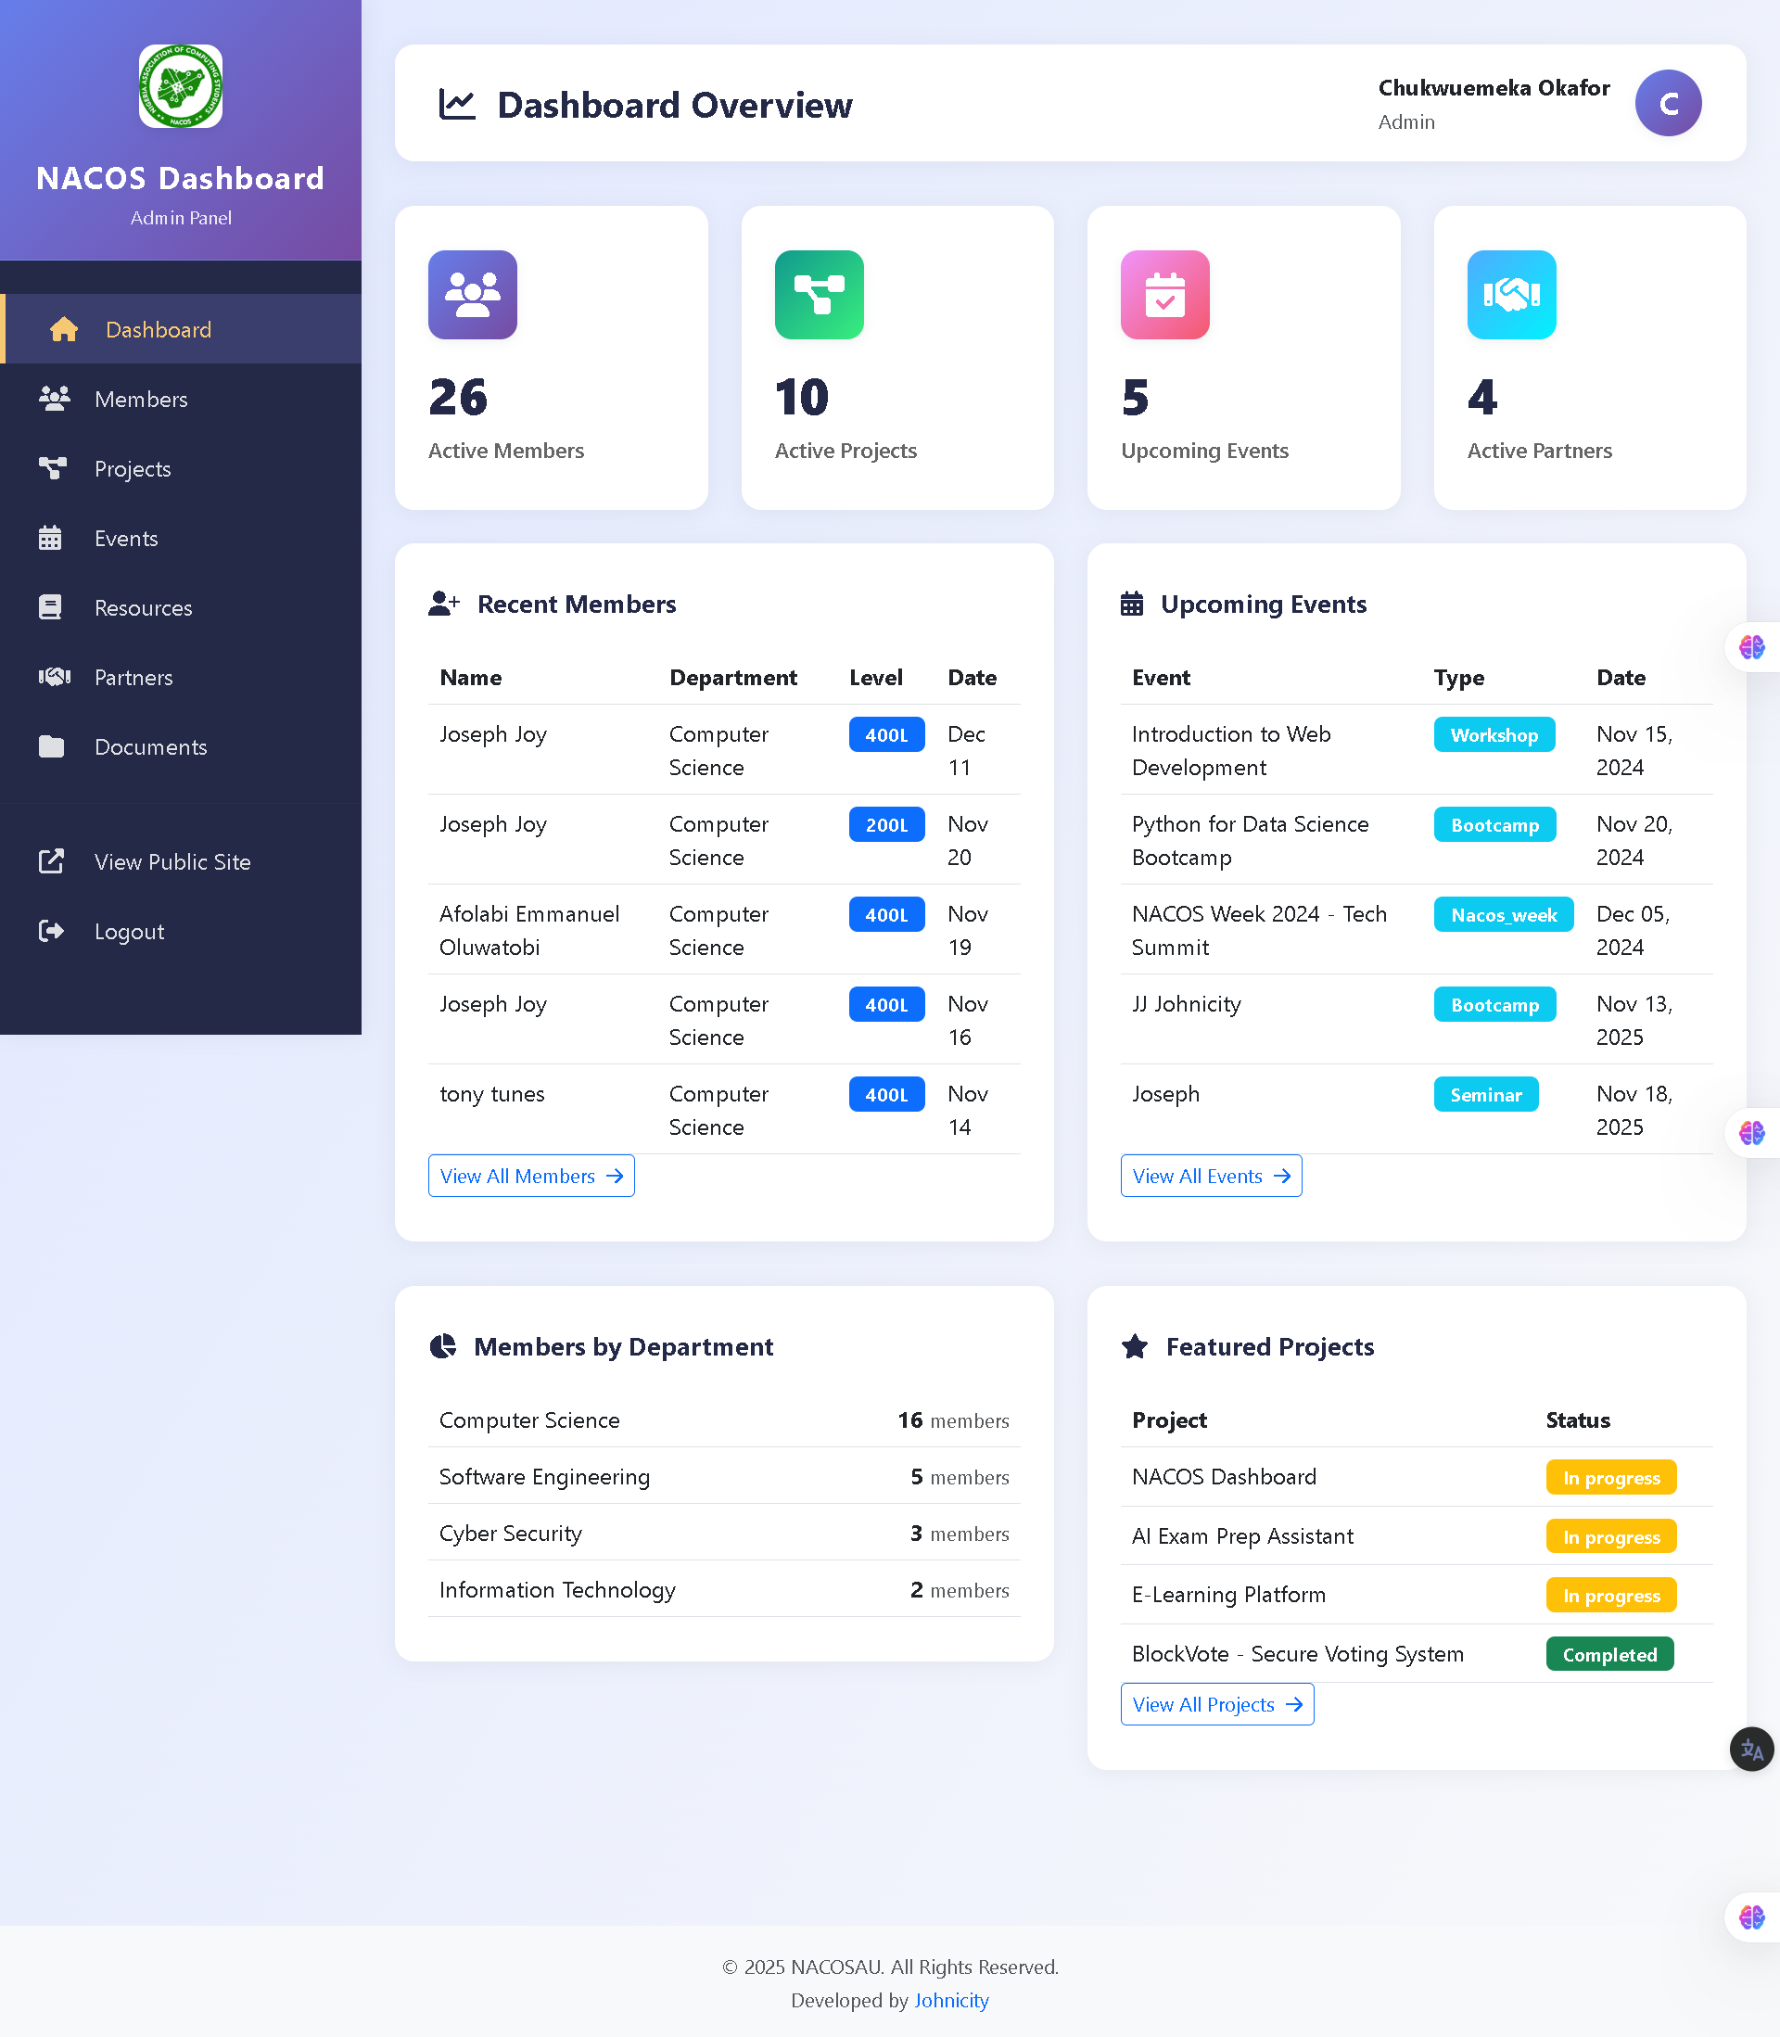

Slide 6
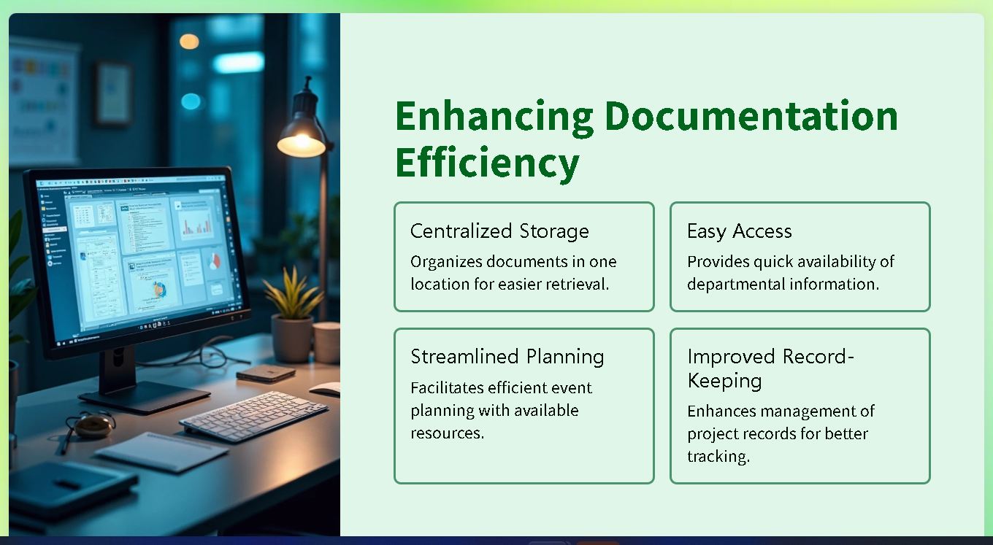

Slide 7
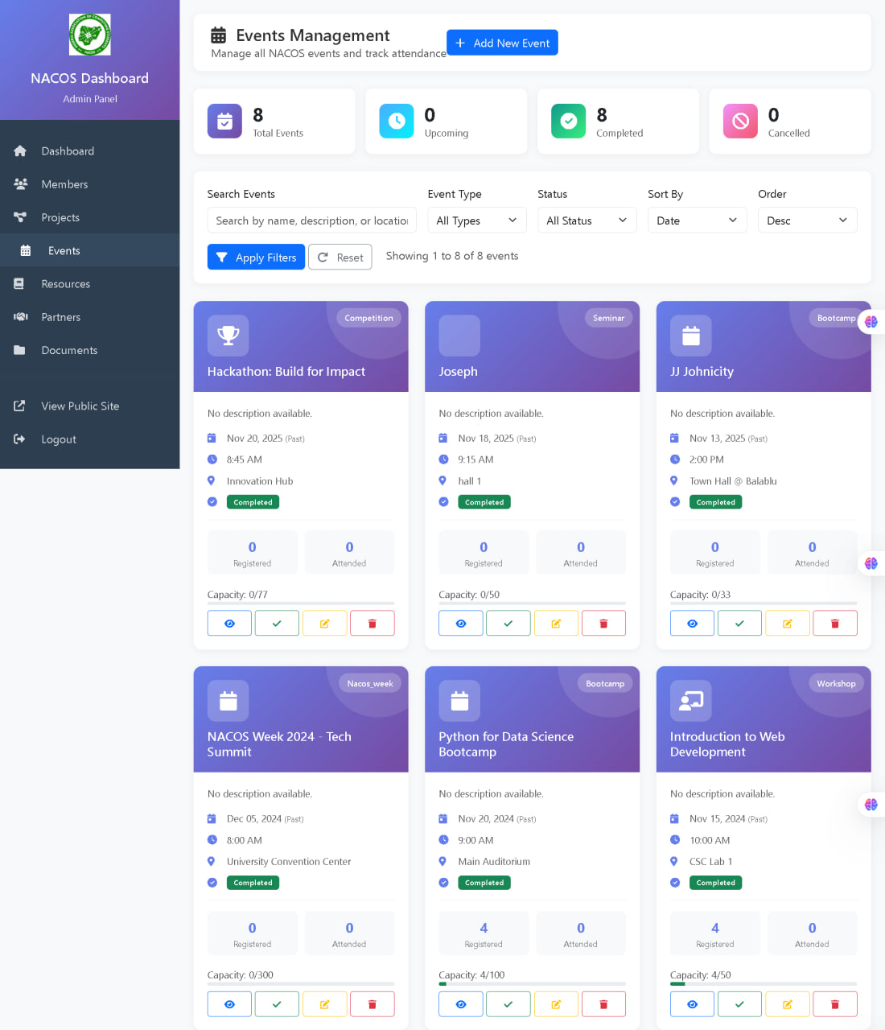

Slide 8
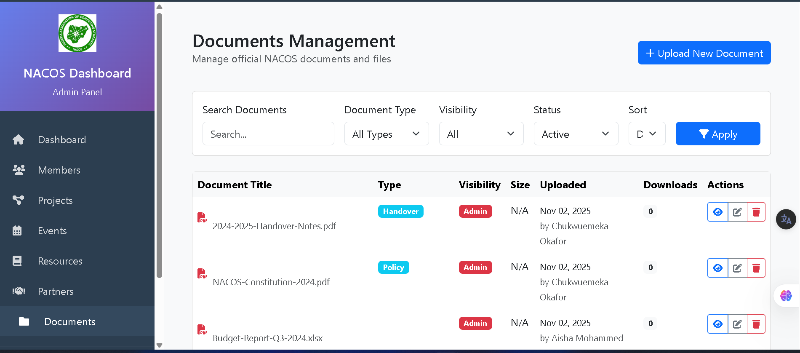
RECORD
KEEPING

Slide 9
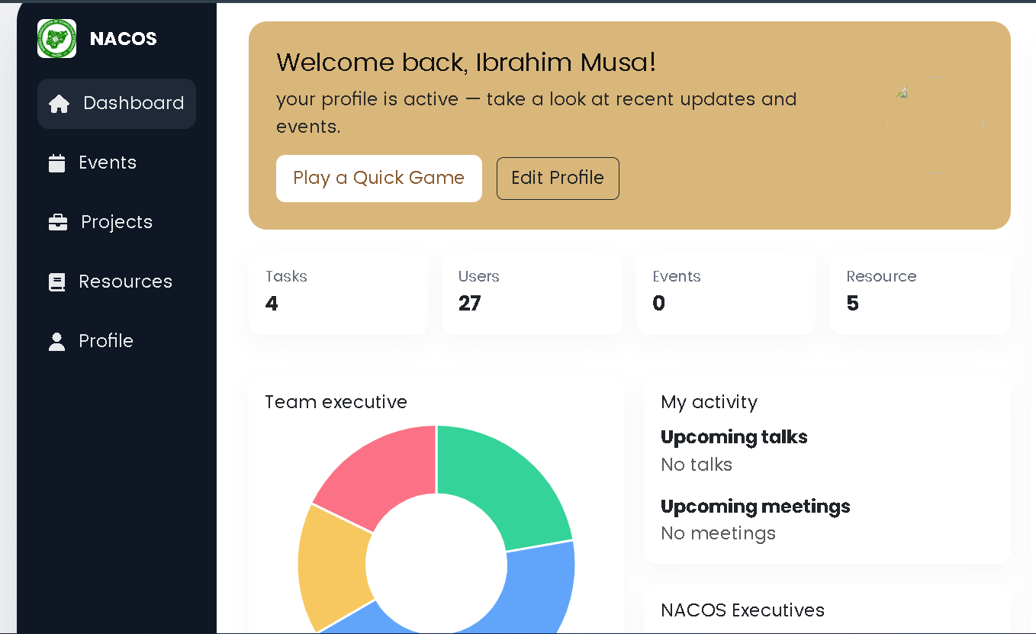

Slide 10

THANK YOU

