Slide 1
RigMaster AI
AI-Assisted System Assembly and Configuration
Blessen P Shaju | BSc Computer Science

Slide 2
Introduction
Specialized web-based system for computer hardware assembly.
Comprehensive tool for planning and validating custom PC builds.
Integrates rule-based logic with Generative AI for smart guidance.
Unified dashboard for managing hardware specifications.

Slide 3
Problem Statement
Compatibility Complexity: Error-prone socket and RAM matching.
Financial Risk: Costly mistakes from incorrect component selection.
Fragmented Information: Information scattered across multiple sites.
Knowledge Barrier: Beginners lack guidance on physical assembly.

Slide 4
Proposed System
Unified Platform for selection, validation, and documentation.
Real-time Validation Engine for immediate feedback.
AI Expert Integration for context-aware assembly instructions.
Advanced Deployment Tools for individual and group projects.

Slide 5
Project Objectives
Eliminate hardware incompatibility through rule-based checks.
Provide accurate Power Supply (PSU) capacity estimations.
Offer step-by-step assembly guidance and safety warnings.
Enable multi-project management and PDF export capabilities.

Slide 6
Methodology
Frontend: HTML5, CSS3, Vanilla JavaScript.
Backend: Python (Flask Framework).
Database: MongoDB Atlas (NoSQL).
Logic: Custom Relational Constraint Engine.
AI: Google GenAI / Groq API Integration.

Slide 7
System Data Flow
User Input -> Builder Interface
System Logic -> MongoDB Schema Checks
Constraint Engine -> Compatibility Validation
Output -> Interactive Analysis & PDF Reports

Slide 8
Database Design (MongoDB)
Users Collection: Authentication and preferences.
Components Collection: Detailed hardware specifications.
Saved Builds: Individual system configurations.
Group Builds: Bulk deployment manifests.

Slide 9
Key Features
Live System Builder with real-time feedback.
Advanced Compatibility Analysis & Power Estimation.
AI-Powered Assembly Advisor.
Bulk Deployment Management (Group Builder).
Standardized PDF Export System.

Slide 10
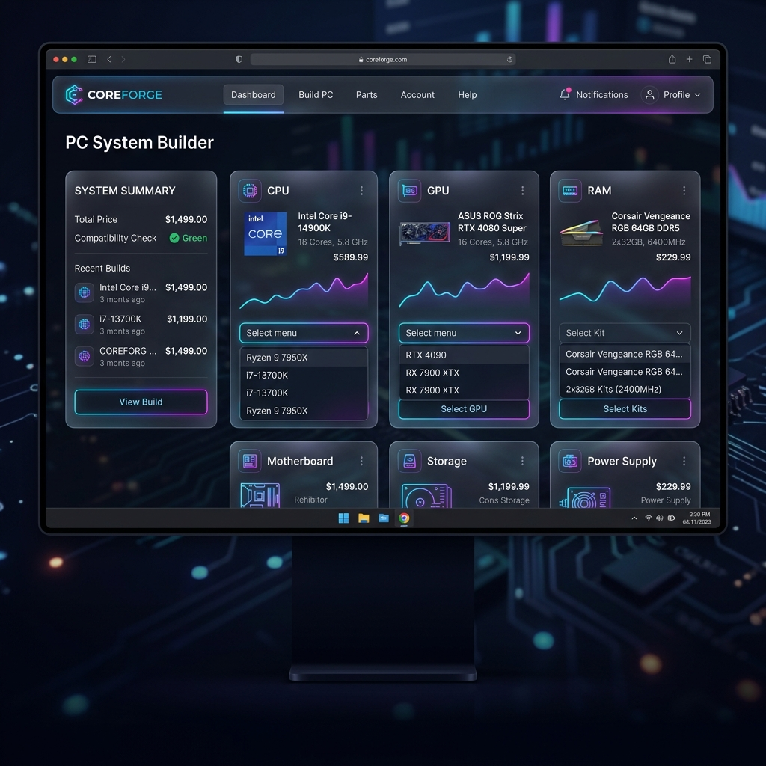

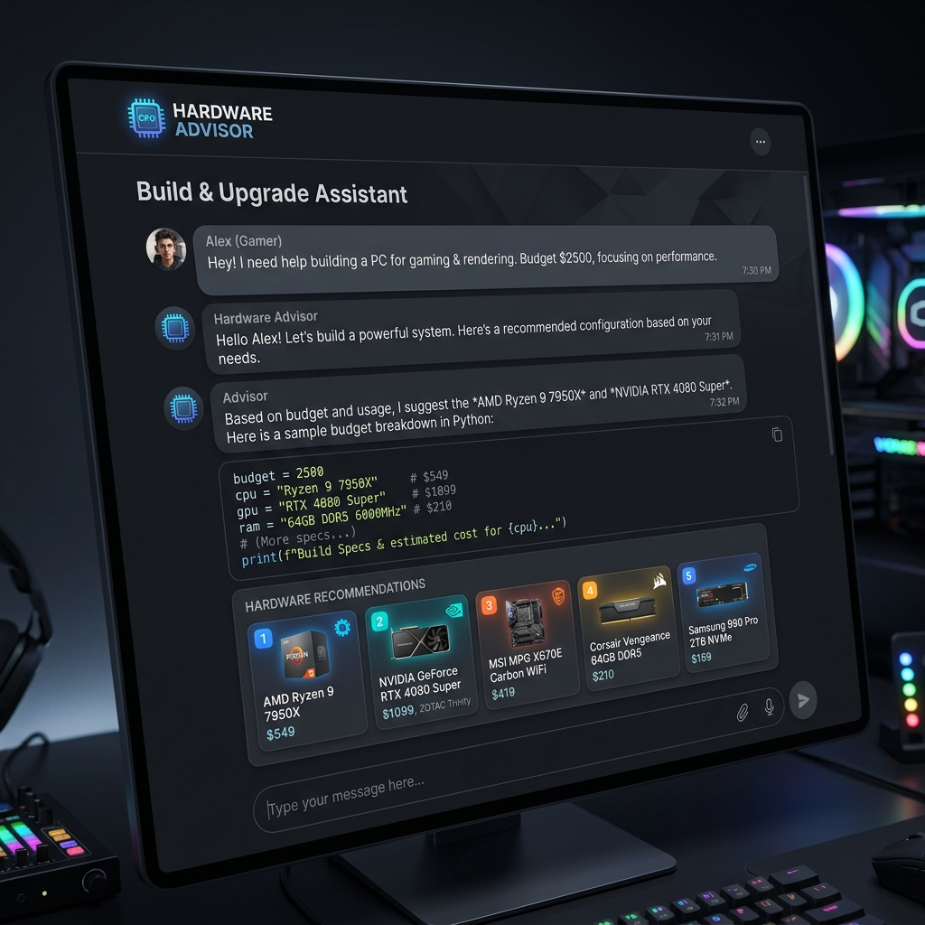
System Screenshots

Slide 11
Future Scope
Performance Benchmarking (FPS prediction).
Real-time E-commerce and Price Integration.
Augmented Reality (AR) assembly guidance.
Global Community Build Repository.

Slide 12
Conclusion
RigMaster AI simplifies complex hardware configuration.
Ensures technical compatibility and reduces build errors.
Lowers the entry barrier for new PC builders.
Provides a professional toolset for deployment planning.

