Slide 1

Aximos

Slide 2
Who is Axis Solutions
Axis Solutions is a software development house and value added reseller of mobile computing, printing security, enterprise content management, IT infrastructure management and cloud computing solutions.
Headquartered in Zimbabwe, the company has opened offices in Zambia, Malawi, Mozambique and South Sudan.
We are a registered supplier of Zebra Devices, offering installation and training.

Slide 3
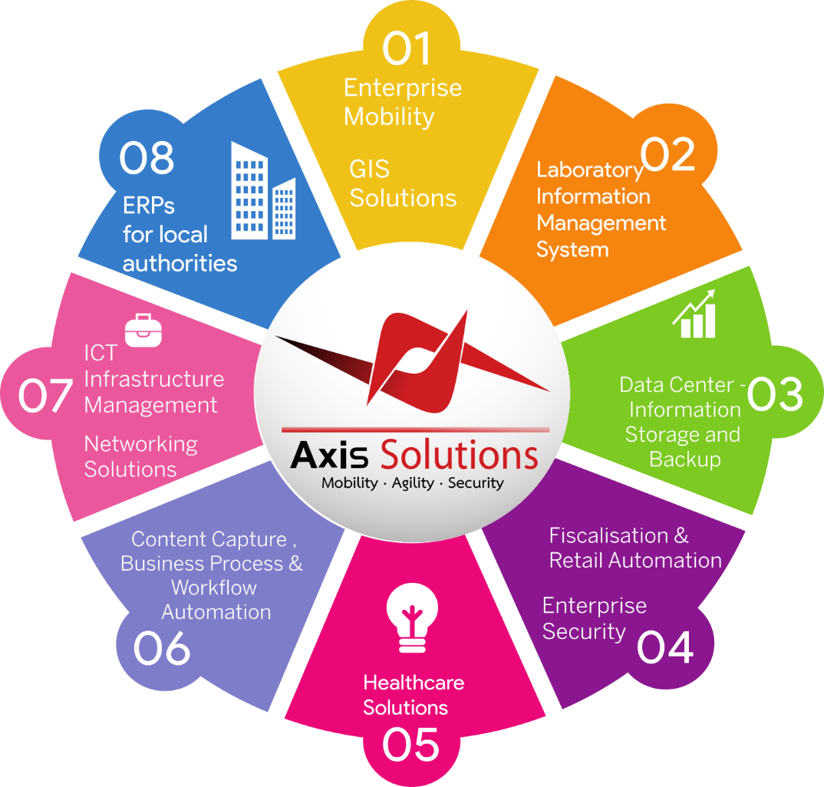

Slide 4

Aximos
An automated salesforce mobile tool , enabling more possibilities than ever before.
With the increase of Online selling during this pandemic, Aximos allows your business to continue sales.
In the next slides , we will show you how Aximos allows for Order taking, Order Fulfillment, Van Sales and Payment Platforms integration.

Slide 5
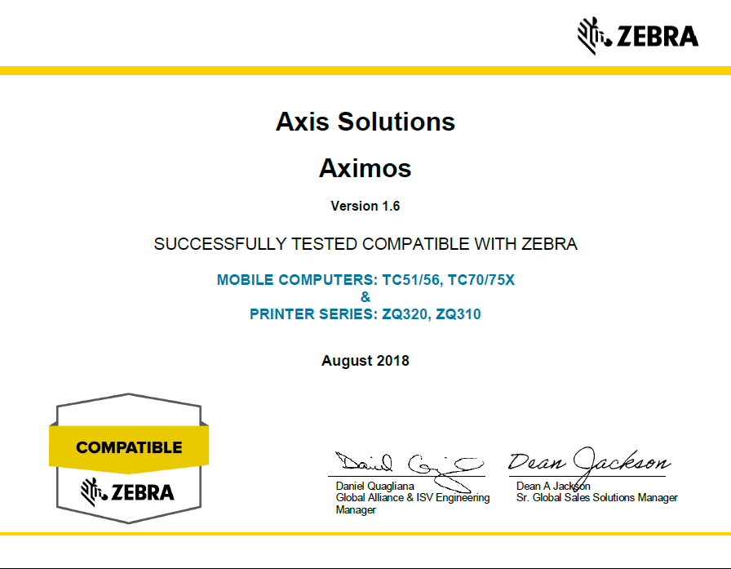

Slide 6





Van Sales
Aximos allows for invoicing of goods on-the-go with the money being directed back to the business.
It allows for visibility of sales by the Van or truck driver and allows for stock reconciliation.
Aximos is already integrated into some major ERPs

Slide 7
Order Taking
Aximos has a ready built integration to the Whatsapp for business API which allows orders to come through Whatsapp from customers.
Online store integration is plug and play with Aximos , allowing customers to order online.
Orders can also be received via SMS and any other services that interface with customers.

Slide 8

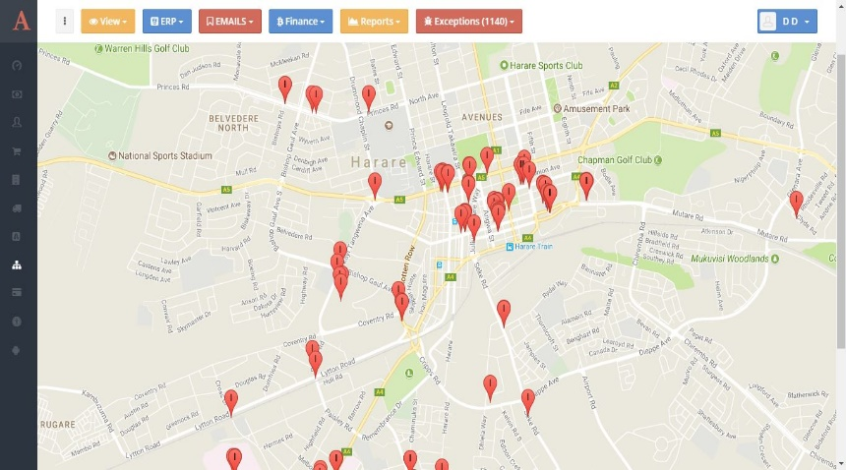
Order Fulfillment
Aximos uses GPS to track the Van that delivers goods.
It has in built route optimization allowing for fast deliveries to customers
The delivery module allows for the customer to sign for their goods on the mobile device.

Slide 9
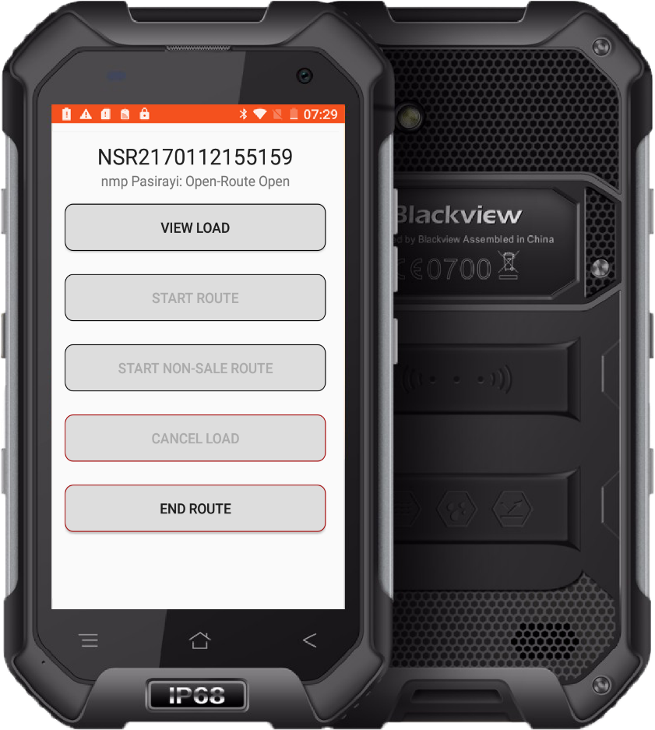
Mobile Money Integration
In Zimbabwe, Aximos is integrated into the country’s biggest mobile money supplier, Ecocash
Another Zimbabwean payments platform, Paynow, allows for payments using Visa and Mastercard.
Aximos is ready to be integrated into any payment platform such as Kenya’s M-pesa, PayU, U-collect, GlobalPay, CashEnvoy and many others.

Slide 10
AXIS EDI
Our Solution to manage communication between different systems using Electronic Data Interchange Standards
The solution allows for automated Inventory Inquiry, Inventory advise, Order Tracking, Quotation tracking, Shipment notifications , Purchase Order acknowledgement and various Reports.
Axis EDI has a development kit to help integrate it into your system, and Axis Solutions developers also run integrations

Slide 11
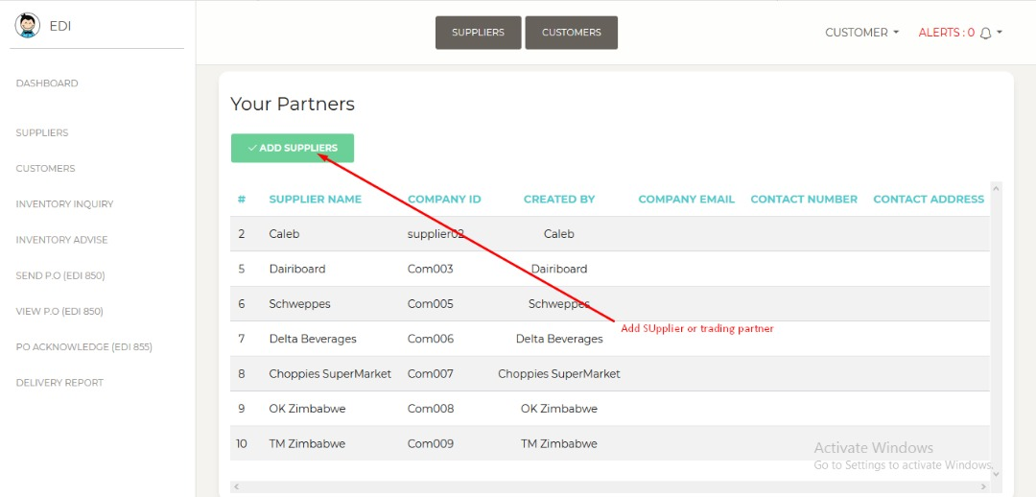

Slide 12
Screenshots

Slide 13
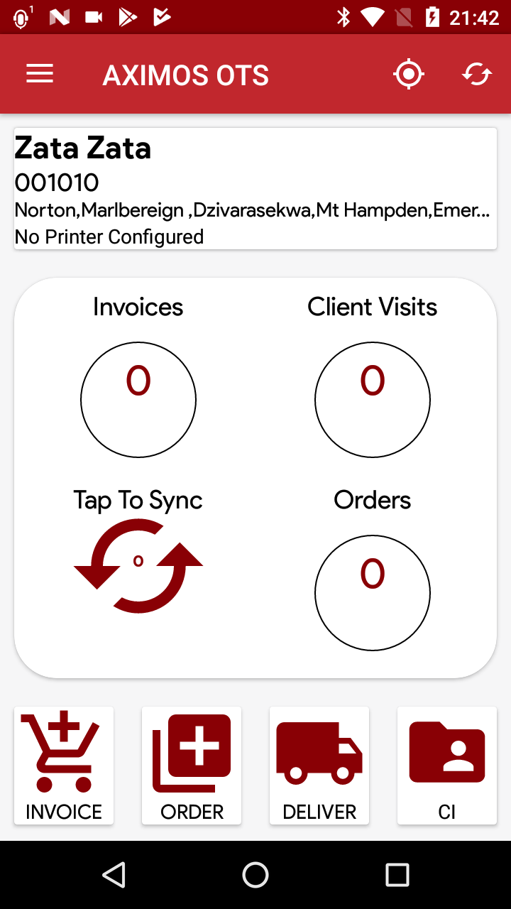
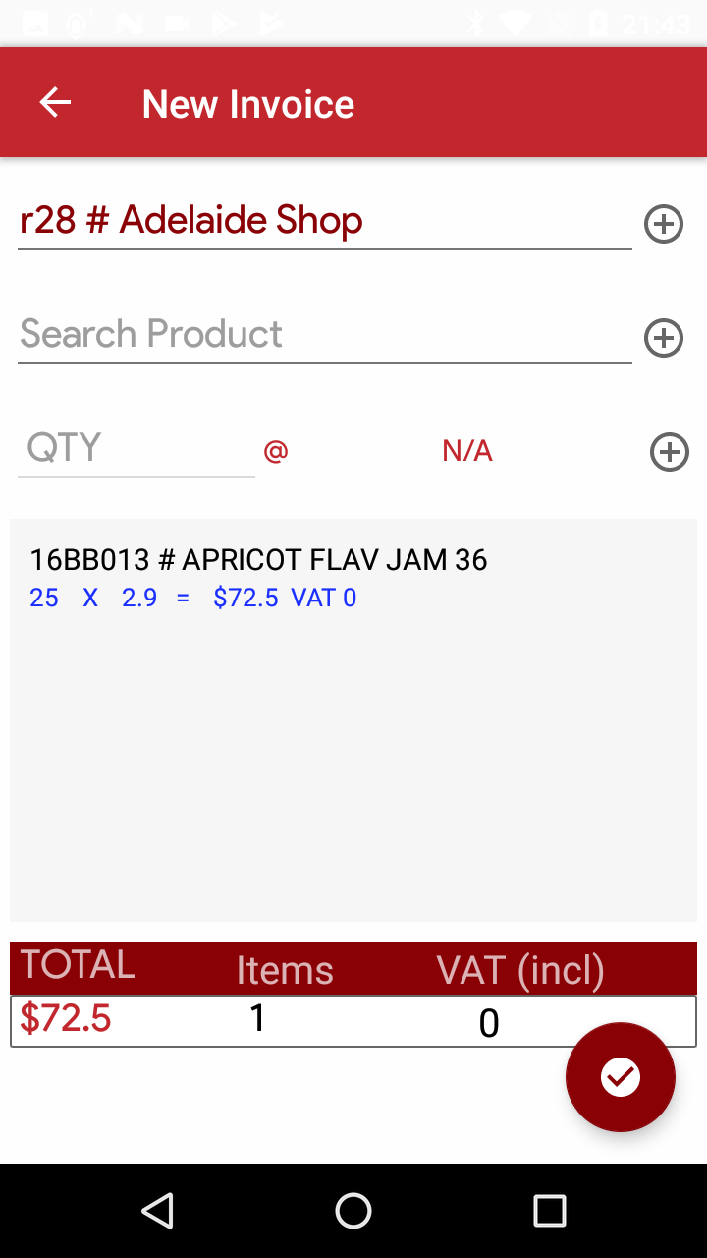

Slide 14
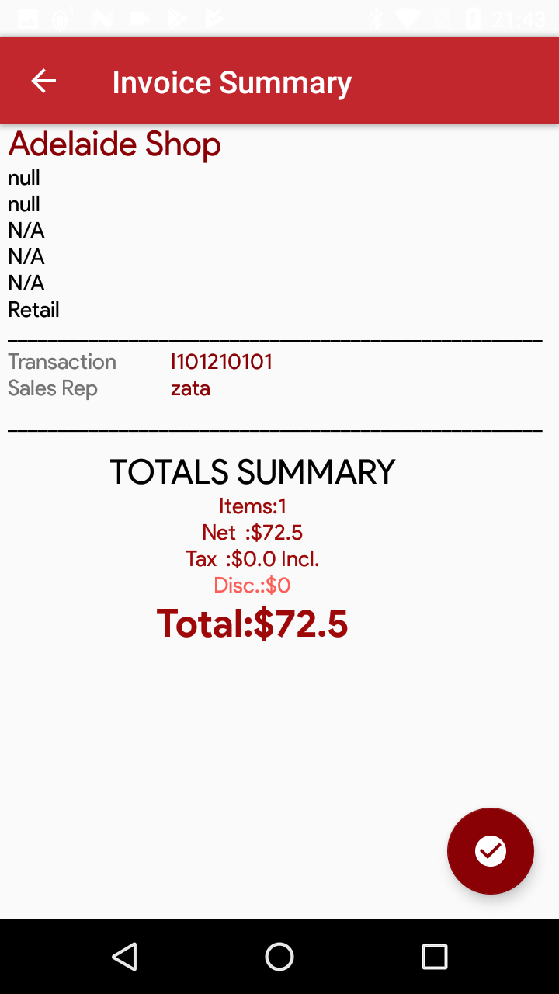
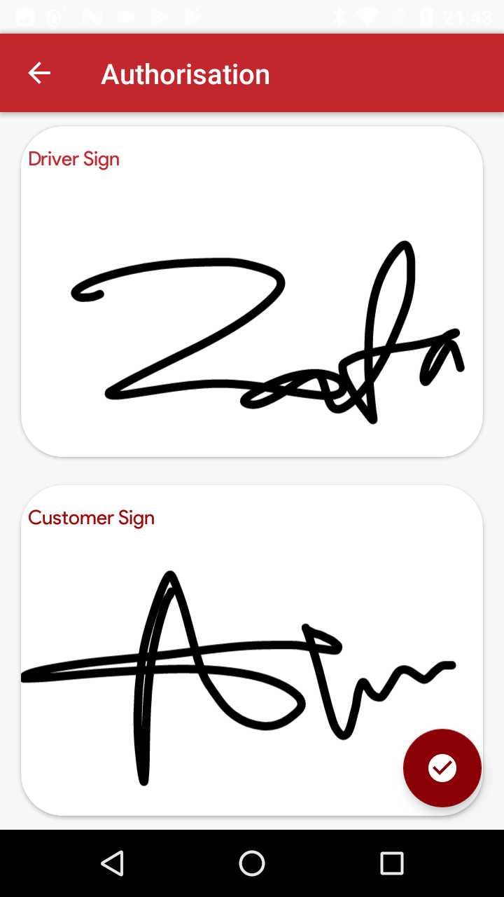

Slide 15
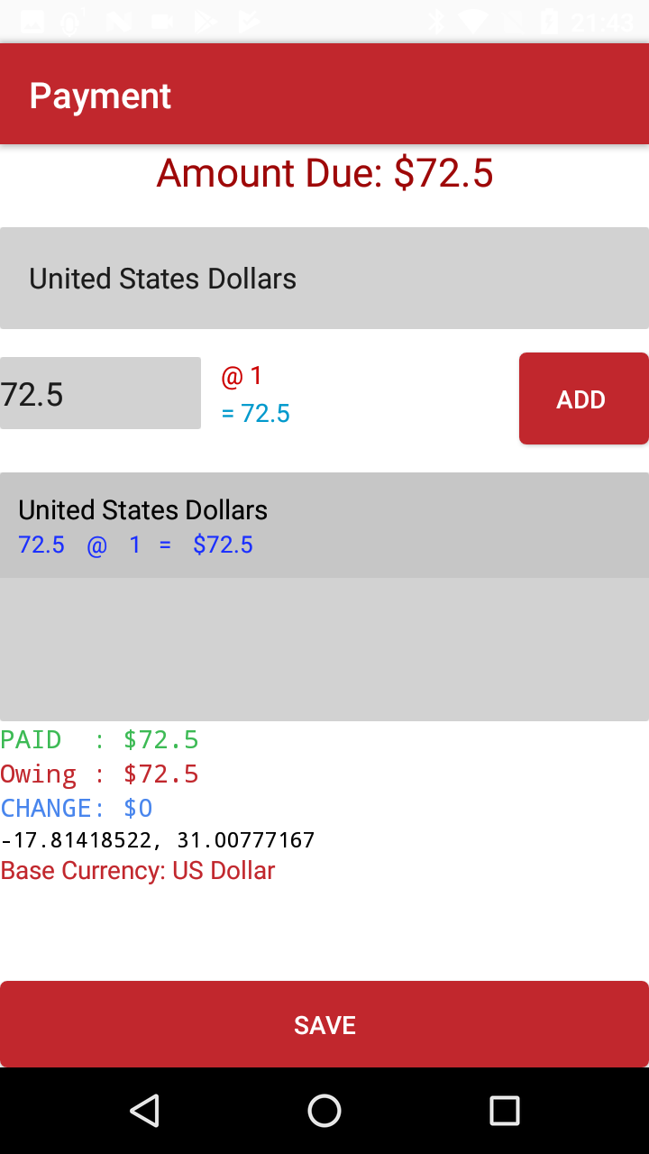
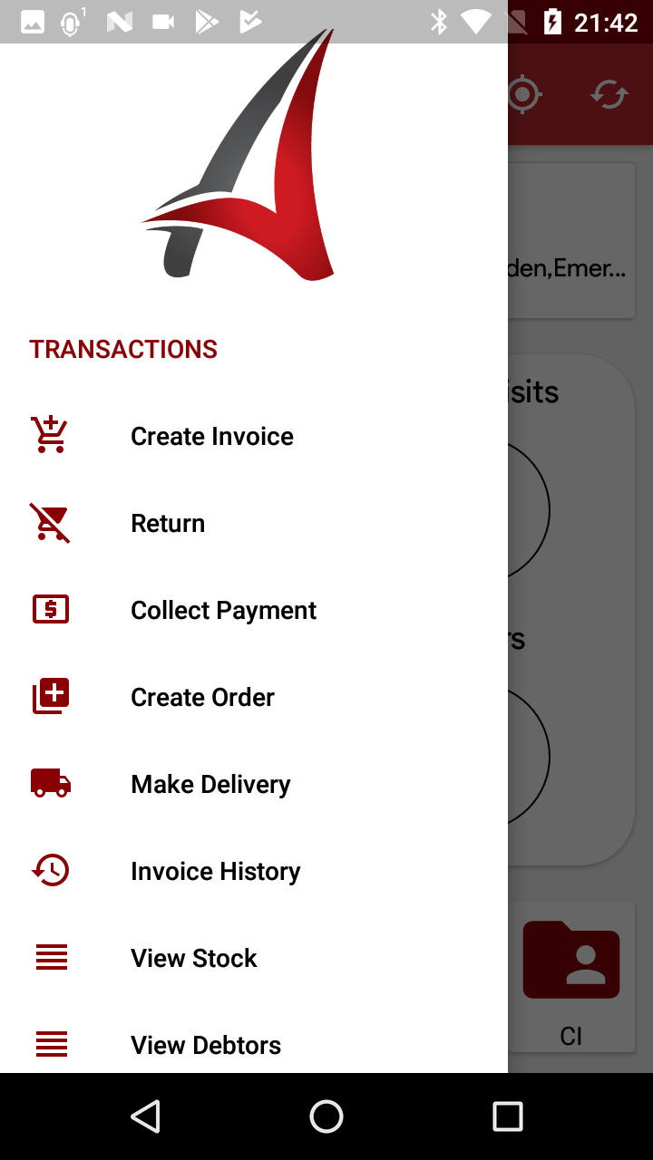

Slide 16
