Slide 1
CIS 330: _ _ _ _ ______ _ _____ / / / /___ (_) __ ____ _____ ____/ / / ____/ _/_/ ____/__ __ / / / / __ \/ / |/_/ / __ `/ __ \/ __ / / / _/_// / __/ /___/ /_ / /_/ / / / / /> < / /_/ / / / / /_/ / / /____/_/ / /__/_ __/_ __/ \____/_/ /_/_/_/|_| \__,_/_/ /_/\__,_/ \____/_/ \____//_/ /_/
Lecture 14:
more class,
C++ streams
May 9th, 2018
Hank Childs, University of Oregon

Slide 2
Announcements
Projects
3B assigned Friday, due today
3C posted today, due May 16
3D posted today, also due May 16
3D is not required to do 3E, etc.
So you can skip it, although you will lose points.
OH:
Weds 12-1 (in Hank’s office)
Thurs 4-5 (in Hank’s office)

Slide 3
Schedule rest of this week
Friday: Lab 4 (Brent)
Friday OH: with Brent, not Hank
Brent will announce location (125 MCK or 100 DES)

Slide 4
Project 3B
Retrofit to use references
Add useful routines for manipulating an image
Halve in size
Concatenate
Crop
Blend

Slide 5
Review

Slide 6
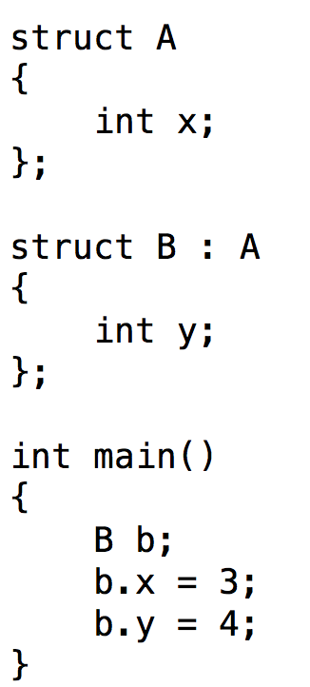
Simple inheritance example
Terminology
B inherits from A
A is a base type for B
B is a derived type of A
Noteworthy
“:” (during struct definition) → inherits from
Everything from A is accessible in B
(b.x is valid!!)

Slide 7
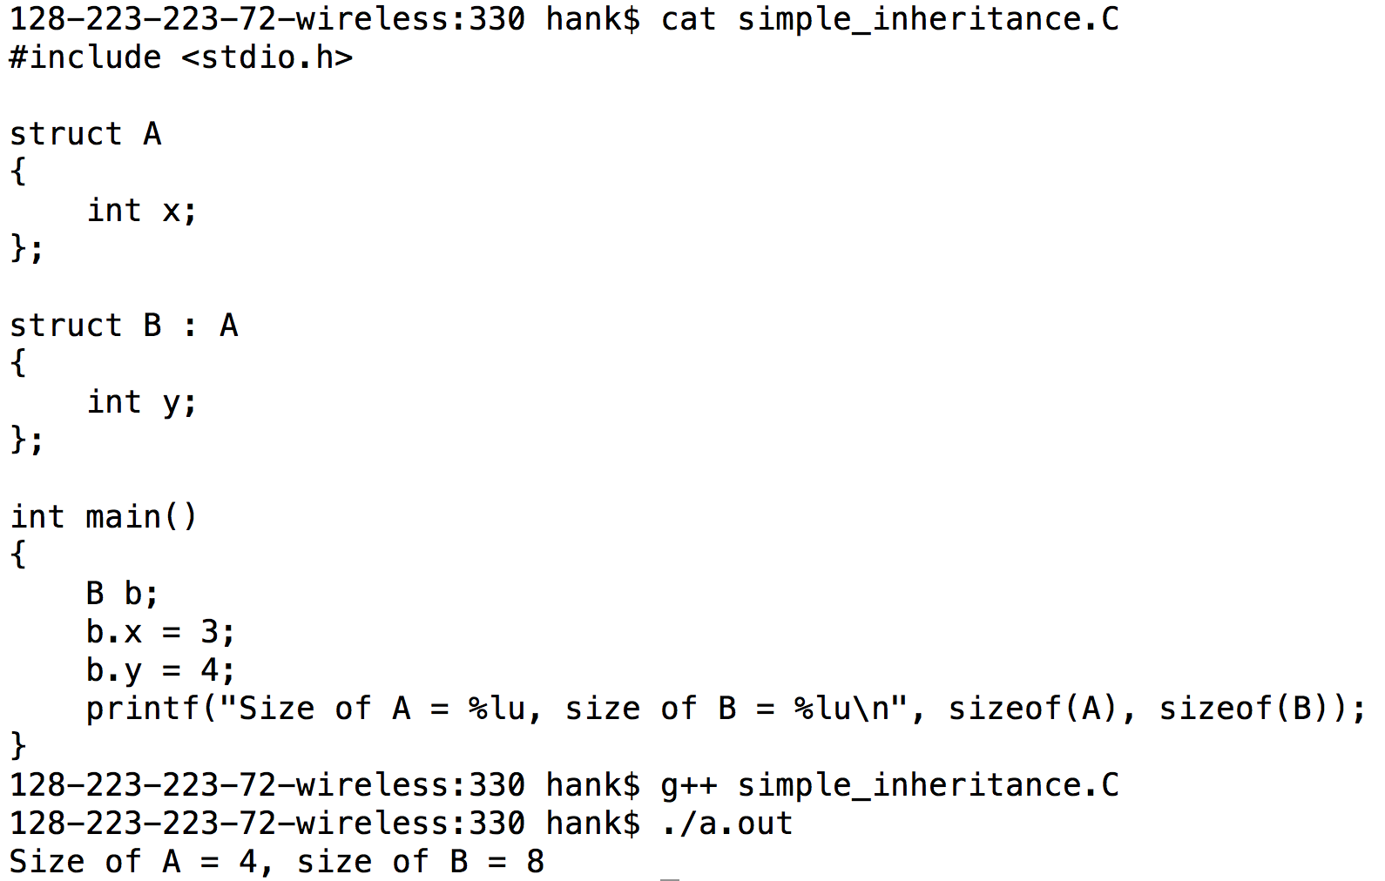
Object sizes

Slide 8
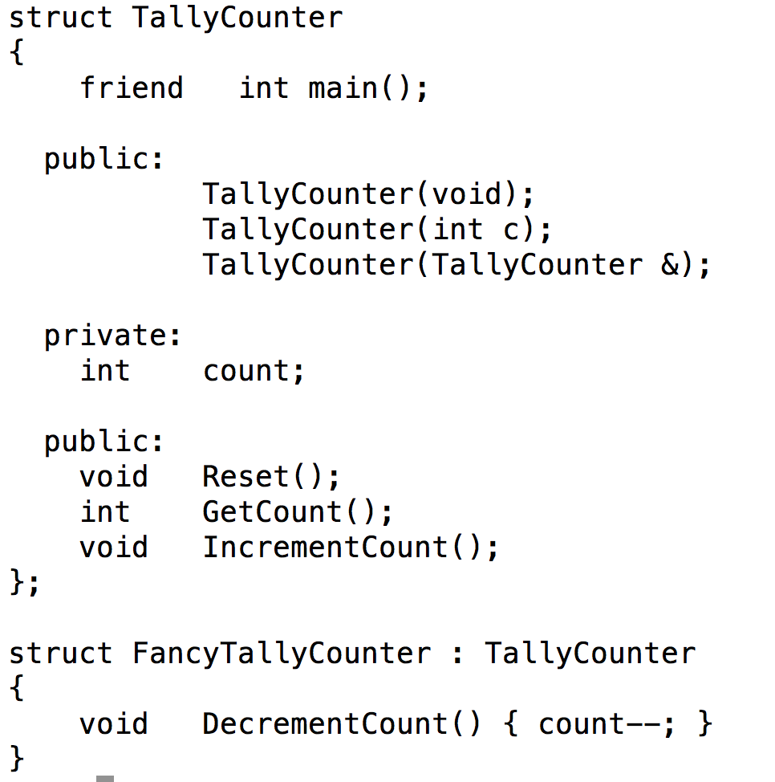
Inheritance + TallyCounter
FancyTallyCounter inherits all of TallyCounter, and adds a new method: DecrementCount

Slide 9
Virtual functions
Virtual function: function defined in the base type, but can be re-defined in derived type.
When you call a virtual function, you get the version defined by the derived type

Slide 10
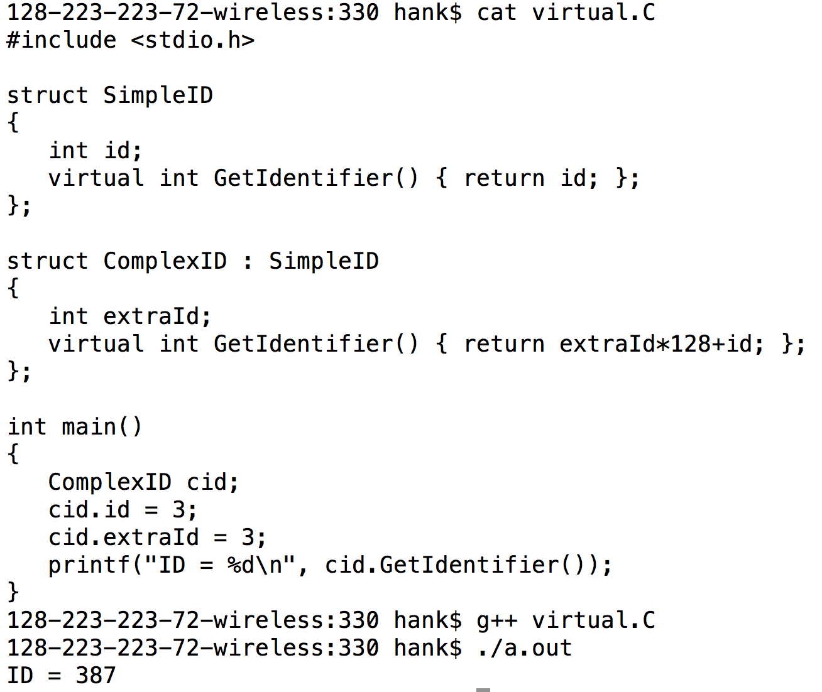
Virtual functions: example

Slide 11
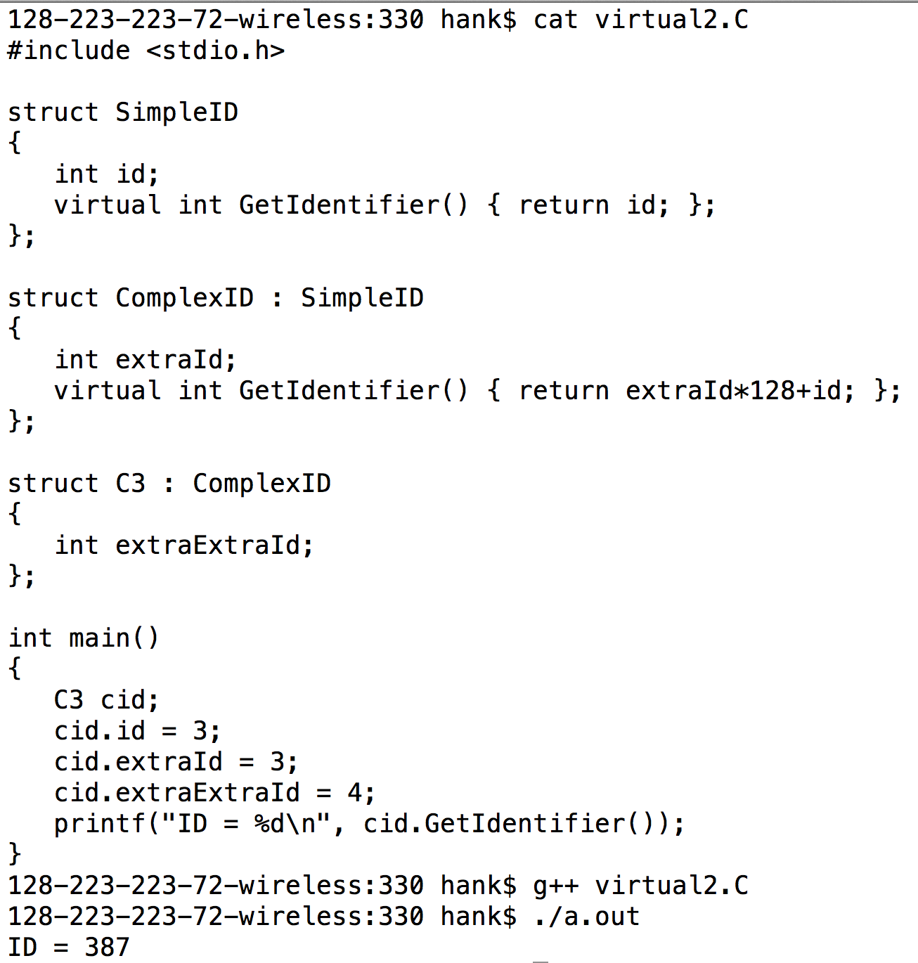
Virtual functions: example
You get the method furthest down in the inheritance hierarchy

Slide 12
public / private inheritance
class A : [public|private] B
→ class A : public B
→ class A : private B
So:
For public, base class's public members will be public
For private, base class's public members will be private
Public common
I’ve never personally used anything else

Slide 13
NEW SLIDE
public inheritance → no restriction beyond what restrictions in base class
Example:
class A { private: int x; }; class B : public A {};
→ B cannot access x
private inheritance → *does* restrict beyond what restrictions in base class
Example 2:
class A { public: int x; }; class B : private A {};
→ B again cannot access x

Slide 14
public / private inheritance
class A : public B
A “is a” B
class A : private B
A “is implemented using” B
And: !(A “is a” B)
… you can’t treat A as a B

Slide 15
One more access control word: protected
Protected means:
It cannot be accessed outside the object
Modulo “friend”
But it can be accessed by derived types
(assuming public inheritance)

Slide 16
Memory Management

Slide 17
C++ memory management
C++ provides new constructs for requesting heap memory from the memory manager
stack memory management is not changed
(automatic before, automatic now)
Allocate memory: “new”
Deallocate memory: “delete”

Slide 18
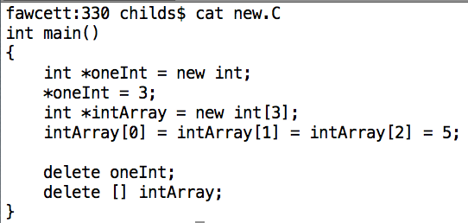
new / delete syntax
No header necessary
Allocating array and single value is the same.
new knows the type and allocates the right amount.
new int → 4 bytes
new int[3] → 12 bytes
Deleting array takes [], deleting single value doesn’t.

Slide 19
new calls constructors for your classes
Declare variable in the stack: constructor called
Declare variable with “malloc”: constructor not called
C knows nothing about C++!
Declare variable with “new”: constructor called

Slide 20
More on Classes

Slide 21
Destructors
A destructor is called automatically when an object goes out of scope (via stack or delete)
A destructor’s job is to clean up before the object disappears
Deleting memory
Other cleanup (e.g., linked lists)
Same naming convention as a constructor, but with a prepended ~ (tilde)

Slide 22
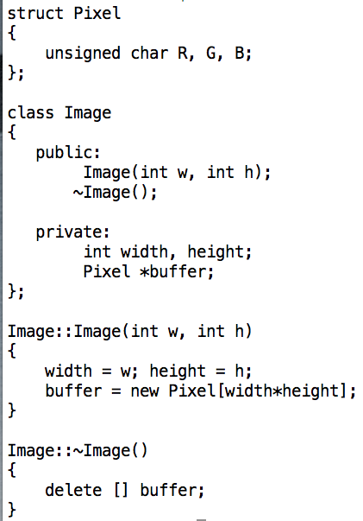
Destructors example
Class name with ~ prepended
Defined like any other method, does cleanup
If Pixel had a constructor or destructor, it would be getting called (a bunch) by the new’s and delete’s.

Slide 23
Inheritance and Constructors/Destructors: Example
Constructors from base class called first, then next derived type second, and so on.
Destructor from base class called last, then next derived type second to last, and so on.
Derived type always assumes base class exists and is set up
… base class never needs to know anything about derived types

Slide 24
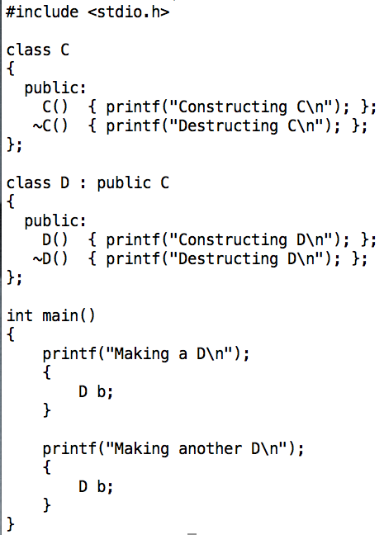
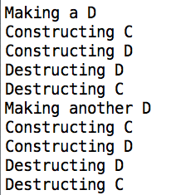
Inheritance and Constructors/Destructors: Example

Slide 25
Possible to get the wrong destructor
With a constructor, you always know what type you are constructing.
With a destructor, you don’t always know what type you are destructing.
This can sometimes lead to the wrong destructor getting called.

Slide 26
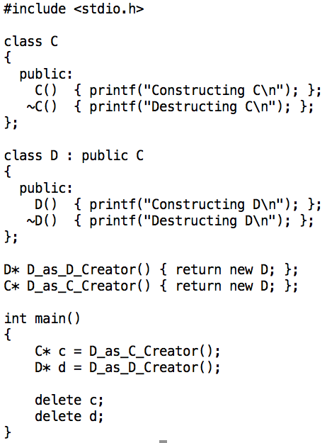
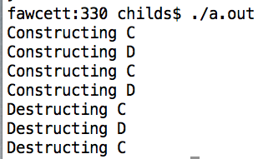
Getting the wrong destructor

Slide 27
Virtual destructors
Solution to this problem:
Make the destructor be declared virtual
Then existing infrastructure will solve the problem
… this is what virtual functions do!

Slide 28
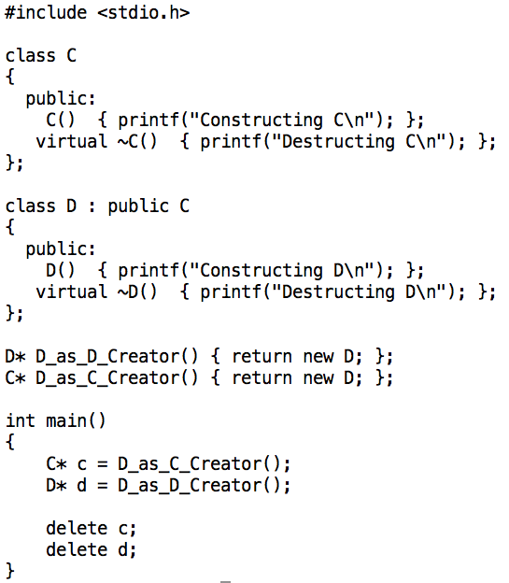
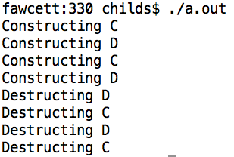
Virtual destructors

Slide 29
NEW STUFF

Slide 30
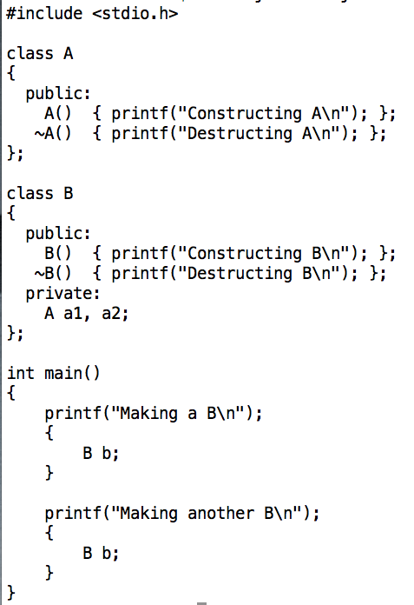
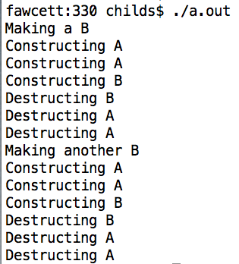
Objects in objects
By the time you enter B’s constructor, a1 and a2 are already valid.

Slide 31
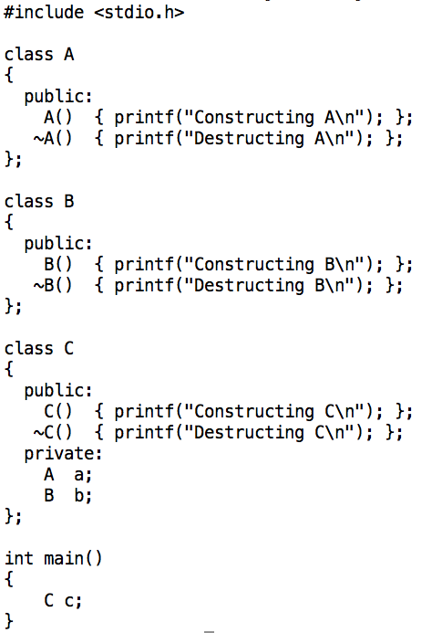
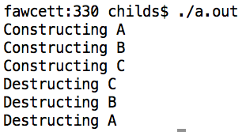
Objects in objects

Slide 32
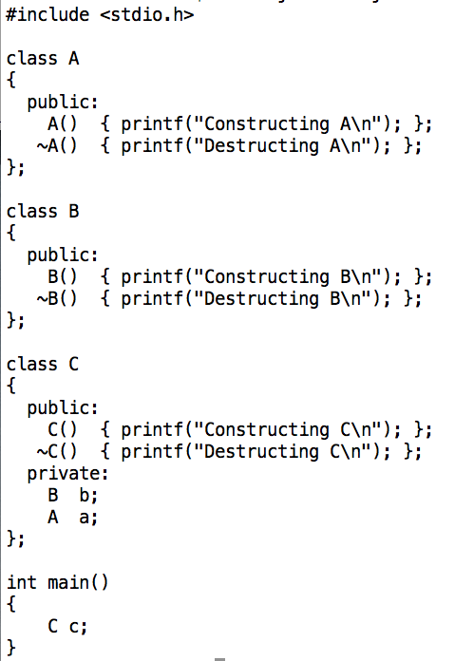
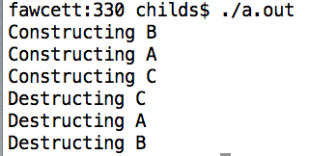
Objects in objects: order is important

Slide 33
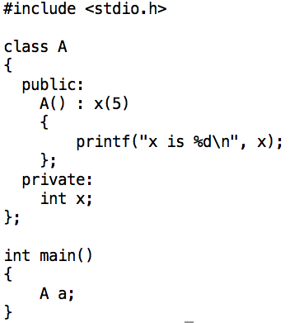

Initializers
New syntax to have variables initialized before even entering the constructor

Slide 34
Initializers
Initializers are a mechanism to have a constructor pass arguments to another constructor
Needed because
Base class constructors are called before derived constructors & need to pass arguments in derived constructor to base class
Constructors for objects contained in a class are called before the container class & need to pass arguments in container class’s destructor

Slide 35
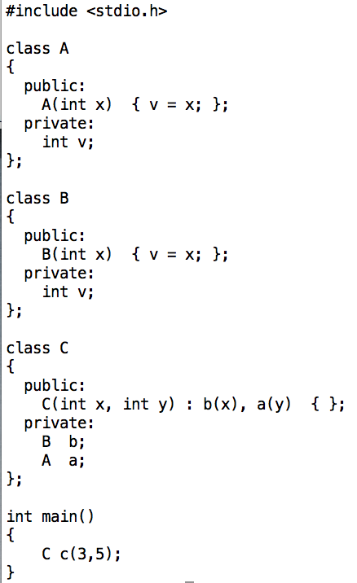
Initializers
Needed because
Constructors for objects contained in a class are called before the container class & need to pass arguments in container class’s destructor

Slide 36
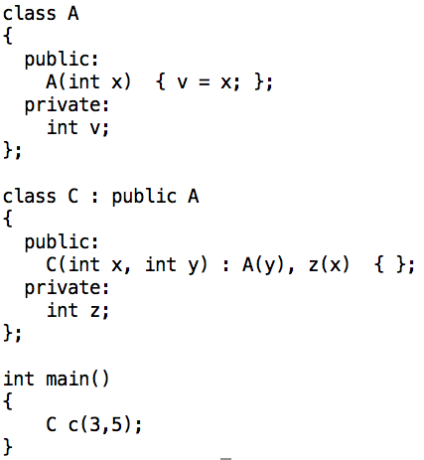
Initializers
Needed because
Base class constructors are called before derived constructors & need to pass arguments in derived constructor to base class
Calling base
class constructor
Initializing data member

Slide 37
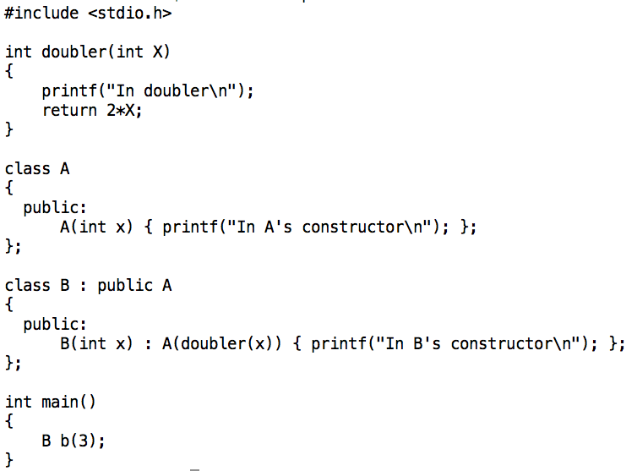

Quiz
What’s the output?

Slide 38
The “is a” test
Inheritance should be used when the “is a” test is true
Base class: Shape
Derived types: Triangle, Rectangle, Circle
A triangle “is a” shape
A rectangle “is a” shape
A circle “is a” shape
I will do a live coding example of this next week, and will discuss how C++ implements virtual functions.
You can define an interface for Shapes, and the derived types can fill out that interface.

Slide 39
Multiple inheritance
A class can inherit from more than one base type
This happens when it “is a” for each of the base types
Inherits data members and methods of both base types

Slide 40
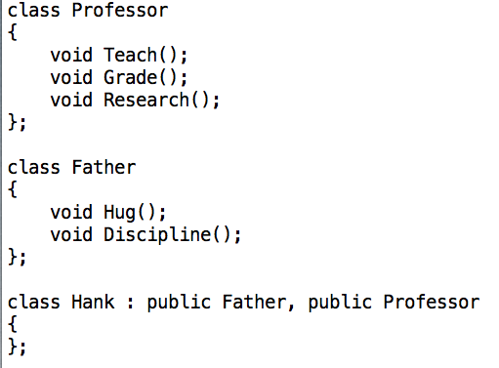
Multiple inheritance

Slide 41
Diamond-Shaped Inheritance
Base A, has derived types B and C, and D inherits from both B and C.
Which A is D dealing with??
Diamond-shaped inheritance is controversial & really only for experts
(For what it is worth, we make heavy use of diamond-shaped inheritance in my project)
A
B
C
D

Slide 42
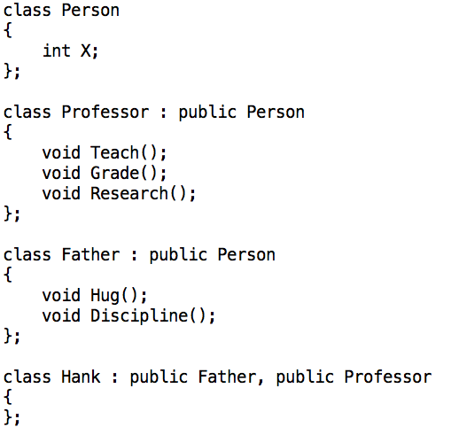
Diamond-Shaped Inheritance Example

Slide 43
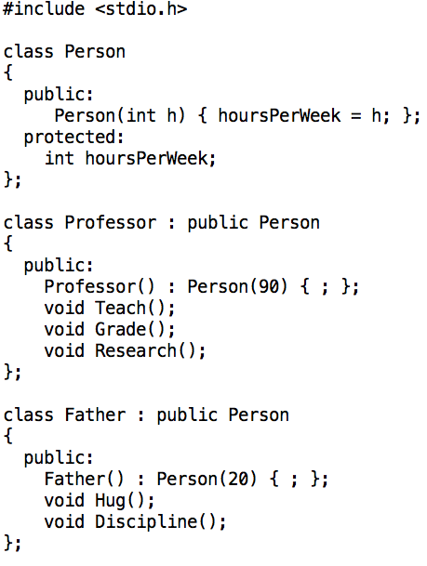
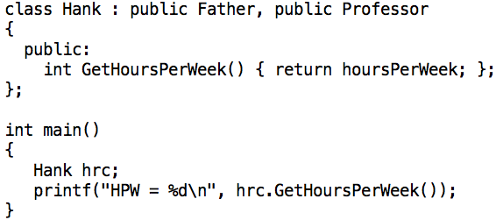
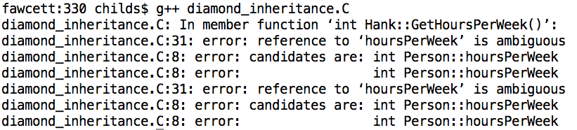
Diamond-Shaped Inheritance Pitfalls

Slide 44
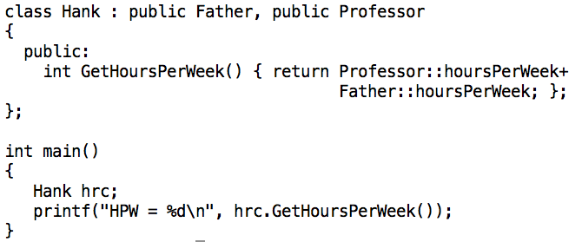

Diamond-Shaped Inheritance Pitfalls
This can get stickier with virtual functions.
You should avoid diamond-shaped inheritance until you feel really comfortable with OOP.

Slide 45
Pure Virtual Functions
Pure Virtual Function: define a function to be part of the interface for a class, but do not provide a definition.
Syntax: add “=0” after the function definition.
This makes the class be “abstract”
It cannot be instantiated
When derived types define the function, then are “concrete”
They can be instantiated

Slide 46
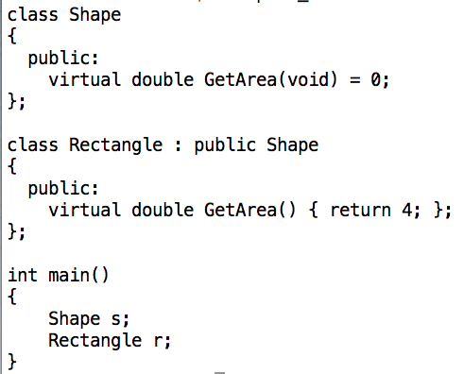
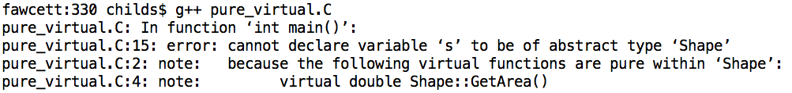
Pure Virtual Functions Example

Slide 47
Data Flow Networks
This is not a C++ idea
It is used for image processing, visualization, etc
So we need to know it for Project C

Slide 48
Data Flow Overview
Basic idea:
You have many modules
Hundreds!!
You compose modules together to perform some desired functionality
Advantages:
Customizability
Design fosters interoperability between modules to the extent possible

Slide 49
Data Flow Overview
Participants:
Source: a module that produces data
It creates an output
Sink: a module that consumes data
It operates on an input
Filter: a module that transforms input data to create output data
Source
Sink
Filter
Nominal inheritance hierarchy:
A filter “is a” source
A filter “is a” sink

Slide 50
Example of data flow (image processing)
Sources:
FileReader: reader from file
Color: generate image with one color
Filters:
Crop: crop image, leaving only a sub-portion
Transpose: view image as a 2D matrix and transpose it
Invert: invert colors
Concatenate: paste two images together
Sinks:
FileWriter: write to file

Slide 51







Example of data flow (image processing)
FileReader
Crop
Transpose
Invert
Color
Concatenate
FileWriter

Slide 52
Example of data flow (image processing)
FileReader
Participants:
Source: a module that produces data
It creates an output
Sink: a module that consumes data
It operates on an input
Filter: a module that transforms input data to create output data
Pipeline: a collection of sources, filters, and sinks connected together
Crop
Transpose
Invert
Color
Concatenate
FileWriter

Slide 53

Benefits of the Data Flow Design
Extensible!
write infrastructure that knows about abstract types (source, sink, filter, and data object)
write as many derived types as you want
Composable!
combine filters, sources, and sinks in custom configurations
What do you think the benefits are?

Slide 54
Drawbacks of Data Flow Design
What do you think the drawbacks are?
Operations happen in stages
Extra memory needed for intermediate results
Not cache efficient
Compartmentalization can limit possible optimizations

Slide 55
Data Flow Networks
Idea:
Many modules that manipulate data
Called filters
Dynamically compose filters together to create “networks” that do useful things
Instances of networks are also called “pipelines”
Data flows through pipelines
There are multiple techniques to make a network “execute” … we won’t worry about those yet

Slide 56
Data Flow Network: the players
Source: produces data
Sink: accepts data
Never modifies the data it accepts, since that data might be used elsewhere
Filter: accepts data and produces data
A filter “is a” sink and it “is a” source
Source, Sink, and Filter are abstract types. The code associated with them facilitates the data flow.
There are concrete types derived from them, and they do the real work (and don’t need to worry about data flow!).

Slide 57
Project 3C
Due in one week
3D also due in one week
3D not needed for 3E, 3F, etc.
So you can “skip”
But you will get 0 points for 3D if you “skip”

Slide 58
Assignment: make your code base be data flow networks with OOP
Source
Sink
PNMreader
Filter
PNMwriter
Shrinker
LRConcat
TBConcat
Blender

Slide 59
Topics for 3D

Slide 60
C++ lets you define operators
You declare a method that uses an operator in conjunction with a class
+, -, /, !, ++, etc.
You can then use your operator in your code, since the compiler now understands how to use the operator with your class
This is called “operator overloading”
… we are overloading the use of the operator for more than just the simple types.
You can also do this with functions.

Slide 61
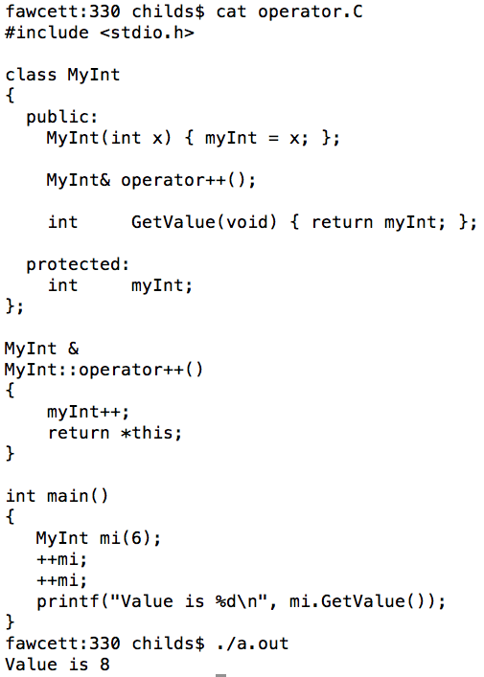
Example of operator overloading
Declare operator ++ will be overloaded for MyInt
We will learn more about operator overloading later in the quarter.
Call operator ++ on MyInt.
Define operator ++ for MyInt

Slide 62
New operators: << and >>
“<<”: Insertion operator
“>>”: Extraction operator
Operator overloading: you can define what it means to insert or extract your object.
Often used in conjunction with “streams”
Recall our earlier experience with C streams
stderr, stdout, stdin
Streams are communication channels

Slide 63
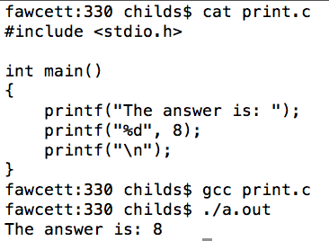
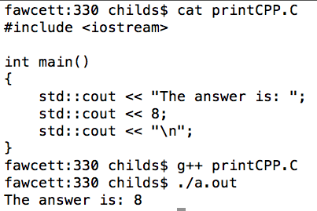
cout: the C++ way of accessing stdout
New header file (and no “.h”!)
New way of accessing stdout stream.
Insertion operation (<<)

Slide 64
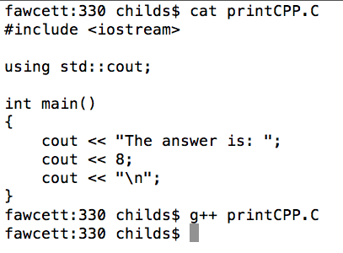
cout is in the “standard” namespace
“using” command puts the “cout” portion of the standard namespace (“std”) in the global namespace.
Don’t need “std::cout” any more…

Slide 65
endl: the C++ endline mechanism
prints a newline
flushes the stream
C version: fflush(stdout)
This is because printf doesn’t always print when you ask it to.
It buffers the requests when you make them.
This is a problem for debugging!!

Slide 66
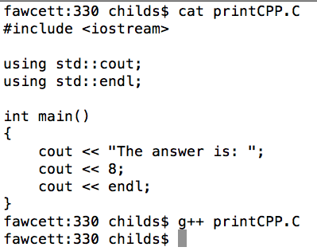
endl in action

Slide 67
<< and >> have a return value
ostream & ostream::operator<<(int);
(The signature for a function that prints an integer)
The return value is itself
i.e., the cout object returns “cout”
This allows you to combine many insertions (or extractions) in a single line.
This is called “cascading”.

Slide 68
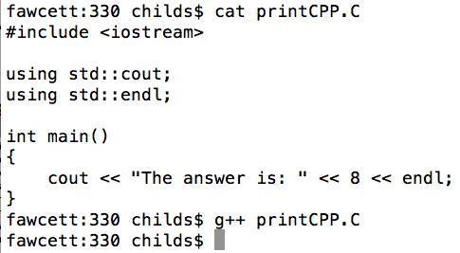
Cascading in action

Slide 69
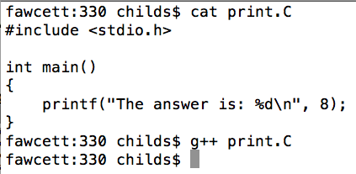
Putting it all together

Slide 70
Three pre-defined streams
cout <= => fprintf(stdout, …
cerr <= => fprintf(stderr, …
cin <= => fscanf(stdin, …

Slide 71
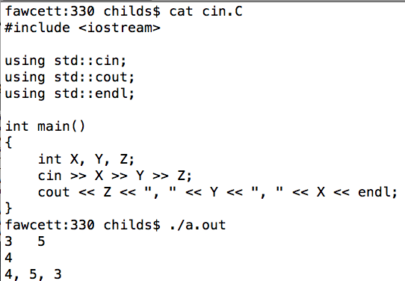
cin in action

Slide 72
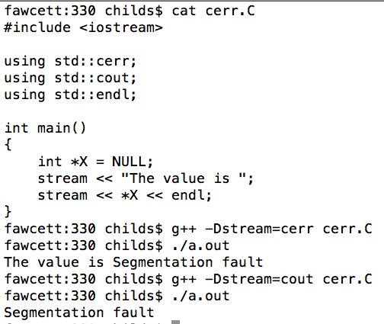
cerr
Works like cout, but prints to stderr
Always flushes everything immediately!
“See the error”

Slide 73
fstream
ifstream: input stream that does file I/O
ofstream: output stream that does file I/O
Not lecturing on this, since it follows from:
C file I/O
C++ streams
http://www.tutorialspoint.com/cplusplus/cpp_files_streams.htm

Slide 74
Project 3D
Assigned: today, 5/9
Due: Weds, 5/16
Important: if you skip this project, you will still be able to do future projects (3E, 3F, etc)
Assignment:
Write PNMreaderCPP and PNMwriterCPP … new version of the file reader and writer that use fstream.

Slide 75
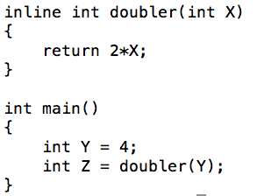
Inline function
inlined functions:
hint to a compiler that can improve performance
basic idea: don’t actually make this be a separate function that is called
Instead, just pull the code out of it and place it inside the current function
new keyword: inline
The compiler sometimes refuses your inline request (when it thinks inlining won’t improve performance), but it does it silently.

Slide 76

Inlines can be automatically done within class definitions
Even though you don’t declare this as inline, the compiler treats it as an inline

Slide 77
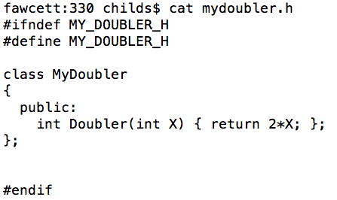
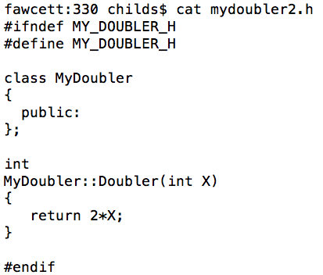
You should only do inlines within header files
Left: function is inlined in every .C that includes it
… no problem
Right: function is defined in every .C that includes it
… duplicate symbols

Slide 78
Bonus Topics

Slide 79
Backgrounding
“&”: tell shell to run a job in the background
Background means that the shell acts as normal, but the command you invoke is running at the same time.
“sleep 60” vs “sleep 60 &”
When would backgrounding be useful?

Slide 80
Suspending Jobs
You can suspend a job that is running
Press “Ctrl-Z”
The OS will then stop job from running and not schedule it to run.
You can then:
make the job run in the background.
Type “bg”
make the job run in the foreground.
Type “fg”
like you never suspended it at all!!

Slide 81
Web pages
ssh –l <user name> ix.cs.uoregon.edu
cd public_html
put something in index.html
→ it will show up as
http://ix.cs.uoregon.edu/~<username>

Slide 82
Web pages
You can also exchange files this way
scp file.pdf <username>@ix.cs.uoregon.edu:~/public_html
point people to http://ix.cs.uoregon.edu/~<username>/file.pdf
Note that ~/public_html/dir1 shows up as http://ix.cs.uoregon.edu/~<username>/dir1
(“~/dir1” is not accessible via web)

