Slide 1
CIS 330: _ _ _ _ ______ _ _____ / / / /___ (_) __ ____ _____ ____/ / / ____/ _/_/ ____/__ __ / / / / __ \/ / |/_/ / __ `/ __ \/ __ / / / _/_// / __/ /___/ /_ / /_/ / / / / /> < / /_/ / / / / /_/ / / /____/_/ / /__/_ __/_ __/ \____/_/ /_/_/_/|_| \__,_/_/ /_/\__,_/ \____/_/ \____//_/ /_/
Lab 7: performance analysis
& (more) debugging
May 26, 2017
University of Oregon

Slide 2
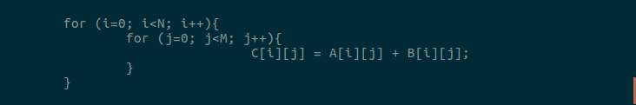
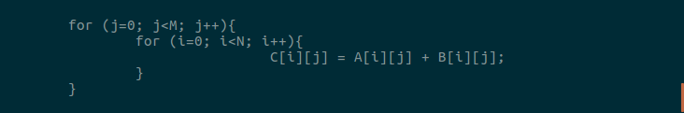
Performance question
Add matrices row by row
Add matrices column by column

Slide 3
many ways to time a program!
Unix 'time' command
Example: time ./my_program
Measures execution time of entire program run
Unix gettimeofday system call
Code into program
Can time execution of certain portions of the program

Slide 4
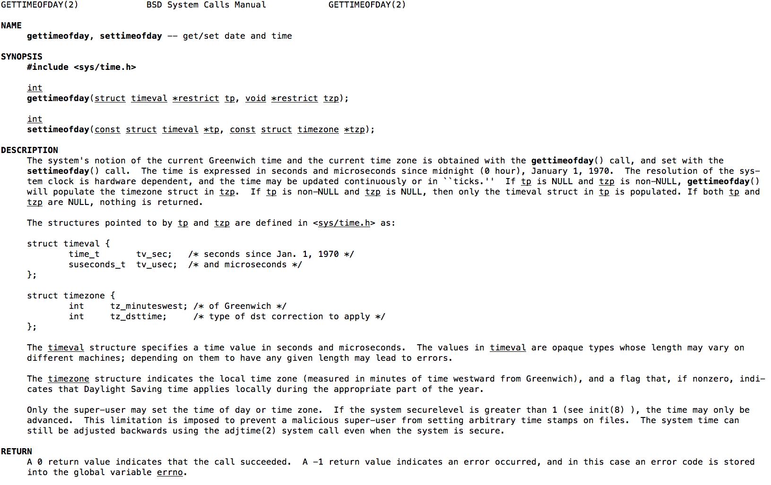
gettimeofday
(there are lots of Unix system calls, which do lots of different things)

Slide 5
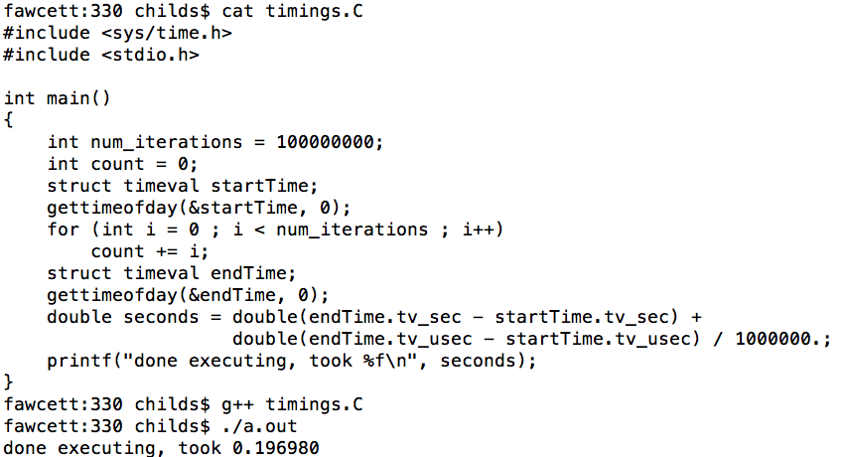
gettimeofday example

Slide 6
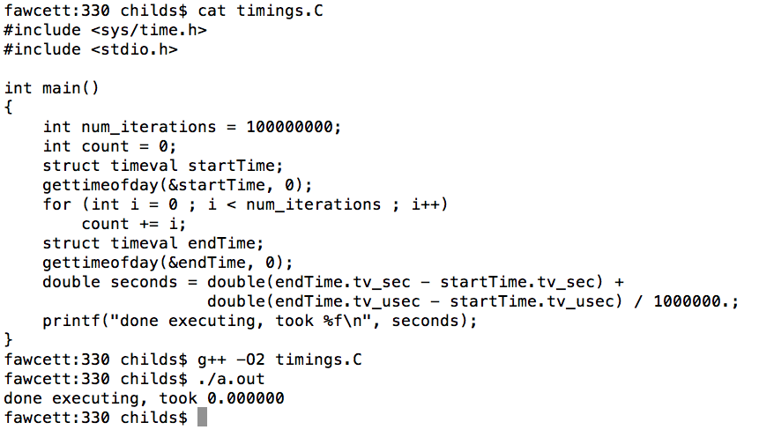
gettimeofday example

Slide 7
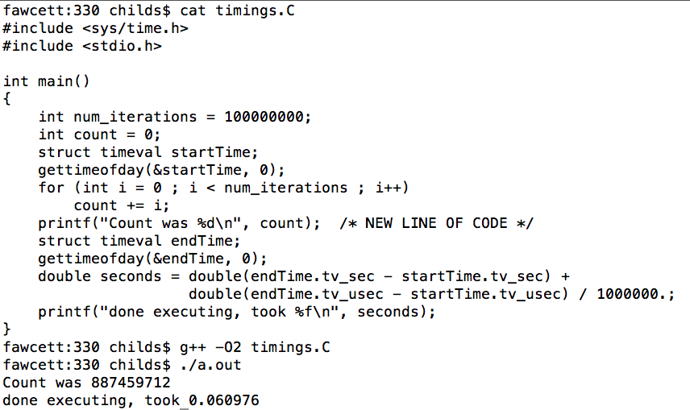
gettimeofday example

Slide 8
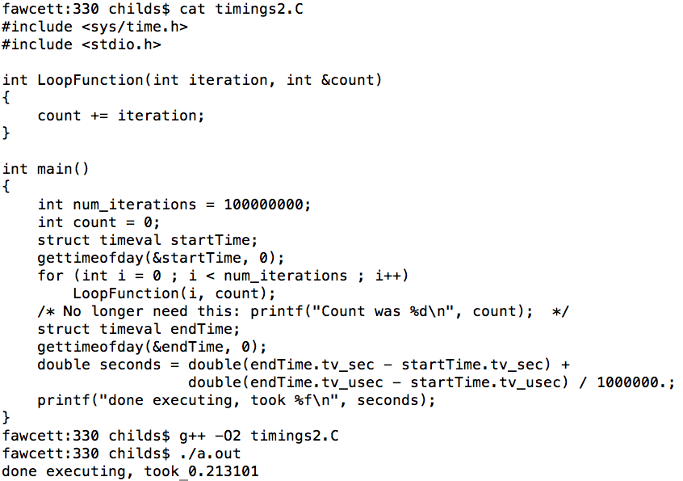
gettimeofday example

Slide 9
More performance analysis tools
gprof: old program … I’m struggling to get it to work
PAPI: library used widely to capture things like L1 cache misses, stalls, etc
TAU: full performance analysis infrastructure
made right here at UO

Slide 10
Matrix addition example
DEMO

Slide 11
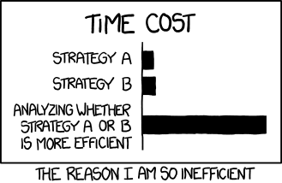
Matrix addition example
xkcd 1445

Slide 12
Performance analysis
There will be an assignment for you to add timing information to your image pipeline project.

Slide 13
#1 complaint I hear from employers
“students can’t debug”
If you can debug, you can progress on their projects (even if slowly)
If not, they will have to hand hold you
Think about your debugging approach.
How would you describe it during an interview?
This lecture describes how I would answer that question

Slide 14
Debugging Strategy
(#1) Figure out _where_ the error is occurring
(#2) Figure out _why_ the error is occurring
(#3) Form a plan to fix the error

Slide 15
Terrible debugging strategy
fix it by repeatedly making random changes
typically, code is pretty close to working in the first place
each random change creates a new problem that then has to be debugged
code ends up as a complete mess
This is a “bugging” strategy.
Always make sure you feel confident about what the problem is before you start changing code

Slide 16
Debugging as the scientific method
Debugging involves the scientific method:
You have a hypothesis
(“the bug is because of this”)
You form an experiment
(“I will test my theory by examining the state of some variables”)
You confirm or deny the hypothesis
(“the state was OK, my hypothesis was wrong”)
(“the state was bad, my hypothesis was right”)

Slide 17
Backups
The “scientific method” of debugging – which is good – can leave your code as a mess
My recommendation:
when you have a bug, immediately make a copy of your program
apply the scientific method-style of debugging until you understand the problem and how to fix
then go back to your original program and make the fix there

Slide 18
Debugging Overview
To me, effective debugging is about two things:
Challenging your own assumptions
Divide-and-conquer to find the problem

Slide 19
Challenging Assumptions
you thought the code would work and it doesn’t
so something you did is wrong, and you have to figure out what
I find students are often turning under the wrong stones, since there are some stones they don’t see
the way to find these “hidden stones” is to start with the bad outcome and search backwards
why is this pointer NULL? why is this value bad?

Slide 20
Divide-and-Conquer
There are lots of things that could be wrong with your program
This is a search problem!!
Divide-and-Conquer: try to focus on hypotheses that will eliminate half the possibilities, no matter what the outcome is

Slide 21
Divide-and-Conquer
“Halving” hypotheses:
The problem is in this module
The problem is in this function
Non-halving hypotheses:
The problem is in this line of code
The problem is with this variable
As you divide the space smaller and smaller, you will eventually end up hypothesis that are small in scope

Slide 22
Good practice / Poor practice
Good practice:
Write a few lines of code and test that it does what you want
Poor practice:
Write a bunch of code and compile it all at the end
Why is it better to write smaller
portions of code at a time?

Slide 23
Why is it better to write smaller portions of code at a time?
If you have one bug
it is easier to figure out where that bug is
searching through tens of lines of code, not hundreds
If you have many bugs
this is a disaster and you end up chasing your tail
and you are still searching through hundreds of lines of code, not tens
The extra effort of modifying the main program to test your new code pays off ten-fold (WAG)

Slide 24
Final thought: always initialize your variables!!
Many crashes in your HW assignments due to uninitialized pointers.
If you assign it to NULL, then at least you know that is set to something not valid
Otherwise, you see an address and think it might have valid memory
Initialize non-pointers too!
Classic point that employers look for.
This practice becomes increasingly essential when you work in teams on large projects.

Slide 25
Print statements
Print statements (cerr, printf):
the world’s most used debugger
very successful SW professionals are able to debug large SW projects using only print statements
Pitfalls:
output buffering
too many print statements

Slide 26
Pitfall #1: output buffering
output is sometimes buffered, and buffered output is dropped when a program crashes
if you don’t see a print statement
your program may have crashed before it got to that print statement
your program may have gotten to that print statement, but crashed before it got outputted
cerr: automatically flushes & mostly prevents this problem
cerr << “*(NULL) = “ << *NULL << endl; // still doesn’t work

Slide 27
Output buffering and cerr
cerr: automatically flushes & mostly prevents output buffering problem
Exception:
cerr << “*(NULL) = “ << *NULL << endl;
(crashes before anything is printed out)
Work-around:
cerr << “*NULL) = “;
cerr << *NULL << endl;

Slide 28
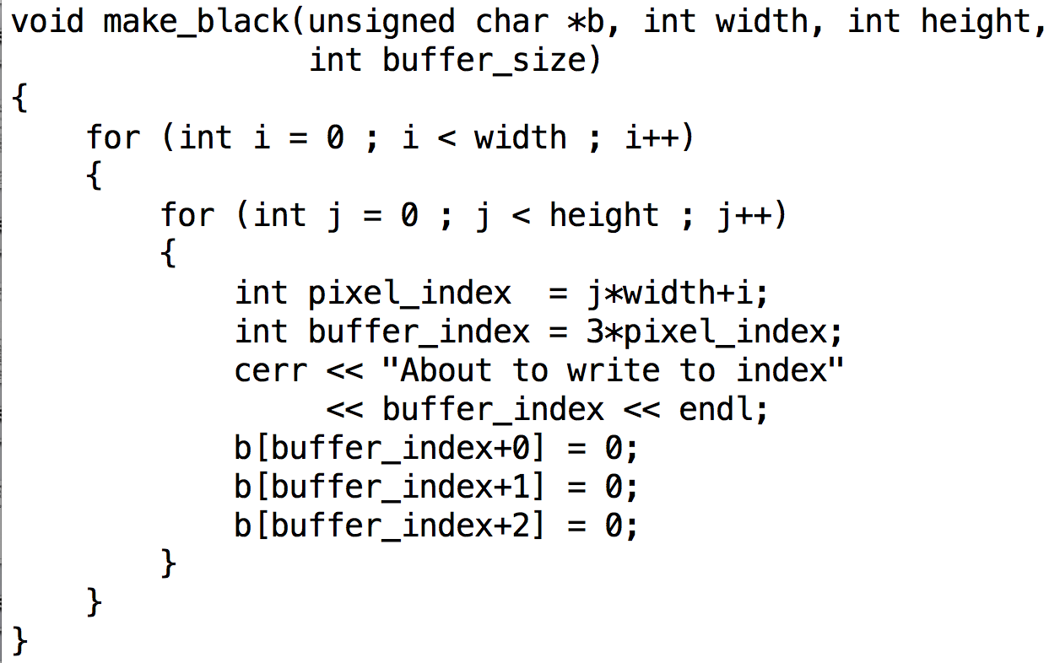
Pitfall #2: millions of print statements
This will result in millions of print statements … hard to debug.

Slide 29
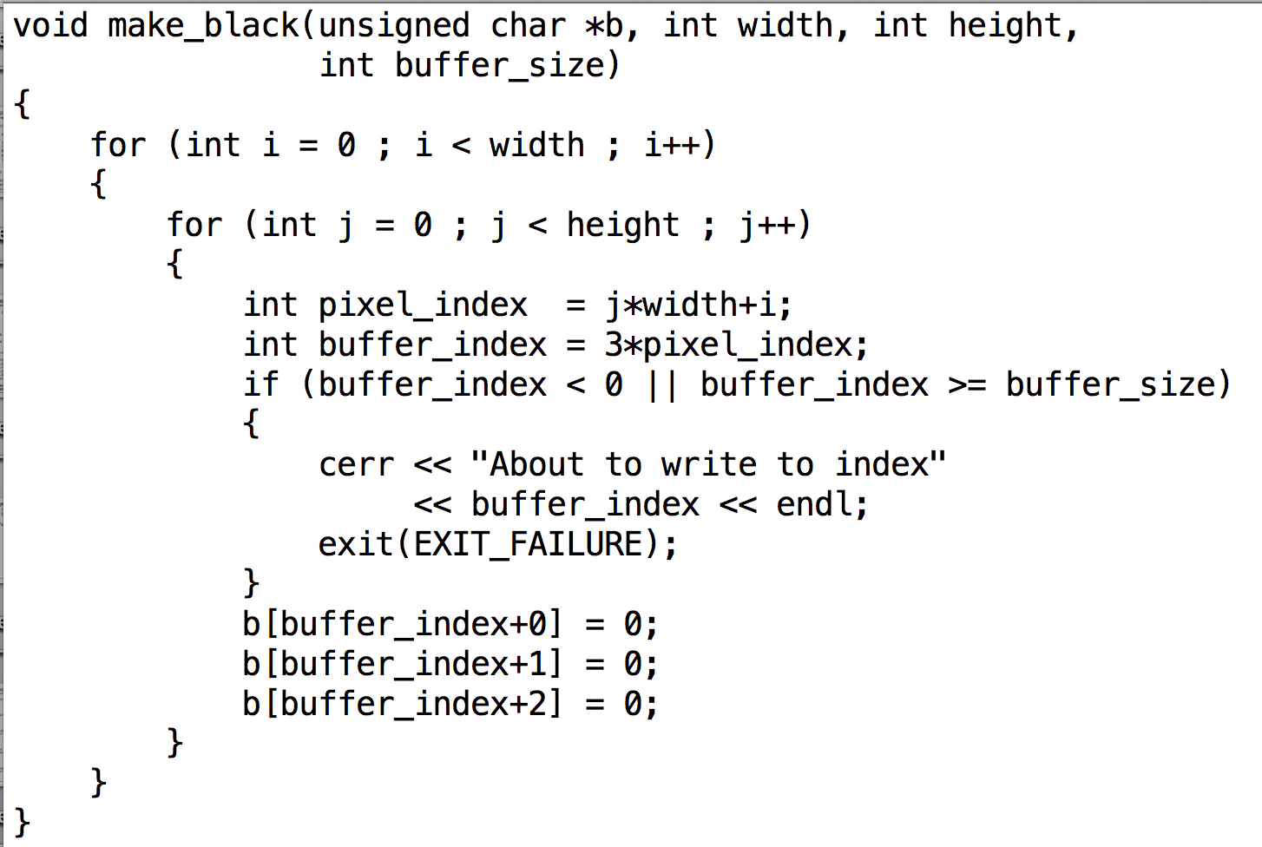
Reducing print statements

Slide 30
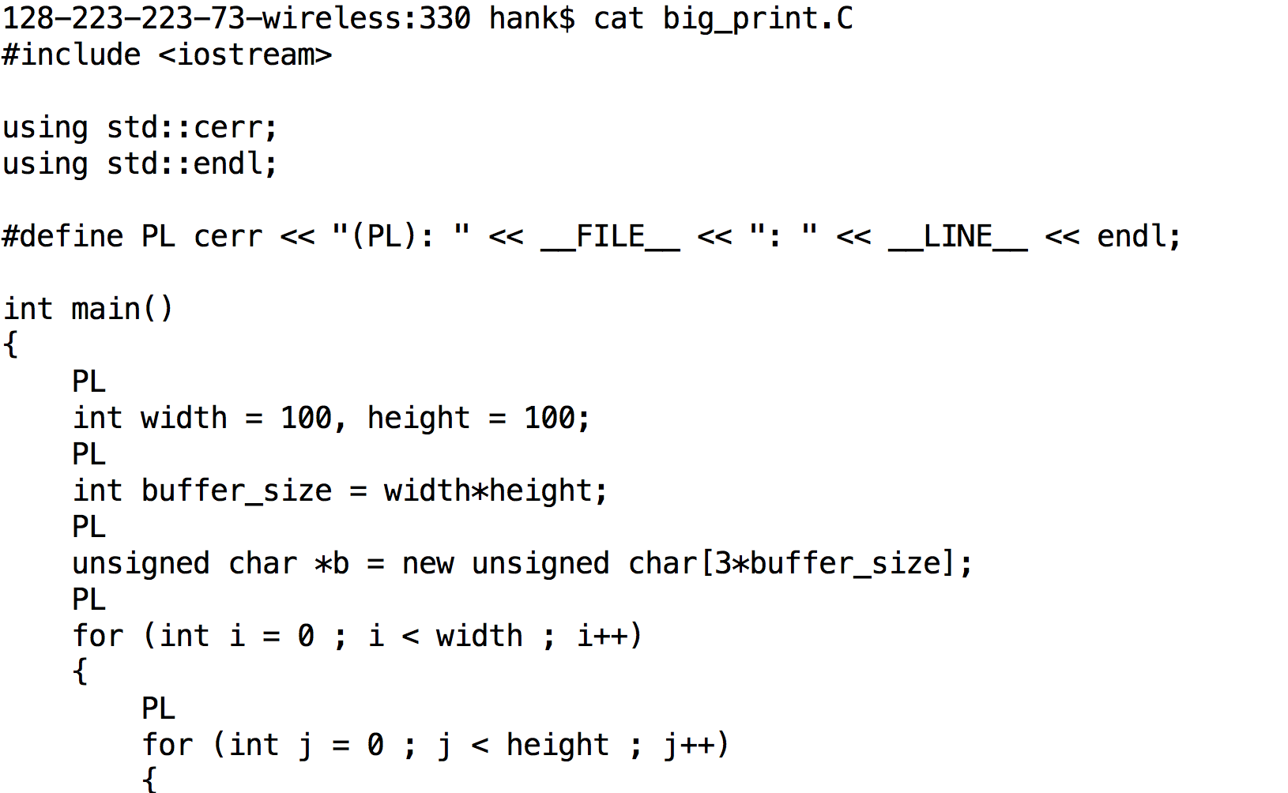
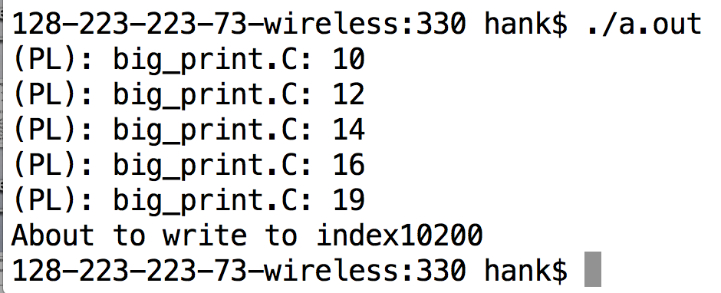
Make it easy on yourself…

Slide 31
Make it easy on yourself ...
If it takes you two minutes to type in the commands to compile, execute, and inspect the output for your program, then you probably won't test it enough.
Remember stuff like 'alias', ssh config, scp, shell scripting, etc …
If you can run tests quickly, you'll do them more often and save yourself tons of debugging time!

Slide 32
Debuggers
Allow you to set breakpoints
Allow you to inspect variables
Show you where a program crashed

Slide 33
Debuggers
gdb:
See Lab 1 notes for tips on using gdb!
valgrind:
See Lab 1 notes for tips on using valgrind to find memory errors (segfault)!
TIL: it's pronounced val - grin - ed

Slide 34
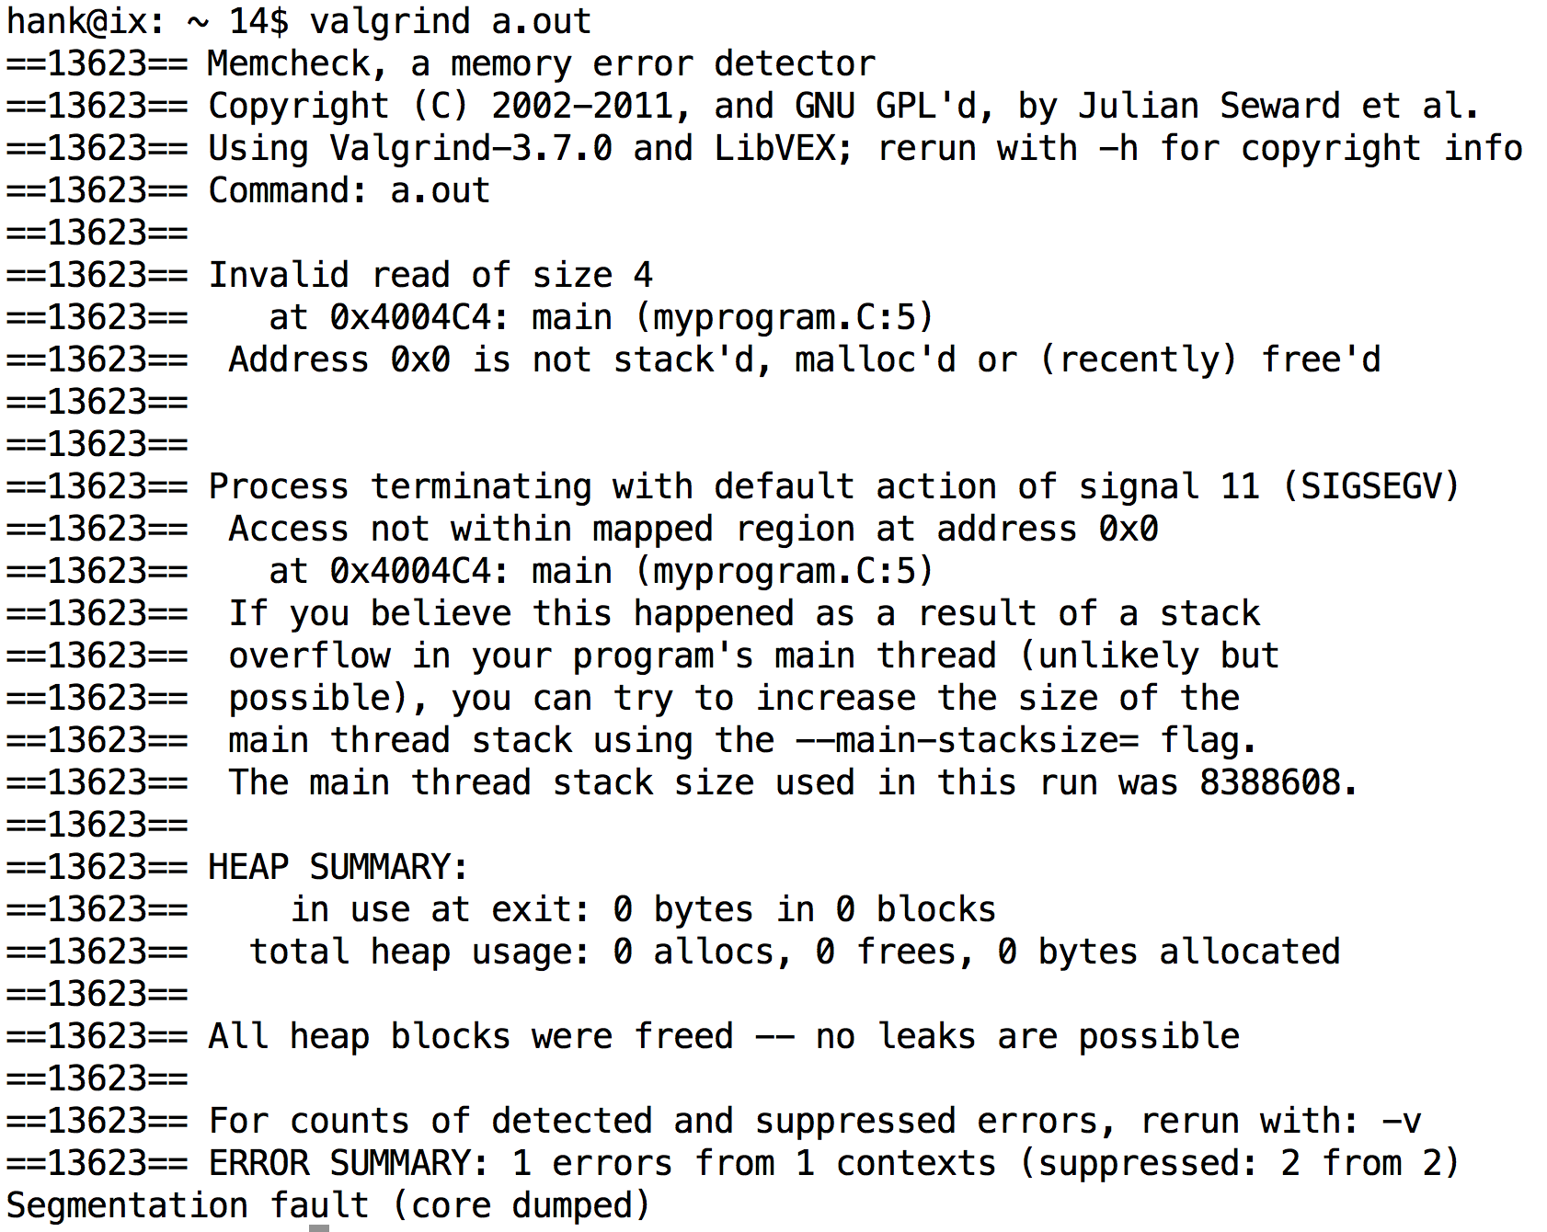
Valgrind: a memory checker

Slide 35
Valgrind
There will be an assignment to have a memory error-free and memory leak-free program. Use valgrind!

Slide 36
Valgrind: a memory (leak) checker
To see details, call valgrind with the flag:
--leak-check-full=yes
Might be really slow!
Tells you the number of heap allocations and frees … should be the same
Definitely lost = you goofed
Indirectly lost = fix the definitely lost parts
Possibly lost = nonstandard situations
Still reachable = just need to free

Slide 37
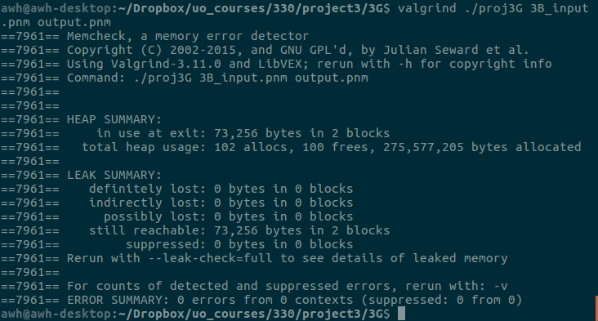
Valgrind: memory leak checker
Issue you may run into:

Slide 38
Valgrind: memory leak checker
Issue you may run into:
https://stackoverflow.com/questions/30376601/valgrind-memory-still-reachable-with-trivial-program-using-iostream

