Slide 1
CIS 330: _ _ _ _ ______ _ _____ / / / /___ (_) __ ____ _____ ____/ / / ____/ _/_/ ____/__ __ / / / / __ \/ / |/_/ / __ `/ __ \/ __ / / / _/_// / __/ /___/ /_ / /_/ / / / / /> < / /_/ / / / / /_/ / / /____/_/ / /__/_ __/_ __/ \____/_/ /_/_/_/|_| \__,_/_/ /_/\__,_/ \____/_/ \____//_/ /_/
Lab: Helpful Unix Content
"I searched my .bash_history for the line with the highest ratio of special characters to regular alphanumeric characters, and the winner was:
cat out.txt | grep -o "[[(].*[])][^)]]*$"
I have no memory of this and no idea what I was trying to do, but I sure hope it worked."
-- from xkcd #1638
xkcd.com
April 25, 2018
University of Oregon

Slide 2
Standard Streams
Wikipedia: “preconnected input and output channels between a computer program and its environment (typically a text terminal) when it begins execution”
Three standard streams:
stdin (standard input)
stdout (standard output)
stderr (standard error)
What mechanisms in C allow you to access standard streams?

Slide 3
printf
Print to stdout
printf(“hello world\n”);
printf(“Integers are like this %d\n”, 6);
printf(“Two floats: %f, %f”, 3.5, 7.0);

Slide 4
fprintf
Just like printf, but to streams
fprintf(stdout, “helloworld\n”);
→ same as printf
fprintf(stderr, “helloworld\n”);
prints to “standard error”
fprintf(f_out, “helloworld\n”);
prints to the file pointed to by FILE *f_out.

Slide 5
Unix shells allows you to manipulate standard streams.
“>” redirect output of program to a file
Example:
ls > output
echo “this is a file” > output2
cat file1 file2 > file3

Slide 6
Unix shells allows you to manipulate standard streams.
“>>” concatenate output of program to end of existing file
(or create file if it doesn’t exist)
Example:
echo “I am starting the file” > file1
echo “I am adding to the file” >> file1
cat file1
I am starting the file
I am adding to the file

Slide 7
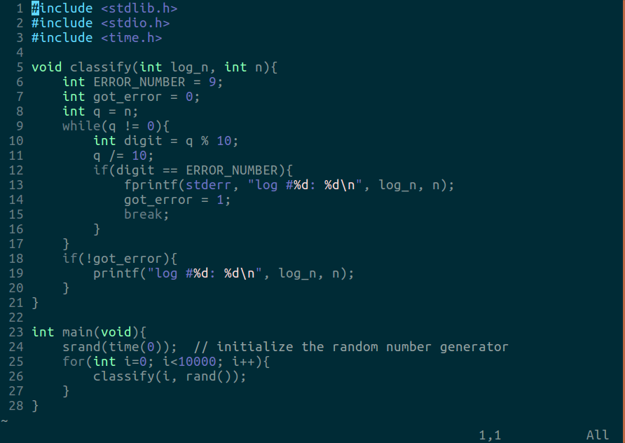
Example: redirect output from C program

Slide 8
Example: redirect output from C program
let's try to write the output of this program to files … stderr should go to a file called bad_log and stdout should go to a file called good_log
DEMO

Slide 9
Example: redirect output from C program
let's try to write the output of this program to files … stderr should go to a file called bad_log and stdout should go to a file called good_log
./unix_fun 1> good_log 2> bad_log
cat good_log bad_log | wc –l
Check: should be 10,000 print statements/lines
wc: counts number of bytes/words/lines
stderr and stdout are very useful!

Slide 10
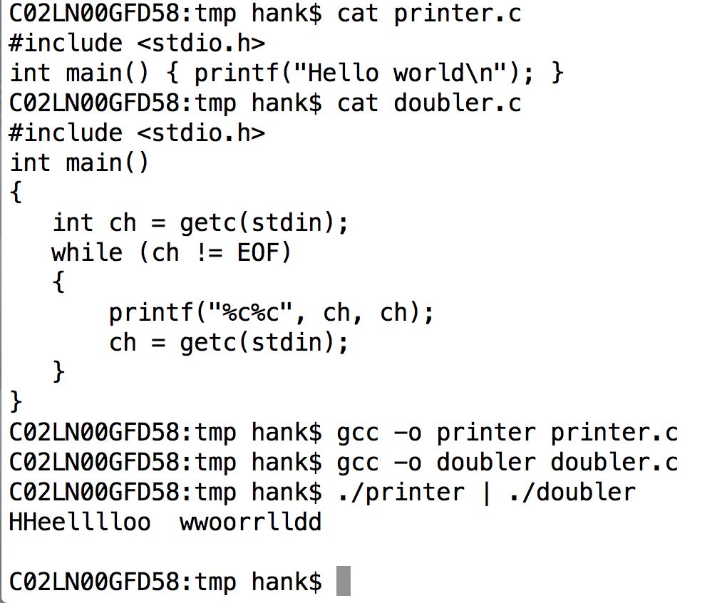
pipes in Unix shells
represented with “|”
output of one program becomes input to another program

Slide 11
Unix command: alias
alias: avoid typing a long command sequence repeatedly
Example: clean, compile, run
alias go='make clean; make; ./my_program'
Example: ssh to ix-dev a lot
alias ix='ssh username@ix-dev.cs.uoregon.edu'
Put an alias command (or anything else) in your ~/.bashrc file to make it persistent! DEMO

Slide 12
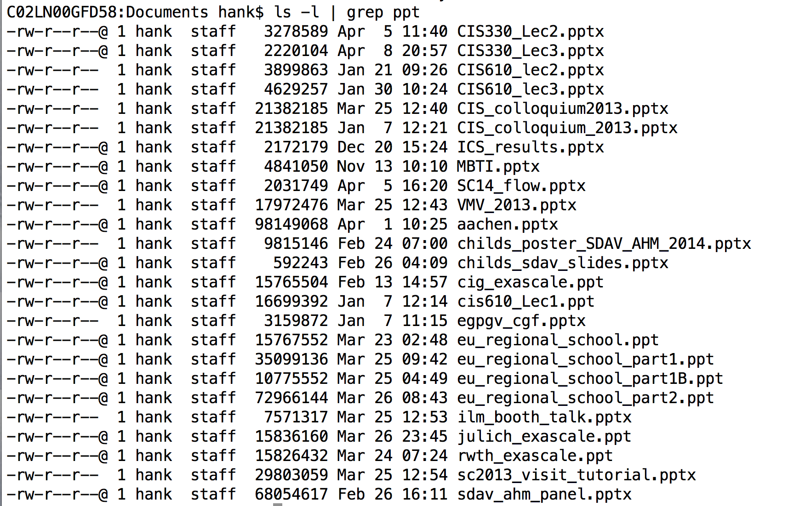
Very useful programs
grep: keep lines that match pattern, discard lines that don’t match pattern

Slide 13
Very useful programs
sed: replace pattern 1 with pattern 2
sed s/pattern1/pattern2/g
s means substitute
g means “global” … every instance on the line
sed is also available in “vi”
:%s/pattern1/pattern2/g (% means all lines)
:103,133s/p1/p2/g (lines 103-133)

Slide 14
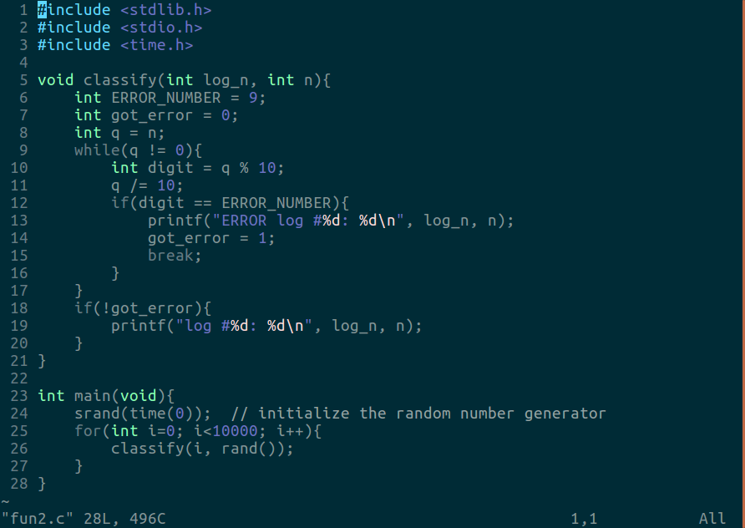
Example: difficult output from C program

Slide 15
Example: difficult output from C program
This one is harder! All of the output goes to stdout, but we still want to separate it. Use pipes, grep, and sed to sort the output into two files called bad_log and good_log … in bad_log, the word ERROR should be removed. It's ok to write to an intermediate file and do this in several steps.
DEMO

Slide 16
Example: difficult output from C program
Solution #1:
./unix_fun > log
grep ERROR log | sed 's/ERROR //g' > bad_log
grep –v ERROR log > good_log
Solution #2:
./unix_fun | tee >(grep ERROR | sed 's/ERROR //g' > bad_log) >(grep -v ERROR > good_log)
Check: Each line in bad_log should have a ‘9’ digit
cat bad_log | grep ‘[9]’ | wc –l (this equals 6025)
cat bad_log | wc -l (this also equals 6025 – good!)

Slide 17
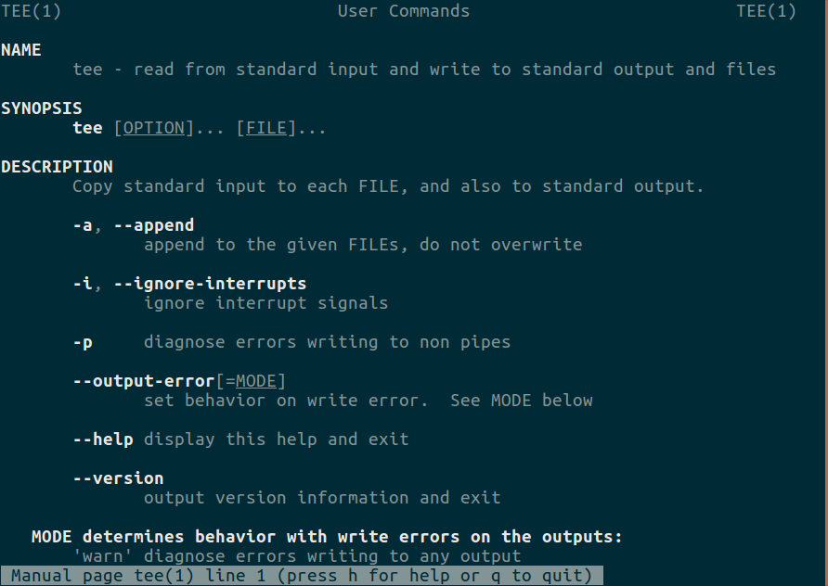

Unix command: tee
man tee

Slide 18
Unix commands: curl
QUESTION: What’s the weather going to be like tomorrow in Eugene?
BUT: You can only use your terminal to find out ☺
DEMO

Slide 19
Unix commands: curl
Interact with remote servers, view and parse webpage content …and many more options!
Great for downloading files (pdfs, .c/.h files,…) right inside the terminal
If I can get the link/url of the file, I always do it this way!
Avoid using the “Save As” dialogue box
Example: curl http://wttr.in/~Eugene
What’s it do? Try it out right now!

Slide 20
Example: curl
Let's download some of the CIS 330 lecture slides and tar just the PDFs
DEMO

Slide 21
Example: curl
let's download some of the CIS 330 lecture slides and tar just the PDFs
URL=http://ix.cs.uoregon.edu/~hank/330/lectures
curl -O $URL/CIS330_S18_Lec1.pdf
curl -O $URL/CIS330_S18_Lec1.pptx
curl -O $URL/CIS330_S18_Lec2.pdf
curl -O $URL/CIS330_S18_Lec2.pptx
tar -cvf lecture_notes.tar *.pdf

Slide 22
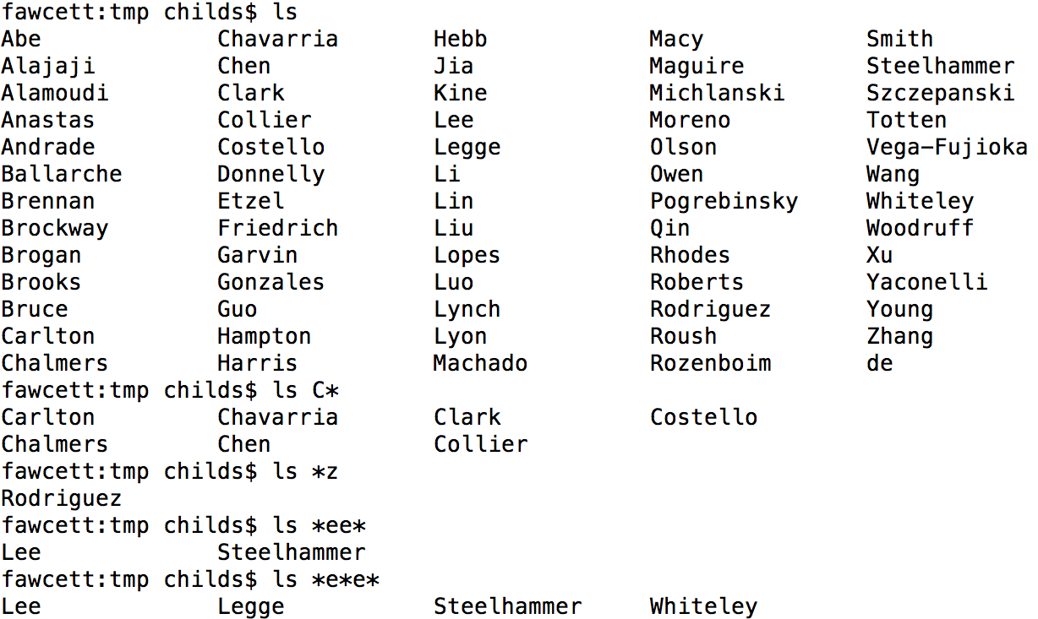
Wildcards
‘*’ is a wildcard with unix shells
‘?’ is a wildcard that matches exactly one character

Slide 23
Other useful shell things
‘tab’: auto-complete
almost impossible to communicate how great this is!!!
esc=: show options for auto-complete
Ctrl-A: go to beginning of line
Ctrl-E: go to end of line
Ctrl-R: search through history for command
Unix tools: clear (clear off terminal screen), top/htop (monitor CPU resources and processes), ”mv” (rename a folder/file)

