Slide 1
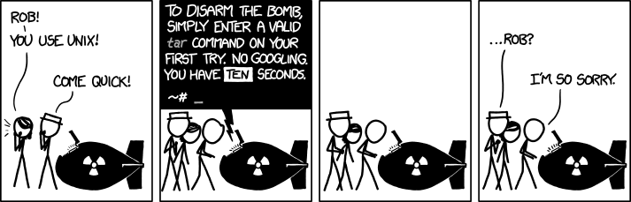
CIS 330: _ _ _ _ ______ _ _____ / / / /___ (_) __ ____ _____ ____/ / / ____/ _/_/ ____/__ __ / / / / __ \/ / |/_/ / __ `/ __ \/ __ / / / _/_// / __/ /___/ /_ / /_/ / / / / /> < / /_/ / / / / /_/ / / /____/_/ / /__/_ __/_ __/ \____/_/ /_/_/_/|_| \__,_/_/ /_/\__,_/ \____/_/ \____//_/ /_/
Lab: ssh, scp, gdb, valgrind
xkcd 1168
April 12th, 2018
University of Oregon

Slide 2
Unix command: ssh
Problem: you're using a computer, but you want to be using a different computer …
the other computer is far away
the other computer is inaccessible
the other computer doesn't have a display (server)
etc.
ssh lets you log onto another machine

Slide 3
Unix command: ssh
Basic Use:
ssh username@machine
( equivalent version using the -l flag )
ssh -l username machine
-Y flag: Enables X11 forwarding ➔ Remote use of GUI applications
DEMO

Slide 4
Unix command: ssh
From demo: don't need to type username / machine name / password every time!
Instructions for accomplishing this could be confusing since there are potentially different steps for different systems … ask after class or come to office hours if interested.

Slide 5
Unix command: scp
Problem: you have files on one computer, but you want those files on a different computer ...
scp lets you send files from one machine to another machine

Slide 6
Unix command: scp
Basic Use:
scp source destination
either source or destination might be a remote machine … examples:
scp my_file username@ix-dev.cs.uoregon.edu:~
(this copies my_file in the current working directory to HOME directory on ix-dev)
scp username@ix-dev.cs.uoregon.edu:/absolute/path/my_other_file .
(this copies my_other_file in /absolute/path on ix-dev to the current working directory)
nothing special about these examples ... DEMO

Slide 7
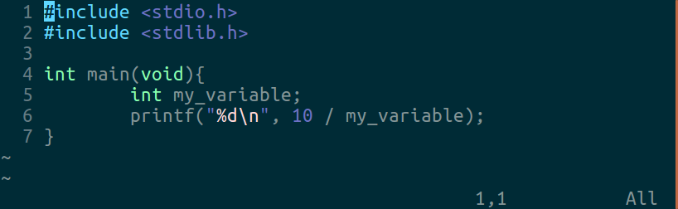
Debugging
Problem: you wrote a computer program and it doesn't work ...

Slide 8
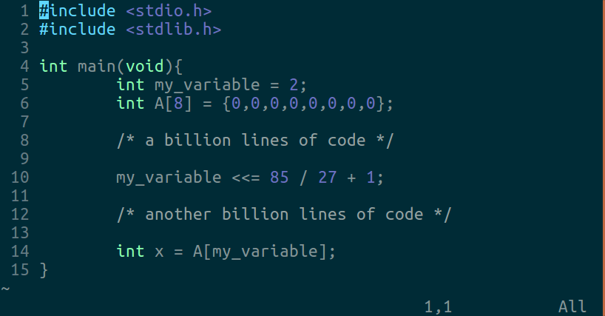
Debugging
Worse problem: someone else wrote a computer program and it doesn't work ...

Slide 9
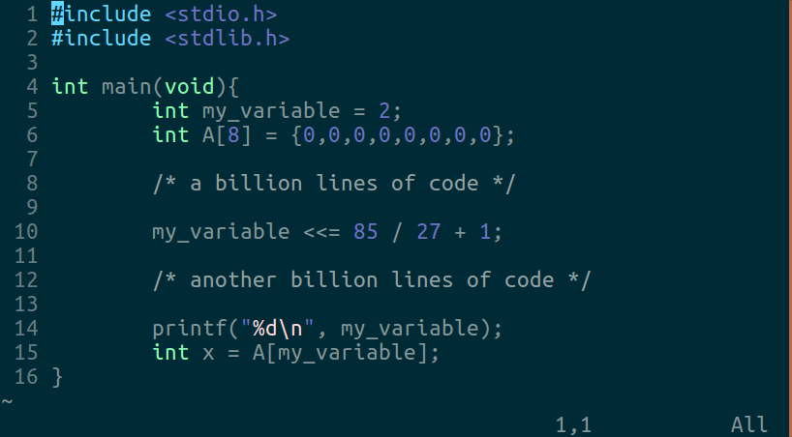
Debugging: lots of printf
Method #1: just print everything and figure it out … this works pretty good most of the time!

Slide 10
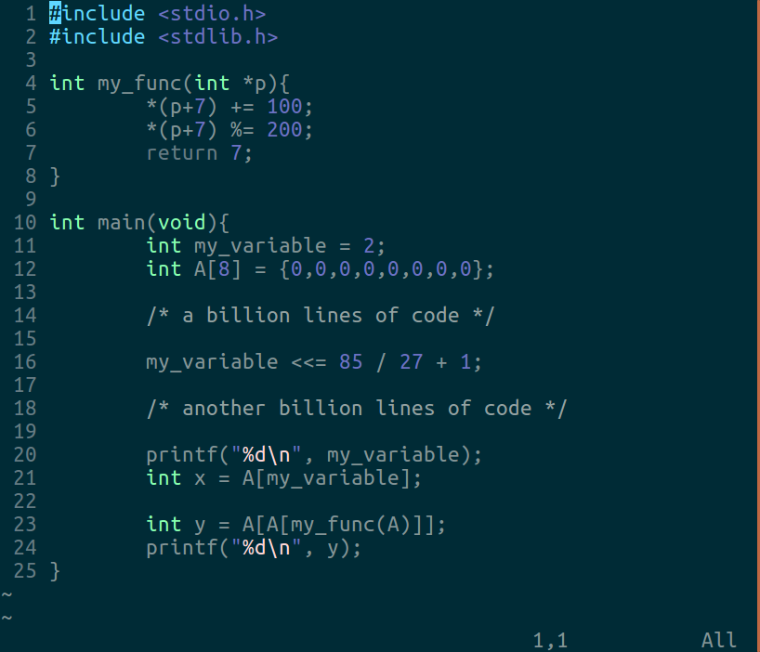
Debugging: lots of printf
Method #1: sometimes you are in a tough spot!
when I run this, I get the value 1661289645 for y

Slide 11
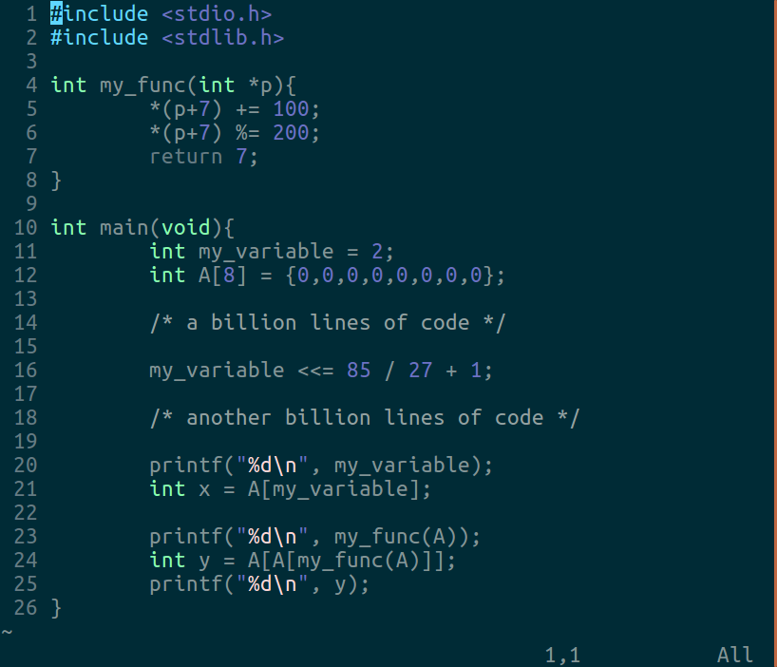
Debugging: lots of printf
Method #1: sometimes you are in a tough spot!
when I run this, I get 7 for the return value of my_func … but now y is 0???

Slide 12
Debugging: lots of printf
Method #1: sometimes you are in a tough spot!
This example is kind of contrived … a more typical situation (for me, at least) is that I'm reading some code and it's completely mind boggling, and putting in print statements would just take a really long time.

Slide 13
Debugging: gdb
More options would be great!
What are all the local variables defined at some point in the program?
What are the values of each variable?
What happens if we change the value of a variable?
Method #2: gdb can do all of this. And much more!

Slide 14
Debugging: gdb
Method #2: gdb
Can inspect and modify code as it runs without recompiling!
Similar program called lldb on macOS
Run from the command line, but need to compile with debug info (-g flag). Example:
Compile: gcc -g -o bad incorrect_program.c
Run: gdb ./bad

Slide 15
Debugging: gdb
DEMO: I’ll be switching over to Ubuntu for this…
Newer macOSX versions stopped supporting gdb
Encourage the use of comparable lldb
“brew install gdb” still there…but errors may occur while using gdb (mine seems broken now)
Recommend: use lldb on Mac; gdb on Linux

Slide 16
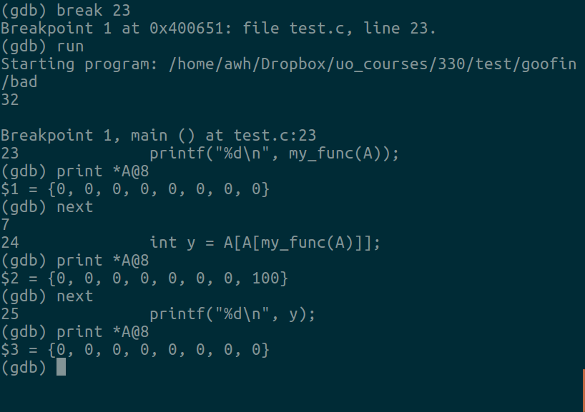
Debugging: gdb
Example gdb session working with the previous example program.
DEMO
These gdb commands, and more, explained on next slide.

Slide 17
Debugging: gdb
Useful commands in gdb:
break N: set breakpoint at line N
break my_func: break whenever my_func is called
watch my_var: break whenever my_var is changed
run: start the program
continue: go until the next breakpoint
next: do the next line of code
step: do the next line of code, descending into function calls
info locals: display local variable information
backtrace: show frames leading to crash
print x: print the value of variable x
print *A@N: print the first N values of array A
set var x=v: set the value of variable x to v
lldb/gdb comparison commands: https://developer.apple.com/library/content/documentation/IDEs/Conceptual/gdb_to_lldb_transition_guide/document/lldb-command-examples.html#//apple_ref/doc/uid/TP40012917-CH3-SW3

Slide 18
Debugging: gdb
Useful commands in gdb: these are just a sampling of the most-used commands. There are a lot more, too. It can be super helpful … have fun!
Story from Andy Hampton, Spring ‘17 330 GTF: “At the start of my internship last summer, my mentor said he'd be on vacation for a week and asked me to get a program working. Running it gives one line of output: seg fault. Upon further inspection: program is 50k lines of code, built on library that's 100k lines :( “
It would be great to have some way to automatically detect certain errors ...

Slide 19
Debugging: valgrind
Method #3: valgrind
Need to compile with debug info (-g flag). Example:
Compile: gcc -g -o bad incorrect_program.c
Run: valgrind ./bad
Might not be installed by default on macOS.
Install with homebrew (brew install valgrind)
Run on ix-dev (already installed)
If using Ubuntu: sudo apt-get install valgrind

Slide 20
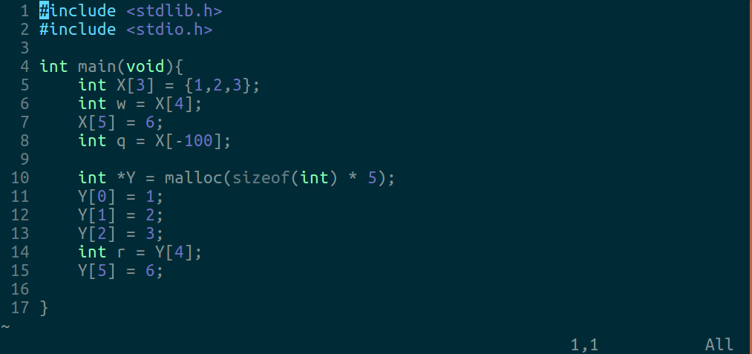
Debugging: valgrind
Valgrind finds only a certain type of error: memory errors. This is great, though! These errors can be really tough. Let's try finding the memory errors in this program using valgrind.

Slide 21
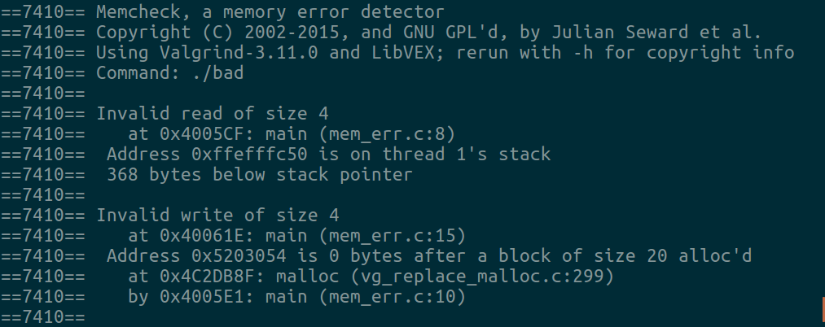
Debugging: valgrind
DEMO: valgrind ./bad

Slide 22
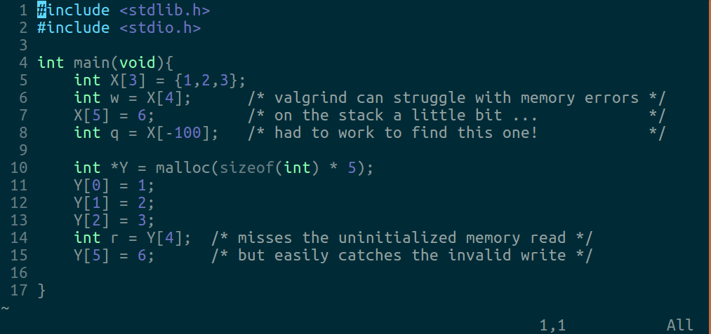
Debugging: valgrind

Slide 23
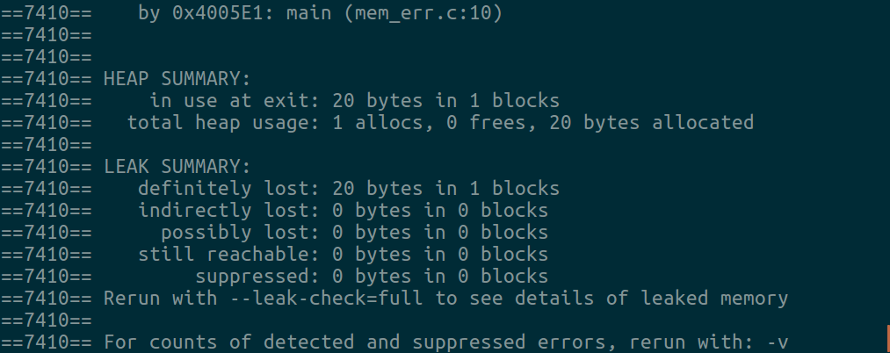
Debugging: valgrind
What about the other output? Valgrind tells us that there is a "memory leak" … memory allocated on the heap that was never freed. A memory leak isn't great because the program is unable to re-use that memory, perhaps leading it to exhaust the available memory. You need to make your projects leak free!

