Slide 1
CIS 330: _ _ _ _ ______ _ _____ / / / /___ (_) __ ____ _____ ____/ / / ____/ _/_/ ____/__ __ / / / / __ \/ / |/_/ / __ `/ __ \/ __ / / / _/_// / __/ /___/ /_ / /_/ / / / / /> < / /_/ / / / / /_/ / / /____/_/ / /__/_ __/_ __/ \____/_/ /_/_/_/|_| \__,_/_/ /_/\__,_/ \____/_/ \____//_/ /_/
Lecture 7: file I/O, more Unix
April 18th, 2018
Hank Childs, University of Oregon

Slide 2
Announcements
Projects
4A due IN CLASS Friday (no late)
2B assigned today, due Monday
3A, 2C to be assigned soon
Next week:
Lecture Monday and Friday
Lab Wednesday
Also, will be a YouTube short lecture
(We are getting ahead of schedule … trying hard to prevent work from this class to be backloaded)

Slide 3
Outline
Review
File I/O
Project 2B
Redirection
Pipes

Slide 4
Outline
Review
File I/O
Project 2B
Redirection
Pipes

Slide 5
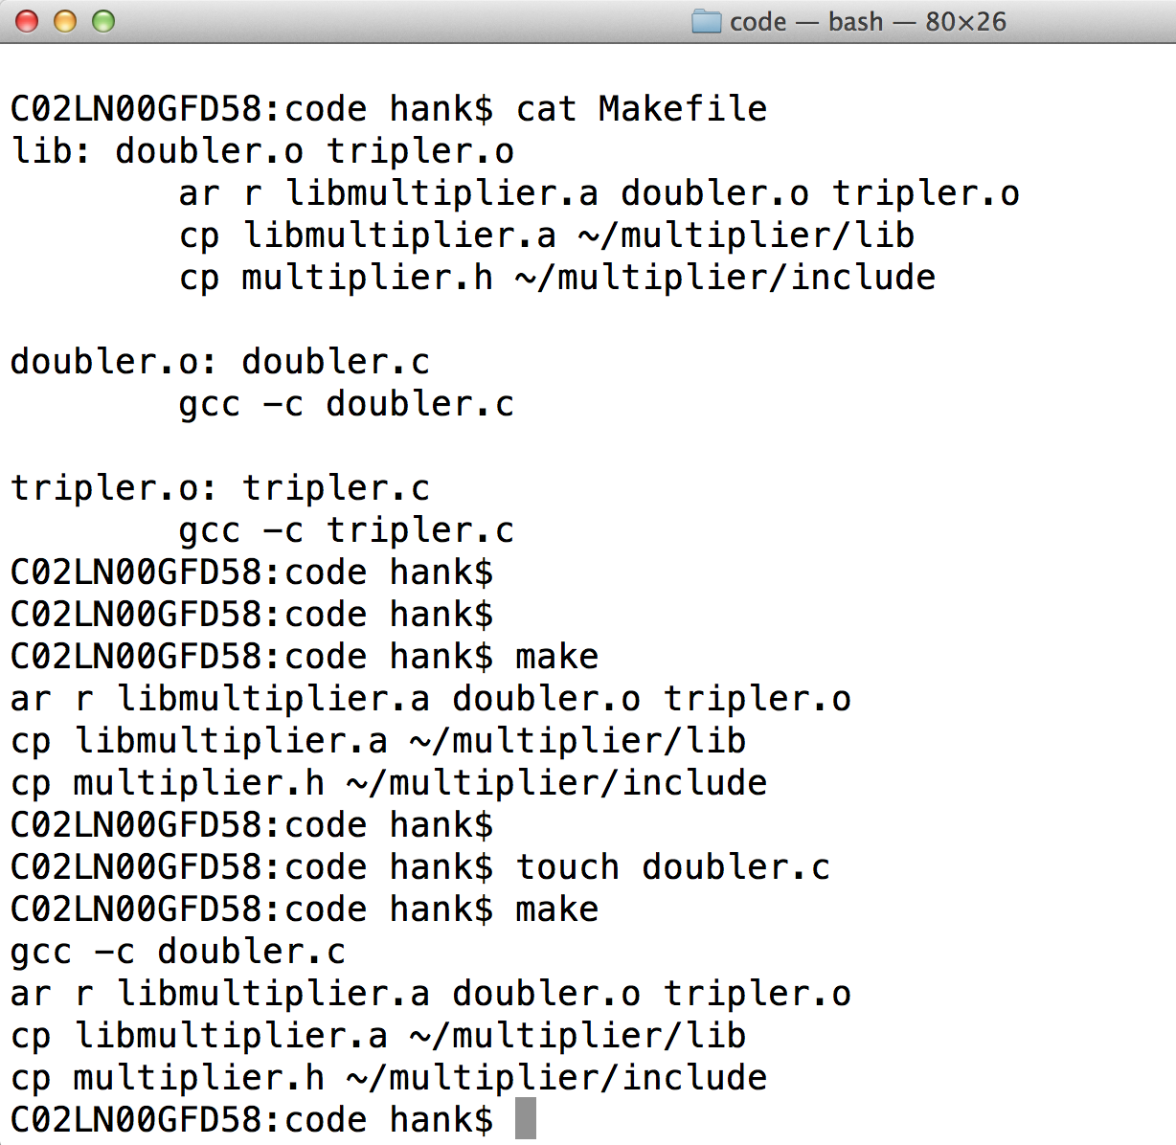
Makefile example: multiplier lib

Slide 6
Unix command: tar
tar cvf 330.tar file1 file2 file3
puts 3 files (file1, file2, file3) into a new file called 330.tar
scp 330.tar @ix:~
ssh ix
tar xvf 330.tar
ls
file1 file2 file

Slide 7
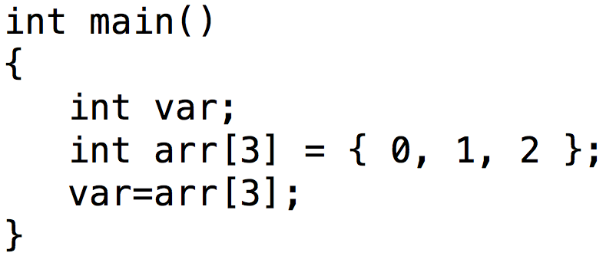
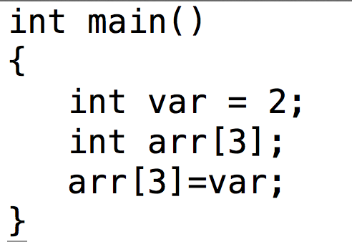
Memory Errors
Array bounds read
Array bounds write

Slide 8
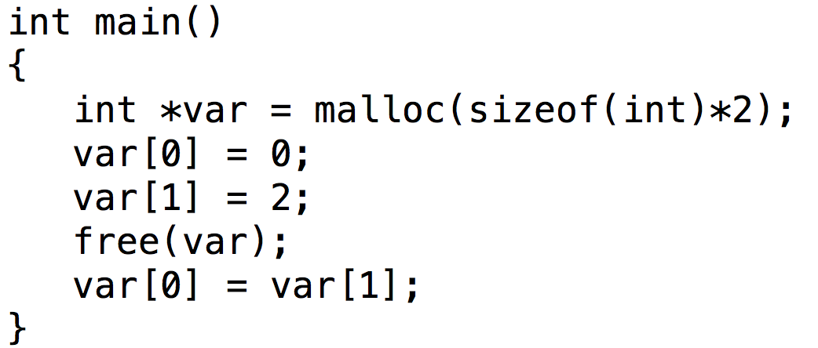
Memory Errors
Free memory read / free memory write
Vocabulary: “dangling pointer”: pointer that points to memory that has already been freed.

Slide 9
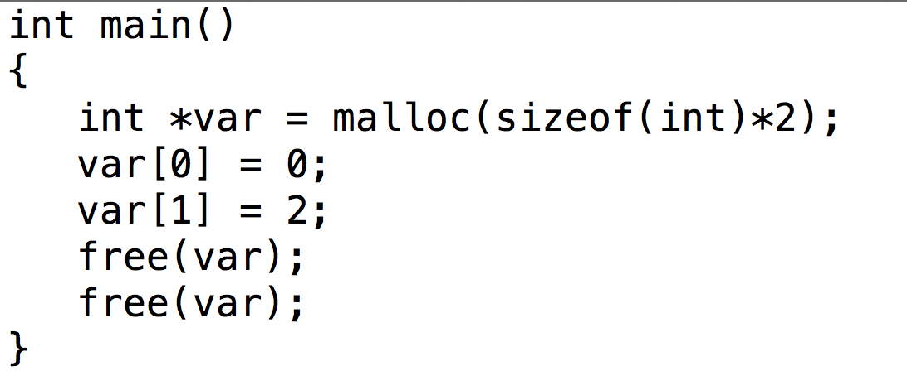
Memory Errors
Freeing unallocated memory

Slide 10
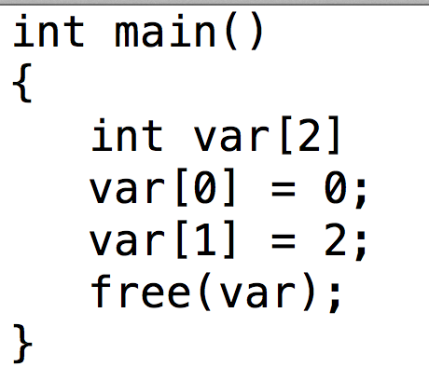
Memory Errors
Freeing non-heap memory

Slide 11
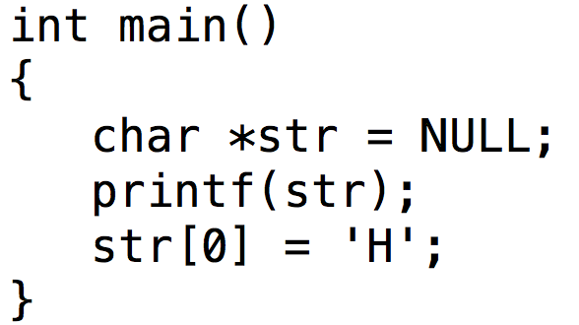
Memory Errors
NULL pointer read / write
NULL is never a valid location to read from or write to, and accessing them results in a “segmentation fault”
…. remember those memory segments?

Slide 12
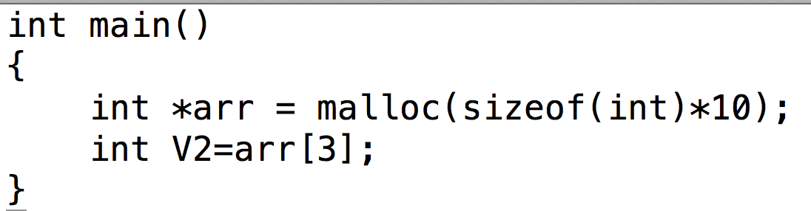
Memory Errors
Uninitialized memory read

Slide 13
NEW: IPR, IPW
int *X = 0xDEADBEEF:
int Y = *X;
what error code fits?
I missed two:
Invalid Pointer Read (IPR)
Invalid Pointer Writer (IPW)

Slide 14
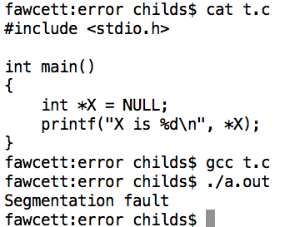
Memory error in action

Slide 15
Project 4A
Posted now
You will practice debugging & using a debugger
There are 3 programs you need to debug
In this case, “debug” means identify the bug
Does not mean fix the bug
Can use gdb or lldb
May want to run on ix
Worksheet due in class Friday
P3.c: 4 errors

Slide 16
Outline
Review
File I/O
Project 2B
Redirection
Pipes

Slide 17
File I/O: streams and file descriptors
Two ways to access files:
File descriptors:
Lower level interface to files and devices
Provides controls to specific devices
Type: small integers (typically 20 total)
Streams:
Higher level interface to files and devices
Provides uniform interface; easy to deal with, but less powerful
Type: FILE *
Streams are more portable, and more accessible
to beginning programmers. (I teach streams here.)

Slide 18
File I/O
Process for reading or writing
Open a file
Tells Unix you intend to do file I/O
Function returns a “FILE *
Used to identify the file from this point forward
Checks to see if permissions are valid
Read from the file / write to the file
Close the file

Slide 19
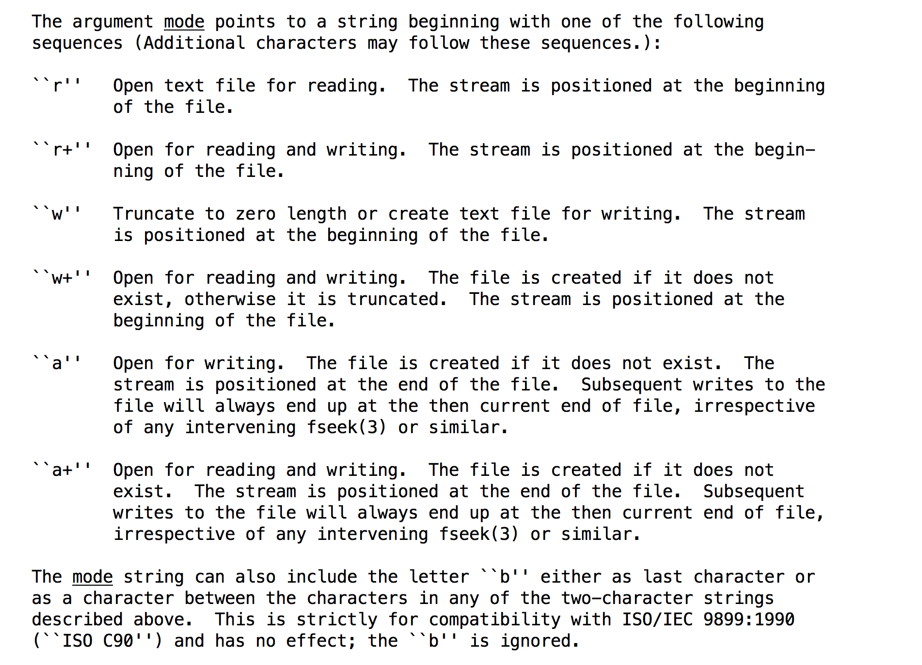
Opening a file
FILE *handle = fopen(filename, mode);
Example: FILE *h = fopen(“/tmp/330”, “wb”);
Close when you are done with “fclose”
Note: #include <stdio.h>

Slide 20
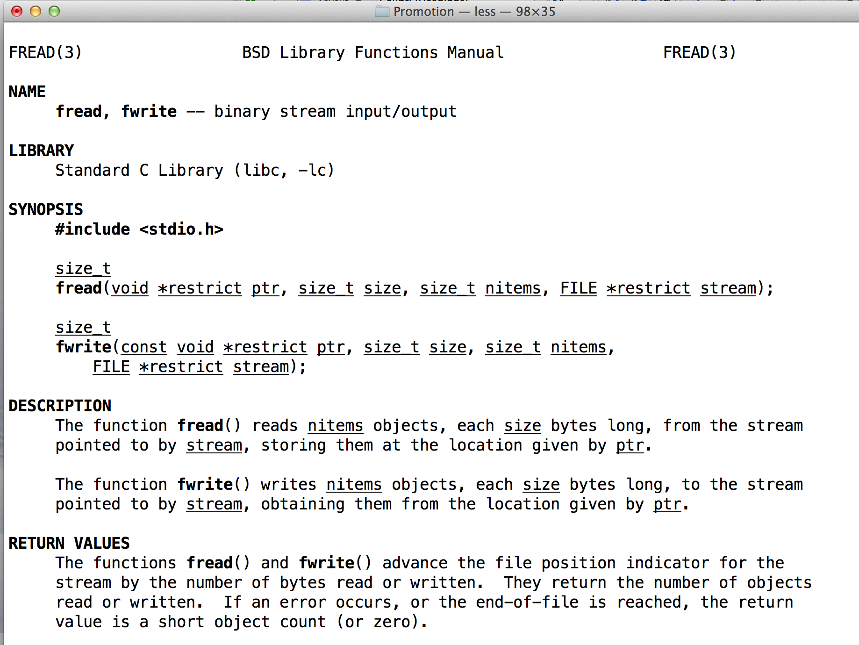
Reading / Writing

Slide 21
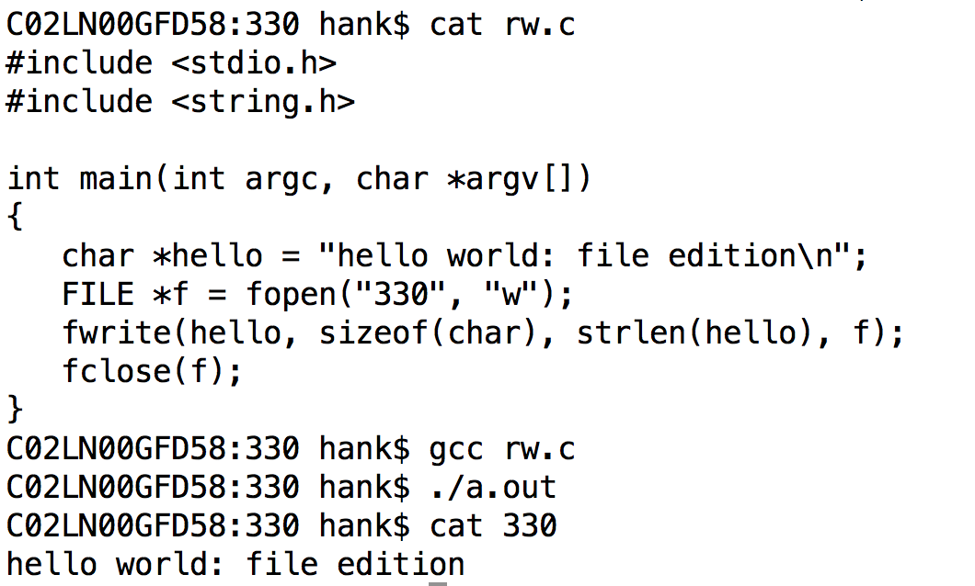
Example

Slide 22
File Position Indicator
File position indicator: the current location in the file
If I read one byte, the one byte you get is where the file position indicator is pointing.
And the file position indicator updates to point at the next byte
But it can be changed…

Slide 23
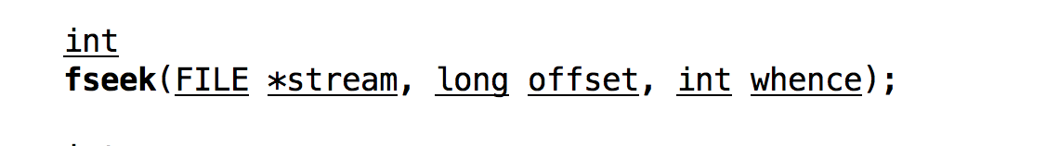
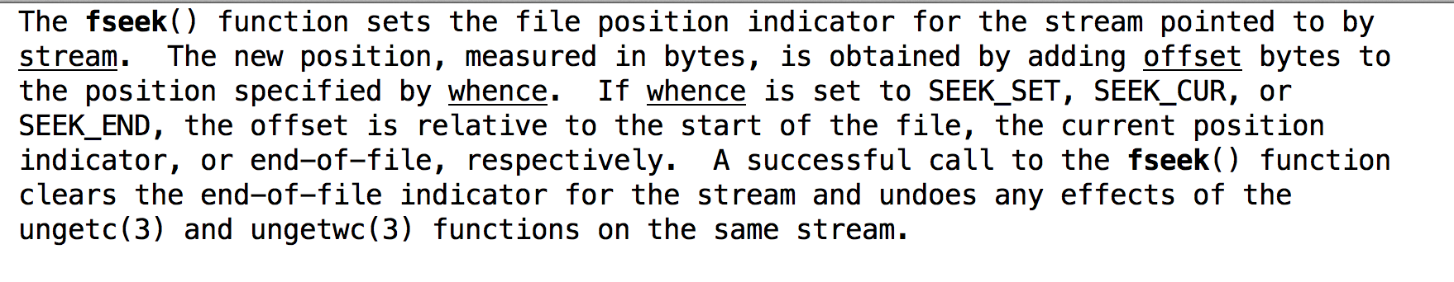
fseek

Slide 24
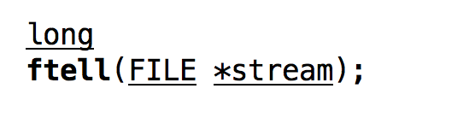
ftell

Slide 25
We have everything we need to make a copy command…
fopen
fread
fwrite
fseek
ftell
Can we do this together as a class?

Slide 26
argc & argv
two arguments to every C program
argc: how many command line arguments
argv: an array containing each of the arguments
“./a.out hank childs”
→ argc == 3
→ argv[0] = “a.out”, argv[1] = “hank”, argv[2] = “childs”

Slide 27
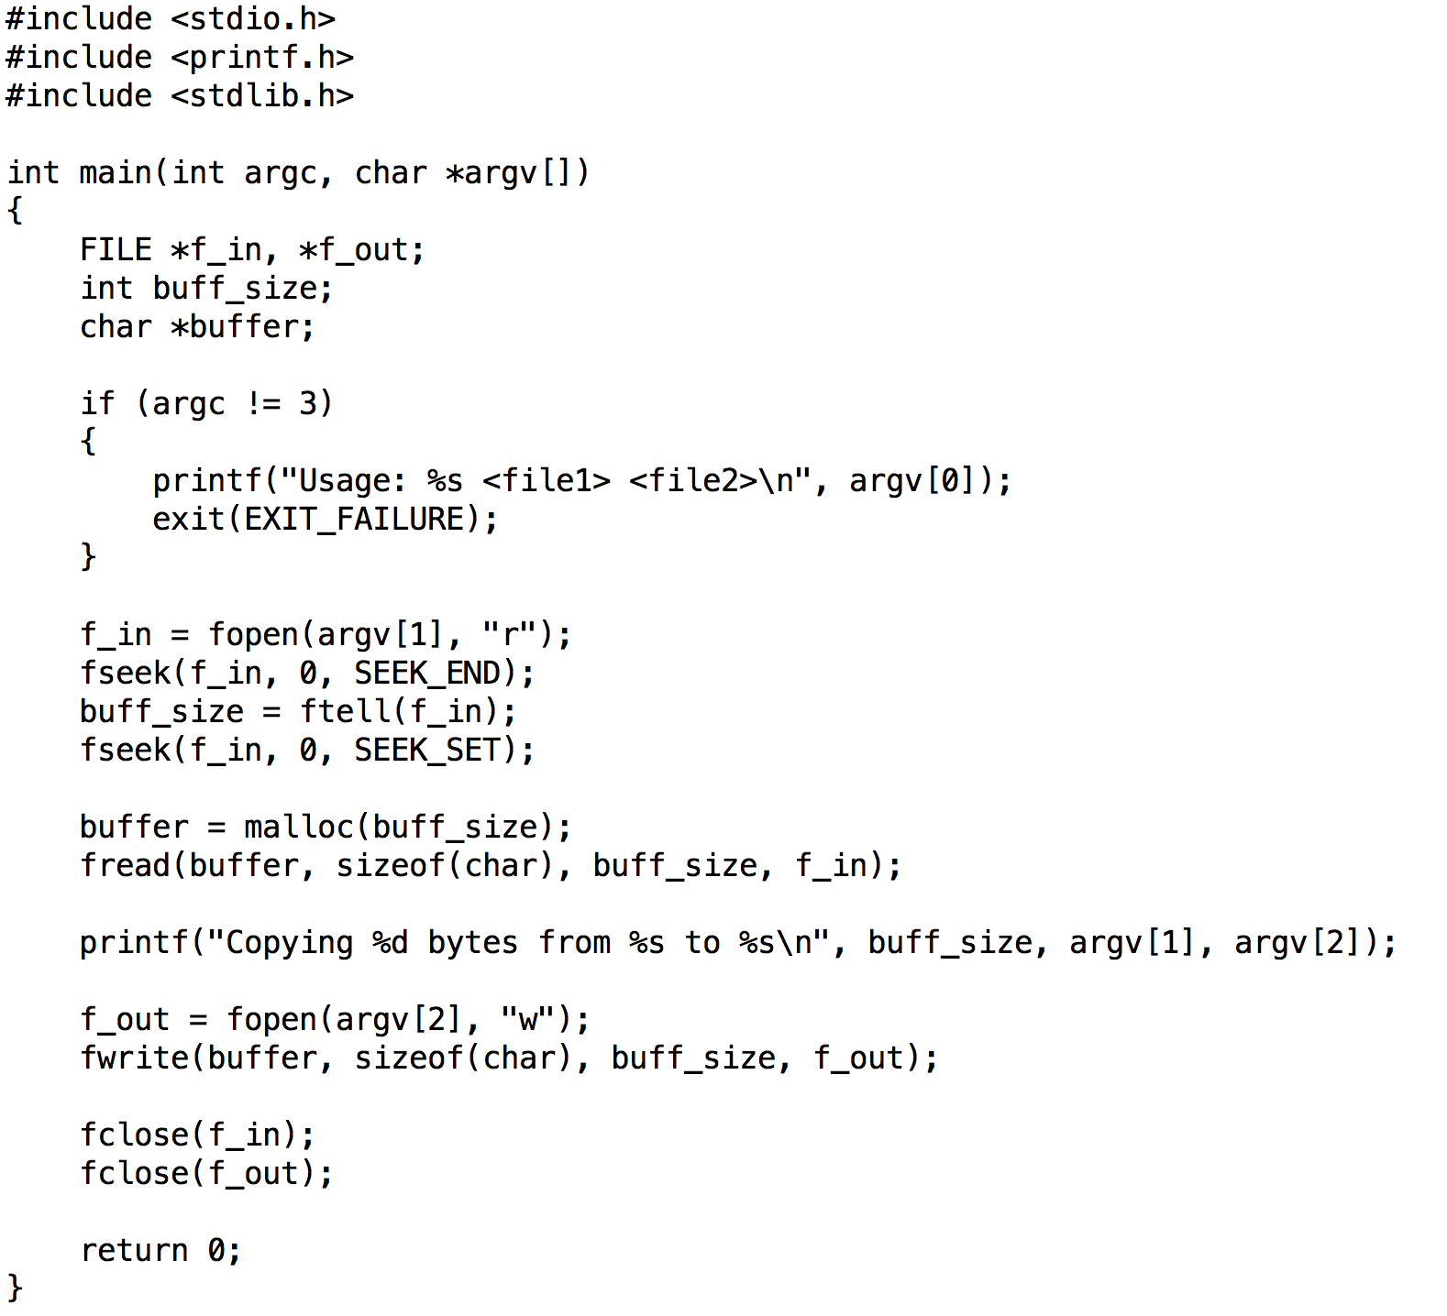

Slide 28
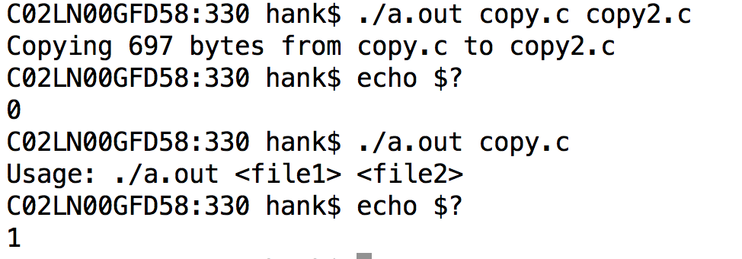
Return values in shells
$? is the return value of the last executed command

Slide 29
Printing to terminal and reading from terminal
In Unix, printing to terminal and reading from terminal is done with file I/O
Keyboard and screen are files in the file system!
(at least they were …)

Slide 30
Standard Streams
Wikipedia: “preconnected input and output channels between a computer program and its environment (typically a text terminal) when it begins execution”
Three standard streams:
stdin (standard input)
stdout (standard output)
stderr (standard error)
What mechanisms in C allow you to access standard streams?

Slide 31
printf
Print to stdout
printf(“hello world\n”);
printf(“Integers are like this %d\n”, 6);
printf(“Two floats: %f, %f”, 3.5, 7.0);

Slide 32
fprintf
Just like printf, but to streams
fprintf(stdout, “helloworld\n”);
→ same as printf
fprintf(stderr, “helloworld\n”);
prints to “standard error”
fprintf(f_out, “helloworld\n”);
prints to the file pointed to by FILE *f_out.

Slide 33
buffering and printf
Important: printf is buffered
So:
printf puts string in buffer
other things happen
buffer is eventually printed
But what about a crash?
printf puts string in buffer
other things happen … including a crash
buffer is never printed!
Solutions: (1) fflush, (2) fprintf(stderr) always flushed

Slide 34
Outline
Review
File I/O
Project 2B
Redirection
Pipes

Slide 35
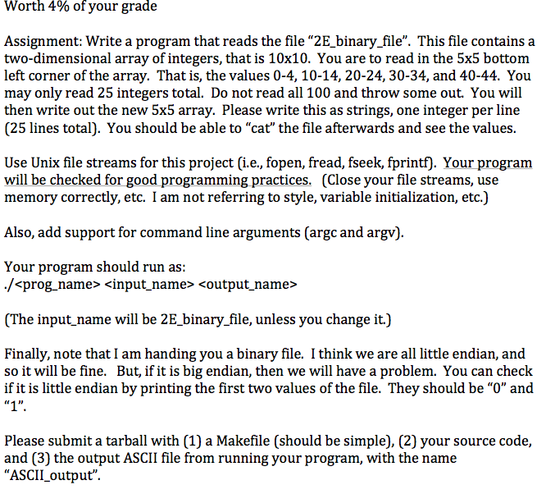
Project 2B
0
1

Slide 36
Outline
Review
File I/O
Project 2B
Redirection
Pipes

Slide 37
Unix shells allows you to manipulate standard streams.
“>” redirect output of program to a file
Example:
ls > output
echo “this is a file” > output2
cat file1 file2 > file3

Slide 38
Unix shells allows you to manipulate standard streams.
“<” redirect file to input of program
Example:
python < myscript.py
Note: python quits when it reads a special character called EOF (End of File)
You can type this character by typing Ctrl-D
This is why Python quits when you type Ctrl-D
(many other programs too)

Slide 39
Unix shells allows you to manipulate standard streams.
“>>” concatenate output of program to end of existing file
(or create file if it doesn’t exist)
Example:
echo “I am starting the file” > file1
echo “I am adding to the file” >> file1
cat file1
I am starting the file
I am adding to the file

Slide 40
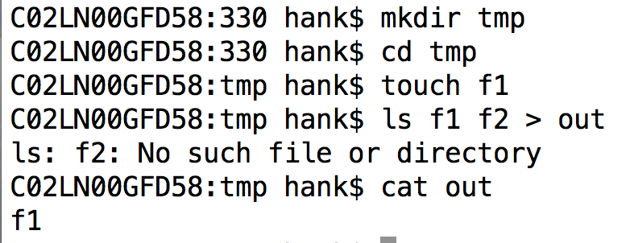
What’s happening here?
ls is outputting its error messages to stderr

Slide 41
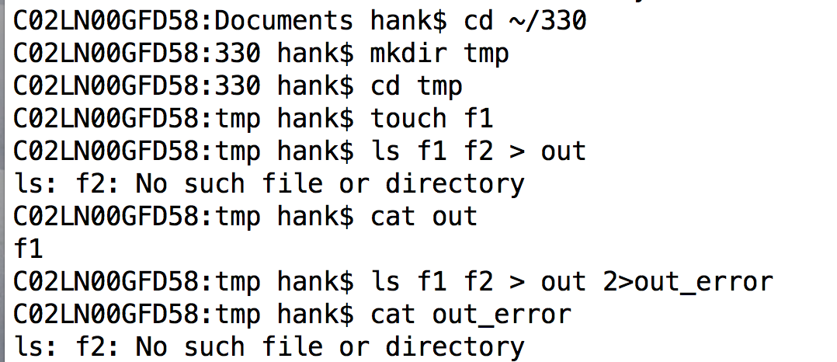
Redirecting stderr in a shell

Slide 42
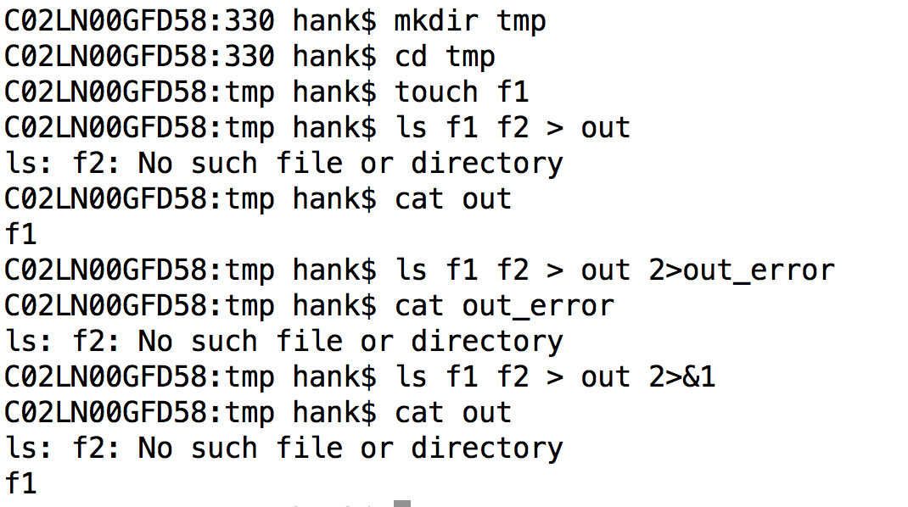
Redirecting stderr to stdout
Convenient when you want both to go to the same stream

Slide 43
Outline
Review
File I/O
Project 2B
Redirection
Pipes

Slide 44
c functions: fork and pipe
fork: duplicates current program into a separate instance
Two running programs!
Only differentiated by return value of fork (which is original and which is new)
pipe: mechanism for connecting file descriptors between two forked programs
Through fork and pipe, you can connect two running programs. One writes to a file descriptor, and the other reads the output from its file descript
Only used on special occasions.
(And one of those occasions is with the shell.)

Slide 45
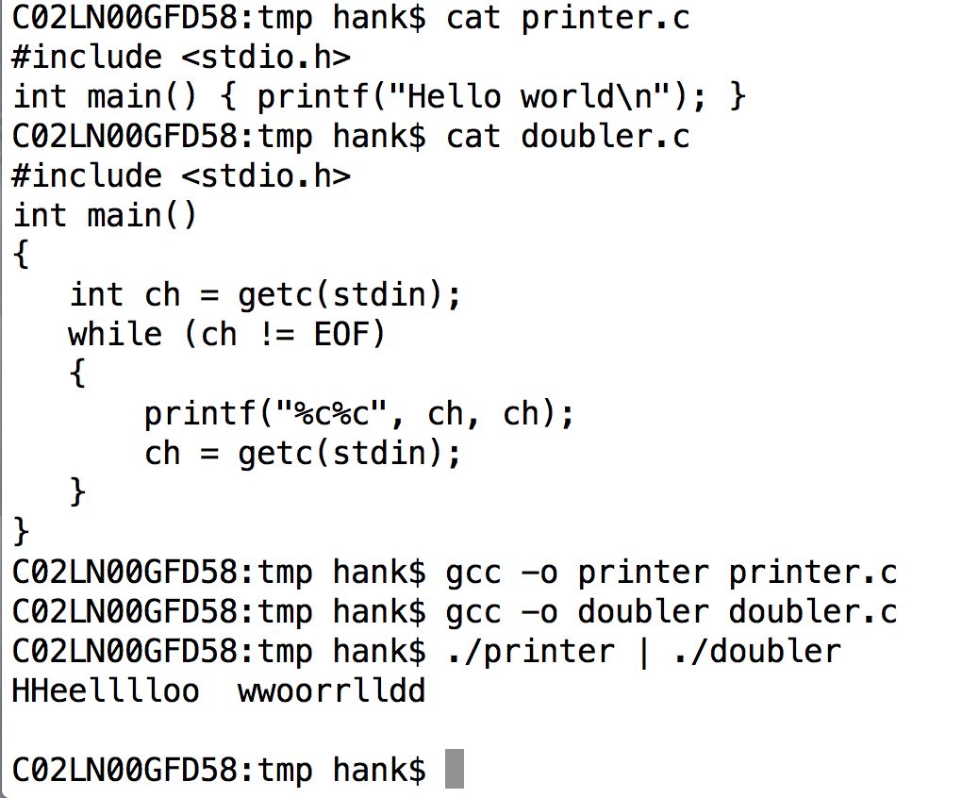
pipes in Unix shells
represented with “|”
output of one program becomes input to another program

Slide 46
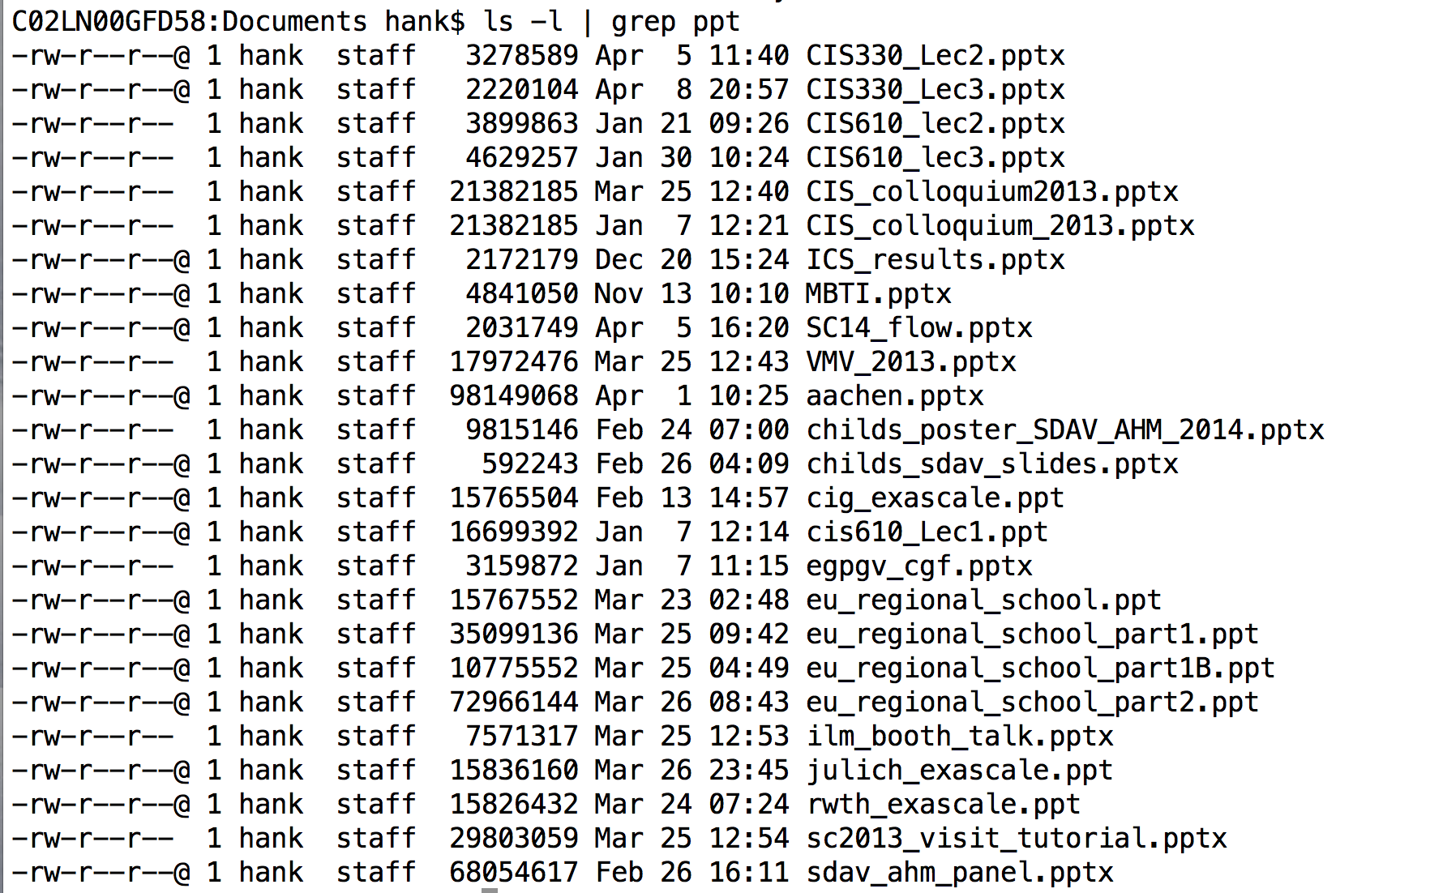
Very useful programs
grep: keep lines that match pattern, discard lines that don’t match pattern

Slide 47
Very useful programs
sed: replace pattern 1 with pattern 2
Sed ‘s/pattern1/pattern2/g’
s means substitute
g means “global” … every instance on the line
sed is also available in vi/vim
:%s/pattern1/pattern2/g (% means all lines)
:103,133s/p1/p2/g (lines 103-133)

Slide 48
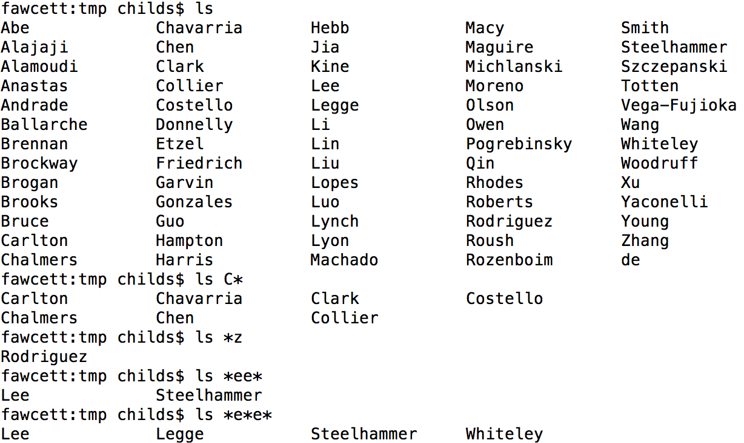
Wildcards
‘*’ is a wildcard with unix shells
‘?’ is a wildcard that matches exactly one character

Slide 49
Other useful shell things
‘tab’: auto-complete
esc=: show options for auto-complete
Ctrl-A: go to beginning of line
Ctrl-E: go to end of line
Ctrl-R: search through history for command
Up and down arrows to cycle through recent commands

