Slide 1
Mental Health in
Tech Survey
To analyze attitudes towards mental health and frequency of mental health disorders

Slide 2
Problem statement
The problem of | Identifying whether a patient should be treated of his/her mental illness
affects | Patients who genuinely need treatment
the impact of which is | To provide help & assistance to patients who need them
a successful solution would be | Able to predict if a patient should be treated of his/her mental illness using machine learning algorithms

Slide 3
Project components
      Data
        https://www.kaggle.com/osmi/mental-health-in-tech-survey
      Model
        Logistic Regression
        Decision Trees
        Random Forest
      Platform
        Databricks.com

Slide 4
Project Plan
Download data
Explore data
Clean and transform data
Model data
Evaluate model accuracy
Visualize results
Deliver demo Databricks.com notebook

Slide 5
Overview of the Dataset
AGE – Numerical
Rest are Categorical:
GENDER
COUNTRY
STATE
FAMILY_HISTORY: Do you have a family history of mental illness?
WORK_INTERFERE: If you have a mental health condition, do you feel that it interferes with your work?
NO_EMPLOYEES: How many employees does your company or organization have?
REMOTE_WORK: Do you work remotely (outside of an office) at least 50% of the time?
BENEFITS: Does your employer provide mental health benefits?
CARE_OPTIONS: Do you know the options for mental health care your employer provides?
WELLNESS_PROGRAM: Has your employer ever discussed mental health as part of an employee wellness program?
More..
Total Records: 1259

Slide 6
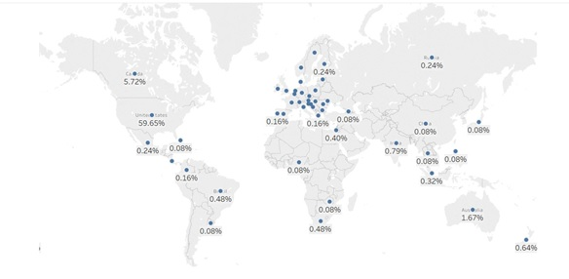
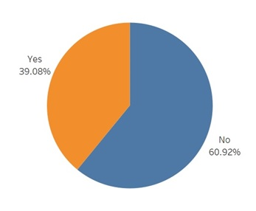
Exploring the data
Country Wise Distribution
Family History of mental illness

Slide 7
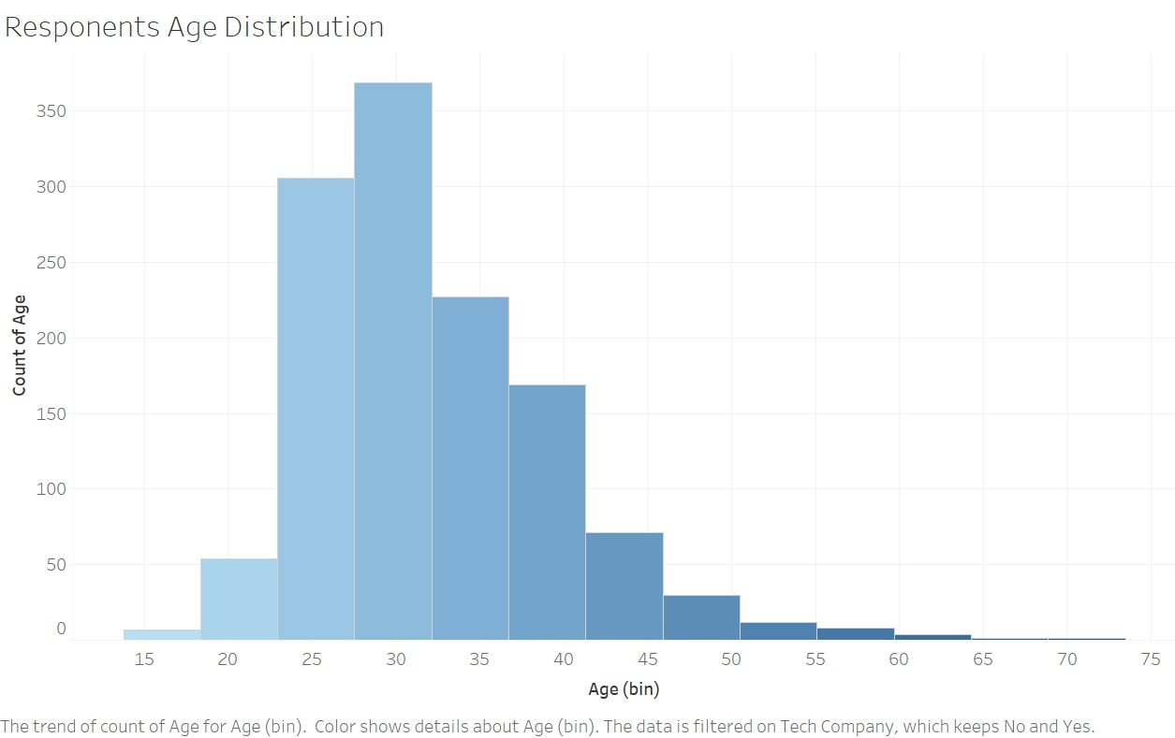
Exploring the data

Slide 8
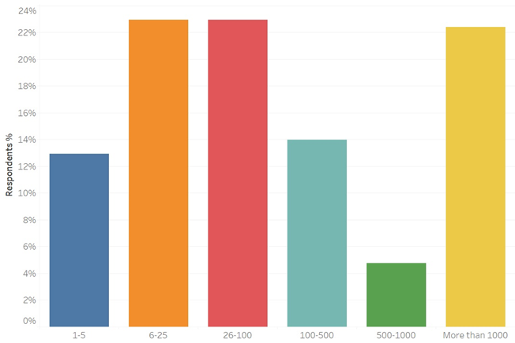
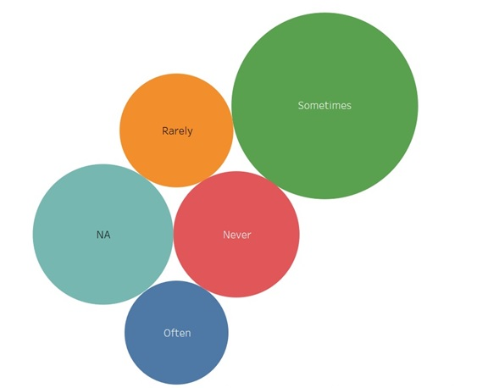
Exploring the data
Emp. Count with company size
Does mental health condition interferes with work

Slide 9
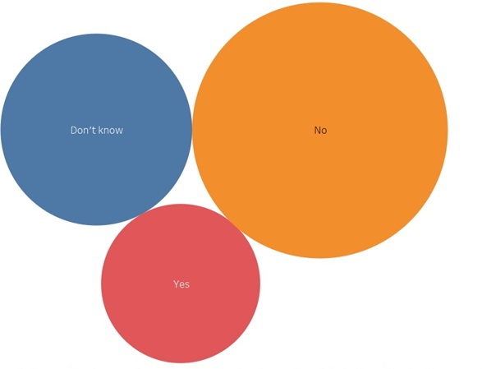
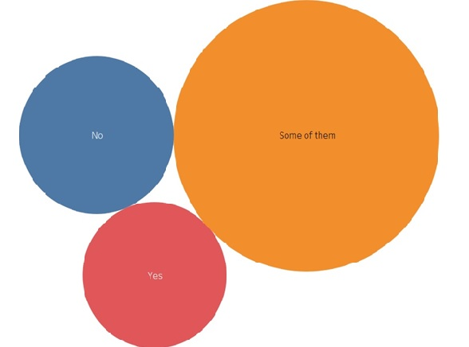
Exploring the data
Does employer provide resources for mental health issue
Willing to discuss mental issue with co-worker

Slide 10
Exploring the data
SELF_EMPLOYED: 88% of the values are NO and also this column is not making an impact on our target variable since its not comparable
TECH_COMPANY: This survey was primarily conducted in the tech workspace so this column is biased
WELLNESS_PROGRAM: This column is similar to BENEFITS and CARE_OPTIONS and also majority of the values are NO and Don’t know
PHYS_HEALTH_CONSEQUENCE: This column is not making an impact on our target variable, also majority of the values are NO and Don’t know
SUPERVISOR: We have considered COWORKERS column and SUPERVISOR comes under the bigger umbrella of COWORKERS
MENTAL_HEALTH_INTERVIEW, PHYS_HEALTH_INTERVIEW, MENTAL_VS_PHYSICAL, OBS_CONSEQUENCE: These columns is not making an impact on our target variable as it is not relevant in our scenario

Slide 11
Steps followed for Data Cleaning
Fields like "TIMESTAMP" & COMMENTS" are textual fields and not important, hence we removed them.
Removed AGE outliers. Considered age range between 0 to 123 years
Categorized GENDER to 3 category Male, Female and Transgender

Slide 12
Steps followed for Data Processing
For analysis we convert categorical variables to numeric variables by Category Indexing or One-Hot Encoding
StringIndexer to encode our labels to label indices
Vector Assembler to combine all the feature columns into a single vector column
Run our stages as a Pipeline

Slide 13
Fit and Evaluate Model
These are the general steps we will take to build our models:
Create initial model using the training set
Tune parameters with a ParamGrid and 5-fold Cross Validation
Evaluate the best model obtained from the Cross Validation using the test set

Slide 14
Logistic Regression
We perform Elastic-Net Regularization with Logistic Regression
Use BinaryClassificationEvaluator to evaluate our model
On the test set we measure accuracy and evaluate the model
Logistic Regression model is 89% accurate

Slide 15
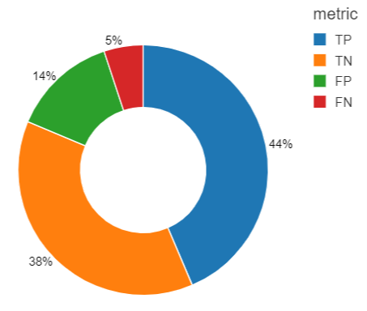
Model Evaluation: Logistic Regression
Precision: 0.761904761905
Recall: 0.896
F1Score: 0.823529411765

Slide 16
Decision Trees
After logistic Regression we use decision tree model
We create a model with number of nodes = 15 and depth = 3
On the test set we measure accuracy and evaluate the model
Decision tree model is 81% accurate

Slide 17
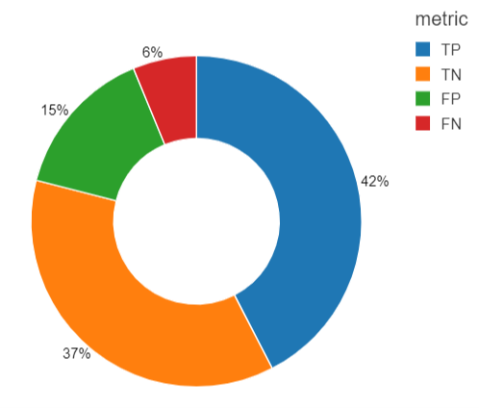
Model Evaluation: Decision Trees
Precision: 0.741496598639
Recall: 0.872
F1Score: 0.801470588235

Slide 18
Random Forest
Random Forest is a collection of decision tree
It aggregates decision tree results into one final result
On the test set we measure accuracy and evaluate the model
Random Forest model is 87.8% accurate

Slide 19
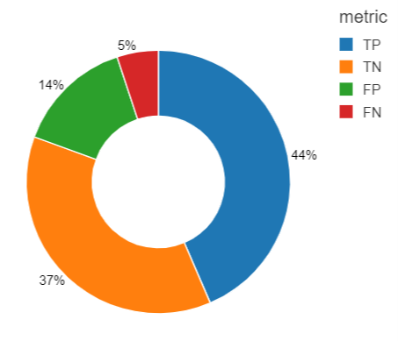
Model Evaluation: Random Forest
Precision: 0.751677852349
Recall: 0.896
F1Score: 0.817518248175

Slide 20
Conclusion
According to the results obtained from the dataset we conclude that Logistic Regression will be the best model to predict whether a respondent should be consult for his/her mental illness.

Slide 21
THANK YOU

