Slide 1
Mid Evaluation Report

Slide 2
Cache Contention Aware Scheduling In CMP – SMT Systems
PROJECT TITLE

Slide 3
Group Details
TEAM MEMBERS
Niranjan G S (B110773CS)
Rony Joshy (B110419CS)
Blesson Andrews Varghese (B110087CS)
GUIDE
Mr. Saidalavi Kalady, CSED, NITC

Slide 4
Evolution Of Computers
Demand for increased computational power led to significant improvements in Processor Architecture
Driving Goals
Higher CPU utilization
a fair share of the CPU to all users
Faster Response time despite high load

Slide 5
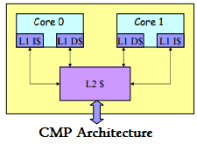
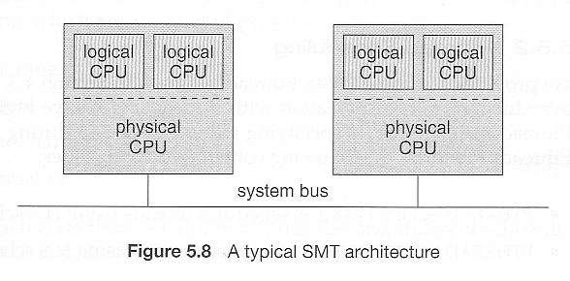
CMP- SMT Architecture
Extracts maximum instruction level and thread level parallelism
A single physical processor core acts as a number of logical processors. Each logical core will be executing a single thread
Chip Multi Processing refers to computing with multiple cores integrated into a single chip.

Slide 6
Resource sharing in CMP-SMT Architecture
resources shared between different cores in CMP-SMT
contention for shared resources cause Overheads
Overheads result in Performance Degradation.
Execution time of a thread greatly vary depending on threads run on other cores of same chip.
Co-run Degradation is the increase in execution time of a process when it shares resources with a co-runner, relative to running solo

Slide 7
Cache Contention
Cache is one among the resources shared between different cores.
Cache contention is one among the major causes of performance degradation
Resolving cache contention is one of the basic functions of the Operating System
Scheduling, as a tool, can be used to reduce this to some extent

Slide 8
Cache Contention Aware Scheduler
Aimed at providing better throughput and faster response time
Any contention aware scheduler consist of two parts
Classification scheme : Helps in identifying which applications should and should not be scheduled together
Scheduling Policy : Assign thread to cores, given their classification.
Our project aims at enabling CFS scheduler to dynamically detect cache contention and act accordingly

Slide 9
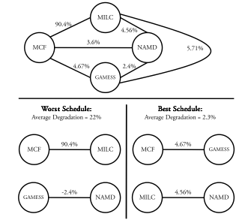
Jiang’s Contention aware scheduler
Classification Scheme: Based on co-run degradation
Scheduling Policy :
A graph with tasks as nodes and sum of co-run degradation as edges between them
Minimum weight Perfect matching in this graph is chosen as the perfect scheduling assignment

Slide 10
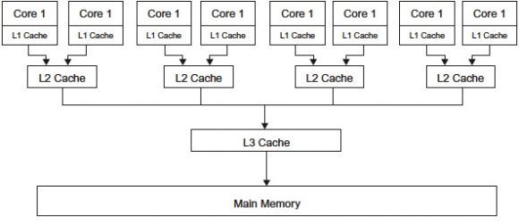
Cache Hierarchy
Different levels of cache may be shared between different cores
In the model in which we consider,
Cache is organized in three levels: L1, L2 and L3
L1 and L2 cache are local to each processor core
L3 cache is shared by all cores

Slide 11
Problem Statement
“Designing a scheduling policy that enables CFS scheduler to schedule threads based on miss rate factor of co-run threads without compromising interactivity and to show that enhanced scheduler has improved the performance of overall system.”

Slide 12
Proposed Scheduling Algorithm

Slide 13
Classification Scheme
L2 cache miss rate is used
For a task t , relative miss rate with other tasks and overall miss rates are stored
Key Idea
Relative miss rates between co-running tasks should be minimized
Two tasks with high overall miss rates should not be scheduled simultaneously on same physical cores

Slide 14
Scheduling Policy
To schedule tasks t on logical processor C0 , We consider the following factors
Relative miss rate with task on C1 [higher, -]
Relative miss rate with task on C2, C3, …C7 [higher, -]
Relative miss rate with current task to be preempted from C1 [higher ,-]
Affinity of t to P0 [if yes, +]
Task that ran before current task on P0, [if t, +]
Cache use of t and task running on C1 [if high, -]
C0
C1
C2
C3
C4
C5
C6
C7
P0
P1
P2
P3
L2
L2
L2
L2
L3

Slide 15
Scheduling Policy
For task t,
Discouragement factor =
f1 relative miss rate wrt task running on the sibling logical core
+ f2 sum of relative miss rates wrt tasks running on other physical cores
+ f3 relative miss rate wrt the current task to preempted from Ck
- lf ( 1, if this is the task that ran immediately before the current task ; 0, otherwise )
- af (1, if this task has affinity with current logical core ; 0, otherwise )
+ uf (1 if this task and task in sibling logical core have high overall miss rate;0 otherwise)
f1 - Discouragement factor for L2 cache contention
f2 - Discouragement factor for L3 cache contention
f3 - Discouragement factor for L2 contention relative
to previous task
lf - Locality Factor
af - Affinity Factor
uf - Cache Use Factor
`

Slide 16
Scheduling Policy
Task with minimum discouragement factor is the best one according to our classification scheme
In every k calls to the scheduler,
Tasks with minimum discouragement factor is scheduled k-1 times
Task returned by default Linux scheduler is scheduled kth time
We calculate discouragement factor only for tasks within a fixed window size w in the CFS red-black tree

Slide 17
Information Storage
A data structure to store pair-wise relative cache miss rates is required. A triangular matrix with nC2 entries is a suitable candidate
A linear array can be used to store overall miss rates of all tasks
The last task preempted from each core must be stored

Slide 18
Future Work
Coefficients for various terms in discouragement factor must be determined
Value of k and w should be determined
Data structure for storage should be optimized
Kernel Module should be implemented and tested against standards

Slide 19
References
Title
Authors
BOOKS
Linux Kernel Development, Third Edition
Understanding the Linux Kernel, Third Edition
Linux System Programming, Second Edition
Robert Love
Daniel P Bovet & Marco Cesati
Robert Love
Blagodurov S, Zhuravlev S. and Fedorova
Ergeny Bplptin
Cho S. AND Jin L
IEEE
Contention-aware scheduling on multi core systems- ACM Trans. Comput. Syst. 28, 4, Article 8 (December 2010),
Chip Multi Processor, VLSI architecture, Seminar 048879
Managing distributed, shared l2 caches through OS-level page allocation

Slide 20
References
Title
Authors
IEEE
Improving performance isolation on chip multiprocessors via an operating system scheduler.
Thread clustering: sharing-aware scheduling on smp- cmp-smt multiprocessors.
www.kernel.org/doc/Documentation/scheduler/sched-design-CFS.txt
http://home.eng.iastate.edu/~zzhang/courses/cpre585-f04/slides/Lecture25.pdf
http://queue.acm.org/
http://www.edn.com/
Fedorova A, Seltzer M. L and Smith
Tam, D., Azimi, R. and Stumm,
M. (2007)
Web

Slide 21
Thank you….

