Slide 1
TECH WAVE 2026 · AI HACKATHON MAURITIUS · TRACK 6
Finding diabetes earlier, in the clinic, in three languages
An explainable risk-screening tool for primary care in Mauritius
Your Team Name
Member 1, Member 2, Member 3

Slide 2
THE PROBLEM
Too many people find out too late
20.1%
28.2%
2 min
of adults (20-79) in Mauritius live with diabetes (IDF 2024)
of them are undiagnosed, about 61,000 people (IDF 2024)
is all a nurse can spare for screening in a busy clinic
• Late diagnosis means complications (kidney, eye, heart, foot) that are costly and avoidable.
• A screening aid only helps if clinicians trust it: it must show WHY a person is flagged.
• Source: IDF Diabetes Atlas, Mauritius page, https://diabetesatlas.org/data-by-location/country/mauritius/
Tech Wave 2026 · Track 6 · Prototype: not a diagnosis, not a replacement for clinical judgement

Slide 3
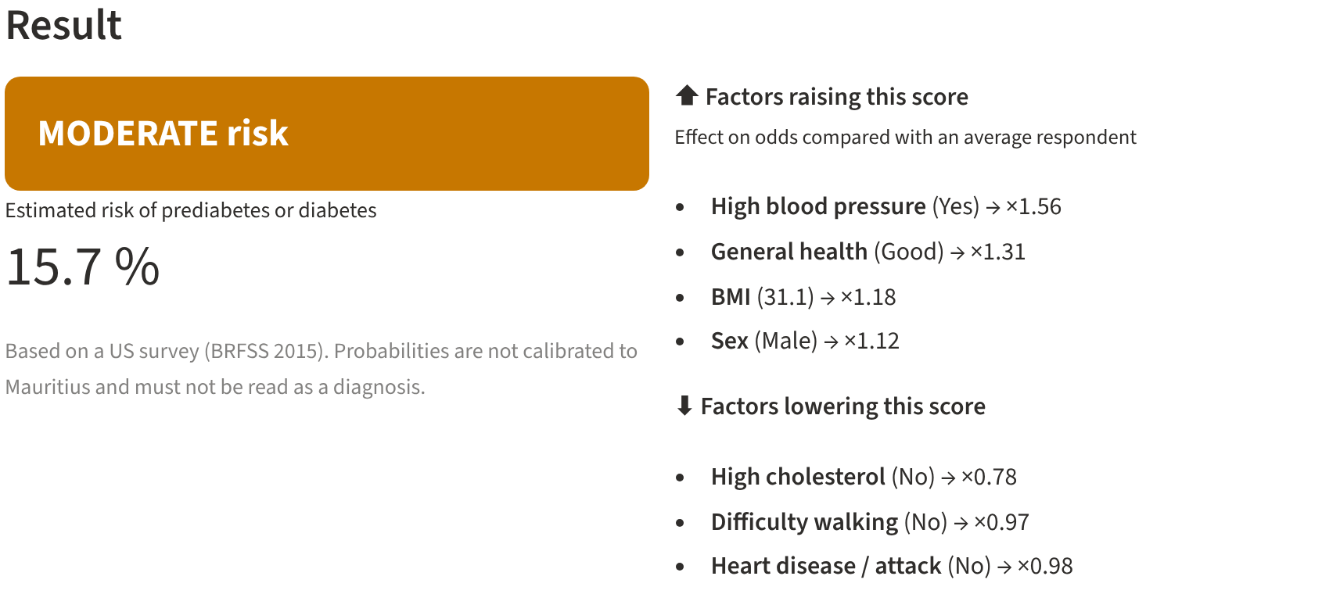
OUR SOLUTION
16 questions, one risk band, clear reasons, a follow-up date
1 Ask
16 simple questions a nurse can answer with the patient: no blood test.
2 Explain
LOW / MODERATE / HIGH band plus the factors that raised or lowered the score.
3 Follow up
Suggested re-screen or blood-test date, exported as a calendar reminder.
Live screenshot of the prototype (example patient, English interface)
• English, Français and Kreol Morisien in one tap. Runs on the device: nothing is stored or sent.
Tech Wave 2026 · Track 6 · Prototype: not a diagnosis, not a replacement for clinical judgement

Slide 4
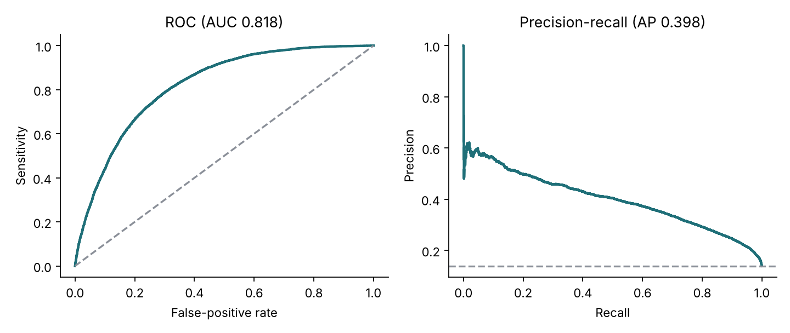
THE MODEL
A transparent model that holds its own against a black box
0.82
80%
95%
ROC-AUC, held-out test set
of true cases flagged at the screening threshold
of people NOT flagged are truly clear (NPV)
• Logistic regression on 16 questions; trained on the real 14% prevalence so risks are calibrated.
• Benchmark: LightGBM on all 21 variables reaches ROC-AUC 0.83 vs our 0.82; a negligible price for full transparency.
• Data: CDC BRFSS 2015, 253,680 survey responses (public). Thresholds tuned on a separate validation set.
Tech Wave 2026 · Track 6 · Prototype: not a diagnosis, not a replacement for clinical judgement

Slide 5
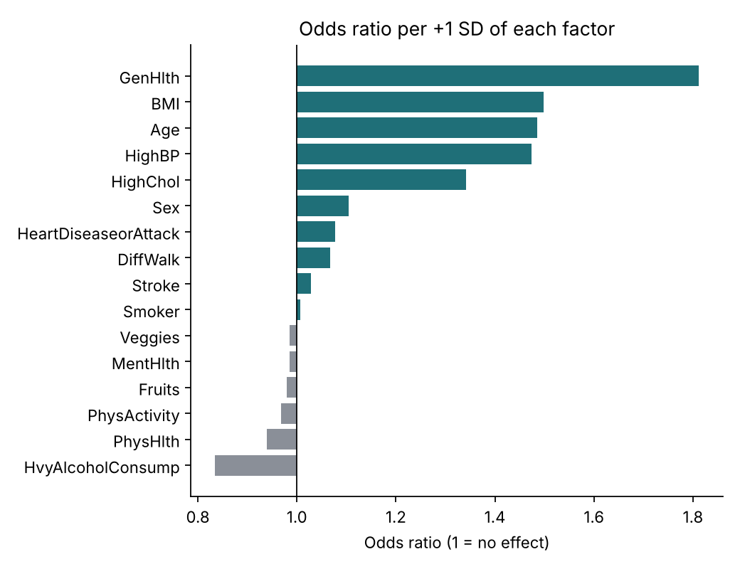
TRUST
Every score comes with its reasons
• Each factor shows its effect on the person's odds versus an average respondent (for example, ×1.4).
• Clinicians can check the logic against what they know: blood pressure, BMI, age and general health lead, as expected.
• The whole model is a short JSON file anyone can read: no hidden layers, no black box.
• A model card inside the app shows accuracy, limits and the fairness audit.
Tech Wave 2026 · Track 6 · Prototype: not a diagnosis, not a replacement for clinical judgement

Slide 6
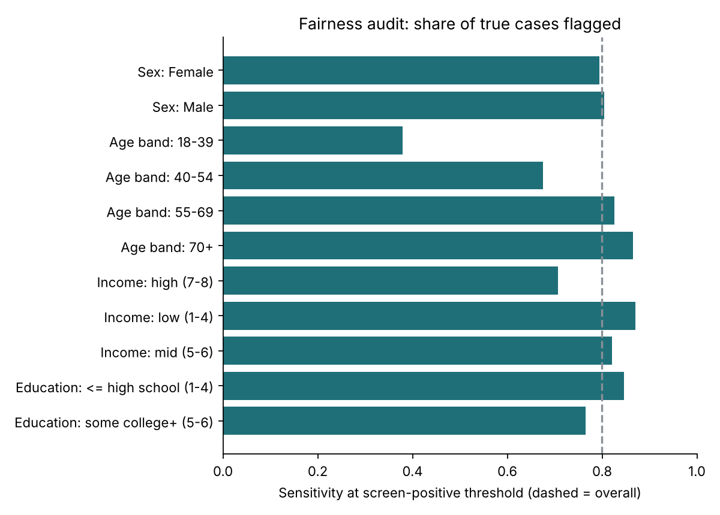
THE HARD PART
Fairness and privacy by design
• Income, education and US insurance variables are NOT predictors, so the tool cannot score people on social status.
• We still audit by sex, age, income and education on the test set.
• Sexes are treated alike (sensitivity gap 1 points). Age is the big gap: only 38% of true cases aged 18-39 are flagged vs 87% at 70+, because young people have low base risk. We say so and advise clinical judgement for younger adults.
• Honest limit: the data has no ethnicity field, so Mauritian community fairness must be tested on local data before any deployment.
• Privacy: no accounts, no storage, no network calls with patient data; all calculation is local.
Tech Wave 2026 · Track 6 · Prototype: not a diagnosis, not a replacement for clinical judgement

Slide 7
IMPACT AND DEPLOYMENT
From prototype to clinic: a safe path
• Who benefits: patients found earlier, nurses and GPs who get a fast second opinion, and public health planners who can target follow-up.
• Step 1 (now): open-source prototype, public data, demo for clinicians.
• Step 2: validate and recalibrate on Mauritian data with ethics approval and the Ministry of Health, including community-level fairness checks.
• Step 3: pilot in a few primary-care centres, measuring cases found and follow-ups completed.
• Risks we manage: over-reliance (clear prototype banner), false reassurance (a LOW band still suggests re-screening), over-referral (tunable threshold), language errors (native-speaker review).
Tech Wave 2026 · Track 6 · Prototype: not a diagnosis, not a replacement for clinical judgement

Slide 8
SUMMARY
What we built, and what we ask
• A calibrated, explainable diabetes risk model plus a trilingual screening tool with follow-up reminders.
• Built on public data only; no real patient data was used.
• Fully reproducible: public repository, one command to train, one command to run.
• Ask: clinical partners to review the questions and thresholds, and access to de-identified local data to validate.
• Team: Your Team Name · Member 1, Member 2, Member 3
Tech Wave 2026 · Track 6 · Prototype: not a diagnosis, not a replacement for clinical judgement

