Slide 1
New York City Airbnb Data Analysis
Blessy, Dawit, Yohannes

Slide 2
Objective
How the Prices of Room_type vary by Location?
How populated Airbnb in NYC localities?
What are the different types of rooms in NYC? Do they vary by neighborhood?
Are the demand and prices of the rentals correlated?
Most commonly used word in comments
Analyse the comments

Slide 3
Introduction
Airbnb
online marketplace for arranging or offering lodging, primarily homestays, or tourism experiences.
provides a platform for hosts to accommodate guests with short-term lodging and tourism-related activities

Slide 4
DataSet
Since 2008, guests and hosts have used Airbnb to expand on traveling possibilities and present more unique, personalized way of experiencing the world. This dataset describes the listing activity and metrics in NYC.
Information about hosts, geographical availability, necessary metrics to make predictions and draw conclusions.

Slide 5
Exploratory Data Analysis (EDA)
Understanding the data sets by summarizing their main characteristics often plotting them visually.
Data profiling :- summarizing the dataset through descriptive statistics
Feature Selection
Correlation Identification
Sentiment Analysis
Most used word count
Spatial Data Analysis

Slide 6
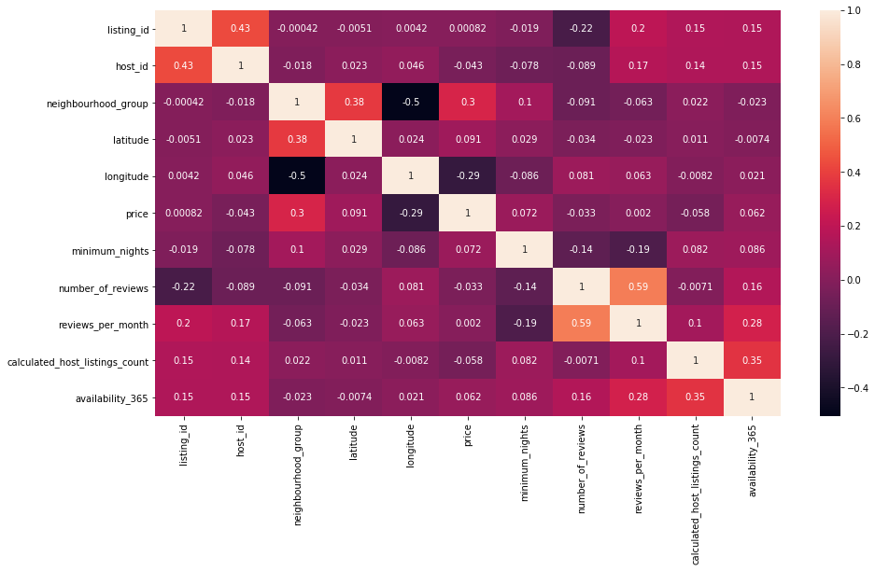

Slide 7
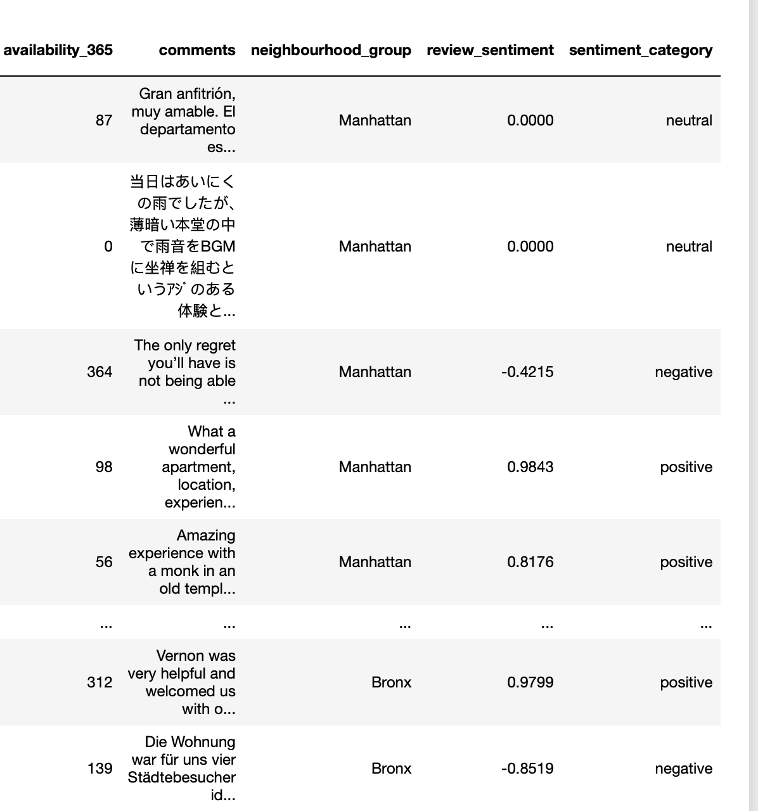
Analysis and Visualizations
very nice neighborhood, close enough to a train, comfortable bed and clean home over all. Jenny’s cat is very sweet and fun to play with, but wants to sleep in bed with you and won't shut up unless such privileges are granted . . .Meyow meyow meyow.

Slide 8
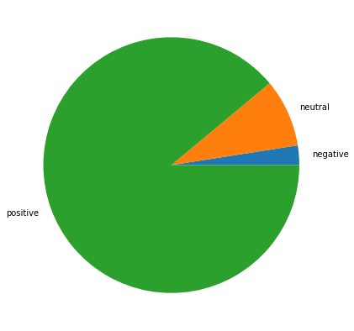
Sentiment analysis shows:
1547
445
16011

Slide 9
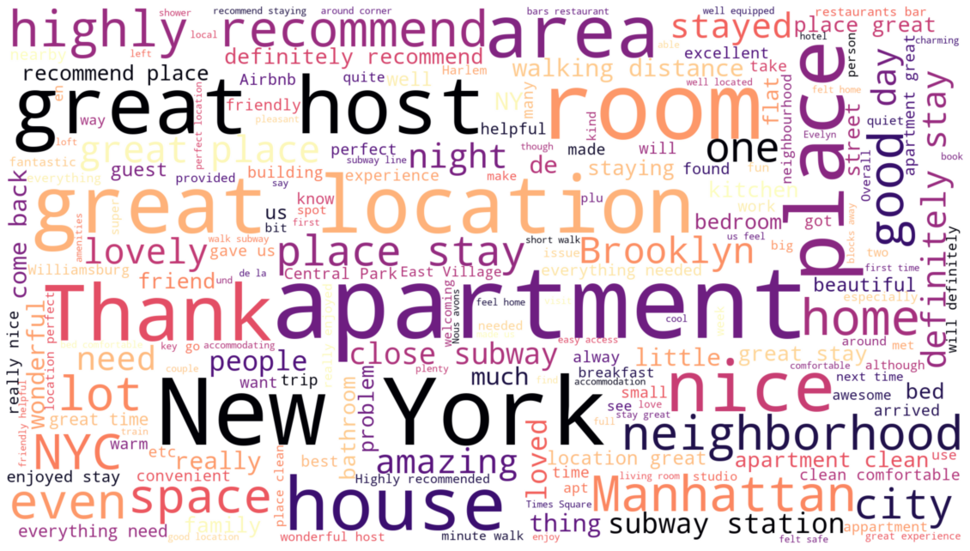
Notes:
Comments made by the customers

Slide 10
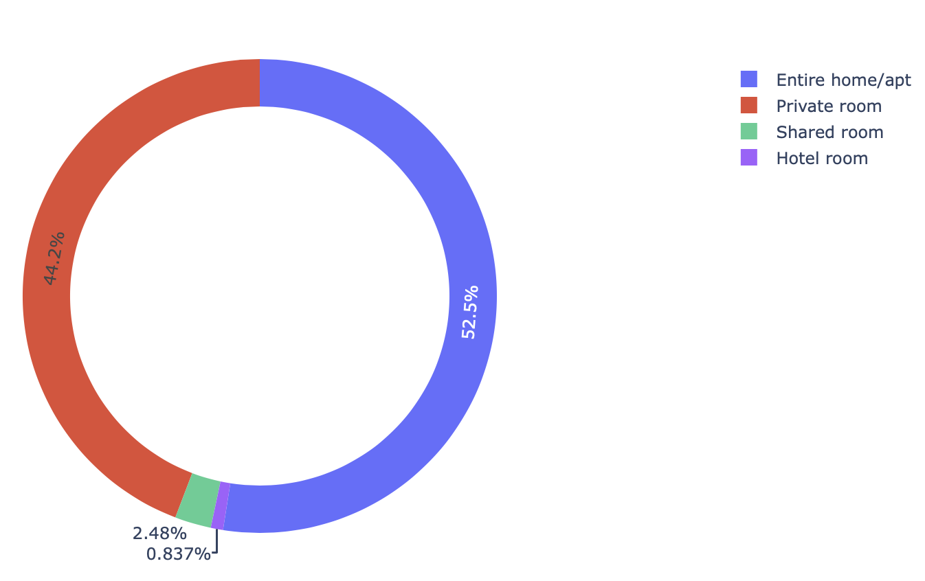
Analysis and Visualizations

Slide 11
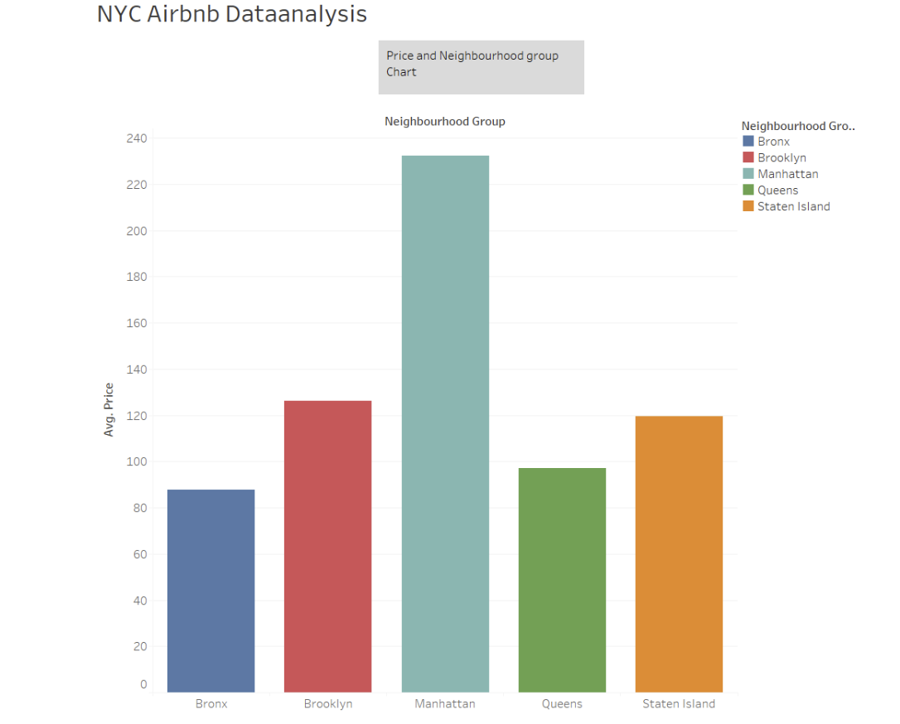
Price vs Neighbourhood group

Slide 12
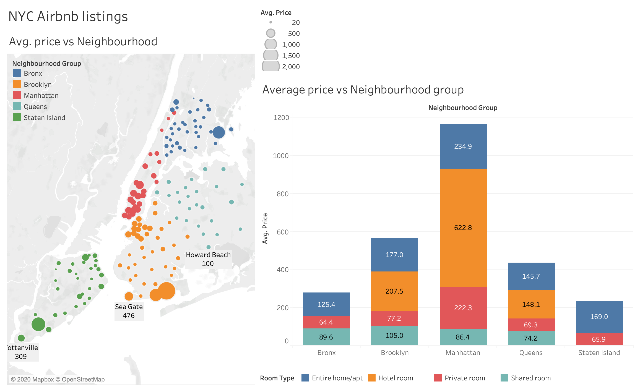

Slide 13
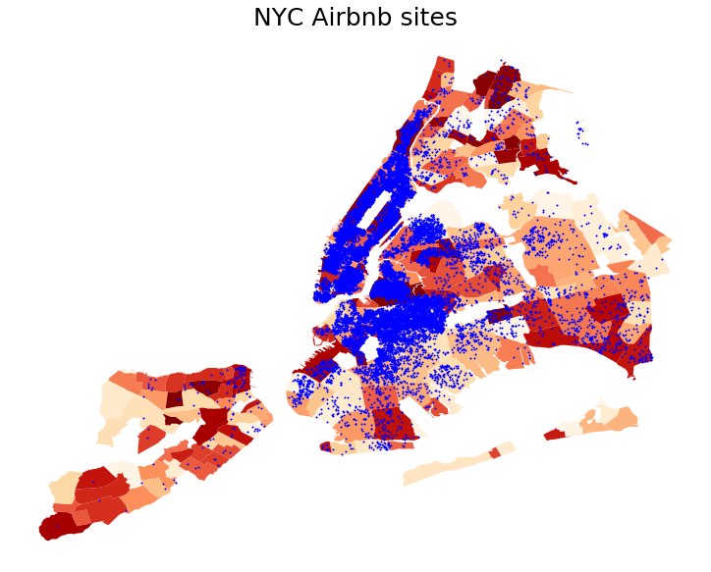
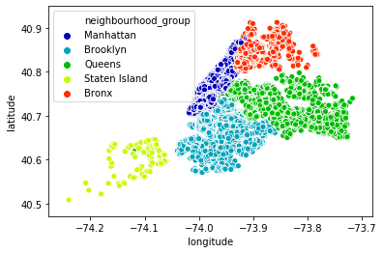

Slide 14
Concluding remarks
Price seems to be correlated with longitude, implying that one can expect variation of prices as position in NYC moves West.
In a similar vein, latitude also indicate to have effect on the price.
Price is negatively correlated with number of reviews and reviews per month. From which one can safely infer that prior reviews could impact the prices to some extent

Slide 15
...cont’d
There seems to be high demand for airbnb services in and around Manhattan, which is the most expensive borough of the city, and we can see this is located on the west side of the city. This figure also goes in line with our conclusion that average prices are high around western part of the city.
Sentiment analysis, indicates that customers overwhelmingly approve their hosts.
Observation on sentiment analysis:
We note that comments left by languages other than english are seen to be categorized as negative (German/Dutch) or neutral (Japanese).

Slide 16
Thank you for your attention

