Slide 1
FSD MINI PROJECT | 2026–2027
STUDENT SMART
CALCULATOR
STUDENT TOOL
87.50
+
−
×
A simple student utility application
built with React.js
7
8
9
4
5
6
PRESENTED BY
Blessy Valaparla
1
2
3
B.Tech – Computer Science and Engineering
Potti Sriramulu Chalavadi Mallikarjuna Rao
Engineering and Technology
CALCULATE
REACT.JS • JAVASCRIPT • CSS

Slide 2
Introduction
Overview of the project
Student Smart Calculator is a simple web application developed using React.js. It brings four useful calculation modes into one interface.
Single interface
Easy input
Quick result
Select a calculation mode from the dropdown menu.
Enter two numeric values in the input fields.
Click Calculate to display the result on the page.
The application is designed to be simple, beginner-friendly and easy to demonstrate.
02

Slide 3
Aim and Objectives
Purpose of the project
Aim
To develop a simple React-based calculator that performs basic and student-related calculations in one application.
Objectives
• Provide Basic, Percentage, CGPA and Attendance calculation modes.
• Accept two numeric inputs from the user.
• Perform the selected calculation when the Calculate button is clicked.
• Display the result with two decimal places.
• Show a validation message when inputs are empty or the second value is zero.
03

Slide 4
Proposed System
How the solution works
The proposed system uses one React interface for four types of calculations.
Basic Calculator
Percentage Calculator
Adds the two entered values.
Formula: x + y
Calculates x as a percentage of y.
Formula: (x / y) × 100
CGPA Calculator
Attendance Calculator
Finds the average of two values.
Formula: (x + y) / 2
Calculates attendance percentage.
Formula: (x / y) × 100
Note: In this code, CGPA is the simple average of the two entered values.
04

Slide 5
Technology and Tools Used
Software and technologies
React.js
JavaScript
CSS
Builds the user interface and manages component state.
Handles input values and calculation logic.
Controls page colours, spacing and calculator layout.
VS Code
Git Bash
Web Browser
Used to write and edit App.jsx and App.css.
Used to run setup and development commands.
Used to view and test the running application.
Main files: src/App.jsx | src/App.css
05

Slide 6
Project Structure and Working
Files and application flow
student-calculator/
src/
App.jsx // React code and calculations
App.css // Design and styling
package.json
index.html
Application working
1
Enter the first and second values.
2
Choose Basic, Percentage, CGPA or Attendance.
3
Click the Calculate button.
4
React checks the inputs and performs the calculation.
The useState hook stores both inputs, the selected type and the result.
5
The result is displayed on the screen.
06

Slide 7
Source Code – App.jsx (Part 1)
React component, state and calculation logic
import { useState } from "react";
import "./App.css";
function App() {
const [a, setA] = useState("");
const [b, setB] = useState("");
const [type, setType] = useState("Basic");
const [result, setResult] = useState("");
function calculate() {
let x = Number(a), y = Number(b), r;
if (a === "" || b === "" || y === 0) {
setResult("Enter valid values");
return;
}
if (type === "Basic") r = x + y;
else if (type === "Percentage") r = x / y * 100;
else if (type === "CGPA") r = (x + y) / 2;
else r = x / y * 100;
setResult(r.toFixed(2));
}
07

Slide 8
Source Code – App.jsx (Part 2)
User interface and export
return (
<div className="app">
<h2>Student Smart Calculator</h2>
<select onChange={e => setType(e.target.value)}>
<option>Basic</option>
<option>Percentage</option>
<option>CGPA</option>
<option>Attendance</option>
</select>
<input type="number" placeholder="First value"
onChange={e => setA(e.target.value)} />
<input type="number" placeholder="Second value"
onChange={e => setB(e.target.value)} />
<button onClick={calculate}>Calculate</button>
<h3>Result: {result}</h3>
</div>
);
}
export default App;
08

Slide 9
Source Code – App.css
Application styling
body {
background: lightblue;
font-family: Arial;
}
.app {
background: white;
width: 300px;
margin: 80px auto;
padding: 20px;
text-align: center;
border-radius: 10px;
}
input, select, button {
width: 90%;
padding: 10px;
margin: 8px;
}
button {
background: blue;
color: white;
border: none;
}
Page background
Light blue background and Arial font.
Calculator box
White card, centred with padding and rounded corners.
Controls
Inputs, dropdown and button share spacing and width.
09

Slide 10
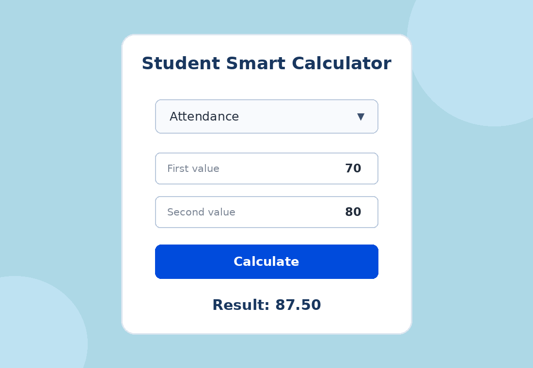
Expected Output
Sample browser output based on the current React code
Example: Attendance mode with First value = 70 and Second value = 80 gives Result = 87.50.

Slide 11
Testing
Test cases used to check the four calculator modes and input validation
Test | Mode / Input | Expected output | Purpose
1 | Basic: 20, 10 | 30.00 | Check addition
2 | Percentage: 45, 50 | 90.00 | Check percentage
3 | CGPA: 8, 9 | 8.50 | Check average
4 | Attendance: 70, 80 | 87.50 | Check attendance %
5 | Empty input / second value 0 | Enter valid values | Check validation
Validation message: “Enter valid values” appears when either input is empty or the second value is zero.
Note: Percentage and Attendance display the numeric percentage without a % symbol in the current code.

Slide 12
Conclusion and Future Scope
Project outcome and improvements
Conclusion
Future Scope
The Student Smart Calculator is a simple React application that performs four types of calculations in one interface. It demonstrates React state, event handling, conditional statements and CSS styling.
• Add a reset or clear button.
• Improve validation for negative and invalid values.
• Add advanced CGPA calculation using credits.
• Display result labels and percentage symbols.
THANK YOU
Questions?
11

