Slide 1

Removing <unk>
Brian Lester
ML Research Engineer
Trove
Notes:
ML engineer at Trove working on NLP as it applies to Email
--
Talk about Input Representation and the assumptions made.
--
http://www.cs.cmu.edu/~lingwang/papers/emnlp2015.pdf

Slide 2
<unk>
A token to handle uncommon words
You need several examples to learn a good embedding
Keeps the vocabulary smaller
Notes:
Unk is a strategy to help NLP systems handle the fact the there are a lot of words.
--
In Deep learning there are lot of parameters to learn so we unk more aggressively.

Slide 3
Removes a lot
the u.s. is one of the few industrialized nations that does n't have a higher standard of regulation for the smooth <unk> fibers such as <unk> that are classified as <unk> according to <unk> t. <unk> a professor of <unk> at the university of vermont college of medicine
The game takes place during the Second Europan War . Gallian Army Squad 422 , also known as " The Nameless " , are a penal military unit composed of criminals , foreign <unk> , and military offenders whose real names are erased from the records and <unk> officially referred to by numbers . <unk> by the Gallian military to perform the most dangerous missions that the Regular Army and Militia will not do , they are nevertheless up to the task , exemplified by their motto , <unk> <unk> , meaning " Always Ready .
Notes:
These are from Penn Tree Bank and Wiki Text 2 as they are often distributed.

Slide 4
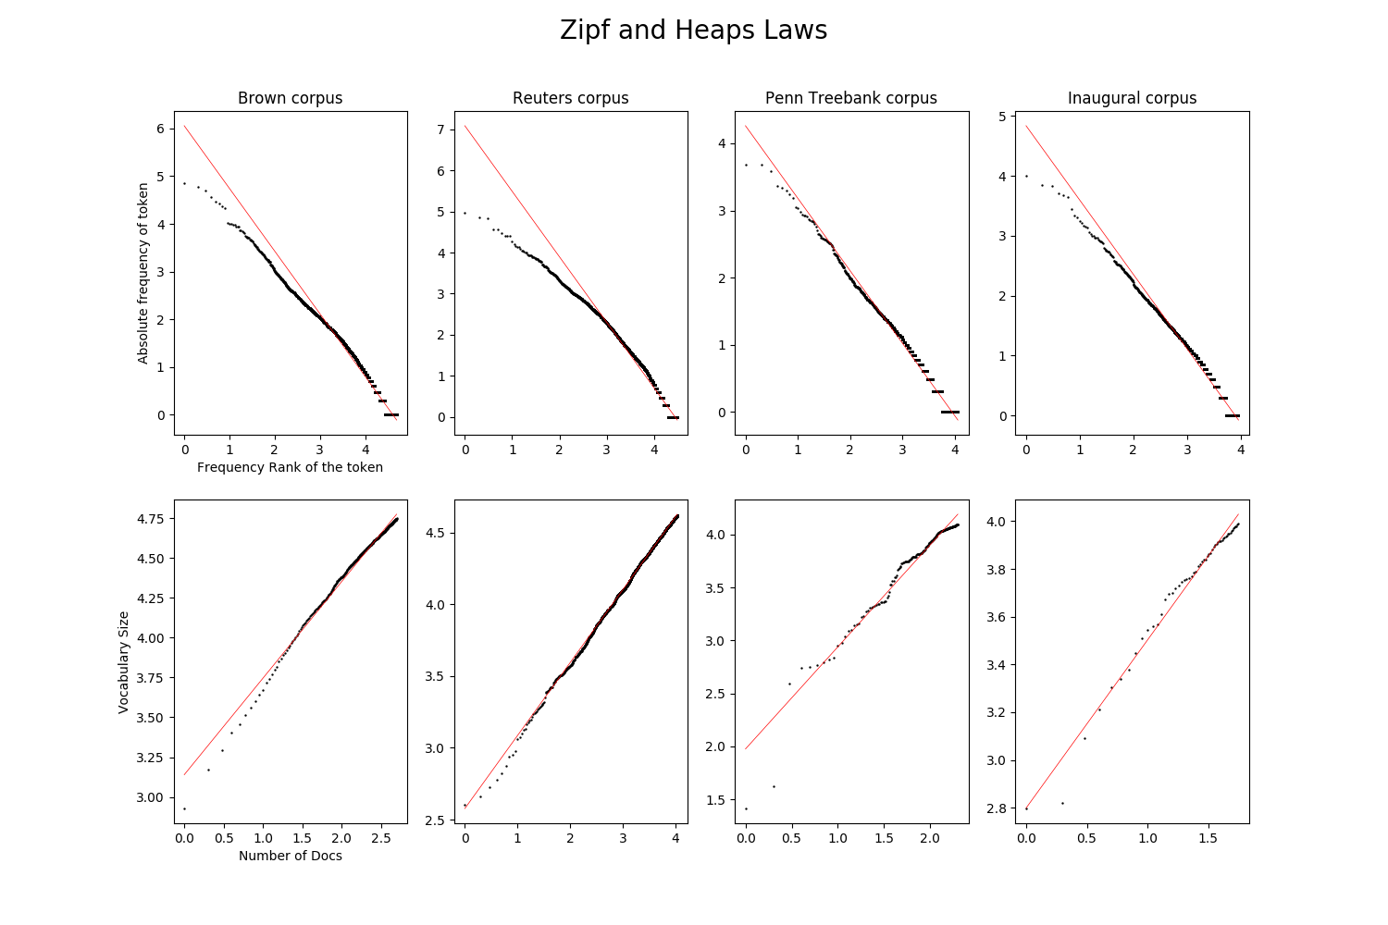
Notes:
Statistical Facts of Language:
--
Zipf’s law: Each word in a corpus is far more frequent than the next most common word
--
Practical meaning – Vocabulary has a really long tail, there are a lot of uncommon words
--
Heap’s law: As you add documents to a corpus the vocabulary size increases.
--
Practical meaning – You are always going to run into words you haven’t seen before
--
You can’t model language with a closed vocabulary.

Slide 5
Keep some information
<unk> before you train word vectors
Average uncommon word vectors together
Notes:
If you imagine all unk’s as the same you word learn a general idea of what uncommon words are.
--
Averaging uncommon words is the same idea when given pretrained embeddings

Slide 6
Use an open vocabulary
Memorize
  Dad – D + B = Bad
Generalize
  Car + s = Cars
  “I love it!” vs. “I loooooove it”
LSTM on the Characters
Notes:
The real solution is to use an open vocabulary which requires subword information.
--
Natural way is to use characters. Closed Vocabulary but has two ways to combine.
--
Sometime there is No pattern which means you need to memorize
--
Morphology can generalize
--
Need a model to combine characters that is flexible, LSTM is a natural choice

Slide 7
Not a CharLSTM
LSTM
Language Model
LSTM
Word Vector
Char Encoding
Embedding
Matrix
Word
Representation
BiLSTM
BiLSTM
One Hot Encoded Word
One Hot Chars
Notes:
CharLSTM has a problem with long range dependencies. Average word length is 5 so to capture a word 30 ago you have a dependencies of about 180 including spaces.
--
This idea is to use an LSTM to encode characters within a word to create a word embedding
--
Combine Characters, concatenation, summing, attention
--
These embeddings are then the inputs to your language model (most likely an LSTM)

Slide 8
But my word embeddings!
Semantic Analogies
Kitty – Cat + Dog = Puppy
Syntactic Analogies
Shorter – Short + Tall = Taller
Notes:
Word embeddings are trained on a huge corpus and include a lot of information.
–
Huge data gives us a good general sense of the context the word appears in.
–
Word2Vec, GloVe
–
Words are trained independently. Even tough we see analogies form the model doesn’t really know the transformation of mom to moms. This sort of model tries to overcome that.

Slide 9
We have those too!
increased | John | Noahshire | phding
reduced | Richard | Nottinghamshire | mixing
improved | George | Bucharest | modeling
expected | James | Saxony | styling
decreased | Robert | Johannesburg | blaming
targeted | Edward | Gloucestershire | christening
http://www.cs.cmu.edu/~lingwang/papers/emnlp2015.pdf
Notes:
This is from a paper from Carnegie Mellon. Which did language model experiments on Wikipedia.
--
The first 2 are words from out vocab and their nearest neighbor. The first has the ‘ed’. The second are names and kings of england.
–
The next two are words that were not in the training set and had no embeddings. These are the nearest neighbors in the training set to the produced embedding.

Slide 10
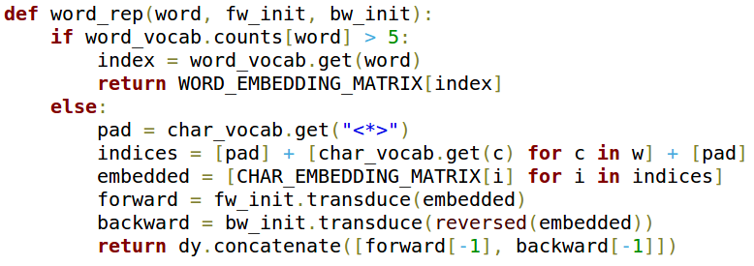
Character Backoff
This is a compromise
Take advantage of large datasets
Notes:
Using the word embeddings form a large corpus we leverage the learning meaning for common words and use this system for uncommon ones.
--
Dynet example

Slide 11
Results
Model | Unk Percent | Perplexity | Parameter Count
Word Level | 4.84 | 145 | 5.6M
Composition Model | 0 | 146 | 3.2M
Back-off Model | 5.04 | 142 | 5.8M
http://www.github.com/blester125/language_model
Notes:
Compare the results of words with unk, char embeddings, word embeddings with char back off
--
Quick tests with small models, not trying for SOTA
--
Mention Parameter size differences

Slide 12
Future Research
Build Robust Models
Composeable output
Pretrained input representation
Byte Pair Encoding as subwords.
Linguistic informed subwords, prefixes, suffixes, etc.
Smarter combination of character encoding.
Notes:
More Robust models
–
NER systems often have novel words
–
Generate uncommon words
–
Pretraining to leverage big data
–
BPE subwords worked well for NMT
–
Linguistic subwords should reinforce the idea of learning morphology
–
Smarter ways to combine words, Attention

