Slide 2
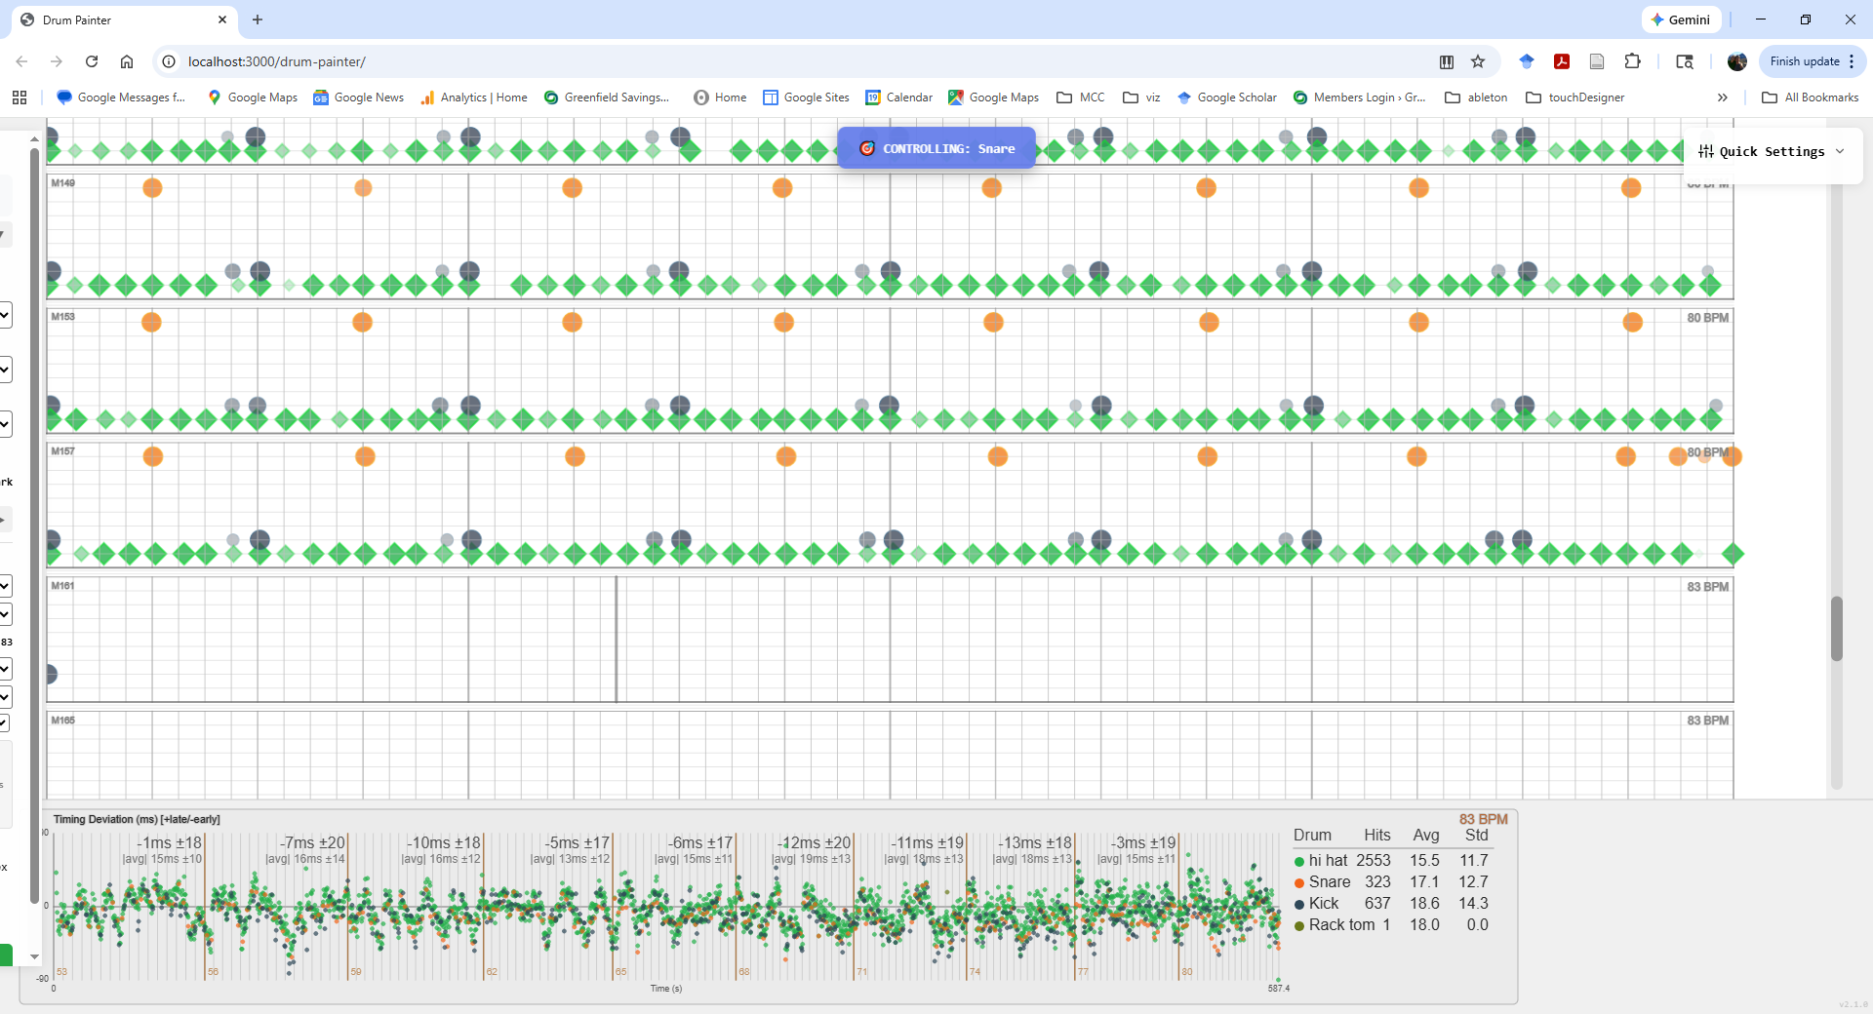
2-23-26

Slide 3
