Slide 1
Chapter 4. Creating and Modifying Tables and Indexes

Slide 2
Outline
4.1 Data types in SQL Server
4.2 Creating/modifying tables and indexes with Management Studio
4.3 Creating/modifying tables and indexes with T-SQL

Slide 3
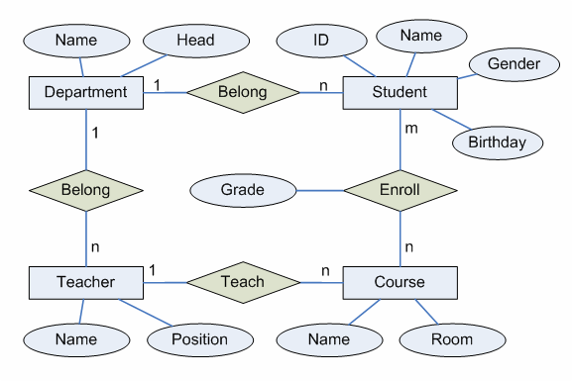
4.0 Example Application
E-R diagram

Slide 4
Relational Schemas
Department (ID, Name, Head)
Teacher (ID, Name, Position, DeptID)
Student (ID, Name, Gender, Birthday, DeptID)
Course (ID, Name, Room, TeacherID)
Enroll (StudentID, CourseID, Grade)

Slide 5
4.1 Data Types in SQL Server
System data types: Numerics
Data Type | Storage | Description
int | 4 bytes | Integer, -2³¹ to 2³¹-1
bigint | 8 bytes | Integer, -2⁶³ to 2⁶³-1
smallint | 2 bytes | Integer, -2¹⁵ to 2¹⁵-1
decimal(p, s) | Dep on p | Fixed precision (p) and scale (s, default to 0) number
float | 8 bytes | Floating point number.

Slide 6
4.1 Data Types in SQL Server
System data types: Character Strings
Data Type | Val of n | Description
char(n) | 1~8000 | Fixed-length character string of n bytes
varchar(n) | 1~8000 | Variable-length character string of n bytes
text |  | Variable-length large character string

Slide 7
4.1 Data Types in SQL Server
System data types: date
Data Type | Description
datetime | Represent date and time. Accuracy: 3.33 milliseconds

Slide 8
Table Structure of Course Management System
Department
Attribute | Data Type | Length | Nullability
ID | char | 3 | No
Name | varchar | 20 | No
Head | varchar | 20 | Yes

Slide 9
Table Structure of Course Management System
Teacher
Attribute | Data Type | Length | Nullability
ID | char | 8 | No
Name | varchar | 20 | No
Position | varchar | 30 | Yes
DeptID | char | 3 | Yes

Slide 10
Table Structure of Course Management System
Student
Attribute | Data Type | Length | Nullability
ID | char | 8 | No
Name | varchar | 20 | No
Gender | char | 1 | Yes
Birthday | datetime |  | Yes
DeptID | char | 3 | Yes

Slide 11
Table Structure of Course Management System
Course
Attribute | Data Type | Length | Nullability
ID | char | 4 | No
Name | varchar | 20 | No
Room | varchar | 15 | Yes
TeacherID | char | 8 | Yes

Slide 12
Table Structure of Course Management System
Enroll
Attribute | Data Type | Length | Nullability
StudentID | char | 8 | No
CourseID | char | 4 | No
Grade | int |  | Yes

Slide 13
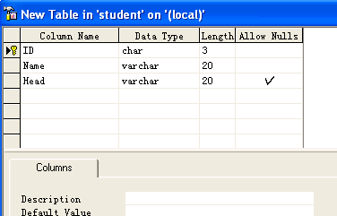
4.2 Creating/modifying tables and indexes with MS

Slide 14
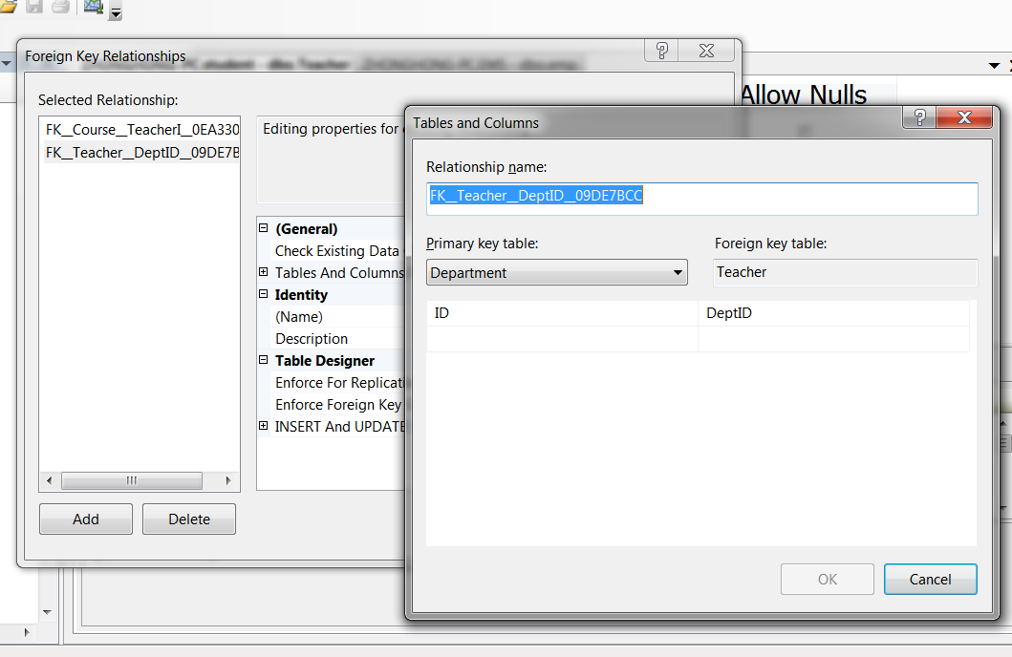
Adding Foreign Keys

Slide 15
Index
Analogy
  A list of goods in a repository
  Book index cards in an old library
A
Goods A
Goods B
Goods C
Goods D
B
C
D

Slide 16
Index
What is a database index?
  A data structure
  Objective: improve the speed of data retrieval operations
  Cost: slower writes and increased storage space
A primary key is set as an index

Slide 17
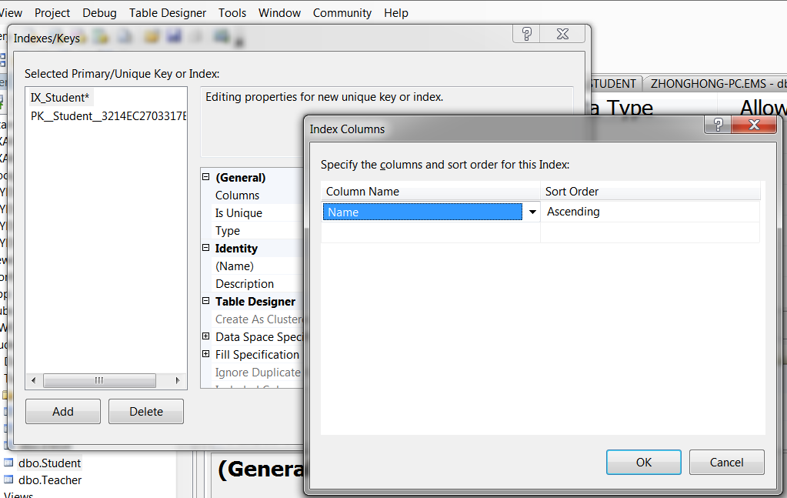
Adding an Index in MS

Slide 18
4.3 Creating/modifying tables and indexes with T-SQL
CREATE TABLE statement
Column definition
  Column name
  Data type
Column constraint
  Primary key
  NULL/NOT NULL
  Foreign key
  Check

Slide 19
Creating Tables: Department
CREATE TABLE Department (
ID char (3) NOT NULL,
Name varchar (20) NOT NULL,
Head varchar (20) NULL,
PRIMARY KEY (ID)
);

Slide 20
Creating Tables: Teacher
CREATE TABLE Teacher (
ID char (8) NOT NULL PRIMARY KEY,
Name varchar (20) NOT NULL,
Position varchar (30) NULL,
DeptID char (3) NULL
REFERENCES Department (ID)
);

Slide 21
Creating Tables: Enroll
CREATE TABLE Enroll (
StudentID char (8) NOT NULL
REFERENCES Student (ID),
CourseID char (4) NOT NULL
REFERENCES Course (ID),
Grade int NULL
CHECK (Grade IS NULL OR
(Grade>=0 AND Grade<=100)),
PRIMARY KEY (StudentID, CourseID)
);

Slide 22
Modifying Table Structure
ALTER TABLE Teacher
ADD Birthday datetime;
ALTER TABLE Teacher
DROP COLUMN Birthday;
ALTER TABLE Teacher
ALTER COLUMN Name varchar (50);

Slide 23
Modifying Table Structure
ALTER TABLE Enroll
ADD CONSTRAINT CK_grade
CHECK (Grade >= 0);
ALTER TABLE Enroll
DROP CONSTRAINT CK_grade;

Slide 24
Creating Indexes
CREATE INDEX dept_name_idx
ON Department (Name);
CREATE INDEX grd_idx
ON Enroll (Grade);
DROP INDEX Enroll.grd_idx;

Slide 25
Review
4.1 Data types in SQL Server
4.2 Creating/modifying tables and indexes with Enterprise Manager
4.3 Creating/modifying tables and indexes with T-SQL

