Slide 1
Chapter 5. Fundamentals of Data Manipulation

Slide 2
Outline
5.1 Data manipulation with MS
5.2 Data retrieval in T-SQL
5.3 Data insertion in T-SQL
5.4 Data modification in T-SQL
5.5 Data removal in T-SQL

Slide 3
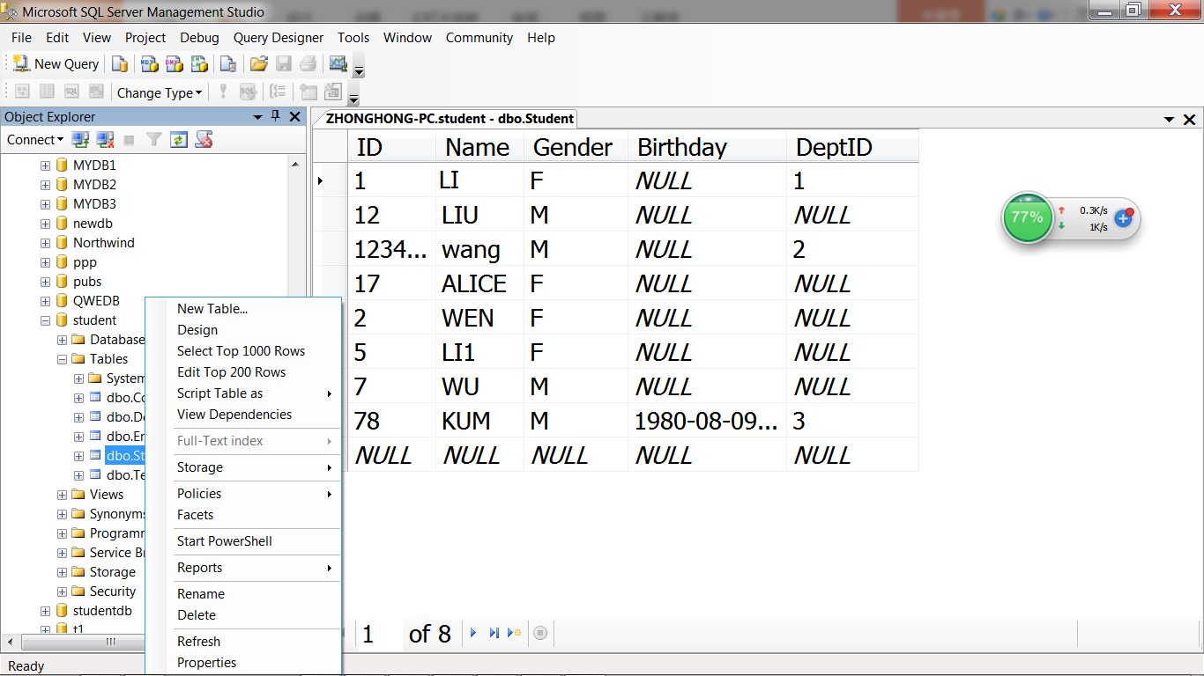
5.1 Data Manipulation with MS

Slide 4
Four Types of Data Manipulation Operations
Retrieval: SELECT statement
  Find rows that satisfy given conditions
Insertion: INSERT statement
  Add new rows to a table
Deletion: DELETE statement
  Remove rows from a table
Modification: UPDATE statement
  Change data values of given rows

Slide 5
5.2 Data Retrieval in T-SQL
Select one or many rows that satisfy given conditions
  Relational algebra: “Selection” operation
Choose one or many columns to display
  Relational algebra: “Projection” operation
Can retrieve data from multiple tables
  Relational algebra: “Join” operation
The result of a relational operation is itself a relation

Slide 6
Relational algebra: “Selection”
σ_{F}(R)＝{t | t∈R∧t(F)}
Select tuples from relation R that satisfy a given prdicate F.
eg. σdept_name=“Physics”(instructor)
A | B | C
a1 | b1 | c1
a2 | b2 | c2
a3 | b3 | c3
a4 | b4 | c4
a5 | b5 | c5
A | B | C
a1 | b1 | c1
a3 | b3 | c3
a5 | b5 | c5

Slide 7
Relational algebra: “Projection”
∏_{x}(R)={t[X] | t∈R}
Return relation with certain attributes of relation R
eg. ∏ID, name, salary(instructor)
A | B | C | D | E
a1 | b1 | c1 | d1 | e1
a2 | b2 | c2 | d2 | e2
a3 | b3 | c3 | d3 | e3
A | C | E
a1 | c1 | e1
a2 | c2 | e2
a3 | c3 | e3

Slide 8
SELECT Statement
Simple query syntax
SELECT column_list
FROM table
WHERE search_condition;

Slide 9
SELECT Statement
Simple query syntax
SELECT ID, Name, Position
FROM Teacher
WHERE Position = ‘Professor’;
ID | Name | Position
10000003 | Bob | Professor
10000005 | Dave | Professor
10000007 | John | Professor

Slide 10
SELECT Statement
Simple query syntax
SELECT *
FROM Teacher
WHERE Position = ‘Professor’;
ID | Name | Position | DeptID
10000003 | Bob | Professor | 101
10000005 | Dave | Professor | 101
10000007 | John | Professor | 103

Slide 11
SELECT Statement
Simple query syntax
SELECT *
FROM Teacher
WHERE Position = ‘Professor’
AND DeptID = 101;
ID | Name | Position | DeptID
10000003 | Bob | Professor | 101
10000005 | Dave | Professor | 101

Slide 12
5.3 Data Insertion in T-SQL
INSERT INTO table_name (column_list)
VALUES (value_list);
INSERT INTO Teacher (ID, Name, Position, DeptID)
VALUES (‘10000003’, ‘Bob’, ‘Professor’, ‘101’);
The order in the value list should be the same as that of the column list
The data types of the new values should be consistent with the definition of the table

Slide 13
5.3 Data Insertion in T-SQL
INSERT INTO Student (ID, Name, Gender, Birthday, DeptID)
VALUES (‘20000001’, ‘Alice’, ‘F’,
‘1990-2-15’, ‘101’);
INSERT INTO Enroll (StudentID, CourseID, Grade)
VALUES (‘20000001’, ‘1001’, 90);

Slide 14
5.4 Data Modification in T-SQL
UPDATE table_name
SET column_name = value
WHERE search_condition;
UPDATE Student
SET Gender = ‘M’, DeptID = ‘103’
WHERE ID = ‘20000001’;
UPDATE Enroll
SET Grade = 95
WHERE StudentID = ‘20000001’
AND CourseID = ‘1001’;

Slide 15
5.5 Data Removal in T-SQL
DELETE FROM table_name
WHERE search_condition;
Delete all rows in a table
DELETE FROM Student;
DELETE FROM Student
WHERE ID = ‘20000001’;
DELETE FROM Enroll
WHERE StudentID = ‘20000001’
AND CourseID = ‘1001’;

Slide 16
Review
5.1 Data manipulation with EM
5.2 Data retrieval in T-SQL
5.3 Data insertion in T-SQL
5.4 Data modification in T-SQL
5.5 Data removal in T-SQL

Slide 17
Homework
Exp01: 4.1, 4.2, 4.5, 4.6, 4.9, 4.14, 4.15, 5.1, 5.2

