Slide 1
C++ Object-oriented Programming
Dandan Song
Beijing Institute of Technology

Slide 2
References
Bruce Eckel, Thinking in C++（Volume one: Introduction to Standard C++）, China Machine Press, (Prentice Hall)
赵清杰等编著，C++程序设计，清华大学出版社，2008.

Slide 3
Assistant Teacher
Keyu Chen
Graduate Student
chenky007@qq.com

Slide 4
1. Introduction to Objects

Slide 5
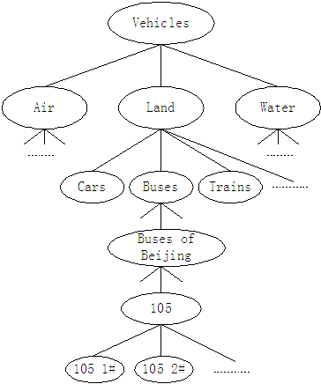

Slide 6
The progress of abstraction
An object has an interface
The hidden implementation
Reusing the implementation
Inheritance: reusing the interface
Interchangeable objects with polymorphism
Creating and destroying objects
Exception handling: dealing with errors
Why C++ succeeds
Strategies for transition to OOP

Slide 7
1.1 The progress of abstraction
All programming languages provide abstractions.(class in C++)
The complexity of the problems you’re able to solve is directly related to the kind and quality of abstraction.
Object-oriented languages require you to think in terms of the structure of the problem you are trying to solve.
Procedural languages (Fortran, BASIC, and C) require you to think in terms of the structure of the computer.

Slide 8
Procedural paradigm:
Program= (Algorithms + Data structures)
Object-oriented paradigm:
Object =（ Algorithms + Data structures ）
Program=(Object1 + Object2 +……)

Slide 9
Characteristics of OOP
Everything is an object.
A program is a bunch of objects telling each other what to do by sending messages.
Each object has its own memory made up of other objects.
Every object has a type.
All objects of a particular type can receive the same messages.

Slide 10
OOP:
Encapsulation (abstract data type)
Inheritance
polymorphism

Slide 11
Creating abstract data types (classes) is a fundamental concept in object-oriented programming.
You can create variables (objects or instances) of a class (type) and manipulate those variables (sending messages or requests).
A class describes a set of objects that have identical characteristics (data elements) and behaviors (functionality).

Slide 12
class Date
{
public:
int year() {return y;}
int month() { return m; }
int day() { return d;}
private:
int y, m, d ;
};
Date a, b;

Slide 13
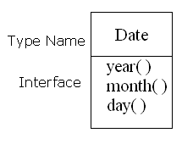
1.2 An object has an interface
The interface establishes what requests you can make for a particular object.
A class has a function associated with each possible request, and when you make a particular request to an object, that function is called.

Slide 14
1.3 The hidden implementation
class creator: build a class that exposes only what’s necessary to the client programmer and keeps everything else hidden.
client programmer: collect a toolbox full of classes to use for rapid application development.
Hiding the implementation reduces program bugs.

Slide 15
Access specifiers
public, private, protected
“public” means the following definitions are available to everyone.
“private” means that no one can access those definitions except the creator of the class, inside member functions of that class. “private” is a brick wall between the class creator and the client programmer.
“protected” acts just like private, with the exception that an inheriting class has access to protected members, but not private members.

Slide 16
Access control
Access control can keep client programmers’ hands off portions they shouldn’t touch.
Access control allows the library designer to change the internal workings of the class without worrying about how it will affect the client programmer.

Slide 17
1.4 Reusing the implementation
Composition: use an object of a class directly.
Inheritance: clone the existing class and then make additions and modifications to the clone.

Slide 18
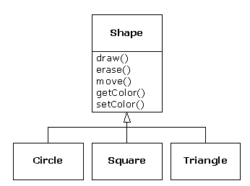
1.5 Inheritance: reusing the interface
base class, parent class
derived class, inherited class, sub class, child class

Slide 19
When you inherit from an existing type, you create a new type.
This new type contains not only all the members of the existing type, but more importantly it duplicates the interface of the base class.
The derived class can be the same type as the base class. In the previous example, “a circle is a shape.”
To differentiate your new derived class from the original base class, you can add new functions to the derived class, or overriding an existing base-class function.

Slide 20
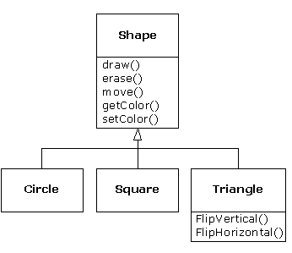
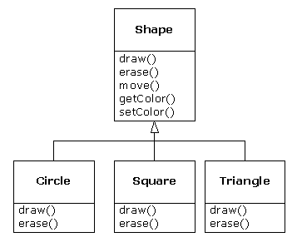

Slide 21
1.6 Interchangeable objects with polymorphism
Connecting a function call to a function body is called binding.
When binding is performed before the program is run (by the compiler and linker), it’s called early binding.
The binding occurring at runtime is called late binding, or dynamic binding or runtime binding.
Polymorphism is realized by using the keyword virtual to declare a function having the flexibility of late-binding properties.

Slide 22
1.7 Creating and destroying objects
Where is the data for an object ? How is the lifetime of that object controlled?
The static storage area is simply a fixed patch of memory that is allocated before the program begins to run.
The stack is an area in memory that is used directly by the microprocessor to store data during program execution.
The heap is managed dynamically at runtime. “new” is used to create a new object (storage), and “delete” is used to release the storage.

Slide 23
1.8 Exception handling: dealing with errors
Exception handling wires error handling directly into the programming language and sometimes even the operating system.
An exception is an object that is “thrown” from the site of the error and can be “caught” by an appropriate exception handler designed to handle that particular type of error.
Exception handling does not interfere with the normally-executing code.

Slide 24
1.11 Why C++ succeeds
To solve many other problems facing developers today, especially those who have large investments in C.
The goal of C++ is to improve the productivity.

Slide 25
1.12 Strategies for transition to OOP
Training
Low-risk project
Model from success
Use existing class libraries
Don’t rewrite existing code in C++

Slide 26
Summary
Class
Object
Interface

