Slide 1

Part 1: Linux Overview
"Some people have told me they don't think a fat penguin really embodies the grace of Linux, which just tells me they have never seen a angry penguin charging at them in excess of 100mph. They'd be a lot more careful about what they say if they had." - Linus Torvalds
Tux
Official Mascot of Linux Kernel

Slide 2
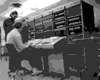
Before Linux
In 80’s, Microsoft’s DOS was the dominated OS for PC
Apple MAC was better, but expensive
UNIX was much better, but much, much more expensive. Only for minicomputer for commercial applications
People was looking for a UNIX based system, which is cheaper and can run on PC
Both DOS, MAC and UNIX were proprietary, i.e., the source code of their kernel is protected
No modification is possible without paying high license fees

Slide 3
Brief History of GNU/Linux
1985 Free Software Foundation (FSF) founded by Richard Stallman. Along with other programmers creates the tools needed to make a UNIX compatible OS
1985 Professor Andy Tannenbaum creates a UNIX like operating system based on System V Unix for the IBM PC & PC/AT computers. It is called Minix.
1989 Richard Stallman releases GPL and GNU software but lacks a free kernel.
1991 Building on the concepts in Minix, Linus Torvalds (Finnish college student) develops Linux along with help from other users on the web.

Slide 4
What Linux is
Strictly speaking Linux refers to the kernel
GNU/Linux more accurately describes the Operating System. Linux Kernel combined with GNU utilities and libraries
Distribution – GNU/Linux bundled with other applications. Examples Red Hat Linux, Debian, Ubuntu, Suse, Knoppix, etc.
Distributions can be compiled and maintained by an individual or corporation. Can be small (single floppy disk) or span several CD/DVDs.
www.distrowatch.com for more information

Slide 5
What is a Distribution?
A Linux distribution (or distro) is a complete Linux operating system: a collection of free and sometimes non-free software created by individuals, groups and organization from around the world and having the Linux kernel at its core.
Companies such as Red Hat, SuSE, MandrakeSoft, as well as the Gentoo project, compile the software and provide it as a complete system ready to install and use. (wikipedia)

Slide 6
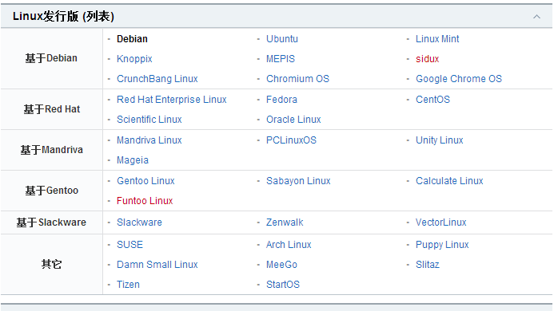
Linux Distributions
Red Hat (Enterprise) Linux is probably the largest commercial Linux vendor. Focus on stability and long term support. Red Hat sponsors a community version (Fedora) which undergoes a more rapid development cycle.
Ubuntu based on Debian Linux. Ubuntu claims to be most popular desktop version. Many applications and excellent “update mechanism” contribute to its sucess. Revenue is created by selling technical support.
Puppy – This distribution is small enough to be loaded entirely in RAM. This frees up the CD/DVD drive for other uses. Configuration can be saved to a file between reboots.
Debian GNU/Linux
OpenLinux (Caldera)
Red Hat
Slackware
SuSE
TurboLinux

Slide 7
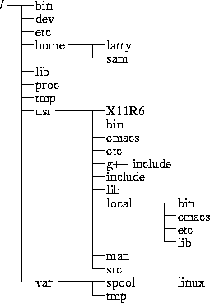
Directory Tree
(root)
When you log on the Linux OS using your username you are automatically located in your home directory.

Slide 8
Important subdirectories inside the root directory
/bin : Important Linux commands available to the average user.
/boot : The files necessary for the system to boot. Not all Linux distributions use this one. Fedora does.
/dev : All device drivers. Device drivers are the files that your Linux system uses to talk to your hardware. For example, there's a file in the /dev directory for your particular make and model of monitor, and all of your Linux computer's communications with the monitor go through that file.
/etc : System configuration files.
/home : Every user except root gets her own folder in here, named for her login account. So, the user who logs in with linda has the directory /home/linda, where all of her personal files are kept.
/lib : System libraries. Libraries are just bunches of programming code that the programs on your system use to get things done.

Slide 9
Important subdirectories inside the root directory
/mnt : Mount points. When you temporarily load the contents of a CD-ROM or USB drive, you typically use a special name under /mnt. For example, many distributions (including Fedora) come, by default, with the directory /mnt/cdrom, which is where your CD-ROM drive's contents are made accessible.
/root : The root user's home directory.
/sbin : Essential commands that are only for the system administrator.
/tmp : Temporary files and storage space. Don't put anything in here that you want to keep. Most Linux distributions (including Fedora) are set up to delete any file that's been in this directory longer than three days.
/usr : Programs and data that can be shared across many systems and don't need to be changed.
/var : Data that changes constantly (log files that contain information about what's happening on your system, data on its way to the printer, and so on).

Slide 10
Linux Shell
whoami
ls
pwd
Shell interprets the command and request service from kernel
Similar to DOS but DOS has only one set of interface while Linux can select different shell
  Bourne Again shell (Bash), TC shell (Tcsh), Z shell (Zsh)
Bash, Tcsh, Zsh
Kernel
Different shell has similar but different functionality
Bash is the default for Linux
Graphical user interface of Linux is in fact an application program work on the shell

Slide 11
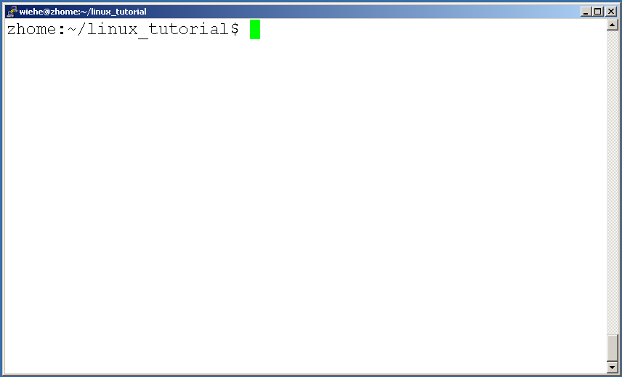
Connecting to a Unix/Linux system
Open up a terminal:

Slide 12
Connecting to a Unix/Linux system
Open up a terminal:
The “prompt”
The current directory (“path”)
The host

Slide 13
UNIX command line tricks
Shell “glob”
  # mkdir /tmp/moved
  # mv * /tmp/moved
  # cp /tmp/moved/* .
Filename Completion (tcsh, bash)
  # ls /tmp/m<TAB>
Command line history (tcsh)
  history
  CTRL-P and CTRL-N, down/up arrows
  !previous – Runs the previous command beginning with the word previous.
Notes:
*： asterisk

Slide 14
Help!
Whenever you need help with a command type “man” and the command name

Slide 15
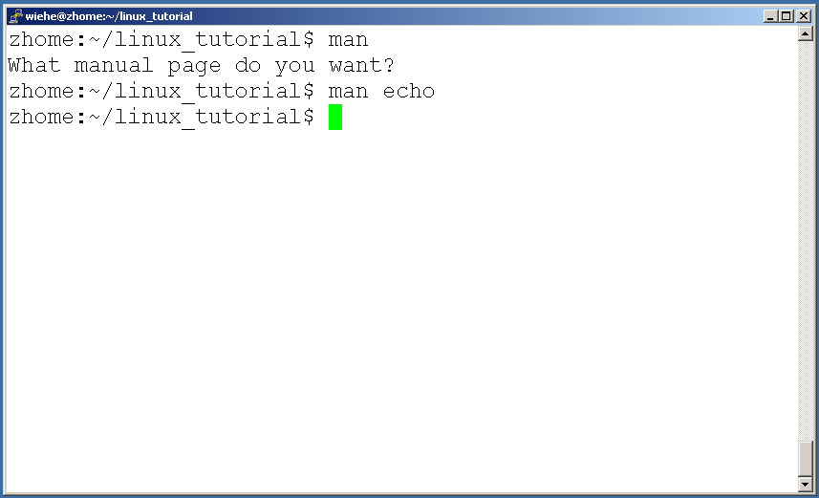
Help!

Slide 16
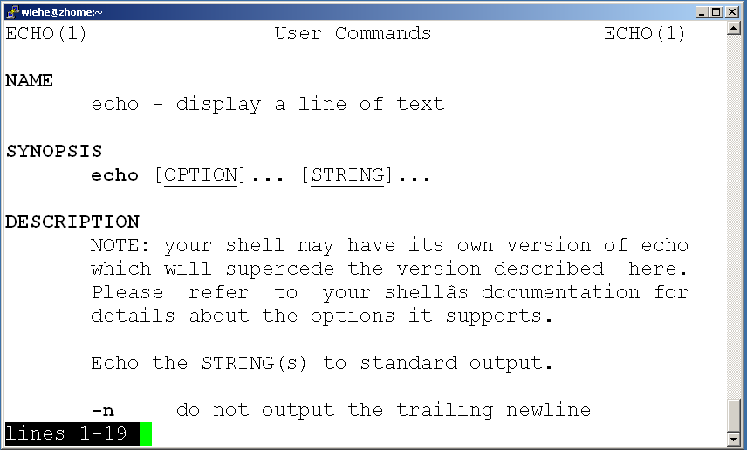
Help!

Slide 17
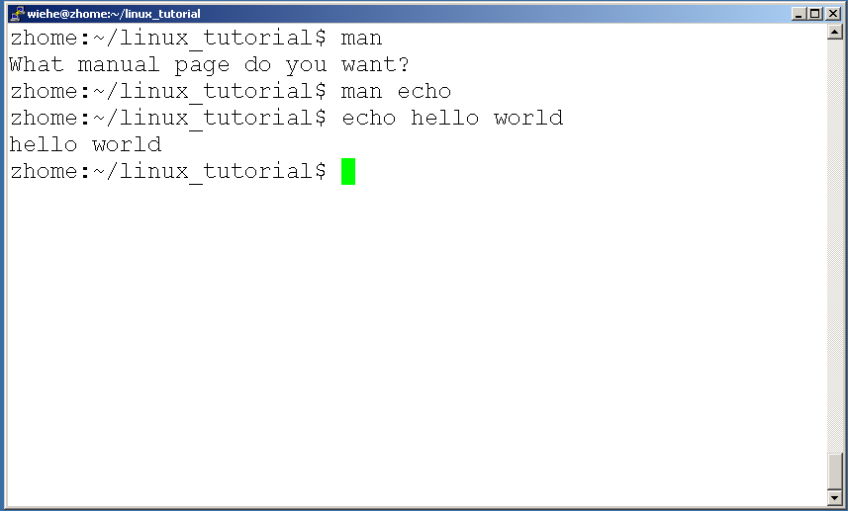
Help!

Slide 18
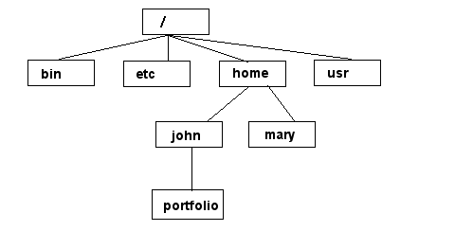
Unix/Linux File System
NOTE: Unix file names
are CASE SENSITIVE!
/home/mary/
/home/john/portfolio/
The Path

Slide 19
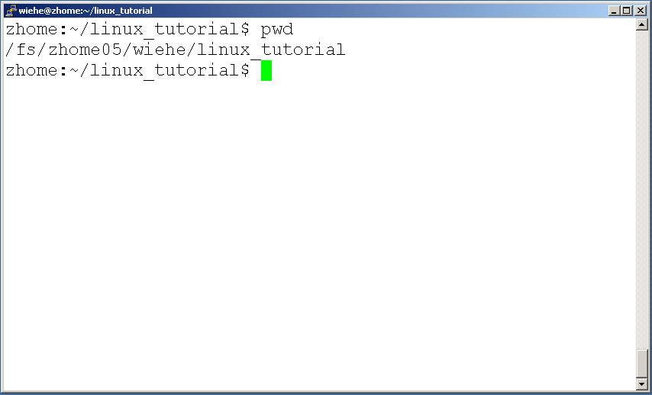
Command: pwd
To find your current path use “pwd”

Slide 20
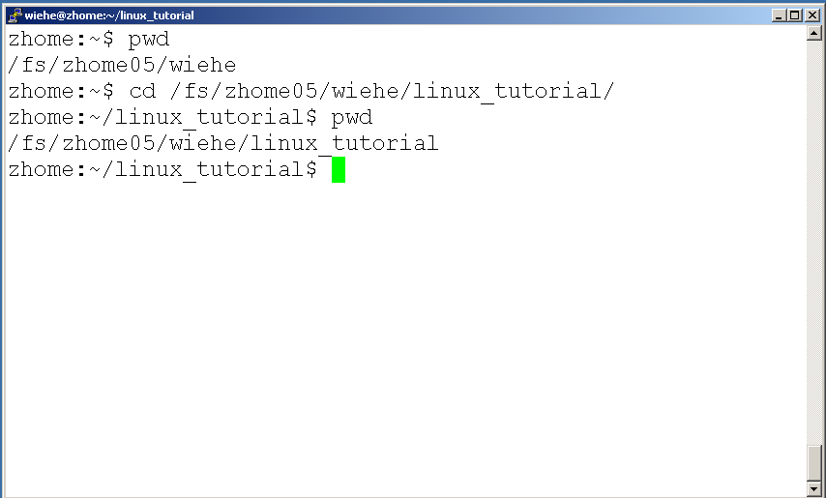
Command: cd
To change to a specific directory use “cd”

Slide 21
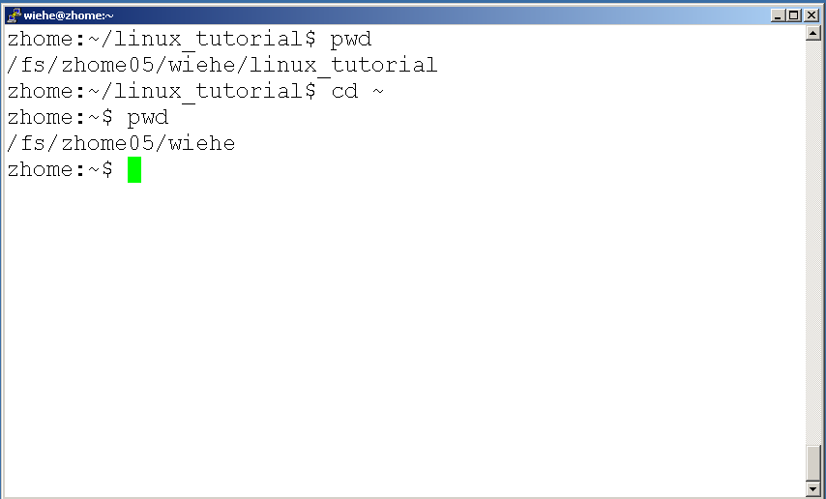
Command: cd
“~” is the location of your home directory

Slide 22
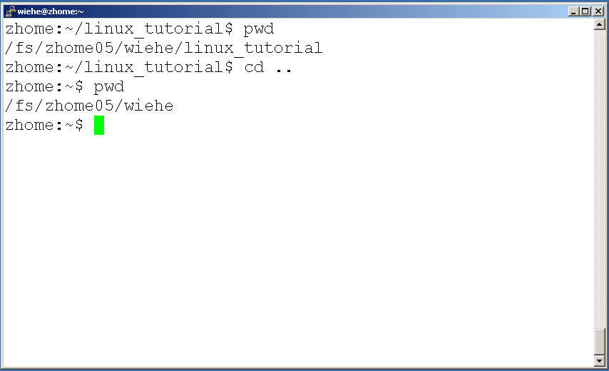
Command: cd
“..” is the location of the directory below current one

Slide 23
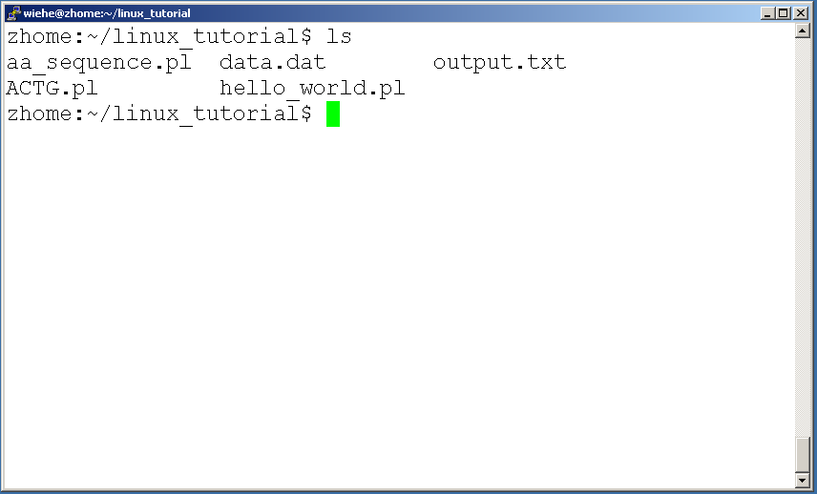
Command: ls
To list the files in the current directory use “ls”

Slide 24
Command: ls
ls has many options
  -l long list (displays lots of info)
  -t sort by modification time
  -S sort by size
  -h list file sizes in human readable format
  -r reverse the order
“man ls” for more options
Options can be combined: “ls -ltr”

Slide 25
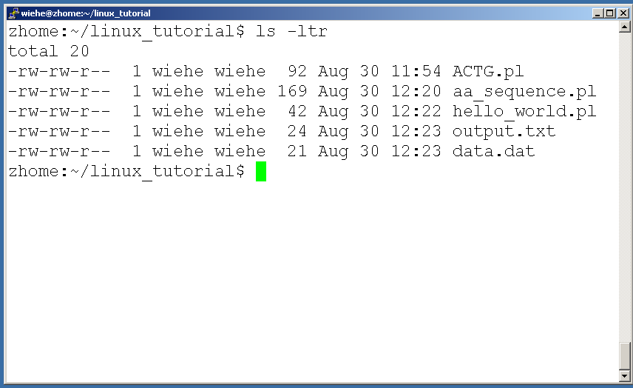
Command: ls -ltr
List files by time in reverse order with long listing

Slide 26
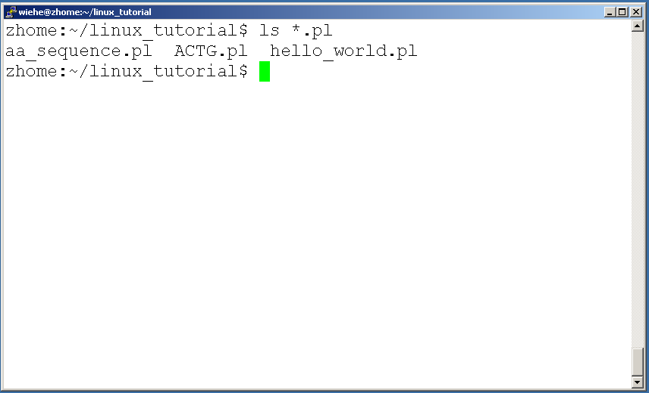
General Syntax: *
“*” can be used as a wildcard in unix/linux

Slide 27
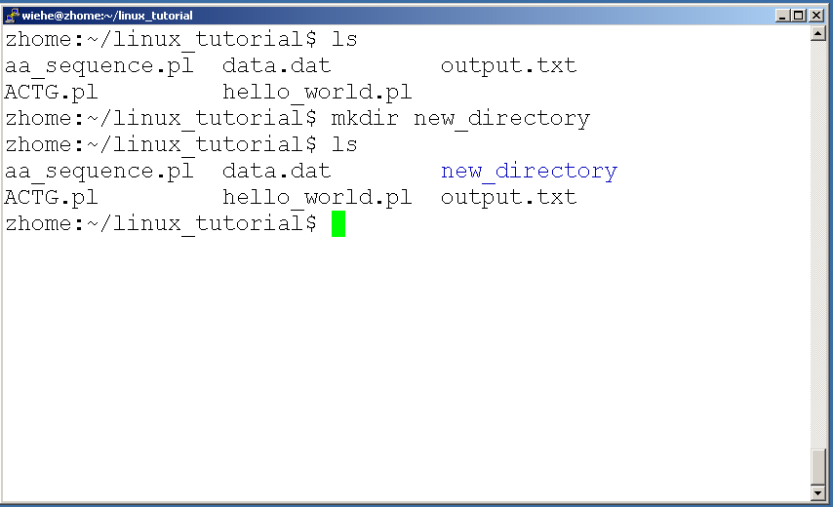
Command: mkdir
To create a new directory use “mkdir”

Slide 28
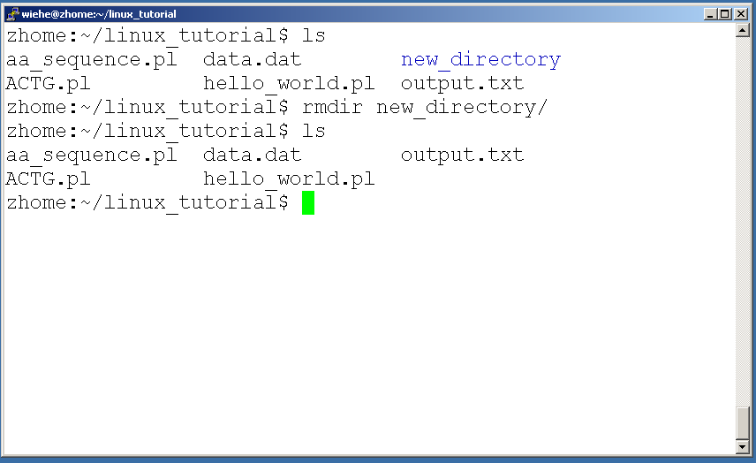
Command: rmdir
To remove and empty directory use “rmdir”

Slide 29
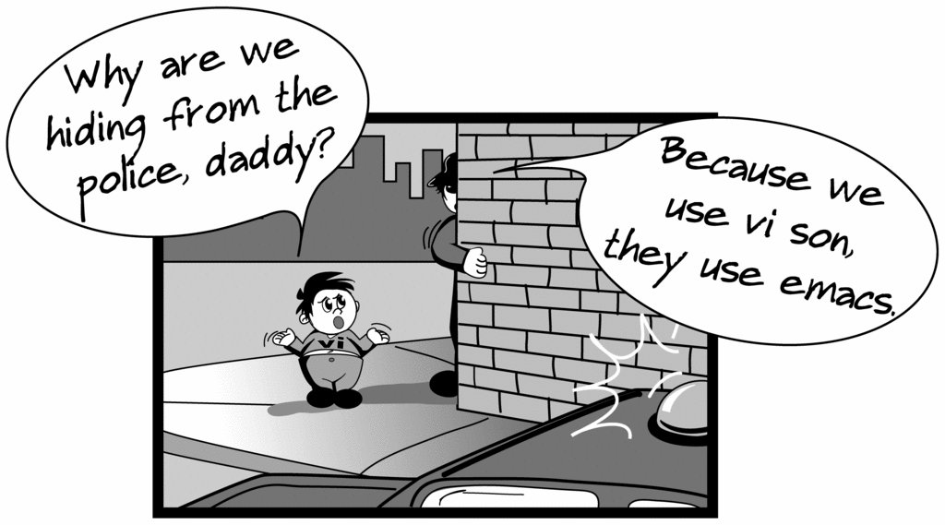
Creating files in Unix/Linux
Requires the use of an Editor
Various Editors:
  nano / pico
  vi
  emacs

Slide 30
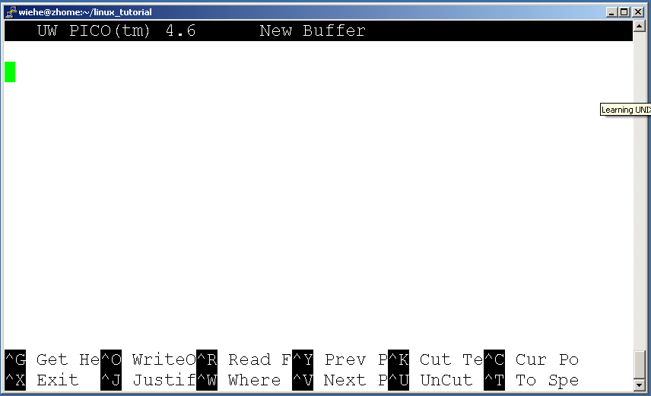
Editing a file using pico or nano
Type “pico” or “nano” at the prompt

Slide 31
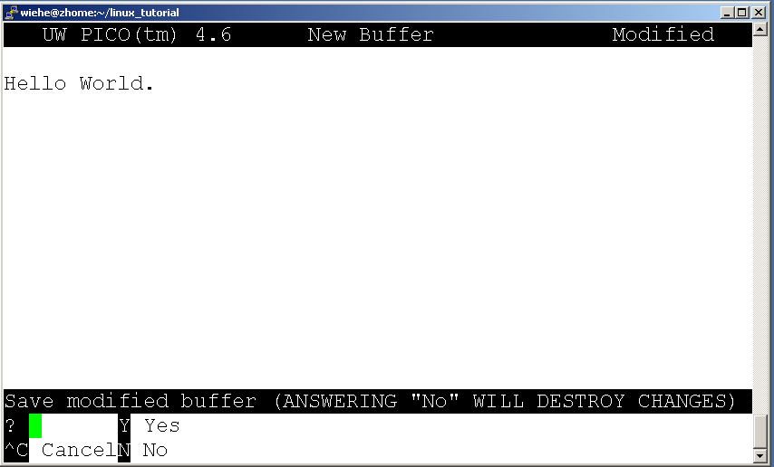
Editing a file using pico
To save use “ctrl-x”

Slide 32
Displaying a file
Various ways to display a file in Unix
  cat
  less
  head
  tail

Slide 33
Command: cat
Dumps an entire file to standard output
Good for displaying short, simple files

Slide 34
Command: less
“less” displays a file, allowing forward/backward movement within it
  return scrolls forward one line, space one page
  y scrolls back one line, b one page
use “/” to search for a string
Press q to quit

Slide 35
Command: head
“head” displays the top part of a file
By default it shows the first 10 lines
-n option allows you to change that
“head -n50 file.txt” displays the first 50 lines of file.txt

Slide 36
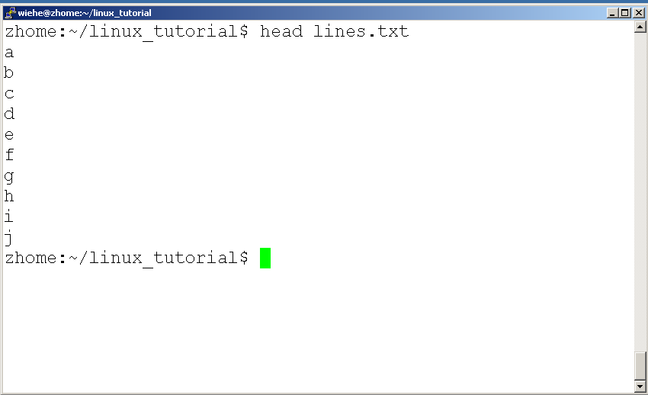
Command: head
Here’s an example of using “head”:

Slide 37
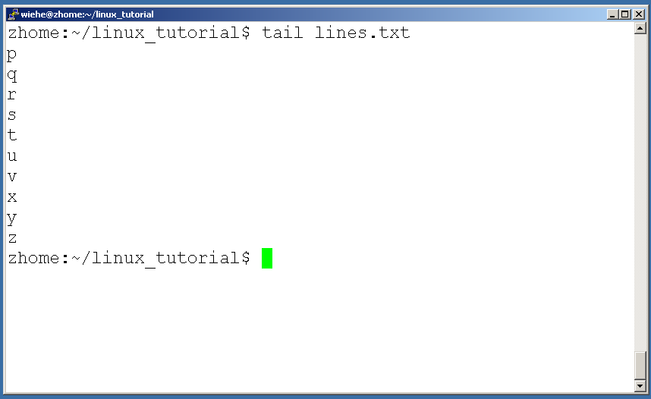
Command: tail
Same as head, but shows the last lines

Slide 38
File Commands
Copying a file: cp
Move or rename a file: mv
Remove a file: rm

Slide 39
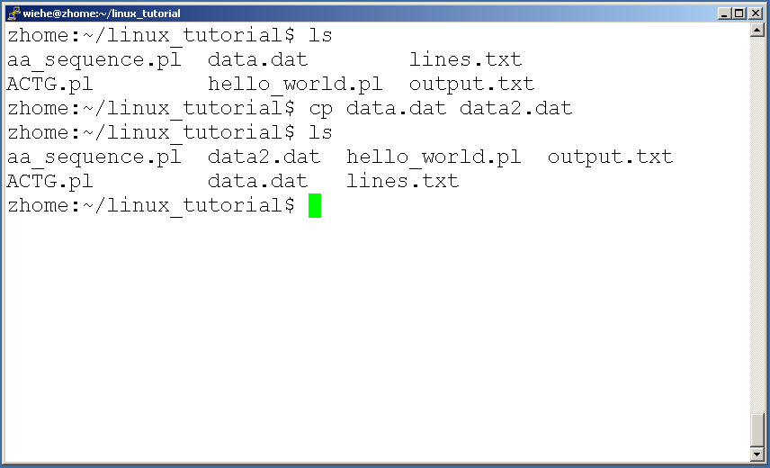
Command: cp
To copy a file use “cp”

Slide 40
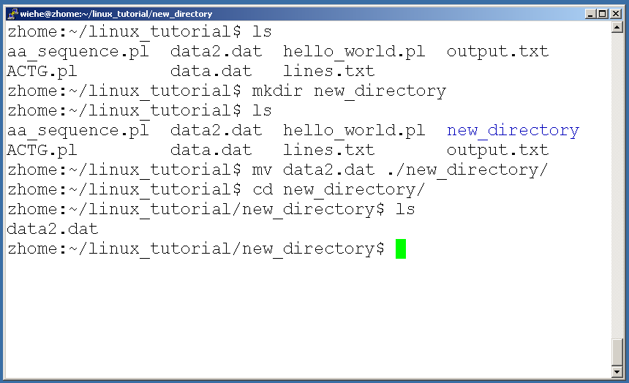
Command: mv
To move a file to a different location use “mv”

Slide 41
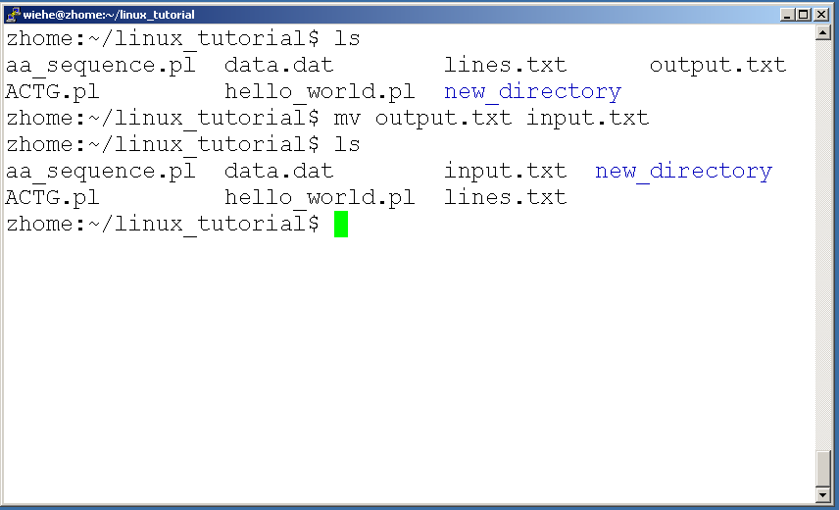
Command: mv
mv can also be used to rename a file

Slide 42
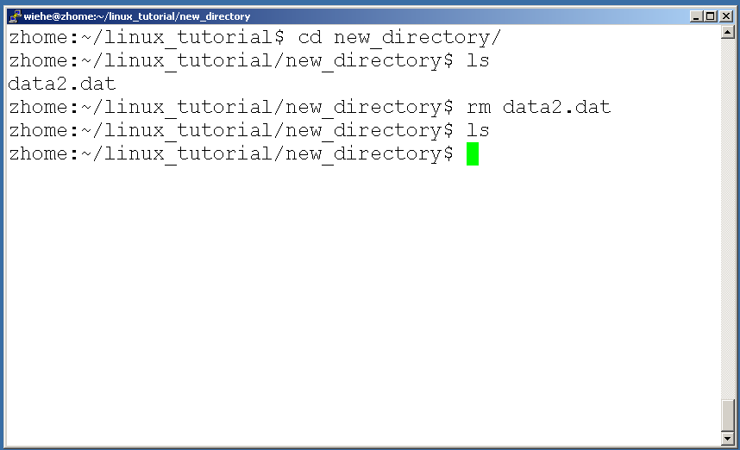
Command: rm
To remove a file use “rm”

Slide 43
Command: rm
To remove a file “recursively”: rm –r
Used to remove all files and directories
Be very careful, deletions are permanent in Unix/Linux

Slide 44
File permissions
Each file in Unix/Linux has an associated permission level
This allows the user to prevent others from reading/writing/executing their files or directories
Use “ls -l filename” to find the permission level of that file

Slide 45
Permission levels
“r” means “read only” permission
“w” means “write” permission
“x” means “execute” permission
  In case of directory, “x” grants permission to list directory contents

Slide 46
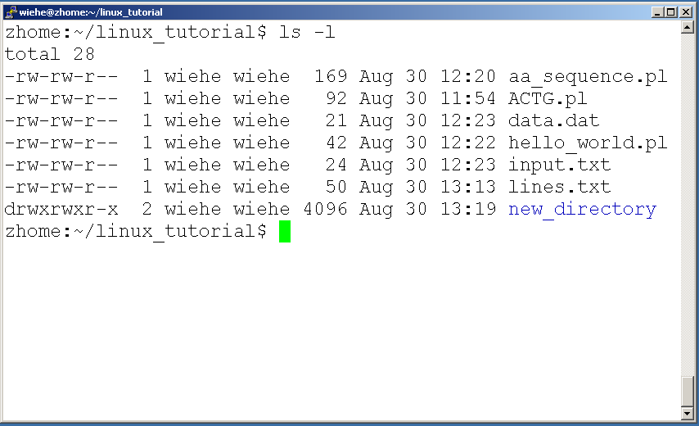
File Permissions
User (you)

Slide 47
File Permissions
Group

Slide 48
File Permissions
“The World”

Slide 49
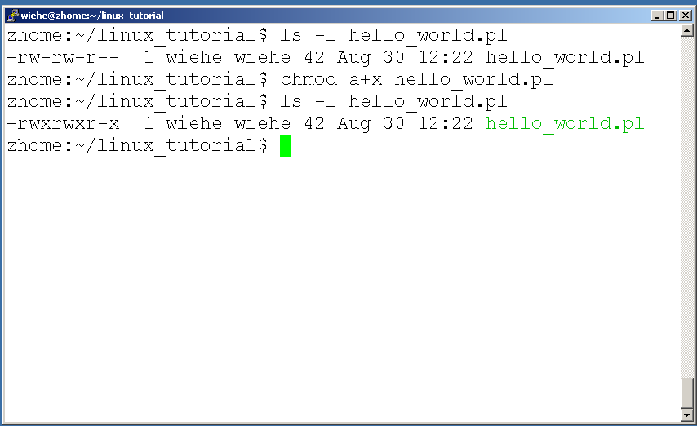
Command: chmod
If you own the file, you can change it’s permissions with “chmod”
  Syntax: chmod [user/group/others/all]+[permission] [file(s)]
  Below we grant execute permission to all:

Slide 50
Running a program (a.k.a. a job)
Make sure the program has executable permissions
Use “./” to run the program

Slide 51
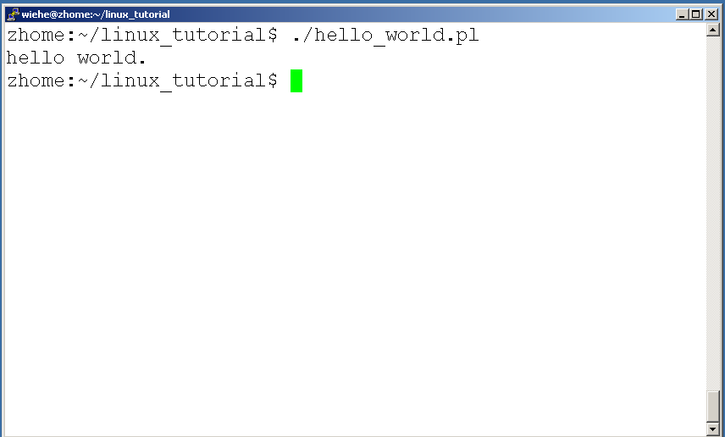
Running a program: an example
Running the sample perl script “hello_world.pl”

Slide 52
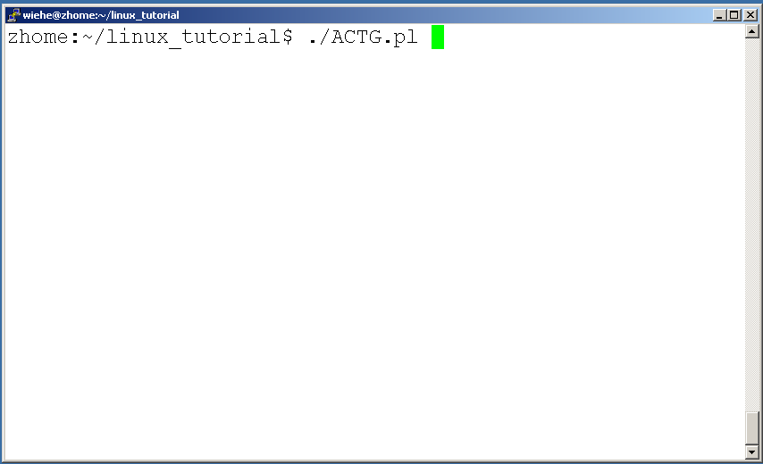
Ending a program
To end a program use “ctrl-c”. To try it:

Slide 53
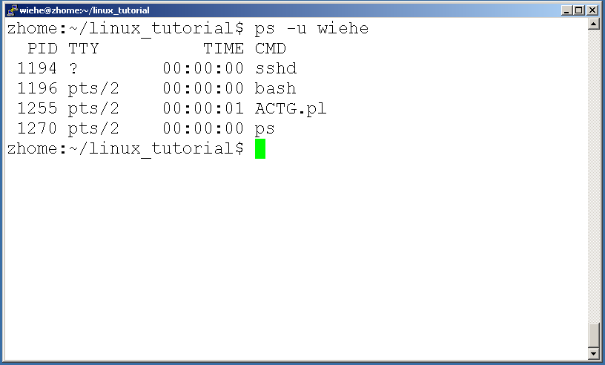
Command: ps
To view the processes that you’re running:

Slide 54
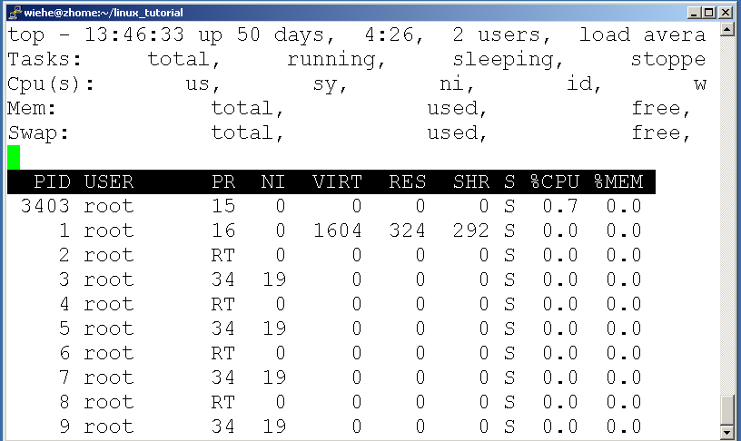
Command: top
To view the CPU usage of all processes:

Slide 55
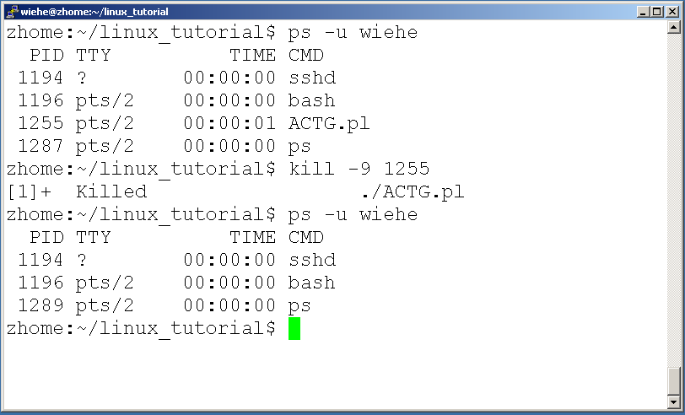
Command: kill
To terminate a process use “kill”

Slide 56
Input/Output Redirection (“piping”)
Programs can output to other programs
Called “piping”
“program_a | program_b”
  program_a’s output becomes program_b’s input
“program_a > file.txt”
  program_a’s output is written to a file called “file.txt”
“program_a < input.txt”
  program_a gets its input from a file called “input.txt”

Slide 57
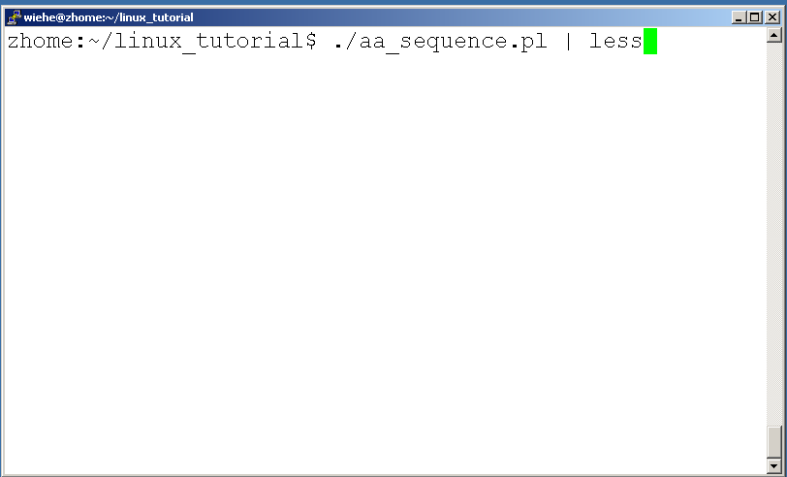
A few examples of piping

Slide 58
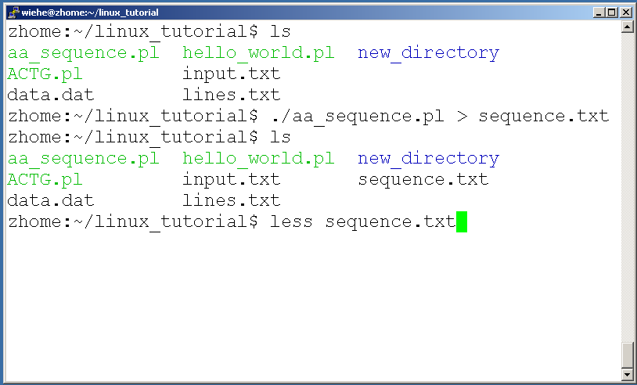
A few examples of piping

Slide 59
Command: wc
To count the characters, words, and lines in a file use “wc”
The first column in the output is lines, the second is words, and the last is characters

Slide 60
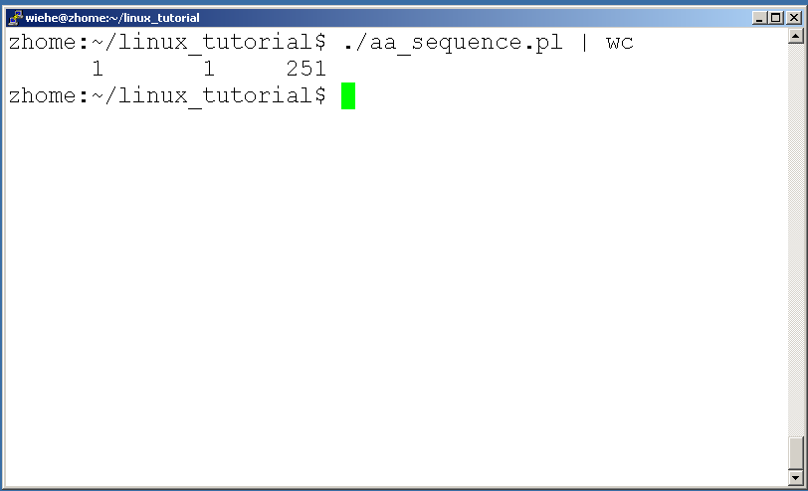
A few examples of piping

Slide 61
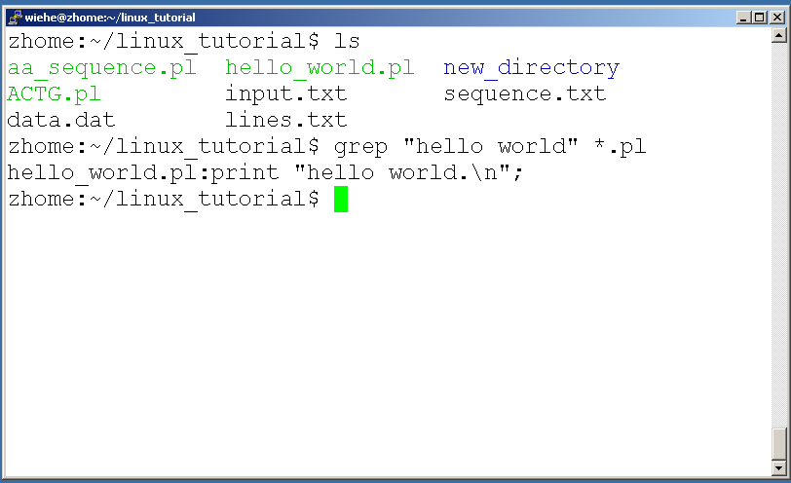
Command: grep
To search files in a directory for a specific string use “grep”

Slide 62
Command: diff
To compare to files for differences use “diff”
  Try: diff /dev/null hello.txt
  /dev/null is a special address -- it is always empty, and anything moved there is deleted

Slide 63
ssh, scp
ssh is used to securely log in to remote systems, successor to telnet
ssh [username]@[hostname]
Try:
ssh yourusername@localhost
  Type “exit” to log out of session
Scp is used to copy files to/from remote systems, syntax is similar to cp:
  scp [local path] [usernme]@[hostname]:[remote file path]
Try:
  scp hello.txt yourusername@localhost:scp-test.txt

Slide 64
Programming on Linux
Tools needed:
  vi, gcc, gdb, make
Some important directories
  /usr/include/ and its subdirectories
  /lib/ , /usr/lib

Slide 65
Vi
2 modes
  Input mode
    ESC to back to cmd mode
  Command mode
    Cursor movement
      h (left), j (down), k (up), l (right)
      ^f (page down)
      ^b (page up)
      ^ (first char.)
      $ (last char.)
      G (bottom page)
      :1 (goto first line)
    Swtch to input mode
      a (append)
      i (insert)
      o (insert line after
      O (insert line before)
    Delete
      dd (delete a line)
      d10d (delete 10 lines)
      d$ (delete till end of line)
      dG (delete till end of file)
      x (current char.)
    Paste
      p (paste after)
      P (paste before)
    Undo
      u
    Search
      /
    Save/Quit
      :w (write)
      :q (quit)
      :wq (write and quit)
      :q! (give up changes)

Slide 66
Compiler
GCC
  GNU C Compiler (GCC)
  Richard Stallman, founder of the GNU Project
  for more info, read An Introduction to GCC.

