Slide 1
Part 2:
Linux system programming

Slide 2
Content
System calls
Process management
File system
Signal
IPC

Slide 3
System Calls
Programming interface to the services provided by the OS
Typically written in a higher-level language (C or C++)
Mostly accessed by programs via a higher-level Application Program Interface (API) rather than direct system call use
Why use APIs rather than the native system calls?
App Software
API
“You are here”
Sys Software
Sys Call (OS) Interface
OS
Sw-Hw I-face (drivers)
Hardware

Slide 4
System Calls vs. Library Routines
A system call is just what its name implies – a request for the OS do something on behalf of the user’s program
  E.g., read is a system call which asks the OS to fill a buffer with data stored on a disk drive (or other device). It would be chaotic if everyone were able to access devices whenever they pleased!
A library routine does not usually need the OS to perform its work
  E.g., the sin function, which computes the sine of an angle

Slide 5
Invoke the OS
Hardware interrupt: Interrupts signal to the CPU that a hardware device has an event that needs attention, e.g. disk I/O complete, network packet arrived, keyboard input arrived, etc.
Software trap: Interrupts also signal errors or requests for OS intervention (a system call), often called an “exception” or “trap”
Explicit system call: application requests service

Slide 6
System Call Implementation
Typically, a number associated with each system call
  System-call interface maintains a table indexed according to these numbers
The system call interface invokes intended system call in OS kernel and returns status of the system call and any return values
The caller need know nothing about how the system call is implemented
  Just needs to obey API and understand what OS will do as a result call
  Most details of OS interface hidden from programmer by API
    Managed by run-time support library (set of functions built into libraries included with compiler)

Slide 7
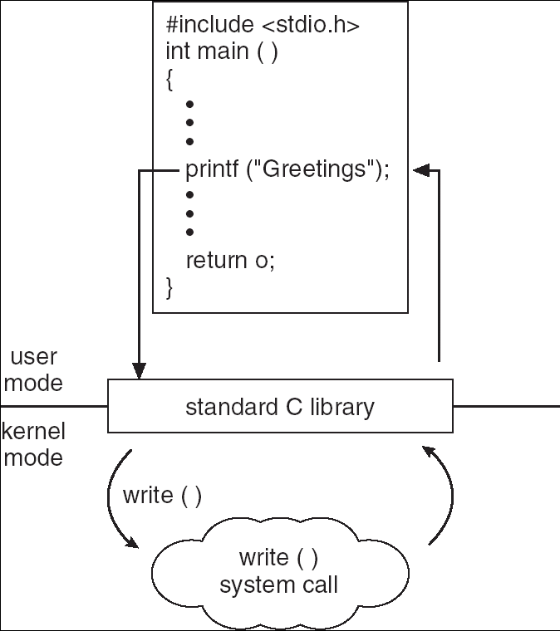
Standard C Library Example
C program invoking printf() library call, which calls write() system call

Slide 8
System API Standards
Three most common API standards are
  POSIX API for POSIX-based systems (including virtually all versions of UNIX, Linux, and Mac OS X)
  Win32 API for Windows
  Java API for the Java virtual machine (JVM)
    out of this course scope
POSIX (IEEE 1003.1, ISO/IEC 9945)
  Very widely used standard based on (and including) C-language
  Complete specification is at http://www.opengroup.org/onlinepubs/9699919799/nframe.html
Win32 (Micro$oft Windows based systems)
  Specifies system calls together with many Windows GUI routines
    VERY complex, no really complete specification

Slide 9
Types of System Calls
A set of (seemingly independent) groups of services:
Process control and IPC (Inter-Process Communication)
Memory management
  allocating and freeing memory space on request
Access to data in files
File and file-system management
Device management
Communications
  Networking and distributed computing support
Other services
  e.g., profiling
  debugging
  etc.

Slide 10
Process

Slide 11
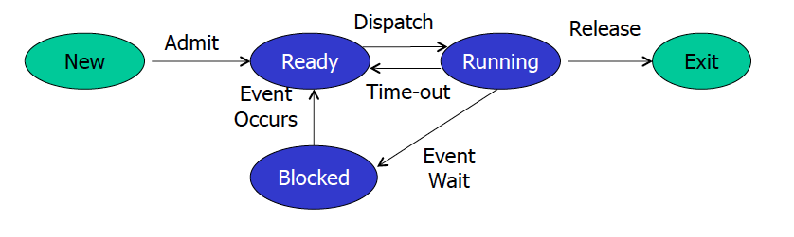
Process Concept
Process – a program in execution
Textbook uses the terms job and process almost interchangeably
A process includes:
  program counter
  stack
  data section
Process life-cycle

Slide 12
Process =? Program
main () {
…;
}
A() {
…
}
main () {
…;
}
A() {
…
}
Heap
Stack
A
main
Program
Process
More to a process than just a program:
  Program is static, with the potential for exection
  process is a program in execution and have a state
  One program can be executed several times and thus has several processes

Slide 13

Process Description: Process Control Block (PCB)
Information associated with each process
  Process state
  Program counter
  CPU registers
  CPU scheduling information
  Memory-management information
  Accounting information
  I/O status information
A process is named using its process ID (PID)
Data is stored in a process control block (PCB)

Slide 14

CPU Switch From Process to Process

Slide 15
Process Creation
A process is created by another process, which, in turn create other processes, forming a tree of processes
Parent and child process
  In Linux, using “ps –f”, the PPID field is the parent
  The fist process is Init
After creating a child, the parent may either wait for it to finish or continue currently
Some system, the children inherit the privileges of the parents
  Unix: children of the shell inherit the Process User ID and thus execute with the user’s privileges

Slide 16
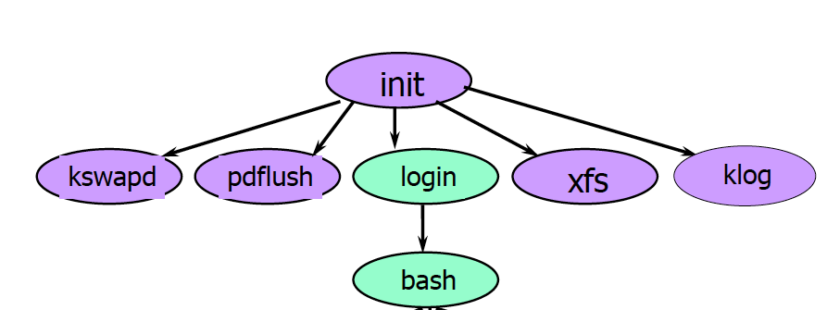
Linux Process Tree

Slide 17
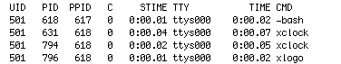
Unix Process: ps -f

Slide 18
Process Creation
Address space
  Child duplicate of parent
  Child has a program loaded into it
UNIX examples
  The fork() system call in Unix creates a new process. After a successful fork() call, two copies of the original code will be running. In the original process (the parent) the return value of fork() will be the process ID of the child. In the new child process the return value of fork() will be 0
  exec system call used after a fork() to replace the process’ memory space with a new program

Slide 19
Process and thread creation
Process Creation
  fork ( )
  execve( )
  clone( )
Thread Creation
  clone( )
  pthread_create( )
cs431-cotter
Notes:
cs431-cotter
cs431-cotter

Slide 20
Process Creation - fork( )
pid_t fork(void);
In Unix, processes are created using fork()
Creates and initializes a PCB and creates a new address space
Initializes the address space with a copy of the entire contents of the address space of the parent
Initializes the kernel resources to point to the resources used by parent (e.g., open files)
Places the PCB on the ready queue
Fork returns twice: Returns the child’s PID to the parent, “0” to the child
Child process returns PID = 0;
Parent process returns child PID
#include <sys/types.h>
#include <unistd.h>
pid_t fork(void);

Slide 21
Creating Processes in UNIX
The child and parent processes execute in their own separate address spaces
This means that even though they have access to the same information, when the child is created, both the child and its parent each reference its own copy of the information
Remember, after fork() the execution order is not guaranteed.

Slide 22
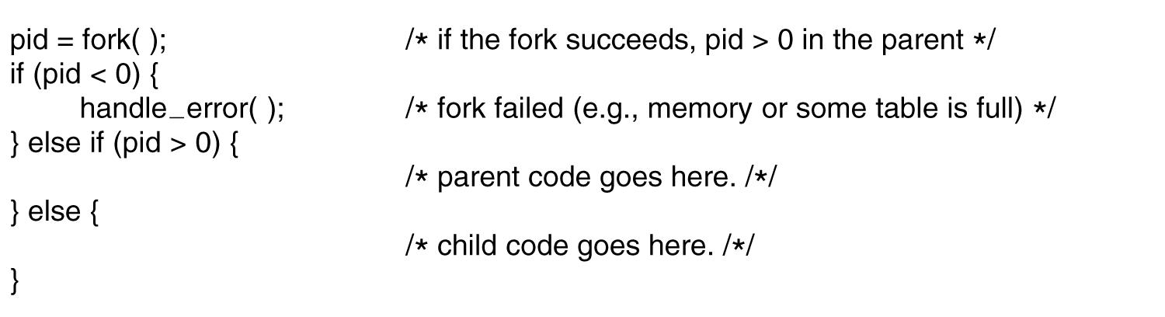
Processes in Linux
Process creation in Linux.
Notes:
cs431-cotter

Slide 23
Process Fork example
#include <stdio.h>
#include <sys/time.h>
#include <sys/types.h>
#define LB_SIZE 128
int main ()
{
time_t now;
char lineBuf[LB_SIZE];
pid_t pid;
void work (char *name);
time (&now);
printf ("Fork test at %s\n", ctime(&now));
Notes:
cs431-cotter
cs431-cotter

Slide 24
Process Fork example
pid = fork();
if (pid < 0) {
printf("Couldn't fork process!\n");
exit(1);
}
else if (pid == 0) { // child process
work ("child");
return 0;
}
work("main");
printf ("Closing main program...\n");
return 0;
}
void work(char * name) {
printf("This is the %s work cycle\n",name);
sleep (1);
}
Notes:
cs431-cotter
cs431-cotter

Slide 25
Process Fork example (Output)
[root]@bobs-RHLINUX cs431_linux]# gcc -o proc_fork proctest.c
[root]@bobs-RHLINUX cs431_linux]# ./proc_fork
Fork test at Wed Jan 10 14:57:53 2001
This is the main work cycle
Closing main program...
This is the child work cycle
Notes:
cs431-cotter
cs431-cotter

Slide 26
Process-related System Calls
Simple and powerful primitives for process creation and initialization.
  Unix fork creates a child process as (initially) a clone of the parent
  parent program runs in child process – maybe just to set it up for exec
  child can exit, parent can wait for child to do so.
#include <sys/types.h>
#include <sys/wait.h>
pid_t wait(int *status);
pid_t waitpid(pid_t pid, int *status, int options);
#include <stdlib.h>
void exit(int status);

Slide 27
Process Control
The fork syscall returns a zero to the child and the child process ID to the parent.
Fork creates an exact copy of the parent process.
int pid;
int status = 0;
if (pid = fork()) {
/* parent */
…..
pid = wait(&status);
} else {
/* child */
…..
exit(status);
}
Parent uses wait to sleep until the child exits; wait returns child pid and status.
Wait variants allow wait on a specific child, or notification of stops and other signals.
Child process passes status back to parent on exit, to report success/failure.

Slide 28
Fork/Exit/Wait Example
fork parent
fork child
Child process starts as clone of parent: increment refcounts on shared resources.
OS resources
Parent and child execute independently: memory states and resources may diverge.
wait
exit
On exit, release memory and decrement refcounts on shared resources.
Parent sleeps in wait until child stops or exits.
“join”
Child enters zombie state: process is dead and most resources are released, but process descriptor remains until parent reaps exit status via wait.

Slide 29
Creating New Processes - execve( )
Children should have lives of their own.
Exec* “boots” the child with a different executable image.
  parent program makes exec* syscall (in forked child context) to run a program in a new child process
  exec* overlays child process with a new executable image, (i.e. loads a new program within current process).
  restarts in user mode at predetermined entry point (e.g., crt0)
  no return to parent program (it’s gone)
  arguments and environment variables passed in memory
  file descriptors etc. are unchanged
  The new image is either regular executable binary file or a shell script.
Notes:
The exec variants are library calls that use the sys call execve

Slide 30
Creating New Processes - execve( )
int execve (
  const char *filename,
  char *const argv[ ],
  char *const envp[ ]);
filename: name of executable file (or script) to be executed
argv[]: list of arguments to be passed to executable file
(an array of strings. May use NULL)
envp[]: list of environment variables to be used
(an array of strings. May use NULL)
No return on success. -1 on failure
Notes:
cs431-cotter
cs431-cotter

Slide 31
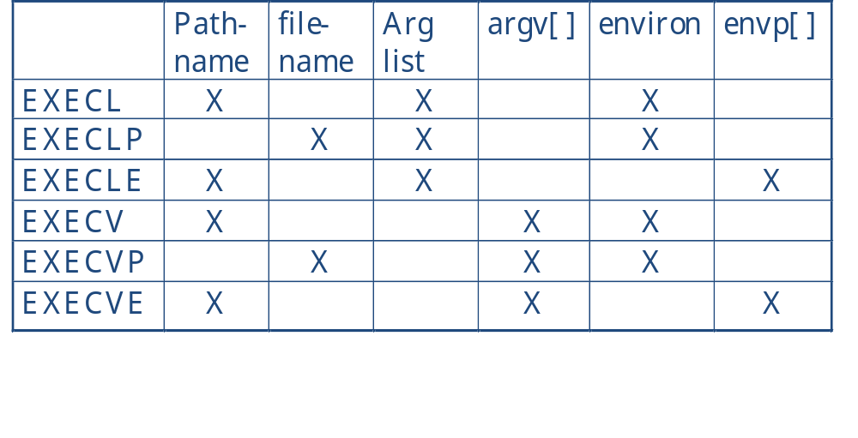
Creating Processes - Execve
Used to call an executable program from a child process. 6 varieties available, depending on options needed:
The exec variants are library calls that use the sys call execve
Notes:
cs431-cotter
cs431-cotter

Slide 32
The exec()System Call (1)
By exec() we usually refer to a family of calls:
  int execl(char *path, char *arg, ...);
  int execv(char *path, char *argv[]);
  int execle(char *path, char *arg, ..., char *envp[]);
  int execve(char *path, char *argv[], char *envp[]);
  int execlp(char *file, char *arg, ...);
  int execvp(char *file, char *argv[]);
Here's what l, v, e, and p mean:
  l means an argument list,
  v means an argument vector,
  e means an environment vector, and
  p means a search path.

Slide 33
Fork/Exec/Exit/Wait Example
int pid = fork();
  Create a new process that is a clone of its parent.
exec*(“program” [, argvp, envp]);
  Overlay the calling process virtual memory with a new program, and transfer control to it.
exit(status);
  Exit with status, destroying the process.
int pid = wait*(&status);
  Wait for exit (or other status change) of a child.
fork parent
fork child
initialize child context
exec
wait
exit
Notes:
Consider what happens if the child exits first, or if the parent exits first, to understand why the reference counts are necessary.

Slide 34
New Process Example (exec.cpp)
#include <iostream>
#include <unistd.h>
#include <sys/types.h>
#include <string.h>
#include <errno.h>
extern char **environ;
extern int errno;
pid_t pid;
using namespace std;
int main (int argc, char* argv[]) {
FILE *fin;
char lineBuf[128];
char *progname= argv[1];
char myname[15] = "Bob";
char mynum[5] = "5";
static int result;
char *args[4];
Notes:
cs431-cotter
cs431-cotter

Slide 35
New Process Example
if (argc == 2)
strcpy (progname, argv[1]);
else {
cout << "Usage: " << argv[0] << " progname" << endl;
exit(1);
}
pid = fork();
if (pid==0) { //We are in the child process
args[0] = progname;
args[1] = (char *) &myname;
args[2] = (char *) &mynum;
args[3] = (char *) 0; // array must be null terminated
if ( execv (progname, args) == -1) {
cout << "ERROR IN EXECVE " << endl;
perror("execve");
}
}
Notes:
cs431-cotter
cs431-cotter

Slide 36
New Process Example
else //We are in the parent process
{
cout << “Created new process with process ID " << pid << endl;
sleep(1);
}
return 0;
}//main
Notes:
cs431-cotter
cs431-cotter

Slide 37
Child Process (hello.cpp)
#include <iostream>
using namespace std;
int main(int argc, char * argv[])
{
int i, mynum;
if (argc != 3) {
cout << "Usage: : " << argv[0] << " NAME NUMBER" << endl;
return 0; }
cout << "Hello, World!" << endl;
cout << “Passed in " << argc << " arguments" << endl;
cout << "They are: " << endl;
mynum = atoi(argv[2]);
cout << "Program name is " << argv[0] << endl;
cout << "Name argument is " << argv[1] << endl;
cout << "The number is " << mynum << endl;
return 0;
}

Slide 38
New Process Example (Output)
[rcotter@kc-sce-450p2 cs431]$ g++ -o exec exec.cpp
[rcotter@kc-sce-450p2 cs431]$ g++ -o hello hello.cpp
[rcotter@kc-sce-450p2 cs431]$ ./exec hello
Created new process with process ID 2795
Hello, World!
Passed in 3 arguments
They are:
Program name is hello
Name argument is Bob
The number is 5
[rcotter@kc-sce-450p2 cs431]$
Notes:
cs431-cotter
cs431-cotter

Slide 39
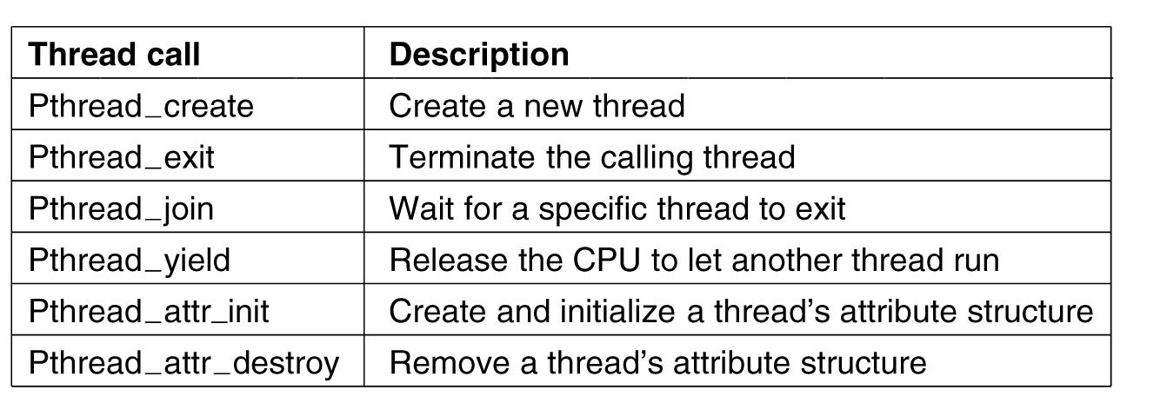
POSIX Threads (1)
Some of the Pthreads function calls.
Notes:
cs431-cotter

Slide 40
Creating Threads - _pthread_create()
#include <pthread.h>
int pthread_create (
  pthread_t *thread, //variable to store returned thread ID
  pthread_attr_t *attr, // thread attributes
  void * (*start_routine)(void *), //function to run
  void * arg); //args to pass to new thread
Notes:
cs431-cotter
cs431-cotter

Slide 41
POSIX Thread example
#include <stdio.h>,<sys/time.h>, <sys/types.h>, <pthread.h>
#define LB_SIZE 128
int flag;
int main (int argc, char * argv[]) {
FILE *fin;
time_t now;
char lineBuf[LB_SIZE];
pthread_t tid; //structure that holds thread number
int childno, childcount = 3, mainnum = 0;
void work (void * childnum); //function prototype
Notes:
cs431-cotter
cs431-cotter

Slide 42
POSIX Thread example
time (&now);
printf ("Thread test at %s\n", ctime(&now));
childno = 1;
while (childno <= childcount) {
flag = 0;
if ((pthread_create (&tid, NULL, (void *)&work,
(void *)&childno))>0) {
printf("Couldn't create new thread!\n");
exit(1);
} else //we're in main {
while (flag == 0) ;
printf("Just created thread %d\n", tid);
childno++;
}
}
Notes:
cs431-cotter
cs431-cotter

Slide 43
POSIX Thread example
work(&mainnum);
printf ("Terminating Main program......\n");
return 0;
} //end of main
void work(void * arg) {
int i,j, childnum;
flag = 1;
childnum = *(int *) arg;
for (i = 0; i < 3; i++) {
printf("Loop %d of thread %d work cycle\n", i, childnum);
sleep (1);
}
}
Notes:
cs431-cotter
cs431-cotter

Slide 44
POSIX Thread example (Output)
[root]@bobs-RHLINUX cs431_linux]# gcc -o thread_test proctest_v4a.c -lpthread
[root]@bobs-RHLINUX cs431_linux]# ./thread_test
Thread test at Fri Jan 12 14:49:52 2001
Loop 0 of thread 1 work cycle
Just created thread 1026
Loop 0 of thread 2 work cycle
Just created thread 2051
Loop 0 of thread 3 work cycle
Just created thread 3076
Loop 0 of thread 0 work cycle
:
:
Loop 2 of thread 2 work cycle
Loop 2 of thread 3 work cycle
Loop 2 of thread 0 work cycle
Terminating Main program......
Notes:
cs431-cotter
cs431-cotter

Slide 45
UNIX / Linux library inclusion
Only basic libraries included by default.
Other libraries (math, pthread, etc.) must be explicitly linked.
Libraries included in /usr/lib
File name format is “libxxx.a” where xxx is library name
  Math library: libm.a use “-lm”
  POSIX threads library: libpthread.a use “-lpthread”
Jump to File
Notes:
cs431-cotter
cs431-cotter

Slide 46
Creating “Native Threads” clone( )
#include <sched.h>
pid = __clone(
int (*fn) (void *arg), //pointer to function
void *child_stack, //pointer to a new stack
int flags, //various flags (see next slide)
void *arg) //argument passed to function
A new stack must be created for the cloned task (process or thread).
Notes:
cs431-cotter
cs431-cotter

Slide 47
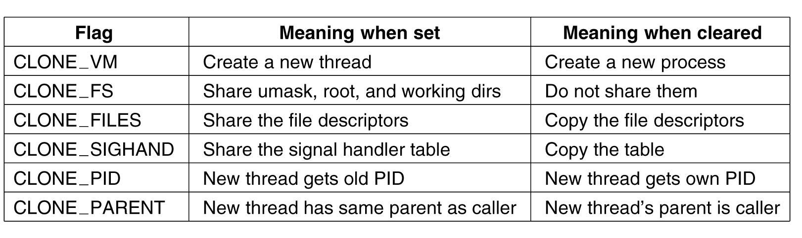
The Clone System Call
Bits in the sharing_flags bitmap.
Notes:
cs431-cotter

Slide 48
Clone Example
#include <stdio.h>, <math.h>, <sys/time.h>, <sys/types.h>, <sched.h>
#define LB_SIZE 128
int flag;
extern int errno;
int main (int argc, char * argv[])
{
time_t now;
char lineBuf[LB_SIZE];
pid_t pid;
int childno = 1, mainnum = 0;
void *csp, *tcsp;
void test (void *childnum); //function prototype
Notes:
cs431-cotter
cs431-cotter

Slide 49
Clone Example
csp=(int *)malloc(8192*8); //create a new stack
if(csp)
tcsp=csp+8192*8; //move pointer to the end of the stack
else
exit(errno);
time (&now);
printf ("Clone Test run on %s\n\n", ctime(&now));
flag = 0;
childno = 1;
if (( pid = __clone( (void *)&test, tcsp, CLONE_VM,
(void *)&childno )) < 0)
{
printf("Couldn't create new thread!\n");
exit(1);
}
Notes:
cs431-cotter
cs431-cotter

Slide 50
Clone Example
else { //we're in main
while (flag == 0) ;
printf("Just created thread %d\n", pid);
}
test(&mainnum);
printf ("Main program is now shutting down\n\n");
return 0;
}
void* test(void * arg) {
int childnum;
flag = 1;
childnum = *(int *) arg;
printf("Thread %d work cycle\n",childnum);
sleep (3);
}
Notes:
cs431-cotter
cs431-cotter

Slide 51
Clone Example (Output)
[root]@bobs-RHLINUX cs431_linux]# gcc -o clone_test proctest_v6.c
[root]@bobs-RHLINUX cs431_linux]# ./clone_test
Clone Test run on Fri Jan 12 14:49:30 2001
Thread 1 work cycle
Just created thread 430
Thread 0 work cycle
Main program is now shutting down
Notes:
cs431-cotter
cs431-cotter

Slide 52
Summary
Linux schedules threads for execution.
Linux supports creation of new processes and threads
  Fork(): create a duplicate process
  Exec*(): create a new process
  Pthread_create(): create a POSIX thread
  Clone(): Create a Linux native thread

Slide 53
File management system calls

Slide 54
• A FILE MANAGEMENT Primer
- File-management system calls
allow you to manipulate the full collection of regular, directory,
and special files, including:
 disk-based files
 terminals
 printers
 interprocess communication facilities, such as pipes and sockets
- open() is initially used to access or create a file.
If system call succeeds,
it returns a small integer called a file descriptor that is used in
subsequent I/O operations on that file.

Slide 55
- A typical sequence of events:
int fd; /* File descriptor */
…
fd = open( fileName, … ); /* Open file, return file descriptor */
if ( fd==-1 ) { /* Deal with error condition */ }
…
fcntl( fd, … ); /* Set some I/O flags if necessary */
…
read( fd, … ); /* Read from file */
…
write( fd, …); /* Write to file */
…
lseek( fd, …); /* Seek within file */
…
close(fd); /* Close the file, freeing file descriptor */

Slide 56
- When a process no longer needs to access an open file,
it should close it using the “close” system call.
- All of a process’ open files are automatically closed
when the process terminates.
but, it’s better programming practice to explicitly close your files.
- File descriptors are numbered sequentially, starting from zero.
By convention,
the first three file descriptor values have a special meaning:
Value Meaning
0 standard input
1 standard output
2 standard error

Slide 57
- For Example,
the “printf()” library function always sends its output
using file descriptor 1.
the “scanf()” always reads its input using file descriptor 0.
Fd1
File
Fd2
Many file descriptors, one file
Fd3

Slide 58
• File Pointer
- A single file may be opened several times and, thus may have several
file descriptors associated with it:
Each file descriptor has its own private set of properties:
A file pointer that records the offset in the file where it is reading and
or writing.
When a file descriptor is created, its file pointer is positioned
at offset 0 in the file (the first character) by default.
As the process reads and/or writes,
the file pointer is updated accordingly.

Slide 59
• THE MOST BASIC I/O SYSTEM CALLS
Name Function
open opens/creates a file
read reads bytes from a file into a buffer
write writes bytes from a buffer to a file
lseek moves to a particular offset in a file
close closes a file
unlink removes a file

Slide 60
• Opening a File: open()
System Call: int open( char* fileName, int mode[, int permissions])
“open()” allows you to open or create a file for reading and/or writing.
fileName : an absolute or relative pathname,
mode : a bitwise of a read/write flag together with zero or
more miscellaneous flags.
permission : a number that encodes the value of the file’s permission
flags.
- The permissions value is affected by the process’umask value that
we studied earlier.

Slide 61
- The read/write flags are as follows:
FLAG MEANING
O_RDONLY Open for read only.
O_WRONLY Open for write only.
O_RDWR Open for both read and write.
- The miscellaneous flags are as follows:
FLAG MEANING
O_APPEND Position the file pointer at the end of the file
before each “write()”.
O_CREAT If the file doesn’t exist, create the file and
set the owner ID to the process’ effective UID.
O_EXCL If O_CREAT is set and the file exists,
then “open()” fails.
O_TRUNC If the file exists, it is truncated to length zero.

Slide 62
• Creating a File
- To create a file, use the O_CREAT flags as part of the mode flags and
supply the initial file-permission flag settings as an octal value.
sprintf( tmpName, “.rev.%d”, getpid() ); /* Random name */
/* Create temporary file to store copy of input */
tmpfd = open( tmpName, O_CREAT | O_RDWR, 0600);
if ( tmpfd== -1 ) fatalError();
- The “getpid()” function is a system call
that returns the process’ID(PID), which is guaranteed to be unique.
- Files that begin with a period are sometimes known as hidden files.
it doesn’t show up in an ls listing.

Slide 63
- To open an existing file, specify the mode flags only.
fd = open( fileName, O_RDONLY );
if ( fd== -1 ) fatalError();

Slide 64
- Reading From a File : read()
To read bytes from a file, it uses the “read()” system call,
System Call: ssize_t read( int fd, void* buf, size_t count)
“read()” copies count bytes from the file referenced
by the file descriptor fd into the buffer buf.
- if we read one character of input at a time,
⇨ a large number of system calls,
thus slowing down the execution of our program considerably.
⇨ to read up to “BUFFER_SIZE” characters at a time.
charsRead = read( fd, buffer, BUFFER_SIZE );
if ( charsRead == 0 ) break; /* EOF */
if ( charsRead == -1 ) fatalError(); /* Error */

Slide 65
- Writing to a File: write()
To write bytes to a file, it uses the “write()” system call,
which works as follows:
System Call: ssize_t write( int fd, void* buf, size_t count)
“write()” copies count bytes from a buffer buf to the file referenced
by the file descriptor fd.
If the O_APPEND flag was set for fd, the file position is set to the end
of the file before each “write”.
If successful, “write()” returns the number of bytes that were
written; otherwise, it returns a value of -1.

Slide 66
- Perform the “write” operation:
/* Copy line to temporary file if reading standard input */
if ( standardInput )
{
charsWritten = write(tmpfd, buffer, charsRead );
if ( charsWritten != charsRead ) fatalError();
}

Slide 67
- Moving in a File : lseek()
System Call: off_t lseek( int fd, off_t offset, int mode )
“lseek()” allows you to change a descriptor’s current file position.
fd : the file descriptor,
offset : a long integer,
mode : how offset should be interpreted.
- The three possible values of mode
VALUE MEANING
SEEK_SET offset is relative to the start of the file.
SEEK_CUR offset is relative to the current file position.
SEEK_END offset is relative to the end of the file.

Slide 68
$ cat sparse.c ---> list the test file.
#include <fcntl.h>
#include <stdio.h>
#include <stdlib.h>
/*************************************************/
main()
{
int i, fd;
/* Creates a sparse file */
fd = open(“sparse.txt”, O_CREAT | O_RDWR, 0600 );
write( fd, “space”, 6);
lseek( fd, 60006, SEEK_SET );
write( fd, “file”, 4 );
close(fd);
/* Create a normal file */
fd = open(“normal.txt”, O_CREAT | O_RDWR, 0600 );
write( fd, “normal”, 6 );
for ( i=1; i<=60000; i++ )
write( fd, “/0”, 1 );

Slide 69
write( fd, “file”, 4 );
close(fd);
}
$ sparse ---> execute the file.
$ ls -l *.txt ---> look at the files.
-rw-r--r-- 1 glass 60010 Feb 14 15:06 normal.txt
-rw-r--r-- 1 glass 60010 Feb 14 15:06 sparse.txt
$ ls -s *.txt ---> list their block usage.
60 normal.txt* ---> uses a full 60 blocks.
8 sparse.txt* ---> only uses eight blocks.
$ _

Slide 70
• Closing a File: “close()”
- uses the “close()” system call to free the file descriptor of the input.
System Call : int close(int fd)
“close()” frees the file descriptor fd.
If fd is the last file descriptor associated with a particular open file,
the kernel resources associated with the file are deallocated.
If successful, “close()” returns a value of 0;
otherwise, it returns a value of -1.
close(fd); /* Close input file */

Slide 71
• Deleting a File: unlink()
System Call: int unlink( const char* fileName )
“unlink()” removes the hard link from the name fileName to its file.
If fileName is the last link to the file,
the file’s resources are deallocated.
An executable file can “unlink” itself during execution
and still continue to completion.
If successful, “unlink()” returns a value of 0;
otherwise, it returns a value of -1.

Slide 72
• Obtaining File Information: stat(), lstat(), and fstat()
System Call : int stat( const char* name, struct stat* buf )
int lstat( const char* name, struct stat* buf )
int fstat( int fd, struct stat* buf )
“stat()” fills the buffer buf with information about the file name.
The “stat” structure is defined in “/usr/include/sys/stat.h”.
“lstat()” returns information about a symbolic link itself rather than
the file that it references.
“fstat()” performs the same function as “stat()”, except that it takes
the file descriptor of the file to be “stat” end as its first parameter.

Slide 73
• Obtaining File Information: stat(), lstat(), and fstat()
- The “stat” structure contains the following members:
NAME MEANING
st_dev the device number
st_ino the inode number
st_mode the permission flags
st_nlink the hard-link count
st_uid the user ID
st_gid the group ID
st_size the file size
st_atime the last access time
st_mtime the last modification time
st_ctime the last status-change time

Slide 74
• Obtaining File Information: stat(), lstat(), and fstat()
- some predefined macros defined in “/usr/include/sys/stat.h”
“st_mode” as their argument and return true( a value of 1 ) for
the following file types:
MACRO RETURNS TRUE FOR FILE TYPE
S_IFDIR directory
S_IFCHR character special device
S_IFBLK block special device
S_IFREG regular file
S_IFFIFO pipe
S_IFDIR(buf.st_mode);

Slide 75
• Creating Hard Links: Link
- “link()” creates a hard link to an exsiting file and works as follows:
System Call : int link( const char* oldPath, const char* newPath )
“link()” creates a new label newPath and links it to the same file
to which the label oldPath is linked.
The hard-link count of the associated file is incremented by one.
If oldPath and newPath reside on different physical devices,
a hard link cannot be made and “link()” fails.
“link()” returns a value of -1
if unsuccessful and a value of 0 otherwise.

Slide 76
$ cat mylink.c ---> list the program.
main()
{
link(“orginal.txt”, “another.txt”);
}
$ cat original.txt ---> list original file.
this is a file.
$ ls -l original.txt another.txt ---> examine the files before.
another.txt not found
-rw-r--r-- 1 glass 16 May 25 12:18 original.txt
$ mylink ---> run the program.
$ ls -l original.txt another.txt ---> examine files after.
-rw-r--r-- 2 glass 16 May 25 12:18 another.txt
-rw-r--r-- 2 glass 16 May 25 12:18 original.txt
$ cat >> another.txt ---> alter “another.txt”.
hi
^D

Slide 77
$ ls -l original.txt another.txt ---> both labels reflect the change.
-rw-r--r-- 2 glass 20 May 25 12:19 another.txt
-rw-r--r-- 2 glass 20 May 25 12:19 original.txt
$ rm original.txt ---> remove original label.
$ ls -l original.txt another.txt ---> examine labels.
original.txt not found
-rw-r--r-- 1 glass 20 May 25 12:19 another.txt
$ cat another.txt ---> list contents via other label.
this is a file.
hi
$ -

Slide 78
• Directory Management Calls
mkdir – make a directory relative to directory file descriptor
err = mkdir(const char *path, mode_t mode);
  The mkdir() function shall create a new directory with name path. The new directory access rights shall be initialized from mode.
rmdir – remove a directory
err = rmdir(const char *path);
  The rmdir() function shall remove a directory whose name is given by path. The directory shall be removed only if it is an empty directory.
chdir – change working directory
err = chdir(const char *path);
  The chdir() function shall cause the directory named by the pathname pointed to by the path argument to become the current working directory. Working directory is the starting point for path searches for relative pathnames.

Slide 79
• Directory Management Calls
opendir – open a directory file for reading
DIR *opendir(const char *name);
closedir – close a directory
int closedir(DIR *dir);
readdir – read a directory
struct dirent *readdir(DIR *dir);
  The readdir() function returns a pointer to a dirent structure representing the next directory entry in the directory stream pointed to by dir. It returns NULL on reaching the end of the directory stream or if an error occurred.
struct dirent {
ino_t d_ino; /* inode number */
off_t d_off; /* offset to the next dirent */
unsigned short d_reclen; /* length of this record */
unsigned char d_type; /* type of file; not supported
by all file system types */
char d_name[256]; /* filename */
};

Slide 80
• Miscellaneous File Management System Calls
- a brief description of the following miscellaneous file management
system calls:
NAME Function
chown changes a file’s owner and/or group
chmod changes a file’s permission settings
dup duplicates a file descriptor
dup2 similar to dup
fchown works just like chown
fchmod works just like chmod
fcntl gives access to miscellaneous file characteristics
ftruncate works just like truncate
ioctl controls a device
link creates a hard link
mknod creates a special file
sync schedulers all file buffers to be flushed to disk
truncate truncates a file
Jump to Signal

Slide 81
• Changing a File’s Owner and/or Group: chown(),
ichown() and fchown()
- “chown()” and “fchown()” change the owner and/or group of a file and
work like this:
System Call: int chown( const char* fileName, uid_t ownerId,
gid_t groupId )
int lchown( const char* fileName, uid_t ownerId,
git_t groupId )
int fchown( int fd, uid_t ownerId, gid_t groupId )
- “chown()” causes the owner and group IDs of fileName to be changed
to ownerId and groupId, respectively.
A value of -1 in a particular field means that its associated value
should remain unchanged.
lchown():changes the ownership of a symbolic link
fchown():takes an open descriptor as an argument instead of a filename.

Slide 82
• Changing a File’s Owner and/or Group: chown(),
ichown() and fchown()
- Example, changed the group of the file “test.txt” from “music” to “cs”.
which has a group ID number of 62.
$ cat mychown.c ---> list the program.
main()
{
int flag;
flag = chown(“test.txt”, -1, 62 ); /* Leave user ID uchanged */
if ( flag == -1 ) perror(“mychown.c”);
}
$ ls -lg test.txt ---> examine file before the change.
-rw-r--r-- 1 glass music 3 May 25 11:42 test.txt
$ mychown ---> run program.
$ ls -lg test.txt ---> examine file after the change.
-rw-r--r-- 1 glass cs 3 May 25 11:42 test.txt
$ -

Slide 83
• Changing a File’s Permissions: chmod() and fchmod()
- “chmod()” and “fchmod()” change a file’s permission flags
System Call : int chmod( const char* fileName, int mode )
int fchmod( int fd, mode_t mode );
“chmod()” changes the mode of fileName to mode,
where mode is usually supplied as an octal number,
To change a file’s mode, you must either own it or be a super-user.
“fchmod()” works just like “chmod()” except that it takes an open
file descriptor as an argument instead of a filename.
They both return a value of -1 if unsuccessful,
and a value of 0 otherwise.

Slide 84
• Changing a File’s Permissions: chmod() and fchmod()
- changed the permission flags of the file “test.txt” to 600 octal,
which corresponds to read and write permission for the owner only:
$ cat mychmod.c ---> list the program.
main()
{
int flag;
flag = chmod(“test.txt”, 0600); /* Use an octal encoding */
if ( flag==-1 ) perror(“mychmod.c”);
}
$ ls -l test.txt ---> examine file before the change.
-rw-r--r-- 1 glass 3 May 25 11:42 test.txt
$ mychmod ---> run the program.
$ ls -l test.txt ---> examine file after the change.
-rw------- 1 glass 3 May 25 11:42 test.txt
$ -

Slide 85
• Duplicating a File Descriptor: dup() and dup2()
- “dup()”, “dup2()”
to duplicate file descriptors, and they work like this:
System call: int dup( int oldFd )
int dup2( int oldFd, int newFd )
“dup()” finds the smallest free file-descriptor entry and points it
to the same file to which oldFd points.
“dup2()” closes newFd if it’s currently active and then points it
to the same file to which oldFd points.
- the original and copied file descriptors share the same file pointer
and access mode.
- return the index of the new file descriptor if successful and a value of
-1 otherwise.

Slide 86
• Duplicating a File Descriptor: dup() and dup2()
- I created a file called “test.txt” and wrote to it via four different file
descriptors:
The first file descriptor was the original descriptor.
The second descriptor was a copy of the first, allocated in slot 4.
The third descriptor was a copy of the first, allocated in slot 0
( the standard input channel ), which was freed by the “close(0)”
statement.
The fourth descriptor was a copy of the third descriptor,
copied over the existing descriptor in slot 2
( the standard error channel ).

Slide 87
• Duplicating a File Descriptor: dup() and dup2()
$ cat mydup.c ---> list the file.
#include <stdio.h>
#include <fcntl.h>
main()
{
int fd1, fd2, fd3;
fd1 = open( “test.txt”, O_RDWR | O_TRUNC );
printf(“fd1 = %d”\n”, fd1 );
write( fd1, “what’s “, 6 );
fd2 = dup(fd1); /* Make a copy of fd1 */
printf( “fd2=%d\n”, fd2);
write( fd2, “up”, 3 );
close(0); /* Close standard input */
fd3 = dup(fd1); /* Make another copy of fd1 */
printf(“fd3 = %d\n”, fd3);
write(0, “ doc“, 4);
dup2(3,2); /* Duplicate channel 3 to channel 2 */
write(2, “?\n”, 2 );
}

Slide 88
• Duplicating a File Descriptor: dup() and dup2()
$ mydup ---> run the program.
fd1 = 3
fd2 = 4
fd3 = 0
$ cat test.txt ---> list the output file.
what’s up doc?
$ -

Slide 89
• File Descriptor Operations: fcntl()
- “fcntl()” directly controls the settings of the flags associated with
a file descriptor, and it works as follows:
System Call : int fcntl( int fd, int cmd, int arg )
“fcntl()” performs the operation encoded by cmd on the file associated
with the file descriptor fd.
arg is an optional argument for cmd.

Slide 90
• File Descriptor Operations: fcntl()
- Here are the most common values of cmd:
VALUE OPERATION
F_SETFD set the close-on-exec flag to the lowest bit of arg
( 0 or 1 )
F_GETFD return a number whose lowest bit is 1
if the close-on-exec flag is set and 0 otherwise.
F_GETFL return a number corresponding to the current
file status flags and access modes.
F_SETFL set the current file-status flags to arg.
F_GETOWN return the process ID or process group that is
currently set to receive SIGIO/SIGURG signals.
F_SETOWN set the process ID or process group that should
receive SIGIO/SIGURG signals to arg.

Slide 91
• File Descriptor Operations: fcntl()
$ cat myfcntl.c ---> list the program.
#include <stdio.h>
#include <fcntl.h>
main()
{
int fd;
fd = open(“test.txt”, O_WRONLY ); /* Open file for writing */
write( fd, “hi there\n”, 9 );
lseek( fd, 0, SEEK_SET ); /* Seek to beginning of file */
fcntl(fd, F_SETFL, O_WRONLY | O_APPEND ); /* Set APPEND flag */
write( fd, “ guys\n”, 6 );
close( fd );
}
$ cat test.txt ---> list the original file.
here are the contents of
the original file.
$ myfcntl ---> run the program.

Slide 92
• File Descriptor Operations: fcntl()
$ cat test.txt ---> list the new contents.
hi there
the contents of
the original file.
guys ---> note that “guys” is at the end.
$ -

Slide 93
• Controlling Devices: ioctl()
- “ioctl()” performs many controlling functions on an input/output
channel and works
System Call: int ioctl( int fd, int cmd, int arg )
“ioctl()” performs the operation encoded by cmd on the file associated
with the file descriptor fd.
arg is an optional argument for cmd.
- “ioctl()” returns a value of -1 if unsuccessful.

Slide 94
• Creating Special Files: mknod()
- “mknod()” allows you to create a special file, and it works like this:
System Call: int mknod( const char* fileName, mode_t type,
dev_t device )
“mknod()” creates a new regular, directory, or special file called
fileName whose type can be one of the following:
VALUE MEANING
S_IFDIR directory
S_IFCHR character-oriented file
S_IFBLK block-oriented file
S_IFREG regular file
S_IFIFO named pipe

Slide 95
• Creating Special Files: mknod()
- If the file is a character-or block-oriented file,
the low-order byte of device
should specify the minor device number,
the high-order byte
should specify the major device number.
In other cases, the value of device is ignored.
- Only a super-user can use “mknod()” to create directories,
character-oriented files, or block-oriented special files.
- It is typical now to use the “mkdir()” system call to create directories.
“mknod()” returns a value of -1 if unsuccessful
and a value of 0 otherwise.

Slide 96
• Flushing the File-System Buffer: sync()
- “sync()” flushes the file-system buffers and works as follow:
System Call : void sync()
“sync()” schedules all of the file system buffers to be written to disk.
“sync()” should be performed by any programs that bypass the file
system buffers and examine the raw file system.
“sync()” always succeeds.

Slide 97
• Truncating a File: truncate() and ftruncate()
- “truncate()” and “ftruncate()” set the length of a file,
System Call: int truncate( const char* fileName, off_t length )
int ftruncate( int fd, off_t length )
“truncate()” sets the length of the file fileName to be length bytes,
If the file is longer than length, it is truncated.
If it is shorter than length, it is padded with ASCII NULLS.
“ftruncate()” works just like “truncate()” does, except that it takes
an open file descriptor as an argument instead of a filename.
They both return a value of -1 if unsuccessful
and a value of 0 otherwise.

Slide 98
• Truncating a File: truncate() and ftruncate()
$ cat truncate.c ---> list the program.
main()
{
truncate(“file1.txt”, 10);
truncate(“file2.txt”, 10);
}
$ cat file1.txt ---> list “file1.txt”.
short
$ cat file2.txt ---> list “file2.txt”.
long file with lots of letters
$ ls -l file*.txt ---> examine both files.
-rw-r--r-- 1 glass 6 May 25 12:16 file1.txt
-rw-r--r-- 1 glass 32 May 25 12:17 file2.txt
$ truncate ---> run the program.
$ ls -l file*.txt ---> examine both files again.
-rw-r--r-- 1 glass 10 May 25 12:16 file1.txt
-rw-r--r-- 1 glass 10 May 25 12:17 file2.txt

Slide 99
• Truncating a File: truncate() and ftruncate()
$ cat file1.txt ---> “file1.txt” is longer.
short
$ cat file2.txt ---> “file2.txt” is shorter.
long file
$ -

Slide 100
Signals

Slide 101
• SIGNALS
- Program must sometimes deal with unexpected or unpredictable
events, such as :
 a floating point error
 a power failure
 an alarm clock “ring”
 the death of a child process
 a termination request from a user ( i.e., Control-C )
 a suspend request from a user ( i.e., Control-Z )
- These kind of events are sometimes called interrupts,
as they must interrupt the regular flow of a program in order to
be processed.
- When UNIX recognizes that such an event has occurred,
it sends the corresponding process a signal.

Slide 102
• SIGNALS
- There is a unique, numbered signal for each possible event.
For example,
if a process causes a floating point error,
the kernel sends the offending process signal number 8:
Signal Process
#8
Floating point error signal

Slide 103
• SIGNALS
- any process can send any other process a signal,
as long as it has permission to do so.
- A programmer may arrange for a particular signal to be ignored or
to be processed by a special piece of code called a signal handler.
- the process that receives the signal
1) suspends its current flow of control,
2) executes the signal handler,
3) and then resumes the original flow of control
when the signal handler finishes.

Slide 104
• SIGNALS
- Signals are defined in “/usr/include/sys/signal.h”.
The default handler usually performs one of the following actions:
 terminate the process and generate a core file ( dump )
 terminate the process without generating a core image file ( quit )
 ignore and discard the signal ( ignore )
 suspend the process ( suspend )
 resume the process

Slide 105
• A List of Signals
- Here’s a list of the System V predefined signals,
along with their respective macro definitions, numerical values,
and default actions, as well as a brief description of each:
Macro # Default Description
SIGHUP 1 quit hang up
SIGINT 2 quit interrupt
SIGQUIT 3 dump quit
SIGILL 4 dump illegal instruction
SIGTRAP 5 dump trace trap( used by debuggers )
SIGABRT 6 dump abort
SIGEMT 7 dump emulator trap instruction
SIGFPE 8 dump arithmetic execution
SIGKILL 9 quit kill( cannot be caught, blocked, or ignored )
SIGBUS 10 dump bus error( bad format address )

Slide 106
• A List of Signals
Macro # Default Description
SIGSEGV 11 dump segmentation violation(out-of-range address)
SIGSYS 12 dump bad argument to system call
SIGPIPE 13 quit write on a pipe or other socket with no one
to read it.
SIGALRM 14 quit alarm clock
SIGTERM 15 quit software termination signal(default signal
sent by kill )
SIGUSR1 16 quit user signal 1
SIGUSR2 17 quit user signal 2
SIGCHLD 18 ignore child status changed
SIGPWR 19 ignore power fail or restart
SIGWINCH 20 ignore window size change
SIGURG 21 ignore urgent socket condition
SIGPOLL 22 ignore pollable event

Slide 107
• A List of Signals
Macro # Default Description
SIGSTOP 23 quit stopped(signal)
SIGSTP 24 quit stopped(user)
SIGCONT 25 ignore continued
SIGTTIN 26 quit stopped( tty input )
SIGTTOU 27 quit stopped( tty output )
SIGVTALRM 28 quit virtual timer expired
SIGPROF 29 quit profiling timer expired
SIGXCPU 30 dump CPU time limit exceeded
SIGXFSZ 31 dump file size limit exceeded

Slide 108
• Terminal Signals
- The easiest way to send a signal to a foreground process is
by pressing Control-C or Control-Z from the keyboard.
- When the terminal driver
( the piece of software that supports the terminal )
recognizes that Control-C was pressed.
it sends a SIGINT signal to all of the processes
in the current foreground job.
- Similarly, Control-Z causes it to send a SIGTSTP signal to all of the
processes in the current foreground job.
- By default,
SIGINT terminates a process and SIGTSTP suspends a process.

Slide 109
• Requesting an Alarm Signal : alarm()
- SIGALRM, by using “alarm()”.
The default handler for this signal displays the message “Alarm clock”
and terminates the process.
Here’s how “alarm()” works:
System Call : unsigned int alarm( unsigned int count )
“alarm()” instructs the kernel to send the SIGALRM signal to
the calling process after count seconds.
If an alarm had already been scheduled, that alarm is overwritten.
If count is 0, any pending alarm requests are cancelled.
“alarm()” returns the number of seconds
that remain until the alarm signal is sent.

Slide 110
• Requesting an Alarm Signal : alarm()
- a small program that uses “alarm()”, together with its output:
$ cat alarm.c ---> list the program.
#include <stdio.h>
main()
{
alarm(3); /* Schedule an alarm signal in three seconds */
printf(“Looping forever… \n”);
while(1) ;
printf(“This line should never be executed \n”);
}
$ alarm ---> run the program.
Looping forever…
Alarm clock ---> occurs three seconds later.
$ -

Slide 111
• Handling Signals : signal()
System Call: void(*signal(int sigCode, void (*func)(int))) (int)
“signal()” allows a process to specify the action that it will take
when a particular signal is received.
The parameter sigCode specifies the number of the signal that is to
be reprogrammed, and func may be one of several values:
 SIG_IGN, which indicates that the specified signal should be
ignored and discarded.
 SIG_DFL, which indicates that the kernel’s default handler should
be used.
 an address of a user-defined function, which indicates
that the function should be executed when the specified signal
arrives.

Slide 112
Handling Signals : signal()
“signal()” returns the previous func value associated with sigCode
if successful; otherwise, it returns a value of -1.
- The “signal()” system call may be used to override the default action.

Slide 113
• Handling Signals: signal()
System Call: int pause(void)
“pause()” suspends the calling process and returns
when the calling process receives a signal.
It is most often used to wait efficiently for an alarm signal.
“pause()” doesn’t return anything useful.

Slide 114
• Handling Signals: signal()
$ cat handler.c ---> list the program.
#include <stdio.h>
#include <signal.h>
int alarmFlag = 0; /* Global alarm flag */
void alarmHandler(); /* Forward declaration of alarm handler */
/***************************************************/
main()
{
signal( SIGALRM, alarmHandler ); /* Install signal handler */
alarm(3); /* Schedule an alarm signal in three seconds */
printf(“Looping…\n”);
while( !alarmFlag ) /* Loop until flag set */
{
pause(); /* Wait for a signal */
}
printf(“Loop ends due to alarm signal \n”);
}

Slide 115
• Handling Signals: signal()
/*************************************************/
void alarmHandler()
{
printf(“An alarm clock signal was received \n”);
alarmFlag=1;
}
$ handler ---> run the program.
Looping…
An alarm clock signal was received ---> occurs three seconds later.
Loop ends due to alarm signal
$ _

Slide 116
• Sending Signals: kill()
- A process may send a signal to another process by using the “kill()”
system call.
- “kill()” is a misnomer, since many of the signals that it can send to
do not terminate a process.
- It’s called “kill()” because of historical reasons;
the main use of signals when UNIX was first designed
was to terminate processes.

Slide 117
• Sending Signals: kill()
System Call: int kill( pid_t pid, int sigCode )
“kill()” sends the signal with value sigCode to the process with PID pid.
There are a few variations on the way that “kill()” works:
If pid==0, the signal is sent to all of the processes in the sender’s
process group.
If pid==-1 and the sender is owned by a super-user,
the signal is sent to all processes, including the sender.
If pid<0, but not -1,
the signal is sent to all of the processes in the process group.

Slide 118
• Death of Children
- When a parent’s child terminates, the child process sends its parent
a SIGCHLD signal.
- A parent process often installs a handler to deal with this signal;
this handler typically executes a “wait()” system call to accept
the child’s termination code and let the child dezombify.
- the parent can choose to ignore SIGCHLD signals,
in which case the child dezombifies automatically.

Slide 119
• Death of Children
- Here’s the source code for and sample output from the program.
$ cat limit.c ---> list the program.
#include <stdio.h>
#include <signal.h>
int delay;
void childHandler();
/************************************************/
main( argc, argv )
int argc;
char* argv[];
{
int pid;
signal( SIGCHLD, childHandler ); /* Install death-of-child handler */
pid = fork(); /* Duplicate */
if ( pid == 0 ) /* Child */
{
execvp( argv[2], &argv[2] ); /* Execute command */

Slide 120
• Death of Children
perror(“limit”); /* Should never execute */
}
else /* Parent */
{
sscanf( argv[1], “%d”, &delay ); /* Read delay from command-line */
sleep(delay); /* Sleep for the specified number of seconds */
printf(“Child %d exceeded limit and is being killed \n”, pid );
kill( pid, SIGINT ); /* Kill the child */
}
}
/***************************************************/
void childHandler() /* Executed if the child dies before the parent */
{
int childPid, childStatus;
childPid = wait(&childStatus); /* Accept child’s termination code */
printf(“Child %d terminated within %d seconds \n”, childPid, delay);
exit(/* EXIT SUCCESS */ 0);
}

Slide 121
• Death of Children
- The program works by performing the following steps:
1. The parent process installs a SIGCHLD handler that is executed
when its child process terminates.
2. The parent process forks a child process to execute the command.
3. The parent process sleeps for the specified number of seconds.
when it wakes up, it sends its child process a SIGINT signal to kill it.
4. If the child terminates before its parent finishes sleeping,
the parent’s SIGCHLD handler is executed,
causing the parent to terminate immediately.

Slide 122
• Death of Children
$ limit 5 ls ---> run the program; command finishes OK.
a.out alarm critical handler limit
alarm.c critical.c handler.c limit.c
Child 4030 terminated within 5 seconds.
$ limit 4 sleep 100 ---> run it again; command takes too long
Child 4032 exceeded limit and is being killed.
$ -

