Slide 1
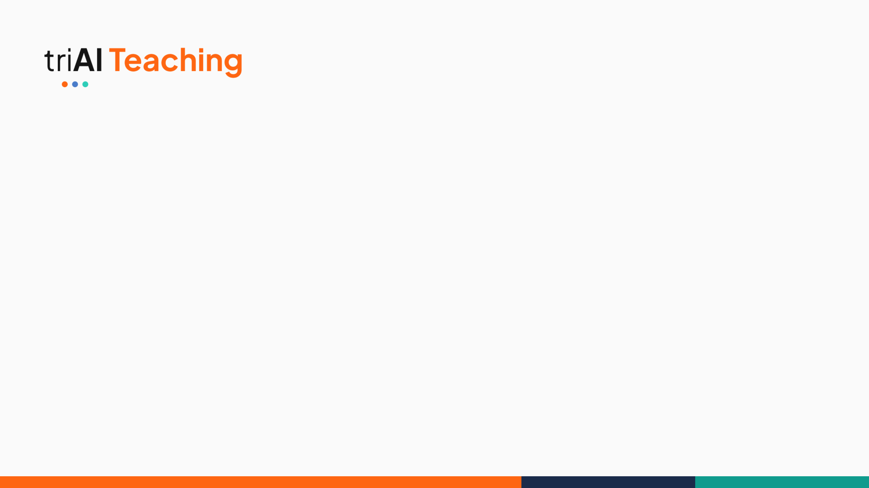

TEAM NYIRAGONGO | LATENT PROBE: TOXICITY DETECTION
Reading toxicity from a frozen language model's hidden states
One small, auditable linear probe on Gemma-2-2B · 92.35% on the held-out test
A signal flows through 26 frozen layers; we read it after block 14
Presented by: Blessings Mambwe · Team Nyiragongo
01
COHORT 10 · WORLDWIDE · 2026
Notes:
Hi everyone, we are Team Nyiragongo. Our project asks one question: can a tiny, auditable classifier read toxicity straight out of a frozen language model, without training the model at all? Short answer: yes, 92.35% on the held-out competition test. In five minutes I'll show you how we got there, including the versions that failed.

Slide 2
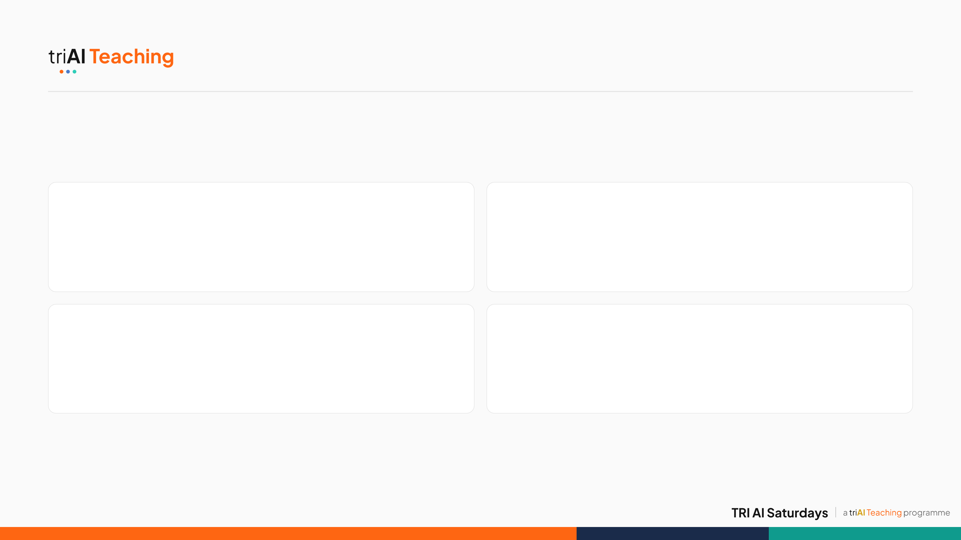
TEAM NYIRAGONGO
Meet Team Nyiragongo
Blessings Mambwe
Hamna Kaleem
Team lead · ML engineer
ML engineer · researcher
Built the final model and optimised it from 70% to 92.35%; coordinated team sessions.
Studied the refusal-direction paper and built test models for insights; researched techniques.
Fafemi Adeola
Musonda Musunga
Researcher · data
Researcher · ethics
Sourced and prepared the datasets; engineered our first models on the early datasets.
Researched techniques and led the literature review; wrote the ethics cards.
Mentor: Moses Olafenwa · Every member attended over 90% of team meetings
02
Notes:
We are Team Nyiragongo. I led the team, coordinated our sessions and built and optimised the final model. Hamna, our second ML engineer, studied the refusal-direction paper and built test models that shaped our next research question. Fafemi found and prepared our datasets and engineered our first models. Musonda led the literature review and techniques research and wrote our ethics cards. Everyone attended over 90% of our meetings, and our mentor was Moses Olafenwa.

Slide 3
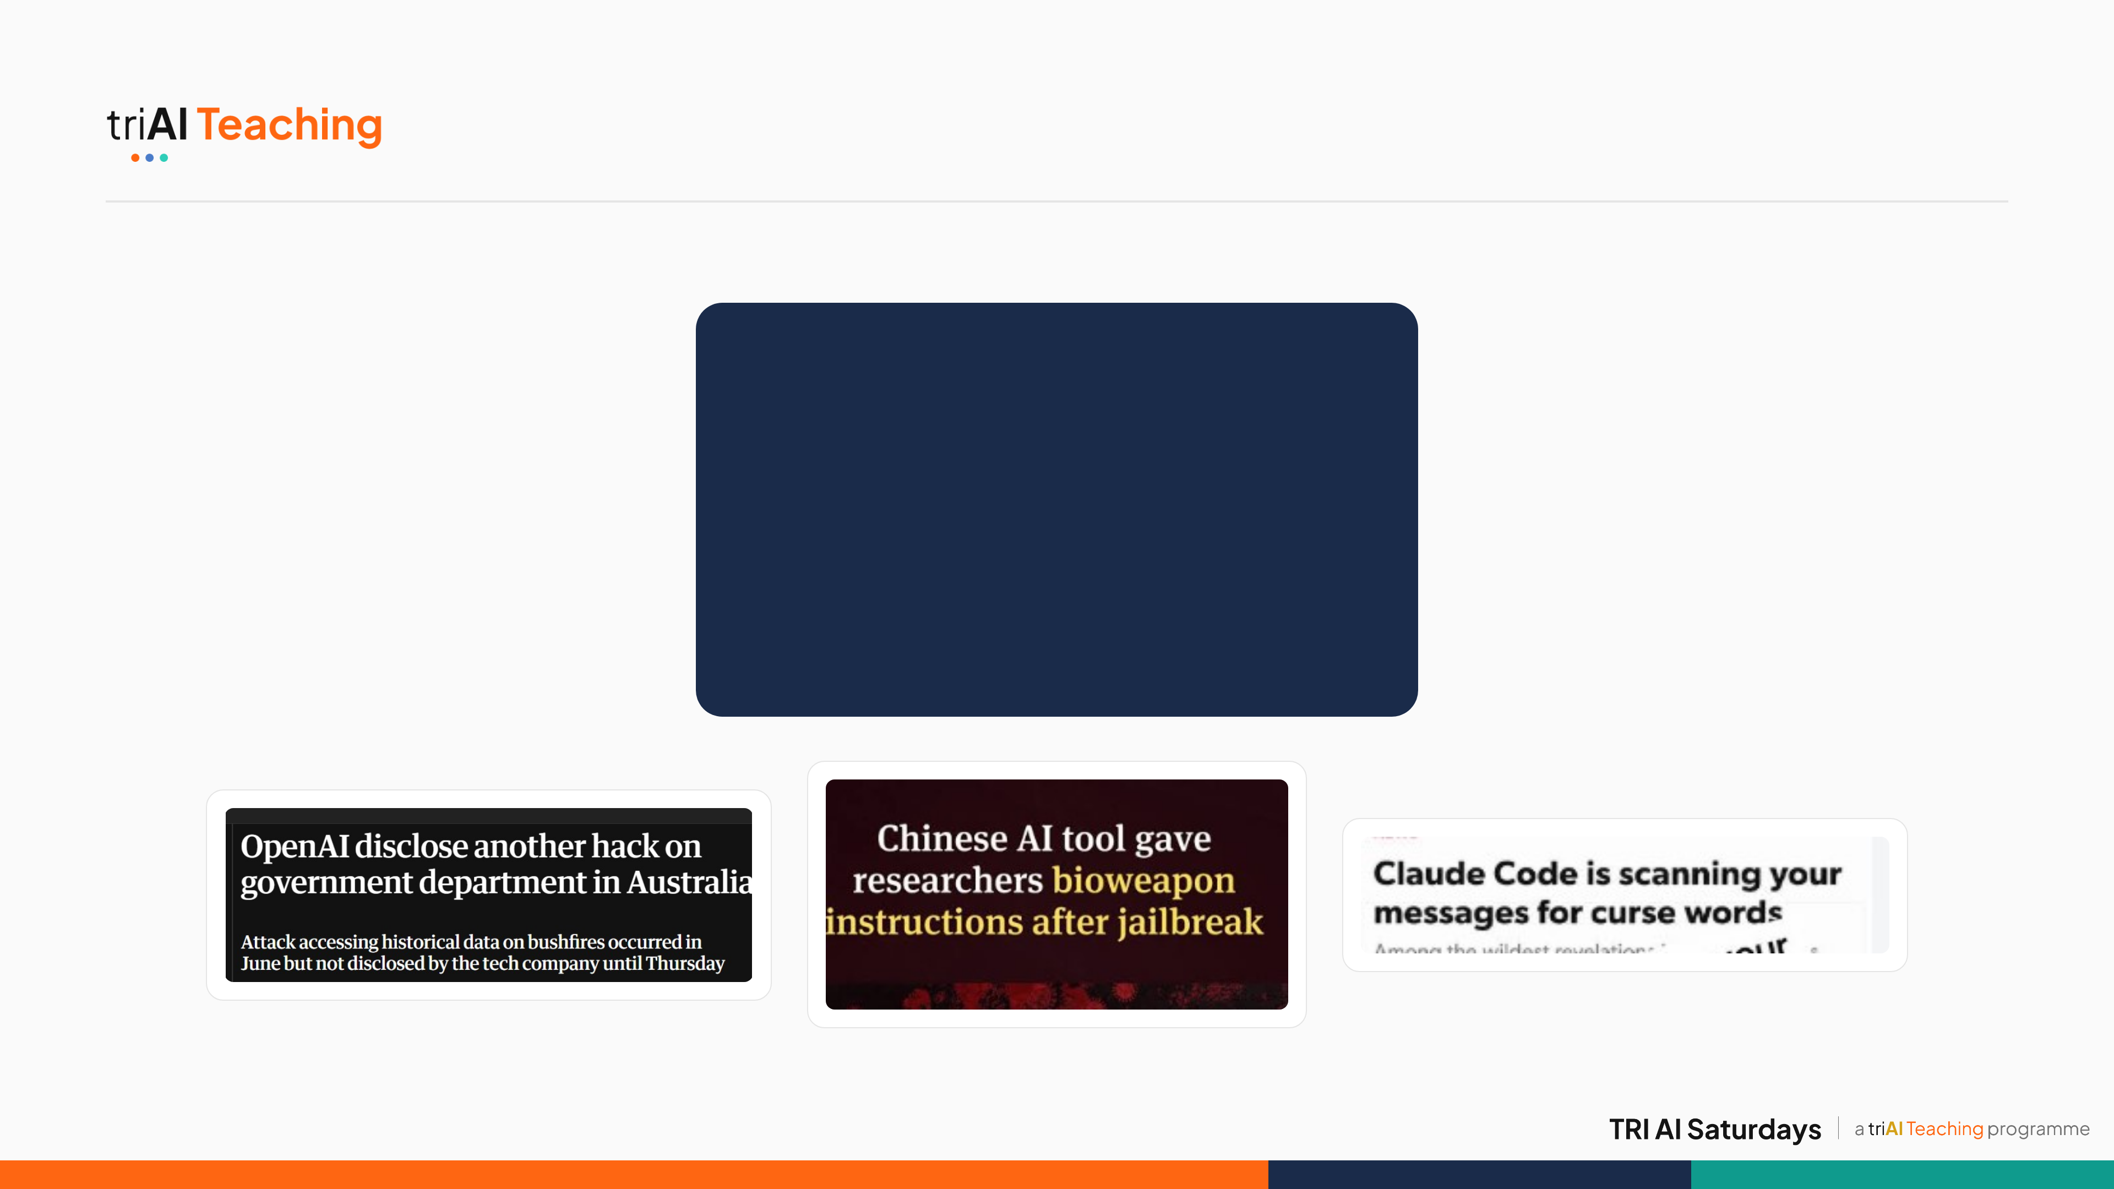

1 · PROBLEM · IN THE NEWS
03
Notes:
[Pause here — let the headlines speak for themselves before moving to the next slide.]

Slide 4
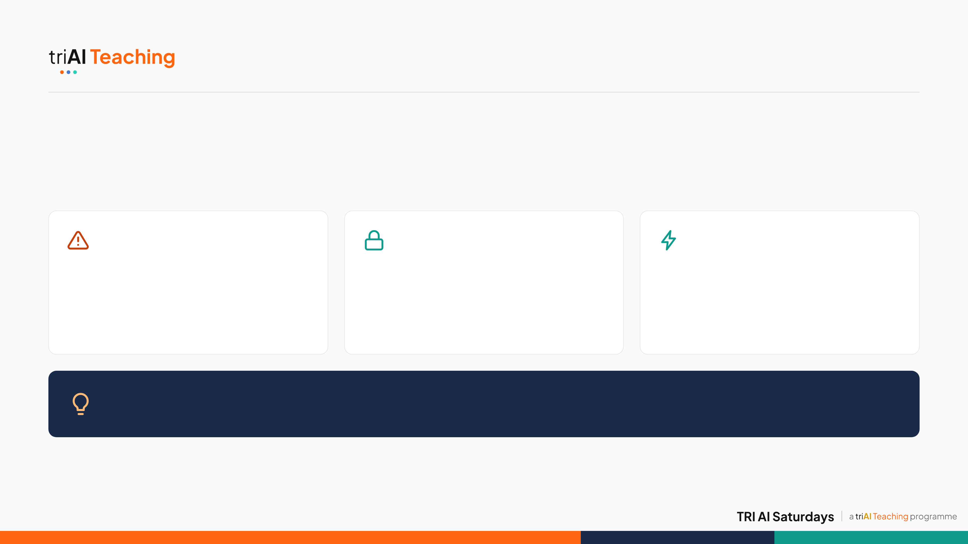
1 · PROBLEM · THE STAKES
When Guardrails Fail, What's at Risk?
Toxicity is the visible symptom. The disease is bigger.
Not just insults
Guardrails get bypassed
Agents, not just chat
Red-team studies show chatbots can be pushed into harmful instructions — self-harm, weapons, malware.
Jailbreaks can bypass safety training entirely — named directly in this competition's own problem statement.
As AI systems act as agents, chat-only safety checks stop covering what they quietly do.
The gap: safety training mostly watches inputs and outputs — the internal process where a model represents harmful intent stays opaque. Latent probing looks inside instead.
04
Notes:
Toxic comments are only the visible edge of a much bigger problem. The same underlying models can be pushed, through jailbreaks and adversarial prompts, into producing real harm: instructions for self-harm, for weapons, for malware. Current safety training is mostly a patch on the outside, watching what goes in and what comes out, while what happens inside the model, where harmful intent actually forms, stays a black box. That blind spot gets more dangerous as models act as autonomous agents, because there is no longer a human reading every token before something happens. That is the real stake behind this challenge's own problem statement. We start with toxicity in text because it is the one slice of that bigger problem with labelled data and a clear way to test whether latent probing works at all.

Slide 5
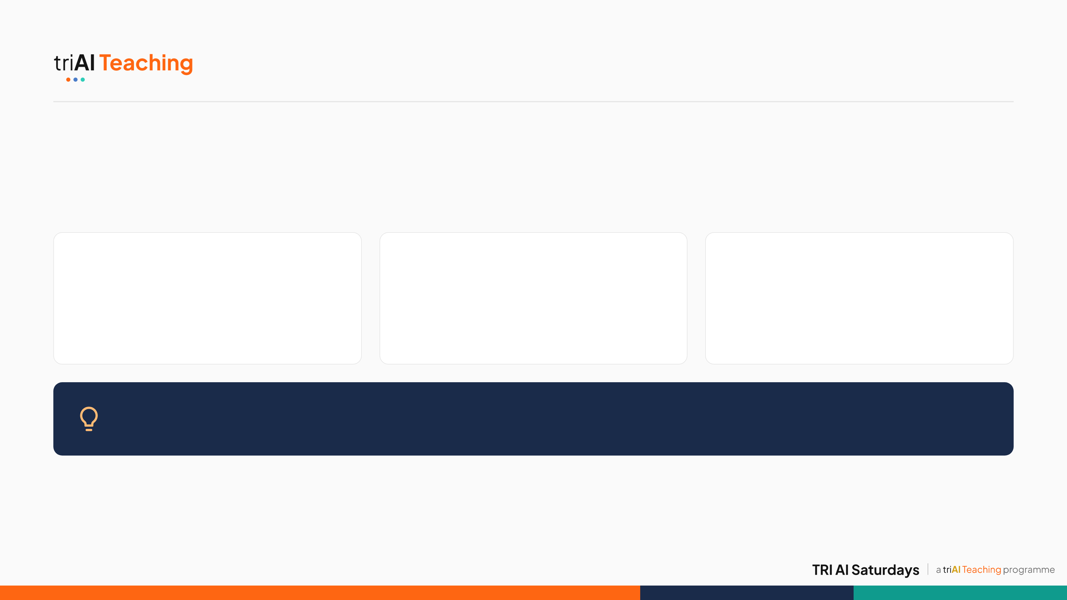
1 · PROBLEM · OUR TESTBED
Where Keyword Filters Fail
Our slice of that bigger problem: toxic and hostile text, where the signal is measurable.
Too much volume
Context matters
Real people pay
LLM outputs, chats and comments arrive faster than any human moderator can read.
Keywords miss implicit hostility and misread quotation, counterspeech, reclaimed terms and dialect.
Targets lose safety, moderators absorb the exposure, and communities get over-flagged.
Our reframe: not "can a model classify this text?" but "is toxicity already encoded inside a frozen LLM, and can a lightweight linear model read it out?"
05
Notes:
We chose text toxicity as our testbed because it is the one slice of the bigger safety problem with labelled data, a clear evaluation, and a competition to test it honestly. Toxic content is a volume problem and a context problem. Humans can't read it all, and keyword filters fail both ways: they miss polite-sounding hostility and flag people quoting slurs to condemn them, or using reclaimed words in their own dialect. The cost lands on real people. Our motivation: big language models already model context very well. So maybe the toxicity signal is already inside them, and we just need to read it out.

Slide 6
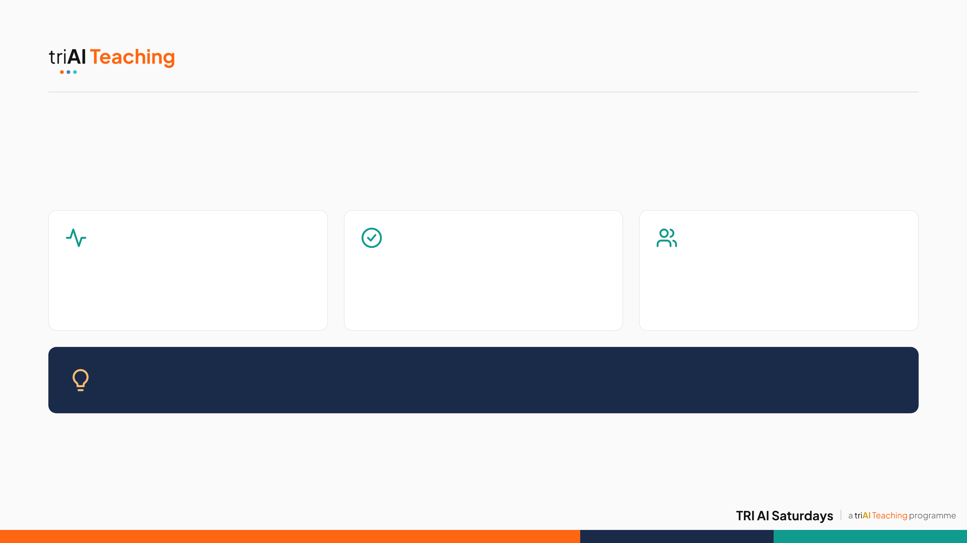
1 · PROBLEM · BACKGROUND RESEARCH
Our Research Starting Point
Before writing code, we studied how clinicians detect hostility.
Neuroscience
Clinical practice
Behavioural science
fMRI and EEG read hidden signals before behaviour shows.
Standardised scales (HCR-20, MOAS) keep every rater's score consistent.
Toxicity is covert; hostility is overt — two related but distinct constructs.
→ We read hidden states, not outputs
→ One consistent label across 13 datasets
→ Our label covers toxic and hostile
Our translation: clinicians separate internal signals from visible behaviour. A latent probe is an fMRI for a language model.
Grounded in Ivanova (2021), Li et al. (2023), Waldis et al. (2026) and Chia et al. (2025) — full list in our GitHub repo.
06
Notes:
Before writing any code, our team studied how humans detect toxicity and hostility. Neuroscience measures hidden signals with fMRI and EEG, for example amygdala reactivity to threat, before any behaviour appears. That became our design: read the model's hidden state, not its output. Clinicians use standardised tools like the HCR-20 and the Broset Violence Checklist so that different raters score consistently; that pushed us to map thirteen very different datasets onto one consistent label. And behavioural science separates covert toxicity from overt hostility, so our label covers both. In short: a latent probe is an fMRI for a language model. Our fuller literature review, including Arditi and colleagues' refusal-direction paper, Ivanova's bridge between neuroscience and neural networks, Li and colleagues' clinical Dark Triad tests on LLMs, Waldis and colleagues' aligned probing study, and Chia and colleagues' work on adversarial latent subspaces, lives in the GitHub repo rather than on this slide.

Slide 7
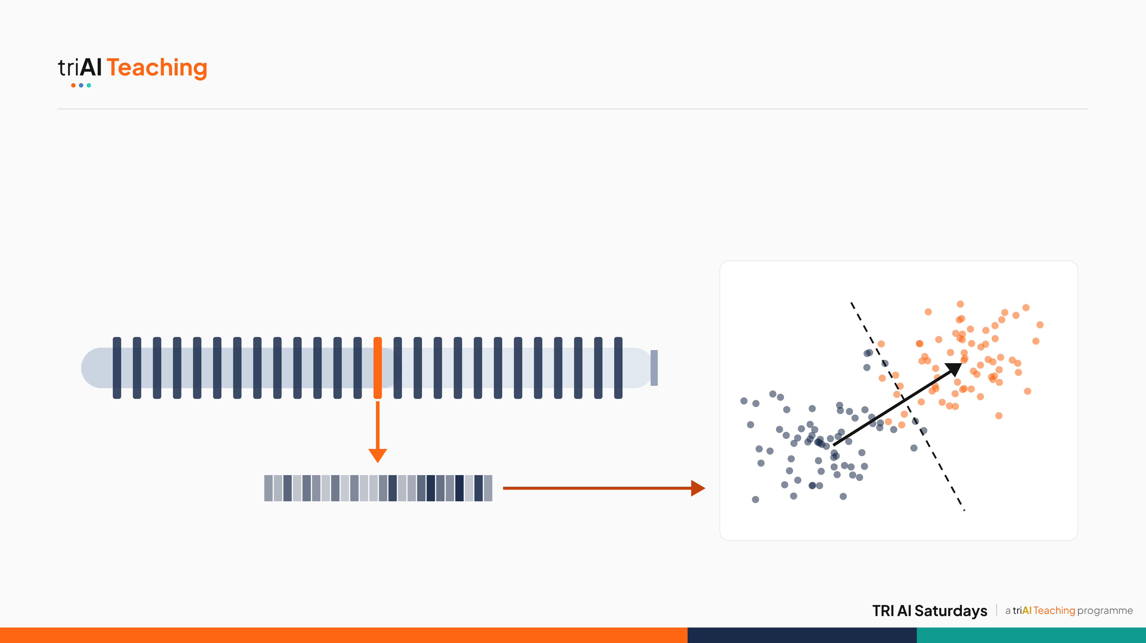
2 · APPROACH
Reading a Frozen Model's Mind
Latent probing: read the model's internal numbers, not its words — then separate them with one straight line.
Probe geometry
toxic
Frozen Gemma-2-2B residual stream: 26 blocks, weights never updated
tokens in
(≤ 64)
read after block 14
next-token head: unused
w
non-toxic
boundary
masked mean over tokens → x ∈ ℝ²³⁰⁴
Schematic 2-D sketch of a 2,304-D space
07
Notes:
Here's the core idea for anyone new to probing. Text flows through Gemma-2-2B's residual stream, 26 blocks, and we never change a single weight. After block 14 we tap the stream and average over the tokens: one vector of 2,304 numbers per text. It's like reading a brain scan instead of asking the person. On the right is the geometry, sketched in two dimensions: toxic and non-toxic texts form two clouds, and the probe learns one direction, w, plus a boundary between them. If a straight line separates them this well, the model has already organised the concept for us.

Slide 8
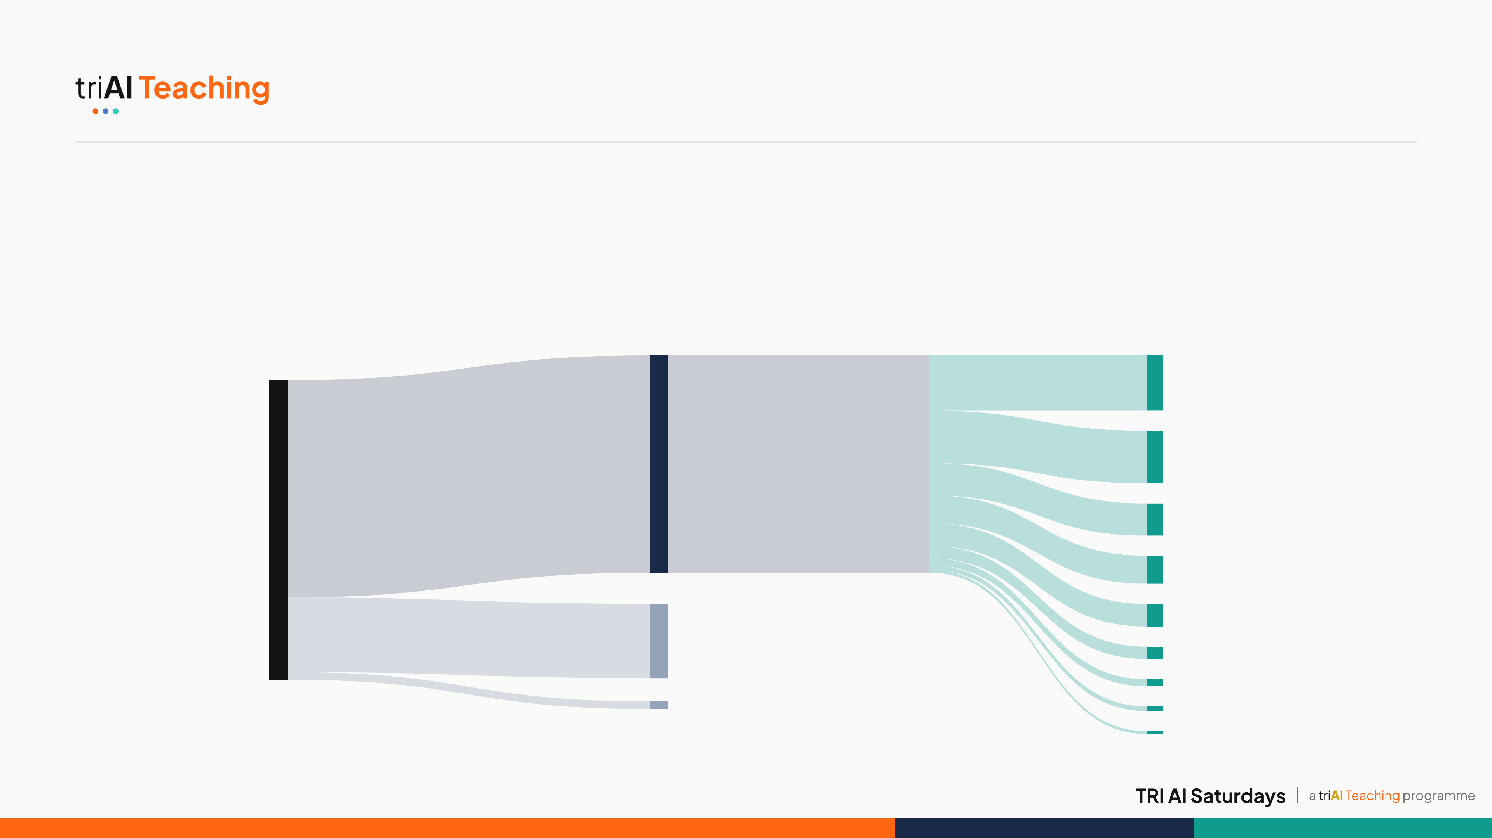
2 · APPROACH · DATA
Data Flow: Building the Corpus
From 149,528 raw rows to 108,468 balanced training rows across 9 dataset families.
108,468 kept for training
Twitter 27,572
Civil Comments 26,218
149,528
rows extracted
from 13 sources
Berkeley 16,000
RealToxicity 14,000
37,232 removed to balance each source's classes
Wikipedia 11,314
Aegis Safety 6,152
3,828 dropped: one source had a single class
OffensiveLang 3,496
HateCheck 2,326
ToxicChat 1,390
08 · Band widths proportional to row counts
Notes:
No training data was supplied, so we built our own. We streamed 149,528 labelled rows from 13 public datasets. One source had only non-toxic rows, so 3,828 rows were dropped. Another 37,232 were removed so that no single source's class balance dominates. That leaves 108,468 training rows across nine dataset families, and those families are exactly what we hold out during validation.

Slide 9
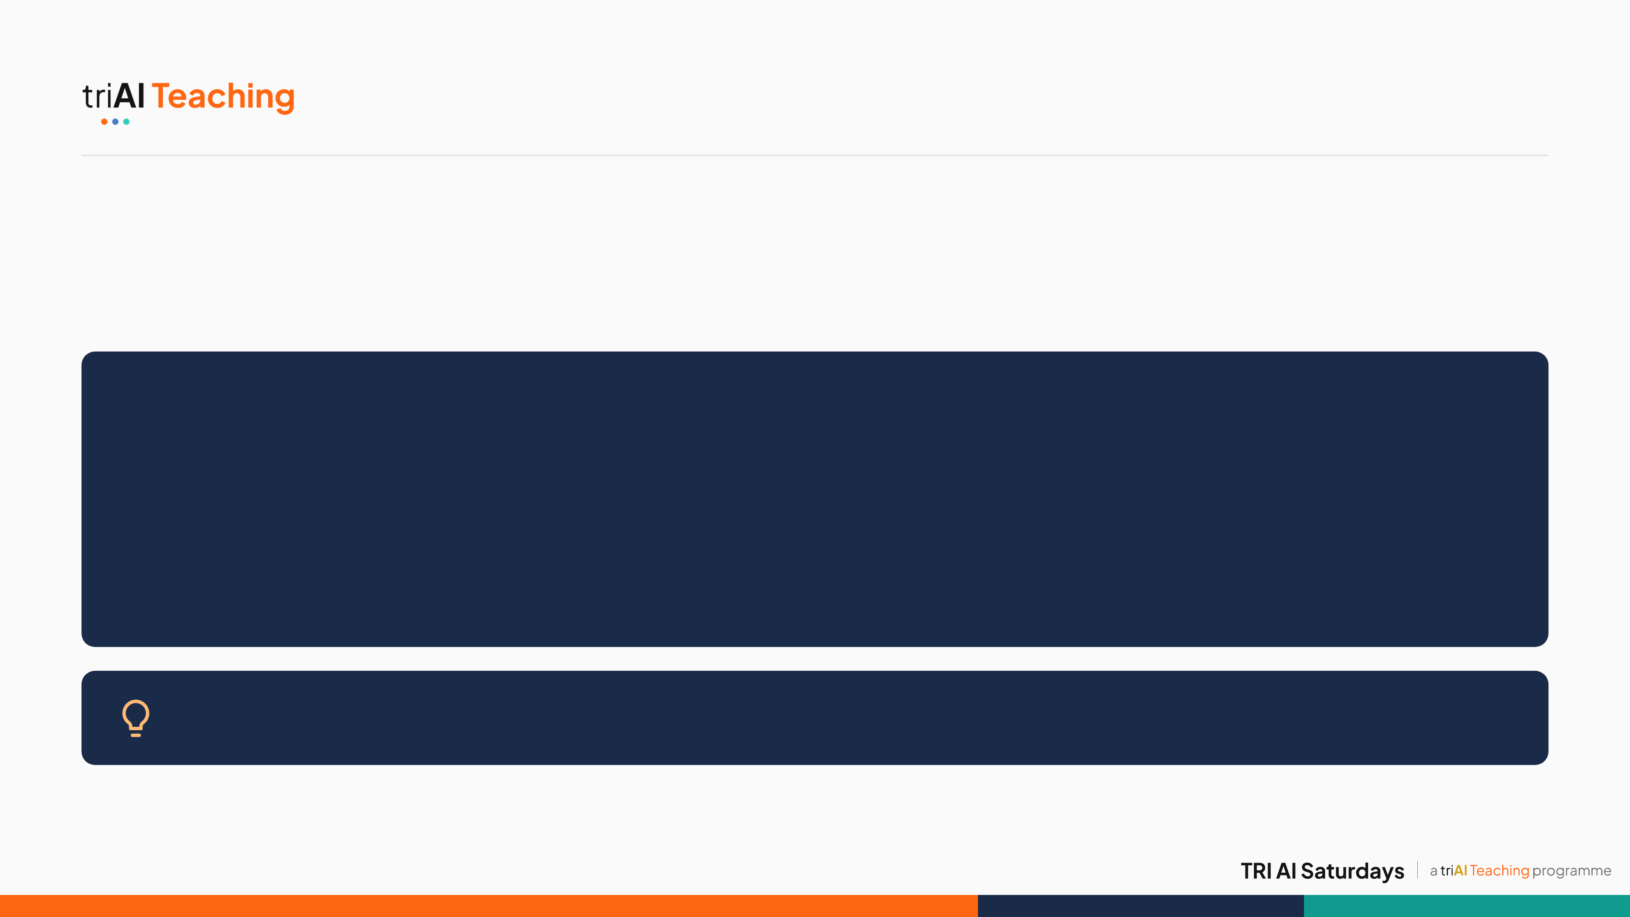
2 · APPROACH · ALGORITHM
Fitting the Probe
One offline linear solve. No gradients, no training loop.
FitProbe(X, y, λ = 0.6)
1 standardise every feature (mean 0, unit variance)
2 μ₁, μ₀ = the mean vector of each class
3 Σ = pooled covariance, shrunk toward identity (λ = 0.6)
4 w = Σ⁻¹(μ₁ − μ₀) ← one linear solve
5 b = −wᵀ(μ₁ + μ₀) / 2
Why shrink Σ: blending the covariance toward a scaled identity keeps the solve stable in 2,304 dimensions — λ = 0.6 worked best on held-out data.
09 · Step 1 of 2: fitting the probe
Notes:
This is how we fit the probe, once, offline. Standardise every feature, take each class's mean, and the shared covariance between them. We shrink that covariance toward a scaled identity, with lambda 0.6, so it stays well-conditioned in 2,304 dimensions. Then one linear solve gives us the direction w. No gradients, no epochs, no training loop — it's a single matrix equation.

Slide 10

2 · APPROACH · ALGORITHM
Scoring a Batch
Rank every score, then apply the class balance we measured on dev.
Classify(batch of n texts)
1 for each text: layer-14 hidden state → mean-pool → x
2 score = wᵀ(x − mean)/std + b
3 rank all n scores, highest to lowest
4 label the top 12 of every 17 toxic — the rest, non-toxic
Why a quota, not a threshold: 12/17 ≈ 70.6% is the class balance we inferred on dev, and ranking stays correct even if raw scores shift.
10 · Step 2 of 2: scoring a batch
Notes:
At test time, we score every text by projecting onto the direction w we just solved for, then we rank the whole batch from highest to lowest score. Instead of a fixed cutoff, we label the top 12 of every 17 as toxic, because that matches the class balance we inferred from our development-phase results, it held on the test set, and ranking is robust even if the raw scores shift up or down.

Slide 11
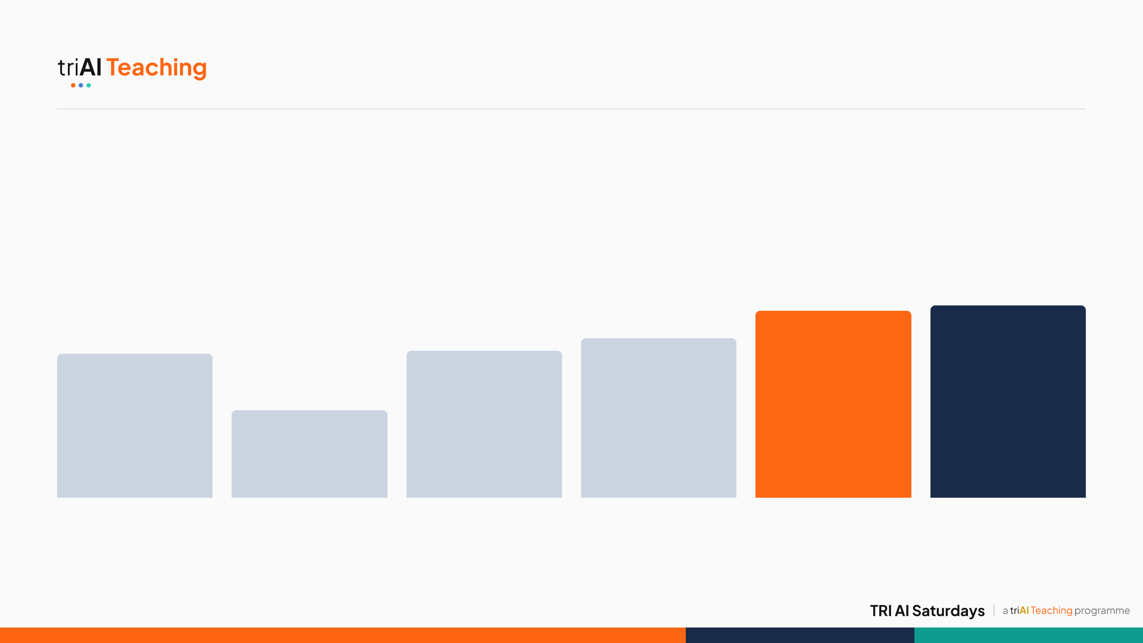
3 · JOURNEY
From 42% to 92.35%
Every version taught us something.
89.8%
92.35%
70.5%
76.7%
69.0%
42.0%
v003
v004
v005
v006
Final · dev
Final · test
Synthetic data, wrong layer
Wrong labels: mental-health data
One toxicity source, logistic ensemble
Same model, rank-based labelling
12 sources + shrinkage LDA
One shot on the hidden test set
11 · Bars start at 0%. v003 to final dev: dev set, 1,700 rows; test: 1,360 rows
Notes:
Our path was not a straight line. v003 used synthetic data and the wrong layer: 69%. v004 actually got worse, 42%, because we trained on mental-health labels, the wrong task entirely. That taught us the data defines the task. v005 used a real toxicity dataset: 70.5%. v006 kept the exact same model bytes and only changed how we turn scores into labels, ranking instead of a fixed threshold, and gained six points. The big jump came from data breadth: twelve sources plus shrinkage LDA took us to 89.8% on dev, and our single allowed test submission scored 92.35%.

Slide 12
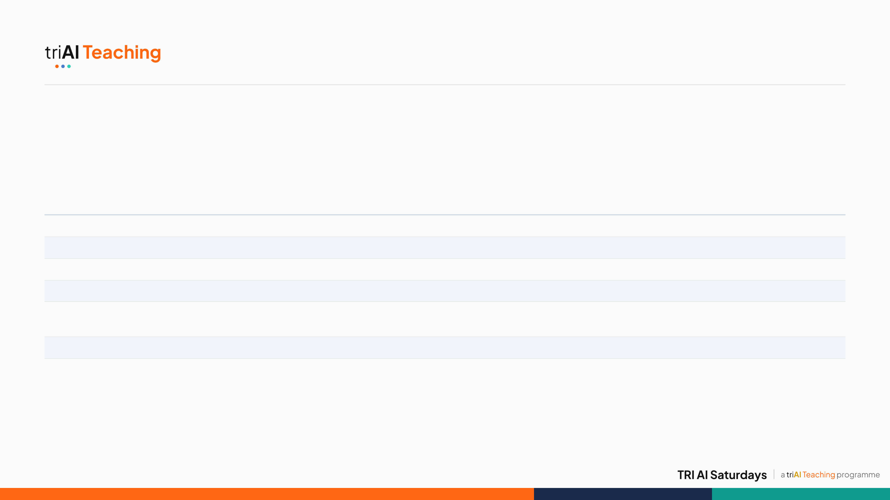
3 · JOURNEY
What We Tried, and Walked Away From
Our rule: keep a change only if it helps on datasets the probe has never seen.
What we tried
Result
Decision and why
Clean labels with a teacher model (toxic-bert)
78.6% vs 79.6% on unseen datasets
Rejected: cleaner labels, worse transfer
Add ParaDetox rewrites
Flat accuracy, lower AUROC
Rejected: no real gain
Route each batch to a source-specific probe
89.76% dev, exact tie
Rejected: more complexity, same score
Source-specific probe only, no fallback
84.9% dev, 82 rows lost
Rejected
Fine-tune the whole language model
Not attempted
Out of scope: breaks the frozen-model question and costs far more compute
Kept: pooled shrinkage LDA on all 12 sources
89.76% dev · 92.35% test
Simplest model that transferred best
12
Notes:
Here's what we tried and threw away. Filtering labels with a teacher model made transfer worse. Adding ParaDetox rewrites did nothing. A router that picks a source-specific probe per batch tied our simple model exactly, and without a fallback it lost 82 rows. We never fine-tuned Gemma, because that would answer a different question and cost far more compute. The rule behind every decision: a change stays only if it helps on data the probe has never seen. The simplest model won.

Slide 13
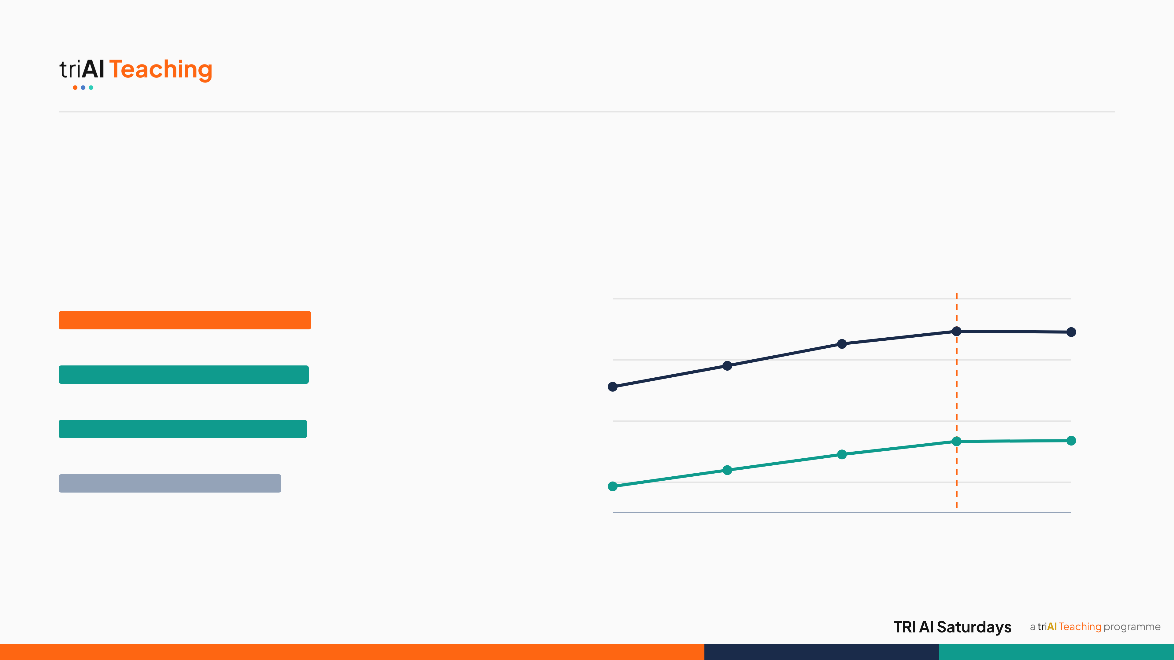
3 · JOURNEY · EVIDENCE
Choosing the Probe
The brief suggested logistic regression. We tested 64 setups on unseen datasets: LDA won.
Best held-out accuracy per probe family
Shrinkage sweep, standardised LDA
Shrinkage LDA
chosen λ = 0.6
84%
79.5%
AUROC · 82.9 at λ 0.6
Logistic regression
82%
78.7%
Difference of means
78.1%
80%
Any probe after removing top-4 PCs
69.9%
78%
Accuracy · 79.3 at λ 0.6
0.02
0.1
0.3
0.6
0.9
shrinkage λ
13 · Mean over 9 held-out families · line chart y-axis starts at 77%
Notes:
We didn't pick shrinkage LDA on instinct. We ran 64 configurations, probe families times preprocessing times hyperparameters, each scored on the nine held-out dataset families. LDA came out on top, narrowly ahead of logistic regression, and it's closed-form. The right chart shows why lambda is 0.6: accuracy and AUROC climb as we add shrinkage and level off there. One striking result: removing the top four principal components drops every probe to about 70%. The toxicity signal lives in the model's dominant directions.

Slide 14
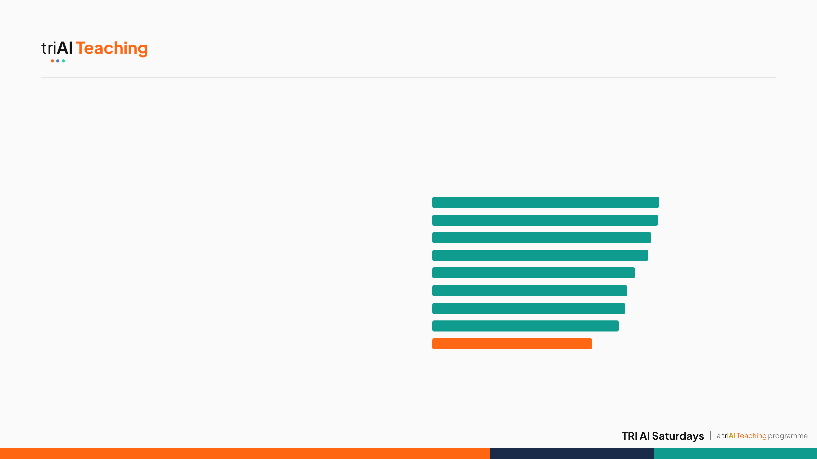
4 · EVALUATION
Held-Out and Honest
Hide a whole dataset, then test on it.
92.35% test · 89.76% dev
Accuracy on each held-out family
Wikipedia
88.8%
1,256 / 1,360 and 1,526 / 1,700 correct on CodaBench
RealToxicity
88.4%
Berkeley
85.6%
79.6% · 0.83 AUROC
ToxicChat
84.6%
Nine folds: train on 8 dataset families, test on the unseen 9th (AUROC: 1.0 = perfect ranking, 0.5 = random)
Civil Comments
79.4%
Aegis Safety
76.3%
HateCheck
75.5%
31 tests
Twitter
73.0%
Offensive Lang.
62.5% weakest
Model contract, data hygiene, submission parity; final ZIP pinned by SHA-256
14 · Per-family bars: std + LDA λ 0.6, top-12/17 rule, bars start at 0%
Notes:
A leaderboard score only tells you about one test set. So we held out entire dataset families: train on eight, test on the ninth, nine times. On data it had never seen, the probe averaged about 80% accuracy and 0.83 AUROC. Encyclopedic and prompt-style text is easy, near 89%. Tweets with slang and reclaimed terms are hardest, 62.5%. That gap is our main measured limitation, and it matters for fairness. We also have 31 automated tests and pinned the exact submitted file by hash so anyone can reproduce it.

Slide 15
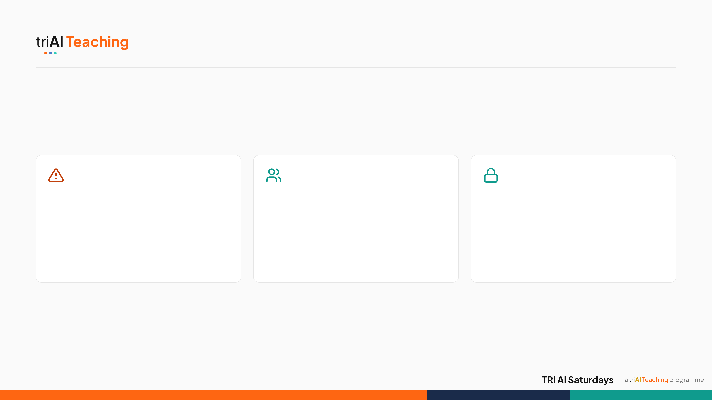
5 · ETHICS
Where It Breaks, and Who Pays
A review aid, never a judge.
Errors & risks
Safeguards
Data care
• Weakest on slang-heavy tweets (62.5%): dialect and identity terms at risk
• Human review before any action
• Harmful raw text kept out of the public repo
• Subgroup audits, appeals and drift monitoring
• Licences respected; gated datasets not bypassed
• False negatives leave targets exposed
• Shadow pilot before real use
• A binary label loses intent, quotation and counterspeech
• Loader code lets others rebuild it
Limitation: the top-12/17 rule assumes batches that are about 70% toxic. Any real deployment must recalibrate it to its own traffic.
15
Notes:
Ethics. This is a research prototype that supports human moderators; it should never be the sole basis for a ban. The risks run both ways: false positives can silence dialects and identity terms, which our weakest fold on tweets hints at, and false negatives leave targets exposed. Safeguards: human review, subgroup audits, appeals, drift monitoring and a shadow pilot. We kept harmful raw text out of the public repo and did not bypass any gated dataset. And one honest caveat: our ranking rule assumes about 70% toxic batches, so it must be recalibrated for real traffic.

Slide 16
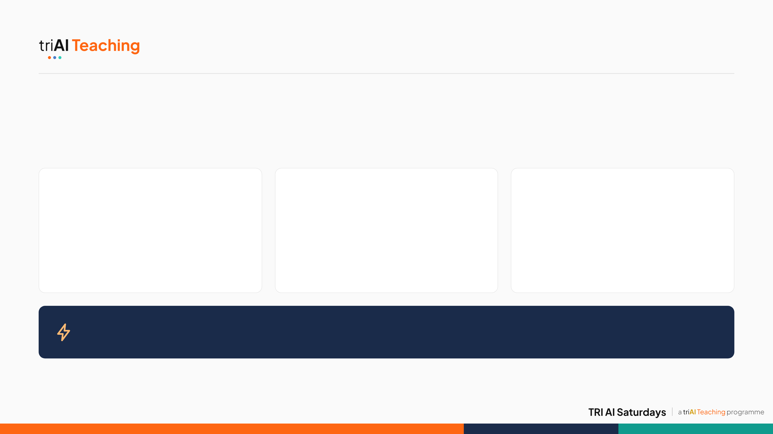
CONCLUSION
What We Learned
The model already knows. Data breadth, not classifier complexity, is what unlocks it.
Data beats tuning
Test on the unseen
Next: seeing ≠ steering
Going from 1 to 12 sources gained more than every classifier tweak combined.
Held-out families exposed the weak spots a single leaderboard hides.
Building on Arditi et al.'s refusal-direction paper, our follow-up preprint asks whether a direction a probe can see also controls the model's behaviour.
Why it matters: the probe is a 53 KB file reading a state the model already computes. All 1,360 test texts scored in 0.05 s, so it can flag risky requests and call heavier safety checks only when needed.
16
Notes:
Three takeaways. One: the toxicity signal really is inside a frozen model, and data breadth unlocked it far more than any classifier trick. Two: always test on data the model has never seen; our held-out families told us the truth a single leaderboard can't. Three, what's next: we've started a follow-up preprint, "Seeing is not steering", asking whether the direction a probe detects can also be used to control the model. Early evidence says not necessarily, which matters for AI safety monitoring. And why this matters in practice: the whole probe is a 53 kilobyte file that reads a state the model computes anyway. CodaBench scored all 1,360 test texts in five hundredths of a second. That makes it a cheap first-pass flag that can trigger heavier safety checks only when they are needed, which is exactly the value the organisers' brief asked us to test.

Slide 17
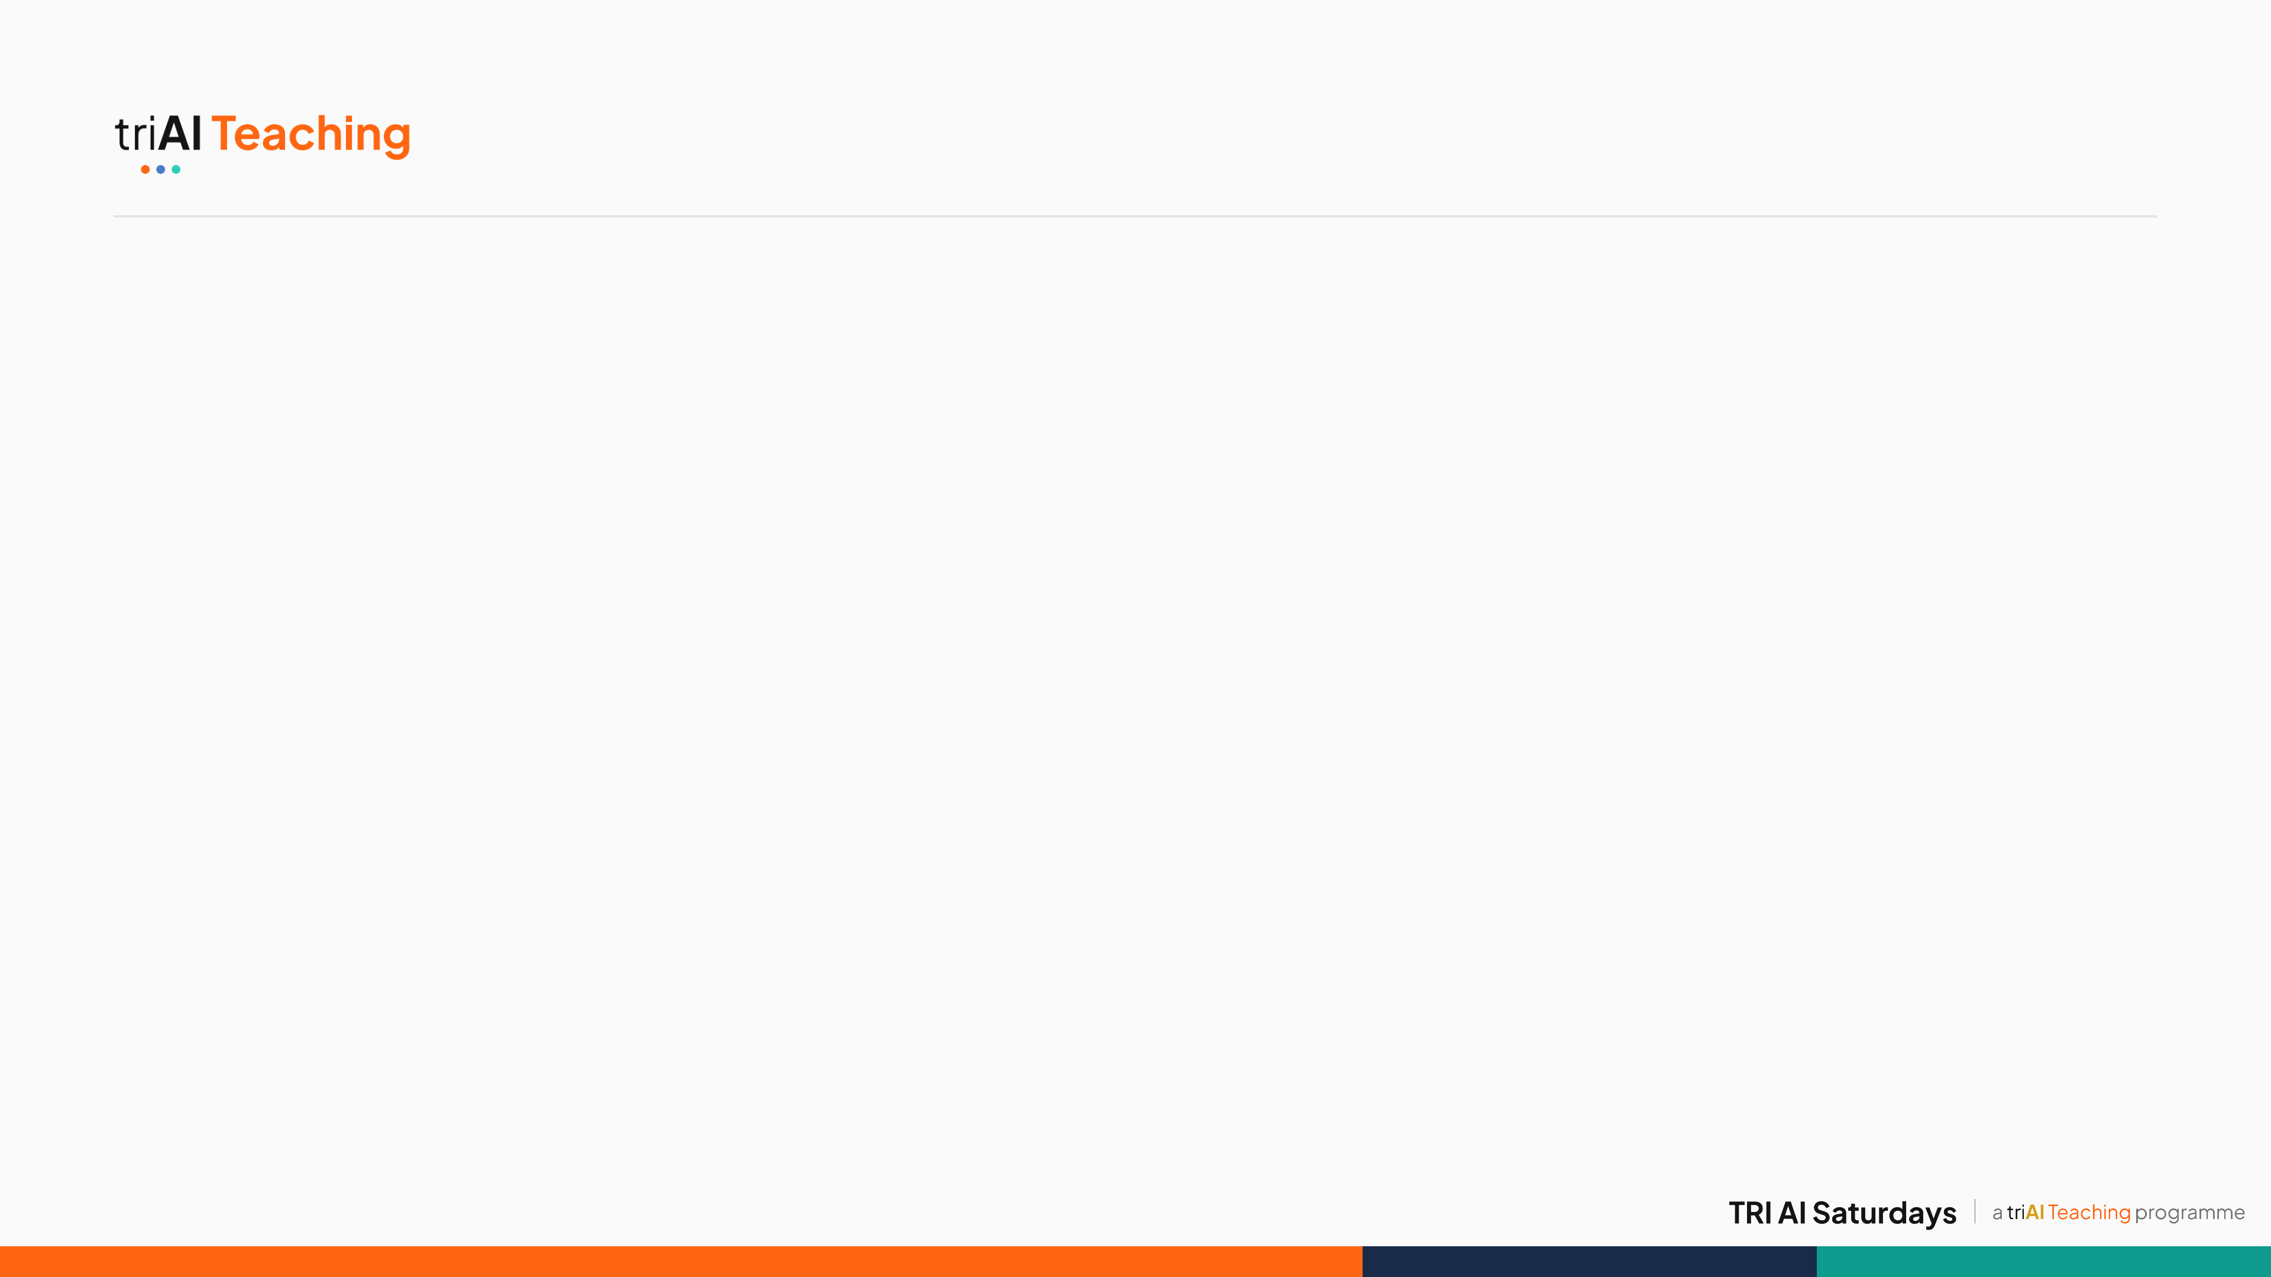

TEAM NYIRAGONGO
Let's Talk
Thank you — questions about our methodology or findings?
github.com/bleymambwe/C10-team-nyiragongo
Blessings Mambwe · Hamna Kaleem · Fafemi Adeola · Musonda Musunga · Mentor: Moses Olafenwa
As the probe direction rotates, the two classes separate along it (schematic)
17
Notes:
Thank you. Thanks to our mentor Moses Olafenwa and to TRI AI. Everything, including the exact submitted file, is reproducible from our GitHub repo. We're happy to take questions.

