Slide 1
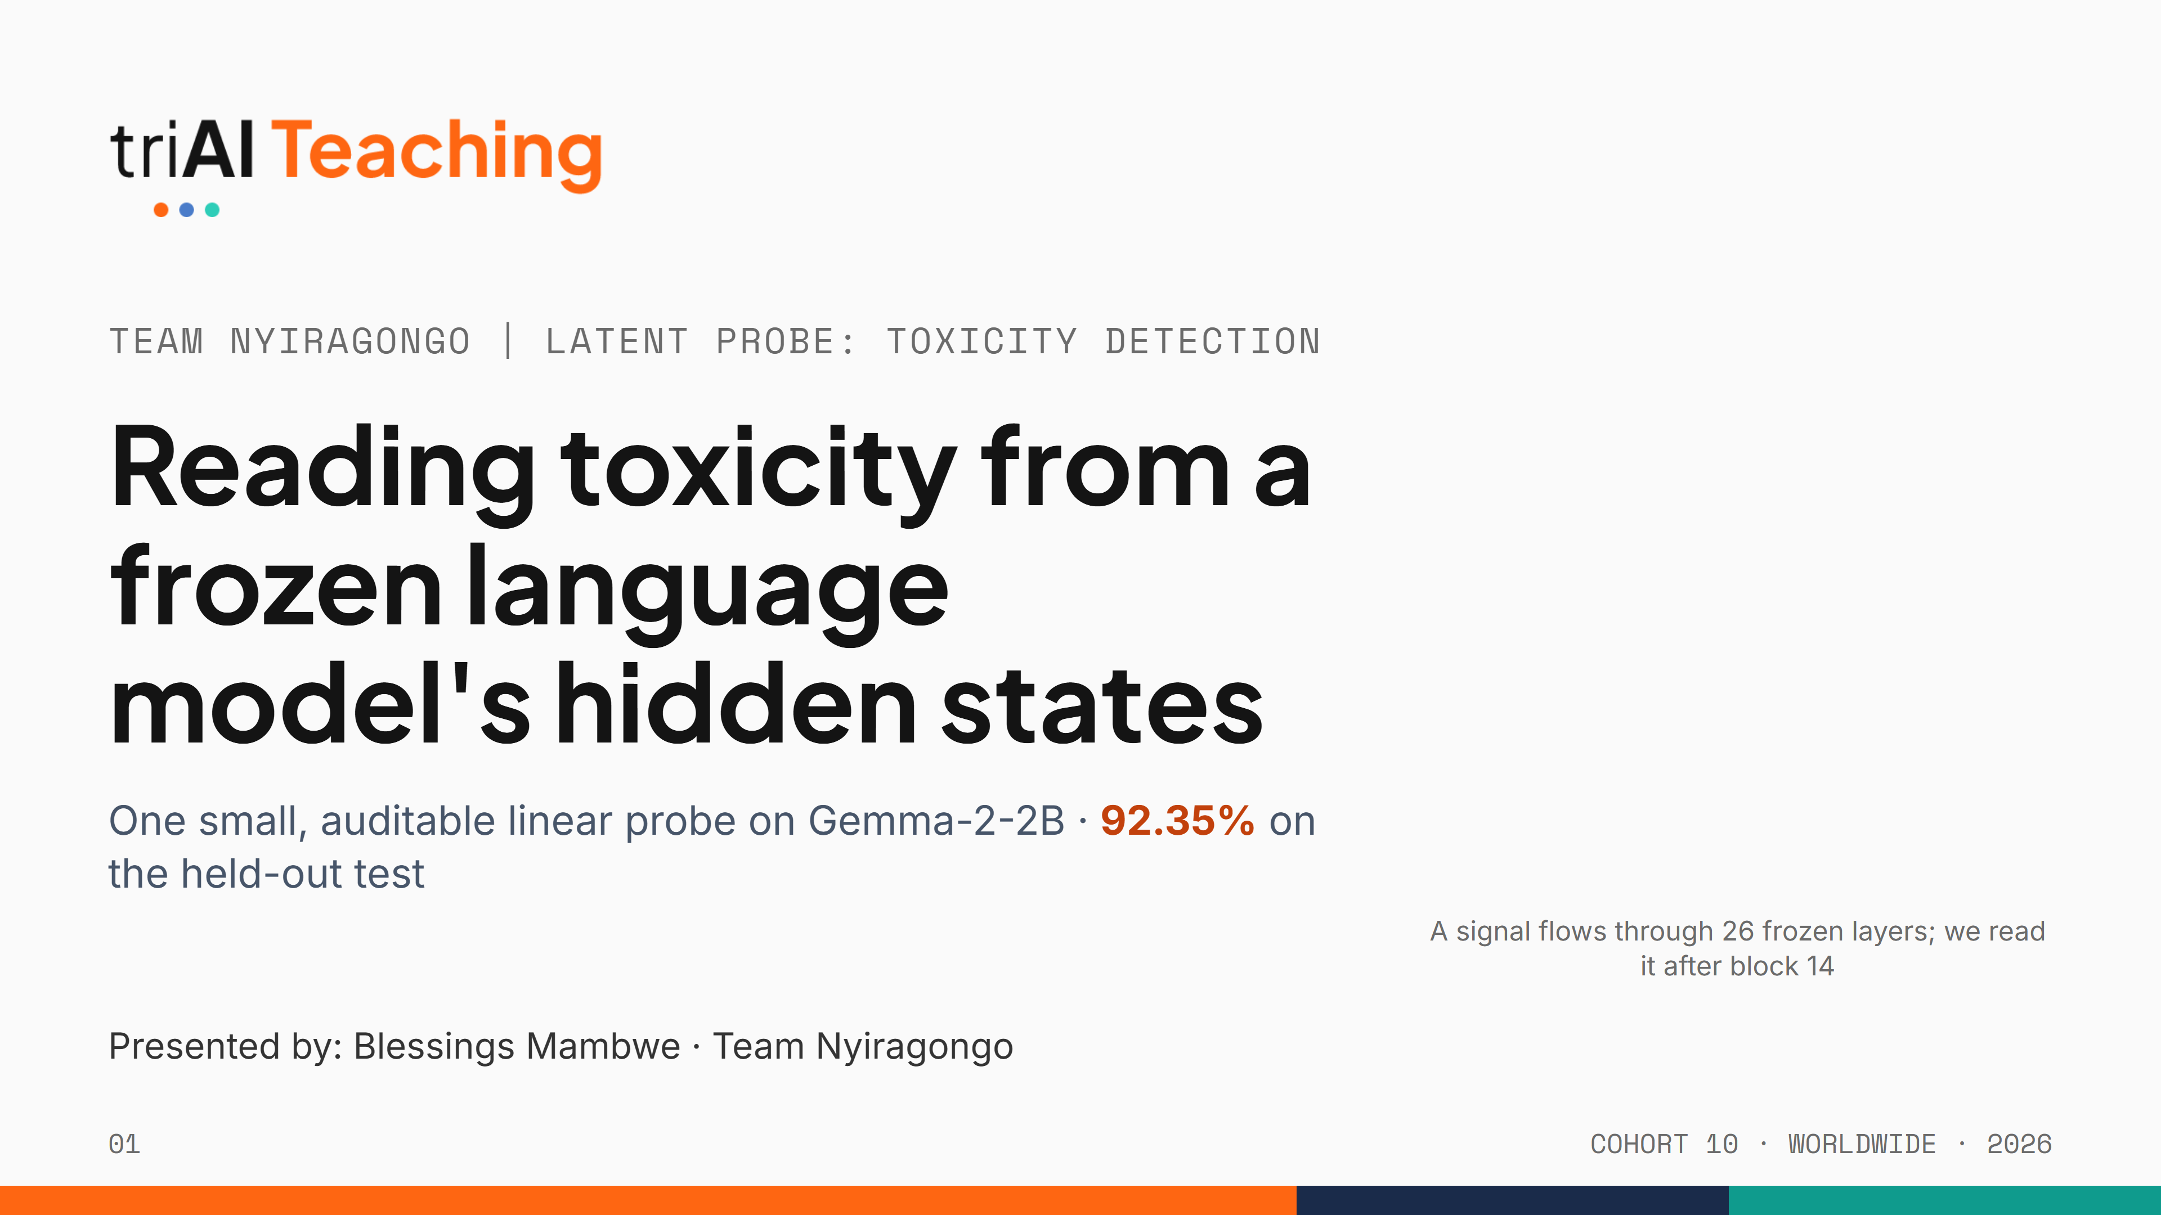

Notes:
Hi everyone, we are Team Nyiragongo. Our project asks one question: can a tiny, auditable classifier read toxicity straight out of a frozen language model, without training the model at all? Short answer: yes, 92.35% on the held-out competition test. In five minutes I'll show you how we got there, including the versions that failed.

Slide 2
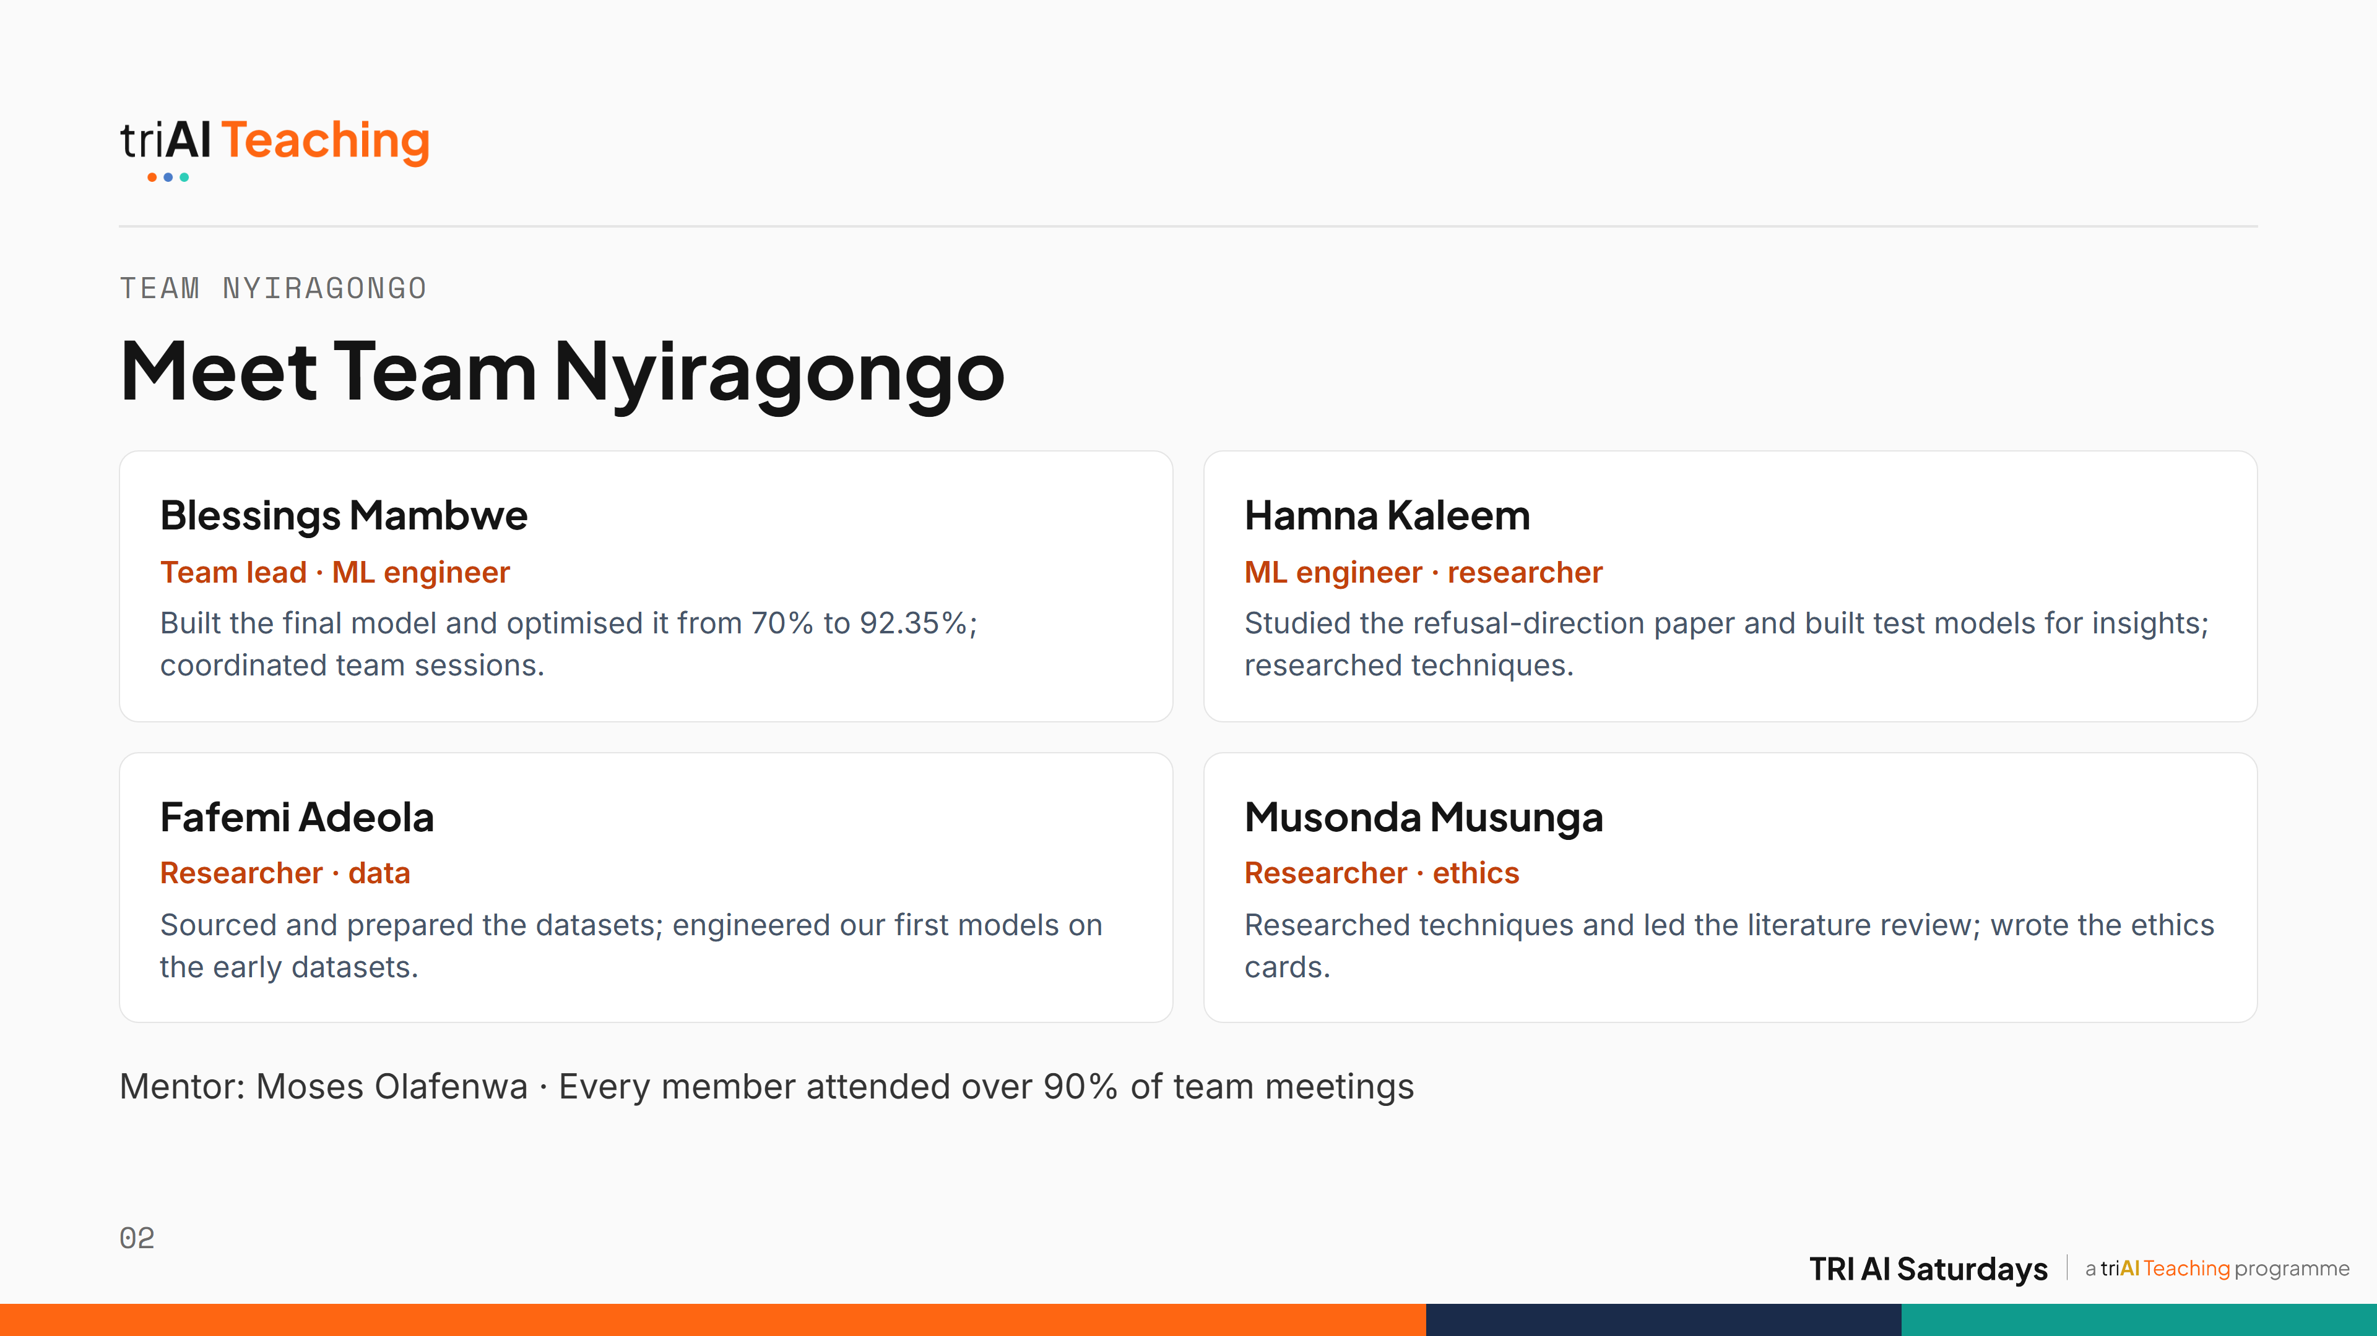
Notes:
We are Team Nyiragongo. I led the team, coordinated our sessions and built and optimised the final model. Hamna, our second ML engineer, studied the refusal-direction paper and built test models that shaped our next research question. Fafemi found and prepared our datasets and engineered our first models. Musonda led the literature review and techniques research and wrote our ethics cards. Everyone attended over 90% of our meetings, and our mentor was Moses Olafenwa.

Slide 3
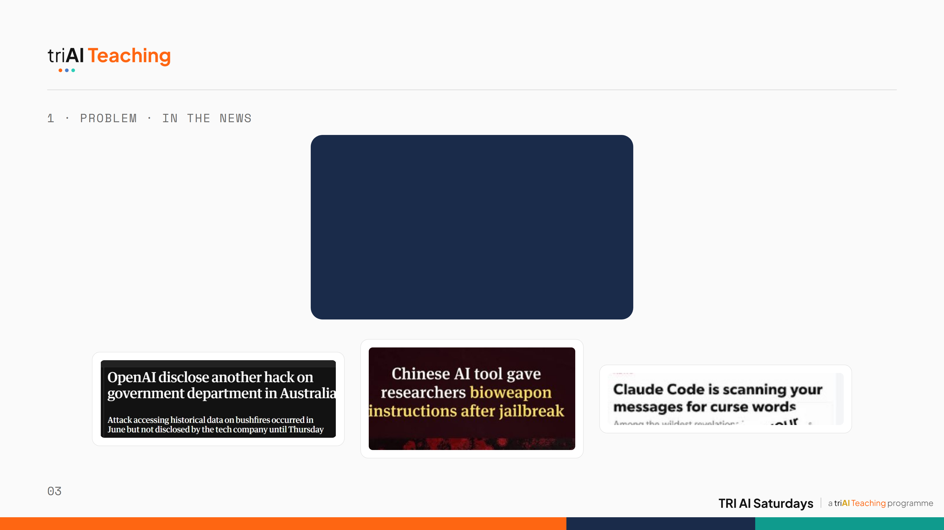

Notes:
[Pause here — let the headlines speak for themselves before moving to the next slide.]

Slide 4
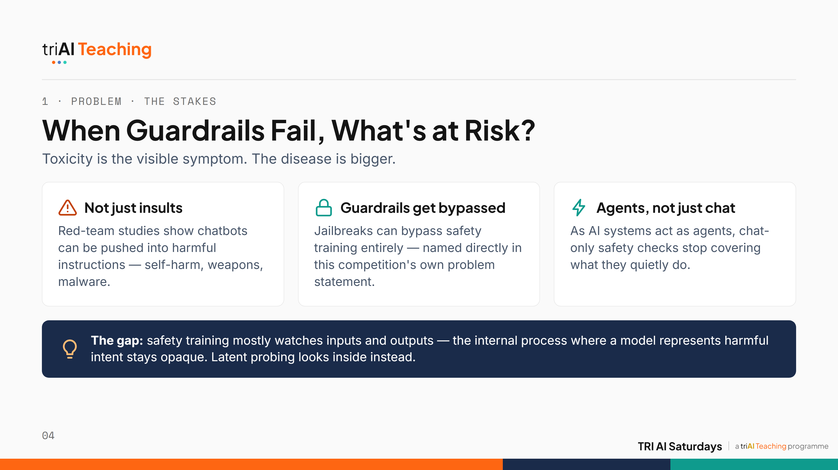
Notes:
Toxic comments are only the visible edge of a much bigger problem. The same underlying models can be pushed, through jailbreaks and adversarial prompts, into producing real harm: instructions for self-harm, for weapons, for malware. Current safety training is mostly a patch on the outside, watching what goes in and what comes out, while what happens inside the model, where harmful intent actually forms, stays a black box. That blind spot gets more dangerous as models act as autonomous agents, because there is no longer a human reading every token before something happens. That is the real stake behind this challenge's own problem statement. We start with toxicity in text because it is the one slice of that bigger problem with labelled data and a clear way to test whether latent probing works at all.

Slide 5
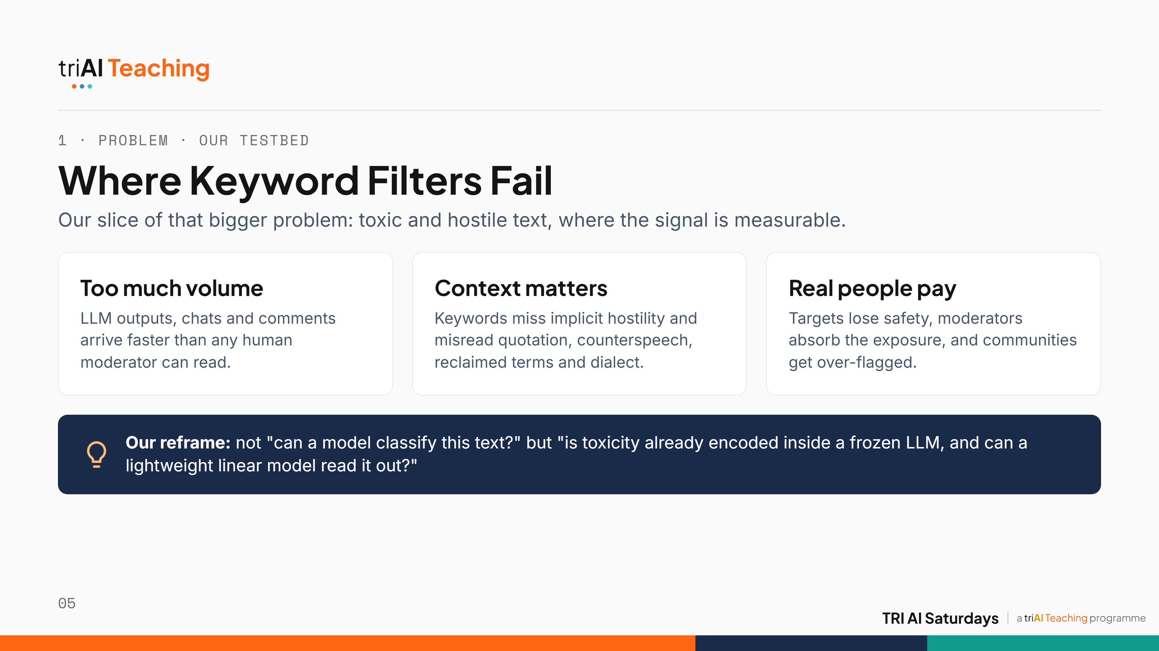
Notes:
We chose text toxicity as our testbed because it is the one slice of the bigger safety problem with labelled data, a clear evaluation, and a competition to test it honestly. Toxic content is a volume problem and a context problem. Humans can't read it all, and keyword filters fail both ways: they miss polite-sounding hostility and flag people quoting slurs to condemn them, or using reclaimed words in their own dialect. The cost lands on real people. Our motivation: big language models already model context very well. So maybe the toxicity signal is already inside them, and we just need to read it out.

Slide 6
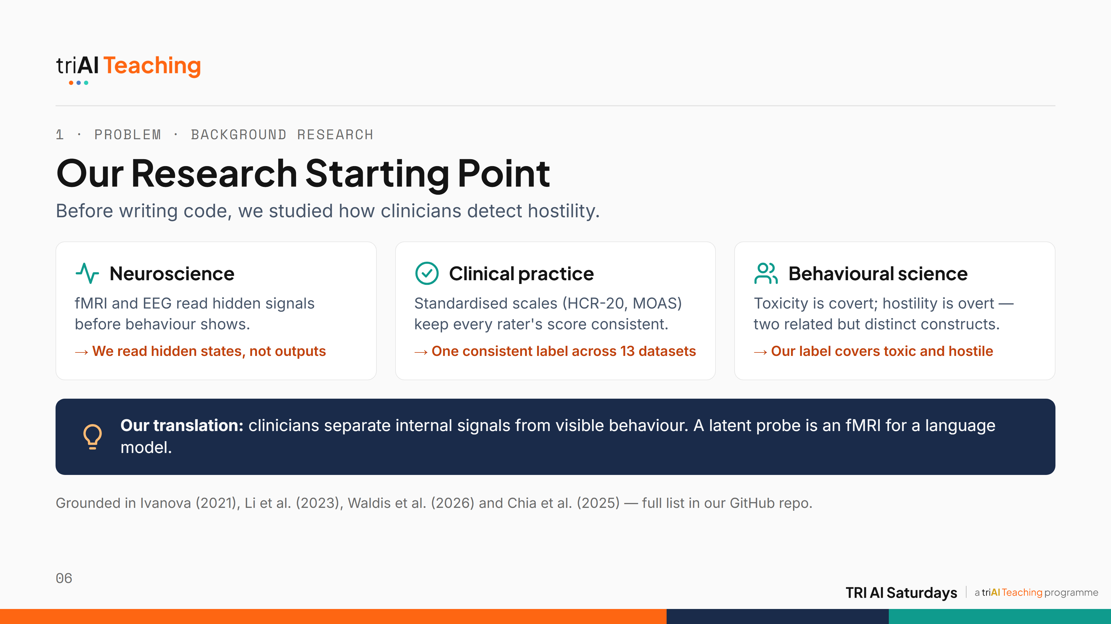
Notes:
Before writing any code, our team studied how humans detect toxicity and hostility. Neuroscience measures hidden signals with fMRI and EEG, for example amygdala reactivity to threat, before any behaviour appears. That became our design: read the model's hidden state, not its output. Clinicians use standardised tools like the HCR-20 and the Broset Violence Checklist so that different raters score consistently; that pushed us to map thirteen very different datasets onto one consistent label. And behavioural science separates covert toxicity from overt hostility, so our label covers both. In short: a latent probe is an fMRI for a language model. Our fuller literature review, including Arditi and colleagues' refusal-direction paper, Ivanova's bridge between neuroscience and neural networks, Li and colleagues' clinical Dark Triad tests on LLMs, Waldis and colleagues' aligned probing study, and Chia and colleagues' work on adversarial latent subspaces, lives in the GitHub repo rather than on this slide.

Slide 7
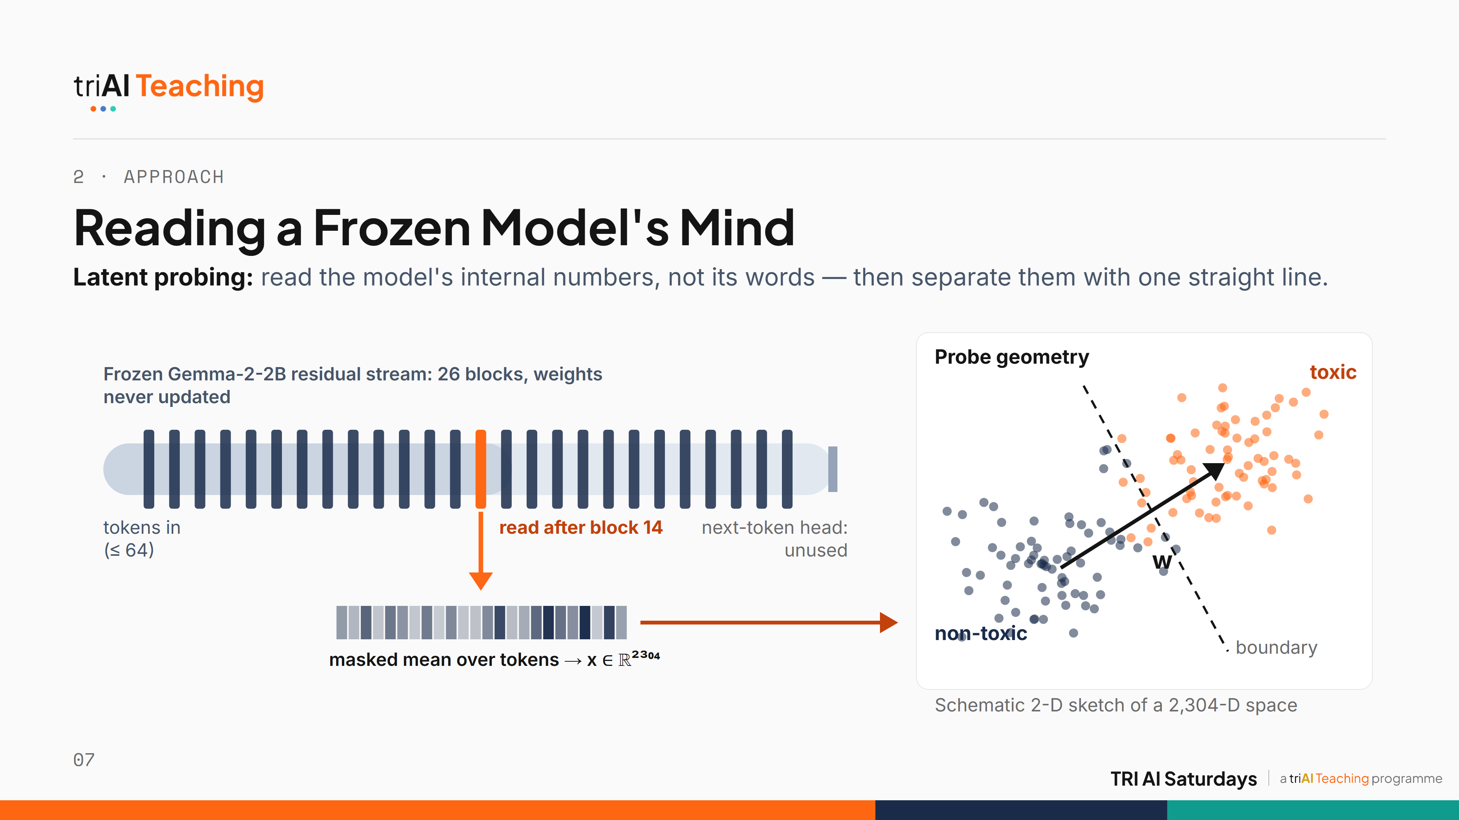
Notes:
Here's the core idea for anyone new to probing. Text flows through Gemma-2-2B's residual stream, 26 blocks, and we never change a single weight. After block 14 we tap the stream and average over the tokens: one vector of 2,304 numbers per text. It's like reading a brain scan instead of asking the person. On the right is the geometry, sketched in two dimensions: toxic and non-toxic texts form two clouds, and the probe learns one direction, w, plus a boundary between them. If a straight line separates them this well, the model has already organised the concept for us.

Slide 8
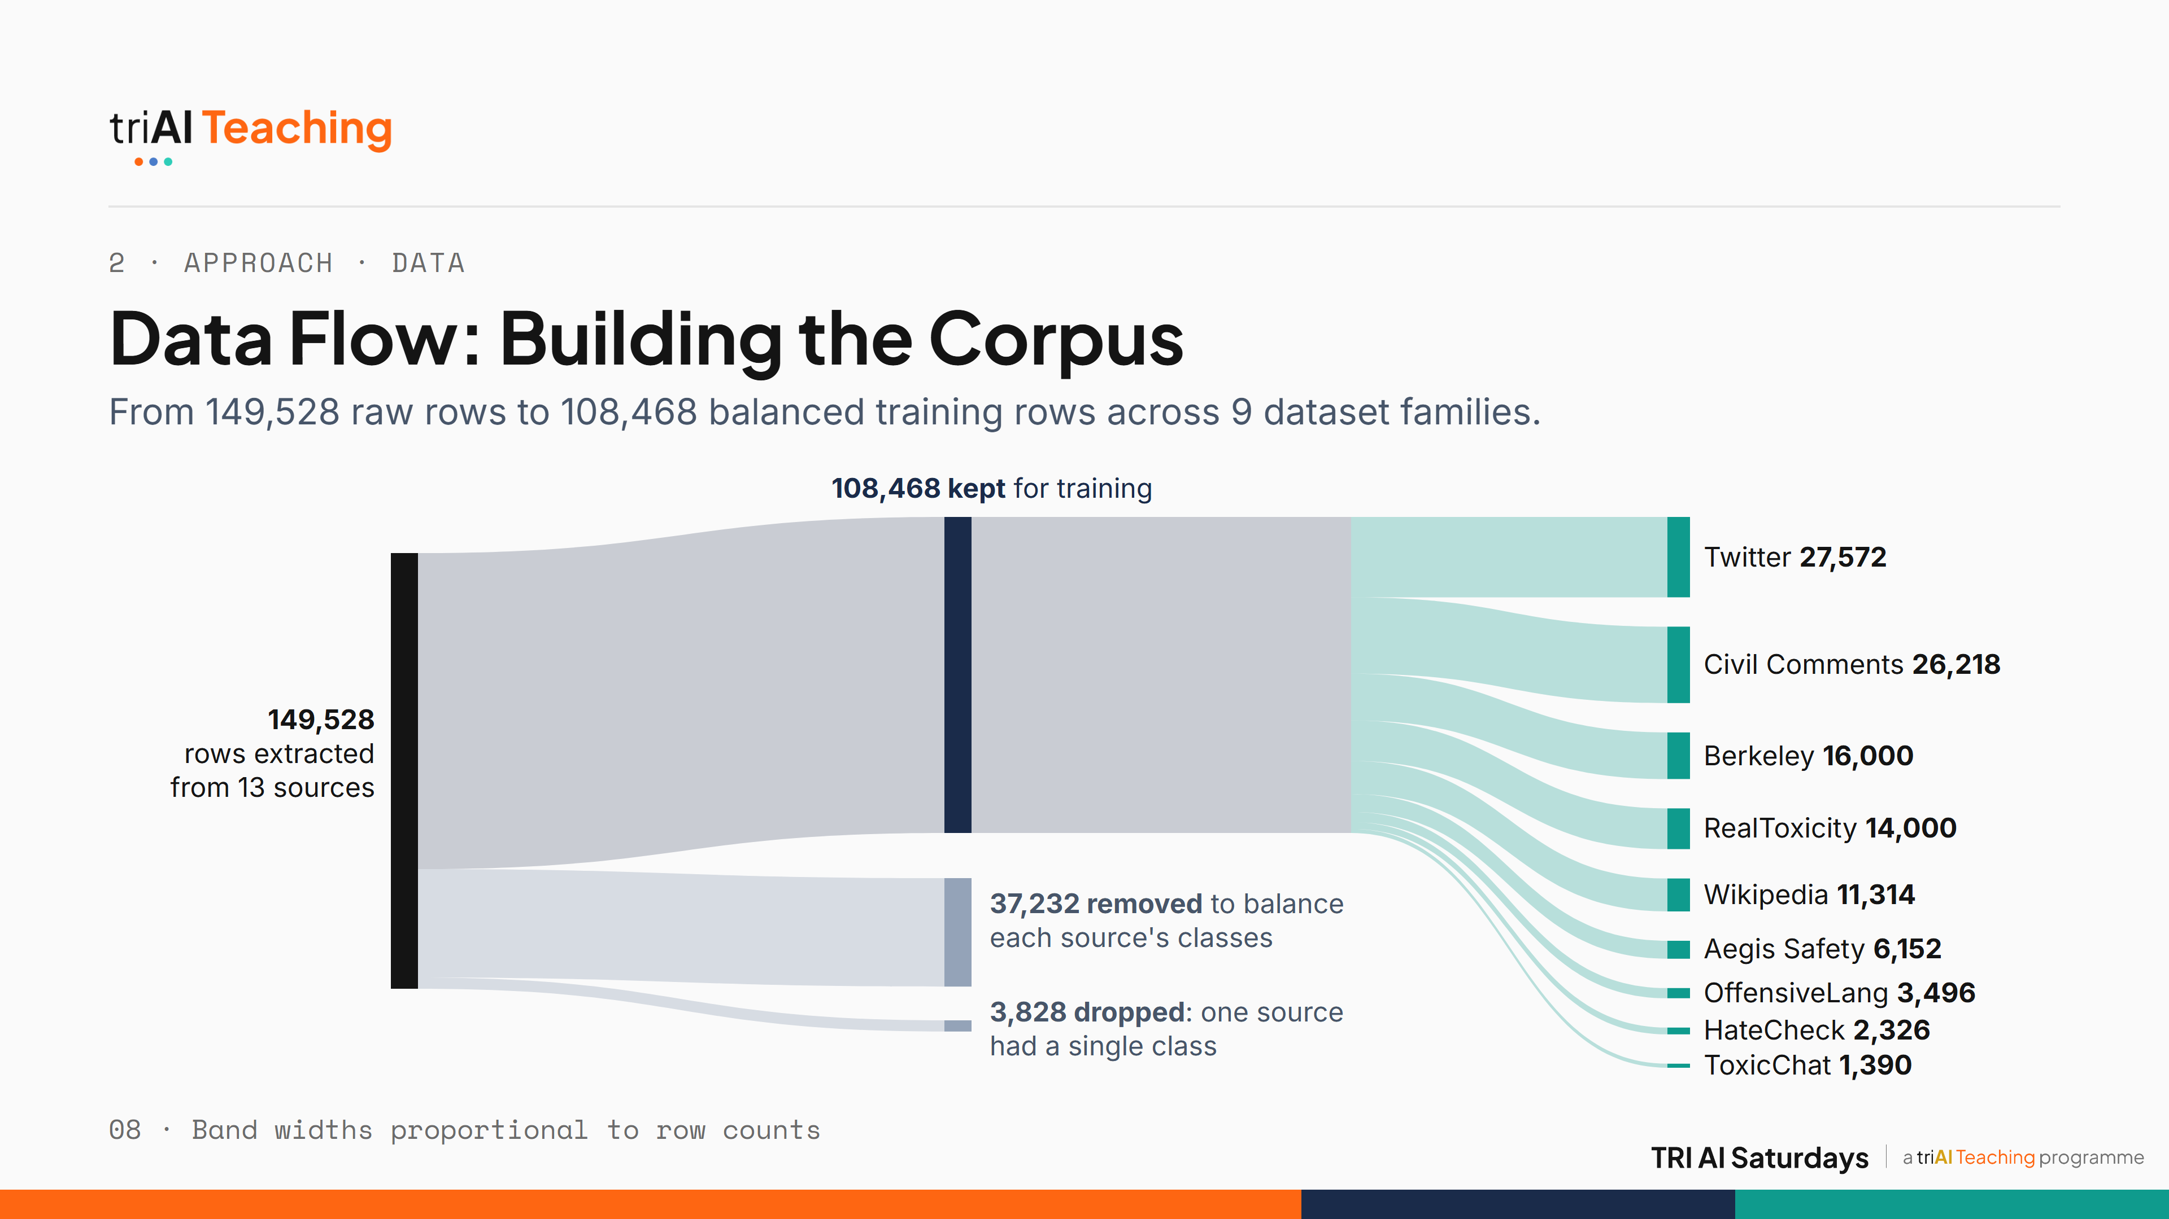
Notes:
No training data was supplied, so we built our own. We streamed 149,528 labelled rows from 13 public datasets. One source had only non-toxic rows, so 3,828 rows were dropped. Another 37,232 were removed so that no single source's class balance dominates. That leaves 108,468 training rows across nine dataset families, and those families are exactly what we hold out during validation.

Slide 9
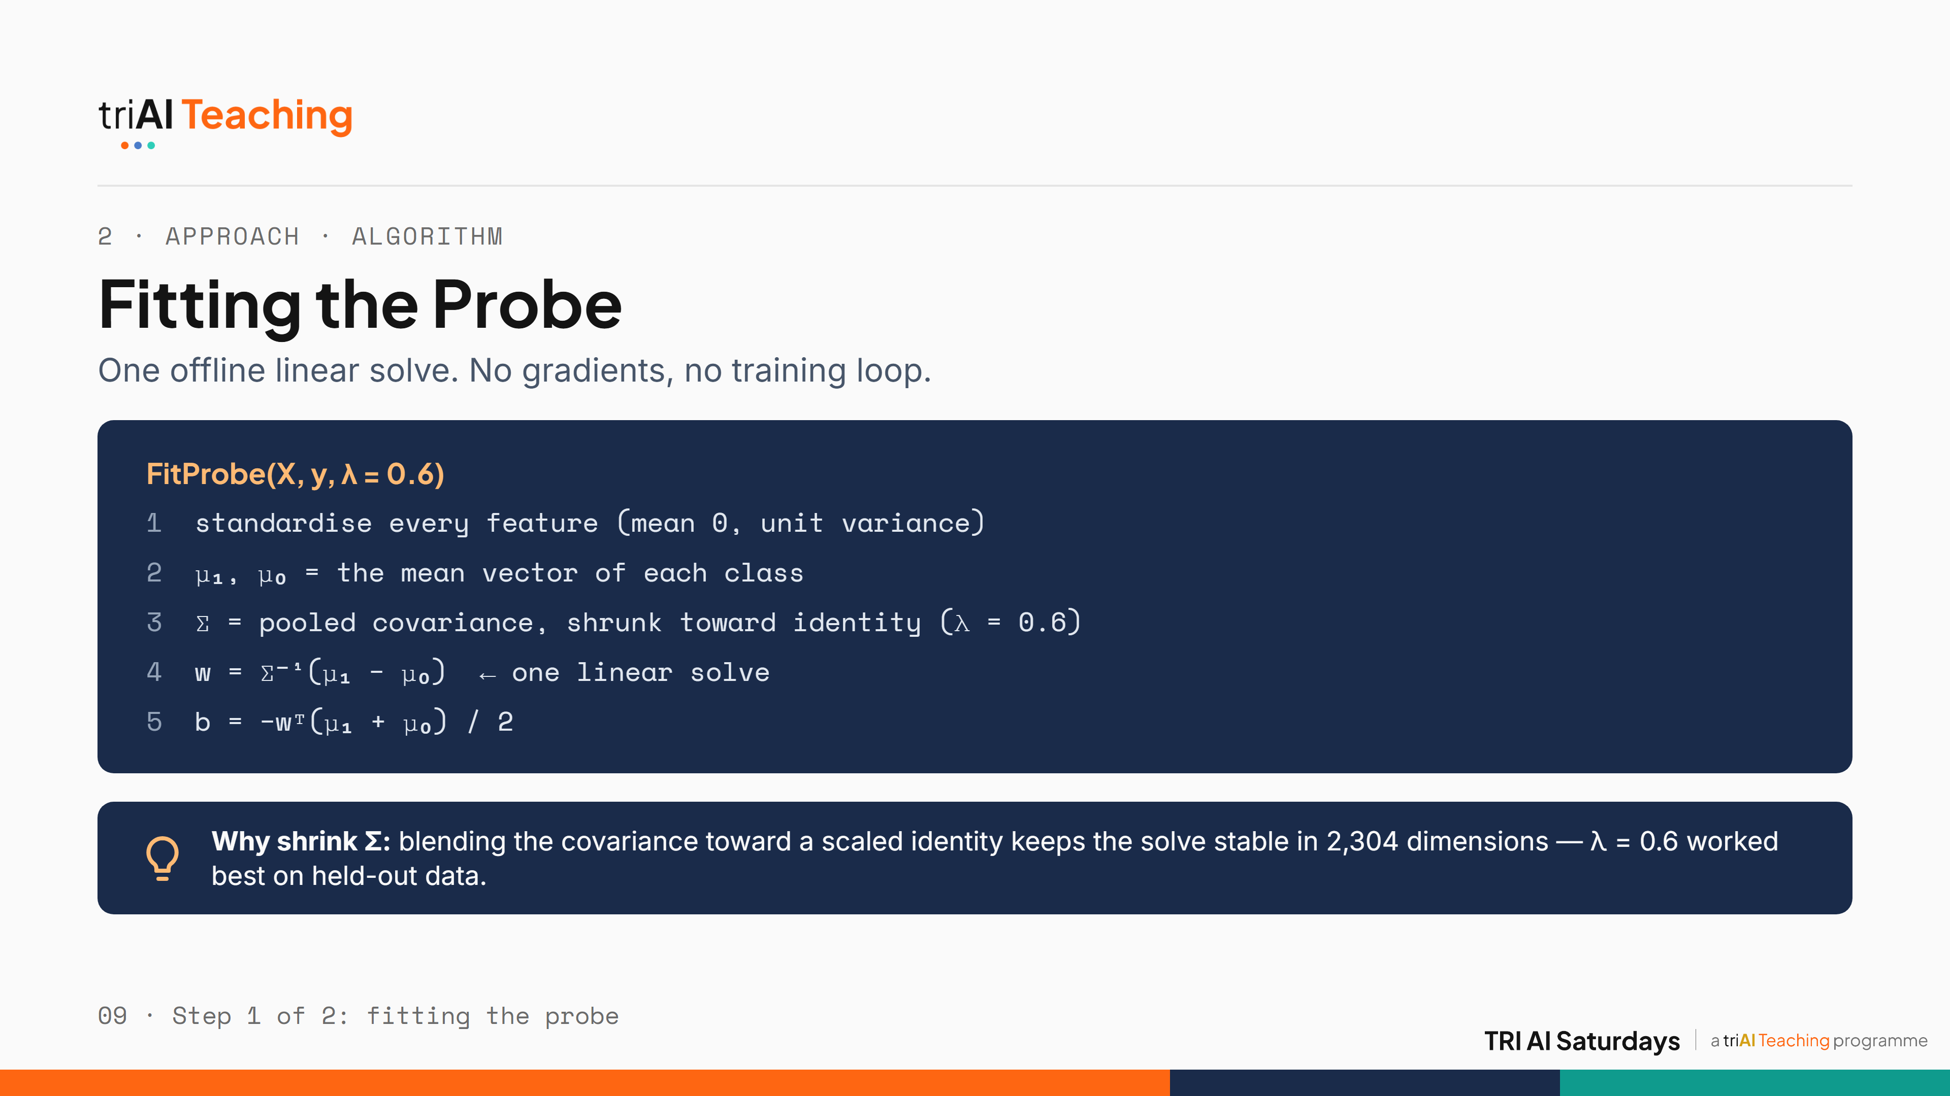
Notes:
This is how we fit the probe, once, offline. Standardise every feature, take each class's mean, and the shared covariance between them. We shrink that covariance toward a scaled identity, with lambda 0.6, so it stays well-conditioned in 2,304 dimensions. Then one linear solve gives us the direction w. No gradients, no epochs, no training loop — it's a single matrix equation.

Slide 10
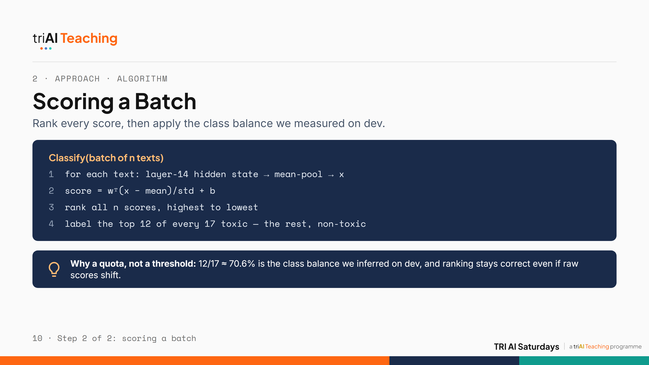
Notes:
At test time, we score every text by projecting onto the direction w we just solved for, then we rank the whole batch from highest to lowest score. Instead of a fixed cutoff, we label the top 12 of every 17 as toxic, because that matches the class balance we inferred from our development-phase results, it held on the test set, and ranking is robust even if the raw scores shift up or down.

Slide 11
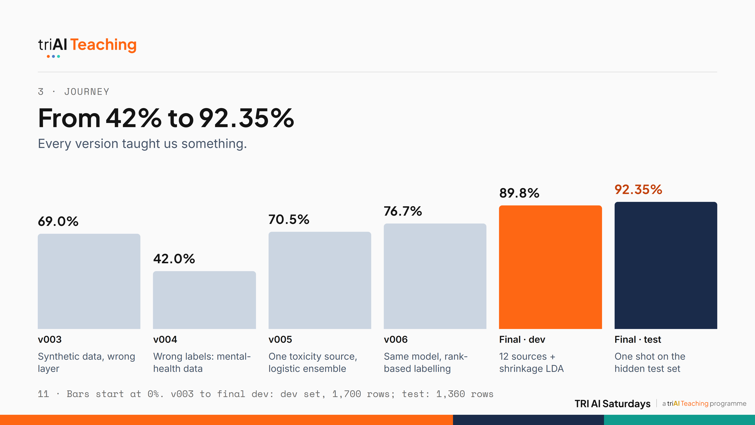
Notes:
Our path was not a straight line. v003 used synthetic data and the wrong layer: 69%. v004 actually got worse, 42%, because we trained on mental-health labels, the wrong task entirely. That taught us the data defines the task. v005 used a real toxicity dataset: 70.5%. v006 kept the exact same model bytes and only changed how we turn scores into labels, ranking instead of a fixed threshold, and gained six points. The big jump came from data breadth: twelve sources plus shrinkage LDA took us to 89.8% on dev, and our single allowed test submission scored 92.35%.

Slide 12
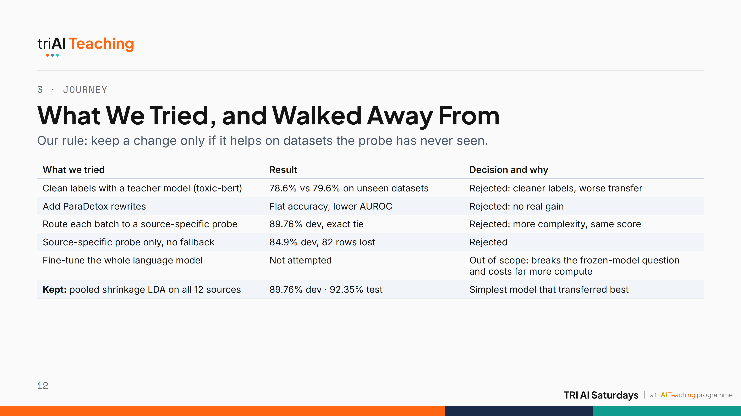
Notes:
Here's what we tried and threw away. Filtering labels with a teacher model made transfer worse. Adding ParaDetox rewrites did nothing. A router that picks a source-specific probe per batch tied our simple model exactly, and without a fallback it lost 82 rows. We never fine-tuned Gemma, because that would answer a different question and cost far more compute. The rule behind every decision: a change stays only if it helps on data the probe has never seen. The simplest model won.

Slide 13
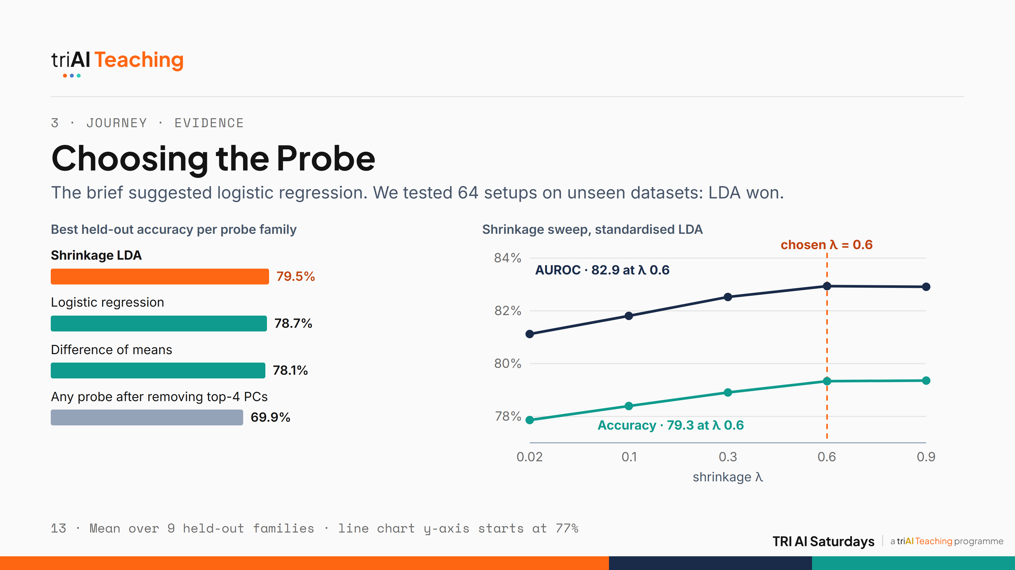
Notes:
We didn't pick shrinkage LDA on instinct. We ran 64 configurations, probe families times preprocessing times hyperparameters, each scored on the nine held-out dataset families. LDA came out on top, narrowly ahead of logistic regression, and it's closed-form. The right chart shows why lambda is 0.6: accuracy and AUROC climb as we add shrinkage and level off there. One striking result: removing the top four principal components drops every probe to about 70%. The toxicity signal lives in the model's dominant directions.

Slide 14
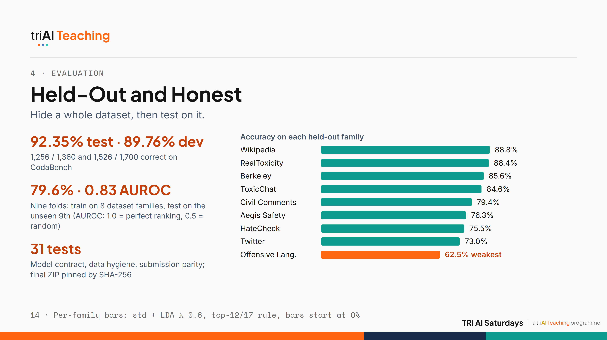
Notes:
A leaderboard score only tells you about one test set. So we held out entire dataset families: train on eight, test on the ninth, nine times. On data it had never seen, the probe averaged about 80% accuracy and 0.83 AUROC. Encyclopedic and prompt-style text is easy, near 89%. Tweets with slang and reclaimed terms are hardest, 62.5%. That gap is our main measured limitation, and it matters for fairness. We also have 31 automated tests and pinned the exact submitted file by hash so anyone can reproduce it.

Slide 15
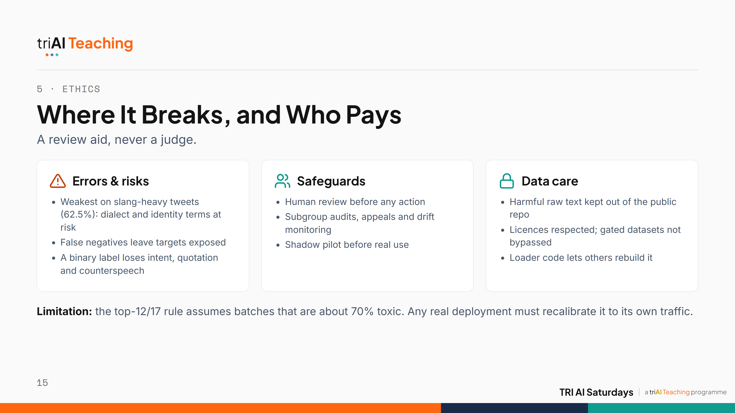
Notes:
Ethics. This is a research prototype that supports human moderators; it should never be the sole basis for a ban. The risks run both ways: false positives can silence dialects and identity terms, which our weakest fold on tweets hints at, and false negatives leave targets exposed. Safeguards: human review, subgroup audits, appeals, drift monitoring and a shadow pilot. We kept harmful raw text out of the public repo and did not bypass any gated dataset. And one honest caveat: our ranking rule assumes about 70% toxic batches, so it must be recalibrated for real traffic.

Slide 16
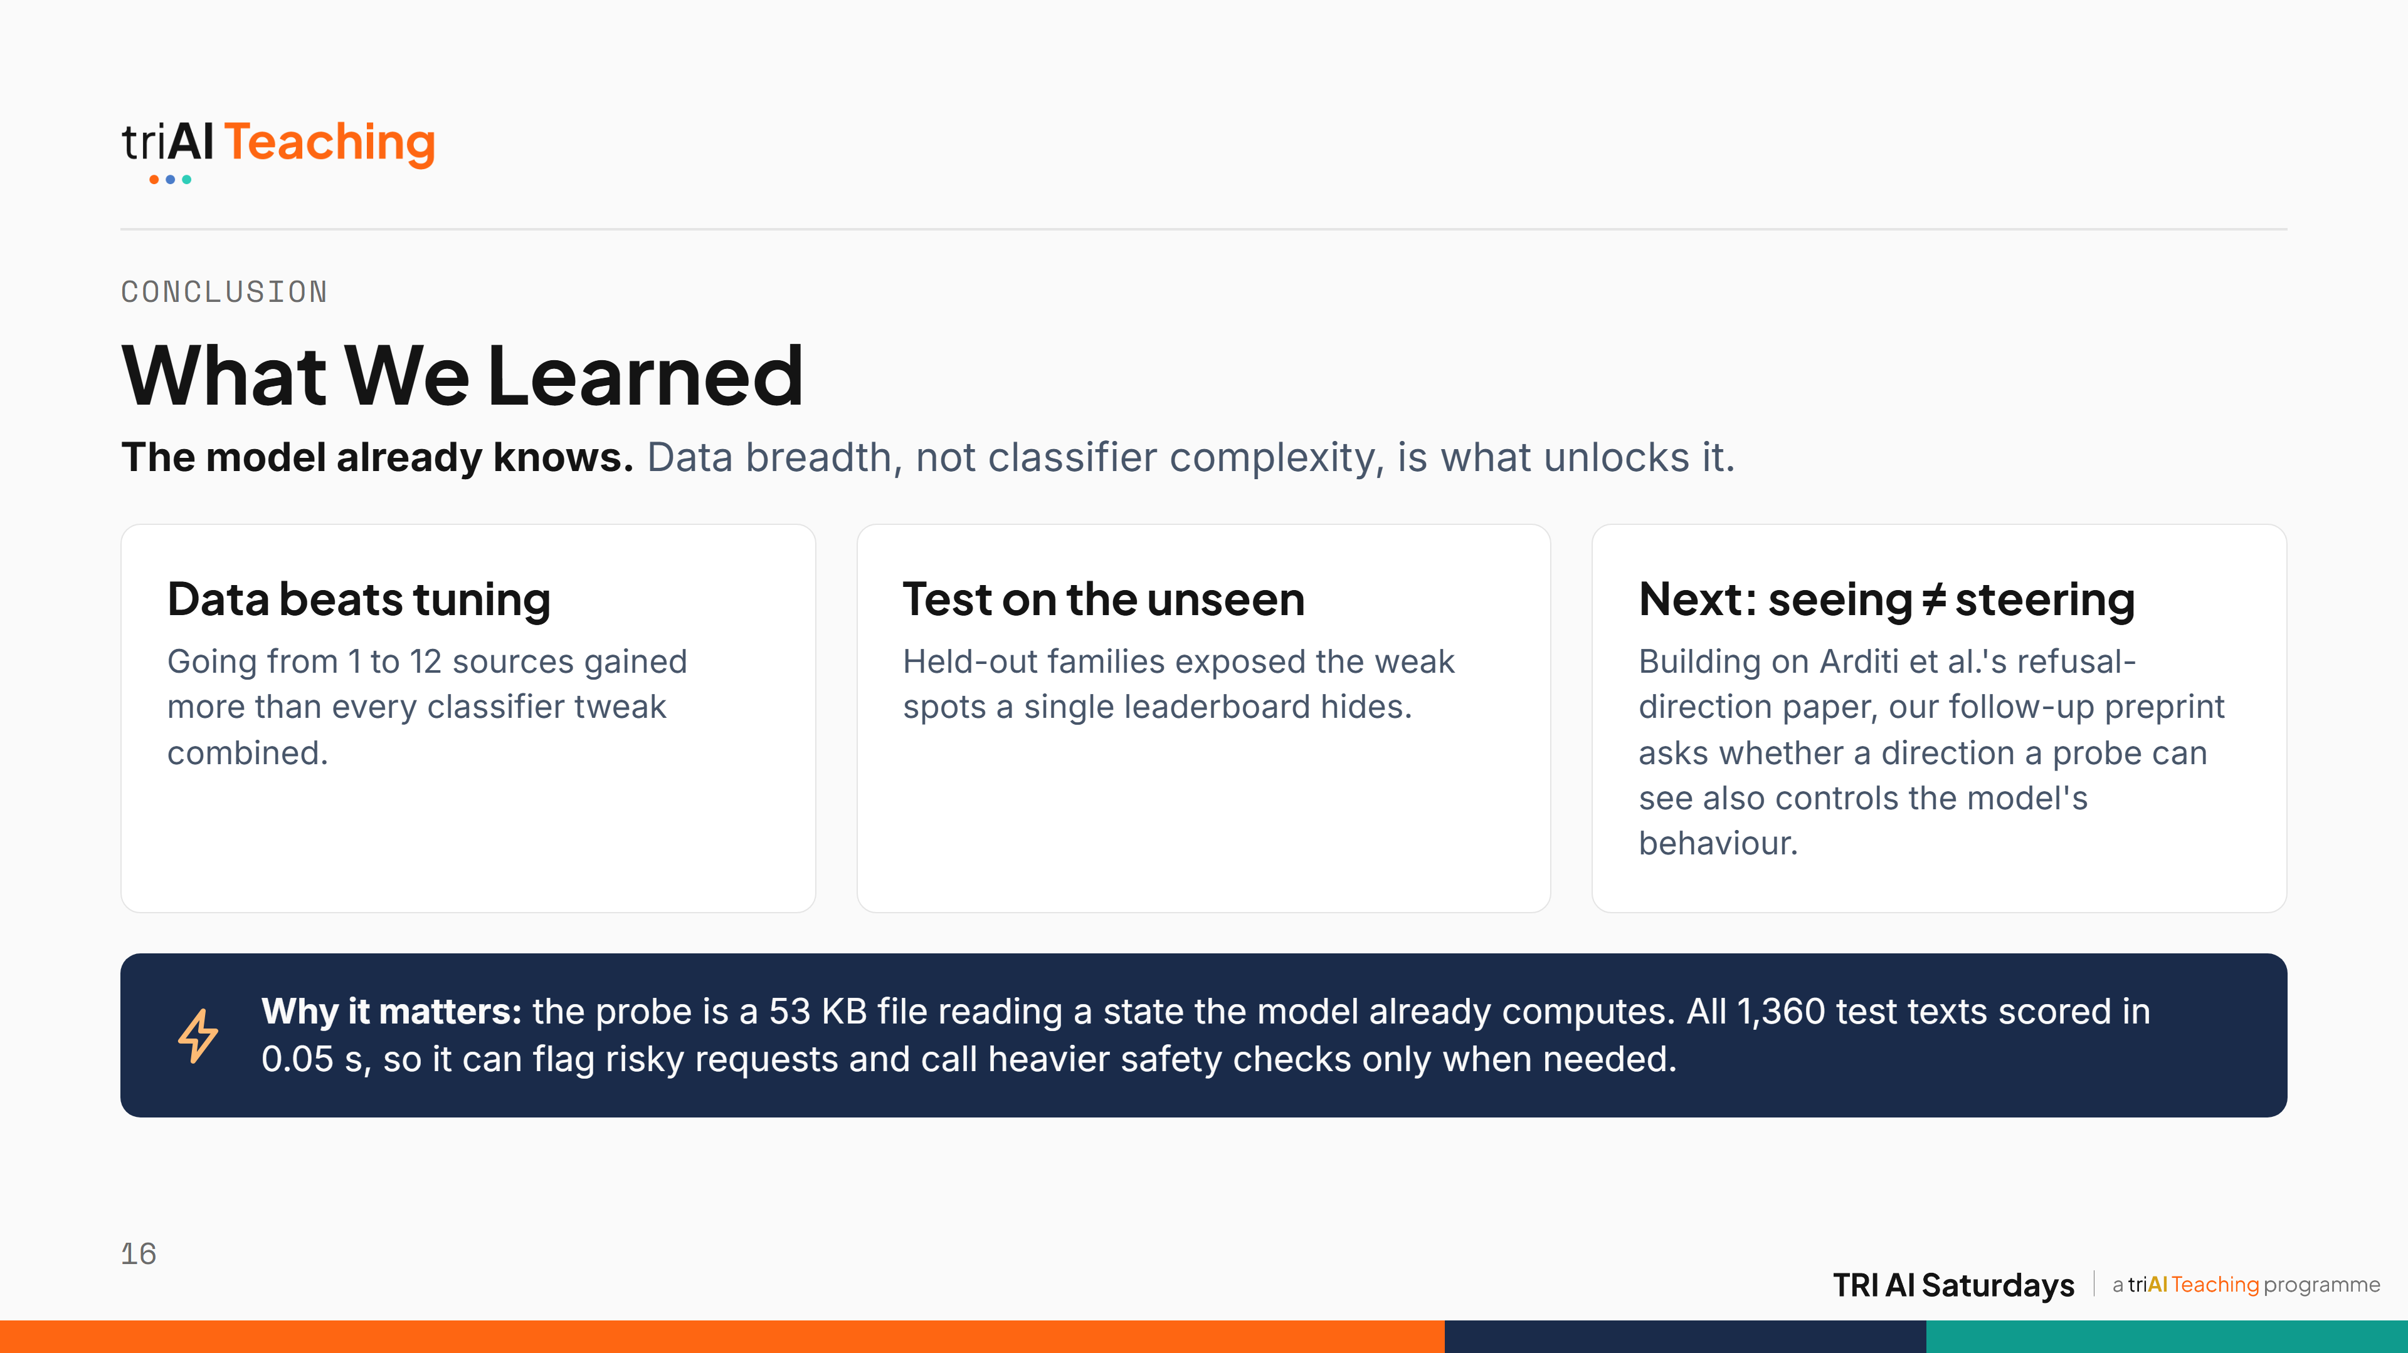
Notes:
Three takeaways. One: the toxicity signal really is inside a frozen model, and data breadth unlocked it far more than any classifier trick. Two: always test on data the model has never seen; our held-out families told us the truth a single leaderboard can't. Three, what's next: we've started a follow-up preprint, "Seeing is not steering", asking whether the direction a probe detects can also be used to control the model. Early evidence says not necessarily, which matters for AI safety monitoring. And why this matters in practice: the whole probe is a 53 kilobyte file that reads a state the model computes anyway. CodaBench scored all 1,360 test texts in five hundredths of a second. That makes it a cheap first-pass flag that can trigger heavier safety checks only when they are needed, which is exactly the value the organisers' brief asked us to test.

Slide 17
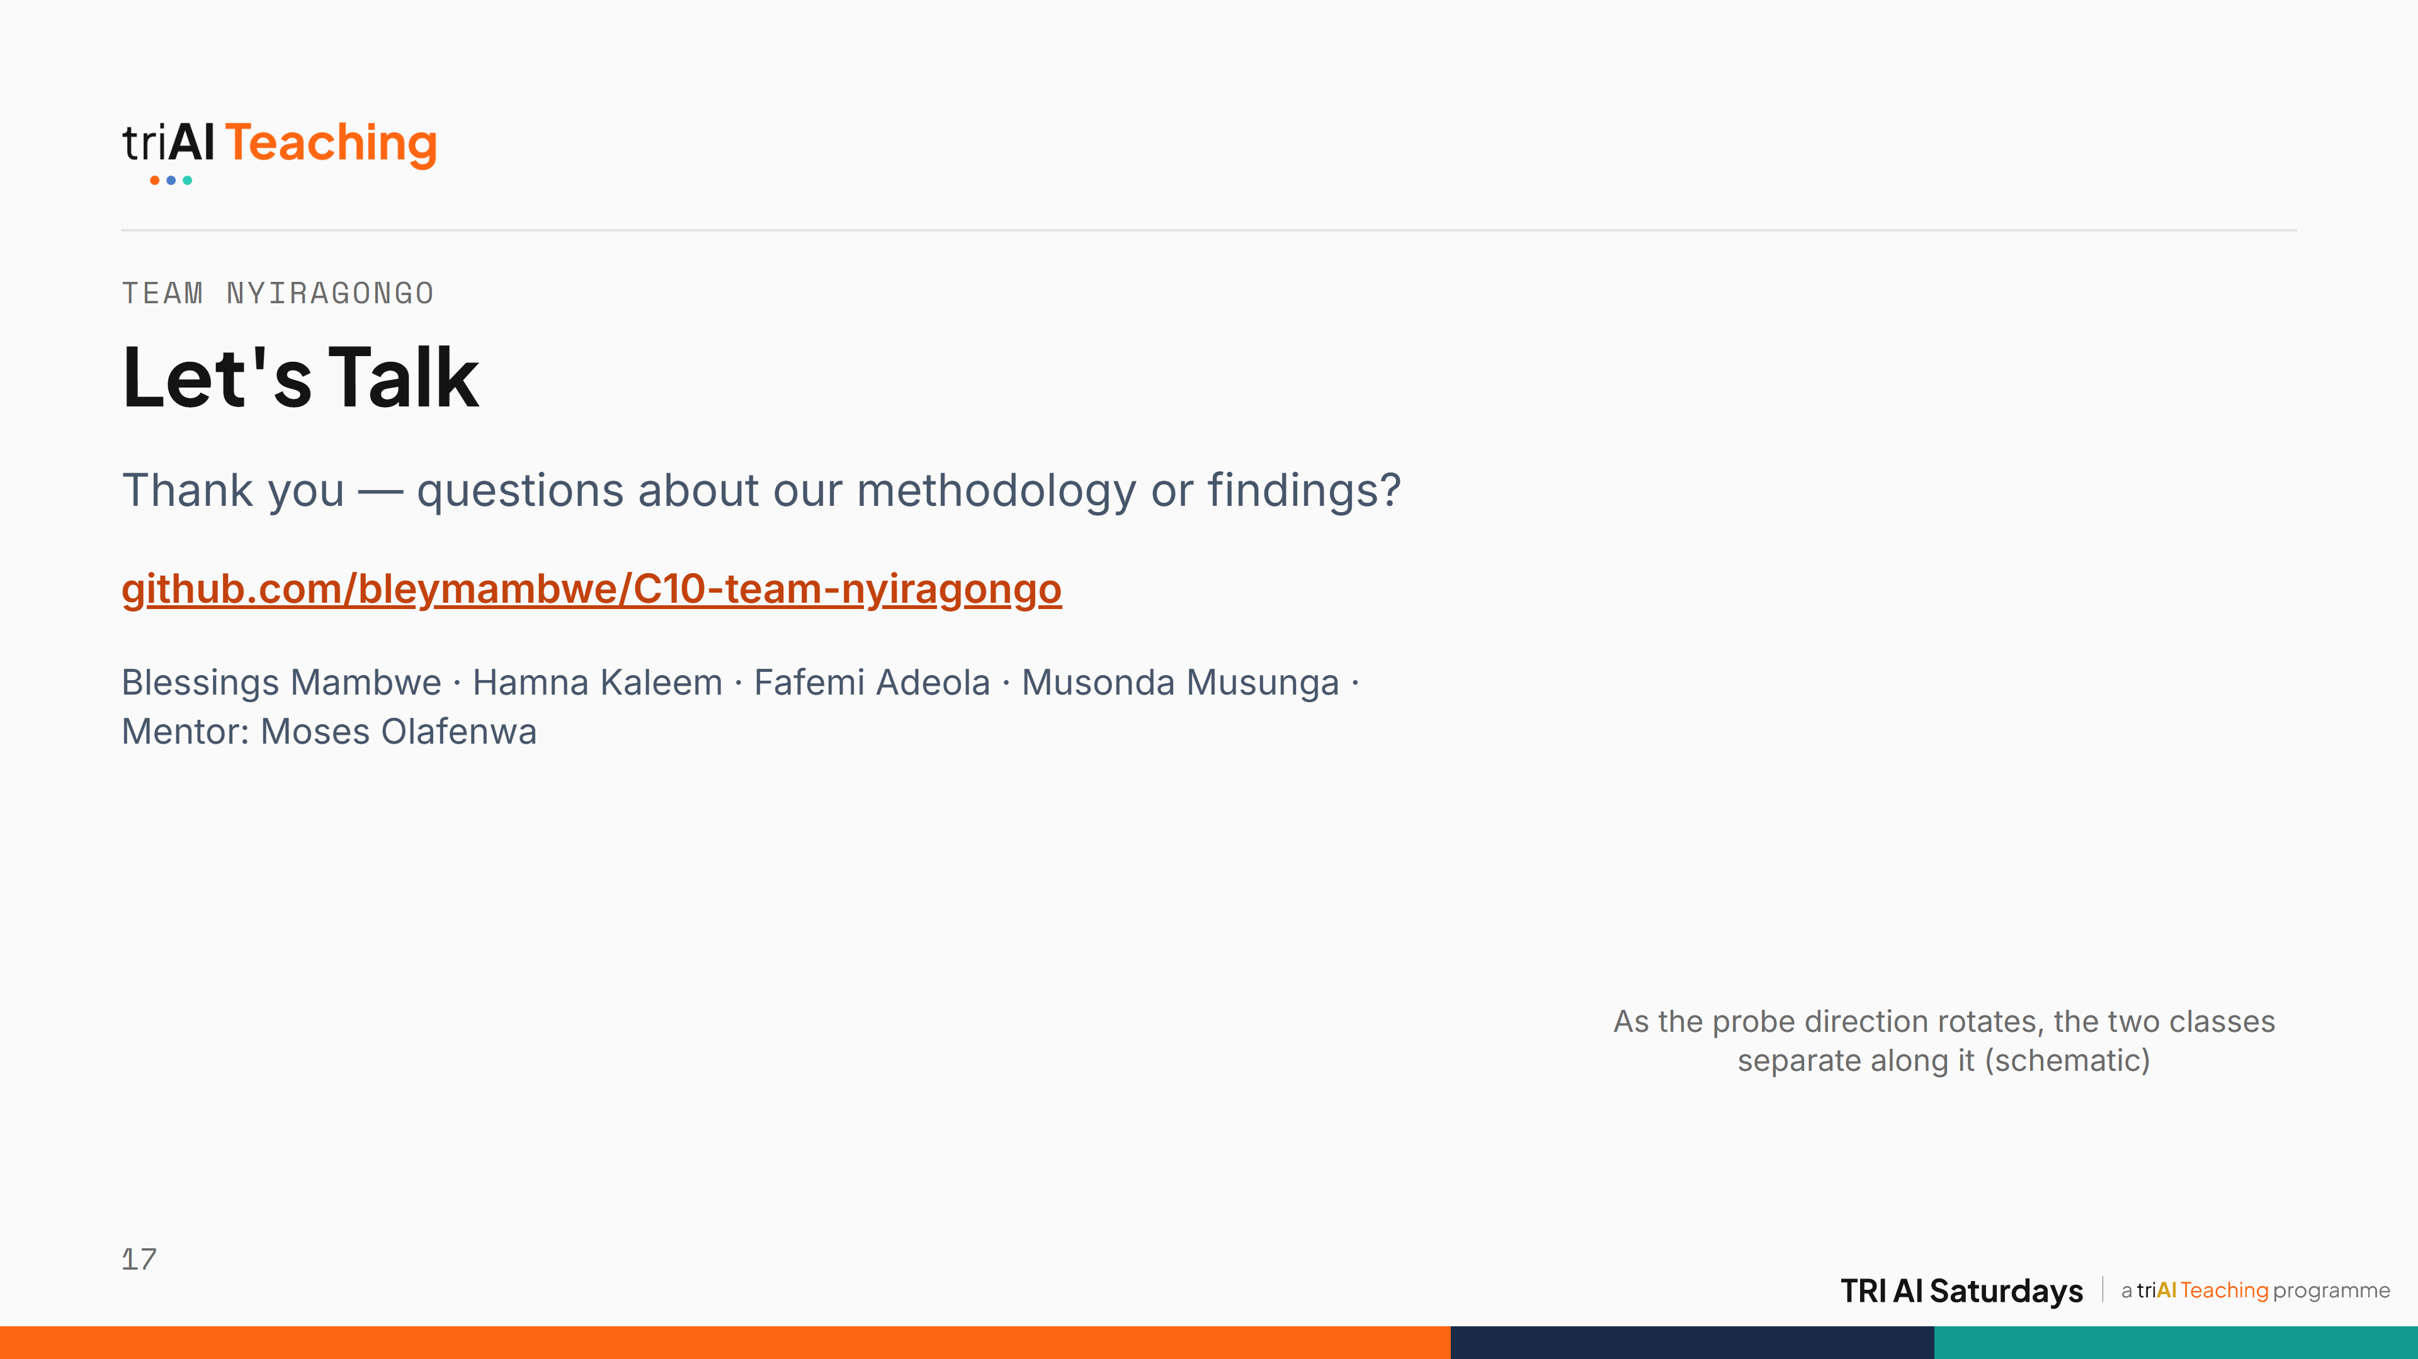

Notes:
Thank you. Thanks to our mentor Moses Olafenwa and to TRI AI. Everything, including the exact submitted file, is reproducible from our GitHub repo. We're happy to take questions.

