Slide 1
Decorator
Group 3

Slide 2
Decorator
Introduction
Problem
Solution
Real-world analogy
Structure
Applicability
Implementation
Pros and Cons
Relations with other patterns

Slide 3
Introduction
Decorator is a structural design pattern that lets you attach new behaviors to objects by placing these objects inside special wrapper objects that contain the behaviors.

Slide 4
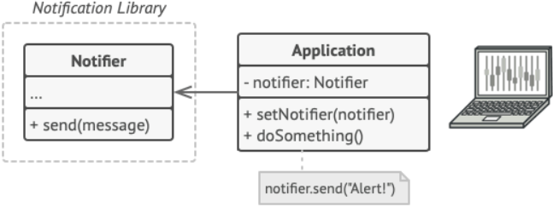
Problem
Imagine that you’re working on a notification library which lets other programs notify their users about important events.

Slide 5
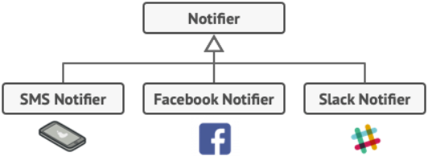
Problem
A program could use the notifier class to send notifications about important events to a predefined set of emails.

Slide 6
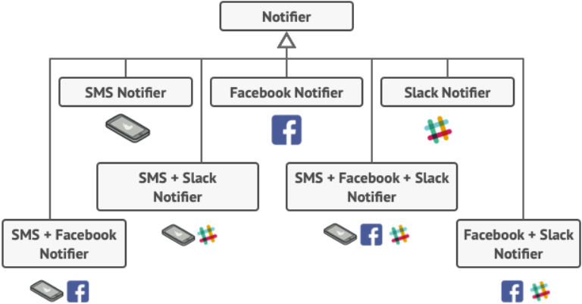
Problem
“Why can’t you use several notification types at once? If your house is on fire, you’d probably want to be informed through every channel.”
You tried to address that problem by creating special subclasses which combined several notification methods within one class.

Slide 7
Solution
Inheritance has several serious caveats that you need to be aware of.
Inheritance is static.
Subclasses can have just one parent class.

Slide 8
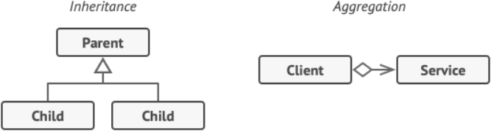
Solution
One of the ways to overcome these caveats is by using Aggregation or Composition

Slide 9
Solution
“Wrapper” is the alternative nickname for the Decorator pattern that clearly expresses the main idea of the pattern.
Is an object that can be linked with some target object.
Contains the same set of methods as the target and delegates to it all requests it receives.
May alter the result by doing something either before or after it passes the request to the target.

Slide 10

Solution
The wrapper implements the same interface as the wrapped object. Make the wrapper’s reference field accept any object that follows that interface.
$⇒$ This will let you cover an object in multiple wrappers, adding the combined behavior of all the wrappers to it.

Slide 11
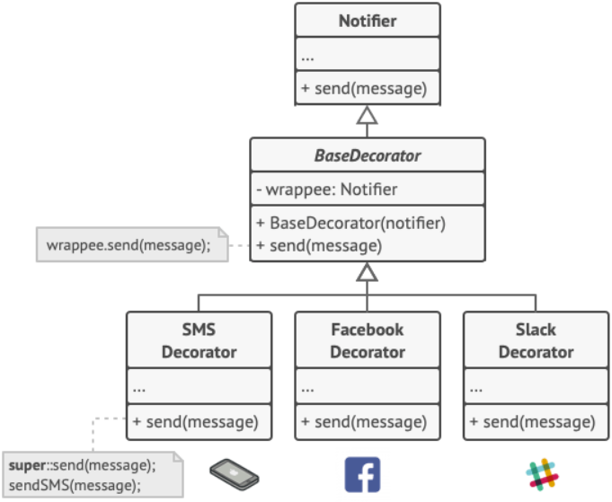
Solution
Let’s leave the simple email notification behavior inside the base Notifier class, but turn all other notification methods into decorators.

Slide 12
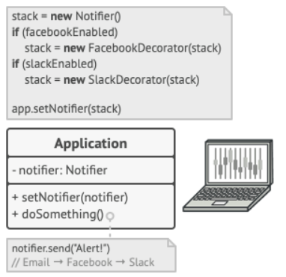
Solution
Apps might configure complex stacks of notification decorators.

Slide 13
Real-World analogy
Wearing clothes is an example of using decorators.
All of these “extend” your basic behavior but aren’t part of you, and you can easily take off any piece of clothing whenever you don’t need it.

Slide 14
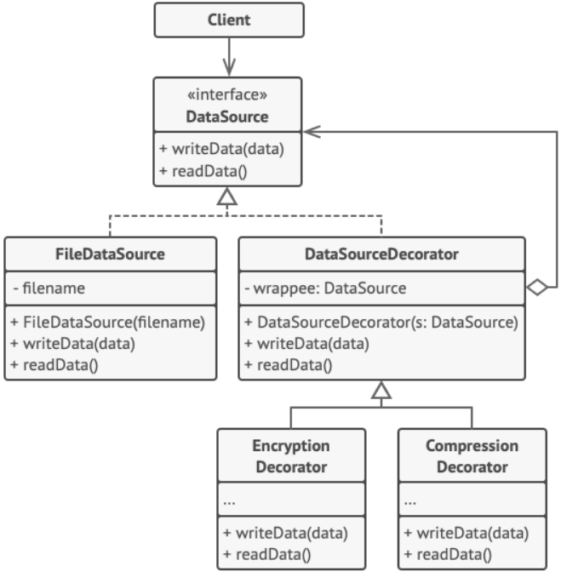
Structure

Slide 18
Applicability
Use the Decorator pattern when you need to be able to assign extra behaviors to objects at runtime without breaking the code that uses these objects.
The Decorator lets you structure your business logic into layers, create a decorator for each layer and compose objects with various combinations of this logic at runtime. The client code can treat all these objects in the same way, since they all follow a common interface.
Use the pattern when it’s awkward or not possible to extend an object’s behavior using inheritance.
Many programming languages have the final keyword that can be used to prevent further extension of a class. For a final class, the only way to reuse the existing behavior would be to wrap the class with your own wrapper, using the Decorator pattern.

Slide 19
Implementation
Make sure your business domain can be represented as a primary component with multiple optional layers over it.
Figure out what methods are common to both the primary component and the optional layers. Create a component interface and declare those methods there.
Create a concrete component class and define the base behavior in it.
Create a base decorator class. It should have a field for storing a reference to a wrapped object. The field should be declared with the component interface type to allow linking to concrete components as well as decorators. The base decorator must delegate all work to the wrapped object.
Make sure all classes implement the component interface.
Create concrete decorators by extending them from the base decorator. A concrete decorator must execute its behavior before or after the call to the parent method (which always delegates to the wrapped object).
The client code must be responsible for creating decorators and composing them in the way the client needs.

Slide 20
Pros and Cons
You can extend an object’s behavior without making a new subclass.
You can add or remove responsibilities from an object at runtime.
You can combine several behaviors by wrapping an object into multiple decorators.
Single Responsibility Principle. You can divide a monolithic class that implements many possible variants of behavior into several smaller classes.
It’s hard to remove a specific wrapper from the wrappers stack.
It’s hard to implement a decorator in such a way that its behavior doesn’t depend on the order in the decorators stack.
The initial configuration code of layers might look pretty ugly.

Slide 21
Relations with other patterns
Adapter changes the interface of an existing object, while Decorator enhances an object without changing its interface. In addition, Decorator supports recursive composition, which isn’t possible when you use Adapter.
Adapter provides a different interface to the wrapped object, Proxy provides it with the same interface, and Decorator provides it with an enhanced interface.
Chain of Responsibility and Decorator have very similar class structures. Both patterns rely on recursive composition to pass the execution through a series of objects. However, there are several crucial differences.
The CoR handlers can execute arbitrary operations independently of each other. They can also stop passing the request further at any point. On the other hand, various Decorators can extend the object’s behavior while keeping it consistent with the base interface. In addition, decorators aren’t allowed to break the flow of the request.
Composite and Decorator have similar structure diagrams since both rely on recursive composition to organize an open-ended number of objects.
A Decorator is like a Composite but only has one child component. There’s another significant difference: Decorator adds additional responsibilities to the wrapped object, while Composite just “sums up” its children’s results.
However, the patterns can also cooperate: you can use Decorator to extend the behavior of a specific object in the Composite tree.
Designs that make heavy use of Composite and Decorator can often benefit from using Prototype. Applying the pattern lets you clone complex structures instead of re-constructing them from scratch.
Decorator lets you change the skin of an object, while Strategy lets you change the guts.
Decorator and Proxy have similar structures, but very different intents. Both patterns are built on the composition principle, where one object is supposed to delegate some of the work to another. The difference is that a Proxy usually manages the life cycle of its service object on its own, whereas the composition of Decorators is always controlled by the client.

