Slide 1
Introduction to Development with Azure IoT
Getting started with the platform services available at Azure
Notes:
This talk will be mostly demos
Walking through the concepts then demo the solution

Slide 2
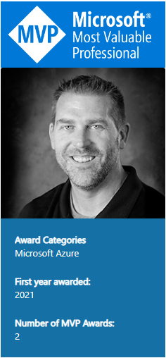
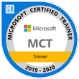
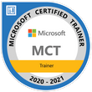
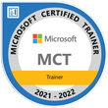
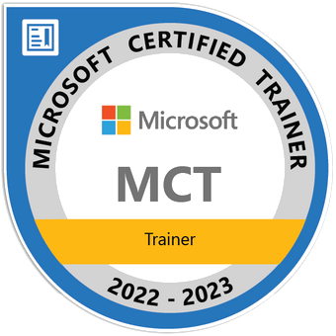
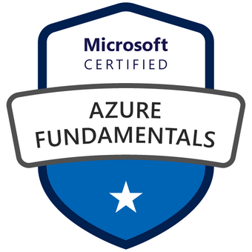
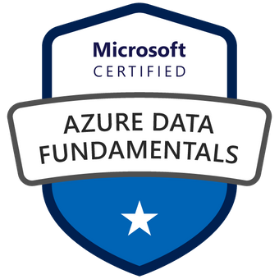
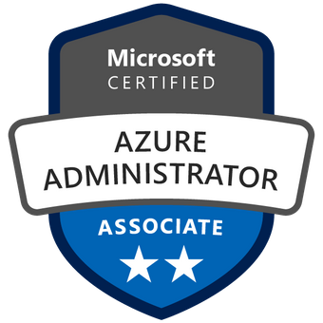

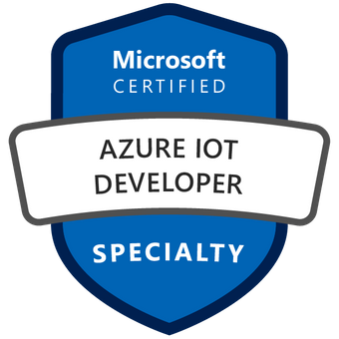
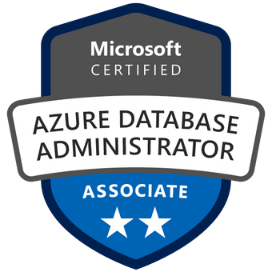
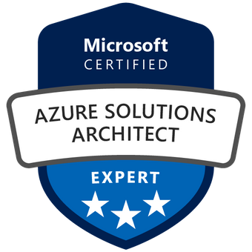
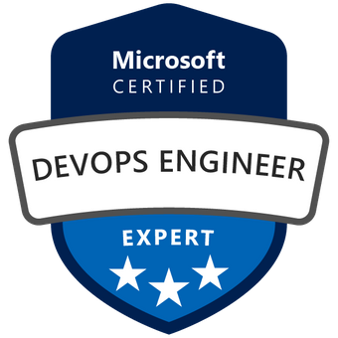

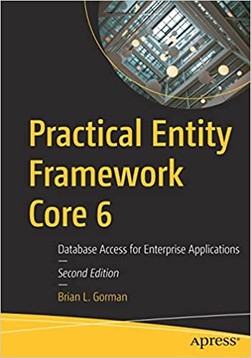

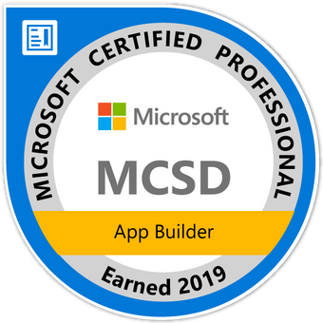
Who am I?
Brian is an experienced speaker, author, trainer, and .Net Developer (~20ish years)
Brian has a masters of science degree in computer information systems, and a bachelor of science degree in computer science. Additionally, Brian has over ten years of experience instructing college courses online in SQL databases, C#/VB .Net programming, Java programming, and Microsoft Office.
Brian has also created many online video courses, available on various platforms. Recently, Brian published the second edition of his first book: Practical Entity Framework Core 6 with APress.
Brian is currently a freelance Azure Trainer, running his own company MajorGuidanceSolutions.
Connect with Brian on Twitter and/or Linked In
@blgorman
https://www.linkedin/in/brianlgorman
Notes:
My name is Brian, and I’ll be your presenter for today.
I’ve been working in .Net since it was released to beta in 2001, and have been in various web development positions throughout my career, working with all the tech stacks along the way, including ASP.Net 1 and 2 Webforms, MVC, and am now looking into Blazor and Razor pages as .Net is evolving.
In addition to developing web solutions for many different companies, I have also been teaching in the Computer Science department at Franklin University since 2010 and have been developing training courses since about 2013.
I hold a bachelors in CS from Iowa State and an MS in Computer Information Systems from the UoP. I also have a number of Microsoft certifications that I’ve been earning since 2003 and recently published my first book: Practical Entity Framework with APress (with a second edition for .Net5/EFCore5 currently in progress)
Please follow me for updates and communication on twitter or Linked In. Twitter: blgorman
LinkedIn: brianlgorman

Slide 3

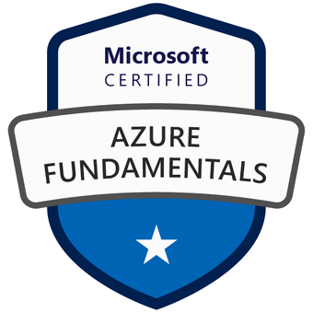
Who am I?
Brian is an experienced speaker, author, trainer, and .Net developer with
MCT (x4) / MVP (x2) MCSD: App Builder Azure Fundamentals Azure Data Fundamentals Azure SCI Fundamentals Azure Administrator Associate Azure Security Associate Azure Developer Associate Azure IOT Developer Specialization Azure Database Administrator Associate Azure Solutions Architect Expert Azure DevOps Engineer Expert
Brian has a masters of science degree in computer information systems, and a bachelor of science degree in computer science. Additionally, Brian has over ten years of experience instructing college courses online in SQL databases, C#/VB .Net programming, Java programming, and Microsoft Office.
Brian has also created many online video courses, available on various platforms. Recently, Brian published the second edition of his first book: Practical Entity Framework Core 6 with APress.
Brian runs a company named Major Guidance Solutions, which does contract and custom training and curriculum development. If you are interested in becoming Azure certified, make sure to connect with me.
Connect with Brian on Twitter and/or Linked In
@blgorman
https://www.linkedin/in/brianlgorman
Notes:
My name is Brian, and I’ll be your presenter for today.
I’ve been working in .Net since it was released to beta in 2001, and have been in various web development positions throughout my career, working with all the tech stacks along the way, including ASP.Net 1 and 2 Webforms, MVC, and am now looking into Blazor and Razor pages as .Net is evolving.
In addition to developing web solutions for many different companies, I have also been teaching in the Computer Science department at Franklin University since 2010 and have been developing training courses since about 2013.
I hold a bachelors in CS from Iowa State and an MS in Computer Information Systems from the UoP. I also have a number of Microsoft certifications that I’ve been earning since 2003 and recently published my first book: Practical Entity Framework with APress (with a second edition for .Net5/EFCore5 currently in progress)
Please follow me for updates and communication on twitter or Linked In. Twitter: blgorman
LinkedIn: brianlgorman

Slide 4
Agenda
IoT Hub
Manual Device Enrollment
IoT Device Provisioning Service
Certificate Attestation using DPS enrollment groups
Lambda Architecture
Cold path storage
Stream Analytics and the Hot Path Storage
IoT Edge Overview
IoT Central
Conclusion
Notes:
In this talk, we’ll cover a couple of the basic tenets of working with IoT At Azure.
The first task is the entry point, where telemetry can be ingested – via the IoT Hub
We’ll create a hub and then manually enroll a device into the hub with C# code to simulate an IoT device
We’ll then look at the DPS to build out an enrollment group and some certificates
With the certificates, we’ll use multiple simulators to automatically enroll and be able to send data to the hub
We’ll then talk a bit about Lambda architecture
We’ll finish demos with a look at stream analytics and ingestion of data to both the hot and cold path from the hub to storage
Finally, we’ll conclude with a quick look at the idea of edge devices and how you can use them to transfer some of the processing out to the field, followed by an overview of what IoT Central is.

Slide 5
IoT Hub

Slide 6
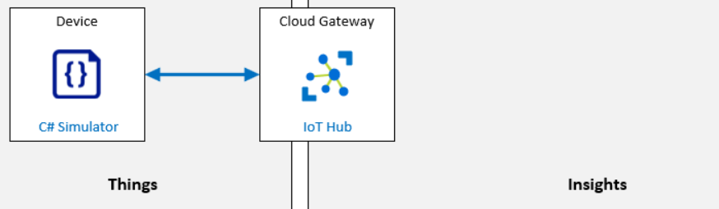
The IoT Hub
Event Hub & the Event Hub SDK
Stream millions of data points per second
az iot cli extension
Free/Basic/Standard Tiers
Partitions
Connect devices directly
https://github.com/Azure/azure-iot-cli-extension
https://docs.microsoft.com/azure/iot-hub/iot-concepts-and-iot-hub
Notes:
https://github.com/Azure/azure-iot-cli-extension

Slide 7
Explore Deploying an IoT Hub
Demo
Notes:
Mention in the interest of time that this is pre-created

Slide 8
Devices
Manual Enrollment
Use a C# Simulator
Can connect a real device
https://github.com/MicrosoftLearning/AZ-220-Microsoft-Azure-IoT-Developer/raw/master/Instructions/Labs/media/LAB_AK_04-architecture.png
Notes:
https://github.com/Azure/azure-iot-cli-extension

Slide 9
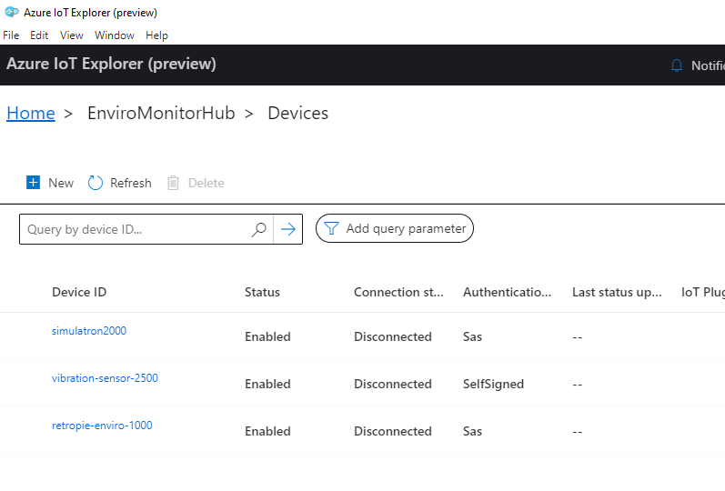
Azure IoT Explorer
https://docs.microsoft.com/en-us/azure/iot-fundamentals/howto-use-iot-explorer

Slide 10
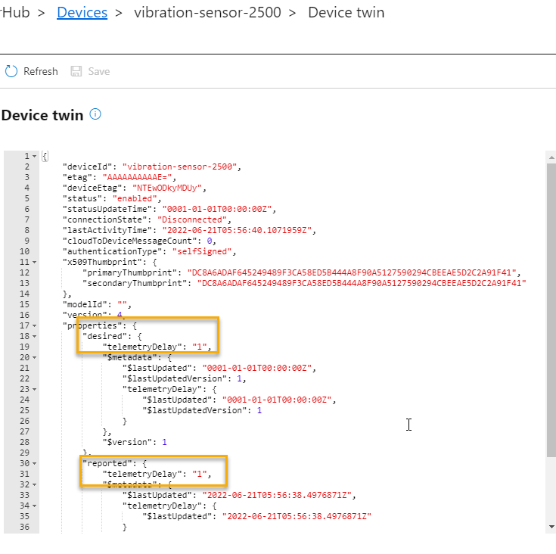
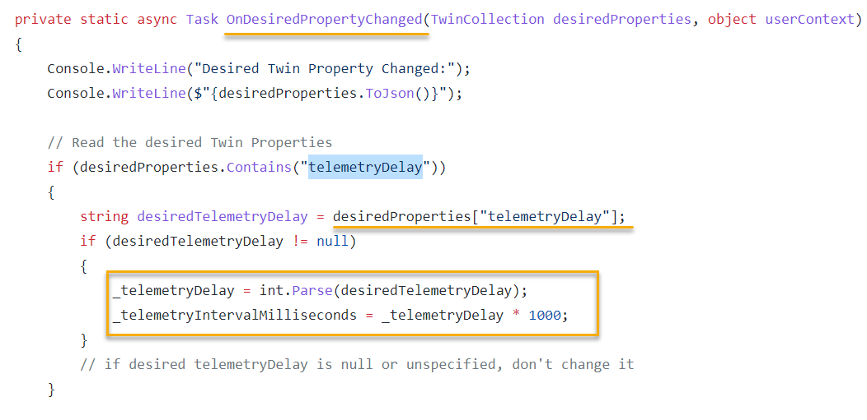
Device Twin
Notes:
Note that you can set some of the properties of a device using the digital twin in the hub. Here you see the property of telemetry delay for desired at 1 and reported at 1. If you change desired, then the reported will be updated when the device has set the property. In order for this to mean anything, it has to map to your code

Slide 11
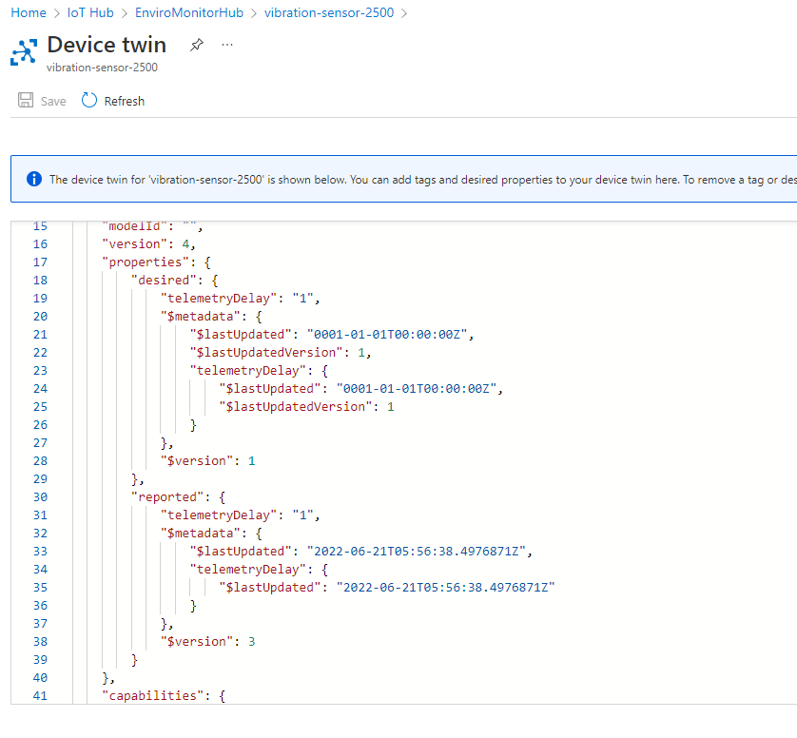
Device Twin in the Hub

Slide 12
Add a device and simulate telemetry
Demo
Notes:
Walk through the device at the IoT Hub and the connection string for the device. Use the simulator to show telemetry being injested

Slide 13
Device Provisioning Service (DPS)

Slide 14
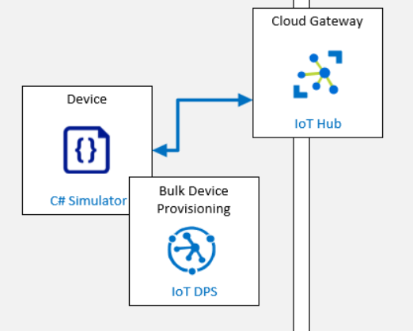
Device Provisioning Service
Create Enrollment Groups
Register root certificates
Enable devices to automatically enroll
Can communicate to the device for configurations
https://github.com/MicrosoftLearning/AZ-220-Microsoft-Azure-IoT-Developer/raw/master/Instructions/Labs/media/LAB_AK_06-architecture.png

Slide 15
Explore the DPS
Demo
Notes:
Walk through the DPS and show the enrollment group and the place where the certificate root was added
Remember to mention that the steps to get it set up are in the repo

Slide 16
Utilize DPS for certificate attestation
Demo

Slide 17
Lambda Architecture

Slide 18
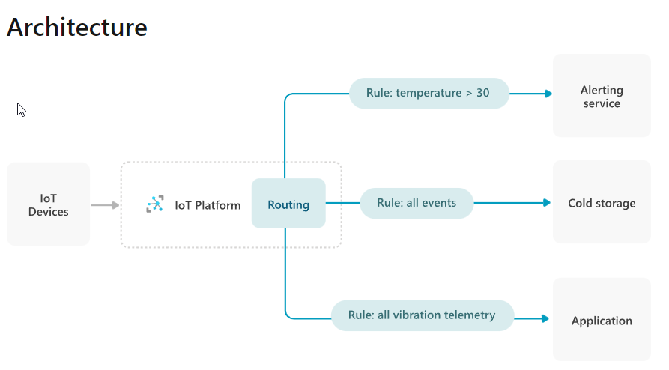
IoT Architecture
Industrial IoT
Monitoring and Alerting
Predictive Maintenance
https://docs.microsoft.com/en-us/azure/architecture/example-scenario/iot/event-routing

Slide 19
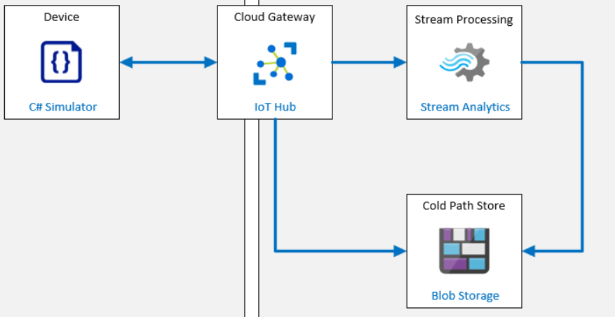
Lambda Architecture
Cold path for all data
Hot path for critical data
Leverages Stream Analytics or another stream processing service
https://github.com/MicrosoftLearning/AZ-220-Microsoft-Azure-IoT-Developer/blob/master/Instructions/Labs/media/LAB_AK_07-architecture.png

Slide 20
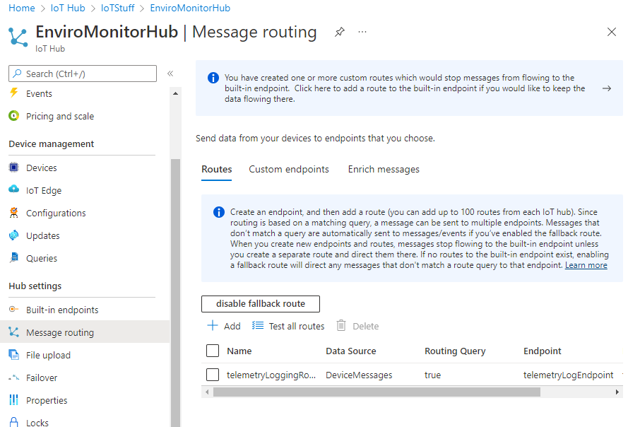
Use Message Routing for cold path storage

Slide 21
Stream Analytics for Hot Path
Notes:
Ideally, this would be a PowerBI or Grafana dashboard output

Slide 22
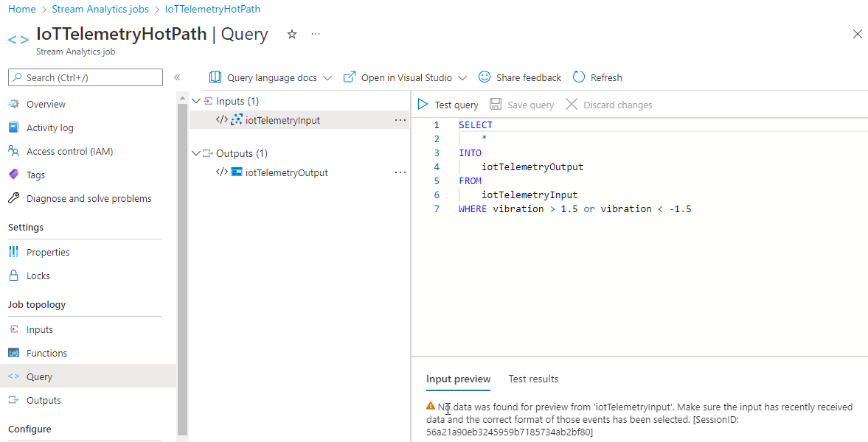
Create a query to filter

Slide 23
IoT Edge Gateways and Devices

Slide 24
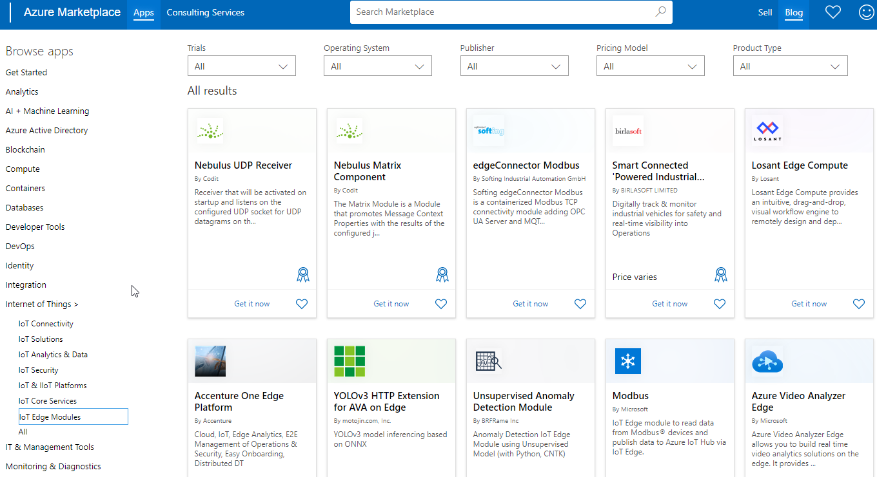
IoT Edge
https://azuremarketplace.microsoft.com/marketplace/apps/category/internet-of-things?page=1&subcategories=iot-edge-modules
Offload processing to the edge
Edge Gateway
Stream Analytics on the Edge
Other IoT Edge Processing
Pre-built
Custom

Slide 25
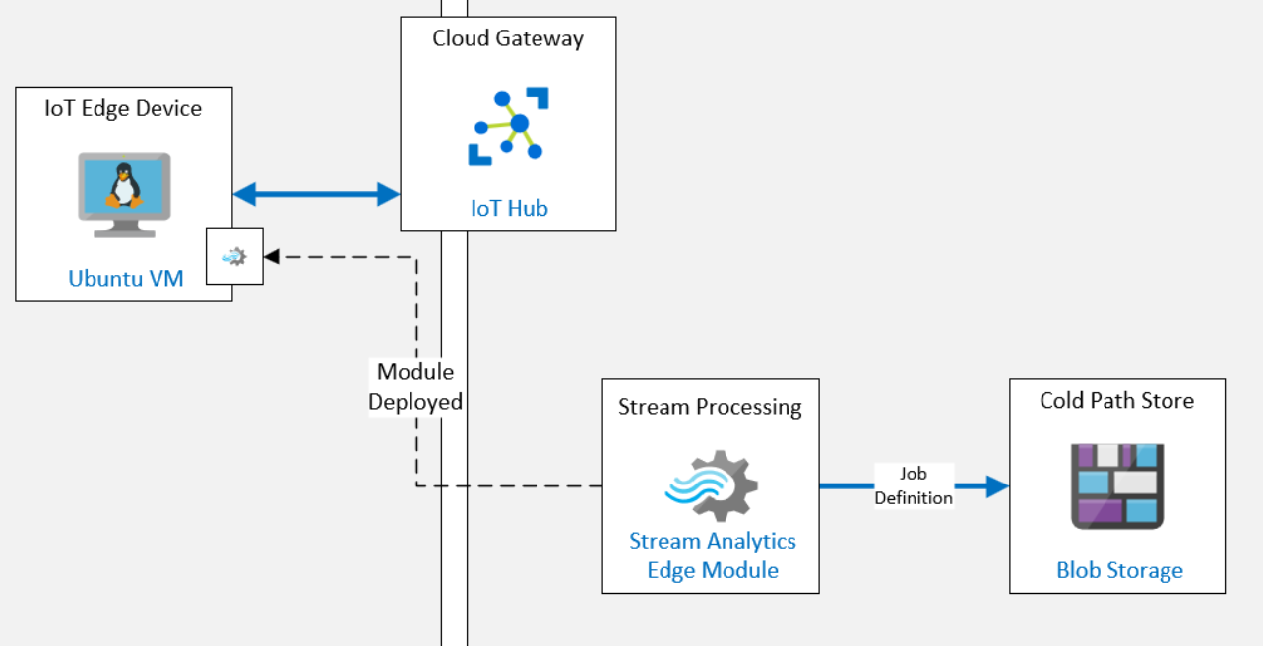
https://github.com/MicrosoftLearning/AZ-220-Microsoft-Azure-IoT-Developer/blob/master/Instructions/Labs/media/LAB_AK_11-architecture.png?raw=true

Slide 26
IoT Central

Slide 27
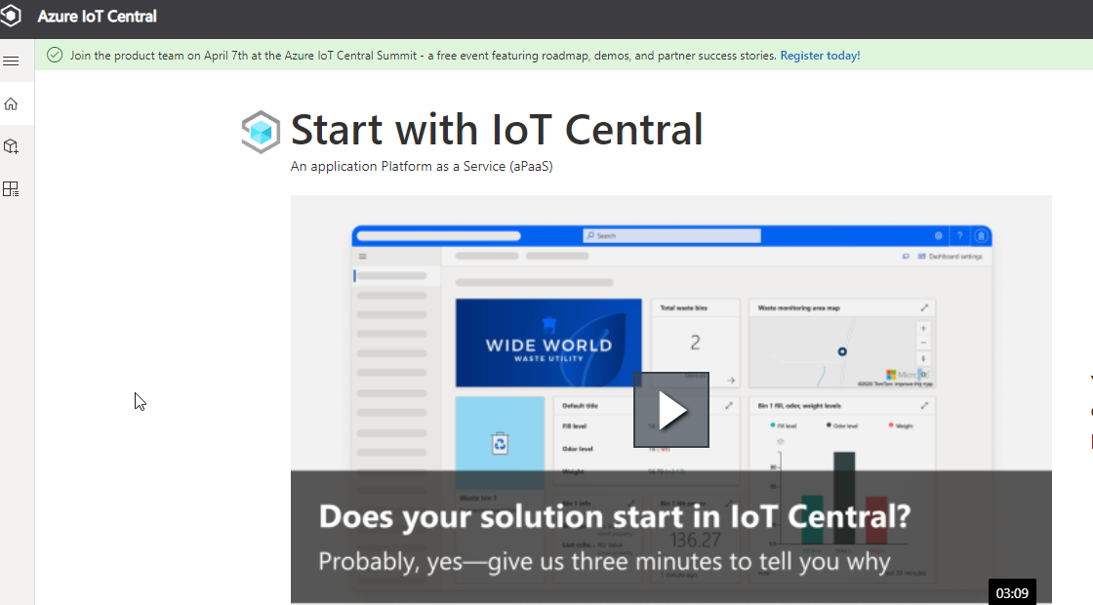
IoT Central
Plug and Play solutions
Low Code but high functionality
Dashboards
Commands
Sample apps
https://apps.azureiotcentral.com/

Slide 28
Stream Live Telemetry to Azure
Raspberry Pi with Pimoroni Enviro and some simple C#/Python

Slide 29
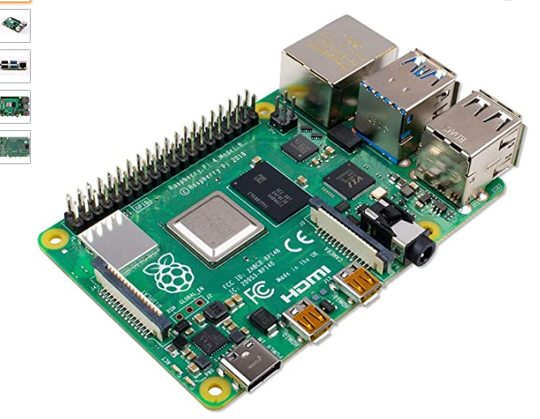
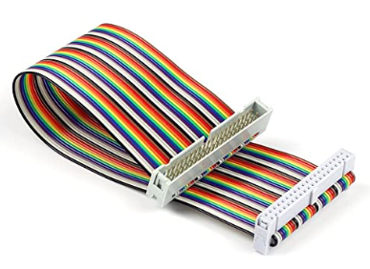
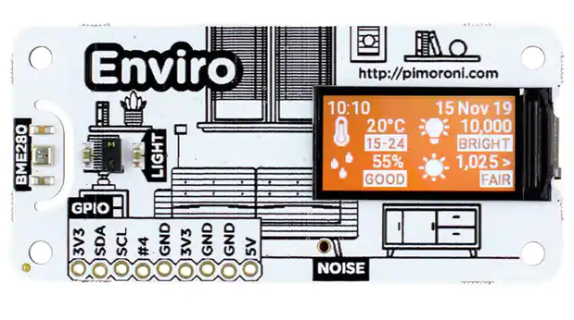
Parts List
Raspberry Pi (3+)
Pimoroni Enviro (recommend EnviroPlus + PMS5003 sensor)
UCTronics Male to Female GPIO Ribbon Cable 40pin Breadboard jumper
Pimoroni Getting started (includes link to GitHub repo): https://learn.pimoroni.com/article/getting-started-with-enviro-plus

Slide 30
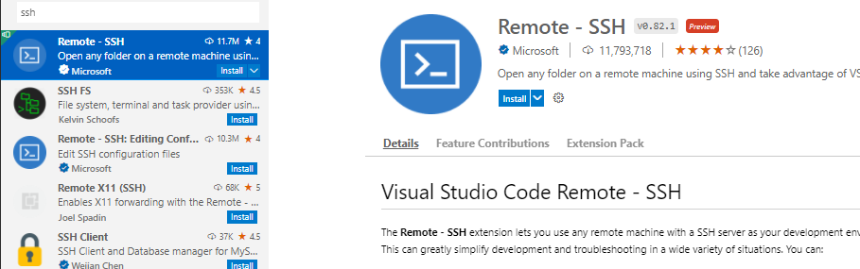
SSH from Visual Studio Code
Using SSH from Visual Studio Code
https://code.visualstudio.com/docs/remote/ssh

Slide 31
Send live telemetry to the IoT Hub
Demo
Notes:
To make this easy, my code connects via a simple device connection string.

Slide 32
Summary
IoT Is easy to get started
Free Tier hub for testing and development
Manually or Automatically Enroll devices
Keys or Certificates
Transport Protocols
Lambda Architecture
IoT Edge

Slide 33
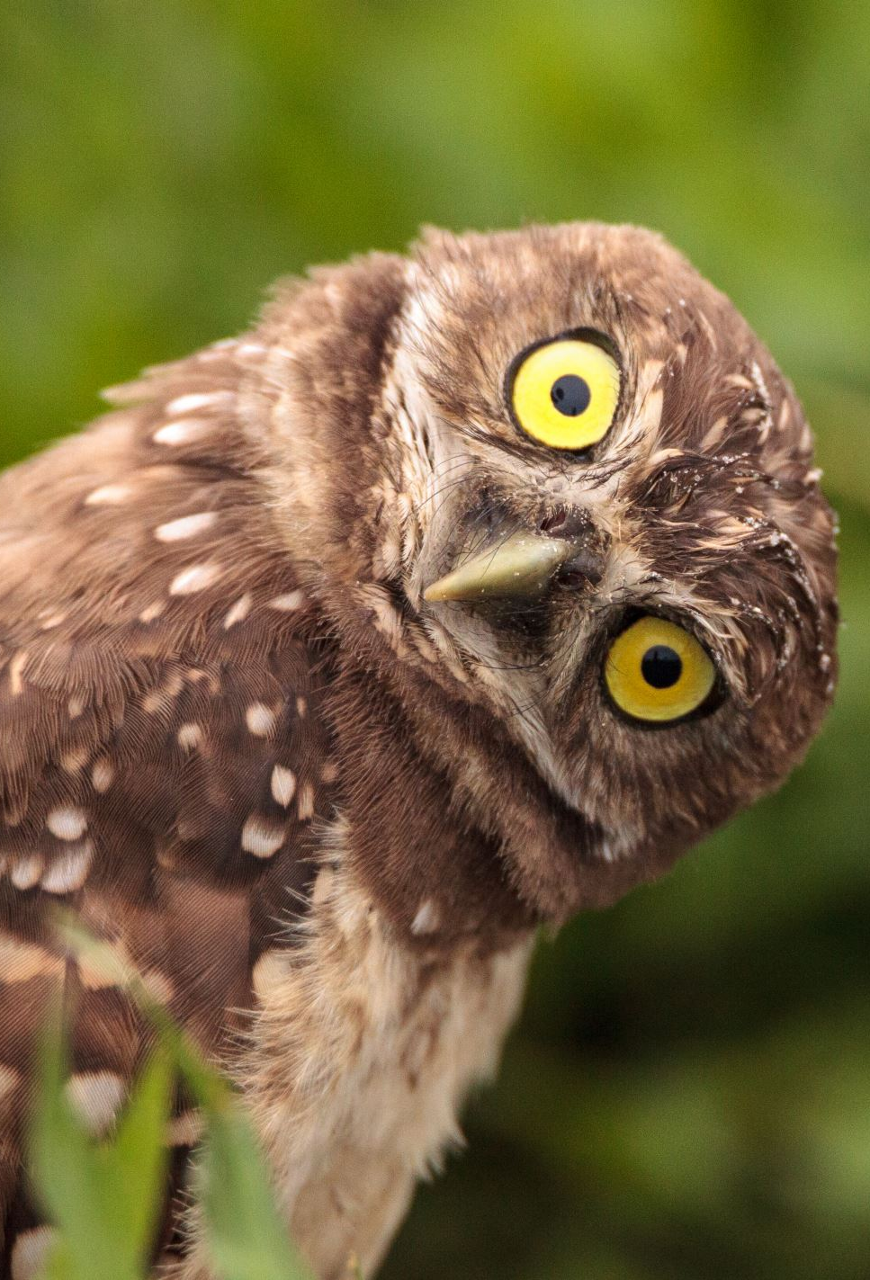
Questions?
Email:
brian@majorguidancesolutions.com
Twitter
@blgorman
Linked In
https://www.linkedin/in/brianlgorman

Slide 34
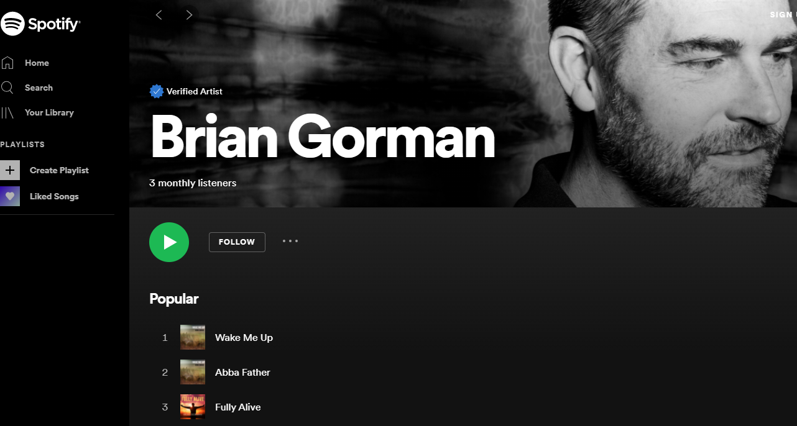
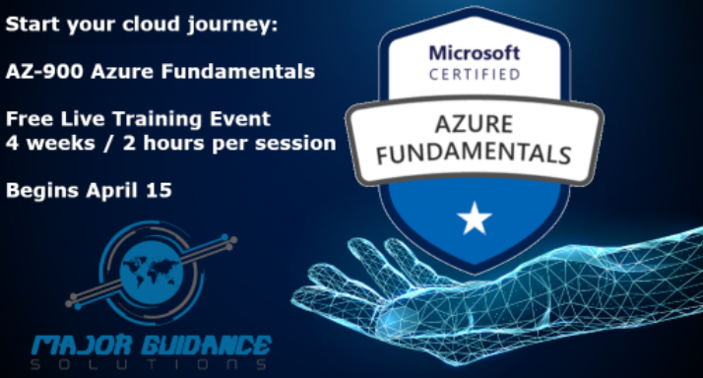
Conclusion
Thank you for having me today!
@blgorman
https://www.linkedin.com/in/brianlgorman
https://training.majorguidancesolutions.com
https://open.spotify.com/artist/0rRlrvBVhAhZCHcENoiFJ0
Notes:
Thank you for attending my talk today. Please reach out and connect.
If you liked the talk today, you can support me by listening to one or more of my songs on spotify ☺
Enjoy the rest of your conference!

