Slide 1
Serverless Messaging Demystified
Best practices and practical uses for various messaging services at Azure
Notes:
Prior to the talk
Establish
Event Hub Namespace
Event Hub
Data Lake Storage
Azure Function to respond to event Grid
Storage account file of plate data for upload
Service bus queue
Service bus topic
Azure Storage Queue

Slide 2
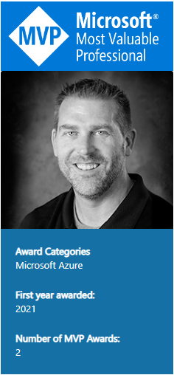



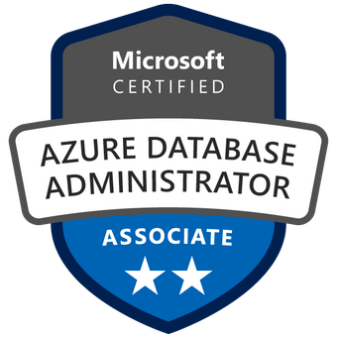


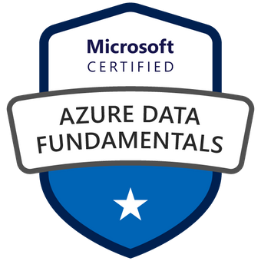


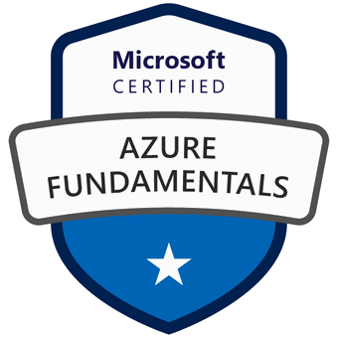

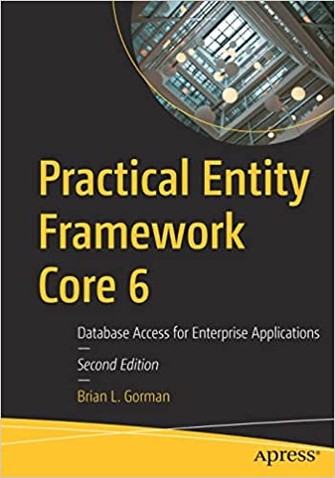
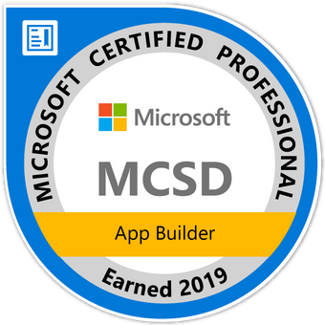
Who am I?
Brian is an experienced speaker, author, trainer, and .Net developer with
MCT (x4) / MVP (x2) MCSD: App Builder Azure Fundamentals Azure Data Fundamentals Azure SCI Fundamentals Azure Administrator Associate Azure Security Associate Azure Developer Associate Azure IOT Developer Specialization Azure Database Administrator Associate Azure Solutions Architect Expert Azure DevOps Engineer Expert
Brian has a masters of science degree in computer information systems, and a bachelor of science degree in computer science. Additionally, Brian has over ten years of experience instructing college courses online in SQL databases, C#/VB .Net programming, Java programming, and Microsoft Office.
Brian has also created many online video courses, available on various platforms. Recently, Brian published the second edition of his first book: Practical Entity Framework Core 6 with APress.
Brian runs a company named Major Guidance Solutions, which does contract and custom training and curriculum development. If you are interested in becoming Azure certified, make sure to connect with me.
Connect with Brian on Twitter and/or Linked In
@blgorman
https://www.linkedin/in/brianlgorman
Notes:
My name is Brian, and I’ll be your presenter for today.
I’ve been working in .Net since it was released to beta in 2001, and have been in various web development positions throughout my career, working with all the tech stacks along the way, including ASP.Net 1 and 2 Webforms, MVC, and am now looking into Blazor and Razor pages as .Net is evolving.
In addition to developing web solutions for many different companies, I have also been teaching in the Computer Science department at Franklin University since 2010 and have been developing training courses since about 2013.
I hold a bachelors in CS from Iowa State and an MS in Computer Information Systems from the UoP. I also have a number of Microsoft certifications that I’ve been earning since 2003 and recently published my first book: Practical Entity Framework with APress (with a second edition for .Net5/EFCore5 currently in progress)
Please follow me for updates and communication on twitter or Linked In. Twitter: blgorman
LinkedIn: brianlgorman

Slide 3






Agenda
Exploring the messaging options
Event Hubs [& namespaces]
Event Grid [Topics/Subscriptions]
Service Bus [Pub/Sub]
Service Bus [Queue]
Storage Queue

Slide 4
Event Hub
Choose the Hub for Telemetry and Event Ingestion, Big Data

Slide 5
Event Hub Namespace
Houses one or more hubs
Unique FQDN across Azure
Determines the tier/pricing
Assigns the number of throughput units [1-40]
Standard or better can “Auto Inflate” to more TUs
Standard or better for enabling Capture events [push to storage, etc]
TU limits:
Ingress: Up to 1 MB per second or 1000 events per second (whichever comes first).
Egress: Up to 2 MB per second or 4096 events per second.

Slide 6
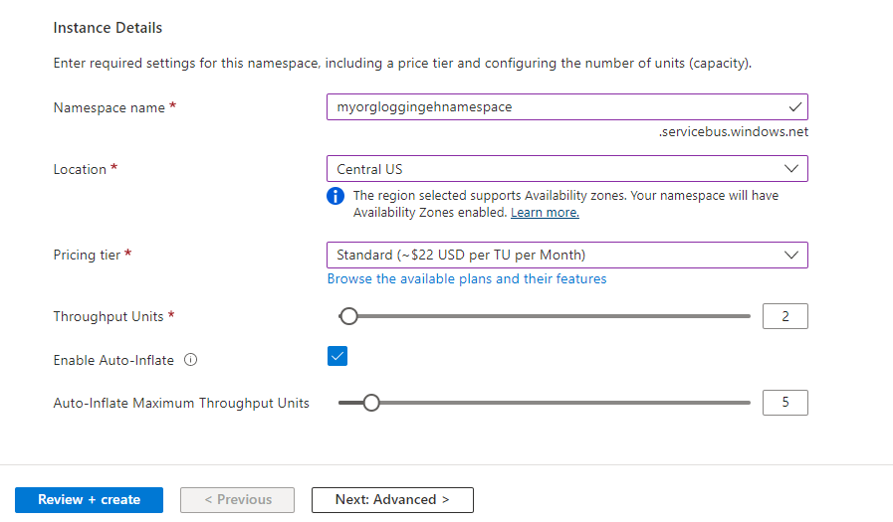
Creating an Event Hub Namespace
Not Shown: TLS, Public/Private Network, Tags
Notes:
The throughput capacity of Event Hubs is controlled by throughput units. Throughput units are pre-purchased units of capacity. A single throughput lets you:
Ingress: Up to 1 MB per second or 1000 events per second (whichever comes first).
Egress: Up to 2 MB per second or 4096 events per second.
https://docs.microsoft.com/en-us/azure/event-hubs/event-hubs-scalability

Slide 7
Event Hub
Event Producers
Publish via HTTPS, AMPQ1.0 or Apache Kafka
Connect via Active Directory OAuth2 JWT or via Shared Access Signature (SAS)
AMQP -> Persistent connection via web socket
HTTPS -> Re-establish connection on every event
Single or batched, always limited to 1MB
Partitions
2-32 partitions (can request more via support ticket)
Use 1 partition for every MB/s you want to have as throughput
Group data by partition keys, agnostic to underlying partitioning strategy, allows for order of events, full multiplexing (think “individual phone calls on shared lines”)
Set on creation, cannot be changed
Retention
1-7 days (Standard), 90 days premium

Slide 8
Event Hub - cont
Consumer Groups
Individual readers for playback, can replay events and not affect other readers
1 consumer group per application, can have up to 5 concurrent readers but recommend one receiver per partition per group
Max 20 consumer groups in an event hub
Stream offsets and checkpointing
Pointer or cursor to a specific place in the stream
Consumers need to manage their own offsets
Use checkpoint to mark as read, resume reading after disconnect, provide playback capabilities

Slide 9
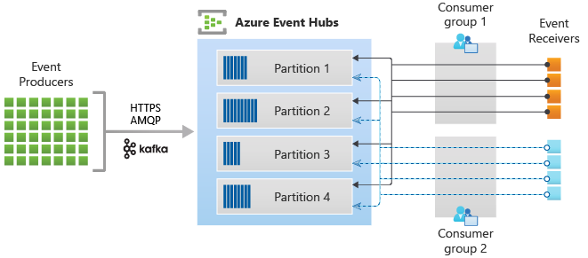
Event Hubs Architecture
https://docs.microsoft.com/en-us/azure/event-hubs/media/event-hubs-about/event_hubs_architecture.png

Slide 10
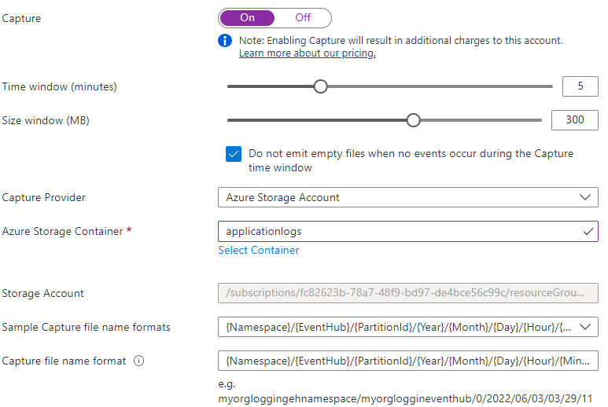
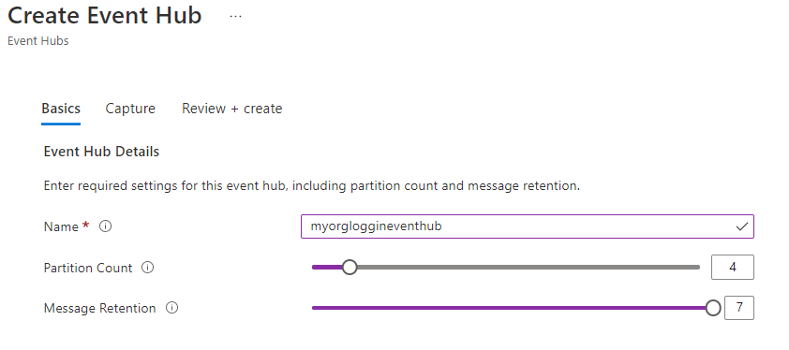
Creating an Event Hub – Naming and Capturing
Notes:
Call out the partition count and data retention days
Call out the storage account is pre-created with a container & datalake ability, set to cool archive (call out that you will say more about the “cool path” in a bit, but that cool tier != cool path in lambda! (can be a big source of confusion))

Slide 11
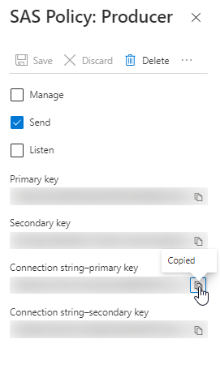
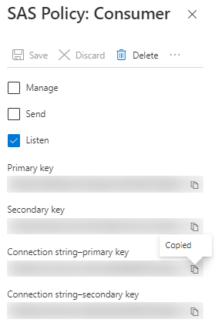
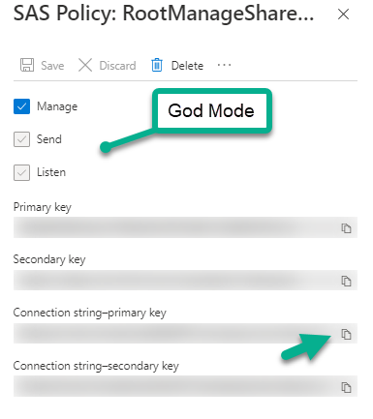
Use the Shared Access Key from the namespace, or specific read/write from the hub
Notes:
Shared access key on the namespace is God mode
It’s better to do a specific key for read/write for security and for your sanity

Slide 12
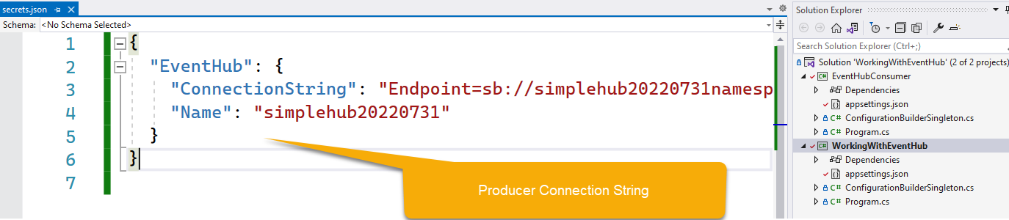
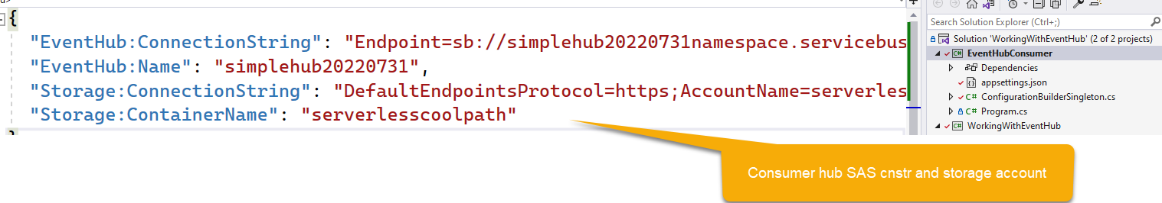
Add the secrets to your user-secrets files
Notes:
Call out both syntaxes. Mention syntax 2 could be useful from other azure services configs ☺

Slide 13
Application Logging Stream
Creating logs from your application to an Event Hub Stream
Notes:
Scenario –
Client is logging verbose logs to log analytics workspace and it’s costing them a fortune (even with reservations). In an effort to skew costs, they are trying to offload some of the logging that is not critical directly to storage so that they have the logs but don’t have to pay for the throughput/storage on a log-analytics workspace. This also means they will have to come up with another solution to splunk the logs or push to another big-data solution via ELT.
However, they will only be pushing critical logs into the workspace going forward, saving money on that utilization.
Show the logging from the application:

Slide 14

IoT Hub
Subset of Event Hub
Most solutions need only 4 partitions
Stream millions of telemetry events per minute to your hub
Ingress your telemetry to Azure
Leverage the Edge to prefilter
Package and deploy edge modules
Register devices
https://github.com/blgorman/IntroToIoT
Notes:
Review my IntroToIoT repo for more information

Slide 15
Event Grid
Respond to one-off events in a pub/sub pattern

Slide 16
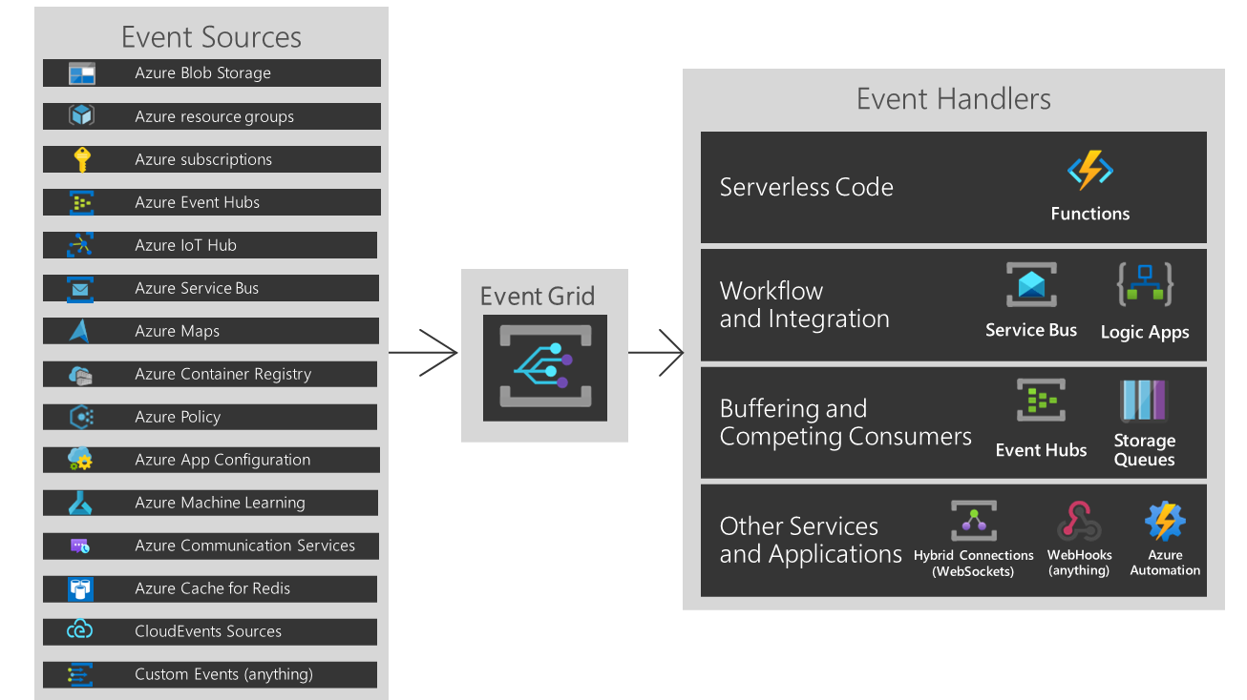
Azure Event Grid
Used for event-based architectures
Highly resilient PaaS offering
Sources can be just about anything at Azure, or your own custom events
Handlers can be set to
Webhooks
Functions
Service Bus
Event Hub
Storage Queue
Hybrid Connections
https://docs.microsoft.com/en-us/azure/event-grid/overview

Slide 17
Event Grid Capabilities
Filtering
Event Type and/or Publish Path
Pub/Sub
Subscribe with as many endpoints as needed for each event
Consumption based
Pay for what you use
Custom Events
You can create and publish your own events
PreFab Events
Respond to built-in events by resource

Slide 18
Event Grid Concepts
Retry
Exponential Retry
Set maximum number of attempts
Event TTL can determine how long to retry (max 24 hours)
Dead-Lettering
Send the event info to storage after retry failure
What won’t be retried?
400 Bad Request
401 Unauthorized
403 Forbidden
404 Not Found
413 Request Too Large

Slide 19
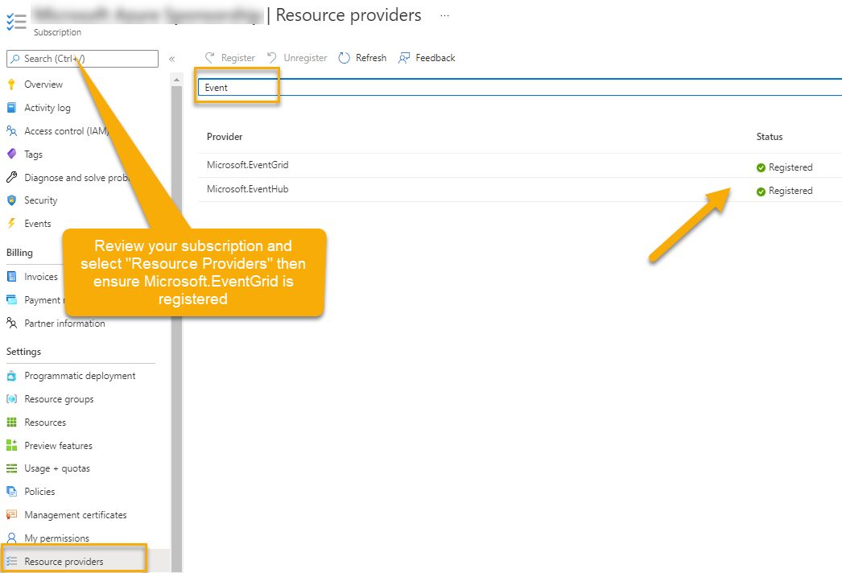
Ensure Event Grid is registered on your subscription

Slide 20
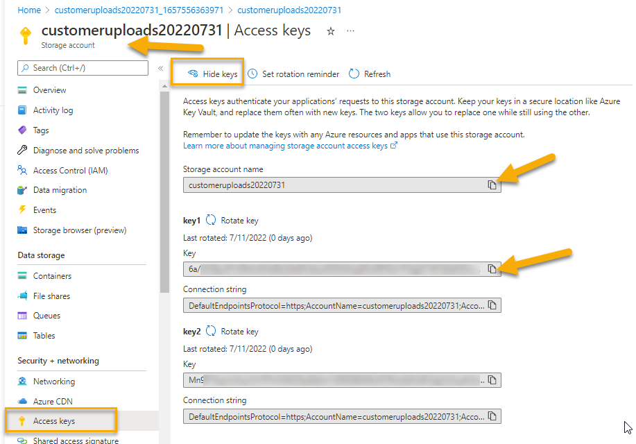
Get the Account Name and Key
Notes:
Get the account name and key for connection info

Slide 21
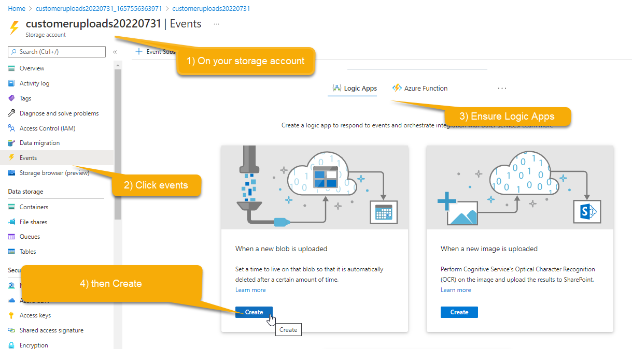
Create the Event Grid Topic/Subscription
Notes:
Note: You will need to get the storage account created first and also make a note of the access token/key and account name

Slide 22

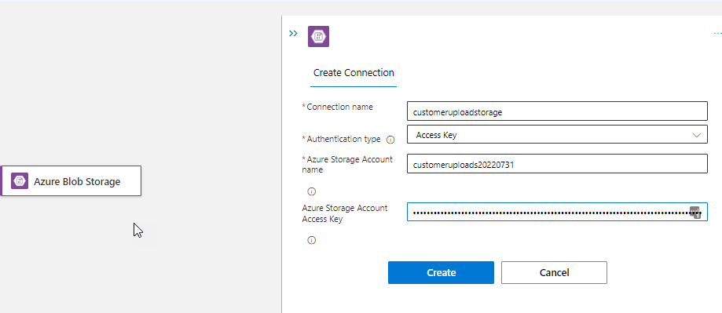
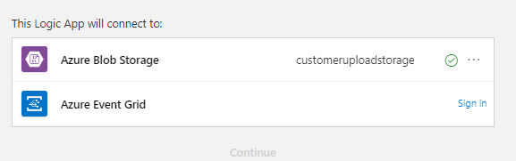
Connect to the correct storage account and your azure event grid

Slide 23
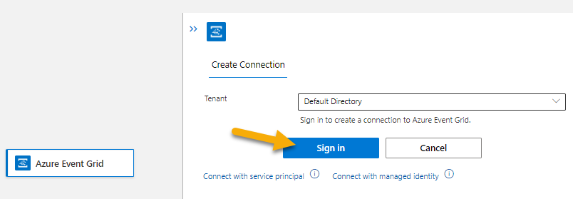
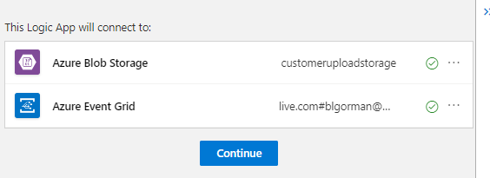
Connect to your Azure Event Grid with sign in
Notes:
Ideally, MI would be better but has a chicken and egg issue. Can’t save logic app and connect create MI without saving the logic app and assigning identity…

Slide 24
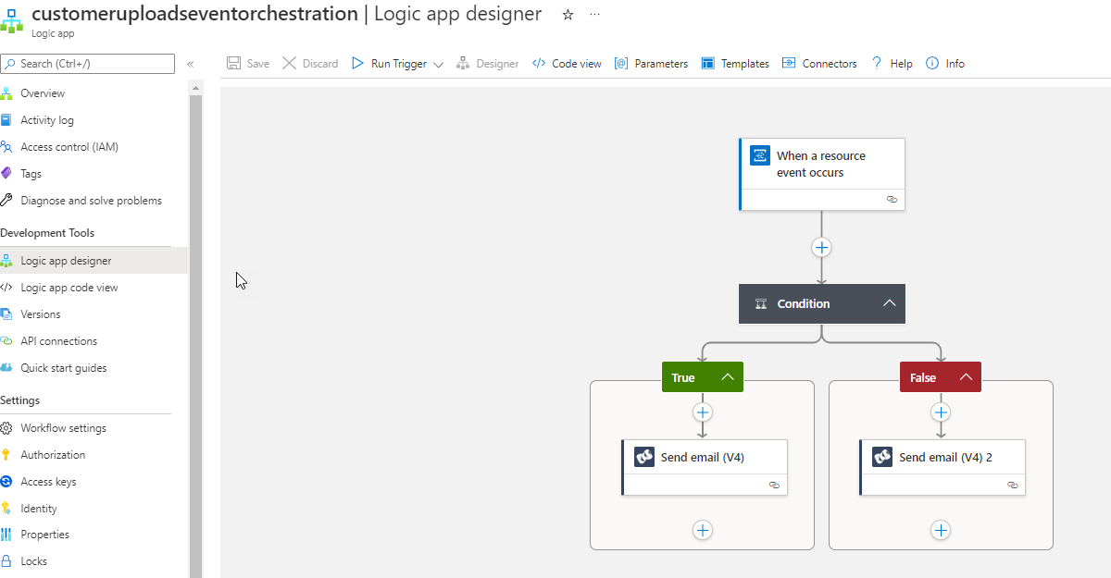
Save & Modify the logic app to do something useful
Notes:
Here I modified to send the name of the file to myself via sendgrid when created or otherwise

Slide 25
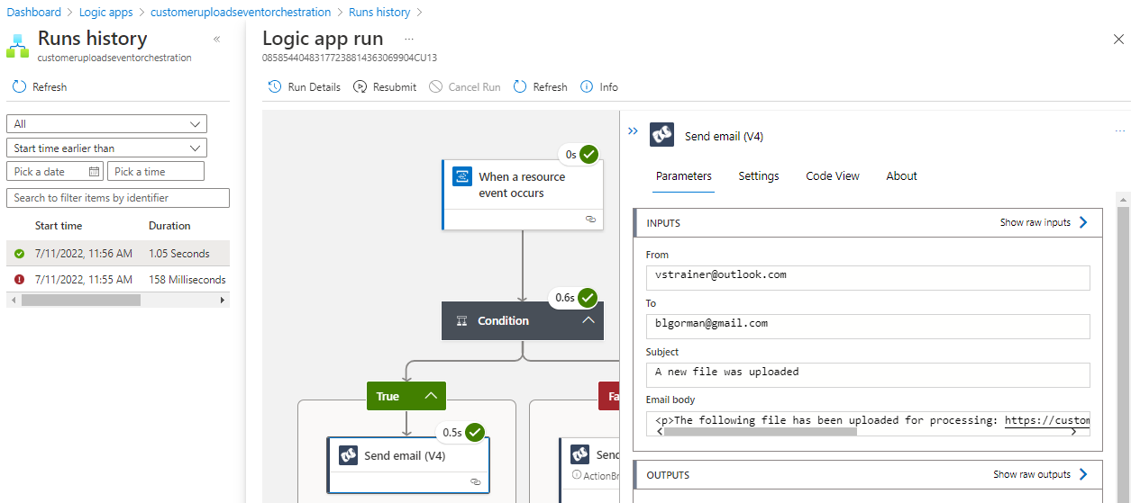
Review results

Slide 26
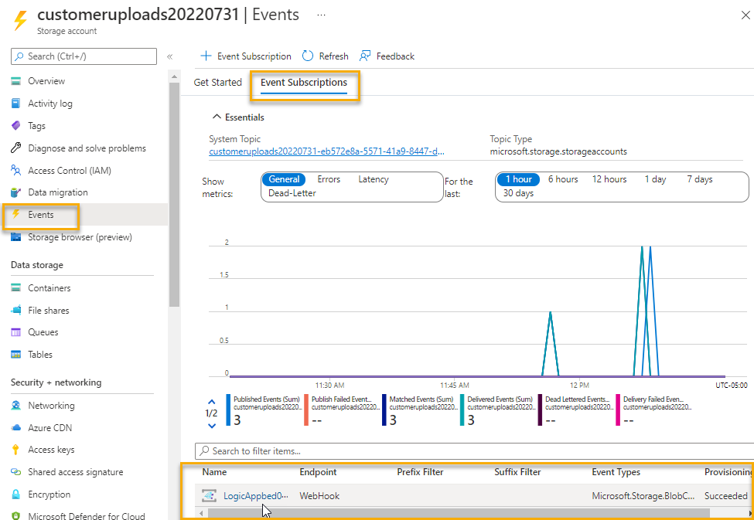
Review Subscription
Notes:
When a subscription is registered correctly, you can see it from the storage account.
Alternatively, you might find this in the Event Grid blade, but it will be much harder to find based on filtering

Slide 27
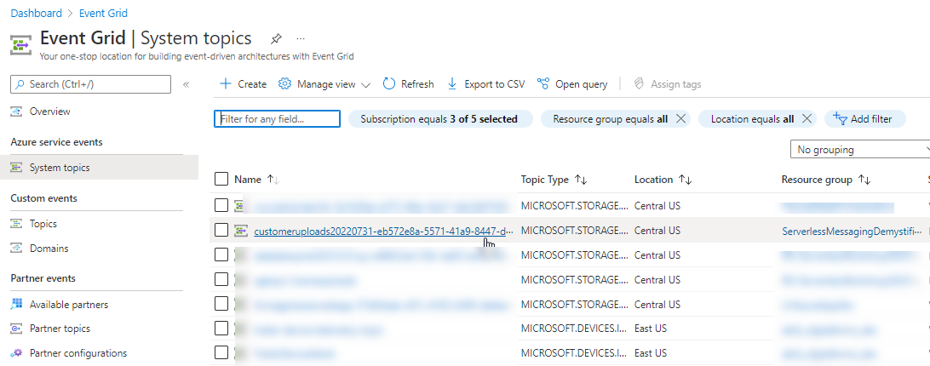
System Topics includes the topic
Notes:
Drilling in just shows the subscriptions. Remember this is pub sub so additional subscribers could listen if they want (i.e. function) but remember, function can also be triggered from LA very easily

Slide 28
Trigger Logic App on Blob Storage Created
Easily wire up events when blobs are created
Notes:
Just create it with the subscription in the portal then drop a file to show it working

Slide 29
Service Bus Queue
Ordered messaging for processing

Slide 30
Service Bus Queue
Capable of true FIFO (ordered) processing to one or more competing consumers
256 kb max message size
Duplicate Detection
Dead-Lettering
Provides decoupling of application components, thereby helping with load-levelling/load-balancing
Modes
Receive and Delete [use when app can tolerate not processing messages]
Peek Lock [apps cannot tolerate not processing. Locks, then marks completed]
Message is abandoned and returned or occurs after timeout expires
At-least once processing
At-most once processing
Notes:
Use for both “At least once” and “At most once” processing types
Service bus “Cares” what the user did with the message, whereas event grid doesn’t care (fire & forget)

Slide 31
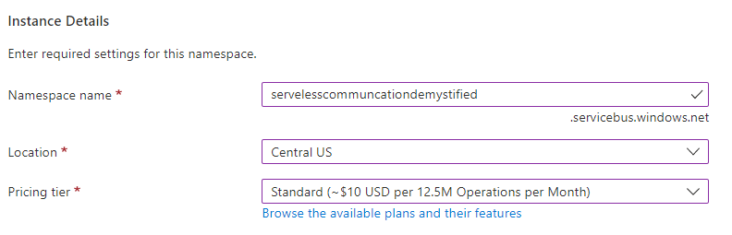
Create Service Bus Namespace
Not shown -> TLS, Public Network, and Tagging
Notes:
Have to use Standard if you want pub/sub features of service bus
All plans include queue

Slide 32
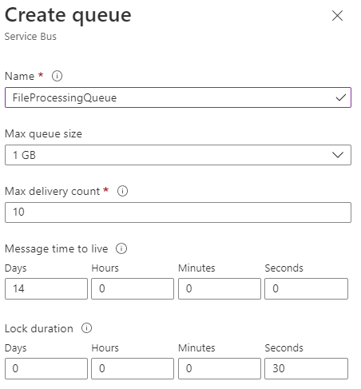
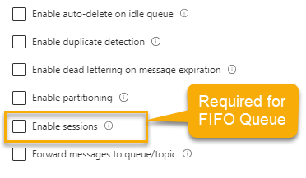
Create Service Bus Queue
One pane shown split in two for ability to show on one slide
Notes:
Create a QUEUE if you want FIFO processing and “at-most-once-delivery (am1)” [also does at least once but can only do am1 here]
If you want AM1 – you must use sessions (this is the only way to guarantee true FIFO queue operations in Azure messaging)

Slide 33
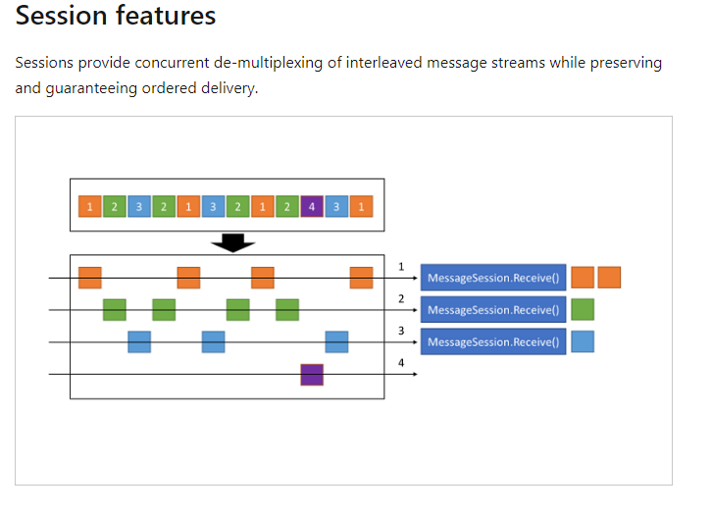
Use sessions to guarantee FIFO
https://docs.microsoft.com/en-us/azure/service-bus-messaging/message-sessions?WT.mc_id=AZ-MVP-5004334

Slide 34
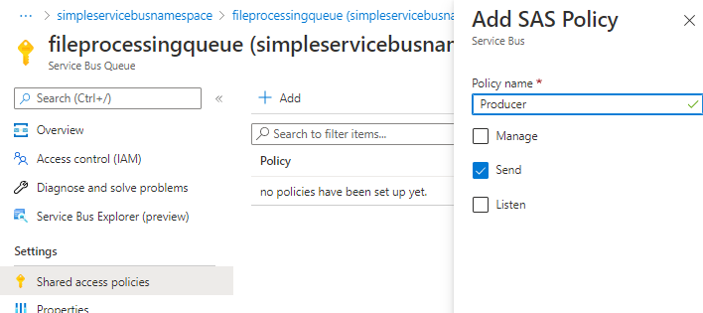
Create SAS policies as with Event Hub
Notes:
Use the keys in your producer and consumer apps

Slide 35
Service Bus Queue
How to work with the Service Bus as a Queue
Notes:
https://docs.microsoft.com/en-us/azure/service-bus-messaging/service-bus-dotnet-get-started-with-queues

Slide 36
Service Bus Messaging
When you need to pub/sub with filtering capabilities

Slide 37
Service Bus Pub/Sub
Create topics with one or more subscriptions for Pub/Sub pattern
Can handle dead-letter messaging
Filter at the subscription level to only receive messages important to the subscriber
Subscriptions act as a virtual queue with copies of the messages
All the same benefits of a queue but can be leveraged through multiple filtered subscriptions

Slide 38
Service Bus Pub/Sub cont.
Leverage both system properties and custom user-defined fields
Filter actions with filter expressions
SQL Filter (exists, IS NULL, AND/OR/NOT)
Boolean Filter (TrueFilter or FalseFilter)
Correlation filter
Correlation Id
ContentType
Label
MessageId
ReplyTo/ReplyToSessionId
SessionId
To
Any user-defined properties

Slide 39
Service Bus Pub/Sub cont.
Service bus Filter examples
Numeric Values (xyzProperty = 10 | xyzProperty > 5 and xyzProperty < 10)
Parameters (@someFilterValue -> somefield < @someFilterValue)
In / Not In ( xyzPropertyId IN (‘string1’, ‘string2’, …, ‘stringN’) and xyzProperty NOT IN (‘anotherstring1’, …)
CorrelationId a

Slide 40
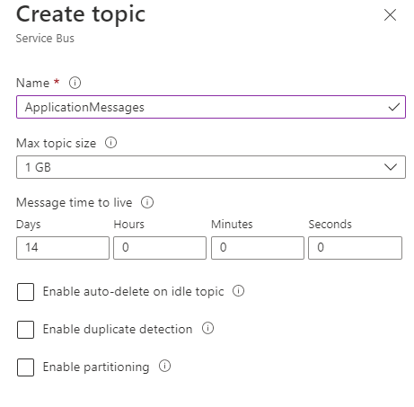
Create a Service Bus Topic

Slide 41
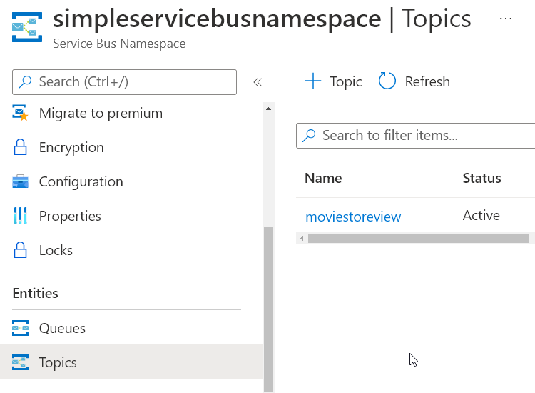
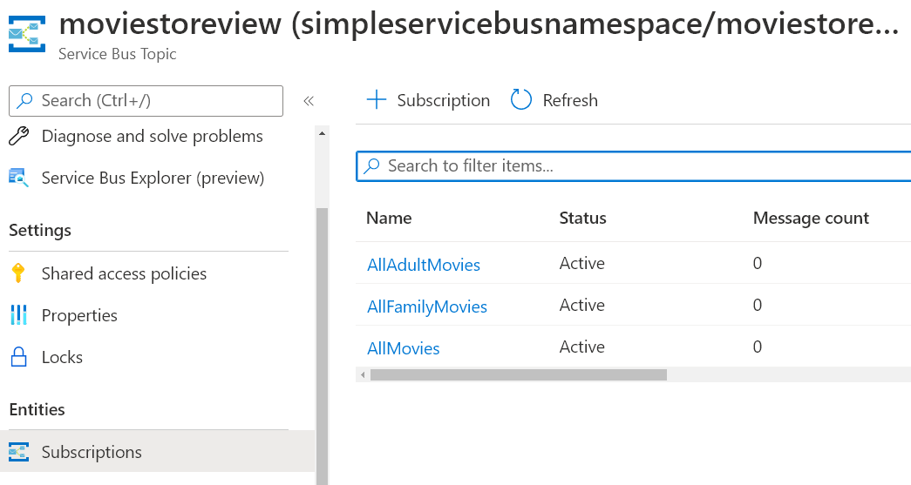
Use the Administrator to create the topic and three subscriptions
Notes:
These can be manually created but the administrator program will run idempotently to create them all or ensure they exist.

Slide 42
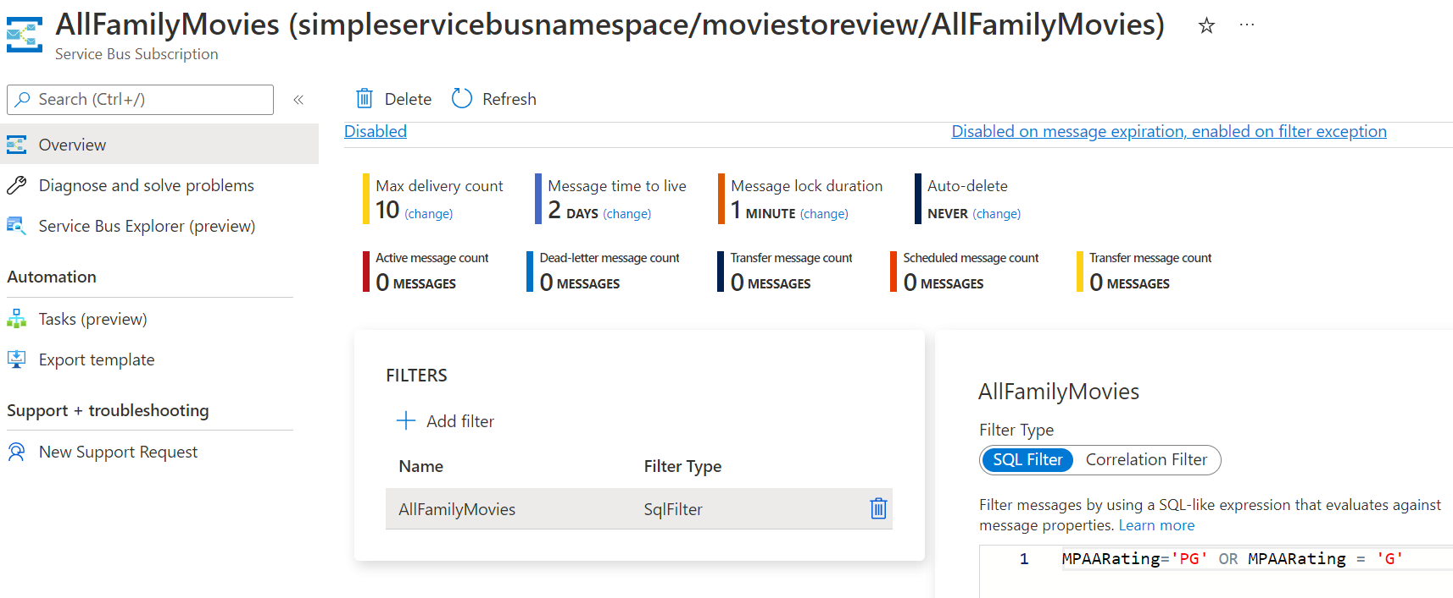
Subscriptions will have filters
Notes:
Service Bus supports three filter conditions:
SQL Filters - A SqlFilter holds a SQL-like conditional expression that is evaluated in the broker against the arriving messages' user-defined properties and system properties. All system properties must be prefixed with sys. in the conditional expression. The SQL-language subset for filter conditions tests for the existence of properties (EXISTS), null-values (IS NULL), logical NOT/AND/OR, relational operators, simple numeric arithmetic, and simple text pattern matching with LIKE.
Boolean filters - The TrueFilter and FalseFilter either cause all arriving messages (true) or none of the arriving messages (false) to be selected for the subscription. These two filters derive from the SQL filter.
Correlation Filters - A CorrelationFilter holds a set of conditions that are matched against one or more of an arriving message's user and system properties. A common use is to match against the CorrelationId property, but the application can also choose to match against the following properties:
ContentType
Label
MessageId
ReplyTo
ReplyToSessionId
SessionId
To
any user-defined properties.
A match exists when an arriving message's value for a property is equal to the value specified in the correlation filter. For string expressions, the comparison is case-sensitive. When specifying multiple match properties, the filter combines them as a logical AND condition, meaning for the filter to match, all conditions must match.
All filters evaluate message properties.
Filters can't evaluate the message body.
https://docs.microsoft.com/en-us/azure/service-bus-messaging/topic-filters

Slide 43
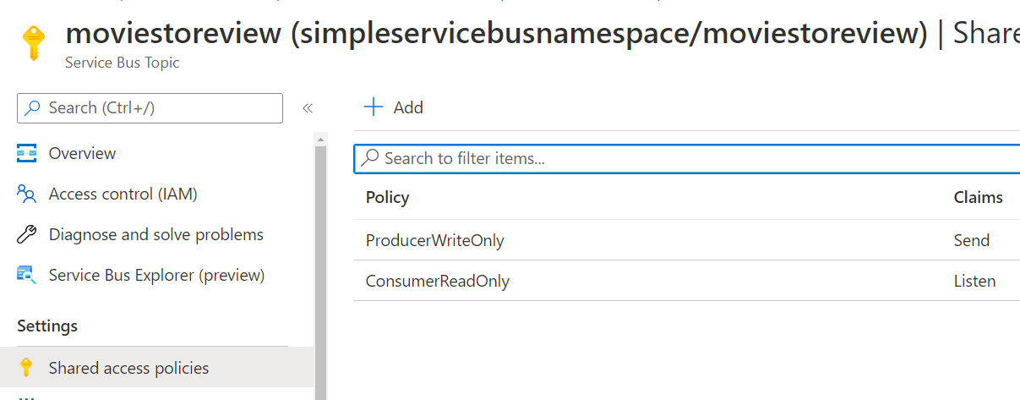
Add SAS tokens for producer and consumer rights

Slide 44
Publishing and Subscribing to messages
Azure Service Bus messaging
Notes:
https://docs.microsoft.com/en-us/azure/service-bus-messaging/service-bus-dotnet-how-to-use-topics-subscriptions

Slide 45
Azure Storage Queue
A messaging solution that is mostly a queue
Notes:
https://docs.microsoft.com/en-us/azure/service-bus-messaging/service-bus-azure-and-service-bus-queues-compared-contrasted

Slide 46
Azure Storage Queue
Store Large numbers of messages
Up to 64kb in size per messaged
Use when you have massive amounts of messages that need to be processed in a decoupled fashion.
Access messages via HTTPs
Need to store > 80GB of message data
Server-side logging of all message interaction

Slide 47
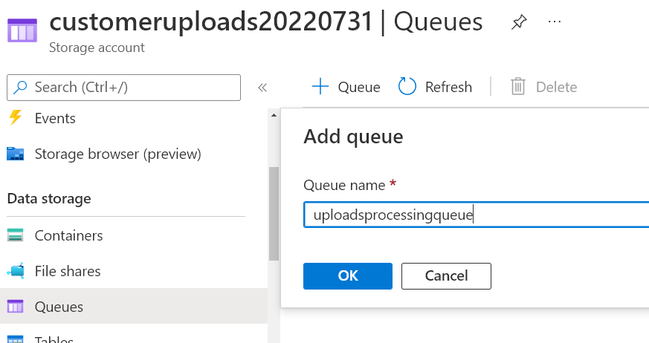
Creating an Azure Storage Queue

Slide 48
Working with Azure Storage Queue
Utilizing Azure storage for your messaging solution
Notes:
https://docs.microsoft.com/en-us/azure/storage/queues/storage-dotnet-how-to-use-queues?tabs=dotnet

Slide 49
Summary
Event Hubs for Big Data Ingestion
Event Grid for one-off event capture
Service Bus Messaging for Pub/Sub
Service Bus Queue for Message Processing
Storage Queue for Message Processing

Slide 50

Questions?
Email:
brian@majorguidancesolutions
blgorman@gmail.com
Twitter
@blgorman
Linked In
https://www.linkedin/in/brianlgorman
Code:
https://github.com/blgorman/

Slide 51
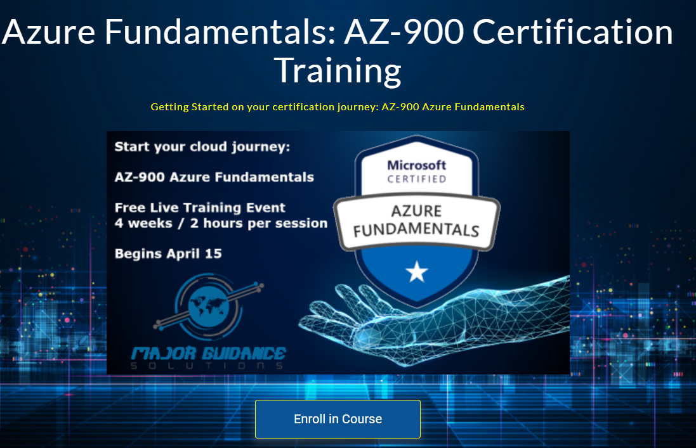
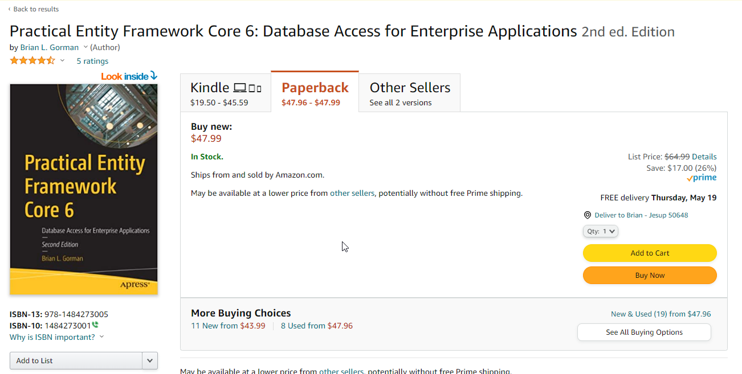
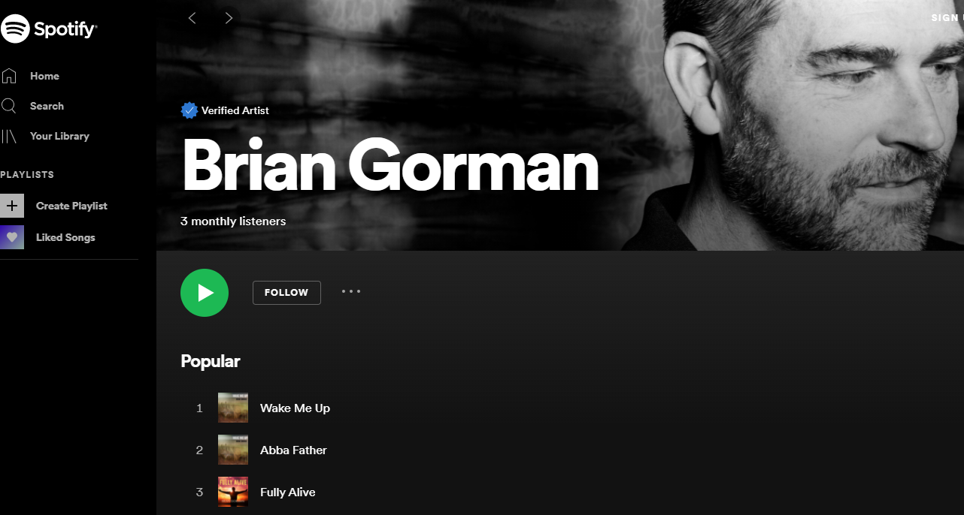
Conclusion
@blgorman
https://www.linkedin.com/in/brianlgorman
Thanks for having me today!
Notes:
Thank you for attending my talk today. Please reach out and connect.
If you liked the talk today, you can support me by listening to one or more of my songs on spotify ☺

