Slide 1
Using Redis at Azure
Best practices and practical uses for Azure hosted Redis instances

Slide 2
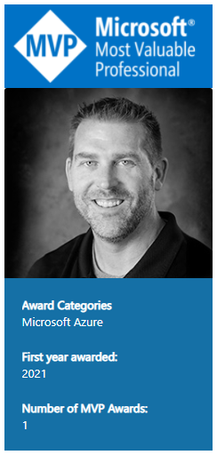
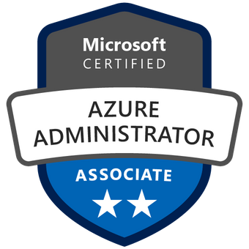


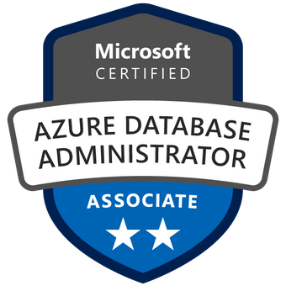


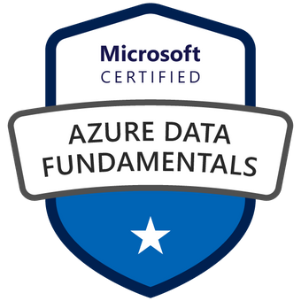

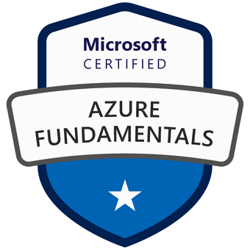
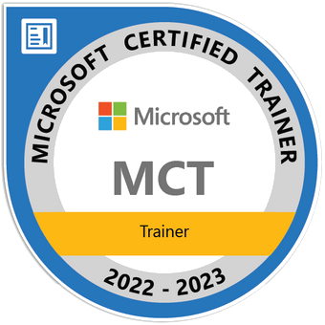
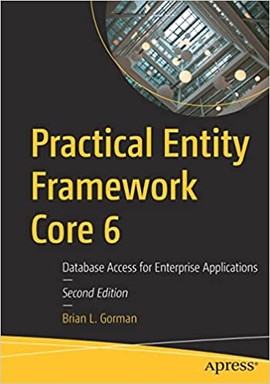
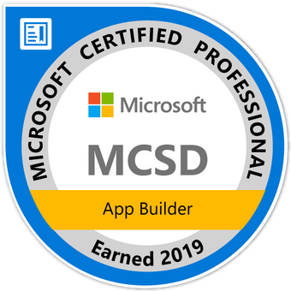
Who am I?
Brian is an experienced speaker, author, trainer, and .Net developer with
MCT (x3) MCSD: App Builder Azure Fundamentals Azure Data Fundamentals Azure Administrator Associate Azure Security Associate Azure Developer Associate Azure IOT Developer Specialization Azure Database Administrator Associate Azure Solutions Architect Expert Azure DevOps Engineer Expert
Brian has a masters of science degree in computer information systems, and a bachelor of science degree in computer science. Additionally, Brian has over ten years of experience instructing college courses online in SQL databases, C#/VB .Net programming, Java programming, and Microsoft Office.
Brian has also created many online video courses, available on various platforms. Recently, Brian published his first book: Practical Entity Framework with APress.
Brian runs a company named Major Guidance Solutions, which does contract and custom training and curriculum development. If you are interested in becoming Azure certified, make sure to connect with me.
Connect with Brian on Twitter and/or Linked In
@blgorman
https://www.linkedin/in/brianlgorman
Notes:
My name is Brian, and I’ll be your presenter for today.
I’ve been working in .Net since it was released to beta in 2001, and have been in various web development positions throughout my career, working with all the tech stacks along the way, including ASP.Net 1 and 2 Webforms, MVC, and am now looking into Blazor and Razor pages as .Net is evolving.
In addition to developing web solutions for many different companies, I have also been teaching in the Computer Science department at Franklin University since 2010 and have been developing training courses since about 2013.
I hold a bachelors in CS from Iowa State and an MS in Computer Information Systems from the UoP. I also have a number of Microsoft certifications that I’ve been earning since 2003 and recently published my first book: Practical Entity Framework with APress (with a second edition for .Net5/EFCore5 currently in progress)
Please follow me for updates and communication on twitter or Linked In. Twitter: blgorman
LinkedIn: brianlgorman

Slide 3
Agenda
Creating an Azure Redis Instance
Introduction to Redis at Azure
Developing for Azure Redis [C#]
Optimizing Web applications
Transactions and Expirations
Eviction Policies
Cache Aside
Session Store
Pub/Sub and Streaming

Slide 4
Live Demo
Create Azure Redis Cache

Slide 5
Summary
Azure provides managed Redis at the opensource and enterprise levels
Quickly and easily use distributed caching in your applications
Consider Redis for pub/sub and streaming

Slide 6

Questions?
Email:
brian@majorguidancesolutions
blgorman@gmail.com
Twitter
@blgorman
Linked In
https://www.linkedin/in/brianlgorman
Code:
https://github.com/blgorman/UsingRedisWithAzure

Slide 7
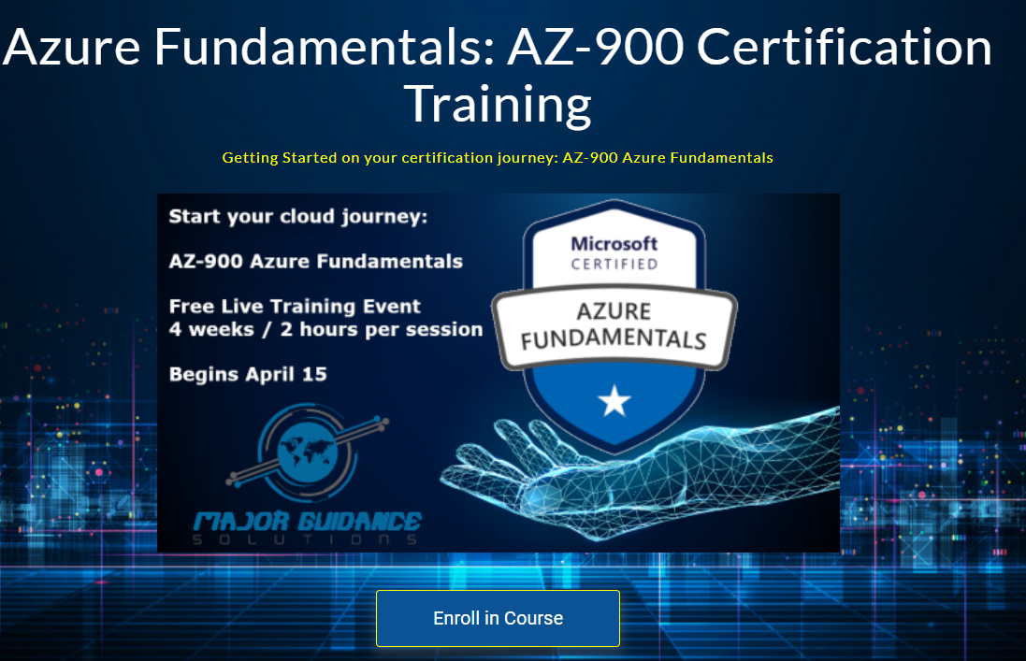
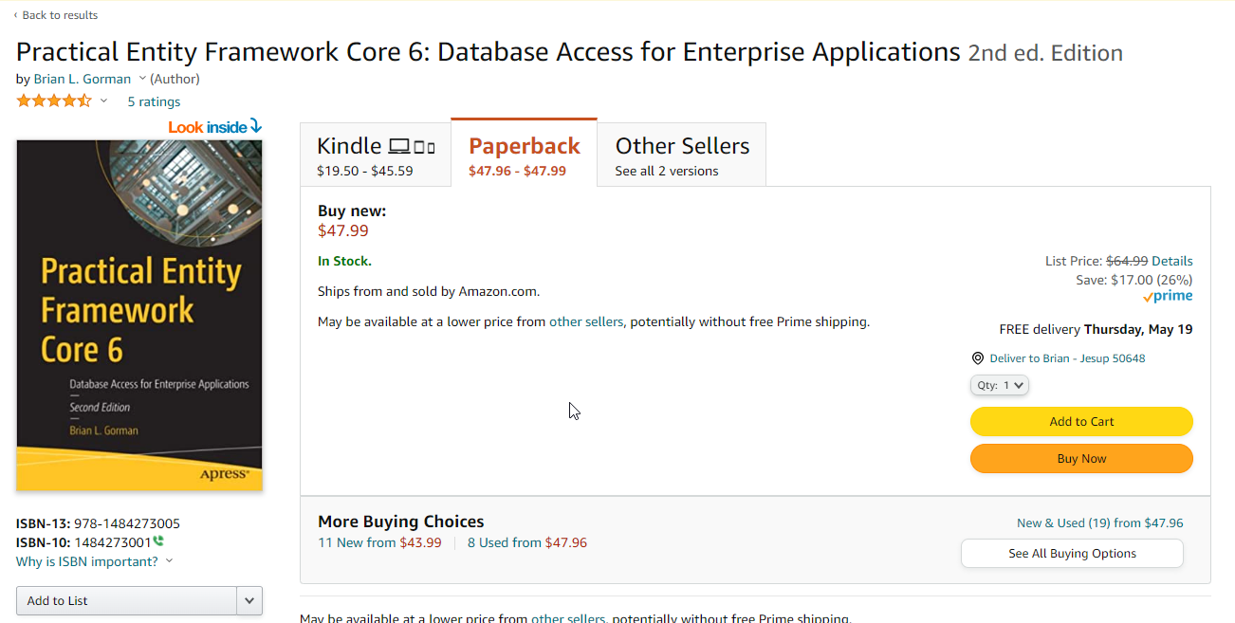
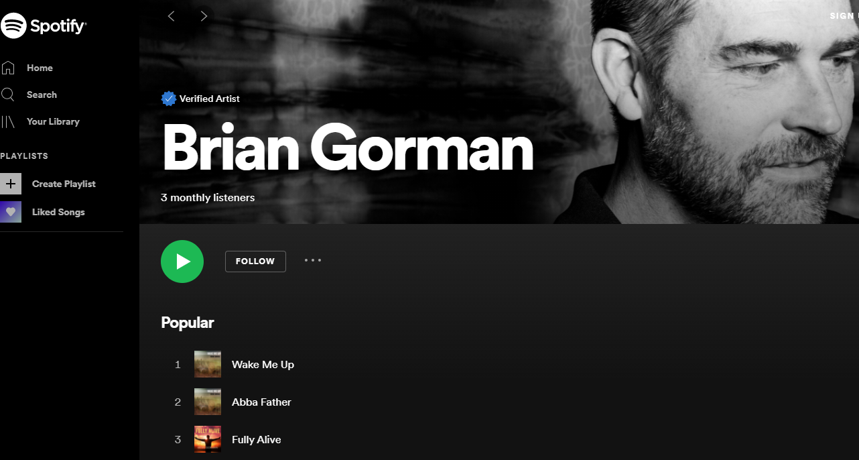
Conclusion
@blgorman
https://www.linkedin.com/in/brianlgorman
Thanks for having me today!
Notes:
Thank you for attending my talk today. Please reach out and connect.
If you liked the talk today, you can support me by listening to one or more of my songs on spotify ☺

