Slide 1
Serverless Solutions with Azure
An overview of Serverless Platform Solutions at Azure

Slide 2
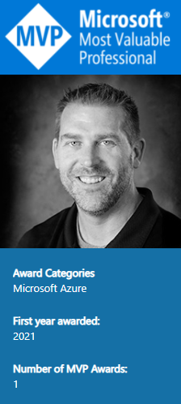



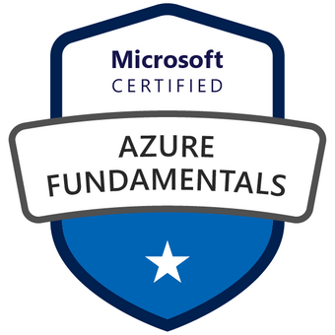
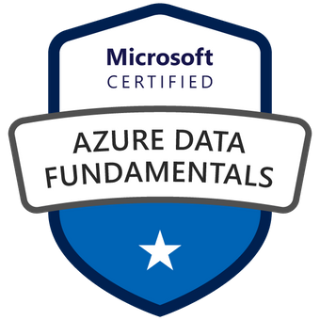
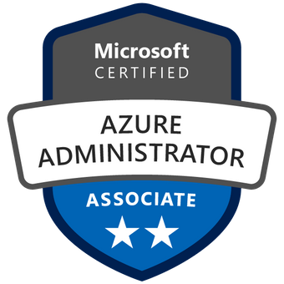


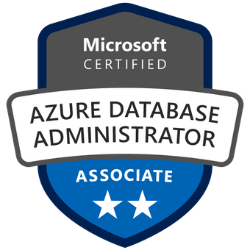
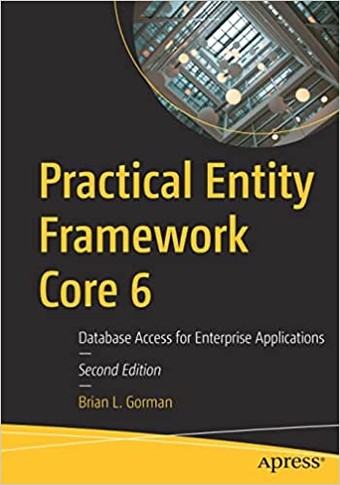
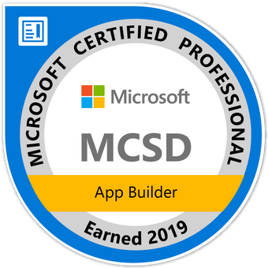
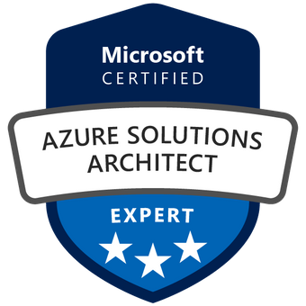


Who am I?
Brian is an experienced speaker, author, trainer, and .Net Developer (~20ish years)
Brian has a masters of science degree in computer information systems, and a bachelor of science degree in computer science. Additionally, Brian has over ten years of experience instructing college courses online in SQL databases, C#/VB .Net programming, Java programming, and Microsoft Office.
Brian has also created many online video courses, available on various platforms. Recently, Brian published his first book: Practical Entity Framework with APress.
Brian is currently a freelance Azure Trainer, running his own company MajorGuidanceSolutions.
Connect with Brian on Twitter and/or Linked In
@blgorman
https://www.linkedin/in/brianlgorman
Notes:
My name is Brian, and I’ll be your presenter for today.
I’ve been working in .Net since it was released to beta in 2001, and have been in various web development positions throughout my career, working with all the tech stacks along the way, including ASP.Net 1 and 2 Webforms, MVC, and am now looking into Blazor and Razor pages as .Net is evolving.
In addition to developing web solutions for many different companies, I have also been teaching in the Computer Science department at Franklin University since 2010 and have been developing training courses since about 2013.
I hold a bachelors in CS from Iowa State and an MS in Computer Information Systems from the UoP. I also have a number of Microsoft certifications that I’ve been earning since 2003 and recently published my first book: Practical Entity Framework with APress (with a second edition for .Net5/EFCore5 currently in progress)
Please follow me for updates and communication on twitter or Linked In. Twitter: blgorman
LinkedIn: brianlgorman

Slide 3
Agenda
What are we going to build today
Set up and deploy [if you haven’t already]
Basic Overview of Azure Platforms
Basic Serverless Architecture Guidelines
Lightning Overviews & quick demos
Event Grid Registering
Storage Accounts
Function Apps
Logic Apps
Event Grid Topics and Subscriptions
Cosmos DB
Let’s GO!

Slide 4
What are we going to build?
What do you want to build?

Slide 5
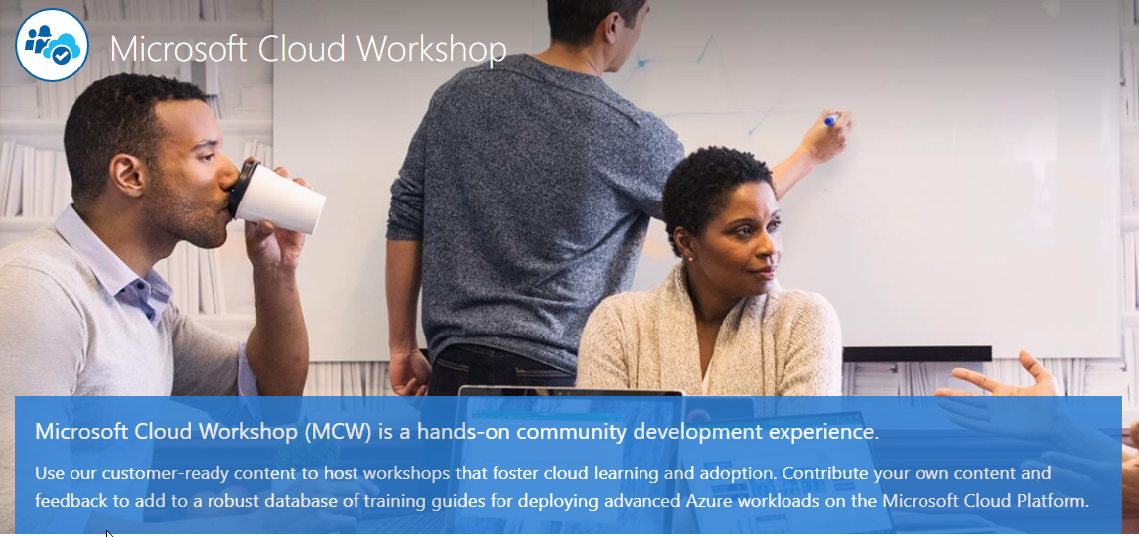
Overview of Microsoft Cloud Workshops
Open Source/MIT
Whiteboard Sessions
Guided walkthroughs
Searchable Library
Why this, why here?
https://microsoftcloudworkshop.com/

Slide 6
Whiteboard Design Session
Typically runs in groups of 4-8 people
Consider the customer case scenario
Design a solution
Present to the other team
Overcome objections

Slide 7
TL/DR on whiteboard [overview]
Collect photo and details to generate bill
Manual Process
Collect images
Export to vendor
Get data about owner of the car
Batch 1000 to a csv export file
Existing system generates the bill
Notes:
Contoso: Financial billing and payment suite w/toll road booth management
Existing Payment Management System

Slide 8
TL/DR on whiteboard [customer needs]
Automated process
Utilize a packaged ML solution
Ability to interact manually for unreadable images
Be able to scale dynamically
Ability to export processed license plate data & send email
Develop locally and have CI/CD
Ability to monitor the various components in the solution
Support future expansion for analytics and batching

Slide 9
TL/DR Customer Objections
Concerned about messaging and component interaction
Avoid substantial monthly bills
Avoid sending bills to the wrong person
Avoid losing track of an unprocessed/unpaid bill
Prevent DDoS attacks
Secure and manageable API
Application Secrets
When to use Functions vs Logic apps
Cold starts with Azure Functions
Notes:
We are concerned about how individual serverless components will be able to "talk" to each other and reliably pass messages through the pipeline.
Azure Functions support multiple triggers, including several Azure services and basic yet flexible trigger types such as HTTP and webhook triggers. In our proposed solution, we use Event Grid bindings that allow events to trigger certain functions. These bindings enable other functions to send data to the reliable queue through an Event Grid topic and designate a specific event type. Hence, functions that need to react to particular events only respond to the filtered events they care about.
Will a serverless architecture that can infinitely scale put us at risk for substantial monthly bills?
Azure Functions comes in three primary offerings, consumption, dedicated, and premium. Understanding the differences between them is essential, as choosing one over the other dictates your application's behavior and how you're billed.
The consumption plan is Microsoft's "serverless" model. In this model, your code reacts to events, effectively scales out to meet load, scales down when code isn't running, and you're billed only for what you use. One of the primary benefits of using serverless components in a consumption plan is that billing is based on resources consumed or the actual time your code is running. For many event-driven workflows, sub-second billing will save more money in the long run compared to paying for constantly running resources, whether they are used or not. When using Azure Functions, short-lived and sporadic use will benefit most from the consumption plan. Most serverless components also provide options to specify upper limits on things like concurrent executions and other rate-limiting options.
However, if you are consistently getting a lot of traffic or have many long-running operations, the dedicated or premium tiers might be more cost-effective. The dedicated plan involves renting control of a virtual machine and a dedicated Azure App Service plan. This control means you can do whatever you like on that machine. It's always available and might make more sense financially if you have functions that need to run 24/7.
When you use the premium plan, instances of the Azure Functions host are added and removed based on the number of incoming events, just like with the Consumption plan. You can also deploy multiple function apps to the same Premium plan, and it allows you to configure the size characteristics of your compute instance.
How do we make sure that erroneous image processing does not make specific toll bills fall through the cracks or, even worse, send an invoice to the wrong person?
Erroneous image processing is handled in our solution by creating a manual verification queue when the OCR process fails or the result's confidence level is low. For example, we can filter out invalid characters and use an empty result to indicate low confidence in the predicted license plate text. More advanced machine learning models may be employed with algorithms specifically tuned to license plate recognition (LPR). Part of the result would include a confidence level, which the system could use to decide whether the photo needs manual verification.
We are considering creating an API to allow our customers to retrieve information about their bills and photos that captured their vehicle but are concerned about unauthorized access and the possibility of a denial of service attack due to an excessive number of requests. Is there an Azure service that would enable us to implement a secure API that we can also monitor and manage, protecting our APIs from unauthorized access and excessive requests?
Given the nature of Contoso's serverless architecture, they can quickly expand functionality by adding more Azure functions. For instance, they can add a new function with an HTTP trigger that runs when a client hits the endpoint. This function can process GET requests with a customer Id or custom identifier, which will return information for that customer's vehicles and any captured photos.
If Contoso would like to add a layer of protection, they should consider using Azure API Management (APIM). This service provides a consistent surface area for API endpoints you wish to expose to the public, including the new Azure function that will serve customers' information.
What is our best option to protect application secrets, such as connection strings, from being viewed by unauthorized users in the portal?
Azure Key Vault can be used to securely store and tightly control access to tokens, passwords, certificates, API keys, and other secrets. Also, secrets stored in Azure Key Vault are centralized, giving the added benefits of only needing to update secrets in one place, such as an application key value after recycling the key for security purposes. Contoso can store their secrets in Azure Key Vault, then configure their Function Apps to securely connect to Azure Key Vault.
There appears to be some functional overlap between Azure Functions and Logic Apps. Can you help us to understand better when to use each and for what?
Both Functions and Logic Apps are Azure services that enable serverless workloads capable of using complex orchestration steps to accomplish tasks. The primary differentiator between them is that Azure Functions is a serverless compute service, whereas Azure Logic Apps provides serverless workflows. You can mix and match services when you build an orchestration, calling functions from logic apps and calling logic apps from functions.
Functions emphasize code-first versus the design-first approach offered by logic apps. For Azure Functions, you write code in various languages, like C#, Node.js, Python, Java, and PowerShell, and you can add orchestration using the [Durable Functions](https://docs.microsoft.com/azure/azure-functions/durable/durable-functions-overview?tabs=csharp) extension to create stateful workflows. You can secure Azure Functions using Authorization keys that are automatically generated and implement additional security measures using the dedicated and premium tiers. For Logic Apps, you create orchestrations using a graphical user interface (GUI) or editing configuration files. Logic Apps makes implementing security very simple. Every connector includes the authentication components needed to connect to the target service, such as the Office 365 Outlook connector requires an Office 365 account.
During our research on serverless architectures, we have read about the possibility of increased latency due to cold starts. Will this be an issue with Azure Functions?
Cold start is a significant discussion point for serverless architectures and is a point of ambiguity for many users of Azure Functions. Concerning Azure Functions, a cold start is only a concern when your Functions use the serverless consumption model. When using Azure Functions in the dedicated or premium plans, the Functions host is always running, which means that cold start is not an issue.
By cold start, we are broadly describing the phenomenon that applications that have not been used take longer to start up. In the context of Azure Functions, latency is the total time a user must wait for their function to execute. This time runs from when an event happens to trigger a function until it completes responding to the event. More precisely, a cold start is an increase in latency for Functions that haven’t been called recently.
Cold start happens due to the serverless nature of the Azure Functions consumption plan. When you execute function code, the following steps must occur to run your code:
- Azure must allocate your application to a server with capacity.
- The Functions runtime must then start up on that server.
- Your code then needs to execute.
To make this experience better for users, instead of starting from scratch every time, Microsoft has implemented a way to keep a pool of servers warm and draw workers from that pool. This pool means that idle workers preconfigured with the Functions runtime are up and running and available at any point in time. These “pre-warmed sites” provide a measurable improvement on cold start times.
Other suggestions to improve this are to use only generally available (GA) languages when writing your function code and focus on writing efficient, lightweight code with minimal dependencies. When you deploy your code, your dependencies are added as files to your application. All code needed by your app eventually gets loaded into memory, which takes longer with a larger application. So, if you have many dependencies, you may experience a longer cold start due to increased time for I/O operations from Azure Files and the increased time needed to load the app into memory.
If cold start times are still an issue, consider using Azure Functions in the dedicated or premium plans, as a cold start is not an issue.

Slide 10
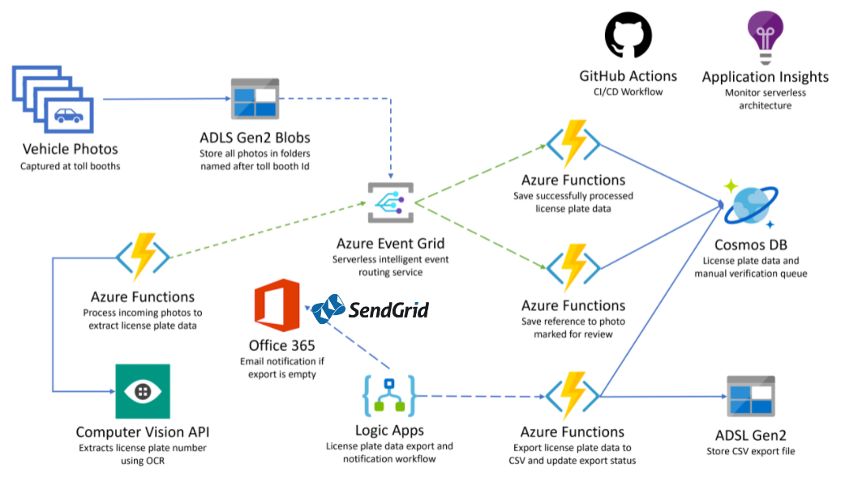
Today’s Project – Serverless Architecture
Notes:
I will be giving you a brief overview of each of these technologies before we dive in to the lab work.

Slide 11
Things you’ll need
If you haven’t already done this, kick off the `Before the Hands-On Lab` deployment to your Azure Subscription [see the prerequisites]
Lab VM
Get the Lab files from Lab VM or GitHub
Deallocate/Delete – don’t need it and it costs $$$
Configure your environment for Serverless development
VSCode / VSCommunity [or better]
Azure Tools/Extensions
.Net Core 3.1 SDK
GitHub account and Git tools [within VSCode/VSCommunity or your own flavor]
Notes:
If you haven’t deployed, do that soon [aka Now]

Slide 12
Demo Provisioning
Storage account
Function App
Cosmos DB
Notes:
Quickly show provisioning the resources but don’t have to wait for them to complete

Slide 13
Azure Platform Services
A whirlwind tour of the tools/tech we’re using today

Slide 14
What platforms are available for serverless development
Web
Storage
Data
Messaging and Events
Serverless Processing
Cognitive Services/AI
Big Data [ETL/ELT] & Analytics
IoT/Streaming

Slide 15







Web
App Services
Container Registry
Container Instances
Kubernetes Service
Container Apps
API Management
Function Apps [Compute/Serverless]

Slide 16








Storage
Container [BLOBs]
Data Lake [Container]
Table
Queue
File
Recovery Services [Vaults]

Slide 17






Data
SQL
Azure SQL
Azure SQL Managed Instance
SQL Server on an Azure VM
Postgre/MariaDb/MySQL
No SQL
Cosmos DB
SQL API
Mongo API
Cassandra API
Gremlin API
Table API
Redis Cache
Migration services

Slide 18




Eventing and Messaging
Event Hub
Event Grid
Service Bus
Storage Queue

Slide 19


Serverless Processing
Functions
Logic Apps
Batch
Automation

Slide 20
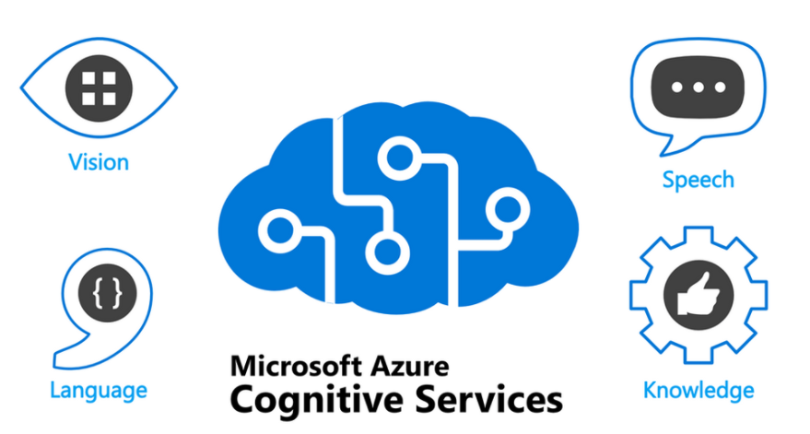
Cognitive Servies/AI
Speech
To and from text
Translation
Language
Sentiment Analysis
Question/Knowledge Base
Vision
Computer Vision
Face API
Decision
Anomaly Detection
Content Moderation
Open AI [New]
https://techcommunity.microsoft.com/t5/azure-developer-community-blog/azure-content-spotlight-amp-8211-what-amp-8217-s-new-with/ba-p/337360

Slide 21









Big Data/Streaming/IoT
Synapse Analytics
DataBricks
HDInsight
Data Factory
Stream Analytics
IoT Hub
IoT Central
Device Provisioning Service
Digital Twins
Time Series Insights

Slide 22
Serverless Apps: Architecture/Patterns and Azure implementation
https://docs.microsoft.com/en-us/dotnet/architecture/serverless/

Slide 23
Architecture Approaches
Monolith
Likely break this down
Difficult to scale
Refactoring is expensive
N-Tier
Serverless can do one or more layers
Only interact with appropriate layers
Microservices
Scaling, testing, and refactoring is much easier and much less risky
Highly performant
Difficult to manage/understand/test full system flow [Documents required]

Slide 24
Deployments
IAAS/Hybrid
PaaS
SaaS
CFaaS
Serverless

Slide 25
Considerations
Managing State
Long-Running Processes
Warm-up time
Data synchronization
Scaling
Monitoring
Dependency Management
Failure and Recovery
Versioning

Slide 26
Design Patterns/Examples
Scheduling
CQRS
Eventing
Triggers
Transformations
Asynchronous processing
Web/API
Data
Streams

Slide 27
Business Scenarios and Use Cases
Big Data Processing
File Processing
Data Visualization
Exposing APIs
IoT Edge relay
Microservices architecture
Messaging
Eventing

Slide 28
Lightning Demos

Slide 29
Event Grid
Registering the Resource Provider
Notes:
Open subscriptions
Go to resource providers
Register Event Grid

Slide 30
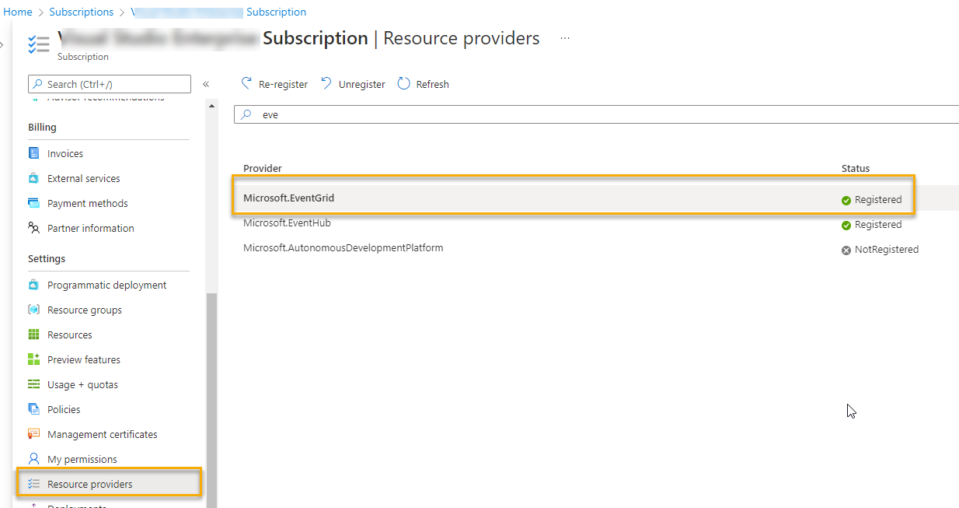
Notes:
Ensure the Microsoft.EventGrid is registered

Slide 31
Storage Accounts
Notes:
Types of storage
Hierarchical
Create a storage account
Add a container to it
Show how could also create file/queue/table
Upload a blob
Show it

Slide 32
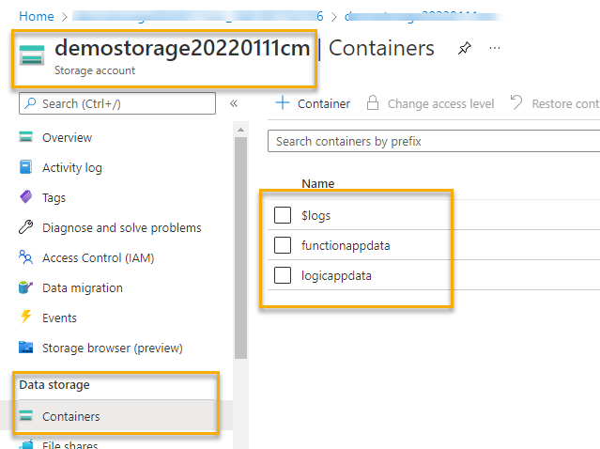
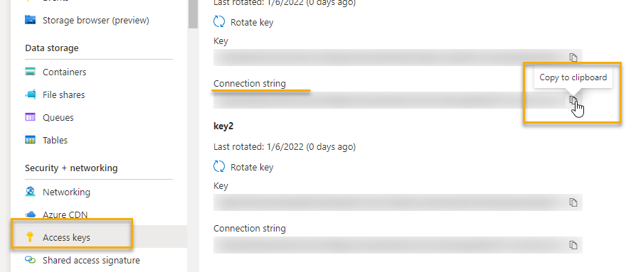
Notes:
Storage account container
Get connection string for use in function app
DefaultEndpointsProtocol=https;AccountName=…;AccountKey=….;EndpointSuffix=core.windows.net

Slide 33
Function Apps
Notes:
Use the public repo
Triggers
- http
- event grid
- schedule
Input and Output bindings
- connect and write to endpoints without having to compose the plumbing
Deploy the function app (should already be there).
Set the default storage connection string
Show how the storage account can be accessed with code
Add bindings for the event grid subscription
Show how the storage account and cosmos can be accessed without code

Slide 34
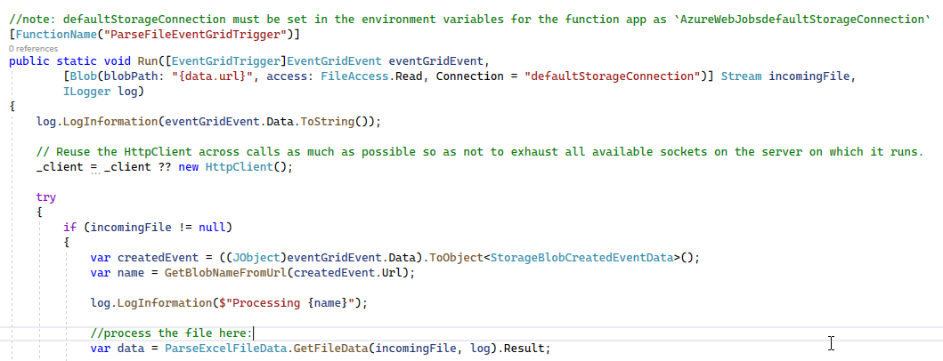

Slide 35
Event Grid
Topics and Subscriptions
Notes:
Create a logic app to respond to a blob storage event from Azure storage container to Logic App, then have it trigger the function with HTTP post

Slide 36
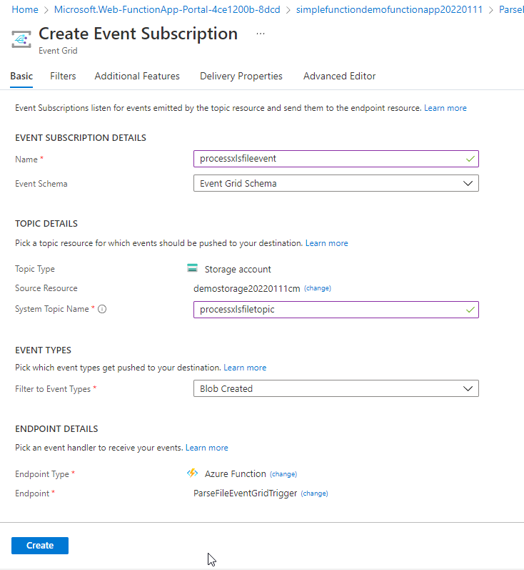

Slide 37
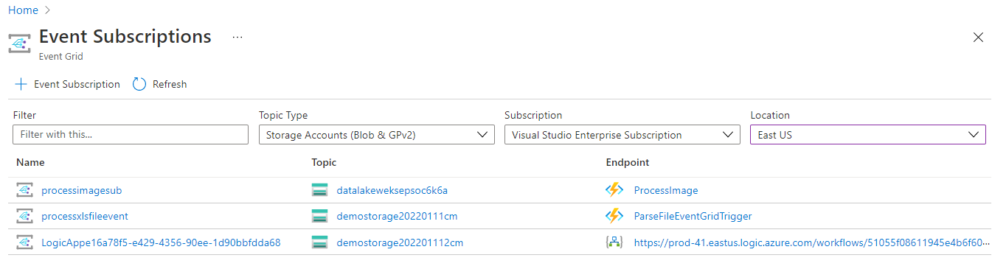

Slide 38
Logic Apps
Notes:
Triggers
Connectors
Actions
Control
Respond to storage account

Slide 39
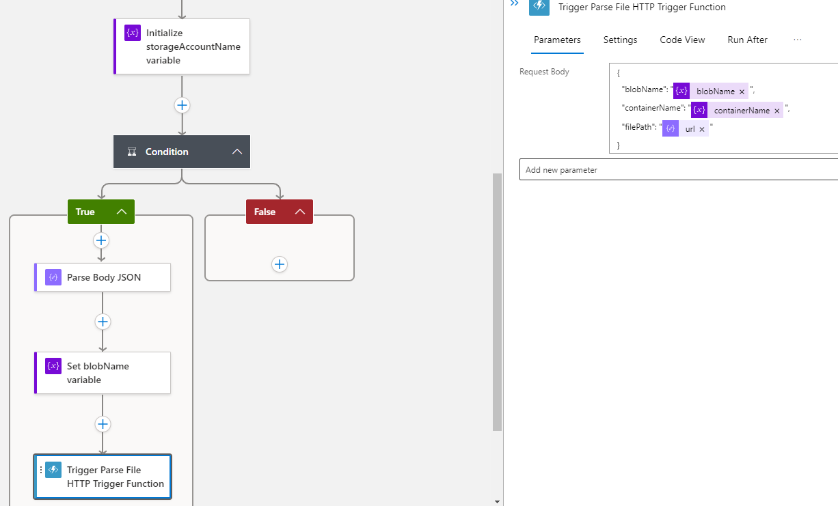

Slide 40
Cosmos DB
Notes:
Show querying the data
Select * from c
Select c.* from c
Select c.field1, c.field2 from c
Select field1, field2 from c

Slide 41
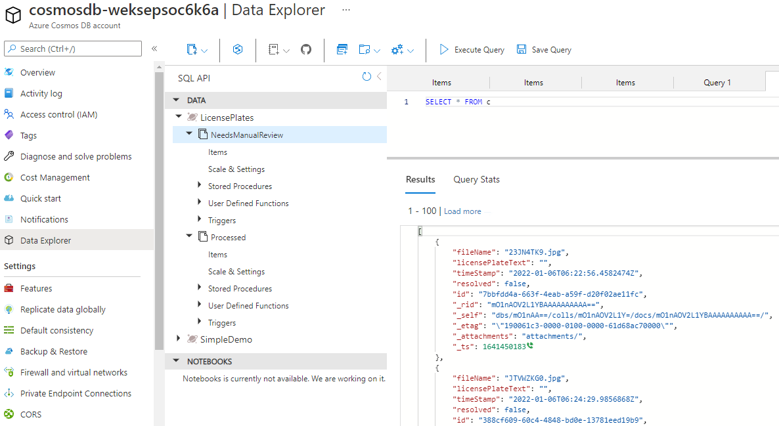
Notes:
Show querying the data
Select * from c
Select c.* from c
Select c.field1, c.field2 from c
Select field1, field2 from c

Slide 42
Summary
Plan your solutions/Use Diagrams
Leverage the right tools
Use the right patterns
Processing considerations
Monitor and respond to failure
Automate your deployments when possible

Slide 43

Please take a moment to fill out a quick survey
https://tinyurl.com/codemashserverless2022

Slide 44

Questions?
Email:
brian@majorguidancesolutions.com
Twitter
@blgorman
Linked In
https://www.linkedin/in/brianlgorman

Slide 45
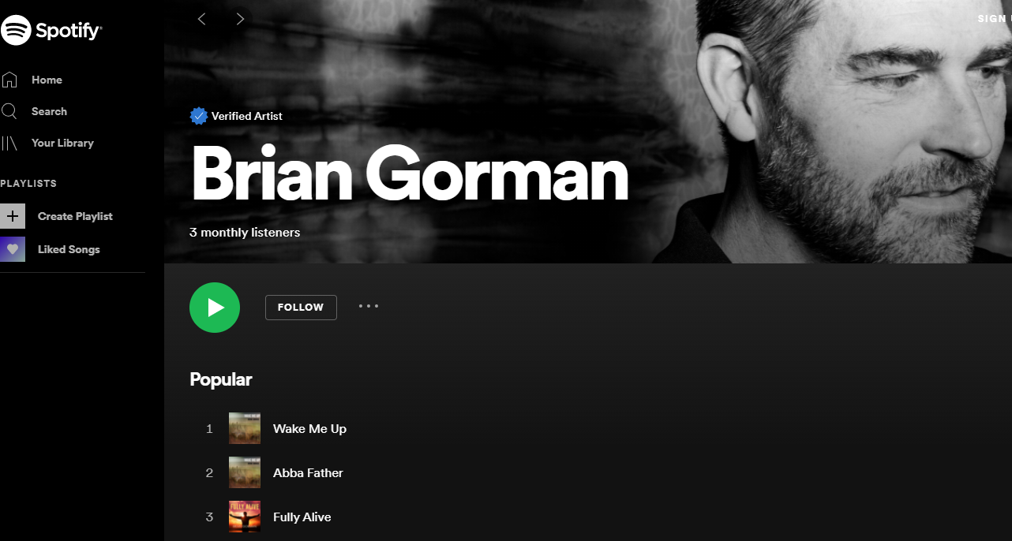
Conclusion
@blgorman
https://www.linkedin.com/in/brianlgorman
https://training.majorguidancesolutions.com
https://open.spotify.com/artist/0rRlrvBVhAhZCHcENoiFJ0
Enjoy the rest of your conference!
Notes:
Thank you for attending my talk today. Please reach out and connect.
If you liked the talk today, you can support me by listening to one or more of my songs on spotify ☺
Enjoy the rest of your conference!

