Slide 1
COMP309: Machine Learning Tools and Techniques
Exploratory Data Analysis (EDA)
Tutorial 5
week 5
Baligh Al-Helali

Slide 2
What questions need to be asked about the data before going ahead with processing and modelling?
What is the purpose of the data?
Which variables are predictive features and what is the target one?
What is the size/scale of the data?
What are the types of the variables (features and target)
Are the data clean?
Are the data balanced?
The distribution of each variable?
How the relationships between the variables look like?
Are there any corelations between variables?
Are there any missing values?
Which features might be more important?
…

Slide 3
Why such questions help for processing and modelling?
Understand the data helps:
Easier to spot mistakes
Easier to set hypothesizes
Allows you to feel your data
Get an idea of how/what the experiment should be conducted
…
Examples of important decisions based on EDA:
Type of target ➔ classification or regression
Data balance➔ performance measure (accuracy, weighted, F1-score)

Slide 4
How to answer such questions?
Some questions require reading the documents of the data creators (e.g. Qs 1 and 2)
Reading the data info and details from the providing websites (e.g. UCI and OpenMl)
Visiting the creators website or reading the paper(s) that published the data (if any)
Contacting the data creators (e.g. email)
Some questions require extracting statistics and visualisation such as Qs 3-11
- Statistics: count, mean, median, quartiles, variance, …
- Visualisation: histograms, scatterplot, boxplot, heatmap, …
How to get the stats and Vizs:
From the data sources (Not always reliable)
Using EDA tools:
Orange
Python: Pandas, Matplotlib, Seaborn
…
The subject of this tutorial

Slide 5
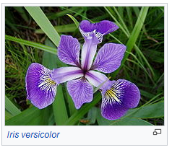
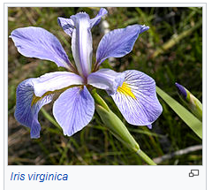
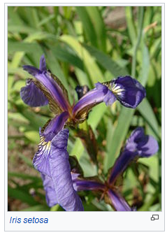
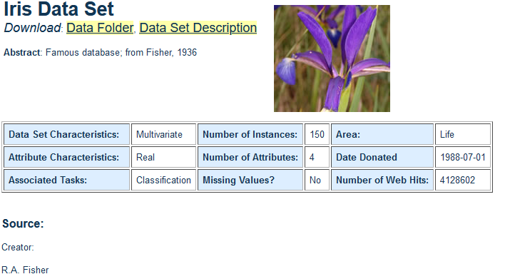
We are considering the popular data set “iris”
-The Iris flower data set or Fisher's Iris data set is a multivariate data set introduced by the British statistician and biologist Ronald Fisher in his 1936 paper The use of multiple measurements in taxonomic problems as an example of linear discriminant analysis.^{[1]}(Wikipedia)
UCI Machine Learning Repository
[1]. R. A. Fisher (1936). "The use of multiple measurements in taxonomic problems". Annals of Eugenics. 7 (2): 179–188. doi:10.1111/j.1469-1809.1936.tb02137.x. hdl:2440/15227.

Slide 6
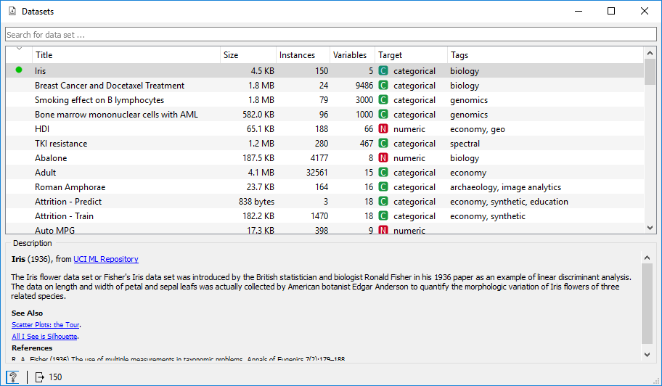
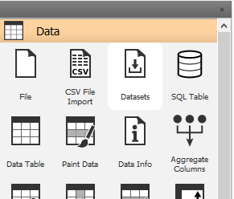
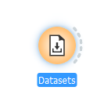
Let’s start with Orange
Load the data set
What to notice?
Type of target is categorical ➔ classification
Data size is small➔ might need cross validation

Slide 7
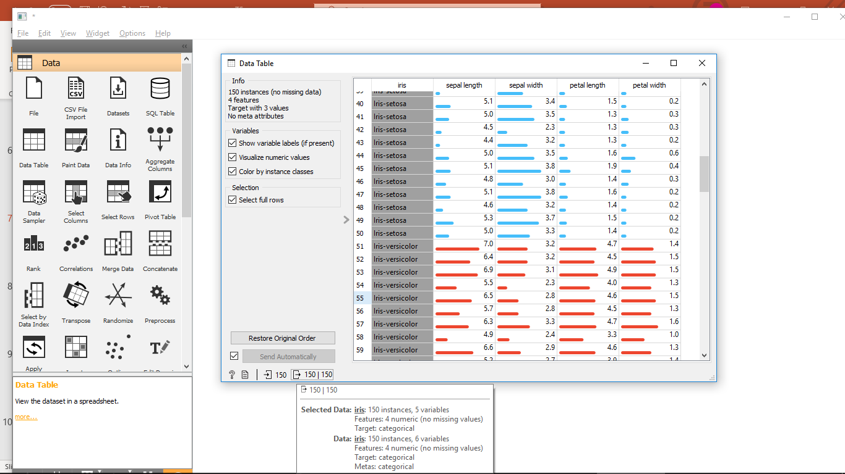
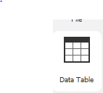
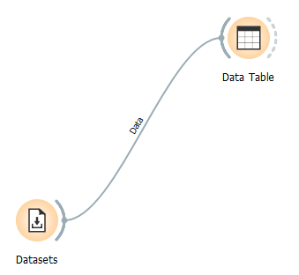
Orange EDA: A first look
What to notice?
Variable scale is different (e.g. sepal length is the widest and petal width is the least)
➔ might need normalization

Slide 8
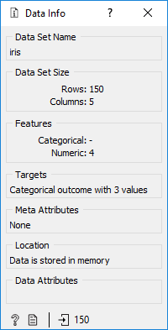
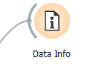
Orange EDA: A first look
What to notice?
Type of target is categorical ➔ classification
Data size is small➔ might need cross validation

Slide 9
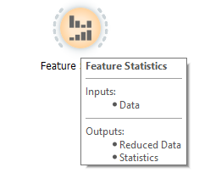
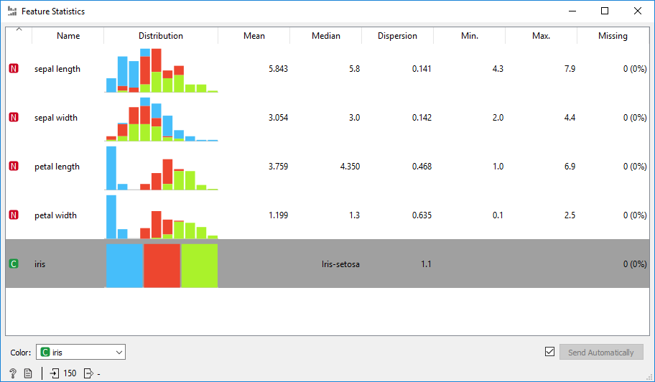
Orange EDA: What are the stats of the variables?
What to notice?
Distributions of variables over classes
Centre, spread, no missing values of variables
Classes balance

Slide 10
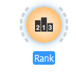
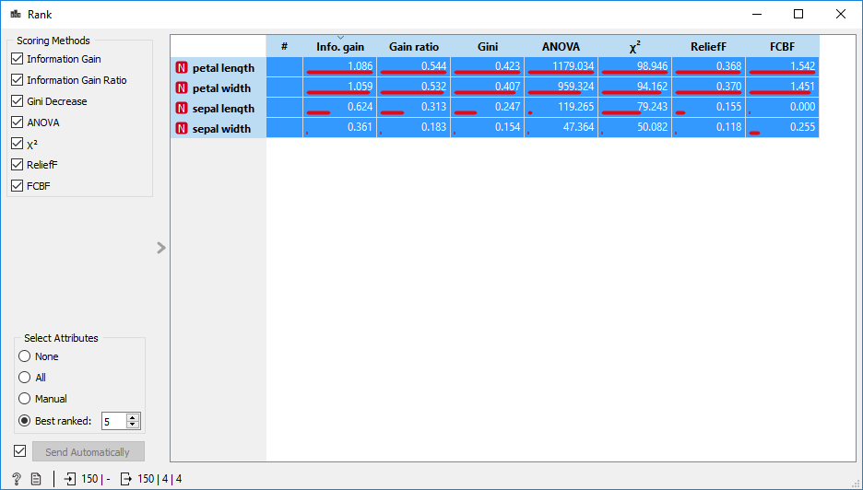
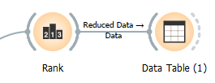
Orange EDA: What are the most important features?
What to notice?
Petal length seems the most important and sepal width is the least
➔ Feature selection

Slide 11
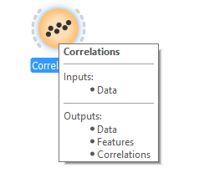
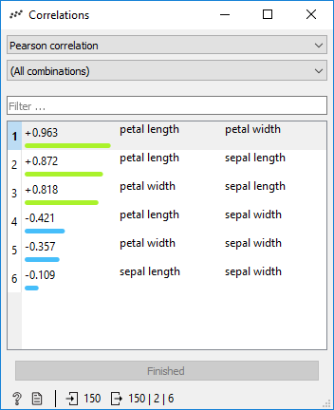
Orange EDA: What are the most important features?
What to notice?
[-1, 1], negative/positive, strong/weak…
Petal length and petal width look strongly corelated
➔ Feature selection

Slide 12
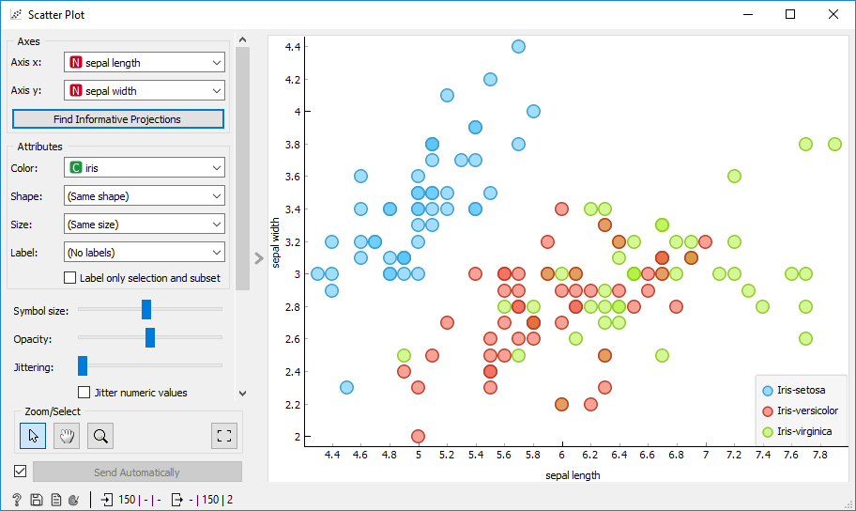

Orange EDA: What is the relationship between two variables (e.g. the sepal length and width) per/regardless class?
Change variables
What to notice?
Compare with the correlation shown previously

Slide 13
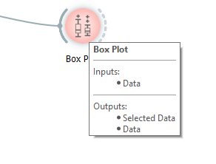
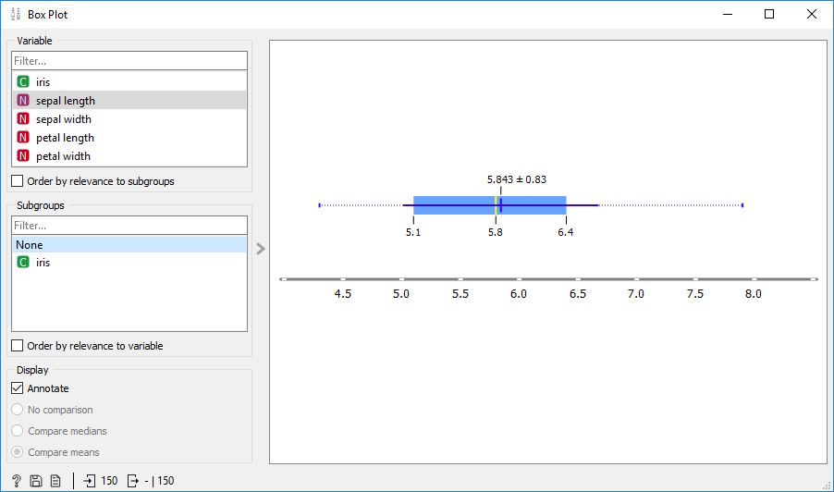
Orange EDA: How the values of a certain variable (e.g. sepal length) are distributed?
Univariate
What to notice?
Graphical presentation for the stats

Slide 14
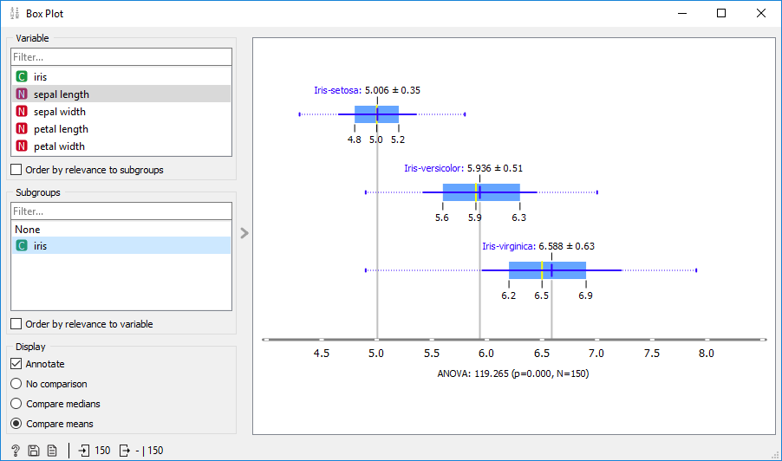
Orange EDA: How the values of a certain variable (e.g. sepal length) are distributed per target class (iris species)?
Multivariate
What to notice?
Graphical presentation for the stats per class
Small sepal length ➔ ieis-setosa class

Slide 15
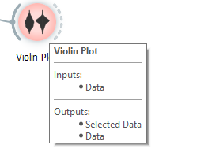
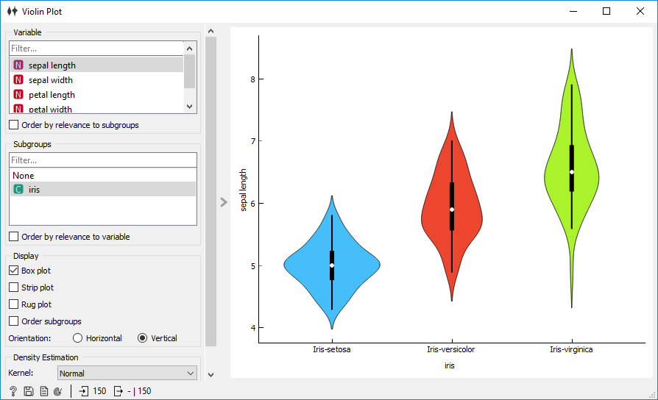
Orange EDA: How the values of a certain variable (e.g. sepal length) are distributed per target class (iris species)?
What to notice?
Similar to box plot but the density/frequency of the samples for variable values is visualized

Slide 16
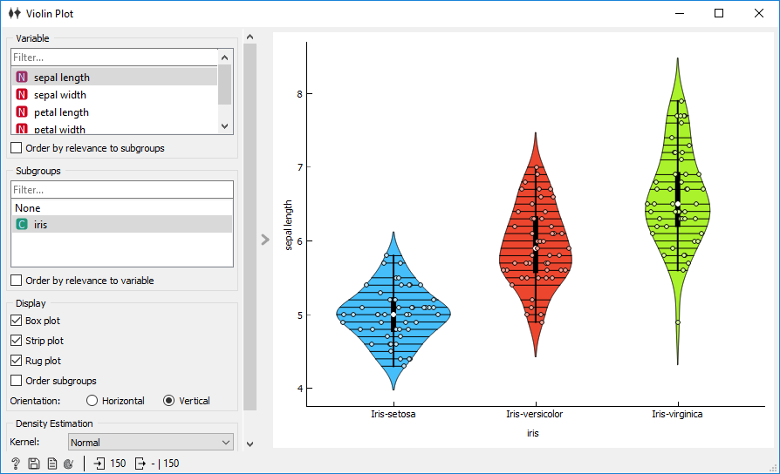
Orange EDA: How the values of a certain variable (e.g. sepal length) are distributed per target class (iris species)?
Change
What to notice?
Show the points for clearer visualization

Slide 17
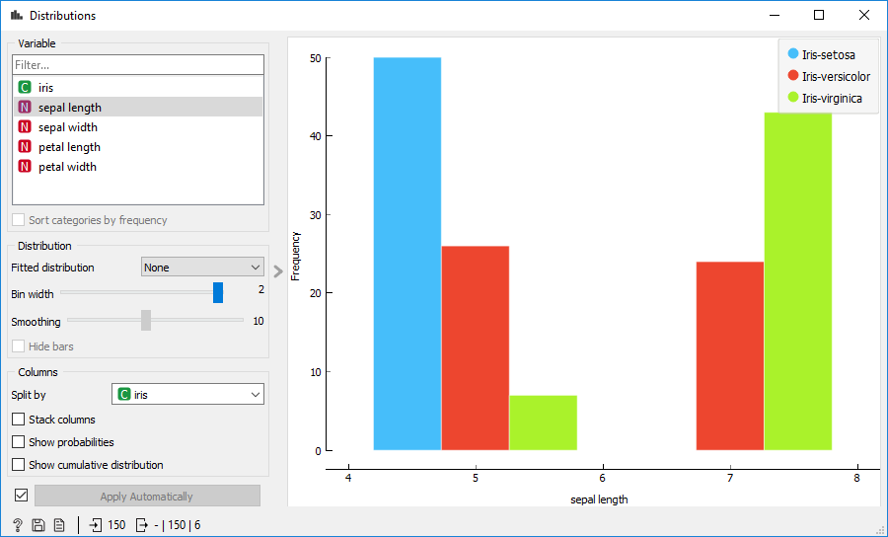
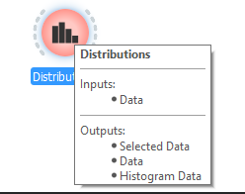
Orange EDA: How the values of a certain variable (e.g. sepal length) are distributed per target class (iris species)?
What to notice?
Shorter sepal ➔Iris-setosa
Longer sepal ➔ more likely Iris-virginica

Slide 18
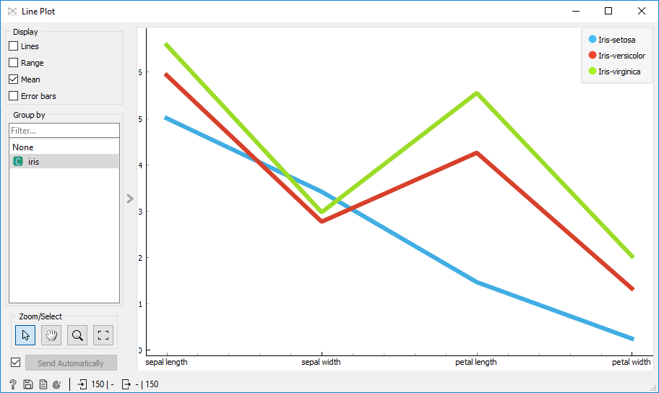

Orange EDA: How the values of input variables are distributed per target class?

Slide 19

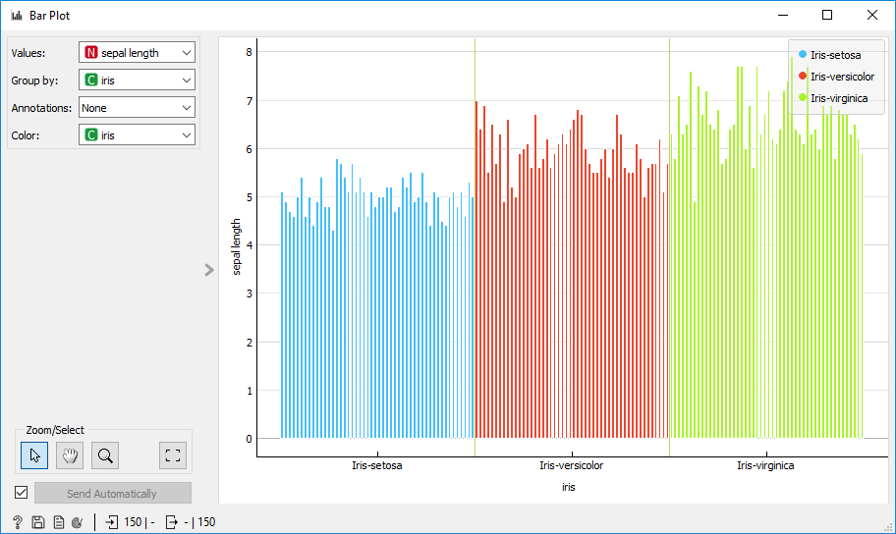
Orange EDA: How the values of input variables are distributed w.r.t. another variable?

Slide 20
Orange EDA
Why there are different ways to answer the same question?

