Slide 1
NEURON Tutorial
Nikki Pelot
Duke University – BME 515
Fall 2014
Notes:
Note the hyperlinks throughout the slides.
Many of these concepts apply to computational neuroengineering outside of NEURON as well.

Slide 2
What is NEURON?
“NEURON provides a powerful and flexible environment for implementing biologically realistic models of electrical and chemical signaling in neurons and networks of neurons.”
– Hines and Carnevale 2002
Notes:
Originally developed at Duke! Now run out of Yale.

Slide 3
Installing
Download and install latest release.
Mac
Extra instructions
Need latest developer tools
Troubleshooting
Windows
I use 32 bit Cygwin (even though I have a 64 bit machine).
Troubleshooting
UNIX
Installation tips for each OS on the forum.
Avoid file paths with spaces.

Slide 4
Resources
New programmer’s reference
Use “Index” rather than “Quick search”
Sometimes still useful to look at old version
Useful to check if a given word is a built-in variable/keyword/etc.
ModelDB
Often helpful to modify from existing code.
MyFirstNEURON
Forum
Suggestions for how to develop models
Tutorials
http://neuron.duke.edu/
http://www.anc.ed.ac.uk/school/neuron/
http://web.mit.edu/neuron_v7.3/nrntuthtml/tutorial/tutA.html
Notes:
Can be useful to revisit the tutorials as you learn more.

Slide 5
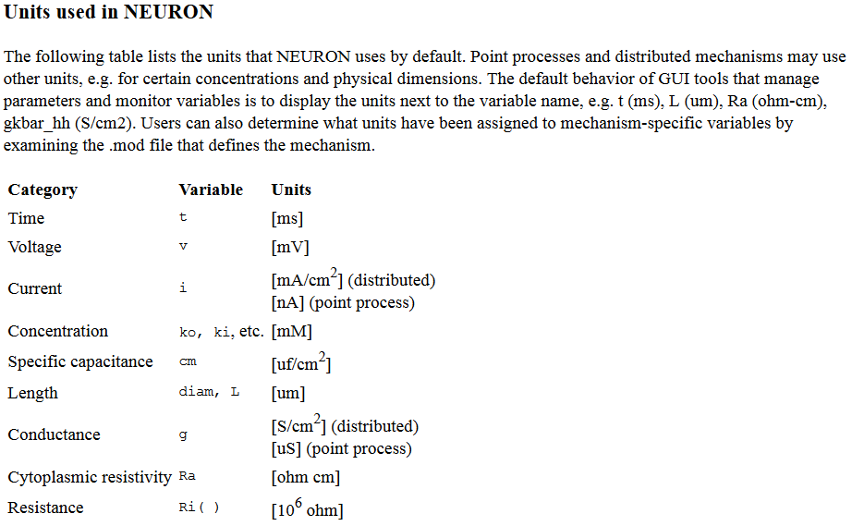
Check your units when performing calculations in NEURON!
Ref.: http://www.neuron.yale.edu/neuron/static/docs/units/unitchart.html

Slide 6
Using NEURON: Two Camps
GUI
Coding
NEURON file extensions
.hoc (Higher Order Computing) or .py (Python)
Scripts, like .m in Matlab
Python implementation is much newer. I do not have
.mod (NMODL)
Membrane mechanisms
No native text editor.
Notepad, Notepad++, Geany, etc.
Set language to C for most syntax highlighting or add NEURON-specific syntax highlighting.
Not mutually exclusive, can use one to design geometry, and the other to run simulations, for example.
Notes:
I am biased towards coding.
Not mutually exclusive. For ex, you can design your neuron in hoc (code), then run your simulations using the GUI.

Slide 7
GUI
Cell Builder tutorial
What’s a session (.ses) file?
Create a simple model axon with soma, dendrites, and axon. Specify geometry and biophysics.
Tutorial for the other main components
Stimulating with current point source
Running simulation
Plotting results
Saving session

Slide 8
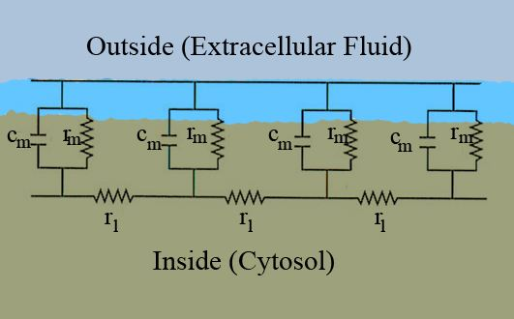
Inside NEURON
Cable model
Sections = Components of a neuron (soma, axon, dendrite, etc.)
Generated with “create” command
Recall equations for membrane resistance & capacitance, and axial resistances. See “Parameters of Cable Equation” on Sakai.
Every section is modeled as a cylinder and has the same parameters:
Ra = Axial resistivity [Ω-cm]
cm = Membrane specific capacitance [uF/cm²]
L = Length [um]
diam = Diameter [um]
nseg = Number of segments
NOTE: Section ≠ Segment
Ref.: Wikipedia

Slide 9
Note on Ra
An axon with perfectly insulating myelin is constructed by connecting nodes of Ranvier (NoR) with resistors modeling the intracellular space. However, these resistors should not merely account for the length of the NoR, but rather the length of the NoR + the length of the myelin.
Axial intracellular resistance: R = 4(Ra)(length)/π(diam)²
Ra = intracellular resistivity
NEURON will compute R = 4(Ra)(L)/π(diam)²
You want R = 4(Ra)(L+INL)/π(diam)²
INL = internodal length
Therefore, need to multiply Ra by (L+INL)/L
NoR
myelinated section
NoR
L
INL

Slide 10
Working with Sections
Referring to section or its parts
section.parameter
section parameter
section { ...
}
access: subsequent commands without section reference will refer to this section

Slide 11
Normalized Length & Sections vs Segments
Generate a section with “create” command.
NEURON uses normalized length, such that each section spans from 0 to 1.
Different sections have different parameters and/or properties. Separate sections must joined using the “connect” command.
connect soma(1), axon(0)
You can connect one segment at any point along another segment.
0
1
soma
0
axon
1
Notes:
For example, the soma may only have passive membrane properties while the axon has HH channels. Or different diameters for different segments. However, note that it is possible to implement spatially varying parameters.

Slide 12
Normalized Length & Sections vs Segments
Each section is divided into nseg segments (spatial discretization). You can access variables (such as Vm) at the center of each segment.
Ex.: For a section with one segment, you can access Vm halfway along the section:
myaxon.v(0.5)
But how many segments (nseg) do you need per section? In other words, how much spatial resolution is needed?
Alternatively, you can have many small sections, each with nseg=1.
Notes:
Spatial discretization

Slide 13
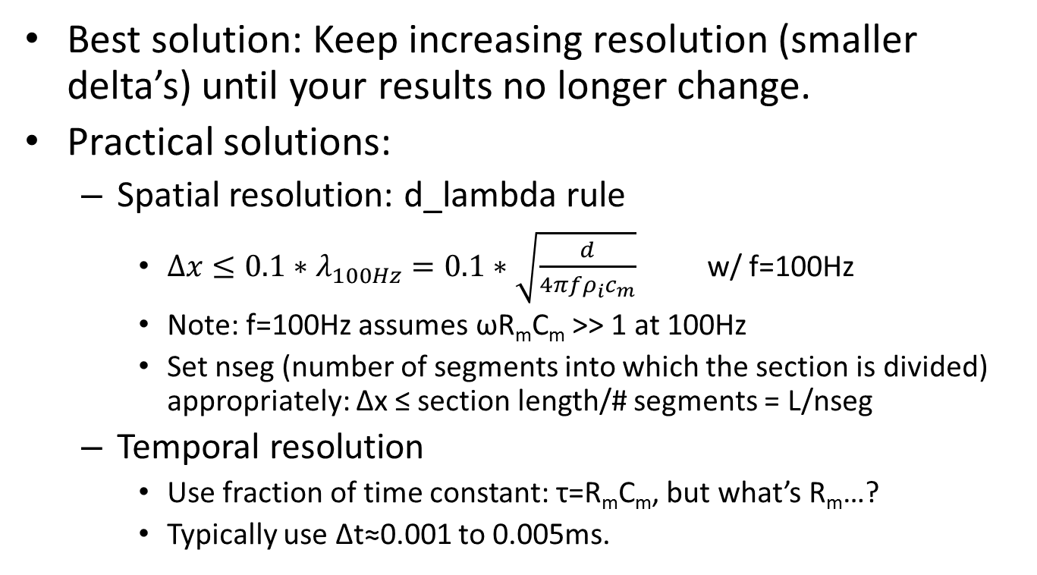
Spatial & Temporal Resolutions
Best solution: Keep increasing resolution (smaller delta’s) until your results no longer change.
Practical solutions:
Spatial resolution: d_lambda rule
$Δx≤0.1∗λ_{100Hz}=0.1∗\sqrt{\frac{d}{4πfρ_{i}c_{m}}}$ w/ f=100Hz
Note: f=100Hz assumes ωR_{m}C_{m} >> 1 at 100Hz
Set nseg (number of segments into which the section is divided) appropriately: Δx ≤ section length/# segments = L/nseg
Temporal resolution
Use fraction of time constant: τ=R_{m}C_{m}, but what’s R_{m}…?
Typically use Δt≈0.001 to 0.005ms.

Slide 14
“insert” command
Add extra layers to the cable to permit extracellular stimulation
insert extracellular
Reinitialize all e_extracellular(…) to zero for all segments of all sections, particularly if batching multiple simulations.
More on extracellular stimulation later.
Add membrane mechanisms
insert pas
Passive mechanism
Set g_pas and e_pas
insert hh
Hodgkin-Huxley
insert axnode (from MRG model)
Additional mechanisms
insert <.mod SUFFIX>
Need to compile…

Slide 15
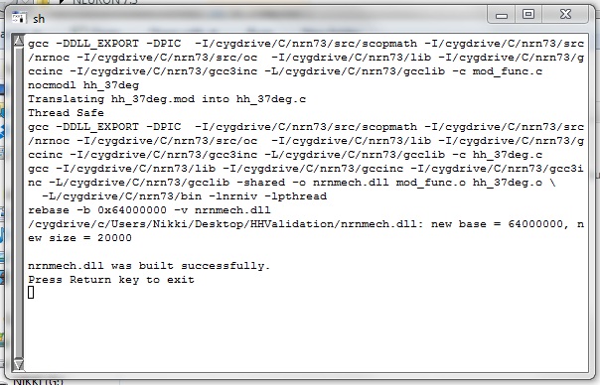
NMODL: .mod files
NMODL = NEURON Model Description Language
Code for membrane mechanisms
Must be compiled with “mknrndll”:
No spaces in file path.
Same drive where NEURON is installed.
Recompile when changing computers.

Slide 16
Recording .mod State Variables
Identify state variable of interest in .mod file of a mechanism that was “inserted” into a section.
Ex.: m, n, h
Identify SUFFIX in .mod file (same as used for “insert” statement).
Let’s say I have a section called “node” with nseg=1 and HH mechanism (SUFFIX = hh). I could access the gating variable halfway along my node:
node.m_hh(0.5)

Slide 17
Classes
Any variable that isn’t a section or a number is part of a class
Vector
File
IClamp
APCount
NetCon
etc.
Declaring objects
objref object_name
object_name = new Class()
Note: objectvar = objref
Compare: use create to declare sections; use objref or objectvar to declare a class object
Each class has its own associated functions and parameters
object_name.ClassFunction(…)
Notes:
Keywords: objref or objectvar; new

Slide 18
File Class Example
objref myfile
myfile = new File()
strdef file_name
sprint(file_name,”Data/MyResults%d.dat”,3)
myfile.wopen(file_name)
// or just myfile.wopen(“Data/MyResults3.dat”)
myfile.printf(“Header1 Header2 \n”)
myfile.printf(“%d %d”, result1, result2)
// Can print results within a for loop.
myfile.close()

Slide 19
Vector Class Example
objref myvec
myvec = new Vector(num_elem, 0)
myvec.x[0] = 10
objref Vm_vec
Vm_vec = new Vector()
Vm_vec.record(&axon.v(0.2),dt)
Run simulation…
create node[num_nodes]
…
objref Vm_vec[num_nodes]
for K = 0, num_nodes-1 {
Vm_vec[K] = new Vector()
Vm_vec[K].record(&node[K].v(0.5),dt)
}
Other vector class functions: copy, min, max, printf, size, etc.

Slide 20
File Class and Vector Class Example
objref Ve_data, Ve_file
Ve_file = new File()
Ve_file.ropen(fname)
Ve_data = new Vector(num_nodes, 0)
Ve_data = scanf(Ve_file)
Ve_data = Ve_data.mul(1000) // convert from V to mV
Ve_file.close()

Slide 21
APCount Class Example
Use to detect action potentials
Note: Can also use NetCon to record spike times.
objref apc
myaxon apc = new APCount(0.1)
apc.thresh = -20
Detect an action potential when Vm at 0.1 along myaxon crosses -20mV with rising phase
if (apc.n >= 1) {
print “Detected ”, apc.n, “action potentials!”
} else {
print “No action potentials.”
}

Slide 22
Code Structure
Modular coding.
Model specification
Model initialization
Instrumentation
Stimulation
Recording
Simulation control
Data post-processing & output
Notes:
Modular coding. Want to design code such that it’s reusable.

Slide 23
Code Structure
Usually, you should begin with
load_file("nrngui.hoc")
load_proc("nrnmainmenu")
Comments: “//”
No semi-colons!
Standard conditional statements…
if ( … ) else if { … } else { … }
for
while
Subroutines:
Procedures
proc proc_name { … }
proc_name()
Functions
func func_name { … return <double precision value> }
func_name()
Subroutines (proc or func) with input variables
proc proc_name {
myval = $1 * $2
}
proc_name(3.5, 6.243)

Slide 24
Intracellular Stimulation
stim
Intracellular: IClamp
objref stim
myaxon {
stim = new IClamp()
stim.loc(0.2)
stim.del = 5 // start time of stimulus [ms]
stim.amp = 4 // amplitude [nA]
stim.dur = 0.1 // duration of stimulus [ms]
}
~
myaxon
0
0.2
1

Slide 25
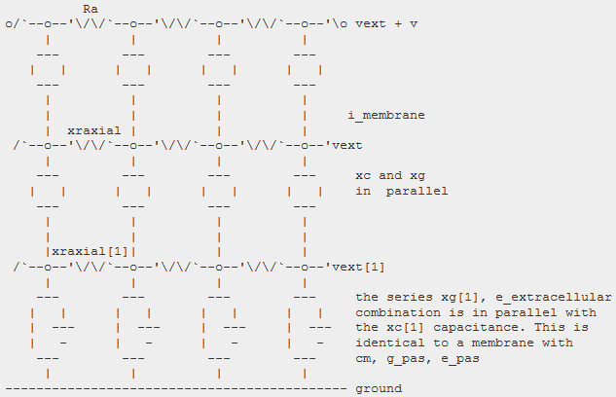

Extracellular Stimulation
Extracellular: IClamp + insert extracellular
Need to…:
“insert extracellular” for each section
create a dummy section to which you can attach your IClamp
manually apply extracellular potentials to each section (check units!!!)
$φ=\frac{I}{4πσr}$
Ref.: http://www.neuron.yale.edu/neuron/static/new_doc/modelspec/programmatic/mechanisms/mech.html#index-5

Slide 26
Extracellular Stimulation
create nodes[num_nodes] // Could instead have one section with many segments
forall {
insert extracellular
}
...
objref stim
create myelec
myelec {
stim = new IClamp()
stim.loc(0.5)
stim.del = 5 // start time of stimulus [ms]
stim.amp = 4 // amplitude [nA]
stim.dur = 0.1 // duration of stimulus [ms]
}
...
while (t<tstop) {
for K = 0, num_nodes-1 {
// r_axon is a vector with the distance from the electrode to each node
nodes[K].e_extracellular = rhoe*stim.i/(4*pi*r_axon.x[K]) // check units!! [mV]
}
fadvance()
}
stim
~
myelec
nodes
0
1

Slide 27
Running Simulation in hoc
finitialize(-85) // initialize to Vrest
white (t<tstop) {
fadvance()
}

Slide 28
Saving & Analyzing Results
Save ASCII file: see File Class Example
Save binary file
Binary file is smaller than text/ASCII file
But then can’t just open in Notepad to see contents
How? myvector.vwrite()
Analyzing data in Matlab
>> importdata
>> textscan
etc.

Slide 29
Saving & Analyzing Results
Plotting in hoc
objref g1
g1 = new Graph()
g1.size(…) // specify (xmin, xmax, ymin, ymax)
myvec.plot(g1)

Slide 30
Other Notes
Declare sections (create), objects (objref, objectvar), and strings (strdef) outside of procedures and functions.
Indexing starts at 0 like C, not 1 like Matlab.
Recompile .mod files with mknrndll for specific machine.
.mod files must be in same directory as .hoc script.
Closing squiggly bracket “}” must be on its own line to end a loop/procedure/function.
Common error: your neuron has been overstimulated; lower amplitude…
exp(<big #>) out of range, returning exp(700)

Slide 31
More Advanced Things…
Networks of neurons
NetCon (“network connection”) class
Realistic morphologies
ModelDB
Neurolucida

Slide 32
Coding example…

