Slide 1
Smart Home
Weekly report
Boyang LI
10/08/2017

Slide 2
The effect of total battery capacity on billing price.
For schedulable appliances demonstration setup
Battery total capacity (fixed in each test) | 25 WH / 50 WH / 75 WH / 100 WH
Charging/Discharging rate (could vary in one test) | 0 W/ ±5 W / ±10 W/ ±15 W/ ±20 W/ ±25 W
Schedulable appliances power consumption (totally three appliances) | 40 W * 3
Runtime | 2 / 3 /5 (slots)
Privacy level | 20
Price | Plotted in the next page

Slide 3
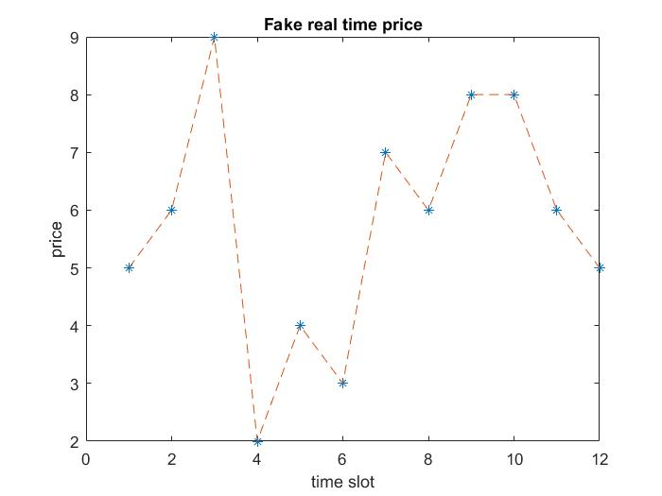
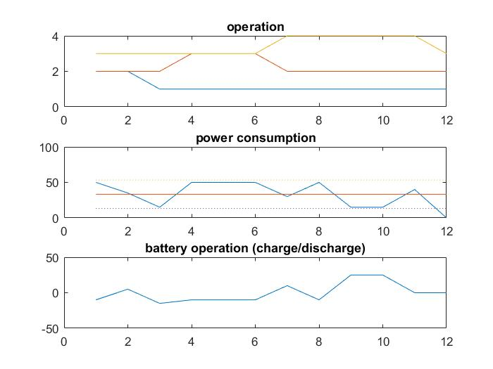
schedulable appliances demonstration
Fake real time price for testing
Scheduling results for
the model with total battery capacity of 50

Slide 4
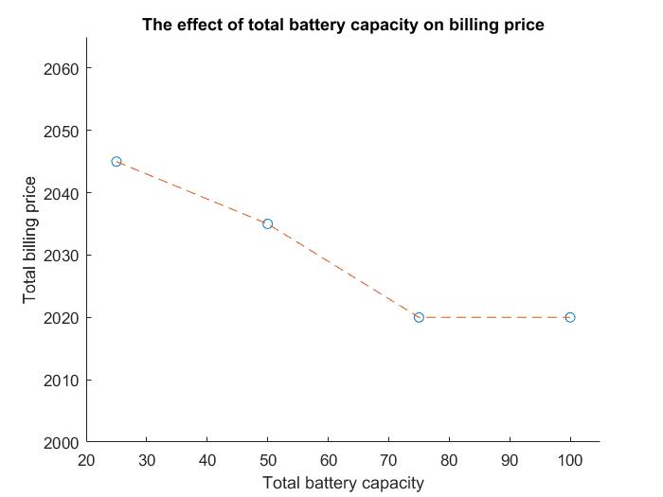
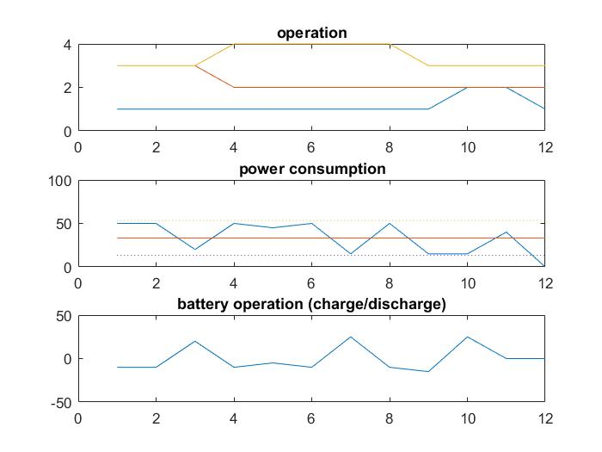
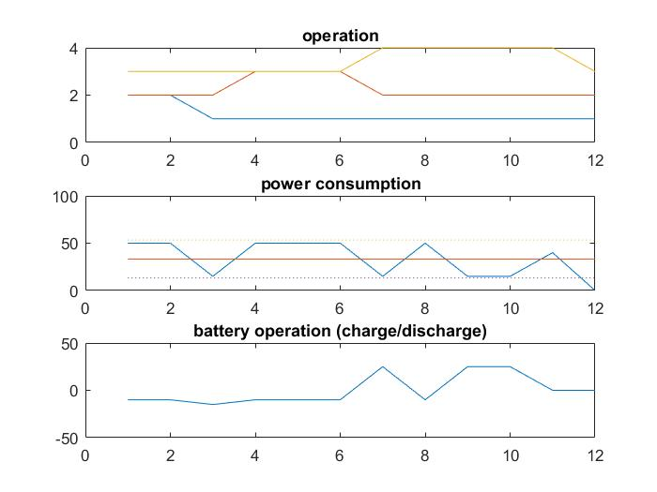
The effect of total battery capacity on billing price.
total battery capacity = 25
total battery capacity = 50
total battery capacity = 75
total battery capacity = 100

