Slide 1
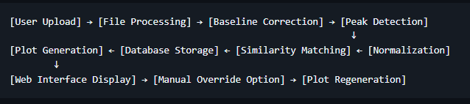
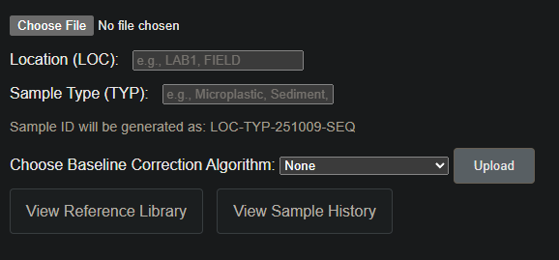
Architecture pipeline
Can be computed in 4 algorithms
Neural network
Objectives of the NN :
Match a test sample with a type of microplastic.
Problem: each type of microplastic is represented by only one spectrum in the DB or has many samples but they differ a lot. Without better data for now the NN can only aim to match to a spectrum and not to the type of microplastic.
->make more data with our spectrometer ?
- Give percentages of similarity for many samples.
Inputs of the NN :
Samples (ideally many samples for each plastic, in different conditions, different ages (only have this in one database))
Wil add a dropdown menu here to choose between peak matching or NN

Slide 2
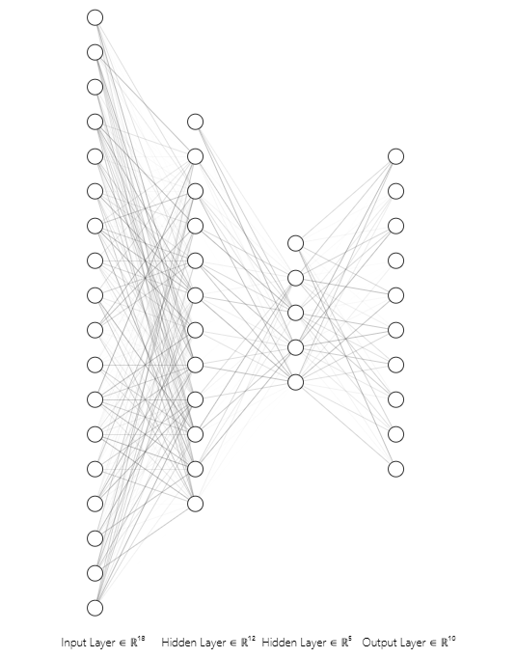
Structure of NN
Datapoints
(~3000 per sample)
Output, microplastics or singular train spectra
Datapoints are not aligned (not the same values of wavenumber are measured each time) ->work on “joining the points with a line and then taking the value of that line for fixed points”
Convolutional first layer is necessary to capture (local steep up (or down), local peak at X intensity value, local noise at points of no interest)
Macro feature layers will be able to activate one or more nodes of the output layer so samples containing multiple plastics will be detected.
-> I will understand what macro features layers identify only during the training process
-> I will be trying any combination of layers, regressors, validations, etc.
Vicinity features layer (convolutional)
Other macro features layers (as many as necessary)

Slide 3
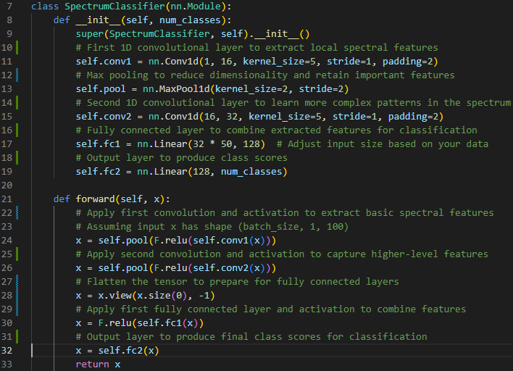
Pytorch
-> I’m not sure of any of the layers in the middle
-> Dense fully connected layers at the end because peaks -> plastic(s)

Slide 4
Problems to solve
Database structure: how to feed all the samples to the network (separate the samples by sample ID)

