Slide 1
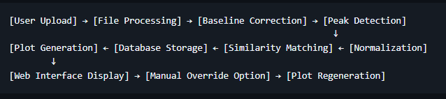
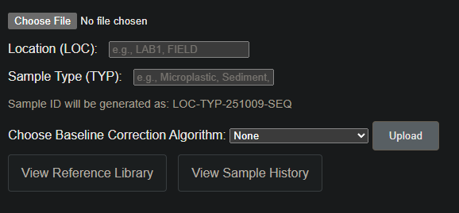
Architecture pipeline
Can be computed in 4 algorithms
Neural network
Objectives of the NN :
Match a test sample with a type of microplastic.
Problem: each type of microplastic is represented by only one spectrum in the DB or has many samples but they differ a lot. Without better data for now the NN can only aim to match to a spectrum and not to the type of microplastic.
->make more data with our spectrometer ?
- Give percentages of similarity for many samples.
Inputs of the NN :
Samples (ideally many samples for each plastic, in different conditions, different ages (only have this in one database))
Wil add a dropdown menu here to choose between peak matching or NN

Slide 2
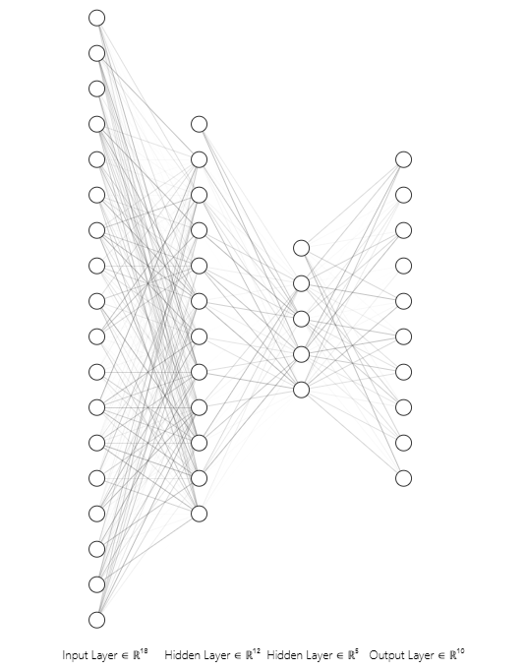
Structure of NN
Datapoints
(~3000 per sample)
Output, microplastics or singular train spectra
Datapoints are not aligned (not the same values of wavenumber are measured each time) ->work on “joining the points with a line and then taking the value of that line for fixed points”
Convolutional first layer is necessary to capture (local steep up (or down), local peak at X intensity value, local noise at points of no interest)
Macro feature layers will be able to activate one or more nodes of the output layer so samples containing multiple plastics will be detected.
-> I will understand what macro features layers identify only during the training process
-> I will be trying any combination of layers, regressors, validations, etc.
Vicinity features layer (convolutional)
Other macro features layers (as many as necessary)

Slide 3
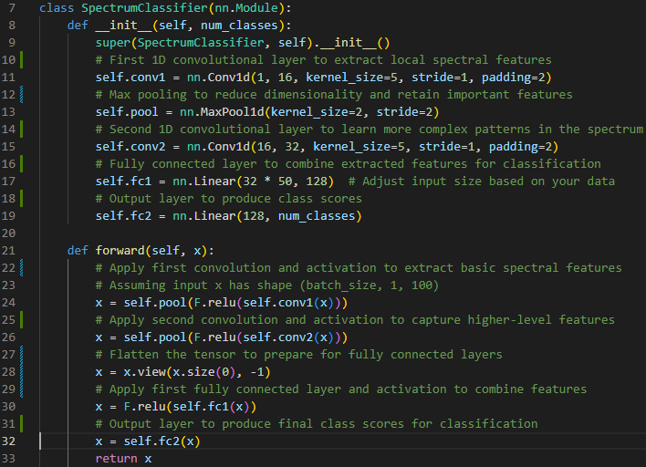
Pytorch
-> I’m not sure of any of the layers in the middle
-> Dense fully connected layers at the end because peaks -> plastic(s)

Slide 4
Problems to solve
Database structure: how to feed all the samples to the network (separate the samples by sample ID)

Slide 5
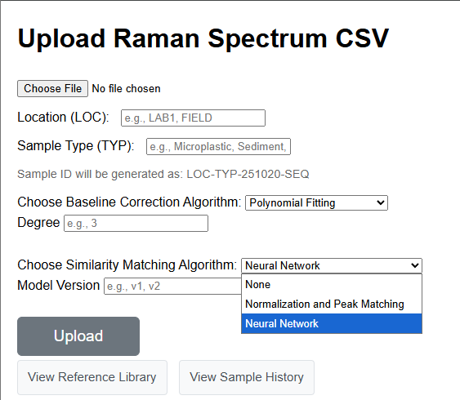
Added drop-down menu. Possibility for user to choose the layers and customize. -> do we want this ? Do we keep model versions ? In that case we should store 1 model cache per each possibility of model.

Slide 6
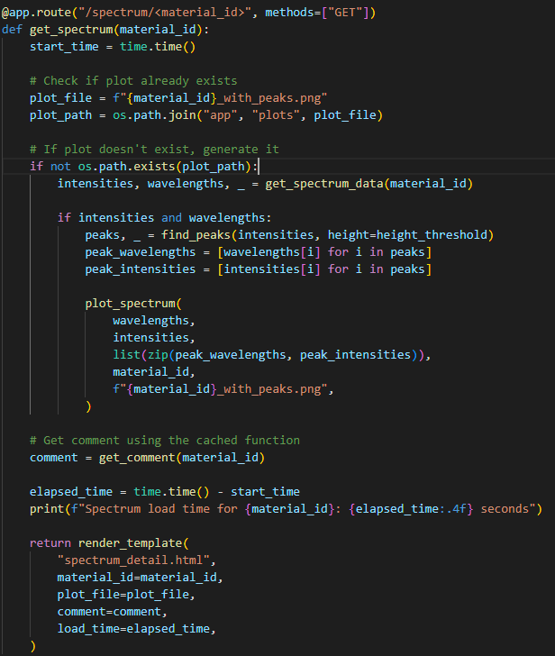
The final model cache should take about ~ 180 MB of space (estimate)
I tried training with one sample only using get_spectrum(material_id). It works for now (the weights get created). Still need to make a function that only feeds the wavelengths to the NN, and ignores plots.
Same problem for last week about the wavelengths, some samples are integer wavelengths (3025.0 , 3024.0, ….), but some have decimals. So for the NN training I will design a function that connects the datapoints and gives out the same values. Hopefully there is no need to make a new DB but I can integrate this at the end of the get_spectrum function and do it each time the sample gets called.
^ This is needed for training with all samples (I only trained one). -> We won’t have this problem anymore when we build our own dataset (we will sample always at given wavelengths)
^ Although, I would like to first try some modules that are already made for this and don’t require resampling.

Slide 7
I kept the same module architecture as last week but sometimes removed a layer for training. Idea : design a user friendly way of customizing the model, training it (on a computer) and then exporting just the cache to the raspberryPI. In my opinion it’s pointless, the model should already work. But can be cool for user.

Slide 11
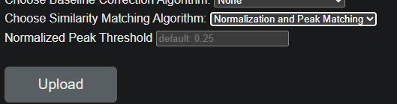
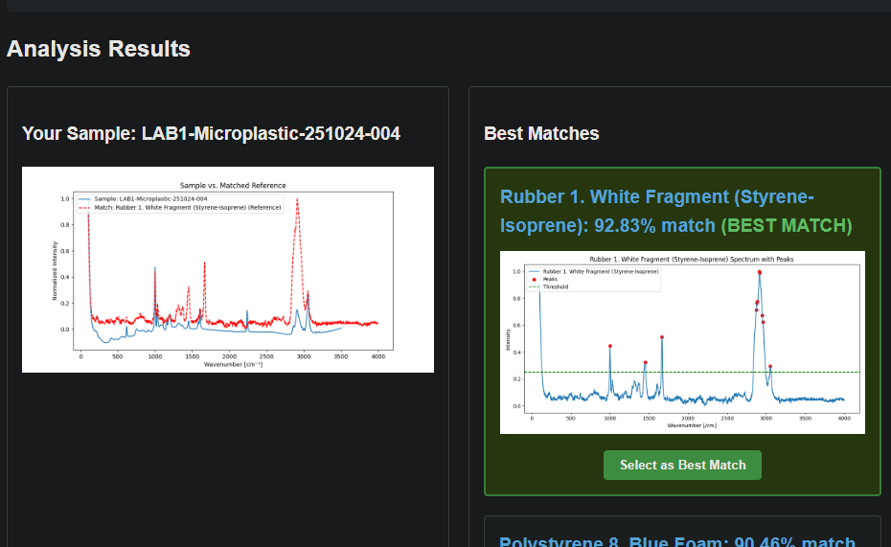
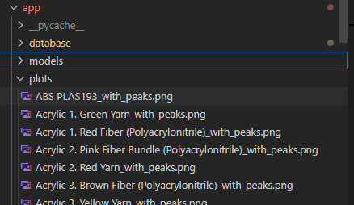
Spent some time debugging the HTML files. (mainly problems between communication of backend to frontend) I realized there is a global value for peak threshold 0.25 and added a field for the user to customize this. Ideally it would be nice to remove the plot files and be able to plot them each time. This would: - remove space in the repository (16MB) - allow to plot samples with customized peak threshold. -> I will not focus on this for now (don’t discard work already done) but I will keep in mind this for when I understand better the code for making the plots and how Francesco stored the plots. For now, the user can fill the field, and the value is correctly passed to the function back-end, but it is not used.

Slide 12

This field can have a default (such as UNKNOWN) so that the user can make tests even without being formal. Since there is going to be a back-and-fourth between the user testing the different baselines algorithms and uploading test samples.

