Slide 1
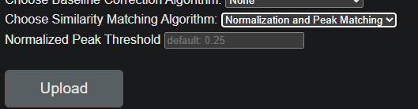
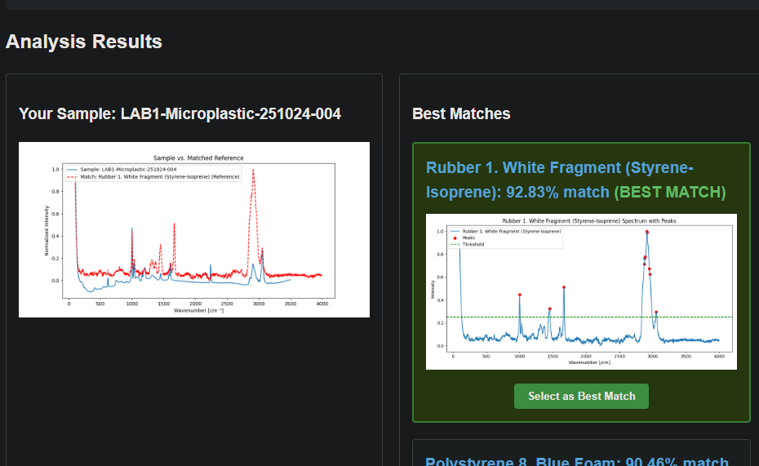
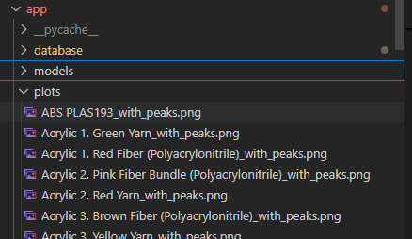
Spent some time debugging the HTML files. (mainly problems between communication of backend to frontend) I realized there is a global value for peak threshold 0.25 and added a field for the user to customize this. Ideally it would be nice to remove the plot files and be able to plot them each time. This would: - remove space in the repository (16MB) - allow to plot samples with customized peak threshold. -> I will not focus on this for now (don’t discard work already done) but I will keep in mind this for when I understand better the code for making the plots and how Francesco stored the plots. For now, the user can fill the field, and the value is correctly passed to the function back-end, but it is not used.

Slide 2

This field can have a default (such as UNKNOWN) so that the user can make tests even without being formal. Since there is going to be a back-and-fourth between the user testing the different baselines algorithms and uploading test samples.

Slide 3
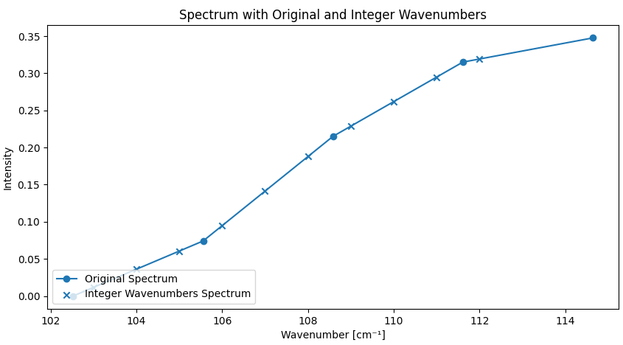
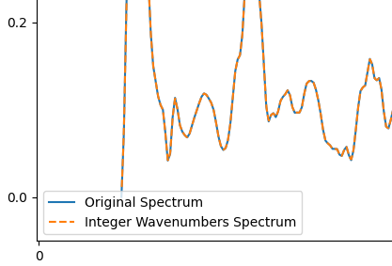
Made resampling function. - can make this degree 2 if needed -no need for the microscope to output integer wavenumbers and datapoints. Its easily doable and integrated in the pipeline. - discuss loss of data/over-representation of data.

