Slide 1
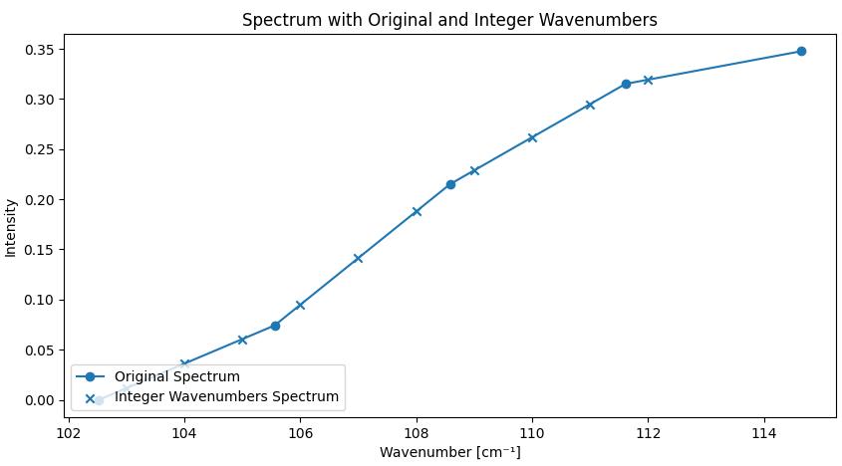
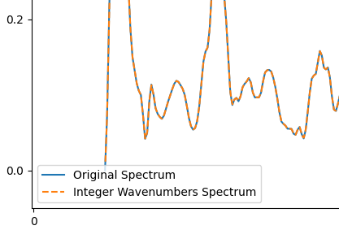
Made resampling function.
- can make this degree 2 if needed
-no need for the microscope to output integer wavenumbers and datapoints. Its easily doable and integrated in the pipeline.
- discuss loss of data/over-representation of data.

Slide 2
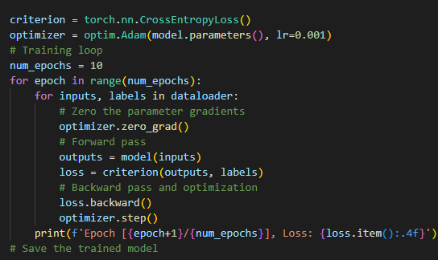
Training cycle.
It currently looks a lot like gradient descent. Epochs are able to fine tune more and more. May introduce batches later: validation set and training set, randomly re-selected at each epoch.
Epochs are independent of the training cycle. If the machine is powerful enough, one can make as many as needed to get good weights. Careful with overfitting.

Slide 3
Currently having problems with dimensions of data input. Different samples have different amount of data points. Consider taking higher interval and treating missing datapoints as 0 or NULL.
->actually, the best option is to do a mask layer (in addition to adding 0s at the end), with either 0s or 1s, which tells the network which datapoints are valid and which not. Nodes with 0s will have no impact on the dense layers after. 650 to 810nm range
Possibility to add GUI for training such that when a good amount of samples are added, one can re-train at home. Then re-store the model cache. Make user friendly
For next week: Design the “actual” testing.
-> Taking a sample from user and instead of calling peak detection, call network.
-> Design the output: Type of microplastic (for now it will be 1 sample) and % of confidence. Make a GUI also.

Slide 4
Database structure (for info)
Abandon the idea of columns as wavenumbers.
-> The SQL works better by being able to fetch directly one value given one wavelength and ID sample. So we keep that structure and call the datapoints each time. For epochs trainings, the current samples are stored in the RAM, so it shouldn’t have performances issues (it hasn’t yet).
DataTensor or torch.tensor structure.

Slide 5
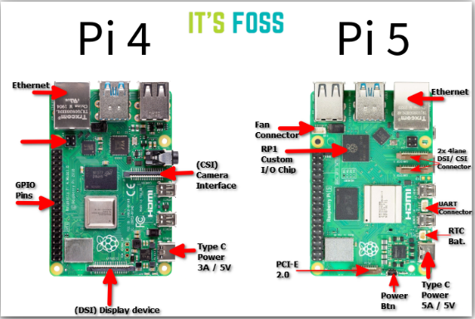
Pi4-Pi5
Pi4 looks similar to Pi5, the 3D printed cage for it should be reusable. Also try using ethernet-usb adaptor.
But the bandwidth is announced as 1000mb/s for both! So the same problem of only getting about 100mb/s may persist.
LattePanda Sigma — 13th-gen Intel Core, dual 2.5 GbE (Intel i225-V),
AAEON UP Squared Pro 7000 — Atom-class but industrial, dual 2.5 GbE (Intel i226),

Slide 6
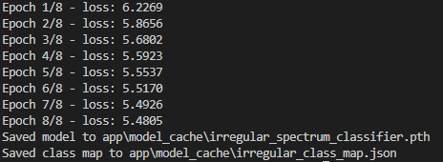
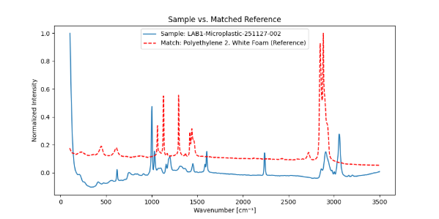
Training takes about 5 minutes with acceptable parameters. GPU allows for much faster (was 30 minutes before)
Can also reduce dimention for faster
Model cache 4.23 MB
Matching is really not good as of now. Tweaks are to be done
On the right: was supposed to be Acrylonitrile.

