Slide 1
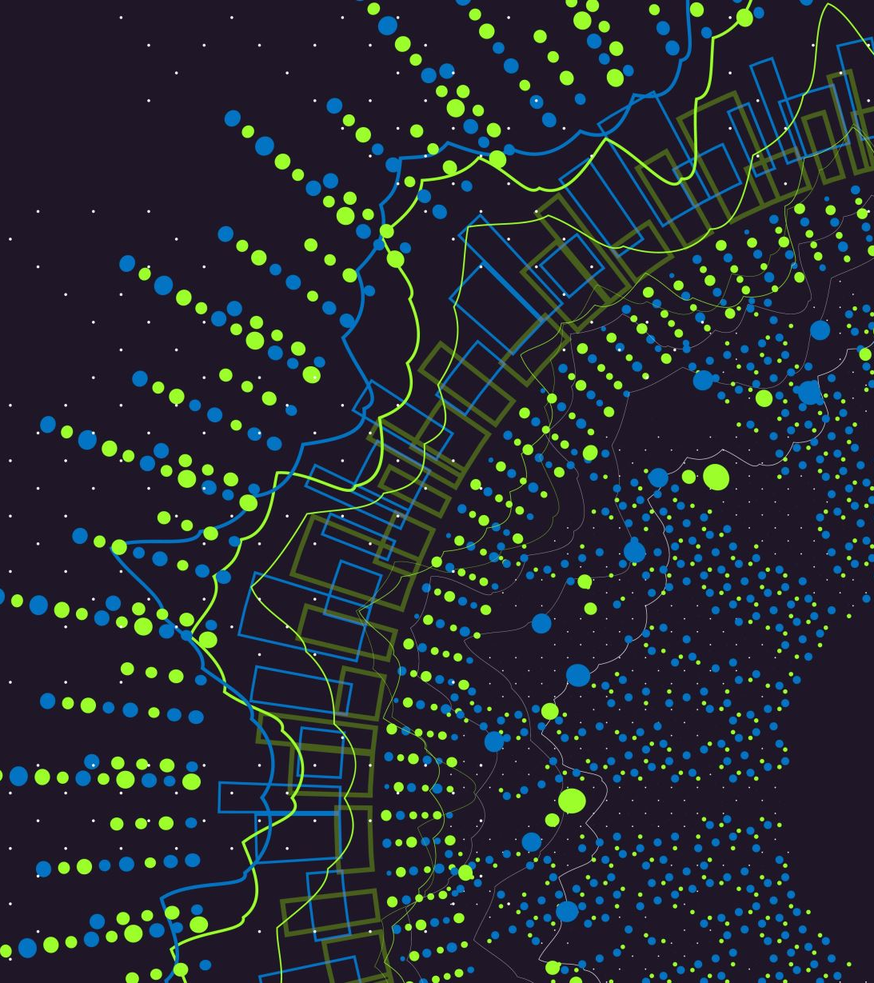
Implementation of a spectrum classifier neural network
And design of a stable data base for future measurements with the microscope
Week 14
1

Slide 2
Steps for proper development:
Data analysis (I haven’t done this properly in the previous weeks)
  Assess shape, features, shifts, etc.
  Clustering and preparation for classification
Data preprocessing
  Make subDBs of processed data (Done by Francesco), and process also during training process.
NN implementation (done)
NN tweaks and improvements
  Additional processed features to be fed to the network
  Different models, loaders, validators, Losses, Optimizers, etc. (Pytorch)
2

Slide 3
Data analysis
I did some plotting as well as some clustering.
3

Slide 4
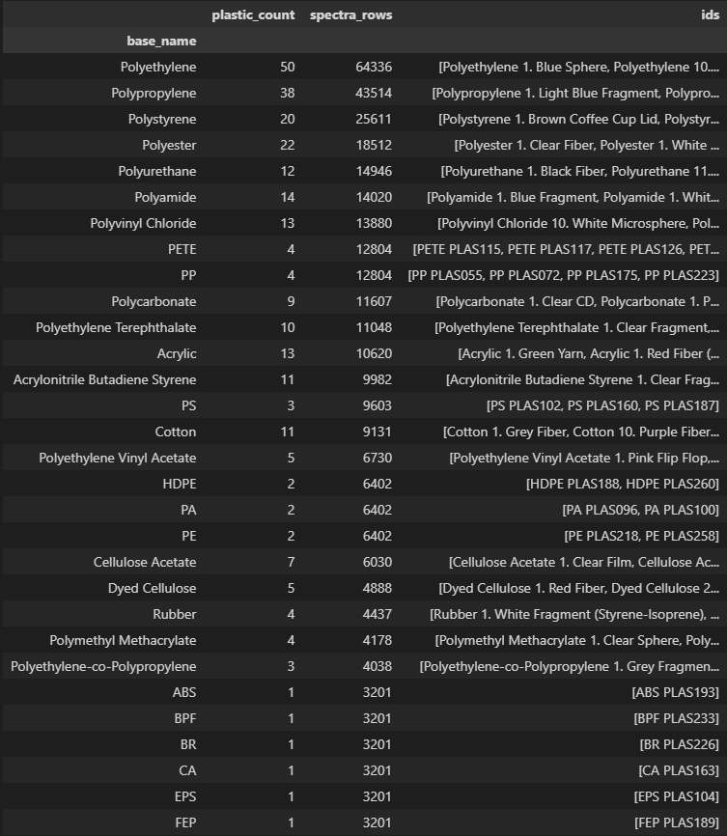
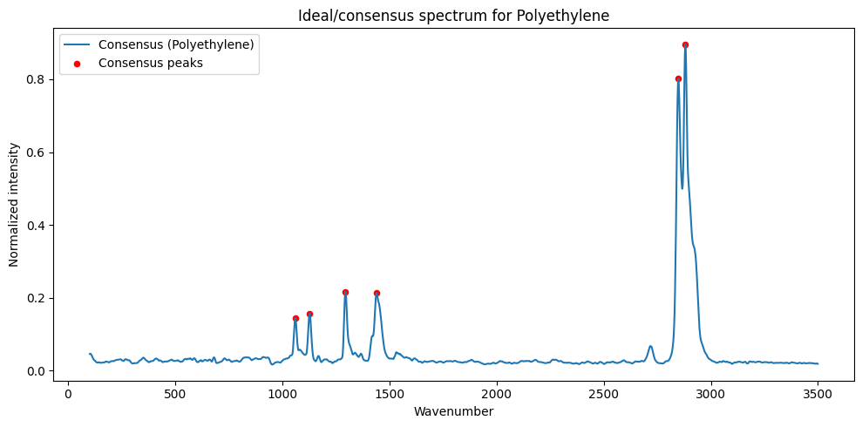
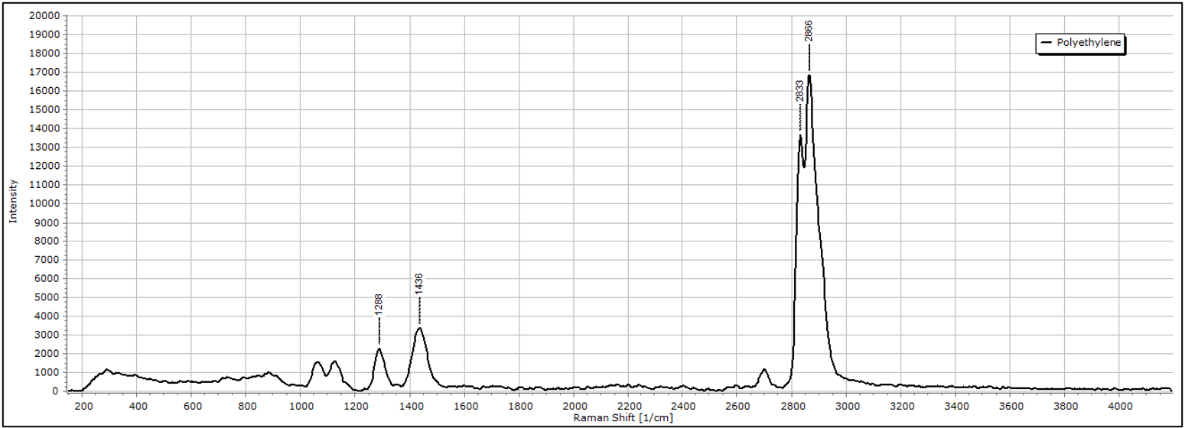
Sample grouping
Groups are ok. Although we have non homogenous numbers, this should be fine and we already knew about this.
These groups are now being fed to the NN and being classified by these. Then, for plotting, one plot will be chosen at random (or we can do a “ideal” plot)
From our database ->
Done with interpolation
Found on internet ->
4

Slide 5
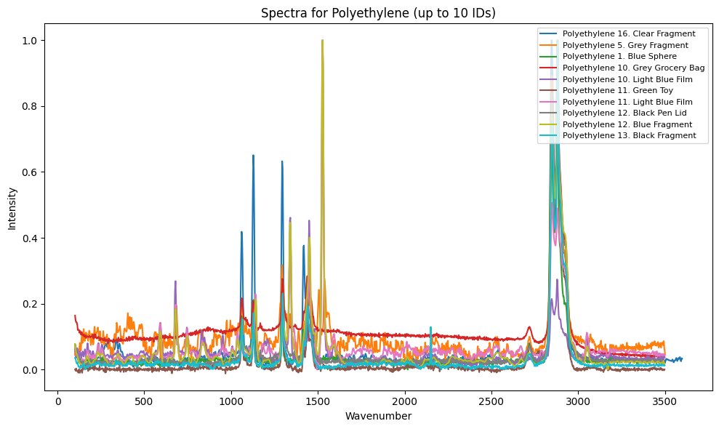
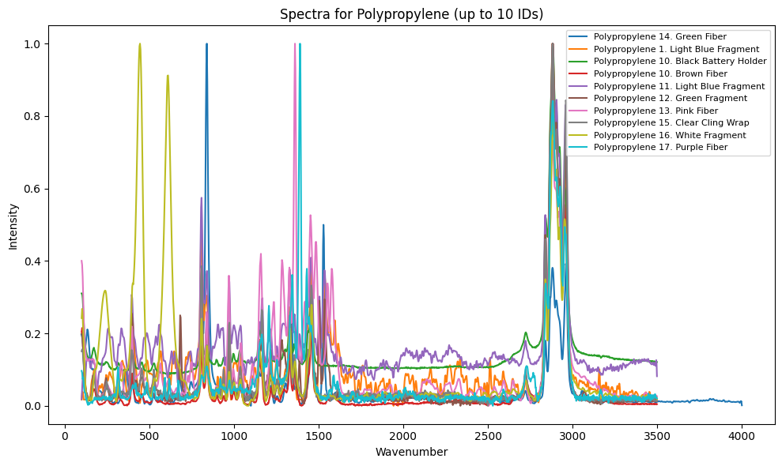
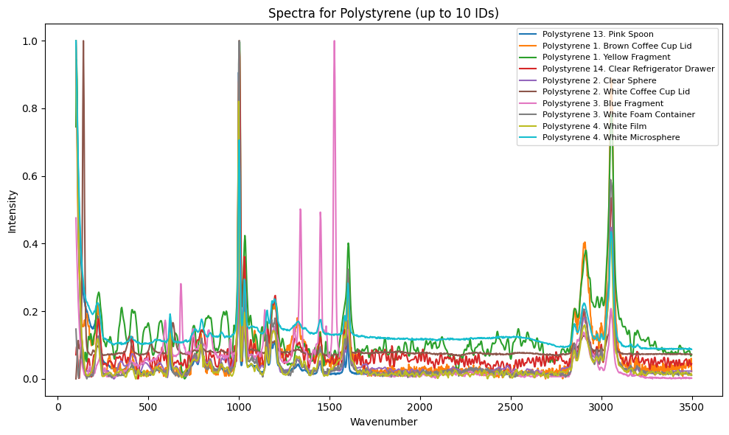
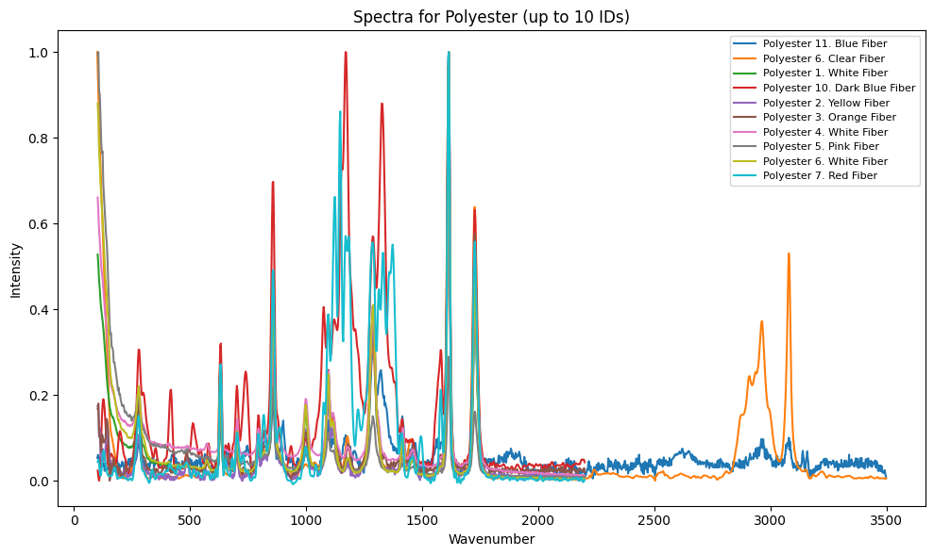
5

Slide 6
Comments on the plots
- The peaks look okay, they make sense, and we have good homogeneity of the spectra.
- There are no apparent shifts in the data (that we hypothesized). I suppose the data has been aligned and/or stretched. We may need to do this also for new samples, before adding them to the database. (it would be part of a preprocessing step where we would have raw DB and processed DB)
- Some samples have more noise than others.
  Can compute StN ratio and see where the worst samples are coming from.
- The baseline is not even that much of a problem here.
6

Slide 7
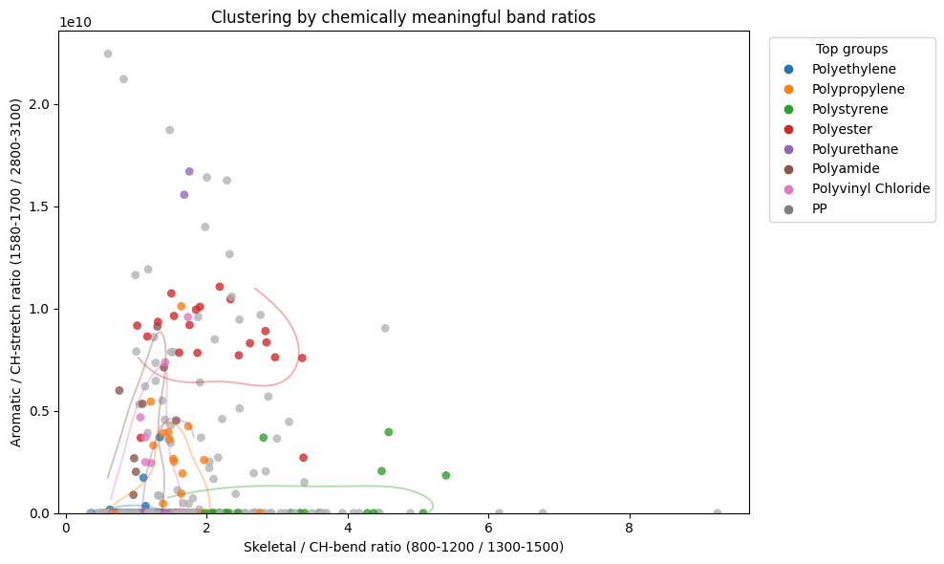
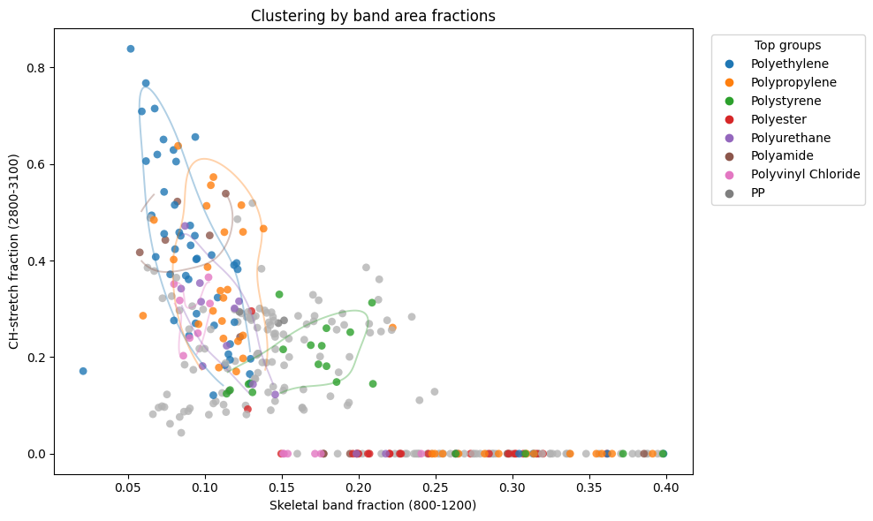
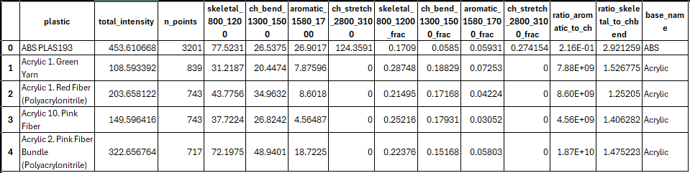
Some clustering
On top: Ratios of intensities between the Aromatic and CH-strech regions, against the ratio of Skeletal/CH-bend regions. Colors are for largest groups determined before. Gray is for smaller groups
Bottom: By intensities of regions. Cluster outlines made with KDE.
Our samples and groups make sense. We are able to get clusters, and they are not much scattered. (it doesn’t matter which features you take: if you get clusters, it’s a good thing). There fore the network can also capture these groups and take into account for classification.
7

Slide 8
Comments on clusters
Samples at 0 at the previous clusters, is because they do not include the ranges mentioned.
All this analysis should be done with the new samples added to database to make sure they make sense.
We can also directly feed the network with already processed features like these ones (haven’t done yet).
8

Slide 9
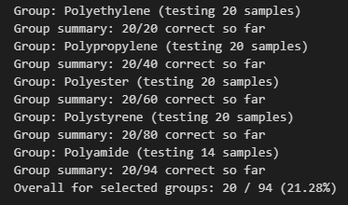
NN new achivements
We have accuracy of about 20%. The model often guesses only polyethylene, which is the most abundant. There are also samples from other groups such as Polyethylene Terephthalate which have similar spectra.
Tried to account for uneven distribution of groups. So far, not good chances of guessing correctly the smaller groups. The validation loss gets low enough for the model to be satisfied with the correct polyethylene while not trying to get the other ones.
I think by the end of year I can get better guessing for under represented groups. Accuracy should be at about 80%. Groups with less than 5 samples (20% of DB) are not expected to be correct (ever).
9

Slide 10
Future directions
Build a database:
  About 20-50 samples for each plastic (at least)
  For more field deployability, include samples n different conditions (microscopic, microscopic, in water)
  Add information about the age of the sample (to be able to study this)
More uniformity of database is required. The size is ok (20-50 per plastic), but it must be more uniform, and the
10

Slide 11
In the past weeks
Improved model
  Still working with a “black box” model, but obtaining better results.
  Improved accuracy for each type of plastic.
  Writing the final report and presentation
10

Slide 12
“Final” Results (as will be presented in the report)
An accuracy of 80% for the most present plastics:
  Polyethylene, Polypropylene, Polystyrene, Polyester, Polyurethane, Polyamide, Polyvinyl Chloride
Plastics with less than 5 samples will have less than 50% accuracy and lower.
I am currently writing the protocols/guidelines for usage so that the application is more user friendly.
10

Slide 13
Continuous support
I plan to still make new modifications to the application
  Due to unpredicted and unwanted behavior of application
  To make further changes or help with database
  Prepare for expeditions, and talked with one possible future student
For the protocols and how to use, there may be some errors and it’s easier to passage the knowledge by writing up to date protocols
10

