Slide 1
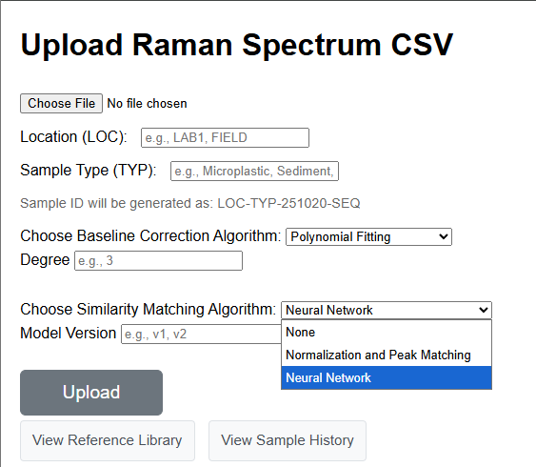
Added drop-down menu. Possibility for user to choose the layers and customize. -> do we want this ? Do we keep model versions ? In that case we should store 1 model cache per each possibility of model.

Slide 2
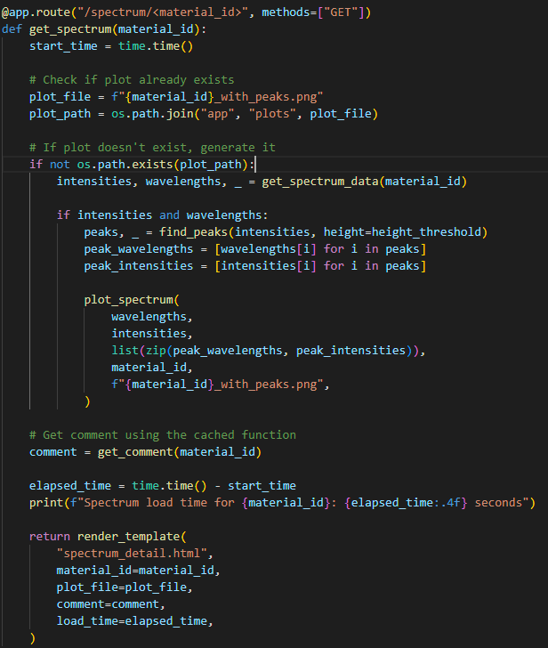
The final model cache should take about ~ 180 MB of space (estimate)
I tried training with one sample only using get_spectrum(material_id). It works for now (the weights get created). Still need to make a function that only feeds the wavelengths to the NN, and ignores plots.
Same problem for last week about the wavelengths, some samples are integer wavelengths (3025.0 , 3024.0, ….), but some have decimals. So for the NN training I will design a function that connects the datapoints and gives out the same values. Hopefully there is no need to make a new DB but I can integrate this at the end of the get_spectrum function and do it each time the sample gets called.
^ This is needed for training with all samples (I only trained one). -> We won’t have this problem anymore when we build our own dataset (we will sample always at given wavelengths)
^ Although, I would like to first try some modules that are already made for this and don’t require resampling.

Slide 3
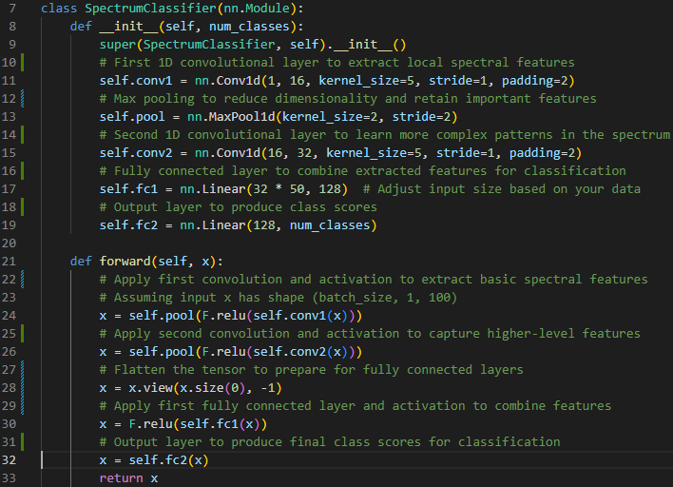
I kept the same module architecture as last week but sometimes removed a layer for training. Idea : design a user friendly way of customizing the model, training it (on a computer) and then exporting just the cache to the raspberryPI. In my opinion it’s pointless, the model should already work. But can be cool for user.

