Slide 1
Software and Programming
machine code, programming languages and applications

Slide 2
Machine Code
Lowest level of programming.​
Very simple instructions.​
Everything is machine code eventually.​
Programs referred to as binaries, executables.​
Different for different CPU architectures (e.g., x86, x86-64, ARM).​
Inefficient and impractical to write.​
Not human-readable.​

Slide 3
Assembly
Similar to machine code.
Unique to CPU architecture.
Partially human-readable.
Must still be compiled.
Useful for porting to new architectures.
Often used for programming microcontrollers in home appliances.

Slide 4
Compilers and Interpreters
Compilers convert source code to machine code, on the developer’s computer.
Machine code cannot realistically be converted back, meaning source code is closed/proprietary.
Interpreted languages generally simpler.
Interpreted languages notoriously slow.
Just-in-time (JIT) and semi- compiled languages.

Slide 5
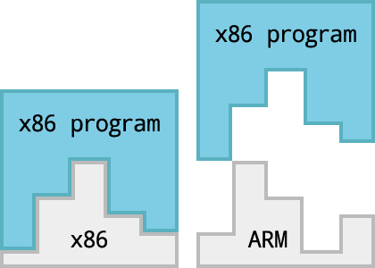
Compiled, High-Level Languages
C and derivatives C++, C#, Objective-C.
Google’s Go or Golang.
Python (e.g.) can be compiled.
More control, but more responsibility (memory management, …).
Typically “closer” to the hardware.
Performance gain from pre-computation.
CC BY 4.0

Slide 6
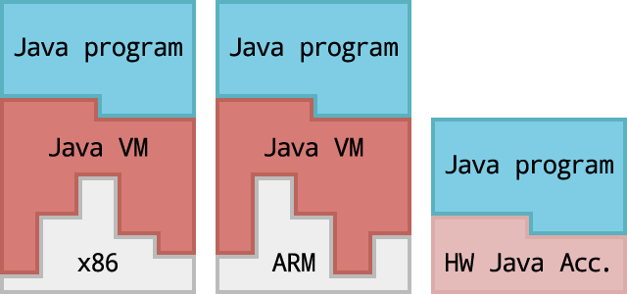
JIT/Semi-Compiled Languages
Just-in-time compilation from bytecode.
Semi-compiled/packaged languages.
Portable across operating systems/platforms.
Popular examples include Java, .NET, PHP (7+).
Average performance.
CC BY 4.0

Slide 7
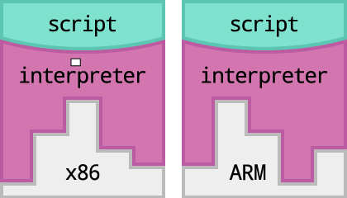
Interpreted, High-Level Languages
Python, Ruby, JavaScript, ActionScript, Perl.
Markup languages like HTML, Markdown, CSS.
Slower to run.
Converted to machine code at runtime, at client-side.
Portable across operating systems/platforms.
Interpreter must be available.
Source visibly open.
Faster and easier to develop.
Interactive debugging.
CC BY 4.0

Slide 8
Applications
Built for an operating system such as Windows, OS X, Linux, iOS, Xbox OS.
Frameworks/SDKs used, including .NET, Cocoa, GTK+, Cocoa Touch.
Libraries used, such as OpenSSL, jQuery, Modernizr.
Built for an environment or compiled for an architecture.
Development tracked with source control.

Slide 9
Thank-you
feel free to ask any questions you have

