Slide 1
通过重构类型系统来提升Javascript的性能
报告人：王海州

Slide 2
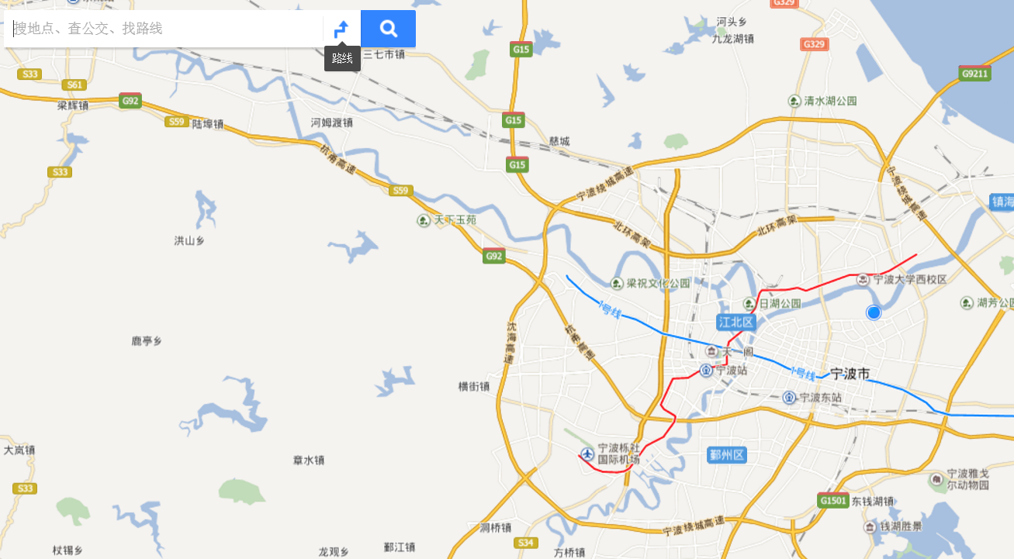


all by
JavaScript

Slide 3
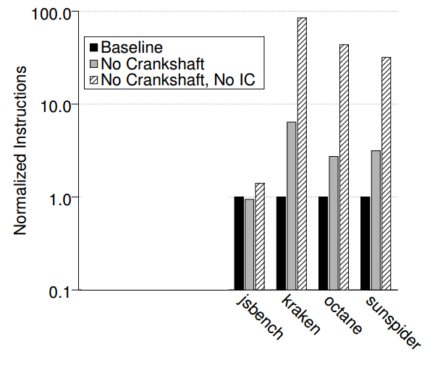
Chrome V8

Slide 4
p.x = 4
C++ 等静态类型语言：
set[ p + xOffset ] 4
JavaScript等动态类型语言：
cache
if (cache)
set[ p + cachedOffset ] 4
else
lookup in heap
hidden class 1
hidden class 2
hidden class 3
. . .
heap
hidden classes

Slide 5
hidden class
property | offset
x | 0
y | 1
__proto__
method1
method2
prototype object
method1 address
method2 address

Slide 6
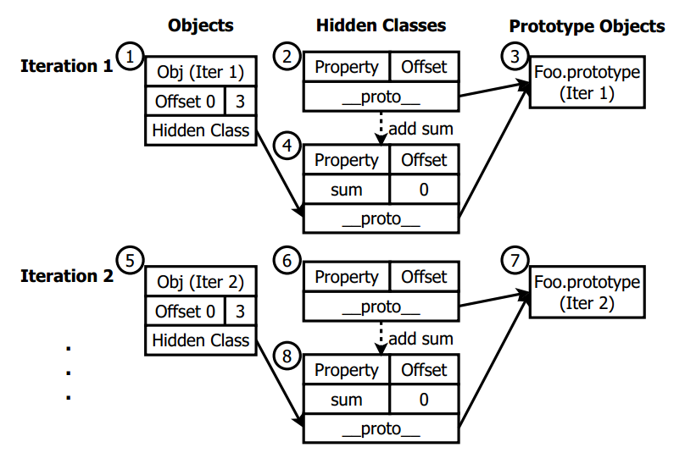
prototype change
1 f o r ( v a r i = 0 ; i < 1 0 0 ; i ++) {
2 v a r Foo = f u n c t i o n ( x , y ) {
3 t h i s . s u m = x + y ;
4 }
5 v a r Obj = new Foo ( 1 , 2 ) ;
6 }

Slide 7
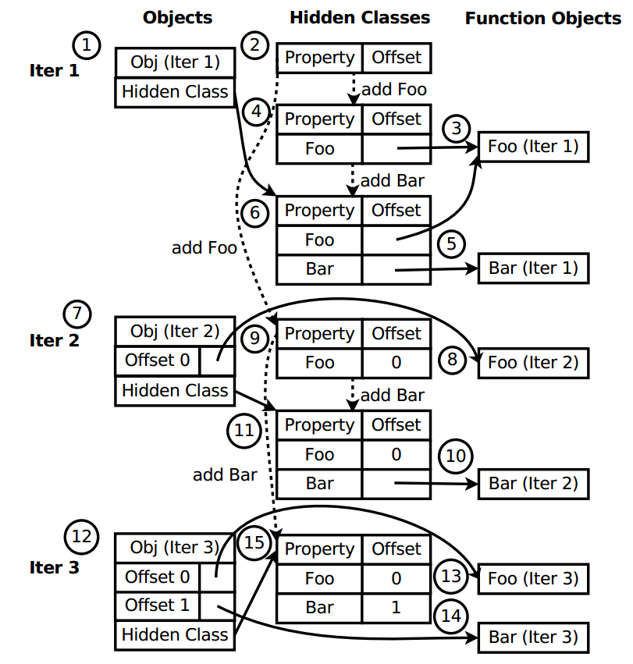
method bindings
1 f o r ( v a r i = 0 ; i < 1 0 0 ; i ++) {
2 v a r Obj = new Ob j e c t ( ) ;
3 Obj . Foo = f u n c t i o n ( ) { } ;
4 Obj . Ba r = f u n c t i o n ( ) { } ;
5 Obj . Foo ( ) ;
6 }

Slide 8
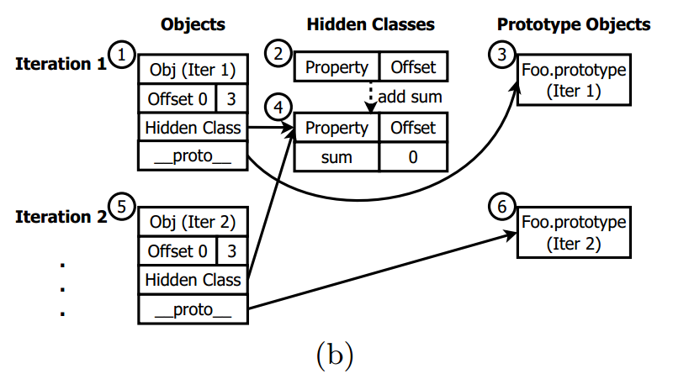
decouple prototype from hidden class
1 f o r ( v a r i = 0 ; i < 1 0 0 ; i ++) {
2 v a r Foo = f u n c t i o n ( x , y ) {
3 t h i s . s u m = x + y ;
4 }
5 v a r Obj = new Foo ( 1 , 2 ) ;
6 }

Slide 9
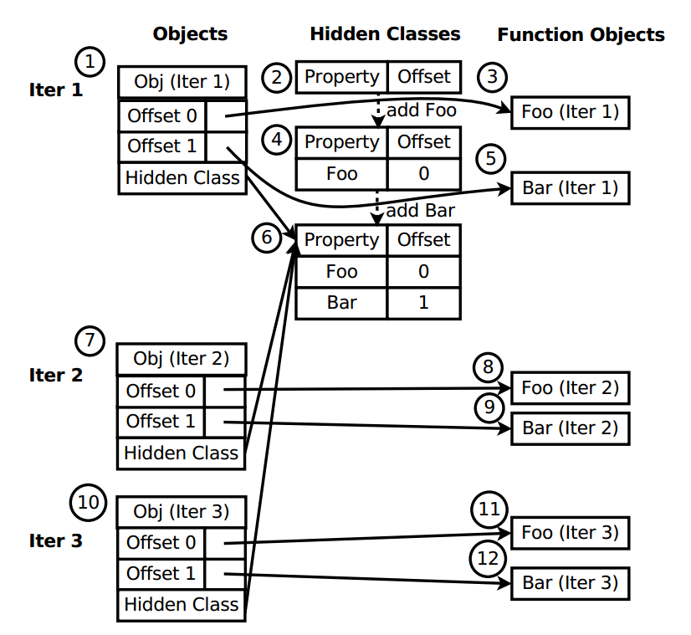
decouple method bindings from hidden class: complete
1 f o r ( v a r i = 0 ; i < 1 0 0 ; i ++) {
2 v a r Obj = new Ob j e c t ( ) ;
3 Obj . Foo = f u n c t i o n ( ) { } ;
4 Obj . Ba r = f u n c t i o n ( ) { } ;
5 Obj . Foo ( ) ;
6 }

Slide 10
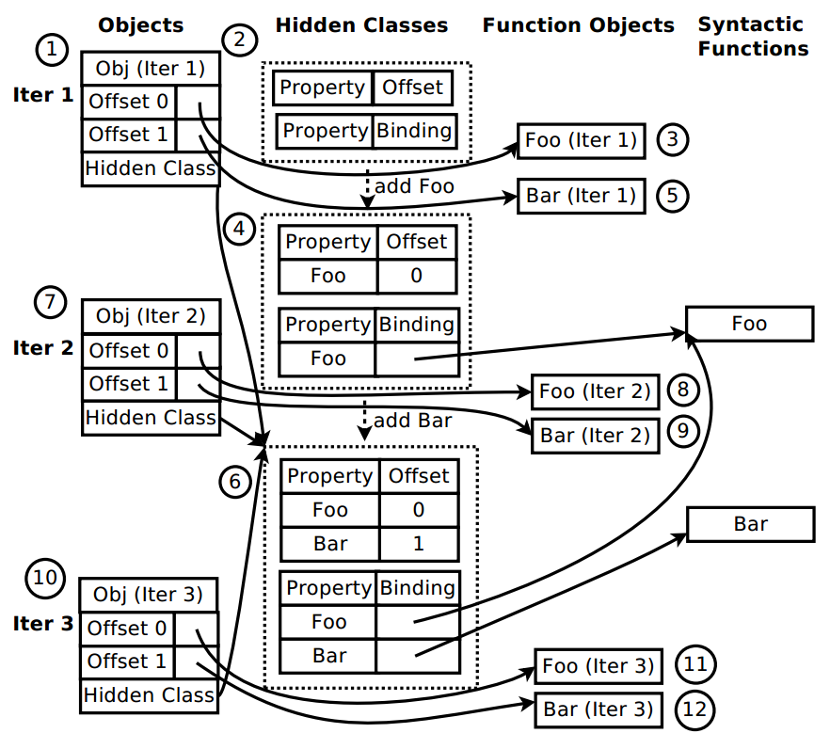
decouple method bindings from hidden class: partial
1 f o r ( v a r i = 0 ; i < 1 0 0 ; i ++) {
2 v a r Obj = new Ob j e c t ( ) ;
3 Obj . Foo = f u n c t i o n ( ) { } ;
4 Obj . Ba r = f u n c t i o n ( ) { } ;
5 Obj . Foo ( ) ;
6 }

Slide 11
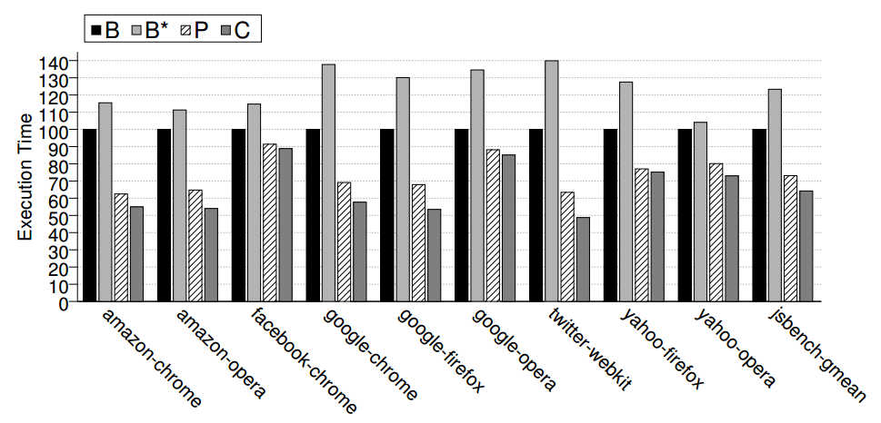
Results

Slide 12
Conclusions
刻画了V8在运行各benchmark时的性能
识别出两大导致性能问题的原因
prototype change
method bindings
提出优化方案
在V8中实现优化
减少了36%的执行时间
减少了49%的动态指令数
节省了20%的堆空间分配

